Slide 1
Novel sensors for highly compact electromagnetic calorimeters
The FCAL collaboration and the LUXE ECAL group
Speaker: Anton Tyazhev,
Tomsk State University, Tomsk, Russia

Slide 2
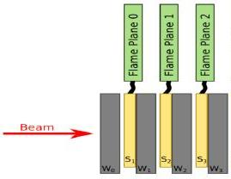

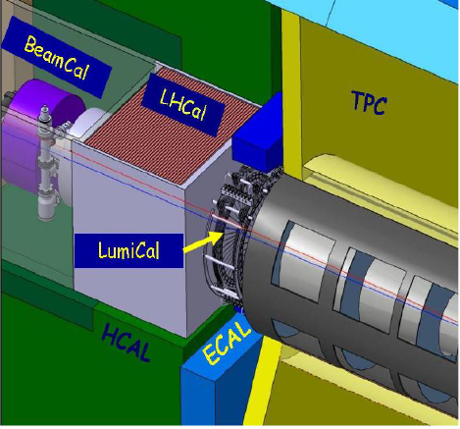
Structure of compact EM calorimeter
W absorber plates interspersed with sensor layers
1mm spacing between W plates leads to a Moliere radius equal to the one of W that makes EM compact as the definition
The very forward region of the ILD detector

Slide 3
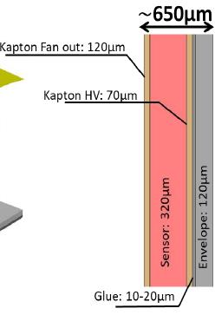
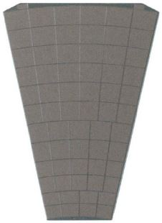
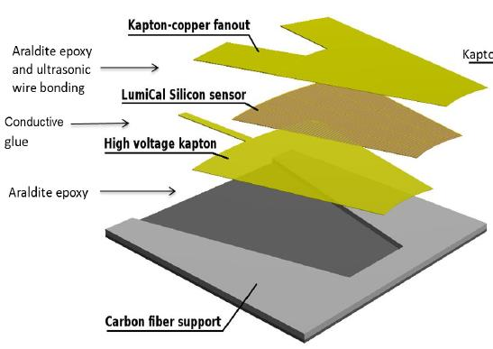

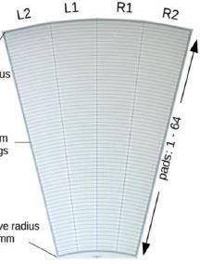
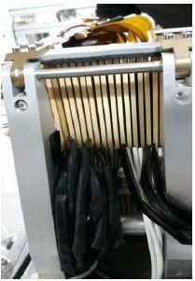
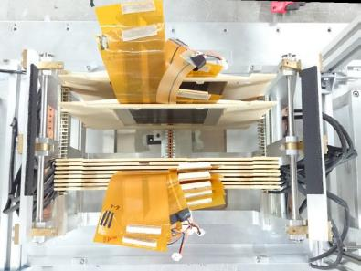
Current sensor design
Radiation hard 500 um thick GaAs sensor
Sensor assembly
830 um thick
830 um
Sensor: 500 um
320 um thick Si sensor
EM calorimeter prototype 2020

Slide 4
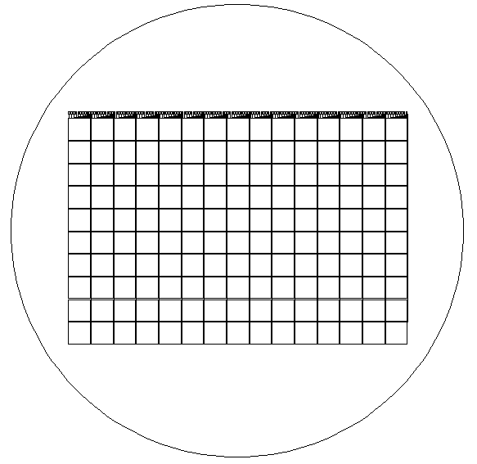
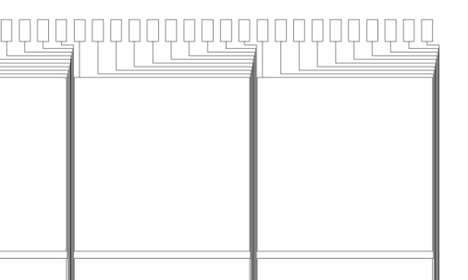
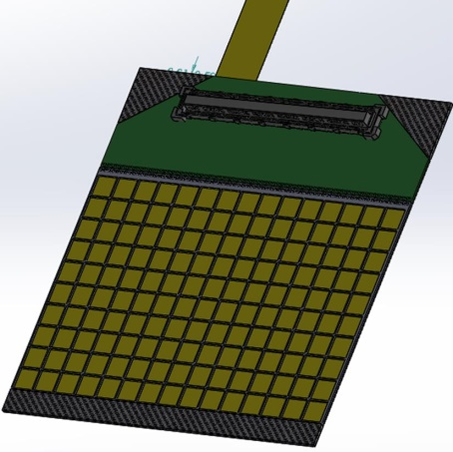
Novel concept: GaAs sensor with tracings
Thin sensor
assembly 700 um !
Sensor : 500 um
Conductive glue
(sensor - RO kapton ): 100 um
RO kapton : 100 um
15x10 pixel array
Al pads for wire bonding
Pixel
Pixel
Compact
sensor module
Pixel
Al tracings
Al tracings
Cross section of the sensor with tracing (not in scale)

Slide 5
Conclusion
Sensor with tracings allows to make the sensor planes
extremely thin that is the key point for compact electromagnetic calorimeters
The sensor prototypes will be produced and tested up to the end of 2021

Slide 6
Wireless readout
Yan Benhammou
Tel Aviv University

Slide 7
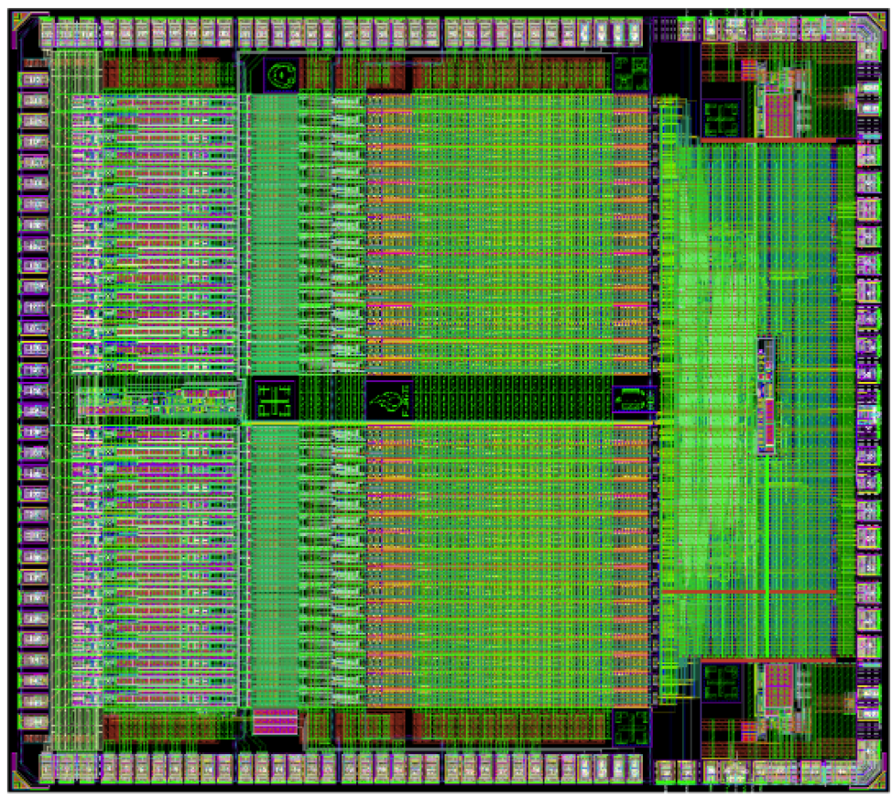
READOUT
Sensor signal is send to a dedicated ASIC : FLAME
32 mix mode channel comprising:
  Variable gain front end
  10 bit SAR ADC with sampling rate up to 50MSps
  Ultra low power consumption
Mutli-phase PLL based fast serializer
Fast SST driver
Two 5.2 Gbps links to the FPGA (we need ~5 FLAME per sensor)
From FPGA to DAQ : zero suppressed and trigger so rate depends on the occupancy and event rate

Slide 8
Typical setup
DAQ PC
SENSOR
FEB
DATA Processing (FPGA,…)
Ethernet/optic fiber
Could be a problem of space in the very forward region : cables,…

Slide 9
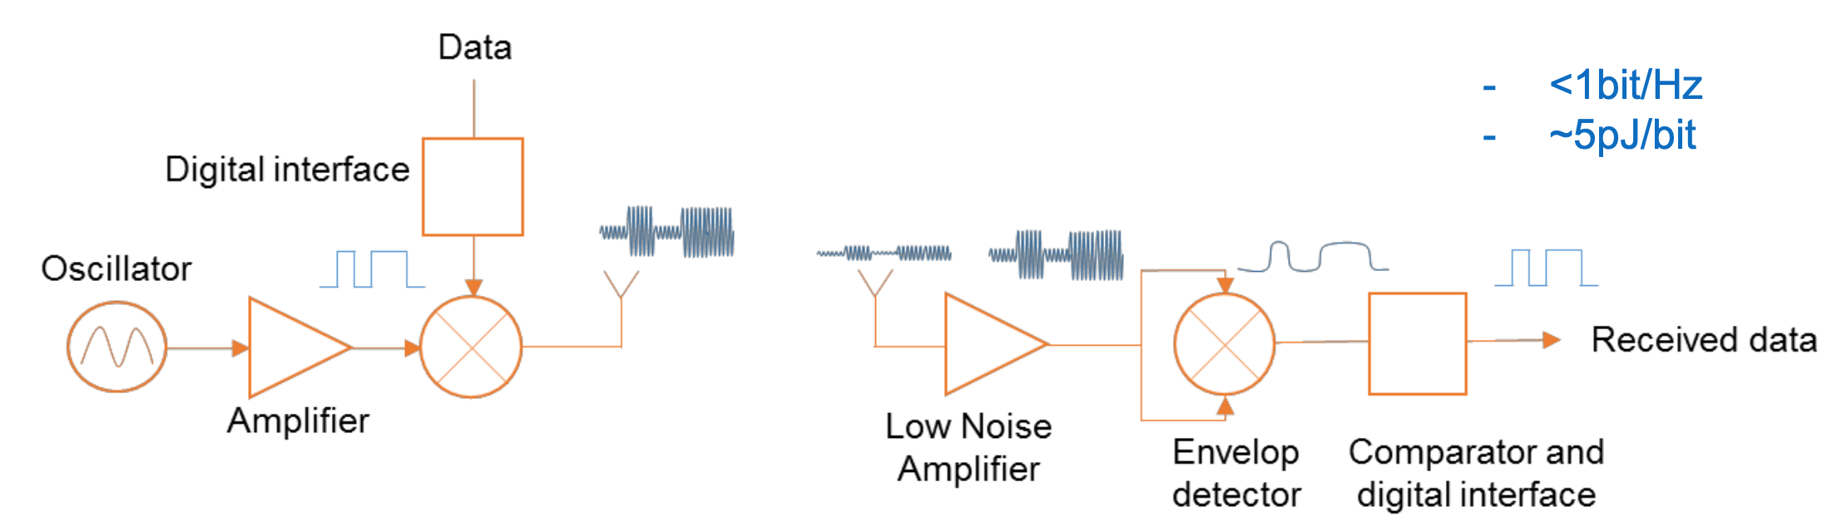
What we want to test
DAQ PC
SENSOR
FEB
Up to 6Gbps
Data processing (FPGA,…)
Ethernet/optic fiber
Thanks to the WADAPT CERN group

