Slide 1
Rough and incomplete power/cost estimates for the SIGRUM-project’s cryogenic system
Rob van Weelderen,
with input from Udo Wagner & Patricia Tavares Coutinho Borges De Sousa
(CERN)

Slide 2
Heat loads at 4.5 K – 5.0 K (excluding powering)
There are two cryo-assemblies on the gantry
At the back consisting of:
2 x 22.5° dipole magnets including 1 pair of 2.5 kA current leads + 1 x quadrupole including 1 pair of 1.25 kA current leads + 2 cold-warm transitions
Total power = 1.24 (dynamic) + 1.10 (static) +CLs = ~2.9 W + CLs
At the top
3 x 45° dipole magnets including 1 pair of 2.5 kA current leads + 2 x quadrupoles including 1 pair of 1.25 kA current leads + 2
Total power = 6.73 (dynamic) + 2.22 (static) +CLs = ~9.4 W + CLs
Loads at 4.5 K – 5.0 K | Static | Dynamic
45° dipole magnet | 0.3 W/m | 1.25 W/m
22.5° dipole magnet | 0.3 W/m | 1.25 W/m
quadrupole | 0.3 W/m | 1.25 W/m
cold-warm transition |  | < 0.5 W

Slide 3
Powering - Current leads (CLs)
In total 2 pairs of CLs for the dipoles + 2 pairs of CLs for the quadrupoles are necessary
The heat brought onto the magnet operating temperature level varies considerably amongst the current-leads concepts and is linearly dependent on the current level
The high current magnet option considers 2.5 kA for the dipoles and 1.25 kA for the quadrupoles
Technology bringing the current from leads to magnets via cold links exists and is used at Cern
CL-type | Power to 4.5-5.0 K (W/kA) | comment
Conduction cooled (with intermediate heat intercepts) | ~ 3 to 4 | high load for high current magnet option (45 W – 60 W). Unreasonable for cryo-coolers
Vapour cooled | ~ 1 | 15 W for high current magnet option, dedicated cryo necessary
HTS –vapour cooled | << 1 | Dedicated cryo necessary, working 600 A, 6 kA, 13 kA, 17 kA leads designs exists. Cryopower, gaseous, levels 50 K and 4.5 K, can be provided by dedicated cryo-coolers

Slide 4
Cooling power at 4.5 K – 5.5 K
Magnet cold-masses
Total cold-mass cooling needed : ~ 12-13 W
This can be achieved with 7 x 2-stage cryo-coolers
This can be achieved with small scale refrigerator providing 5 K supercritical Helium
Thermal screen cooling + cool-down
This can be achieved with one, 1st stage only high power cryo-cooler
This can be achieved with small scale refrigerator providing supercritical Helium
Powering
Current leads cooling power and associated cryo-needs is to be optimized as function of current level and current lead type.
  Cryo-coolers: Only the HTS-leads option looks suitable
  Small-scale refrigerator: could manage any lead-type
Courtesy P. Tavares De Sousa

Slide 5
Readily available cryo-cooler options
Cryocooler | Type | Cooling power (W) | Price (EUR) | Cold head weight (kg) | Compressor dimensions
Cryomech PT420 | Pulse tube | 2.0 W @ 4.2 K (2nd stage) 55 W @ 45 K (1st stage) | 55,000 | 26.3 kg | 61 x 61 x 79 cm 190 kg
Sumitomo RDE-418D4 | Gifford-McMahon | 1.8 W @ 4.2 K (2nd stage) 42 W @ 50 K (1st stage) | 41,000 | 20.0 kg | 59 x 45 x 59 cm 100-120 kg
Cryocooler motor must not be subjected to magnetic fields higher than 30-50 mT (for either type); shielding is difficult due to the relatively large opening required from the motor to the cold part of the cryocooler.
PT-type cryocoolers are sensitive to orientation and drastically lose cooling capacity if tilted > 45°; 1st stage starts to lose cooling power from 10°.
PT-type cryocoolers require maintenance on compressorsw only; GM cryocoolers require also the cold head to be serviced.
Both cryocoolers require compressor units connected to flexible lines to the cryocooler head; each compressor unit.
Both cryocoolers require water cooling and 3-phase power supply to their compressor units (7-11 kW/unit).
Electrical power for ~ 8 – 10 cryo-coolers: 88 kW – 110 kW (cold masses only!)
Cryo-cooler cost per power P needed : cost =37*P^{0.38} (k$)
Courtesy P. Tavares De Sousa

Slide 6
Small refrigerator cost
Cold-mass refrigerator should probably be combined with the accelerator one
Use of ~ 5 K, supercritical helium. Two-phase flow cooling is excluded by the requirement of rotating the gantry magnets
Refrigerator cost per power P needed : cost =2600*(P/1000)^{0.63} (k$)
Source: THE COST OF HELIUM REFRIGERATORS AND COOLERS FOR SUPERCONDUCTING DEVICES AS A FUNCTION OF COOLING AT 4 K
M. A. Green, AIP Conference Proceedings, 2008

Slide 7
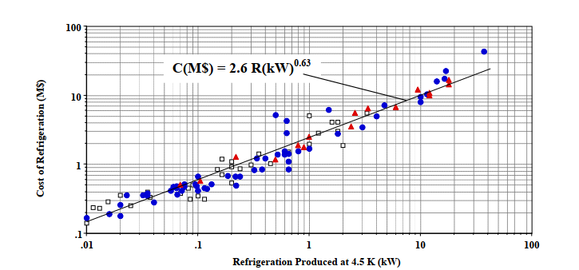
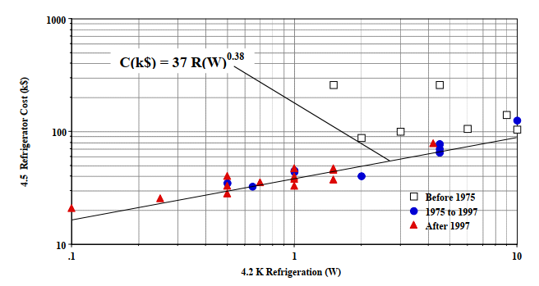
Compared costing
Source: THE COST OF HELIUM REFRIGERATORS AND COOLERS FOR SUPERCONDUCTING DEVICES AS A FUNCTION OF COOLING AT 4 K
M. A. Green, AIP Conference Proceedings, 2008
Refrigerators
Cryo-coolers
For our use the cost (investment) ratio of cryo-coolers wrt using a refrigerator is ~ < 50 %
So if cooling can share a refrigerator with the accelerator: → go for refrigerator
If cooling is to be uniquely for the Gantry: → go for cryo-coolers + HTS-leads

