Slide 1

LHeC Racetrack as Injector to FCC-ee
FCC Week,
28 June - 2 July 2021
Y. Papaphilippou (CERN)
with input from O. Brunning, R. Corsini, M. Klein, K. Oide, F. Zimmermann

Slide 2

Content
Brief overview of FCCee injector
  Design principle
  Layout and parameters
LHeC recirculating linac injector (RLI) for FCCee
  Basic considerations and tentative parameters
Conclusions and future work
FCC week 2021, Y. Papaphilippou
2

Slide 3
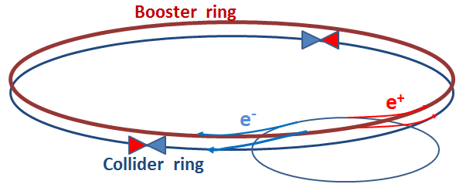
FCC-ee Collider Parameters
parameter | Z | WW | H (ZH) | ttbar
beam energy [GeV] | 45 | 80 | 120 | 182.5
beam current [mA] | 1390 | 147 | 29 | 5.4
no. bunches/beam | 16640 | 2000 | 393 | 48
bunch intensity [10¹¹] | 1.7 | 1.5 | 1.5 | 2.3
SR energy loss / turn [GeV] | 0.036 | 0.34 | 1.72 | 9.21
total RF voltage [GV] | 0.1 | 0.44 | 2.0 | 10.9
long. damping time [turns] | 1281 | 235 | 70 | 20
horizontal beta* [m] | 0.15 | 0.2 | 0.3 | 1
vertical beta* [mm] | 0.8 | 1 | 1 | 1.6
horiz. geometric emittance [nm] | 0.27 | 0.28 | 0.63 | 1.46
vert. geom. emittance [pm] | 1.0 | 1.7 | 1.3 | 2.9
bunch length with SR / BS [mm] | 3.5 / 12.1 | 3.0 / 6.0 | 3.3 / 5.3 | 2.0 / 2.5
luminosity per IP [10³⁴ cm⁻²s⁻¹] | 230 | 28 | 8.5 | 1.55
beam lifetime Bhabha/BS [min] | 68 / >200 | 49 / >1000 | 38 / 18 | 40 / 18
Due to extremely high luminosity, beam lifetime limited to ≤ 20 min (radiative Bhabha scattering, beamstrahlung) maintaining constant luminosity and beam current requires quasi-continuous “top-up injection” (demonstrated @ PEP-II, KEKB, SuperKEKB, light sources) → full-energy booster (same tunnel)
FCC week 2021, Y. Papaphilippou
3

Slide 4
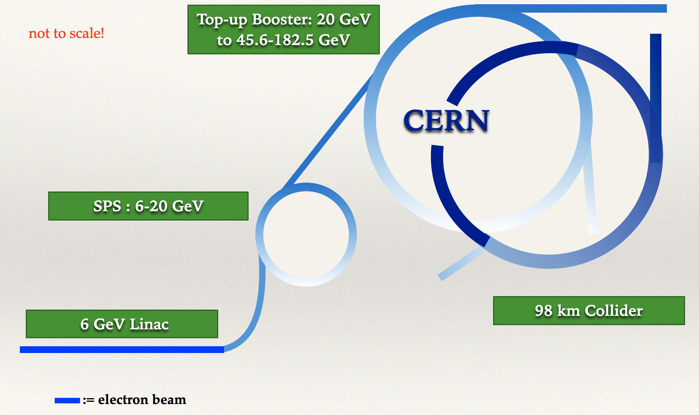
Conceptual Design of FCCee injectors
S-Band linac (as in SLAC and SuperKEKB) @ 6 GeV with positron generation @ 4.46 GeV and Damping Ring @ 1.54 GeV
Modified SPS as pre-booster ring up to 20 GeV (now 16 GeV)
Top-up booster shares tunnel with collide and accelerates e+/e- beam to final energies
FCC week 2021, Y. Papaphilippou
4

Slide 5
Filling scheme for Z-pole
Booster: 16640 bunches
2.1x10¹⁰ p/b
14 cycles of
3.3 sec
10 cycles** of
48 sec
CERN
6 GeV
SPS: ~1190 bunches*
2.1x10¹⁰ p/b
Collider: 16640 bunches
1.7x10¹¹ p/b (~80% efficiency)
595 injections
6 GeV Linac: 2 bunches/Pulse
200 Hz repetition
2.1x10¹⁰ p/b
* 198 mini-trains with 6 b (20 ns) and 71/126 mini-train gaps (15/17.5 ns), kicker gap of 120 ns
** 10 cycles for either species keep charge imbalance within ±5% needed to prevent beam-beam flip-flop (“bootstrapping”)
FCC week 2021, Y. Papaphilippou
5

Slide 6
FCCee injector parameters
FCC week 2021, Y. Papaphilippou
6

Slide 7
FCCee injector parameters
Injector linac provides average current < 1.4 μA
This is ~4 orders of magnitude lower then average current of LHeC ERL (20 mA)
PBR (SPS) duty factor of 76% for FCCee-Z
BR cycle time of ~48 sec dominated by injection
FCC week 2021, Y. Papaphilippou
7

Slide 8
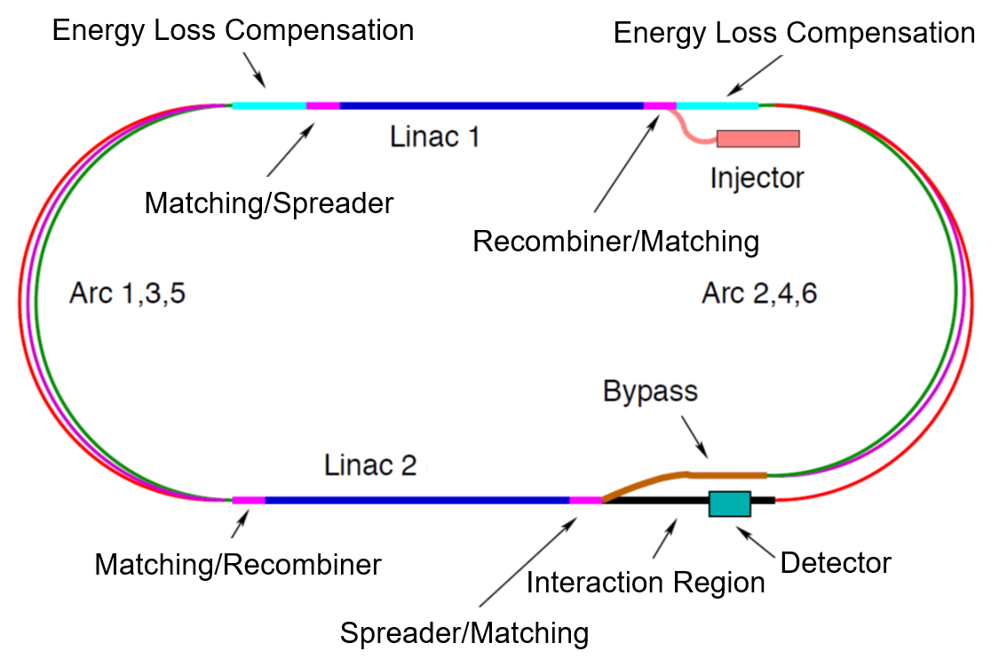
LHeC ERL parameters
Based on 2 SRF Linacs (~800 MHz) with 3 recirculating arcs, total length of ~5.3 km (~1/5 of LHC), reaching energy of ~49 GeV (longer version for reaching 60 GeV)
Bunch intensity of ~500 pC (~3x10⁹ p/b) for ~25ns spacing, average current of 20 mA
Could be used for full energy top-up injector for FCCee-Z and pre-injector for other collider energies
Small footprint PERLE-like version could be used as pre-injector to (P)BR~6-20GeV
FCC week 2021, Y. Papaphilippou
8

Slide 9
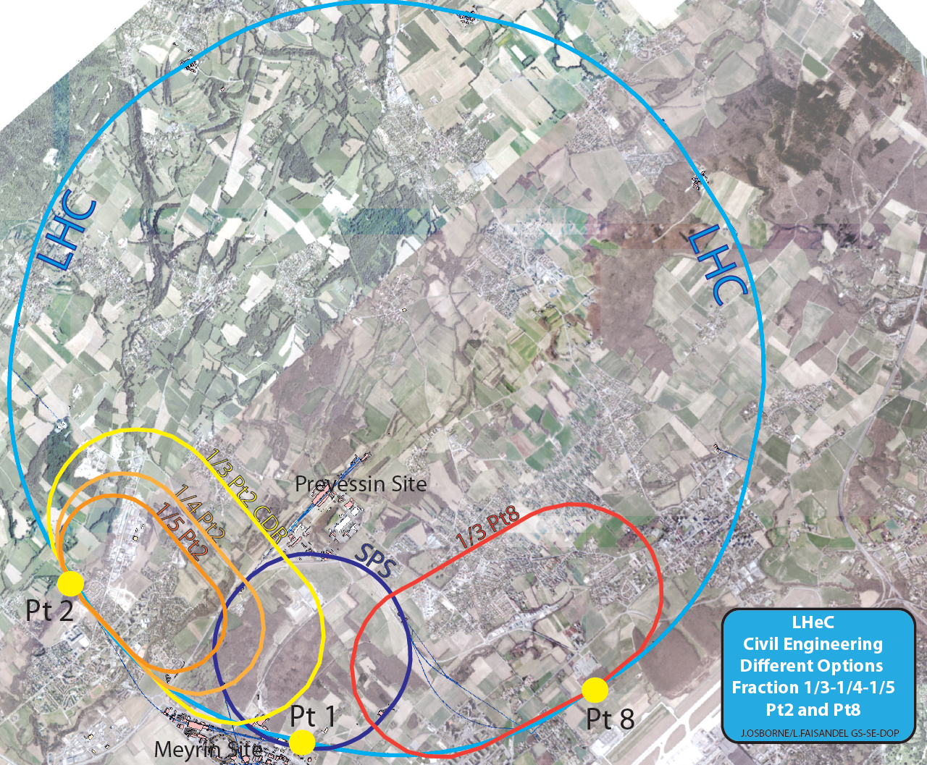
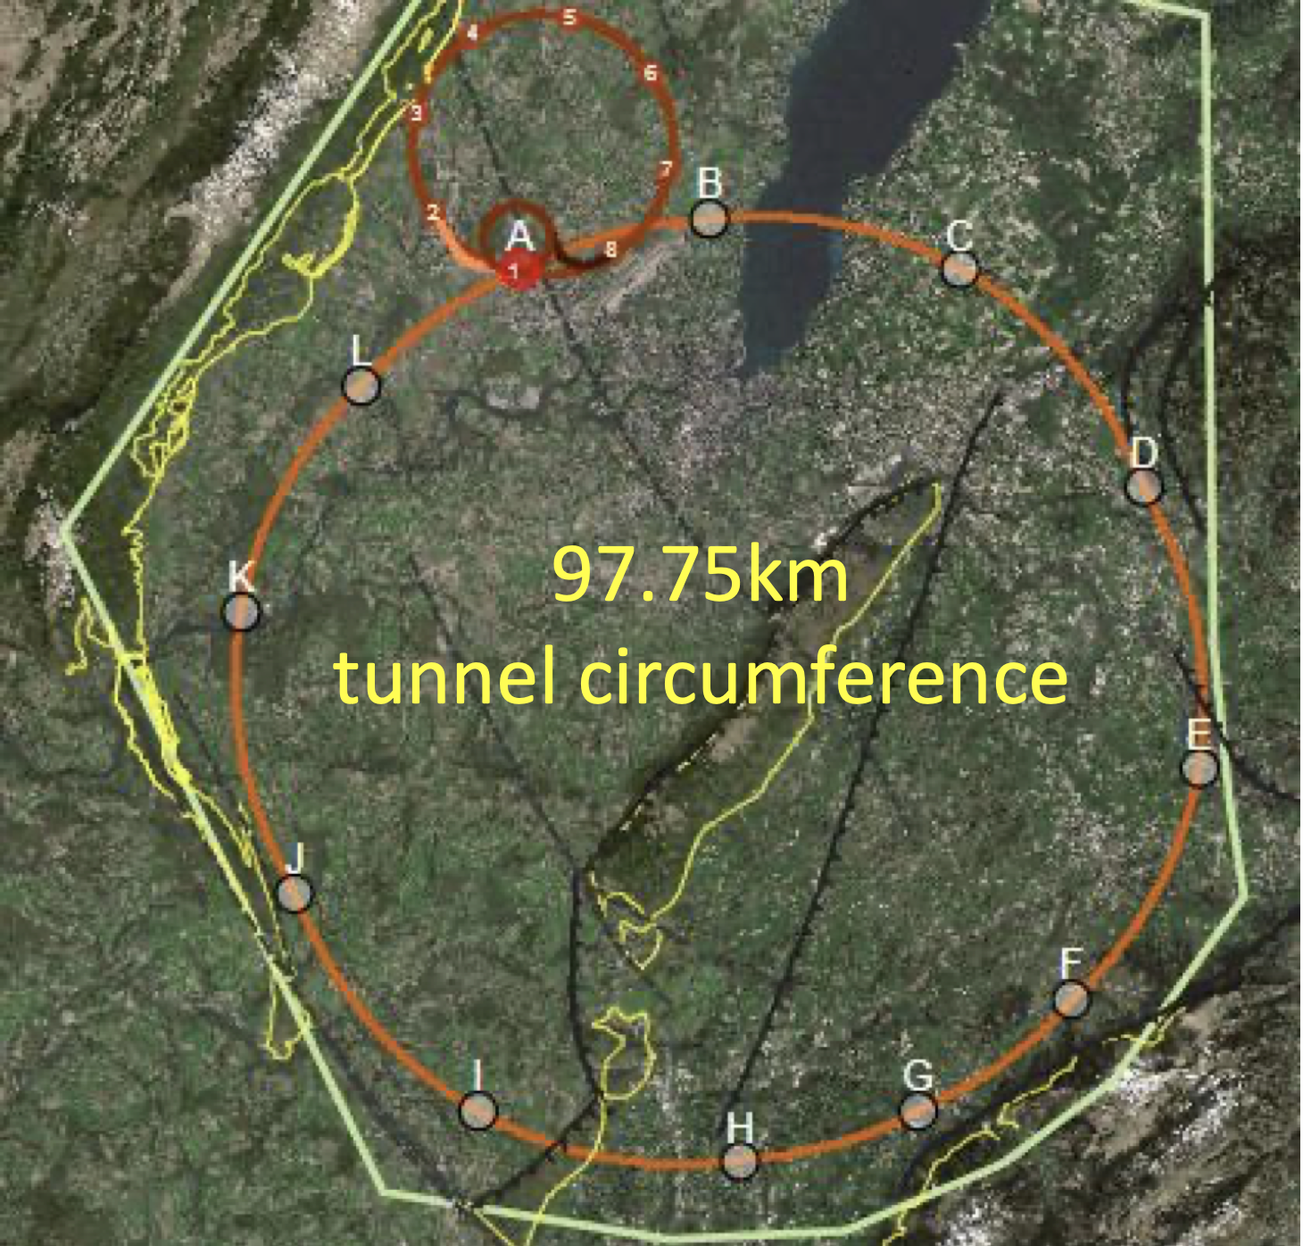
ERL Configuration for LHC and FCC
Common hardware and infrastructure: one could use FCC-ee pre-series SRF
Installation near point L to minimize transfer line length
Would be used as re-circulating linac (RLI) not ERL mode
Different Size Variations:
e.g LHeC and HE-LHC-eh
Interaction region ‘L’ as baseline choice for FCC-eh
FCC week 2021, Y. Papaphilippou
9

Slide 10
PERLE SRF system
FCC week 2021, Y. Papaphilippou
10

Slide 11
Filling scheme for Z
RLI @ ~800 MHz accelerating 832 bunches with 17.5 ns bunch spacing (compatible with collider)
  Other bunch structures can be envisaged, compatible with present bunch structure collider considerations (see talk of D. Shatilov)
Injected 20 times @ 45.6 GeV into collider rise (accumulation cycle), for filling 16640 buckets with required gaps for injection/dump kicker
For 70 accumulating cycles need bunch population of 3x10⁹ for ultra-fast filling (< 1sec), reaching required collider 1.7x10¹¹ with 80% injection efficiency
  Intensity can be significantly reduced lowering power while still allowing full filling in a few seconds
Very comfortable parameters also for top-up, allowing RLI to provide beam to other users
For other collider energies, injection in the booster for top-up is necessary, with feasible intensities and filling time of a few secs
FCC week 2021, Y. Papaphilippou
11

Slide 12
Tentative injector parameters with RLI @ 50 GeV (high power)
Accelerator | FCCee-Z |  | FCCee-W |  | FCCee-H |  | FCCee-tt
Energy [GeV] | 45.6 |  | 80 |  | 120 |  | 182.5
Type of filling | Full | Top-up | Full | Top-up | Full | Top-up | Full | Top-up
RLI # bunches (800 GHz RF) | 832 |  | 1000 |  | 328 |  | 48
RLI bunch population [10⁹] | 3.0 | 0.15 | 1.3 | 0.04 | 1.9 | 0.06 | 2.8 | 0.08
RLI injections | 1400 |  | 140 |  | 100 |  | 100
#of BR cycles | - | 1 | 1 | 2 | 1 | 1 | 1 | 1
# of injections/collider bucket | 70 | 70 | 1 | 2 | 1 | 1 | 1 | 1
Total number of bunches | 16640 |  | 2000 |  | 328 |  | 48
Filling time (both species) [sec] | 0.3 | 0.3 | 5.8 | 5.8 | 4.9 | 4.9 | 8.0 | 8.0
FCC week 2021, Y. Papaphilippou
12

Slide 13
Summary – next steps
RLI very attractive option for FCCee injector
Several synergies with respect to technology (SRF) but also physics (FCCee, FCCeh, other physics program for a high flux electron beam facility)
Next steps
  Refine parameters to include low power/energy options
  Positron production scheme (including damping ring)
  Detailed beam dynamics design
FCC week 2021, Y. Papaphilippou
13

