Slide 1
Parameter table for
Task 3.5/Task 3.6 and first layout

Slide 2
Goals
Provide the input for the Tasks 3.5 and 3.6 to start working on
  Simulation of the radiation environment (quasi-DC power distribution in target vicinity distribution of expected integrated dose over life time) <= high priority (important for continuation of the SC solenoid design)
  Energy deposition simulation (average and PEDD) for the target, matching device and the acc. structures
  Target design (dimensions, rotation speed, cooling system, etc. )
See for more details: WP3_task_list_January2021.docx

Slide 3
Parameter Table: FCC-ee (preliminary)
e- drive beam
Goal: provide 2.1 ⨯ 10¹⁰ e+/bunch ⨯ 2 = 4.2 ⨯ 10¹⁰ e+/bunch accepted by the DR
Target thickness:
6 GeV: 5X₀
20 GeV: 6X₀
Simulations with the conventional scheme + FC + S-band acc. structures
Assumptions up to now (to be validated):
Limit of Peak Energy Deposited Density (PEDD) for a Tungsten-Rhenium alloy (W74Re26) is 35 J/g
Target Heat Load (THL) is not higher than 15 kW
X₀ (W) = 3.5 mm

Slide 4
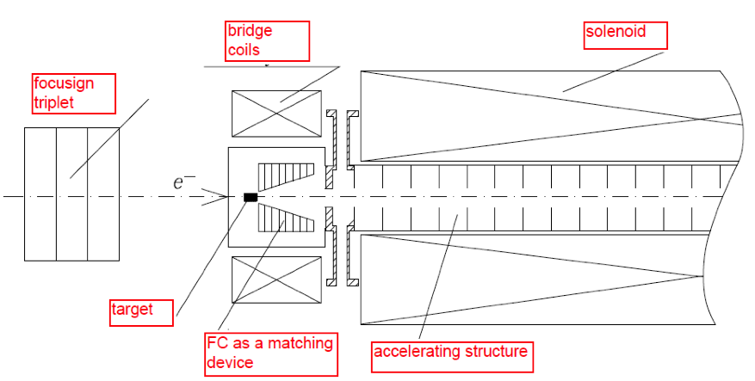
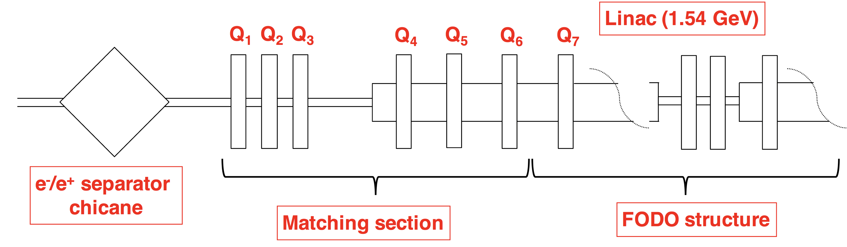
FCC-ee positron source
e+ production and capture section
e+ acceleration up to DR energy (1.54 GeV)

Slide 5
Geometry to put in the simulations for the FCC-ee and PoP @SwissFEL
To be discussed within the Tasks 3.5 and 3.6
(Bridge Coils) + DC solenoid
FC or
SC solenoid
S- or L- band structures
embedded in the solenoid
e- beam
6/20 GeV
96*
~ 8
~ 44
40*
~ 150* (S-band)
~ XXX (L-band)
~ 50* (period)
3*
~ 3
(*) S-band 2.9985 GHz
~ 110
The simulation can start for the FC based scheme (layout is well defined, see slides from Pavel)
Should the fields (FC, acc. Structures and solenoid) be taken into account from the beginning?

