Slide 1
WP6:Overview of the proof-of-principle experiment @PSI
Riccardo Zennaro:: Paul Scherrer Institute
28 01 2021 WP3/WP6 general meeting #1

Slide 2
Experiment goal and constraints
Validation of the technology for e+ production for FCC
Possible comparison of alternative solutions (direct or hybrid scheme)
Design and production of S-band capture cavities
Operation in an existing user machine, bunch charge limitation (≤200 pC) and machine protection (1 Hz)
Limited e+ final energy, measure of the yield for a beam which is not fully captured in a bucket (RF cavities and RF power limitation)

Slide 3
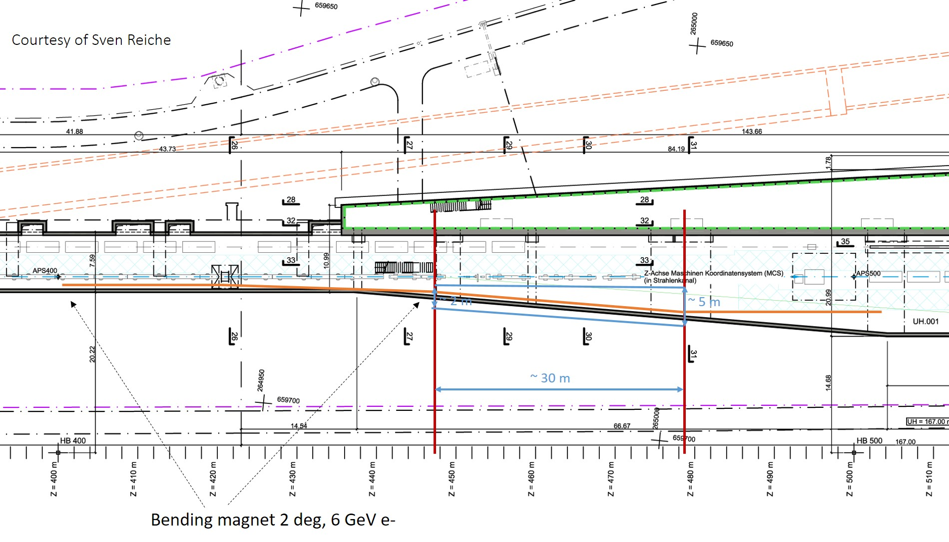
e- beam line from Aramis

Slide 4
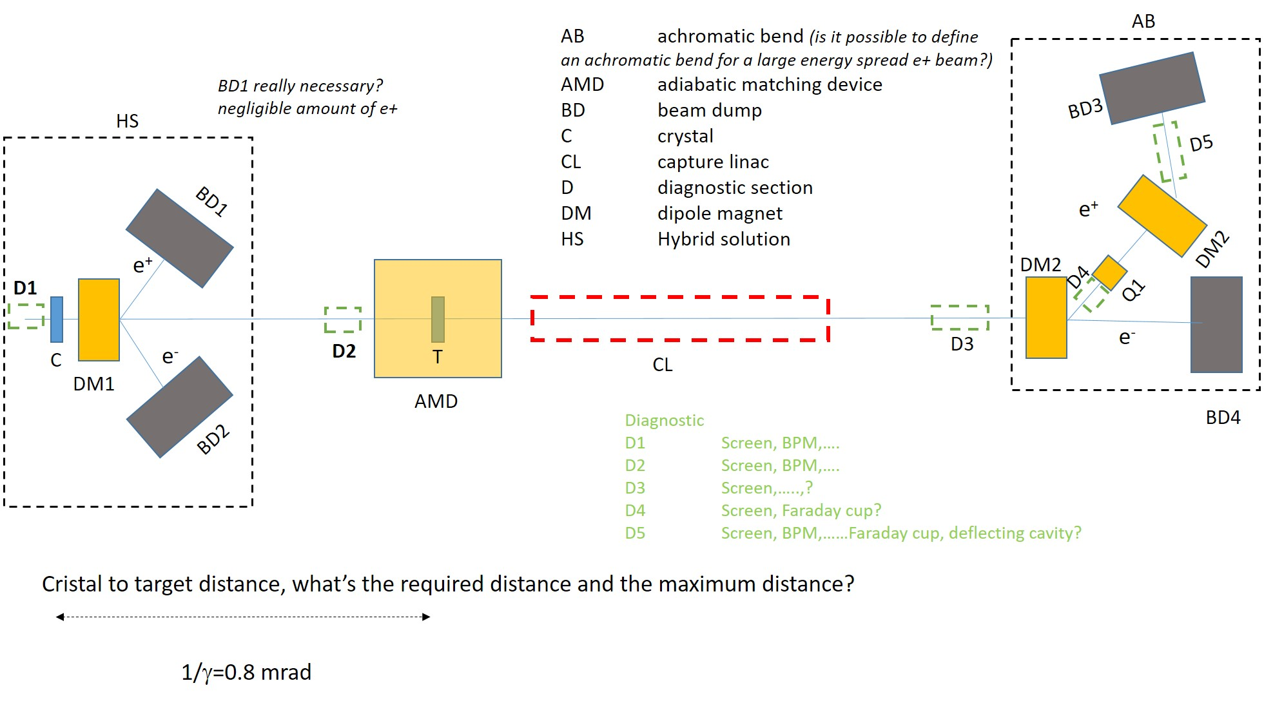
Schematic view of the experiment

Slide 5
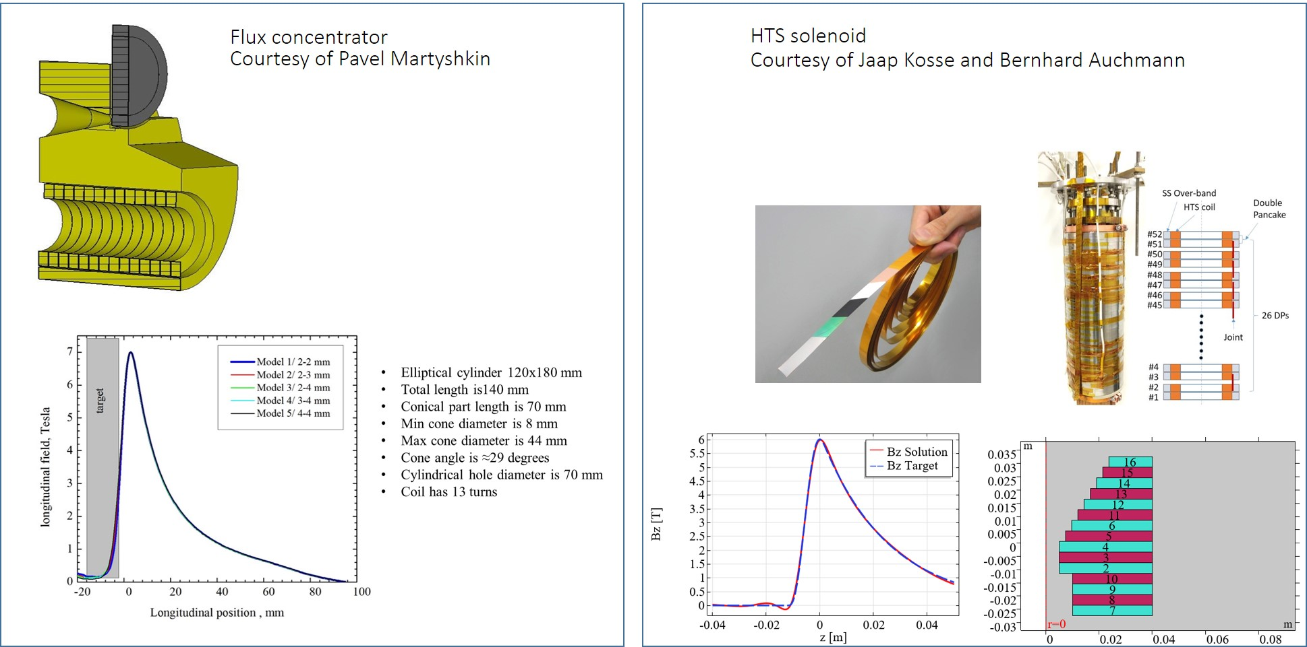
AMD: possible solutions

Slide 6
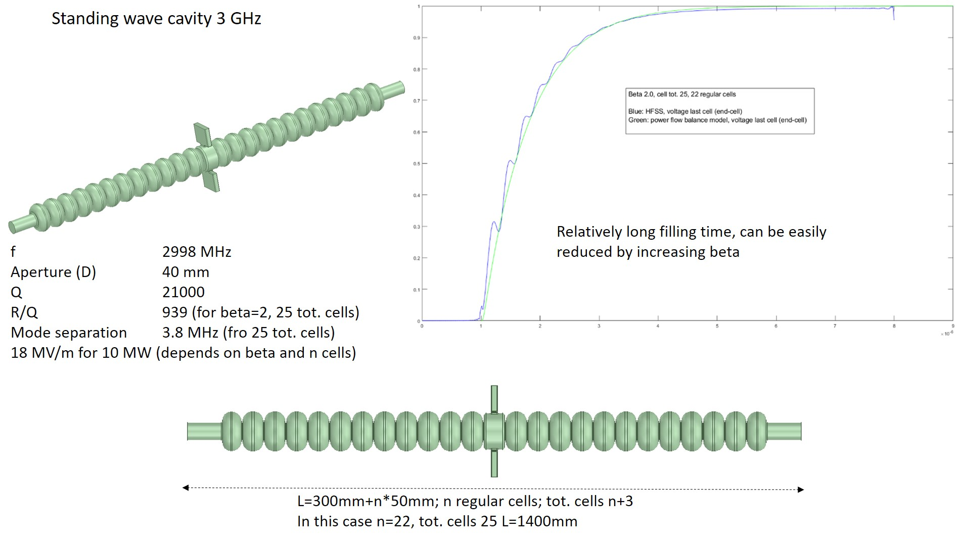
Capture linac, 2,3 or 4 SW S-band cavities*
(*) The amount of cavities depends on the available RF power (30-35 MW peak) and beam dynamics outcome

