Slide 1

DIY.DESPAIR.COM
Still WTF…
About the insecurity of IoT

Slide 2








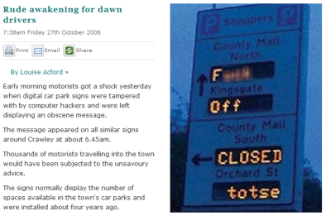
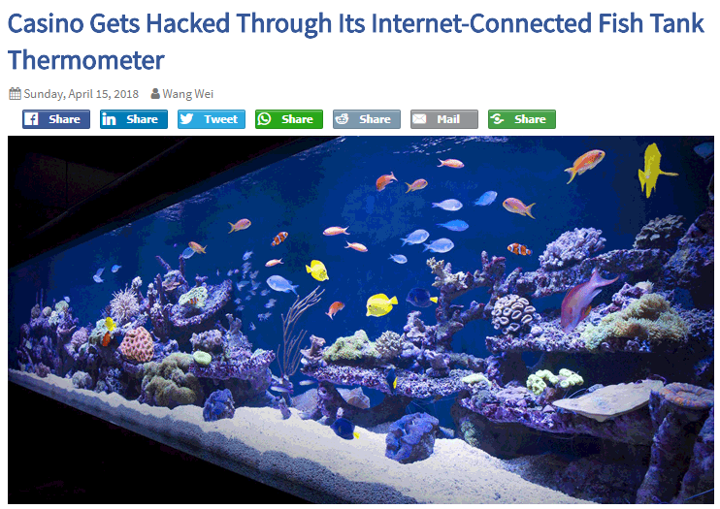








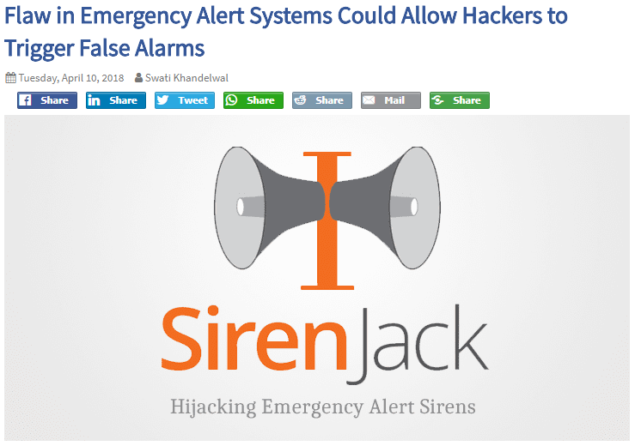

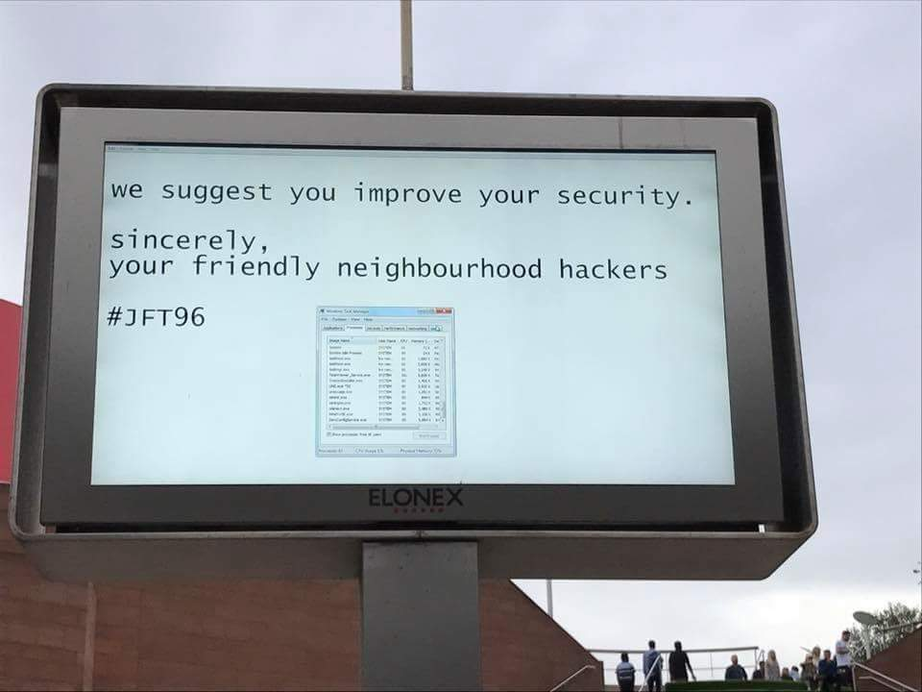


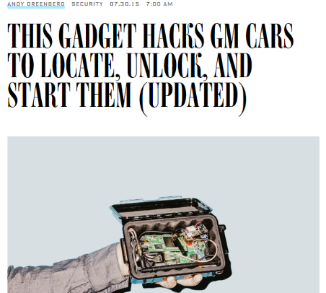
















The Problem 2.0. 100% Fail. WTF.

Slide 3

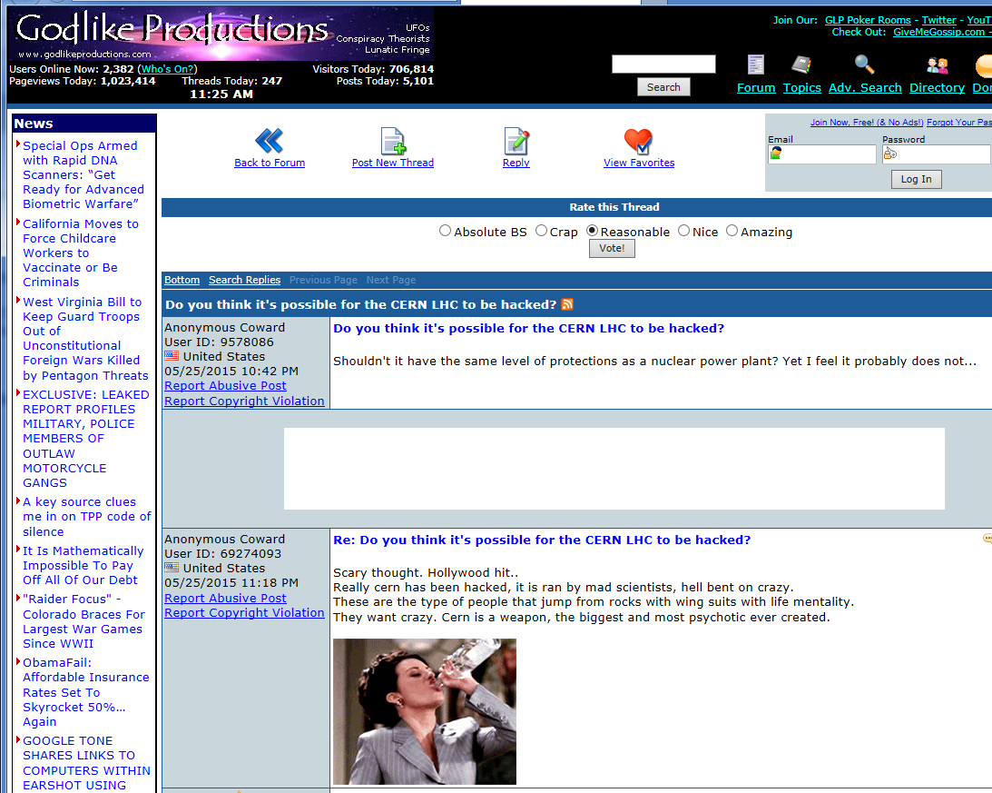

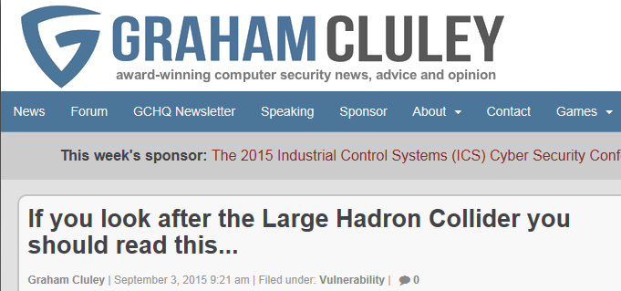
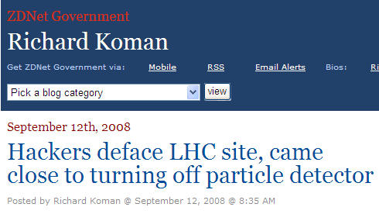
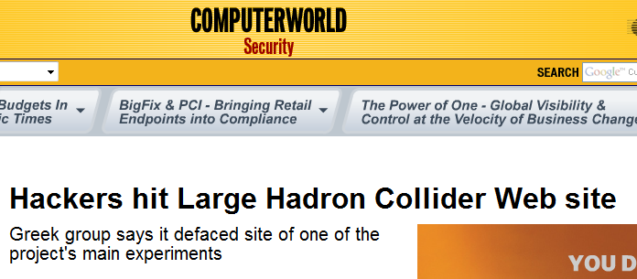
CERN: Under attack like everyone else

Slide 4

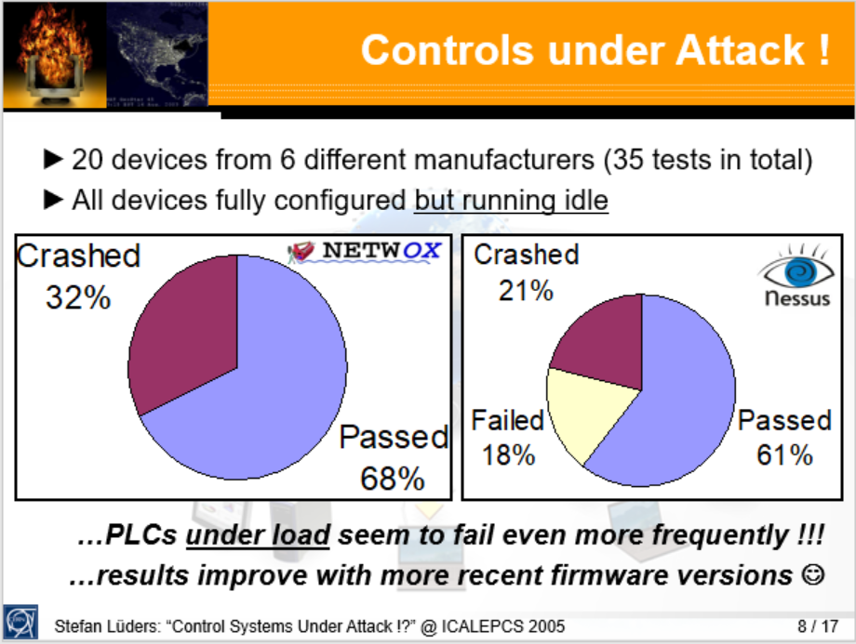

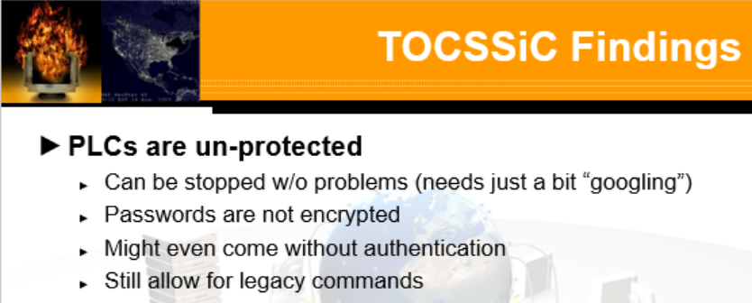

Emerging Threats? Not really

Slide 5
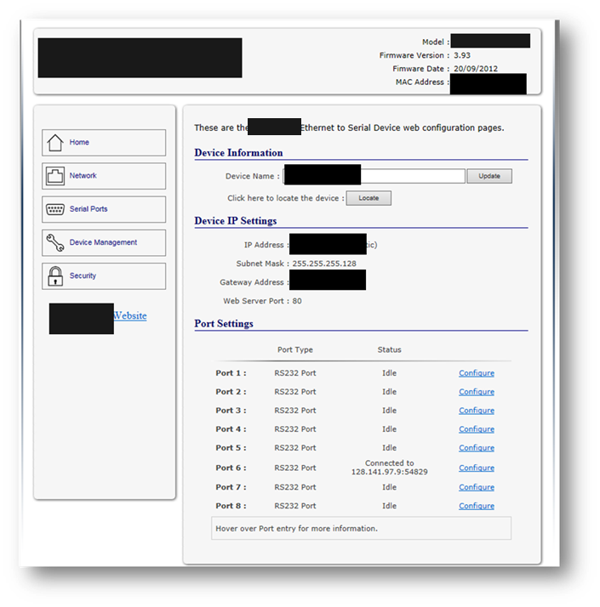
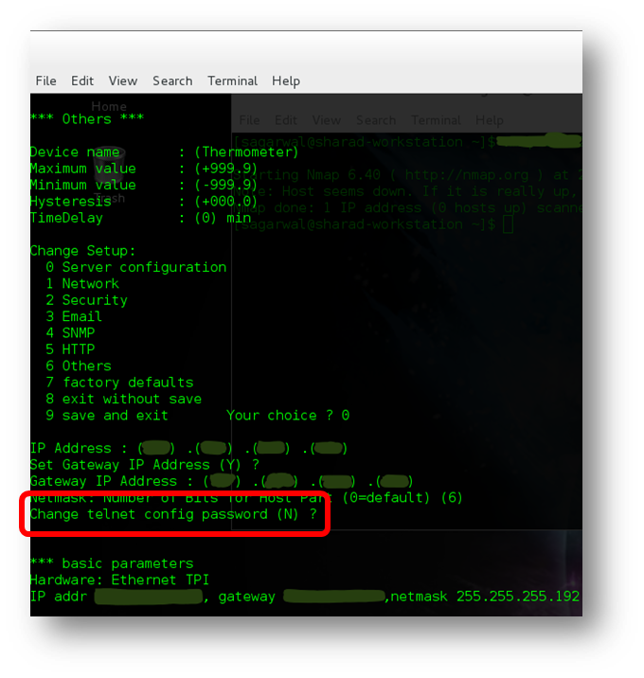
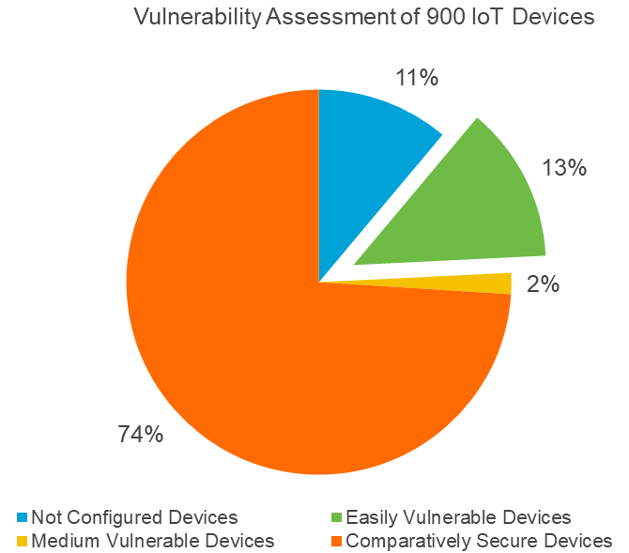
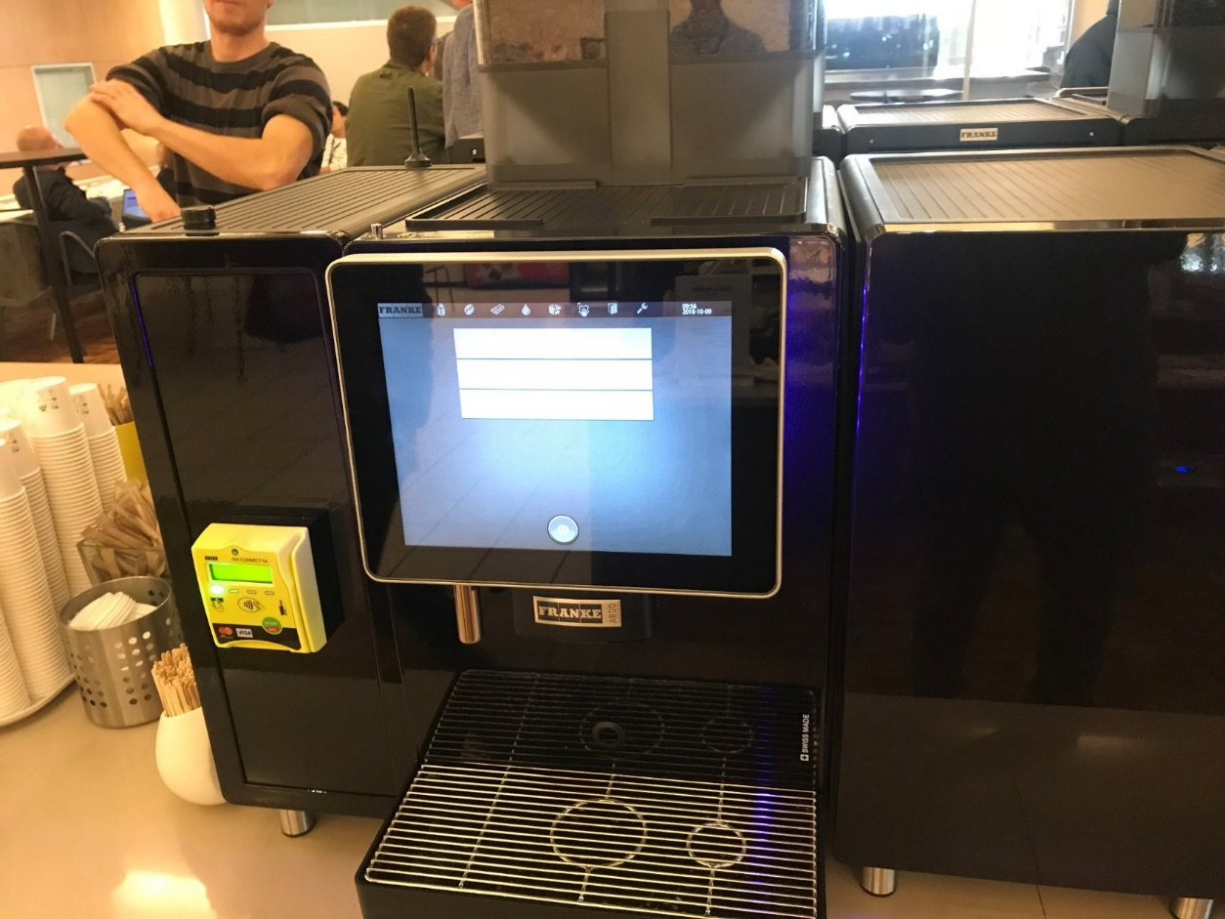
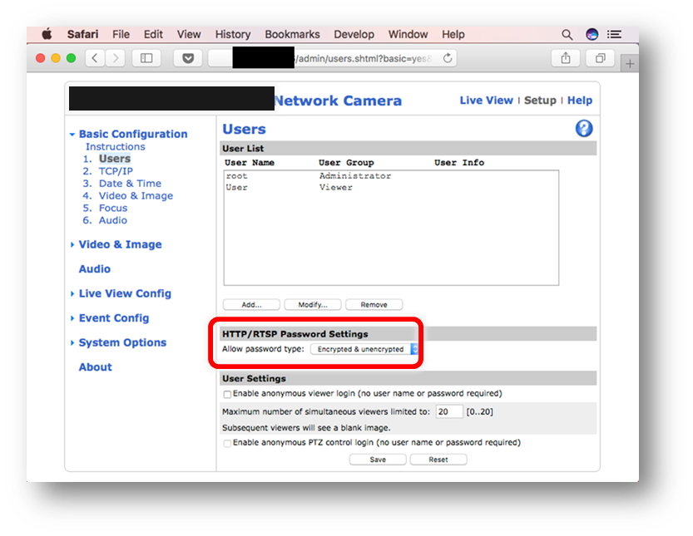
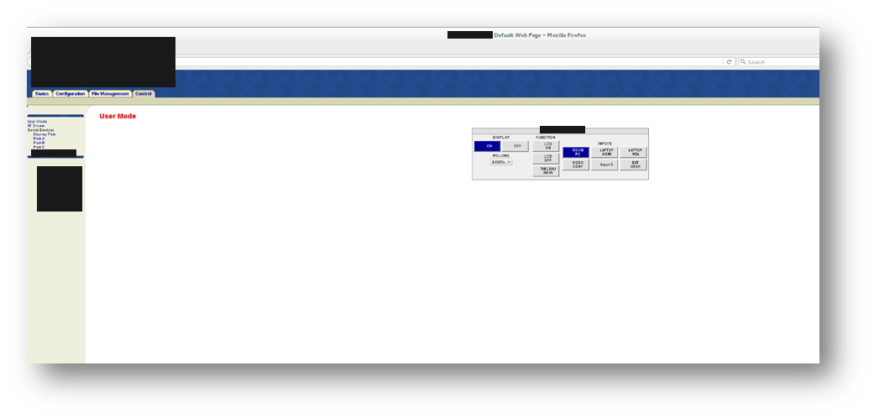
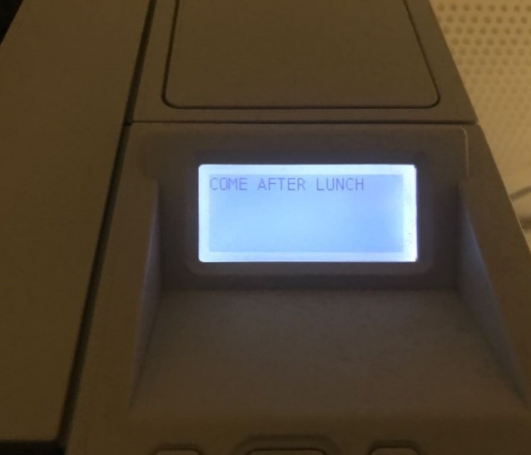
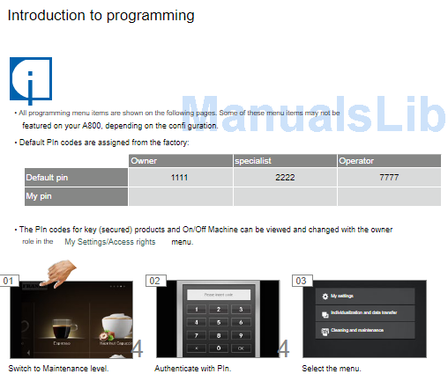
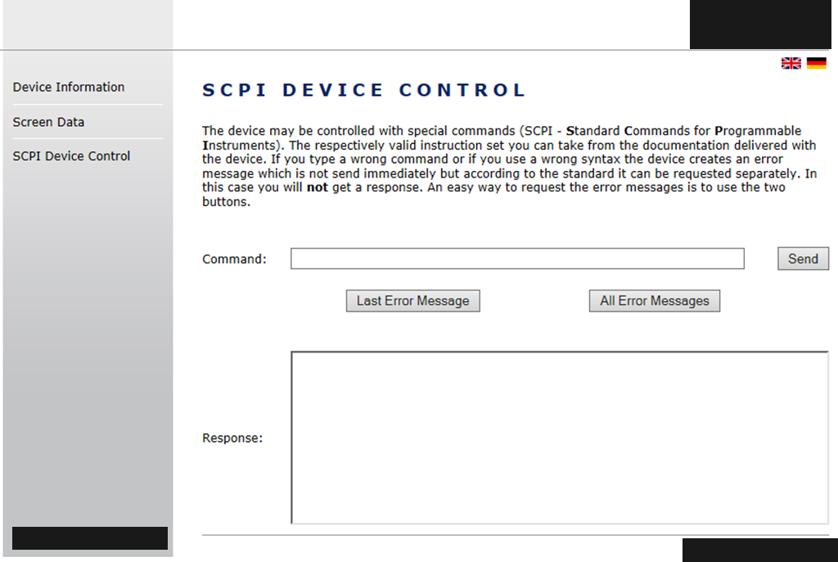
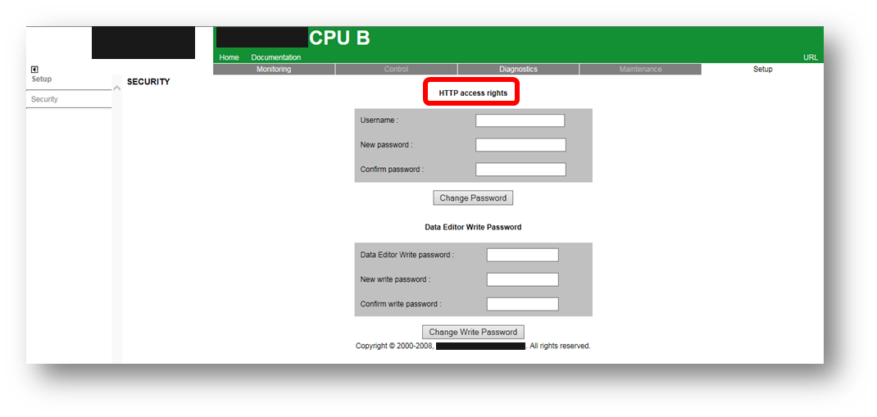
(CERN’s) Internet of Stupid Things

Slide 6
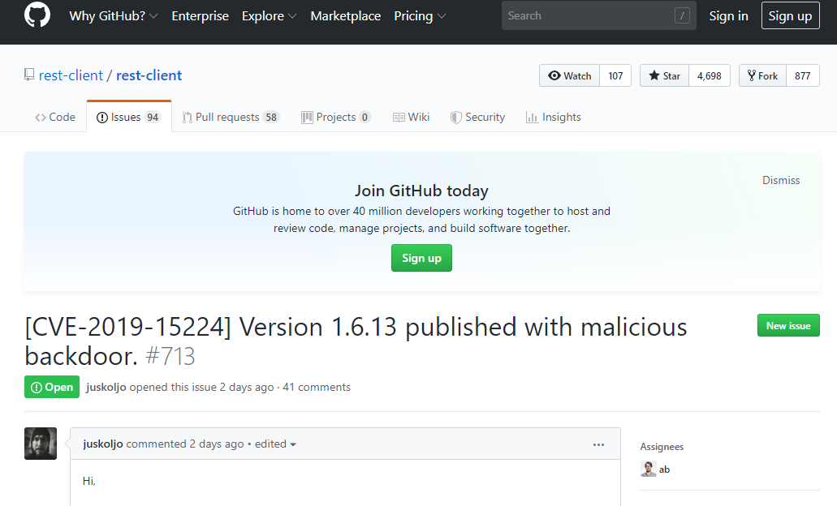
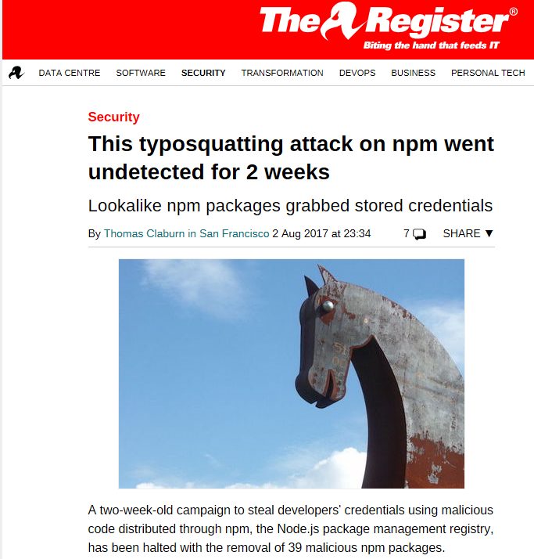
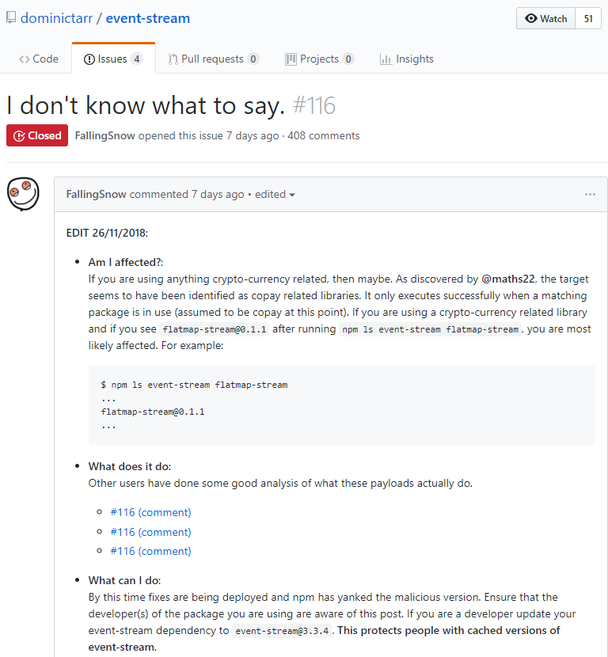
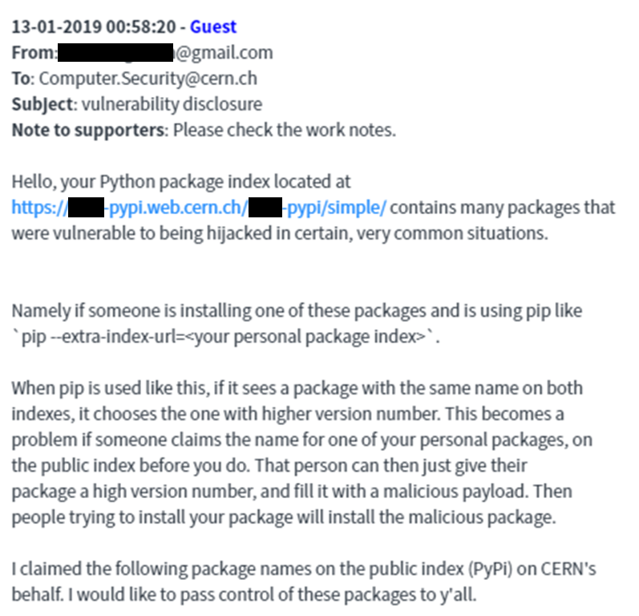
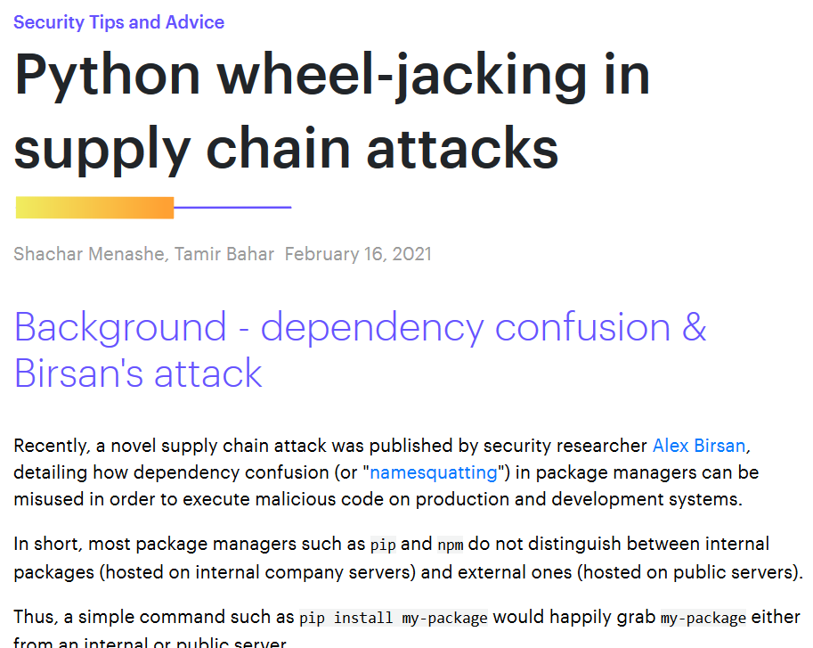
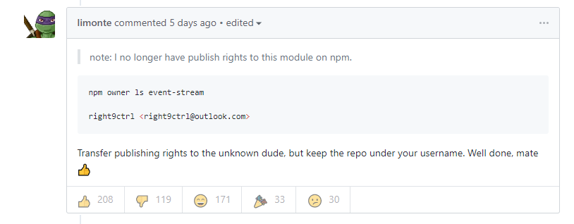
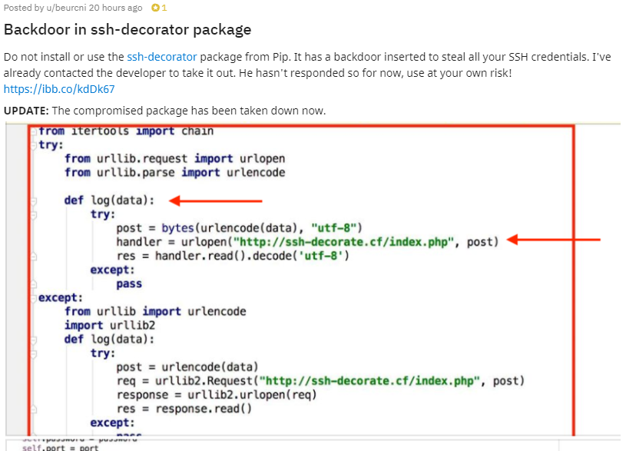

Internet of Stupid Dependencies

Slide 7
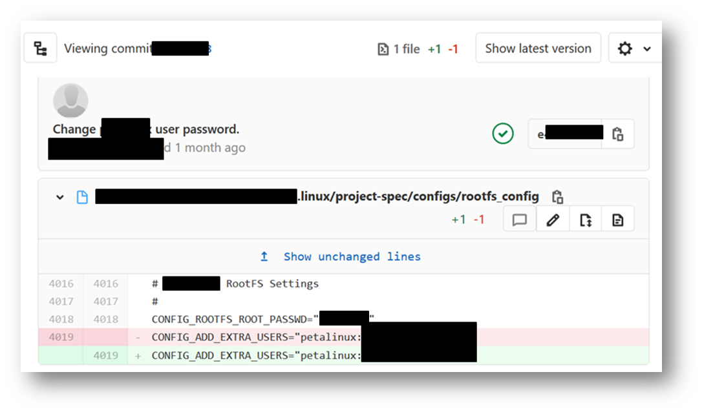
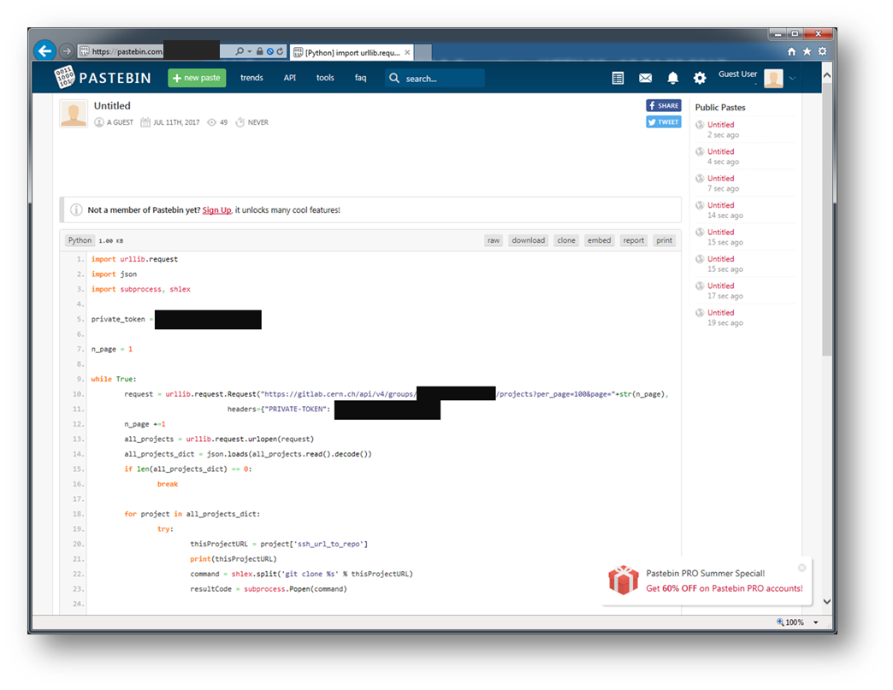
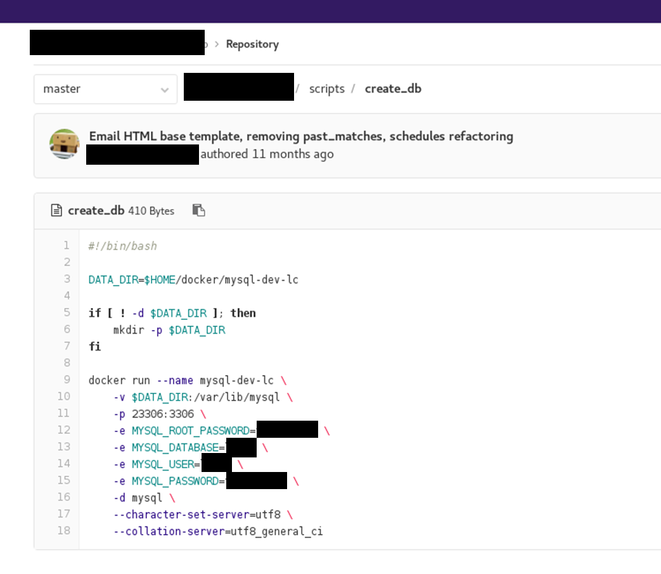
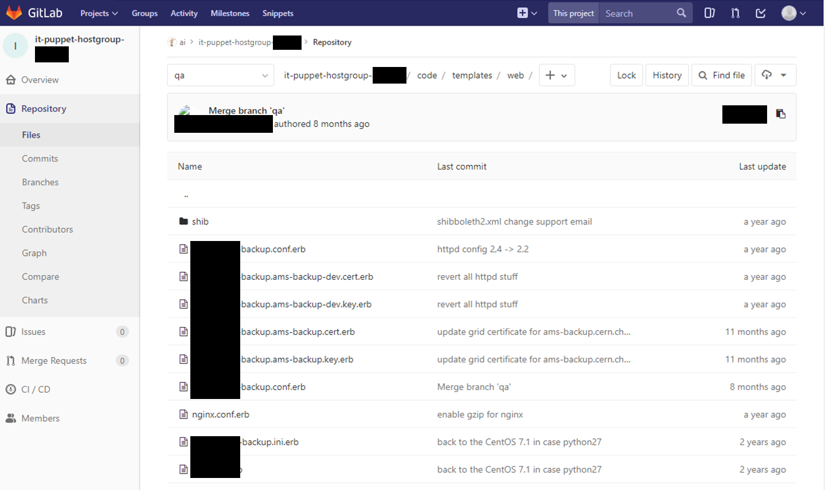
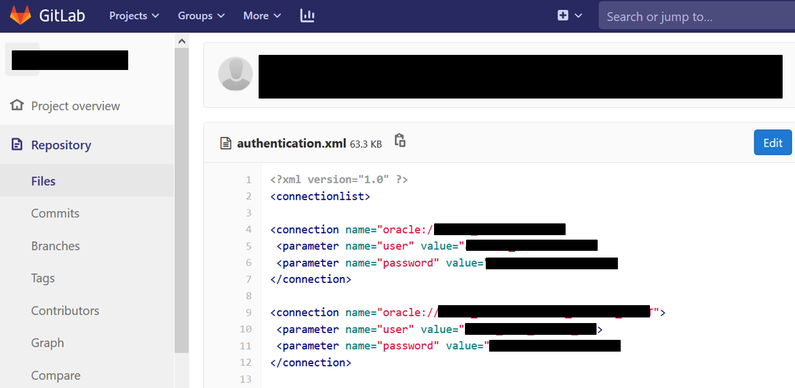
Internet of Stupid Developers

Slide 8

This will not go away!
Exposure
Threats
Complexity
Vulnerabilities
Dependencies Consequences

Slide 9
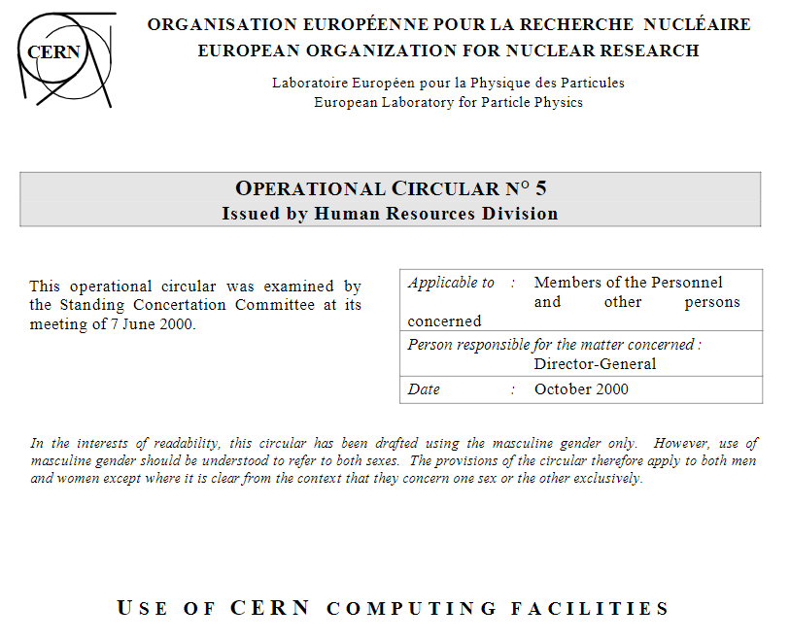
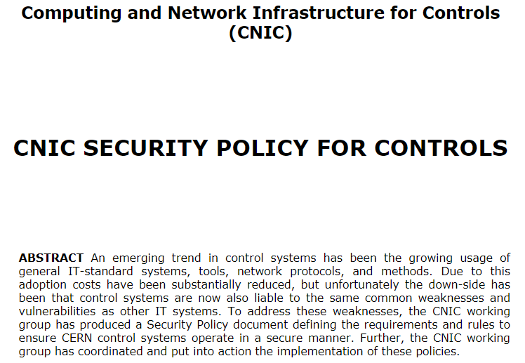
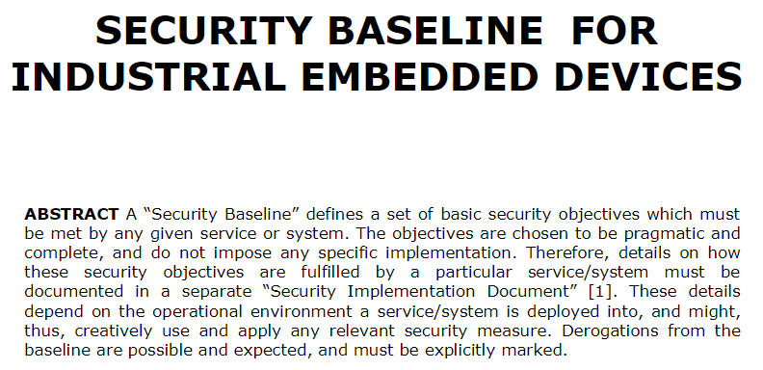
The CERN Computing Rules
“Computer Security” governed by OC5
All CERN staff & users as well as
all users of CERN’s
computing facilities are bound to it
In first instance, you are responsible for the cyber-security of your accounts, devices, systems, software, …
Violation of OC5 might lead to sanctions
Control System Cyber-Security
regulated by the “CNIC”
All systems should follow their respective “Security Baseline”
https://cern.ch/ComputingRules

Slide 10
10 Points to Consider
Stay mainstream:
Do not reinvent the wheel. With the crowd, you benefit from the below.
Keep your system up-to-date: Be able to patch in reasonable time.
Kill all unnecessary services: Disable Telnet, FTP …and run a local firewall.
Control remote access: Delete default accounts. Change default passwords.
Filter inputs: Every remotely provided input must be validated and sanitized!
Develop software securely: Don’t trust remotely imported libraries & packages
Use encryption: …for confidential information (e.g. passwords).
Understand dependencies: DHCP? NTP? SSO/LDAP/AD?
Have a plan: For updating. For business continuity. For incident response.
Get training & let us help you:
https://cern.ch/security & Computer.Security@cern.ch

