Slide 1
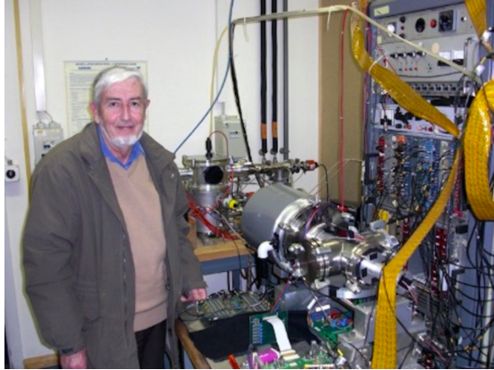
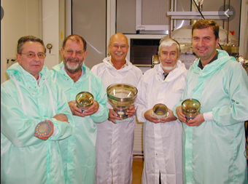
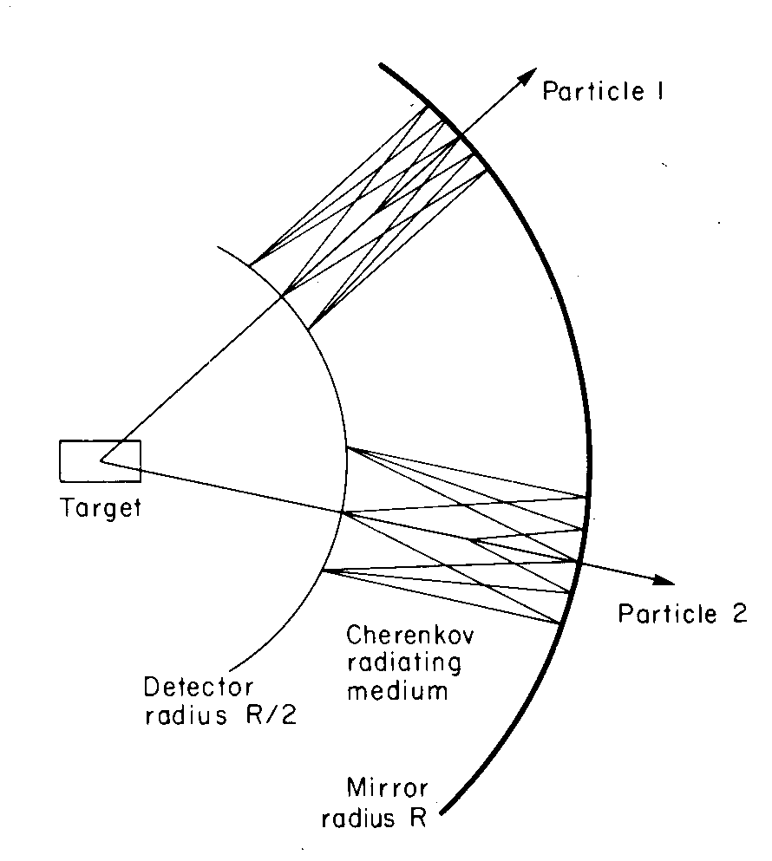
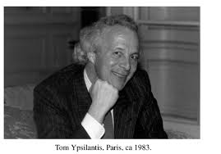
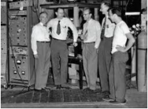
Jacques Seguinot: A great detector physicist
1932 – 2020
J. Seguinot and T. Ypsilantis, Nucl. Instr. and Meth.142 (1977) 377
1928-2001

Slide 2
Jacques Séguinot short CV
1932 Born in Vendée.
Diploma electromechanical engineering at the University of Caen
1954 PhD in physical sciences in.
1981 research director at CdF
1990 retirement
Jacques Séguinot research activities
Middle of 1950 at the French cosmic ray laboratory on the Col du Midi (3500 m)
From 1960 nuclear physics at Saturne (CEA Saclay)
From 1964 at the CERN PS, studying strong interactions with pion and kaon beams.
Around 1970 Jacques started collaborating with Tom Ypsilantis
1977 paper, co-authored by Tom Ypsilantis establishing the basis of the RICH.
During 1980 RICH proposal For DELPHI-LEP development of BARREL RICH
From 1988 fast RICH for the Swiss B-factory at PSI
From 1992 proposal of HELLAZ neutrino experiment
end-1990s, photodetectors sensitive to visible light: Hybrid Photo Detectors (HPD)

Slide 3
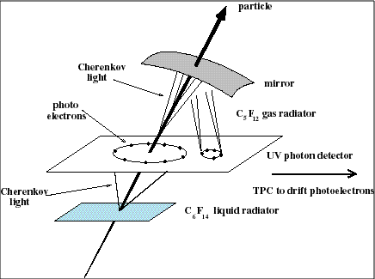
Shematic of the DELPHI RICH detector
Same for SLD detector:
Liquid radiators enclosed in quartz AND gas radiators. TMAE based wire chambers with long drift in E field wire chambers with long drift in E field

Slide 4
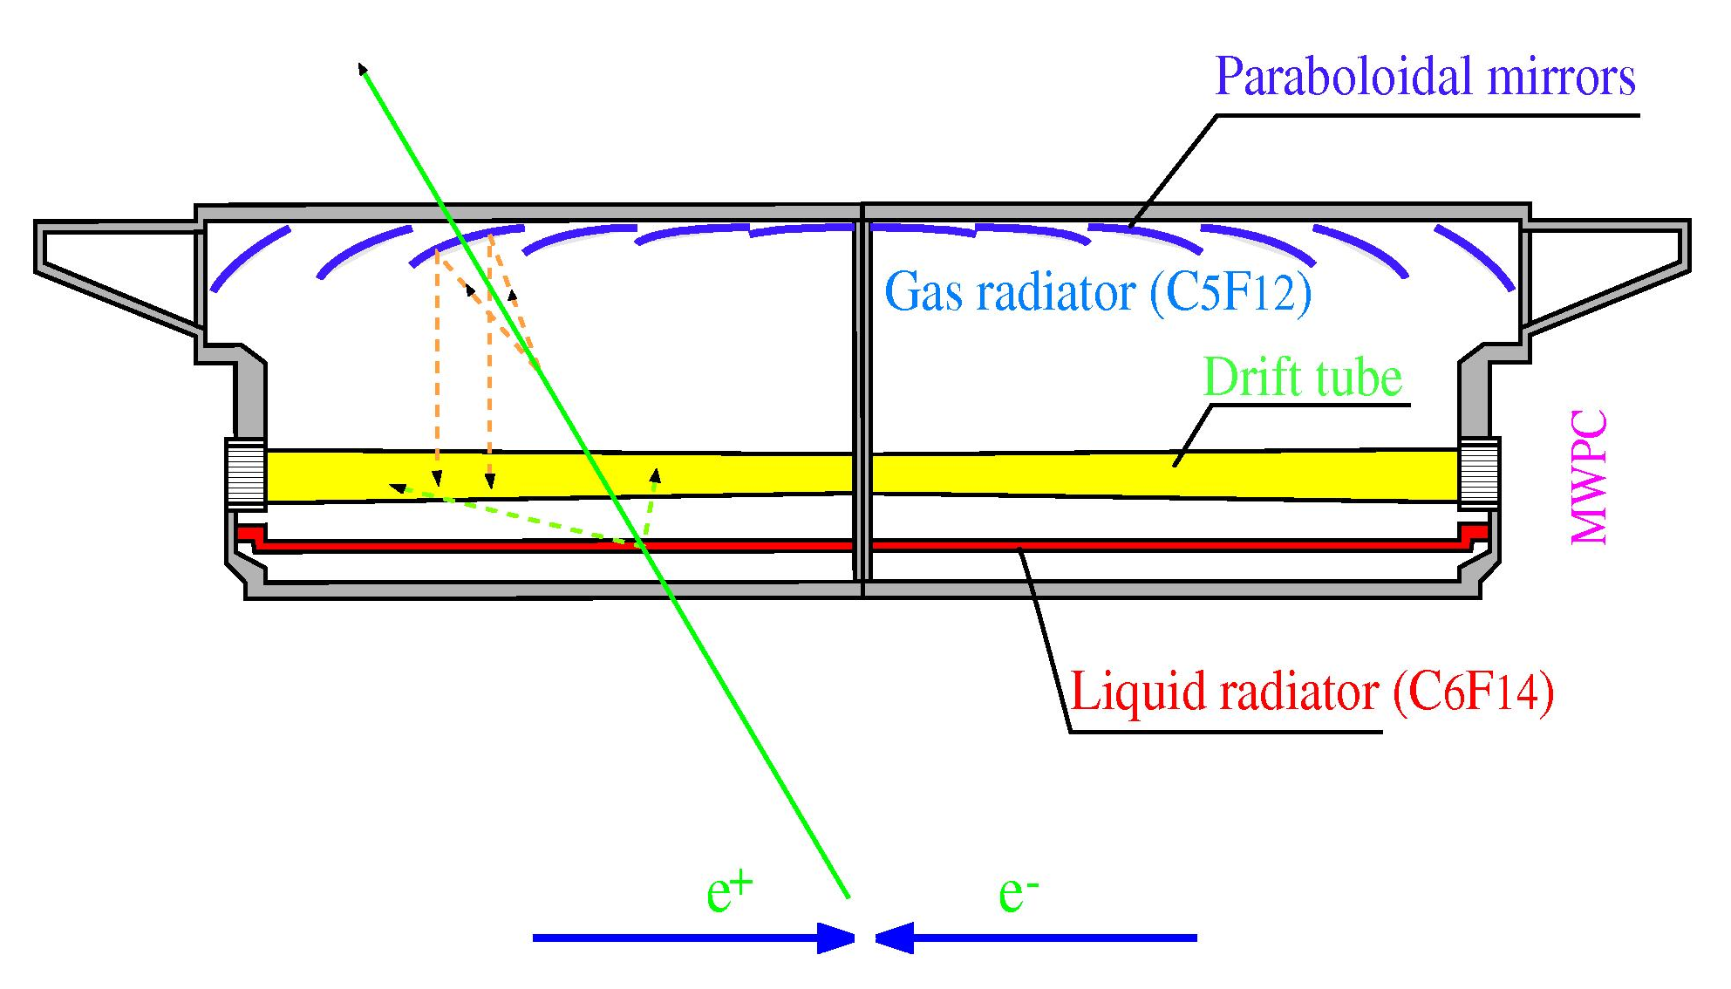
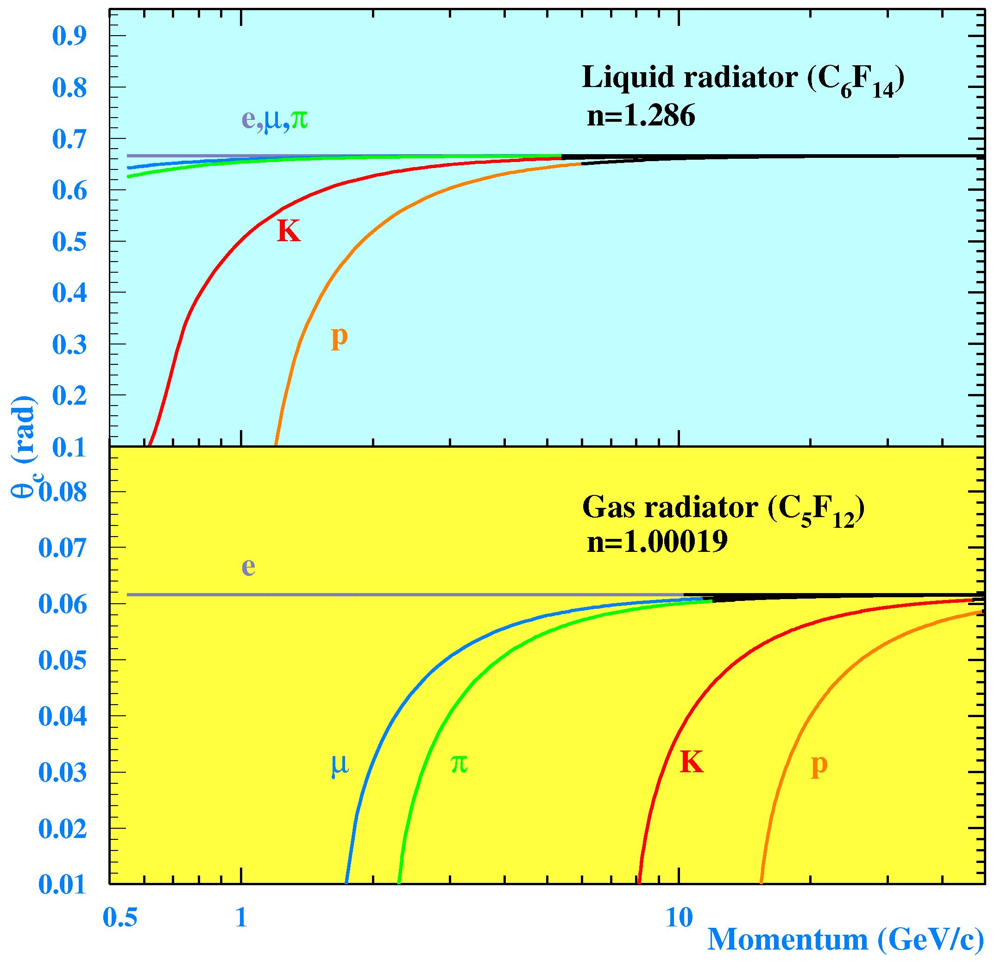
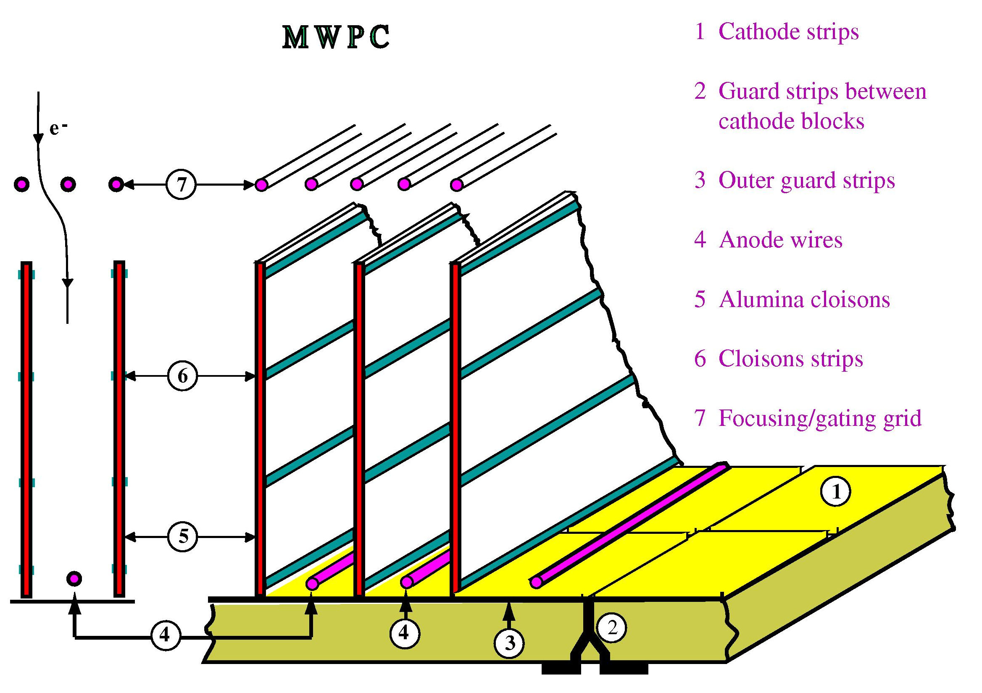
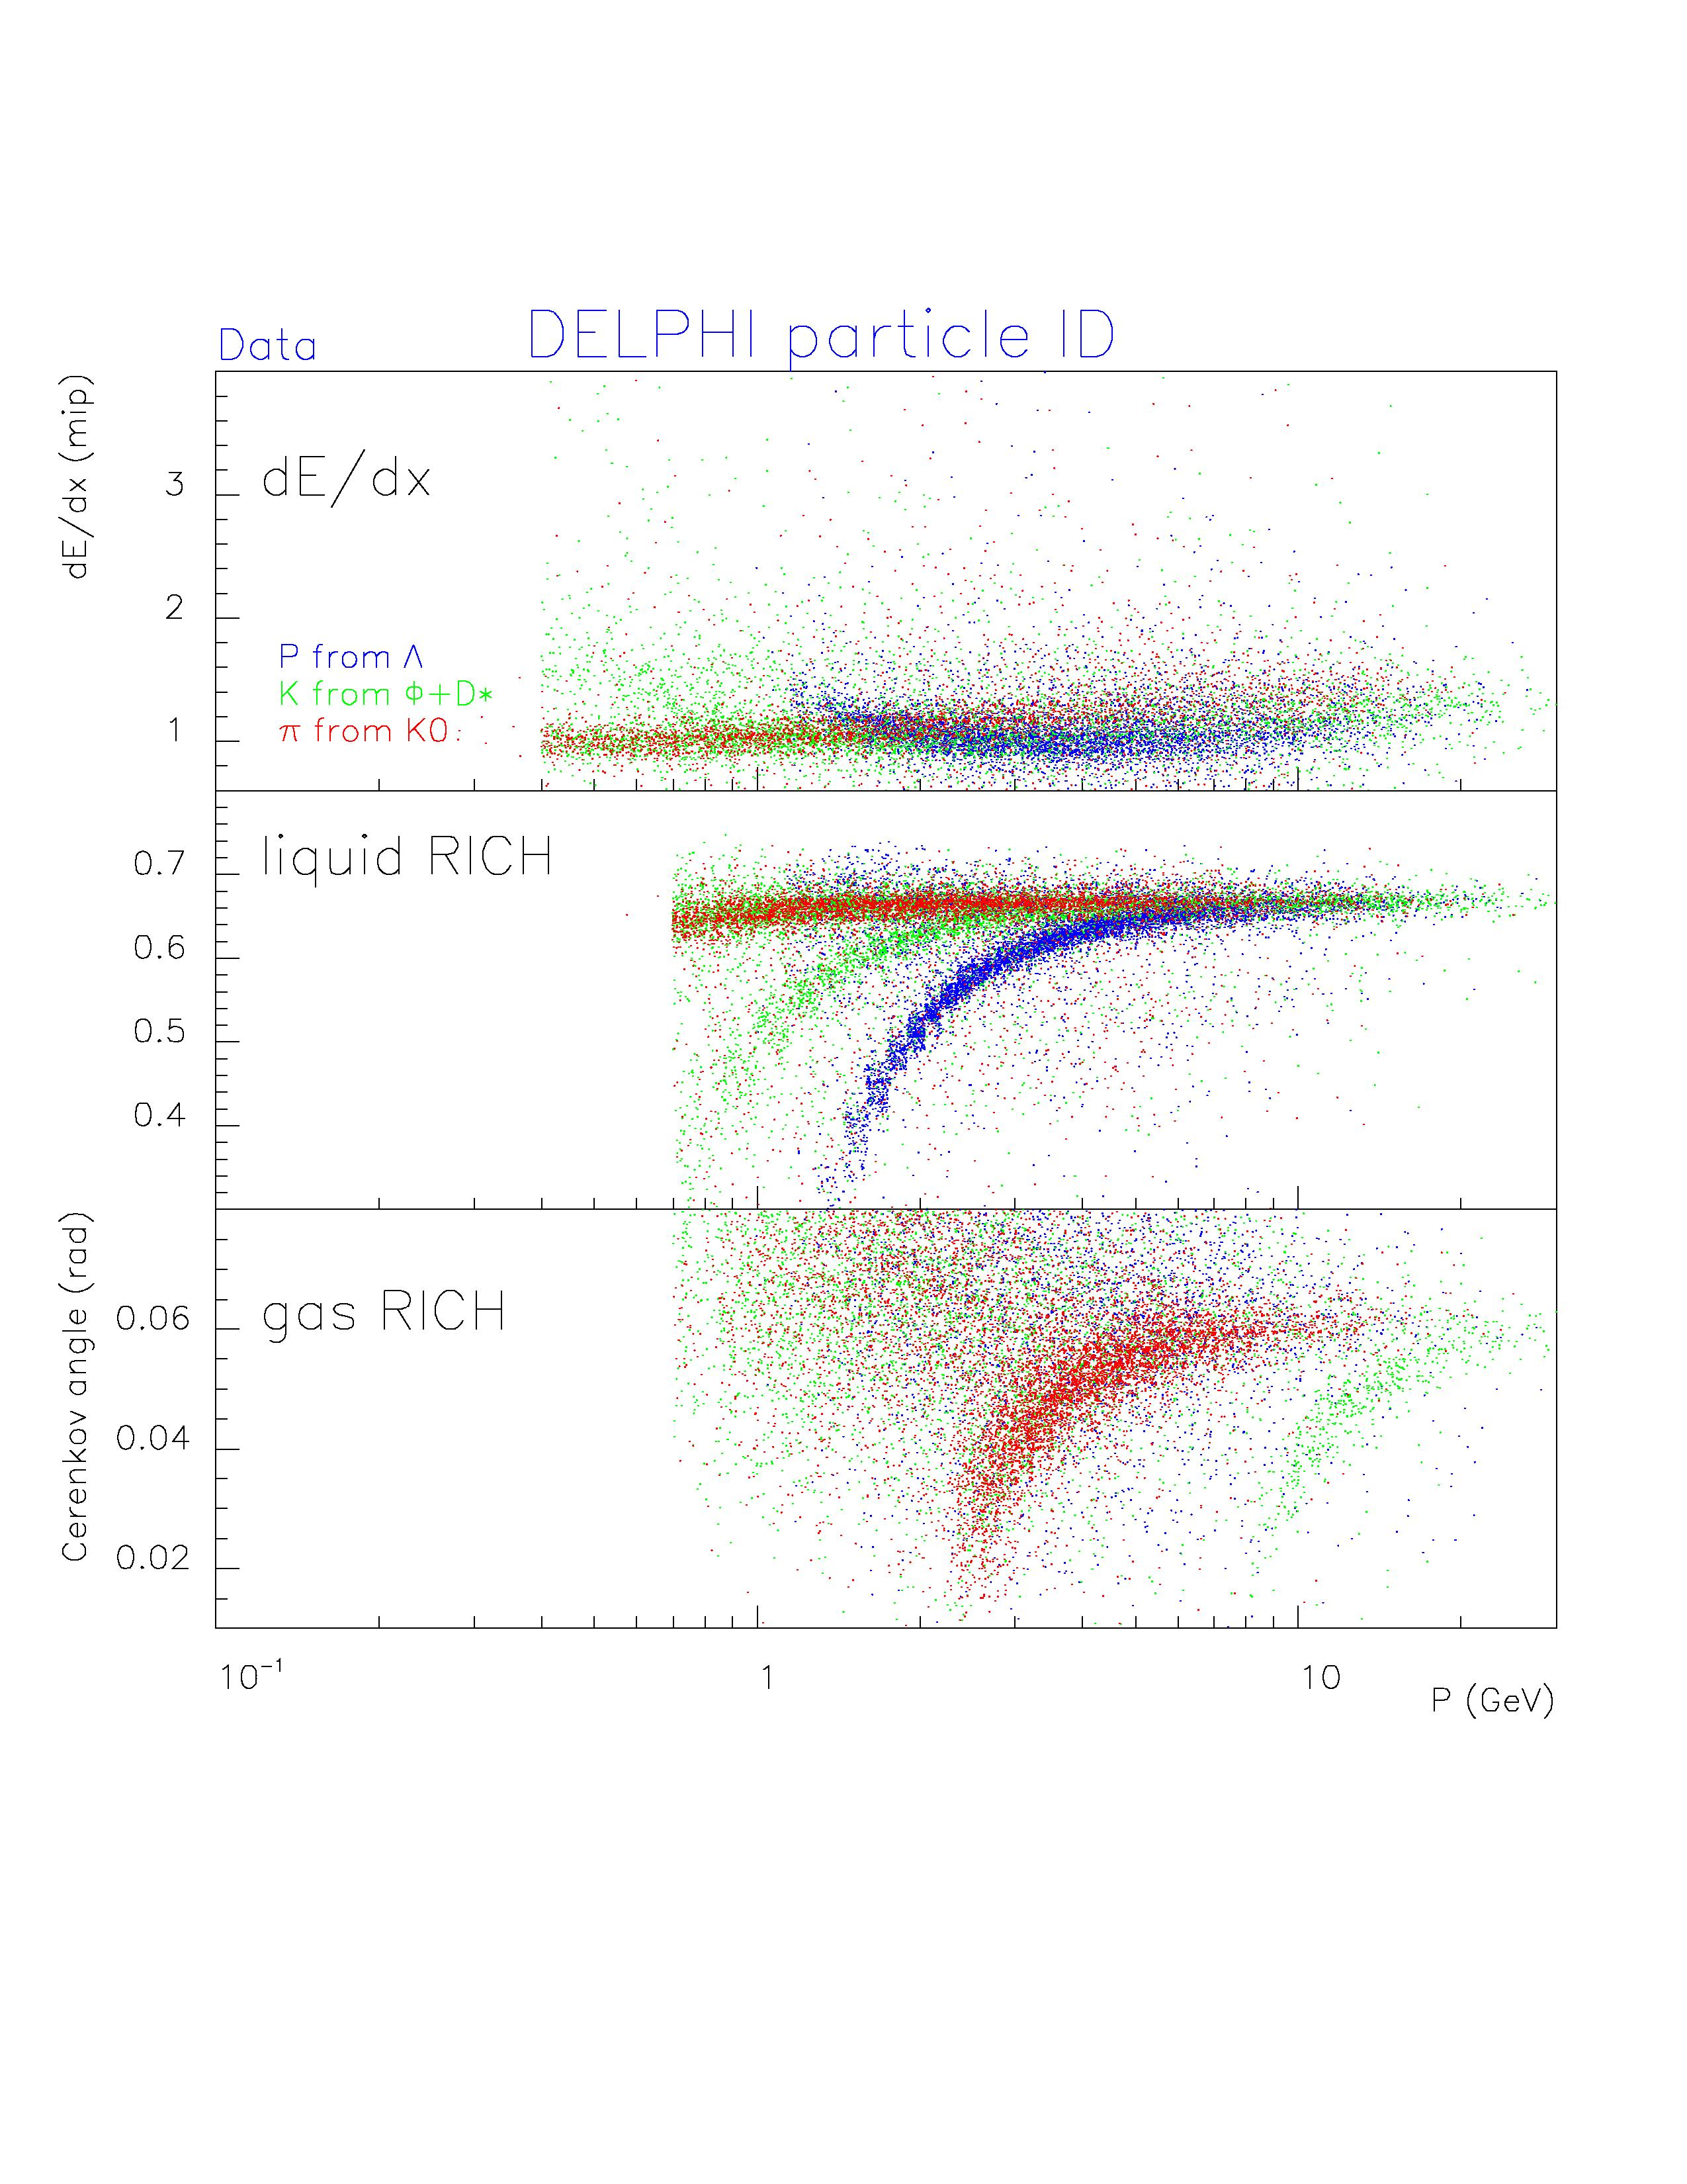
DELPHI RICH
Particle ID with DELPHI RICH

Slide 5
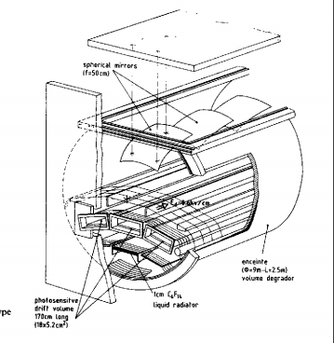
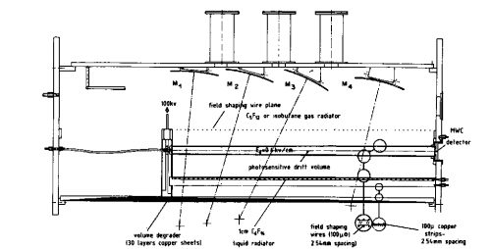
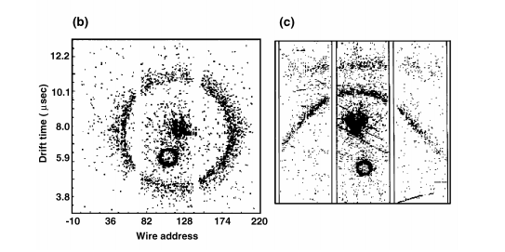
DELPHI RICH PROTOTYPE DESIGN AND RESULTS
R. ARNOLD, P. BAILLON, J. D BERST, H.J. BESCH, M. BOSTEELS, E. CHRISTOPHEL Y. GIOMATARIS,
J.L. GUYONNET, G. PASSARDI, J. SEGUINOT, J. TOQUEVILLE, D. TOET and T. YPSILANTIS, ‘
Photosensitive gas detectors for the ring-imaging Cherenkov (RICH) technique and the delphi barrel rich prototype’, Nuclear Instruments and Methods in Physics Research A252 (1986) 188-207
R. Arnold et al., Nuclear Instruments and Methods in Physics Research A270 (1988) 255-288
R. Arnold et al., Nuclear Instruments and Methods in Physics Research A270 (1988) 289-318
R. Arnold et al., Nucl.Instrum.Meth.A 273 (1988) 466
Good detector stability with high single-electron efficiency
Liquid, gas radiator and quartz window kept at optimal UV transmission
Good angular resolution close to expected value
Good handling-purification of TMAE; long electron absorbtion lenght

Slide 6
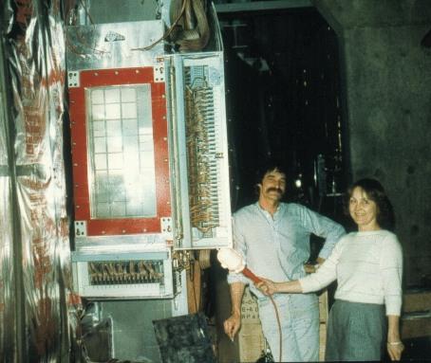
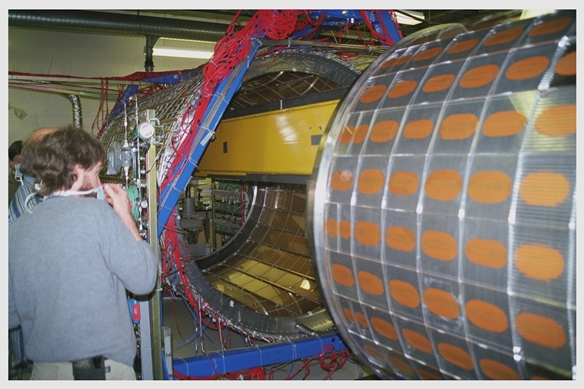
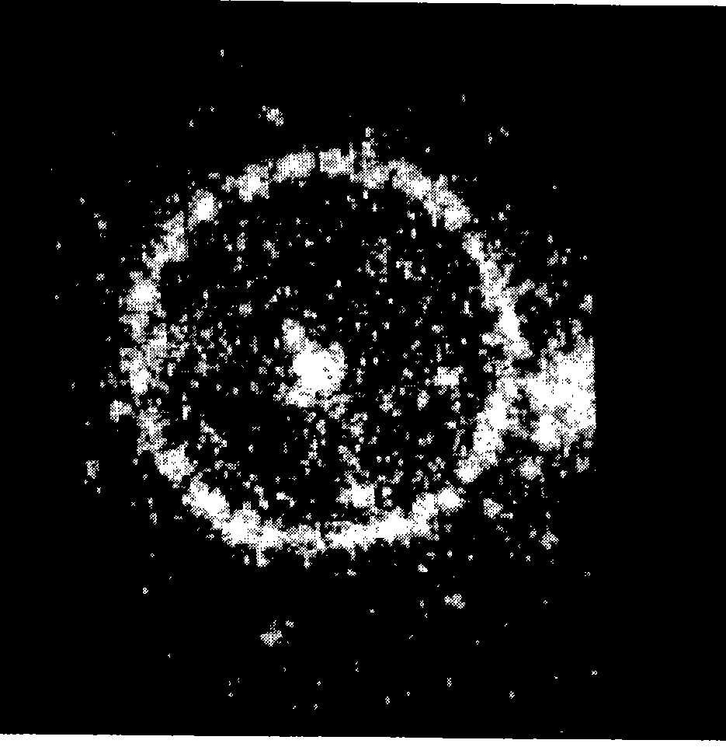
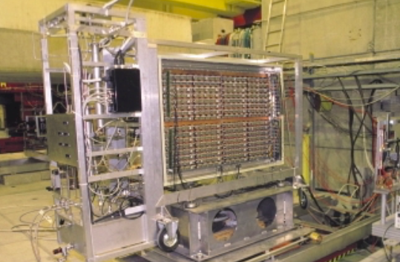
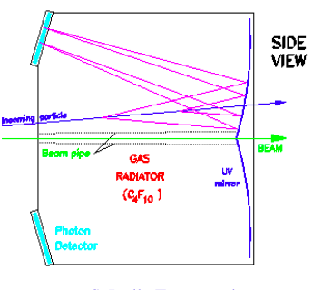
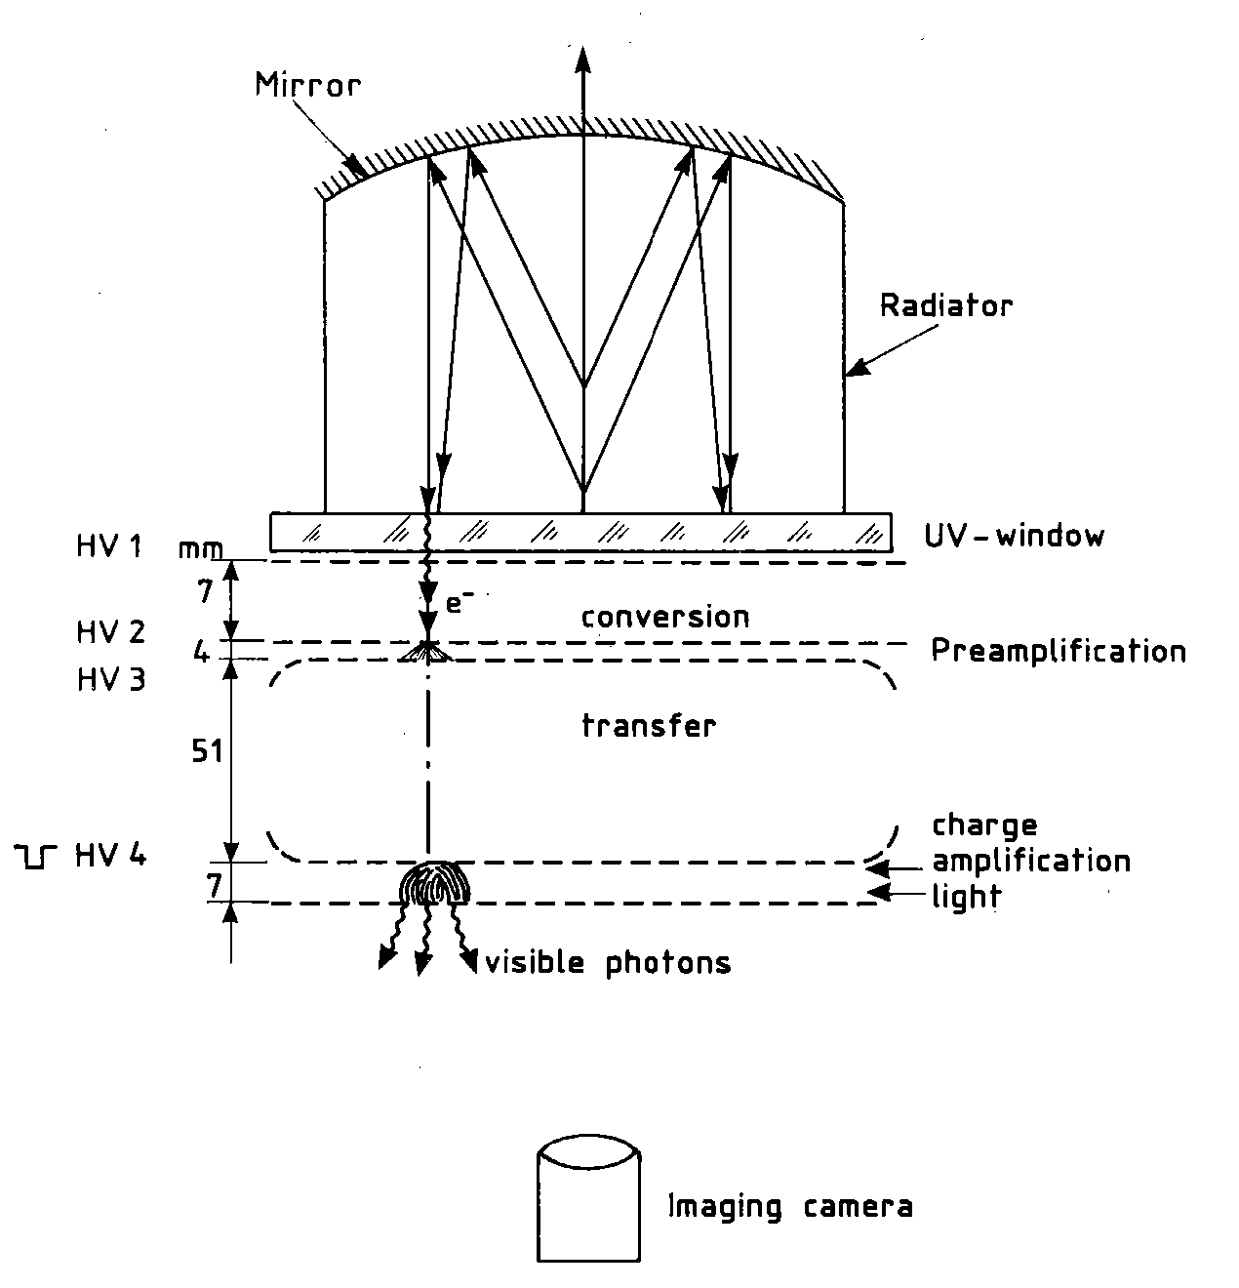
RICH technology has been widely used in many experiments in eighties and nineties
At LEP, many fixed target experiments at CERN, FNAL, JLAB, JPARC,
heavy ion experiments CERN-Brookhaven-GSI
Forward DELPHI RICH Detector
CLEO fast RICH
with TEA
RICH: E605 experiment attFNAL (1985-95)
CERN-FNAL-KEK- Saclay
A high-energy gamma ray telescope
I. Giomataris; G. Charpak, CERN-EP-88-94
ALICE-HMPID prototype
COMPASS RICH

Slide 7
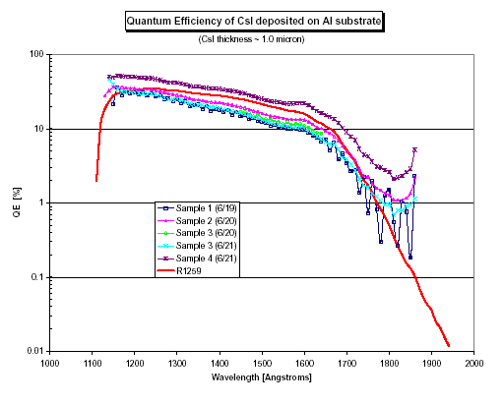
CsI solid photocathode
J. Seguinot, Georges Charpak, Y. Giomataris, V. Peskov, J. Tischhauser, T. Ypsilantis, Nucl.Instrum.Meth.A297:133-147,1990
This work has trigerred
An active research
over the world
SiO2
c

Slide 8
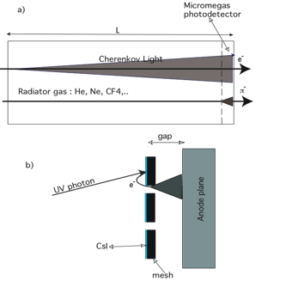
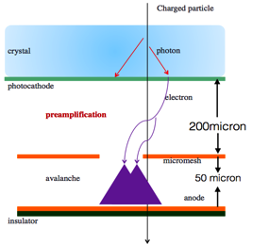
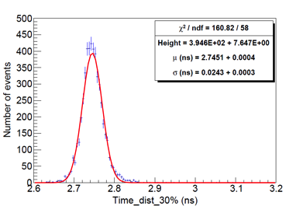
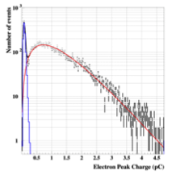
Experimets using CsI photocathodes
HBD a Hadon Blind Detector
Y. Giomataris and G. Charpak, NIM. A310 (1991) 589
Fast timing Picosecond Micromegas
The PHENIX Hadron Blind Detector
The Hadron Blind Detector at J-PARC
The Hadron Blind Detector at J-PARC
And future projects in review
I.Tserruya , K. Aoki , C. Wood,
Nucl.Instrum.Meth.A 970 (2020)
σ=24.ps

Slide 9
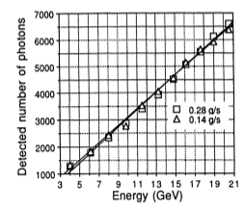
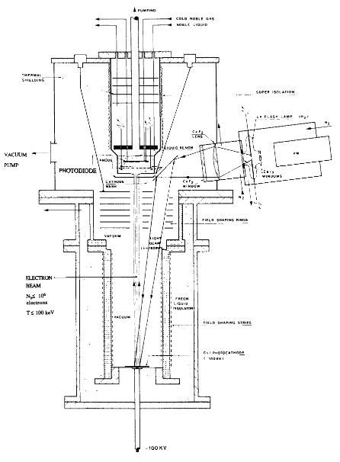
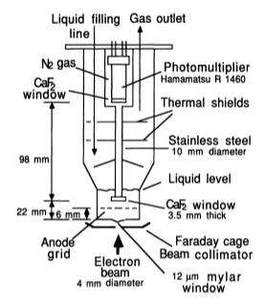
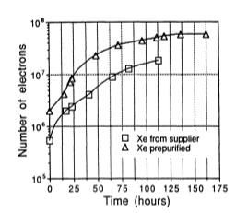
A totally active Xenon calorimeter
Charge and scintillation read-out
J. Seguinot, T. Ypsilantis, M. Bosteels, G. Passardi, J. Tischhauser, Y .Giomataris
Advances in cryogenic Engineering 37B(1992)1137
J. Seguinot et al., NIM A323(1992)583

Slide 10
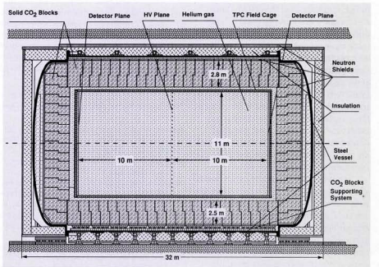
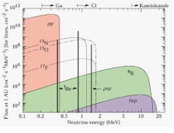
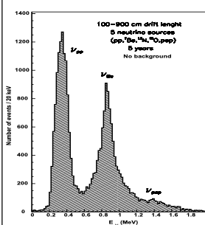
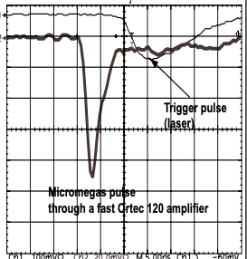
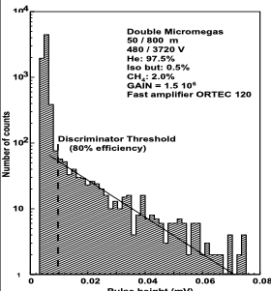
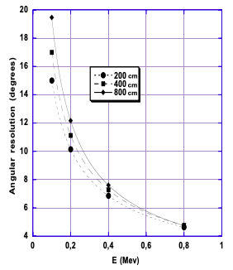
T. Ypsilantis, Europhysics News, 1996
J. Seguinot, T. Ypsilantis, G. Bonvincini, P. Giusti, G. Laurenti and A. Zichichi, CERN-LAA/95-11
G. Laurenti, S. Tzamarias, G. Bonvicini, A. Zichichi, J. Seguinot and T. Ypsilantis, CERN/LAA/PC/93-1
The HELLAZ neutrino detector
P. Gorodetzky et al. “Identification of solar neutrinos by individual electron counting in HELLAZ”, Nucl. Instr. and Meth. A 443 (1999) 554

Slide 11
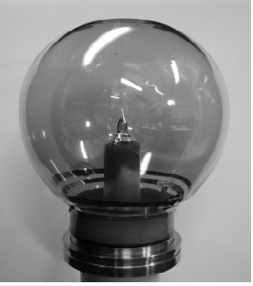
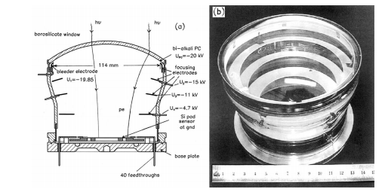
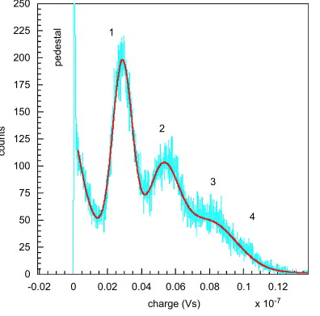
HPD Hybrid Photon Detector
for RICH, LHC-B, PET, Neutrino Telescopes
A. Braem, C. Joram, F. Piuz, E. Schyns and J. Seguinot, NIM. A 502 (2003) 205.
A. Braem et al., Nucl. Instr. Meth. A 570 (2007) 467.
A. Braem et al., Nucl. Instr. Meth. A 581 (2007) 469
Highly segmented large-area hybrid photodiodes with bialkali photocathodes and enclosed VLSI readout electronics

Slide 12
Jacques has put his stamp on detector physics
We will remember him for ever

