Slide 1
"Single Photon Detection with gaseous detectors"
Stefano Levorato
Limited to the PID applications of gaseous photon detectors………
Stefano Levorato | 16 February 2021 | RD51 Workshop on Gaseous Detector Contributions to PID

Slide 2
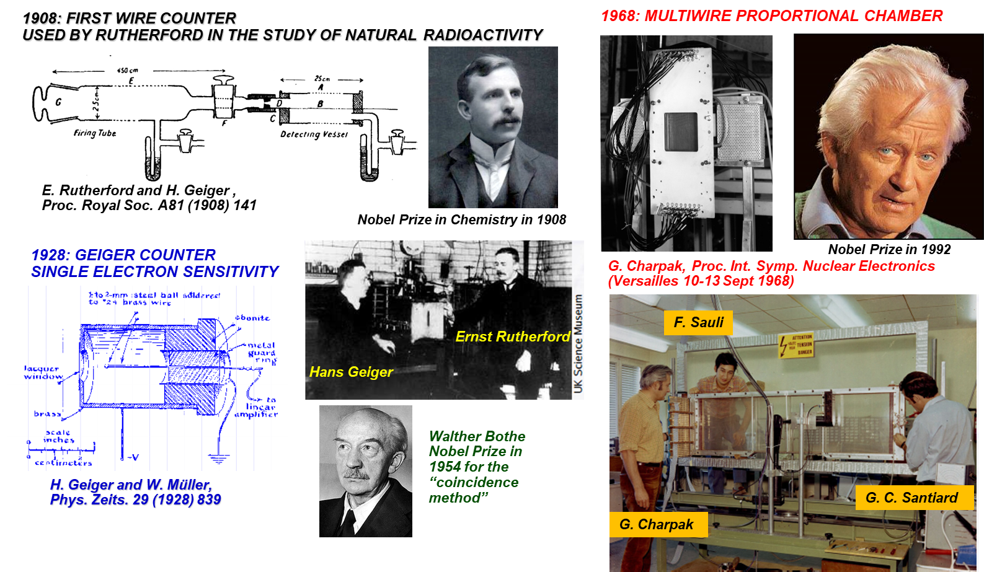
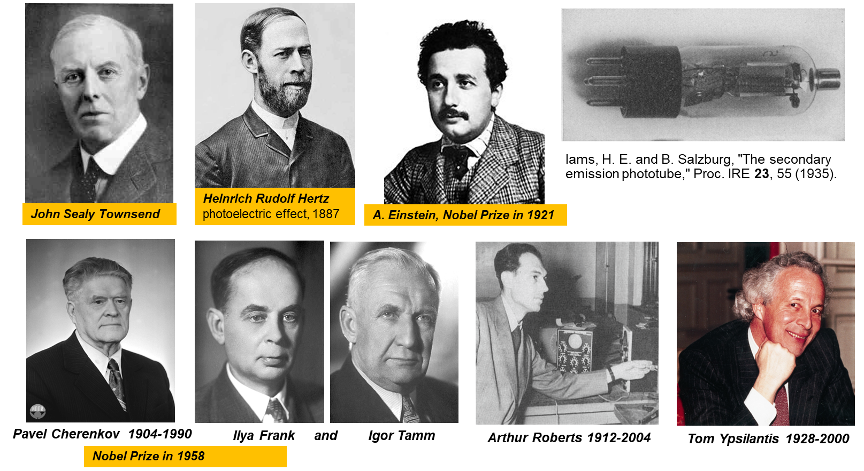
Single photon detection with gaseous detector: a beautiful marriage
More than 100 years of tradition on gaseous detectors development and operation
…the discovery and the exploit of the photoelectric phenomenon and the Cherenkov effect ….
Stefano Levorato | 16 February 2021 | RD51 Workshop on Gaseous Detector Contributions to PID

Slide 3
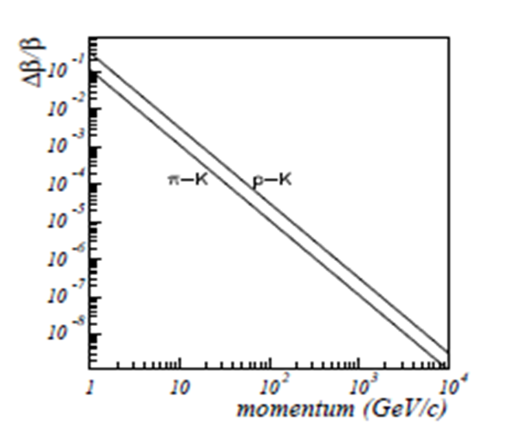
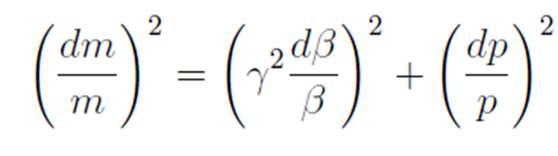
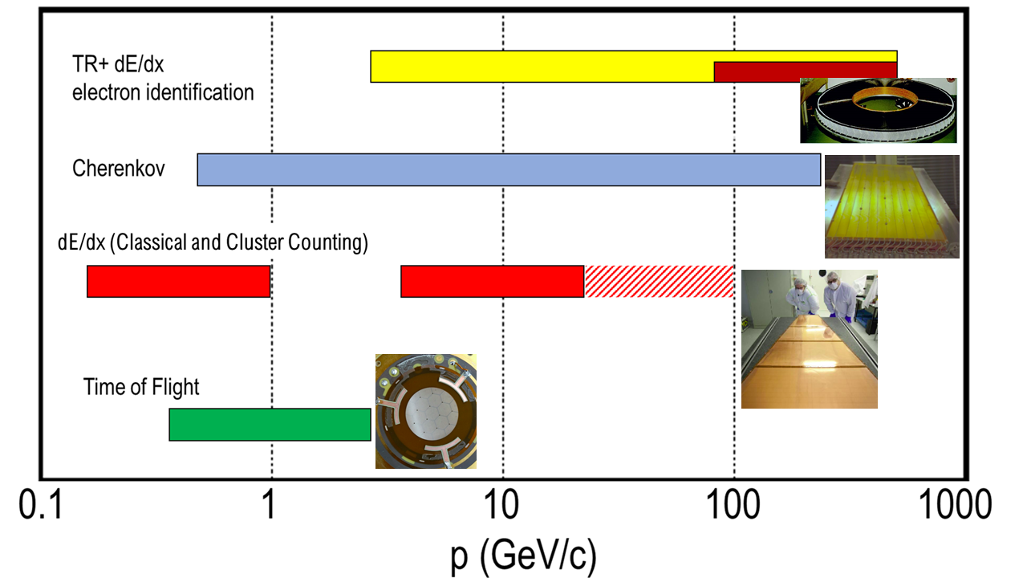
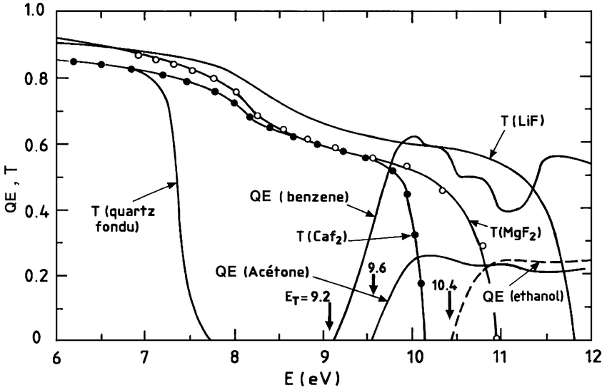
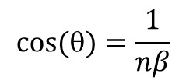
The motivation
Needed for π-K identification from HEP Experiments
Large momentum acceptance → Cherenkov angle measurement technique
Large angular acceptance → large area of efficient single photon detection
$$cos⁡(θ)=\frac{1}{nβ}$$
10⁻⁵ Δβ/β ~ 80 GeV/c π/Κ separation
1970s: large area position sensitive gaseous detectors available
Suitable photo-ionizing agent:
Benzene: Seguinot-Ypsilantis NIM 142
(1977) 377,
TEA (7.6 eV) NIM 173 (1980) 283,
TMAE (5.3 eV) NIM 178 (1980) 125.
a gas gain high enough to detect single photoelectrons
conflicting requirements because of the copious UV emission by the multiplication avalanche.
solution: multistep avalanche chamber
(Charpak-Sauli Phys. Lett. B 142 (1977) 377) or TPC
Gaseous detectors: 1) cheap, 2) magnetic insensitive, 3) low material budget
Stefano Levorato | 16 February 2021 | RD51 Workshop on Gaseous Detector Contributions to PID

Slide 4
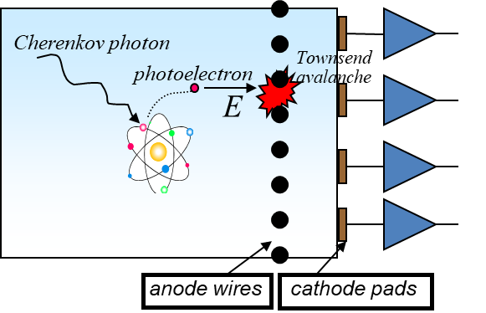
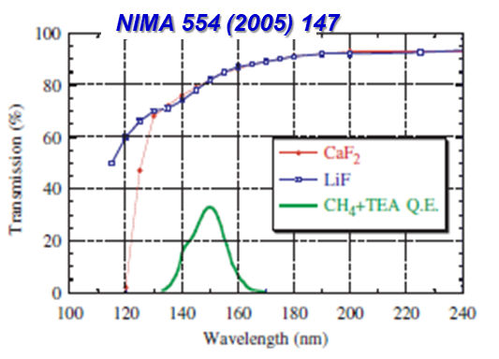
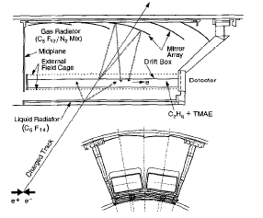
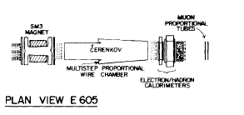
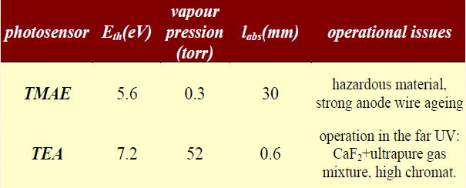
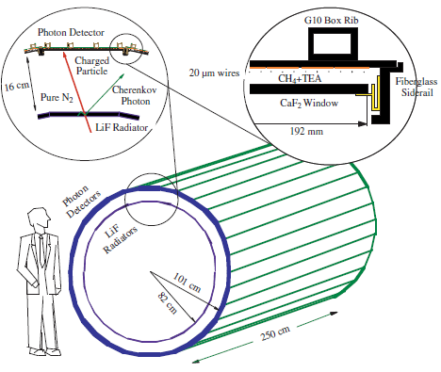
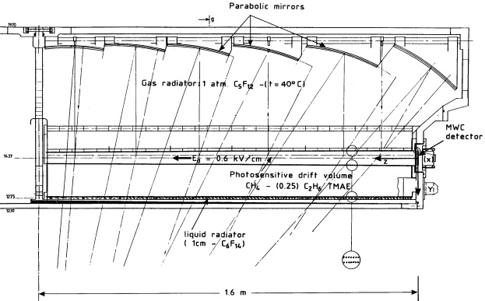
Photoconverting Vapor based RICH coupled to large MWPC: the first generation
SLD - CRID
E605
OMEGA
CLEO III
TMAE(Tetrakis-Dimethylamine-Ethylene)
DELPHI
TEA (Tri-Ethyl-Amine)
Stefano Levorato | 16 February 2021 | RD51 Workshop on Gaseous Detector Contributions to PID

Slide 5
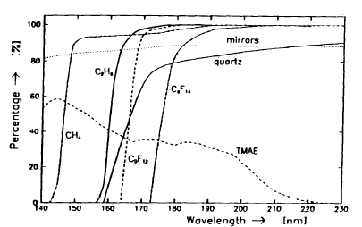
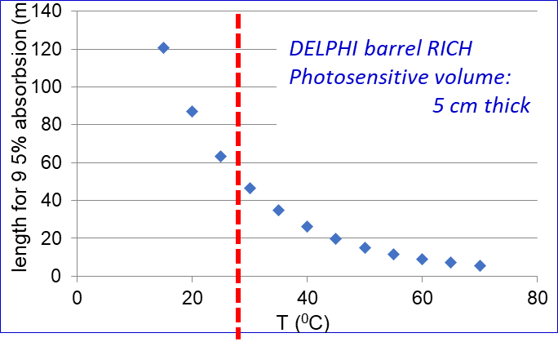
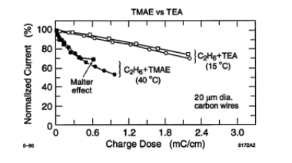
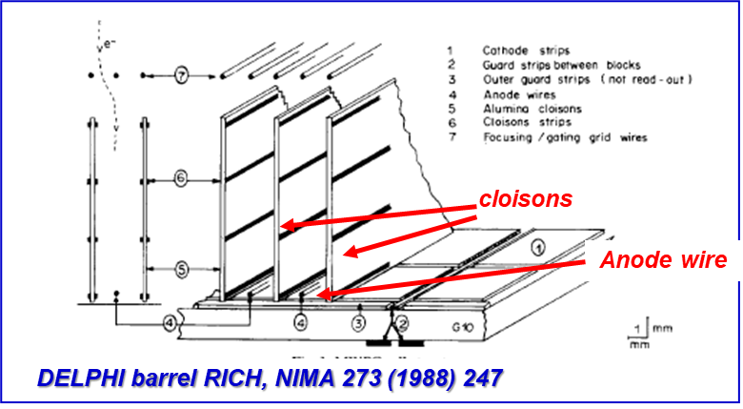
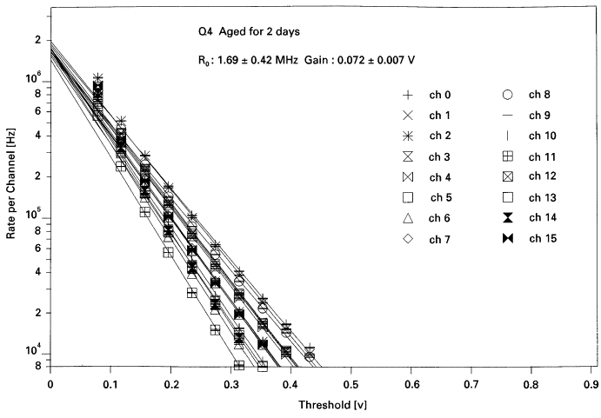
TMAE gas
QE,
NIMA 323 (1992) 351
thick photosensitive volume (slow photon detectors, parallax error)
heating and temperature control
(T bubbling <T of operation)
photon feed-back from amplification region (protections)
chemically extremely reactive
NIMA Volume 433, Issues 1–2, 21 August 1999, Pages 92-97 ( HERA-B RICH)
Stefano Levorato | 16 February 2021 | RD51 Workshop on Gaseous Detector Contributions to PID

Slide 6
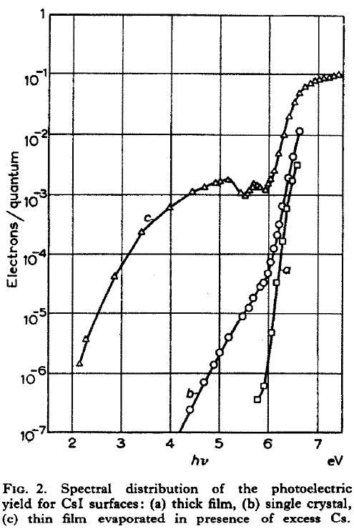
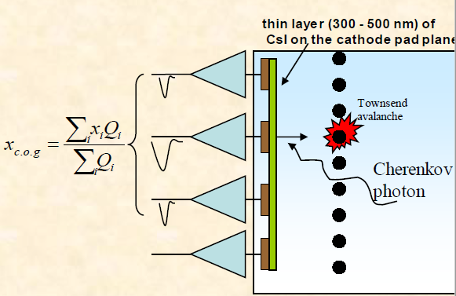
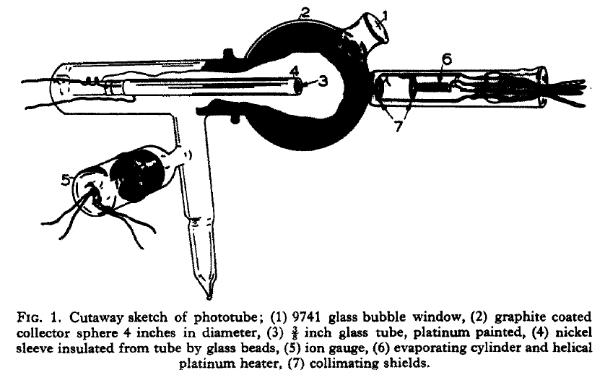
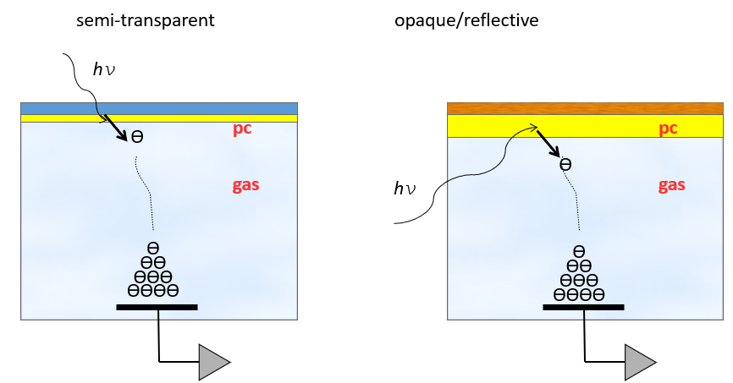
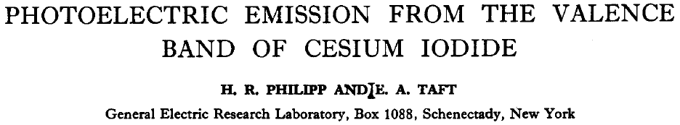
The revolution of the CsI, the conversion on solid photocathode
1956: CsI layer has large QE for photons with hν > 6 eV (Philipp and Taft)
Stefano Levorato | 16 February 2021 | RD51 Workshop on Gaseous Detector Contributions to PID

Slide 7
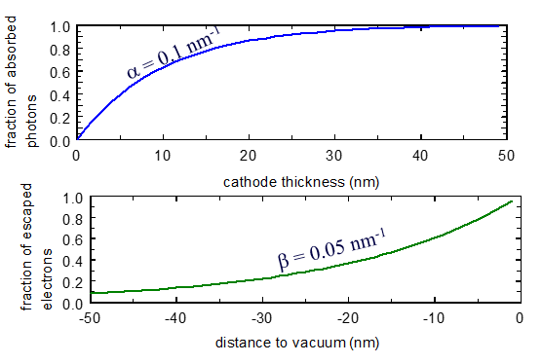
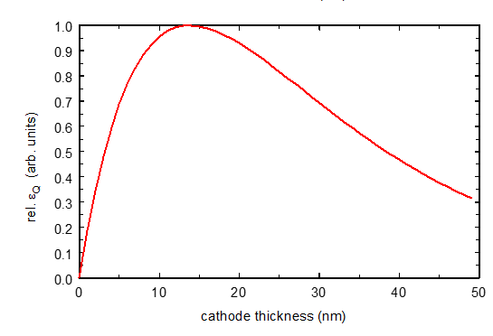
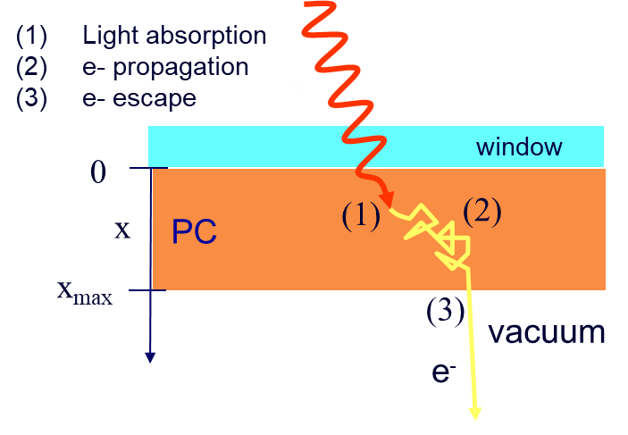
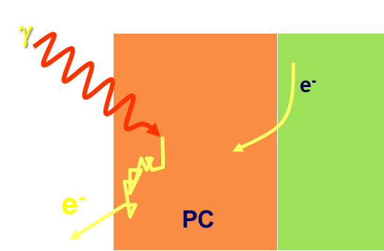
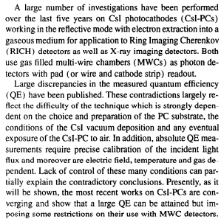
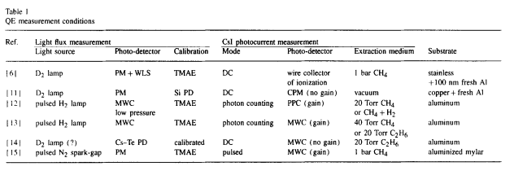
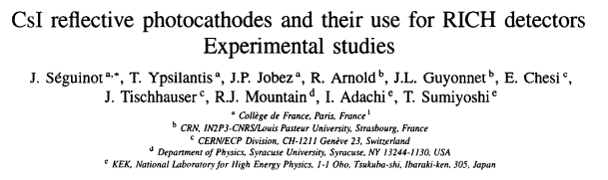
Semitransparent and reflective mode, photoelectron escape probability from thin film photocathodes
Semitransparent photocathode:
Reflective photocathode:
Stefano Levorato | 16 February 2021 | RD51 Workshop on Gaseous Detector Contributions to PID

Slide 8
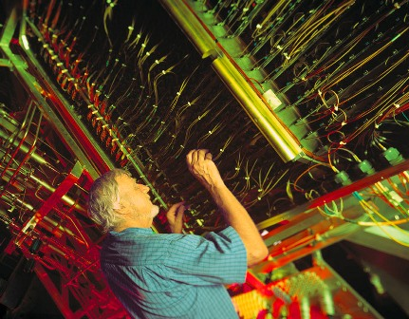
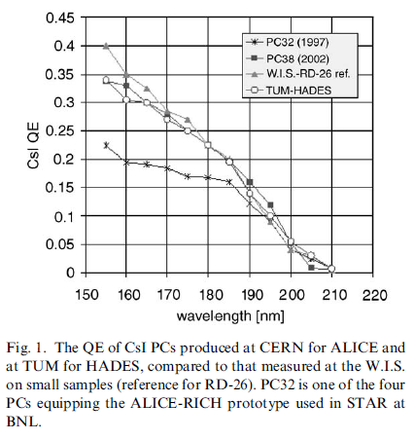
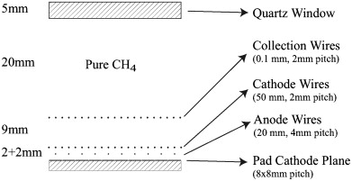
RD26: MWPC coupled to CsI for the large area fast rich detectors
1992, F. Piuz et al. Development of large area advanced fast-RICH detector for particle identification at LHC operated with heavy ions
  TO ACHIEVE HIGH CsI QE:
  Substrate preparation:
  Cu clad PCB coated by Ni (7 µm) and Au(0.5 µm), surface cleaning in ultrasonic bath, outgassing at 60 ºC for 1 day
  Slow deposition of 300 nm CsI film:
  1 nm/s (by thermal evaporation or e⁻-gun) at a vacuum
  of ~ 10⁻⁷ mbar, monitoring of residual gas composition
  Thermal treatment:
  after deposition at 60 ºC for 8 h
  Careful Handling:
  measurement of PC response, encapsulation under dry Ar, mounting by glove-box.
fused silica cut
Schematic structure of the Photon Detector:
A. Di Mauro, NIM A 525 (2004) 173.
Stefano Levorato | 16 February 2021 | RD51 Workshop on Gaseous Detector Contributions to PID

Slide 9
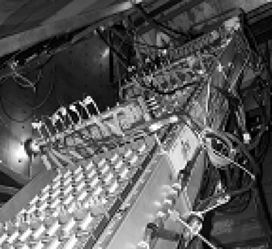
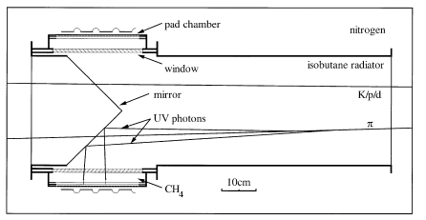
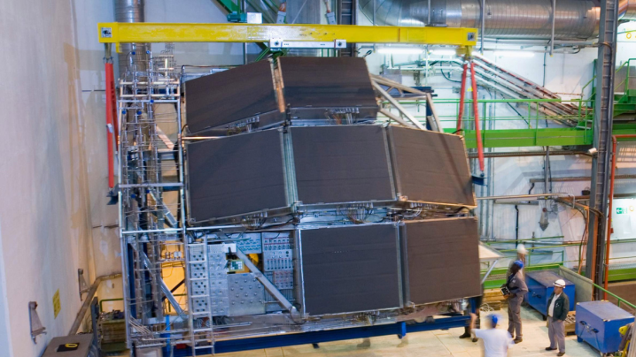
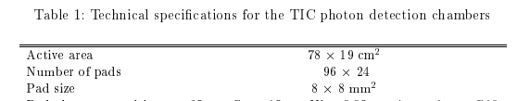
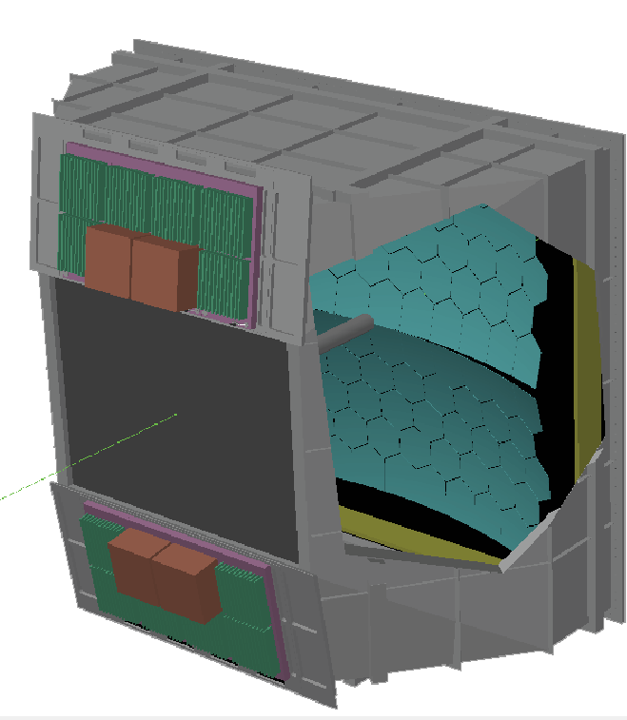
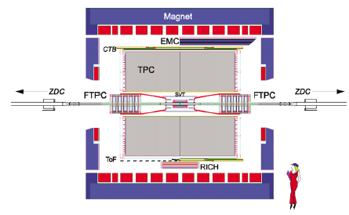
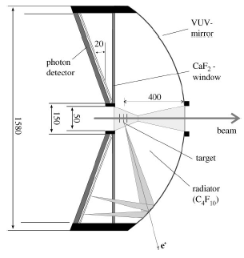
RICH with large area single photon detector based on CsI and MWPC, the second generation
MWPCs with solid state photocathode (the RD26 effort)
ALICE-HMPID
2009
CsI > 10 m²
TIC, NA44
JLAB-HALL A
STAR
CsI ~ 1 m²
HADES 1999
CsI > 1 m²
COMPASS RICH-1 2002 CsI > 5 m²
Stefano Levorato | 16 February 2021 | RD51 Workshop on Gaseous Detector Contributions to PID

Slide 10
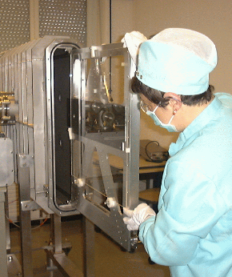
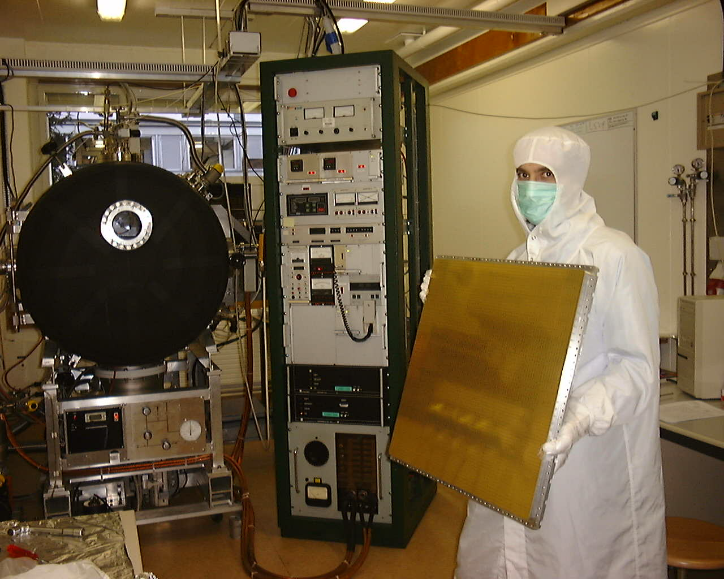
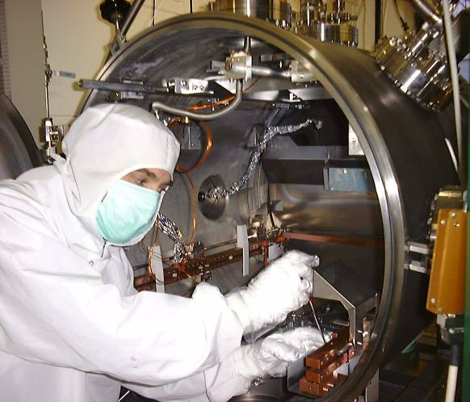
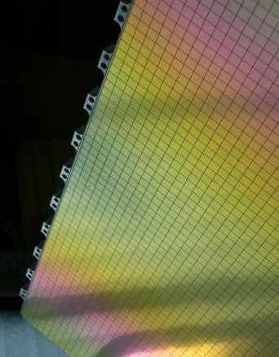
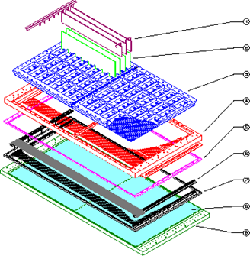
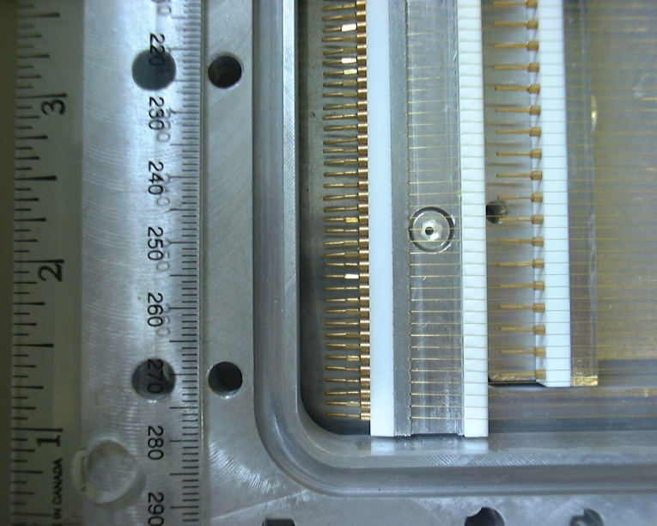
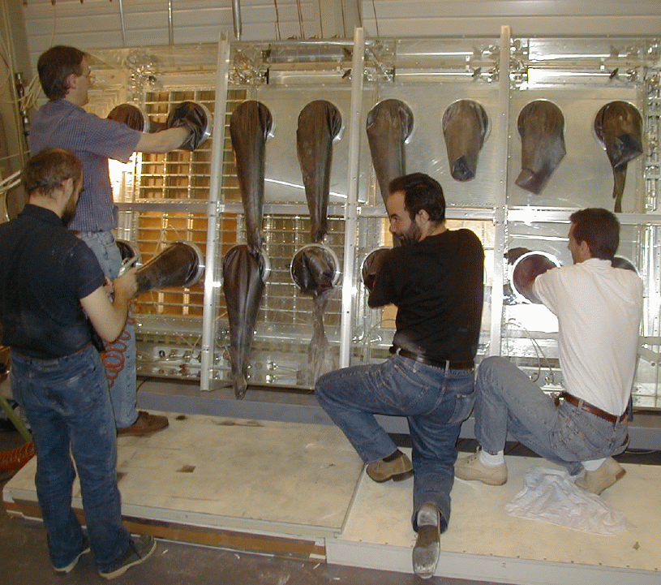
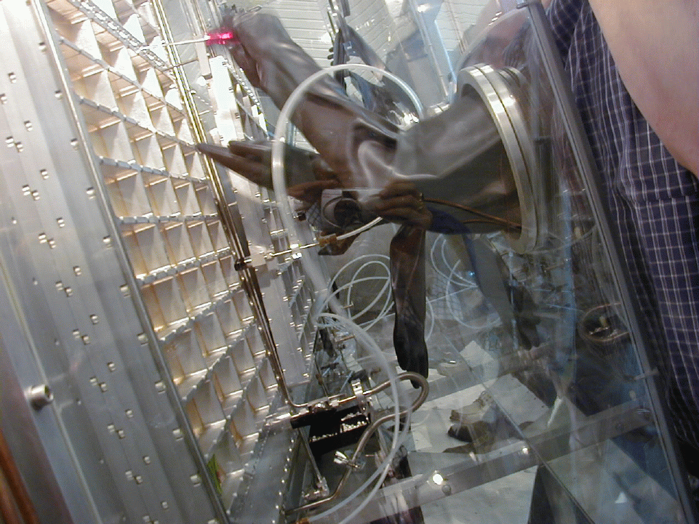
The COMPASS RICH photodetectors
Stefano Levorato | 16 February 2021 | RD51 Workshop on Gaseous Detector Contributions to PID

Slide 11

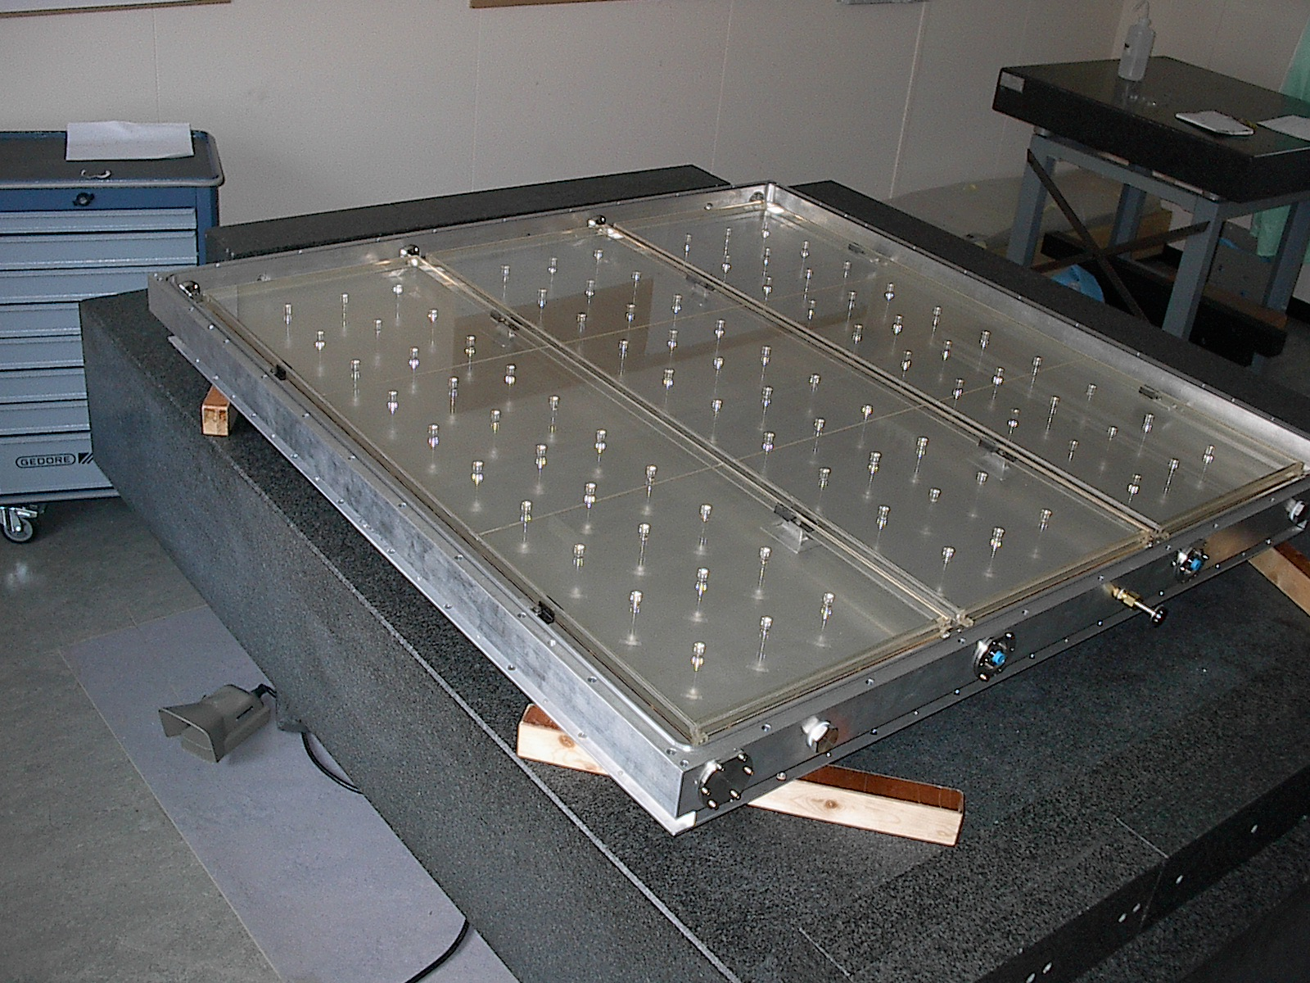




The ALICE RICH photodetectors
RADIATOR: 15 mm liquid C₆F₁₄, n ~ 1.2989 @ 175nm, β_{th} = 0.77
PHOTON CONVERTER: Reflective layer of CsI (QE ~ 25% @ 175 nm)
PHOTOELECTRON DETECTOR: MWPC with CH₄ at atmospheric pressure (4 mm gap) HV = 2050 V.
- Analogue pad readout
Full QC
of the
Photon
detector
Stefano Levorato | 16 February 2021 | RD51 Workshop on Gaseous Detector Contributions to PID

Slide 12





Photoelectron extraction from a CsI film, the role of gas and E
Breskin et al., NIM A 367 (1995) 342
Backscattering of photoelectrons in the gas medium → QE degradation
M. Alexeev et al., NIM A (2010)
Escada et al., J. of Physics D 43(2010)65502
C. D. R. Azevedo et al., 2010 JINST 5 P01002
Stefano Levorato | 16 February 2021 | RD51 Workshop on Gaseous Detector Contributions to PID

Slide 13


The limits of the CsI and MWPC technology
Severe recovery time (~ 1 d) after detector trips
  Ion accumulation at the photocathode
Feedback pulses
  Ion and photons feedback from the multiplication process 2pi → 50%
Aging after integrating a few mC / cm²
  Ion bombardment of the photocathode 50, 60 %
Operation at moderate gain < 10⁵
MPWC based signal
slow signal formation μs and low gain → “slow” electronics (signal integration, low noise level)
  Gassiplex FE : integration time ~ 0.5 μs, time res> 1 μs
  APV (COMPASS RICH-1 upgrade) : resolution ~ 400 ns
  → Detector memory, i.e. not adequate for high rates
Breskin et al., NIMA 371(1996)116
Degradation not well understood – physical and chemical mechanisms competing? Evaporation? Cesiation?..
H. Hoedlmoser et al., NIM A 574 (2007) 28.
Stefano Levorato | 16 February 2021 | RD51 Workshop on Gaseous Detector Contributions to PID

Slide 14

An option for the ALICE HMPID upgrade
Stefano Levorato | 16 February 2021 | RD51 Workshop on Gaseous Detector Contributions to PID

Slide 15


The MPGD era
The Micro Pattern Gaseous Detector technology triggered new possibilities for Gaseous PD performance
    Intrinsic mitigation of the photon feedback
    Strategies for Ion backflow reduction
    High gain
    High position resolution
    Fast signals
    Visible sensitivity
    Nano/Pico second resolution
Stefano Levorato | 16 February 2021 | RD51 Workshop on Gaseous Detector Contributions to PID

Slide 16





The MPGD ion and photon feedback suppression
No photon feedback, reduced ion feedback
An “old” idea
Semi-transparent PC
Reflective PC
3% IBF @ 0.5 kV/cm
Gain ~ 10⁵
e⁻ avalanche
R. Chechik et al., NIM A 419 (1998) 423
- triple gem with CsI pc
- semi-transparent vs reflective pc
- typical stable gains ~ 10⁵
- large area > 1 m² can be produced
ion avalanche
Bachman et al. NIMA 438(1999)376
Breskin et al. NIMA 478(2002)225
Bondar et al. NIMA 496(2003)325
Chechik and Breskin NIMA 595(2008) 116
A. Breskin and R. Chechik, NIM A 595 (2008) 116
Stefano Levorato | 16 February 2021 | RD51 Workshop on Gaseous Detector Contributions to PID

Slide 17



On IBF
IFB in GEM-based detectors
strong dependence from gain and E_{DRIFT}
poor dependence from pressure and gas type
I_{C}
E ~ 1 kV/cm needed for good photoelectron extraction
semi-transparent PC
I_{top1}
E_{D} = 0.5 kV/cm
I_{bottom3}
I_{A}
E_{D} = 0.1 kV/cm
IBF: a few % level in
effective GEM-based
photon detectors
A. Bondar et al., NIMA 496 (2003) 325
A. Breskin et al., NIMA 478 (2002) 225d
Stefano Levorato | 16 February 2021 | RD51 Workshop on Gaseous Detector Contributions to PID

Slide 18





Hadron-Blind detector (HBD) at RHIC-PHENIX reflective mode
- Triple GEM
- CsI reflective pc
- G~10⁴
Anderson et al., NIMA 546 (2005) 466.
S. Milov, et al., J. Phys. G: Nucl. Part. Phys. 34 (2007) S701
Z. Fraenkel, et al., NIMA 546 (2005) 466.
-Proximity focus configuration, no window, no mirror
-CF4 radiator and active gas.
-Lrad=50 cm Very large bandwidth 108 – 200 nm
Detector operated in reverse bias mode to repel the ionization charge from dE/dx
Cherenkov light is formed only by e⁺ or e⁻
Successfull operation at PHENIX since several years
It is not a detector of single photons
Stefano Levorato | 16 February 2021 | RD51 Workshop on Gaseous Detector Contributions to PID

Slide 19
Large gain, one of the key element for an effective single photon detection
LARGE GAIN RELEVANT FOR SINGLE PHOTON DETECTION
GEM-based PDs in laboratory studies
  for single photoelectron detection, they have been operated at gains > 10⁵ (see, for instance, the plots of the previous slides)
GEM-based detectors in experiments
Always a MIP flux and small rates of heavily ionizing fragments crossing the detectors (even when the detectors are used as photon detectors)
    At COMPASS: G ~ 8000 (B. Ketzer, private comm.)
    At LHCb: G ~ 4000 (M.Alfonsi NIMA 581 (2007) 283)
    At TOTEM: G ~ 8000 (G. Catanesi, private comm.)
    Phenix HBD: G ~ 4000 (W. Anderson et al., NIMA 646 (2011) 35)
In experiments, small chances
to operate GEM-based PDs at gains > 10⁴
Stefano Levorato | 16 February 2021 | RD51 Workshop on Gaseous Detector Contributions to PID

Slide 20

THGEM-based PD
About PCB geometrical dimensions:
Hole diameter : 0.2 – 1 mm
Pitch : 0.5 – 5 mm
Thickness : 0.2 – 3 mm
PCB technology, thus:
robust
mechanically self supporting
industrial production of large size boards
large gains can be easily achieved (rim !)
Gain stability is challenging
Comparing to GEMs
Geometrical dimensions X ~10
  But e⁻ motion/multiplic. properties do not!
  Larger holes:
    dipole fields and external fields are strongly coupled
    e⁻ dispersion plays a minor role
RIM
introduced in // by different groups:
L. Periale et al., NIM A478 (2002) 377.
P. Jeanneret, PhD thesis, Neuchatel U., 2001.
P.S. Barbeau et al, IEEE NS50 (2003) 1285
R. Chechik et al, .NIMA 535 (2004) 303
Stefano Levorato | 16 February 2021 | RD51 Workshop on Gaseous Detector Contributions to PID

Slide 21









THGEM-based PD
High-rate device
Photoelectron extraction from
THGEM PC fully confirmed by direct
observation with “Leopard”
photoelectron trajectories from a THGEM
photocathode,simulation, multiplication
switched off
thickness 0.6 mm, diam. 0.4 mm,
pitch: 0.8 mm, ΔV = 1500 V
M. Alexeev et al. JINST 10 (2015 ) P03026
G.Hamar and D.Varga,
NIMA 694(2012) 16
Stefano Levorato | 16 February 2021 | RD51 Workshop on Gaseous Detector Contributions to PID

Slide 22









THGEM R&D for RICHes
Ne+10%CH4, used with ΔV at 650-750 V
N of detected photons is ~60-70% of MWPCs with CsI
ALICE VHMPID
THGEM & HYBRID
V.Peskov et al., NIMA 695 (2012) 154
COMPASS, RICH-1 upgrade by Triple THGEM detectors
beam
Č photon
Stefano Levorato | 16 February 2021 | RD51 Workshop on Gaseous Detector Contributions to PID

Slide 23


THGEMs+Resitive Micromegas combination
THGEM 1- provide support for the CsI pc, gain and partial block of ions and photons
THGEM 2 -extra gain and extra ion blocking and charge splitting
Micromegas – discrete element approach efficient for ion trap and provide extra gain and spark mitigation
Stefano Levorato | 16 February 2021 | RD51 Workshop on Gaseous Detector Contributions to PID

Slide 24



THGEMs+Resitive Micromegas combination, performance
Stefano Levorato | 16 February 2021 | RD51 Workshop on Gaseous Detector Contributions to PID

Slide 25
InGrid – Micromegas integrated in a Timepix
The future...
Stefano Levorato | 16 February 2021 | RD51 Workshop on Gaseous Detector Contributions to PID

Slide 26






RICH at the EIC, exploiting the COMPASS hybrid PD upgrade
-1<η<+1 (barrel) : sPHENIX + Compact-TPC + DIRC
-4<η<-1 (e-going) :
High resolution EM calorimeter + GEM trackers
+1<η<+4 (h-going) :
  1<η<4 : GEM tracker + Gas RICH
  1<η<2 : Aerogel RICH
  1<η<5 : EM Calorimeter + Hadron Calorimeter
Along outgoing hadron beam: ZDC and roman pots
minimum material budget
Different lever arm w.r.t. COMPASS requires pads of small size to improve the space resolution(3mmx3mm)
Studies performed with Ar/CH4 mixtures, towards a windowless
approach using CF4 → Chandradoy Chatterjee
and different photoconverters→ Daniele D’Ago
Stefano Levorato | 16 February 2021 | RD51 Workshop on Gaseous Detector Contributions to PID

Slide 27
InGrid – Micromegas integrated in a Timepix
Innovative approaches to single photon detection with GPD, R&D
Stefano Levorato | 16 February 2021 | RD51 Workshop on Gaseous Detector Contributions to PID

Slide 28




InGrid – Micromegas integrated in a Timepix
- Very interesting performance for imaging (high granularity)
- Compact system with integrated electronics
- Limited to small detection areas – timePix limitation
Melai et al., NIMA 628 (2011)133
Stefano Levorato | 16 February 2021 | RD51 Workshop on Gaseous Detector Contributions to PID

Slide 29




MM-TGHEM – Multi-Mesh
First performance evaluation of a Multi-layer Thick Gaseous Electron Multiplier with in-built electrode meshes—MM-THGEM
Oliveira and Cortesi., JINST 13 (2018) P06019
Stefano Levorato | 16 February 2021 | RD51 Workshop on Gaseous Detector Contributions to PID

Slide 30



MM-TGHEM + RWELL – Multi-Mesh
MM-THGEM/WELL-THGEM detector
First performance evaluation of a Multi-layer Thick Gaseous Electron Multiplier with in-built electrode meshes—MM-THGEM
- Gain ~10⁶
- Fair IBF for CsI pcs
IBF ~2-3%
Low IBF contribution when the WELL-THGEM electrode contribution to the total gain is high
Oliveira and Cortesi., JINST 13 (2018) P06019
Stefano Levorato | 16 February 2021 | RD51 Workshop on Gaseous Detector Contributions to PID

Slide 31





HYBRID MPGD PDs (THGEM + THCOBRA) a low rate application
2 THGEMs
a THCOBRA with 2 d R-O structure
T. Lopes 2013 JINST 8 P09002
IBF high but
Stefano Levorato | 16 February 2021 | RD51 Workshop on Gaseous Detector Contributions to PID

Slide 32




Carbon based photocathodes coupled to Gaseous Detectors, HND and THGEMS
Uncoated THGEM
Coated THGEM
Still presenting some ageing →
Ion bombardment resistance !
Compatible with MPGD operation !
Velardi et al., Diamond & RM 76(2017)1 ; Valentini et al. Patented
Below Quartz cutoff
Windowless approach for
RICH
→ Daniele D’Ago Talk
Stefano Levorato | 16 February 2021 | RD51 Workshop on Gaseous Detector Contributions to PID

Slide 33





Picosec
PICOSEC Collaboration aims for the development of a Micromegas based detector coupled to a photocathode for time resolution in the ten pico second time scale, not single ph.
Ne(80%)/CF4(10%)/C2H6(10%)
Lukas Sohl et al. For the PICOSEC Collab., presented in RD51 collaboration meeting, Munich, June 2018
Papaevangelou et al, Fujiwara et al., EPJ Web Conf., 174(2018)02002
Stefano Levorato | 16 February 2021 | RD51 Workshop on Gaseous Detector Contributions to PID

Slide 34

A comment
Advances in DLC films triggered the possibility of producing photocathodes to operate in gas medium for MPGDs
DLC – Diamond-like carbon
  Widely used in industry as a solid lubricant
  Recently introduced to the MPGD field as excellent resistive electrodes
  Tested with success in the PICOSEC Collaboration
A breakthrough in carbon based photocathodes would favour:
GPMs performance in general
RICH detectors for PID for future NP/HEP experiments: i.e. HND nanodiamonds
Stefano Levorato | 16 February 2021 | RD51 Workshop on Gaseous Detector Contributions to PID

Slide 35
InGrid – Micromegas integrated in a Timepix
Innovative approaches to single photon detection with GPD, R&D , visible range
Stefano Levorato | 16 February 2021 | RD51 Workshop on Gaseous Detector Contributions to PID

Slide 36



The visible range, challenges
  Chemical reactivity (gas purity better than ppm level needed → UHV materials and sealed detectors
  PC stability under ion bombardment - work function lower than CsI one
  AGEING CsI: -16% QE at 25mC/mm²
  Bilkaly: -20% QE at 0.4mC/mm²
T.Moriya et al., NIMA 732 (2013) 263
F.Tokanai et al., NIMA 628 (2011) 190
K-Cs-Sb vs CsI
F-R-MHSP,
IBF: 3 x 10 ⁻⁴
Ion induced secondary emission in CsI is negligible
Double GEM,
IBF: ~ 10 ⁻²
A.V.Lyashenko et al., 2009 JINST 4 P07005
Stefano Levorato | 16 February 2021 | RD51 Workshop on Gaseous Detector Contributions to PID

Slide 37








IBF trapping with dedicated geometries
More complex geometries needed with extra electrodes to trap the ions:
Micro-Hole & Strip Plate (MHSP), COBRA
A.V. Lyashenko et al.,
JINST 2 (2007) P08004
MHSP
J.F.C.A. Veloso et al.,
Rev.Sc. Instr. 71 (2000) 2371
COBRA
A.V. Lyashenko et al.,
NIMA 598 (2009) 116
A.V. Lyashenko et al.,
NIMA 598 (2009) 116
Stefano Levorato | 16 February 2021 | RD51 Workshop on Gaseous Detector Contributions to PID

Slide 38


Visible range single photon detection, GEM approach
Lyashenko et al., JINTS 4(2009)P07005
Stefano Levorato | 16 February 2021 | RD51 Workshop on Gaseous Detector Contributions to PID

Slide 39

Visible range single photon detection, GEM approach
Stefano Levorato | 16 February 2021 | RD51 Workshop on Gaseous Detector Contributions to PID

Slide 40

Visible range single photon detection, Micromegas approach
Nicely working!
Stefano Levorato | 16 February 2021 | RD51 Workshop on Gaseous Detector Contributions to PID

Slide 41
SUMMARY/CONCLUSIONS
GASEOUS PHOTON DETECTORS
  Most effective approach to instrument large surfaces at affordable costs
MPGD-BASED PHOTON DETECTORS
  Allow to overcome the limitations of open geometry gaseous PDs
  A wide effort to refine and consolidate the technology
MANY APPLICATIONS OF MPGD-BASED PHOTON DETECTORS
  From PID to ν, DM, medical applications …
  First step toward large area: Hybrid THGEM+MM for COMPASS
BRIGHT FUTURE FOR:
  Inventions: new ideas, new techniques
  Technology consolidation, new applications
  Large scale projects
Stefano Levorato | 16 February 2021 | RD51 Workshop on Gaseous Detector Contributions to PID

