Slide 1

MPGD-based photon detectors for the upgrade of COMPASS RICH-1 and beyond
PID in COMPASS Experiment
Towards 2016 COMPASS RICH upgrade
Quality control of hybrid components
The upgrade
Detector performance
Summary of COMPASS RICH upgrade
PID in EIC and its challenges
R&D for EIC PID with MPGD technologies
Beam test performance
Summary of EIC related activities
Chandradoy Chatterjee
INFN Trieste

Slide 2
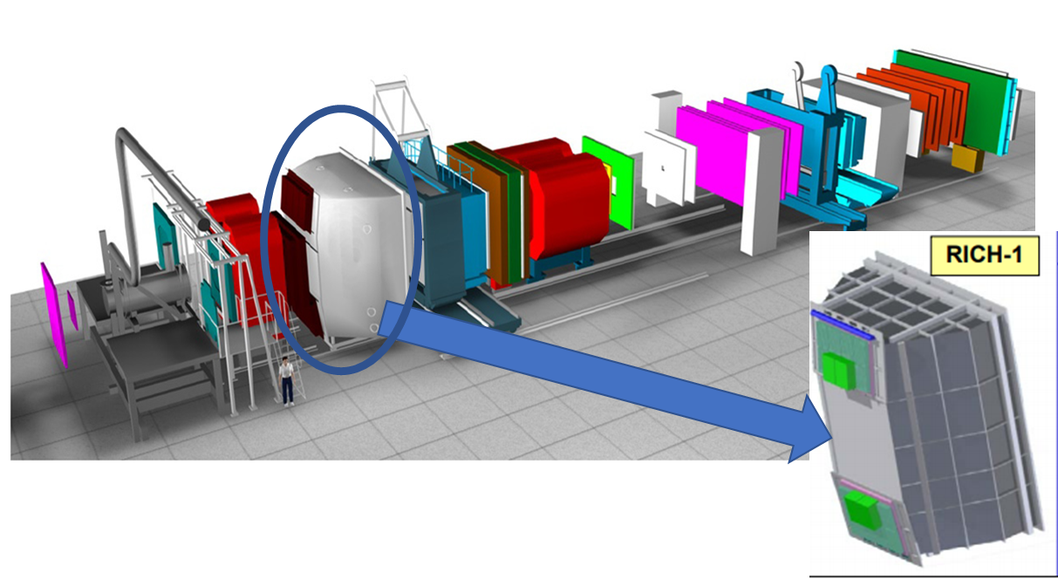
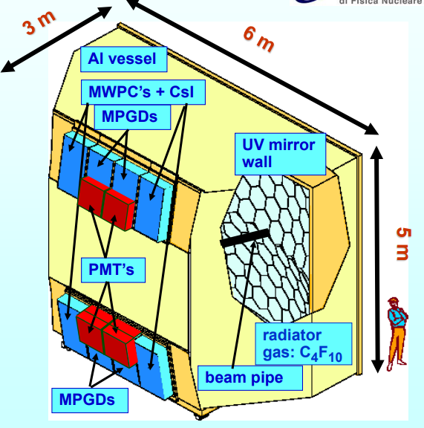
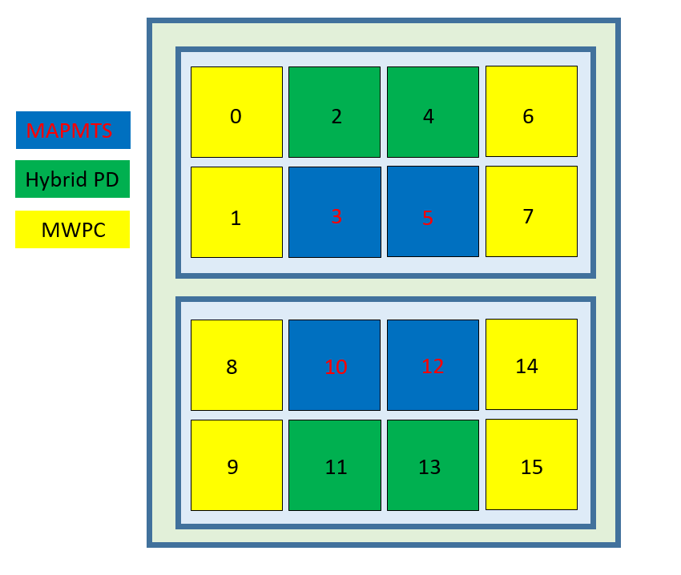
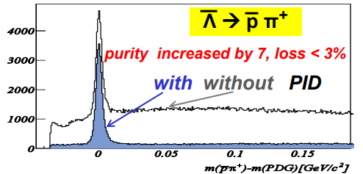
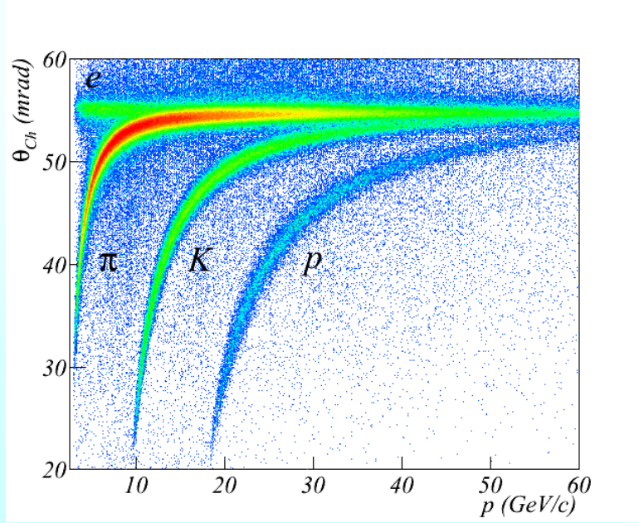
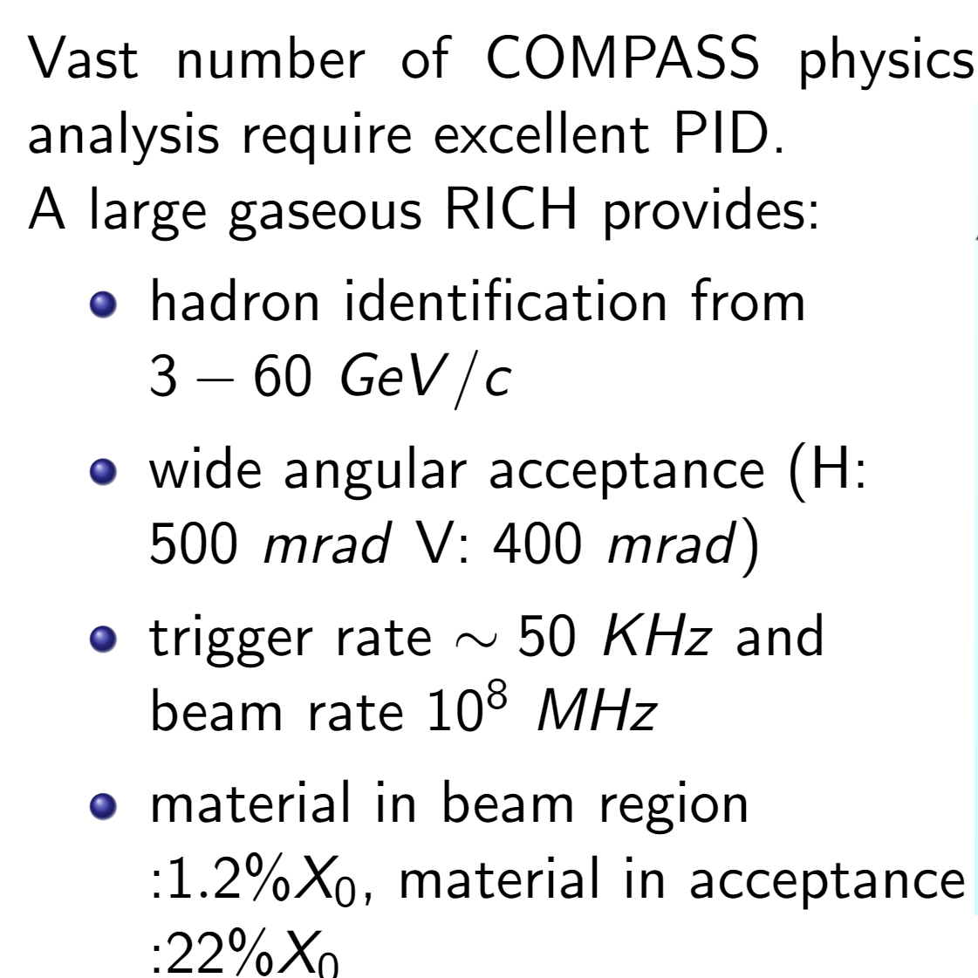
PID in COMPASS Experiment
Approved SIDIS data taking in 2021→ RICH is crucial.
Future COMPASS++/AMBER requires efficient RICH for pbar cross-section, spectroscopy measurements.
In 2016-2017 data taking COMPASS RICH used three different photon detection technology
NIM A 577 (2007) 455
NIM A 779 (2015) 69
5.6 m² photon detection surface
21 m² UV reflective mirror
NIM A 553 (2005) 215;
NIM A(2008) 371;
NIM A(616) (2010) 21;
NIM A 631 (2011) 26

Slide 3
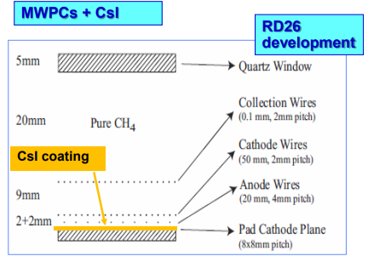
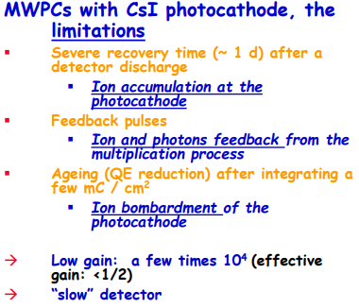
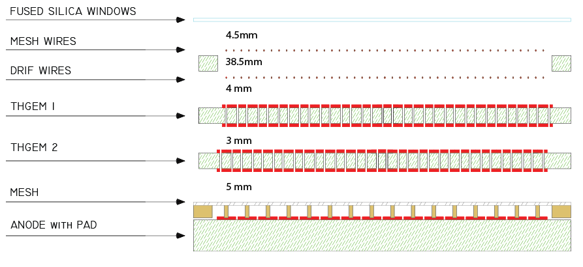
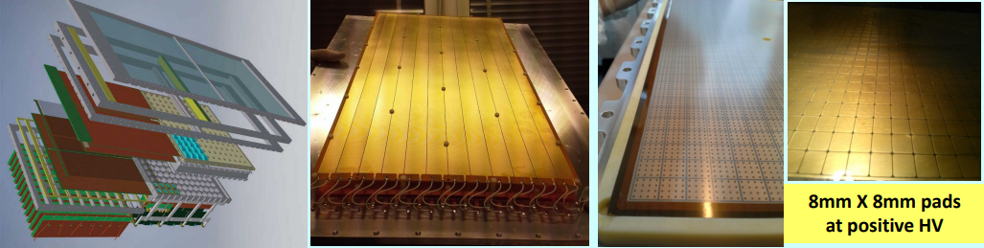
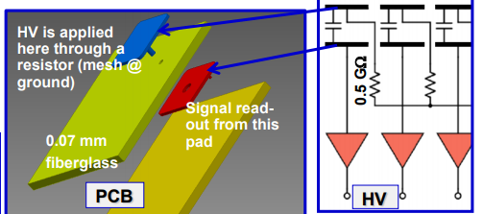
2016 COMPASS RICH UPGRADE
Reduced wire-cathode gap because of :
• Fast RICH (fast ion collection)
• Reduced MIP signal
• Reduced cluster size
• Control photon feedback spread
To overcome the limitations: • Less critical architecture
• suppress the PHOTON & ION feedback
• use intrinsically faster detectors MPGDs
Resistive MICROMEGAS by bulk technology
→ traps the ions
→ ~100 ns signal formation
2016 COMPASS RICH UPGRADE
NIMA 560 (2006) 405.
THGEM, detail 77% surface for CsI coating

Slide 4
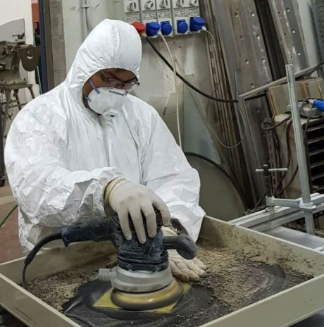
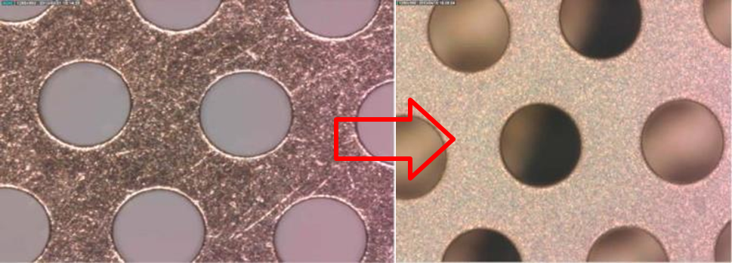
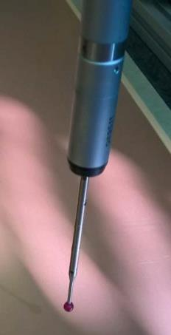
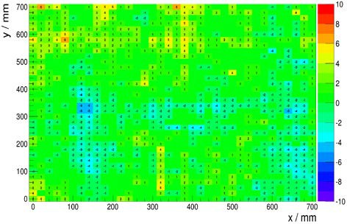
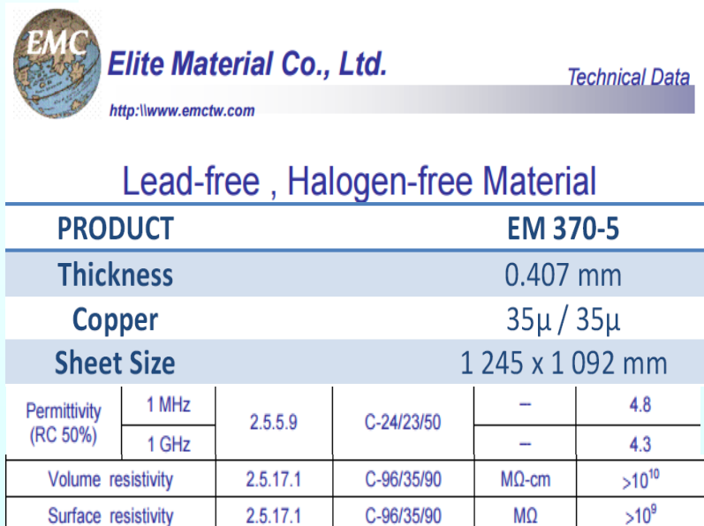
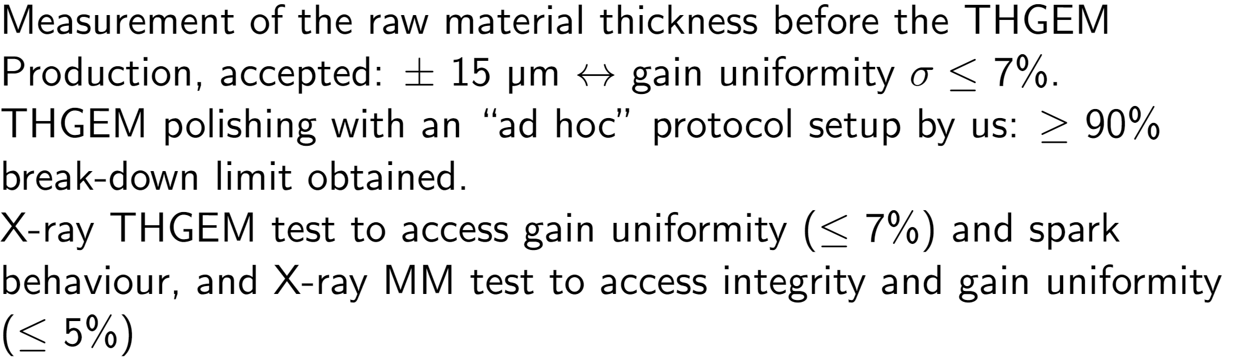
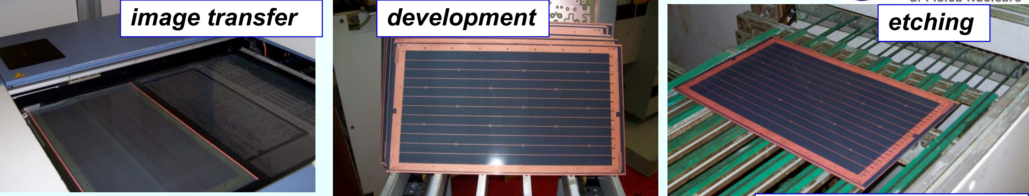
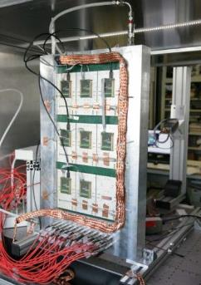
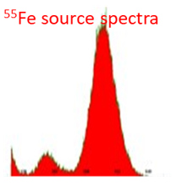
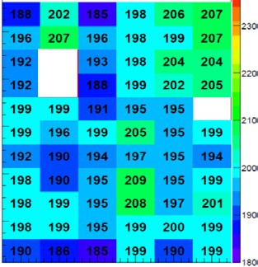
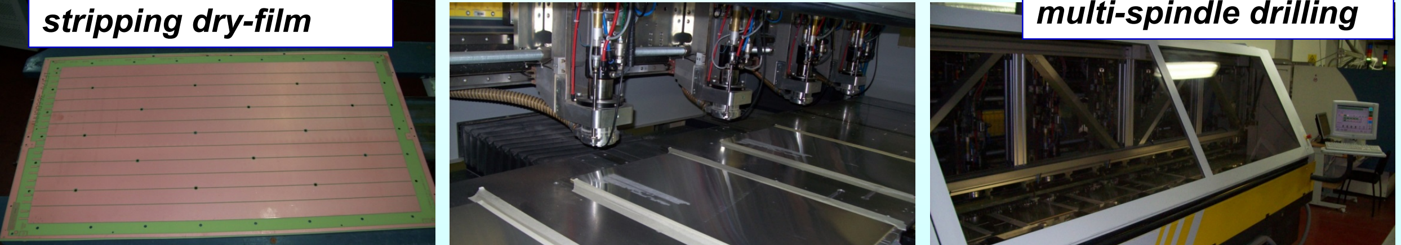
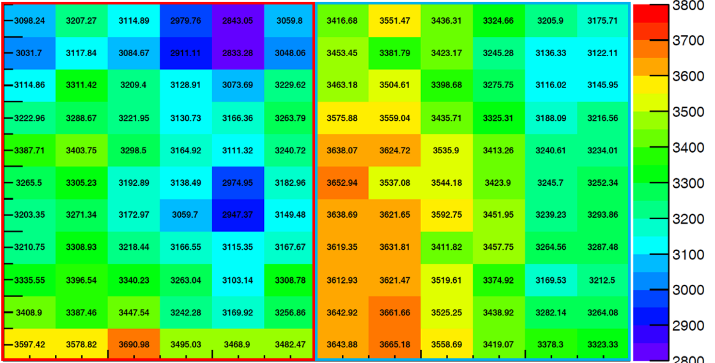
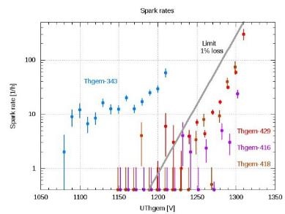
Quality Control of components
Our thickness uniformity requirements are stricter than those offered by producers → material selection → thickness measurement
Post polishing protocol
In Trieste a specific cleaning procedure is applied : polish with fine grain pumice powder, pressure water cleaning, ultrasonic bath with Sonica PCB solution (PH11), distilled water rinsing and oven @ 160^{O}C
Mitutoyo EURO CA776 coordinate measuring machine with ruby touch probe, hosted in a thermalized room
NIMA 610 (2009) 174, NIMA 617 (2010) 396, NIMA 639 (2011) 130
JINST 9 (2014) C09017, JINST 9 (2014) P01006, JINST 10 (2014) P03026

Slide 5
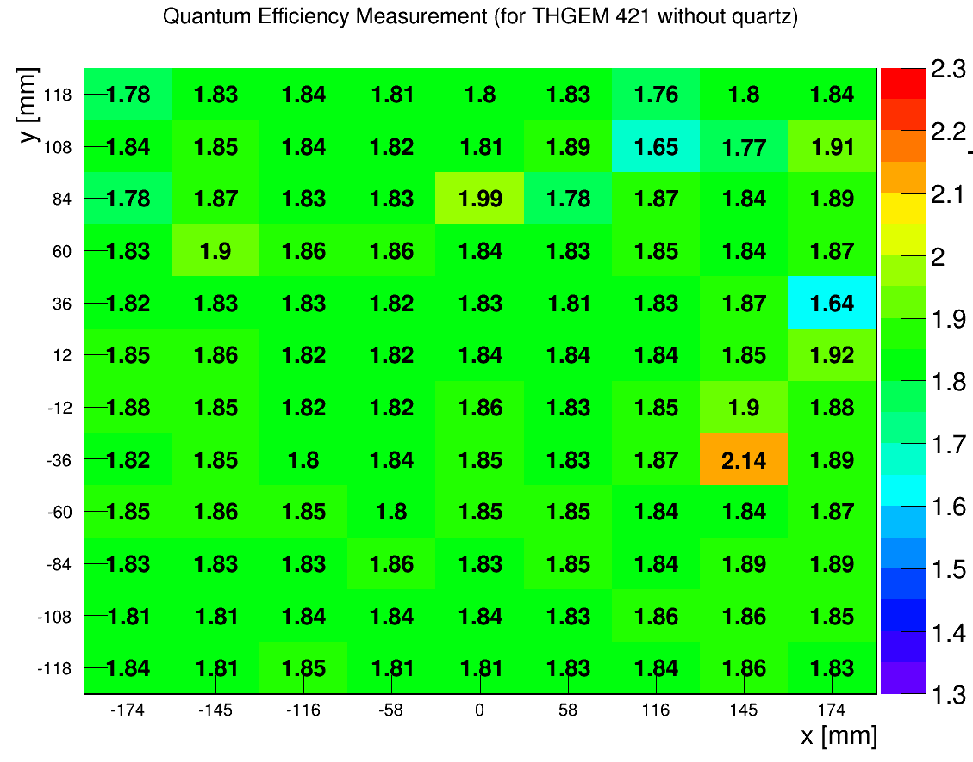
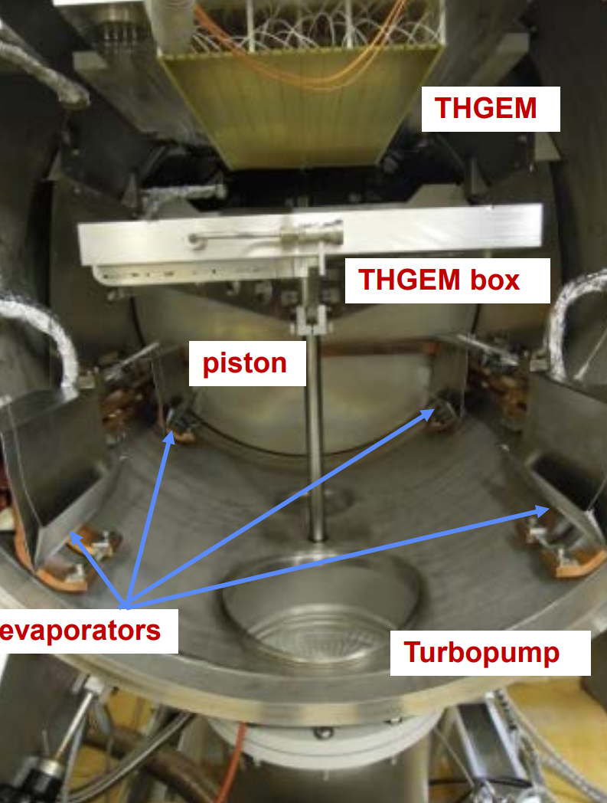
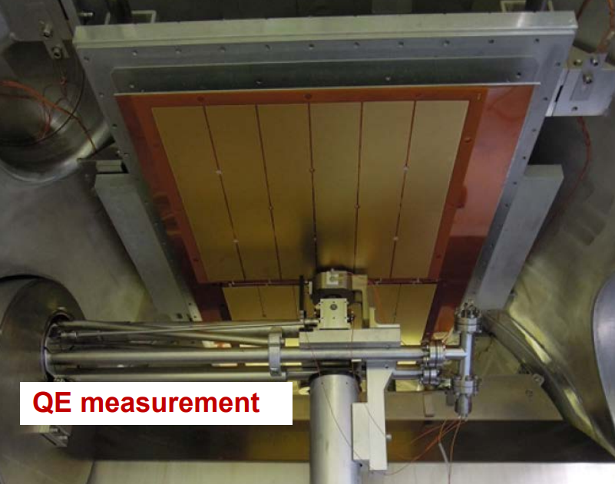
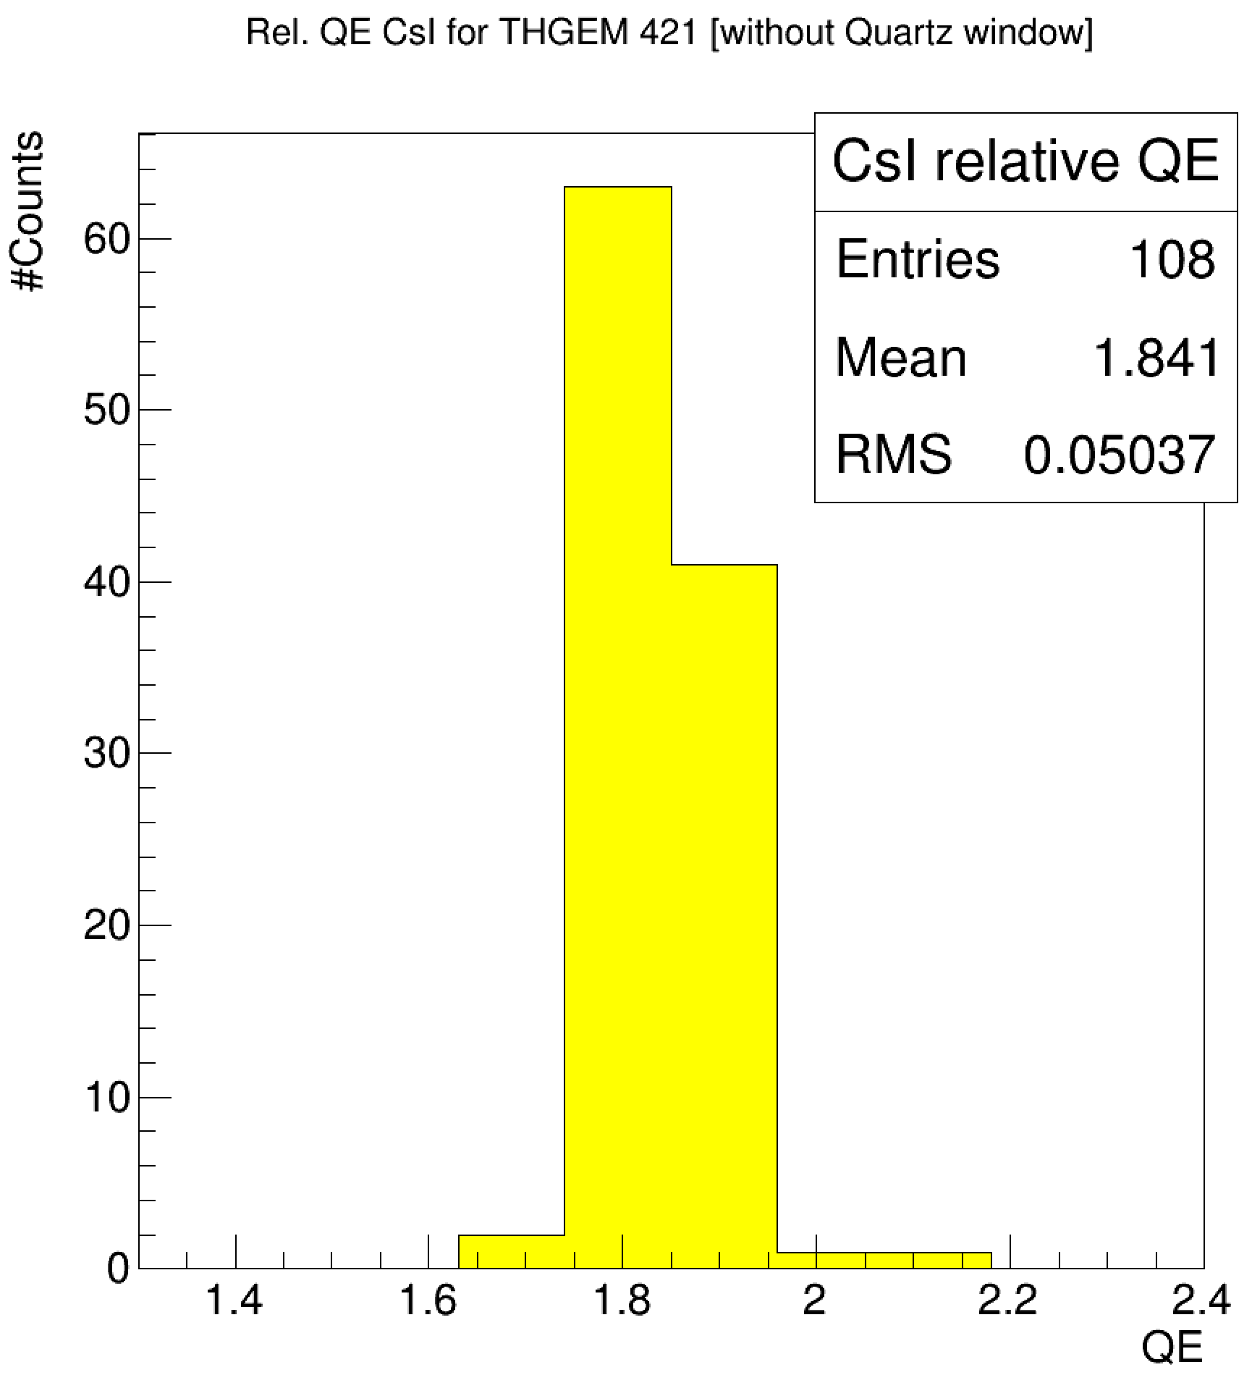
CsI coating at CERN
Uniformity:
3 % r.m.s. within a photocathode
10 % r.m.s. among photocathodes
mean value: 93% of reference

Slide 6
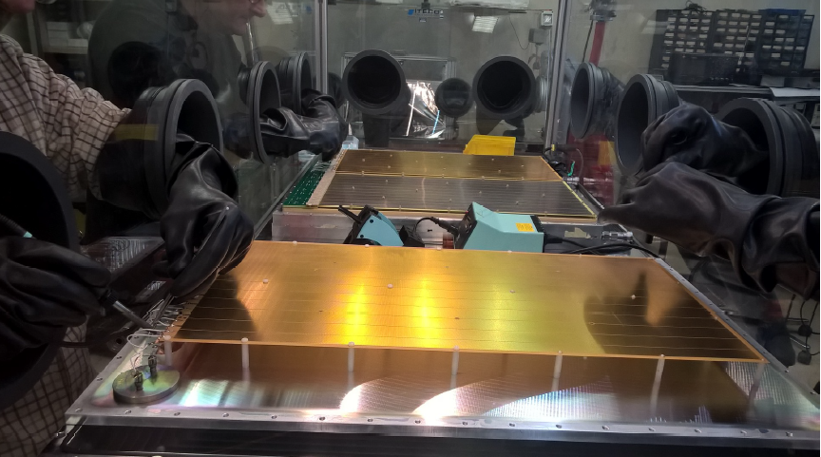
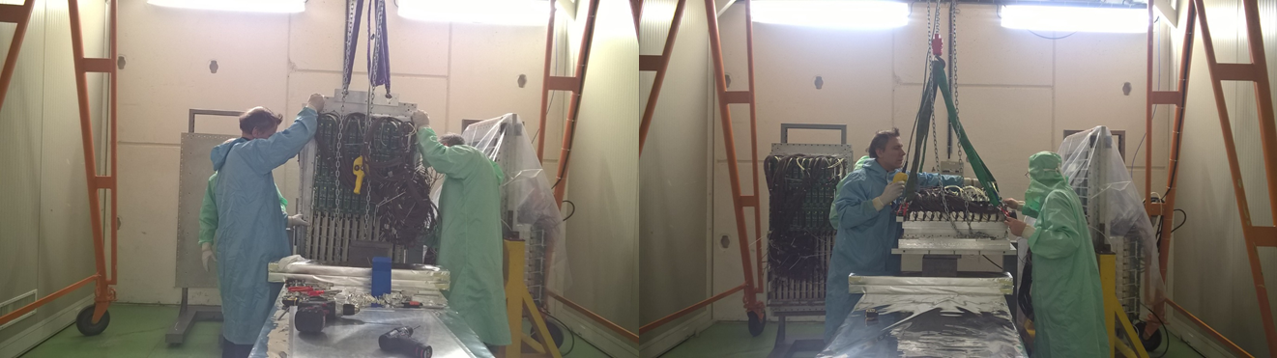
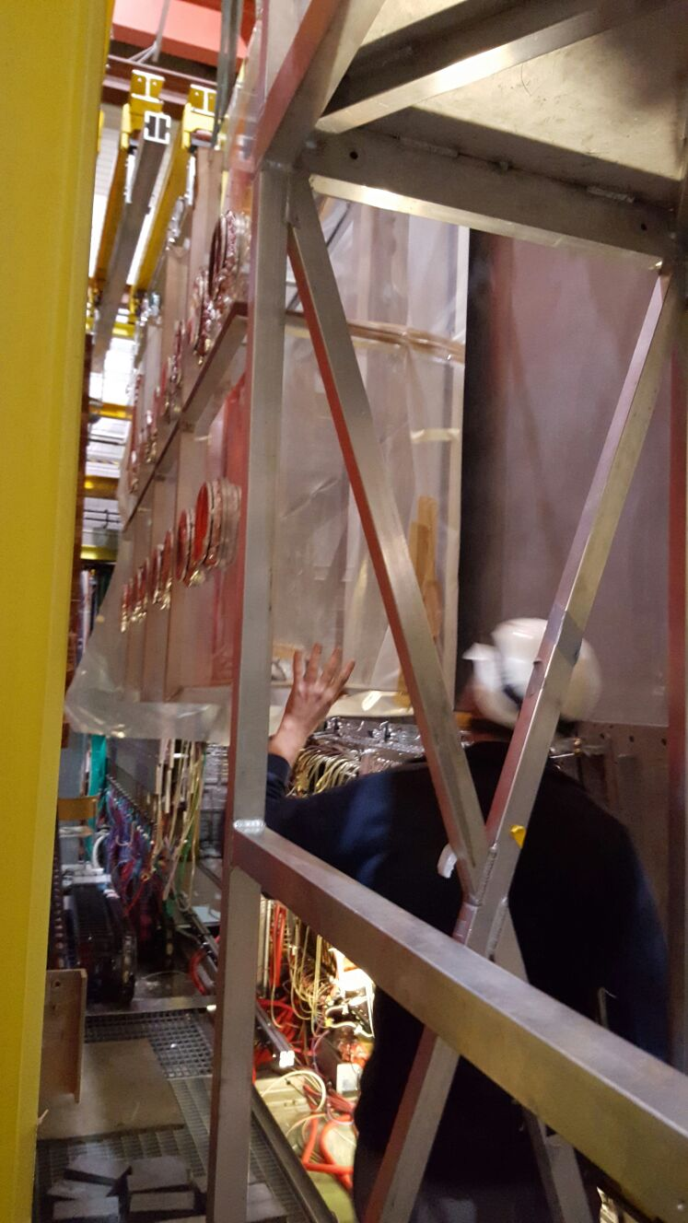
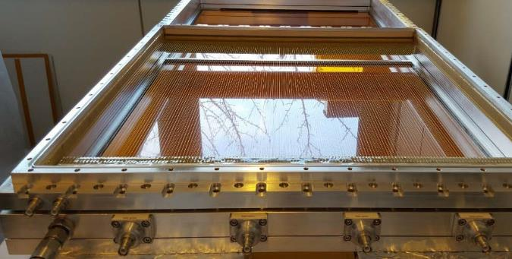
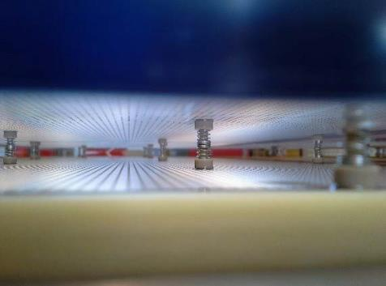
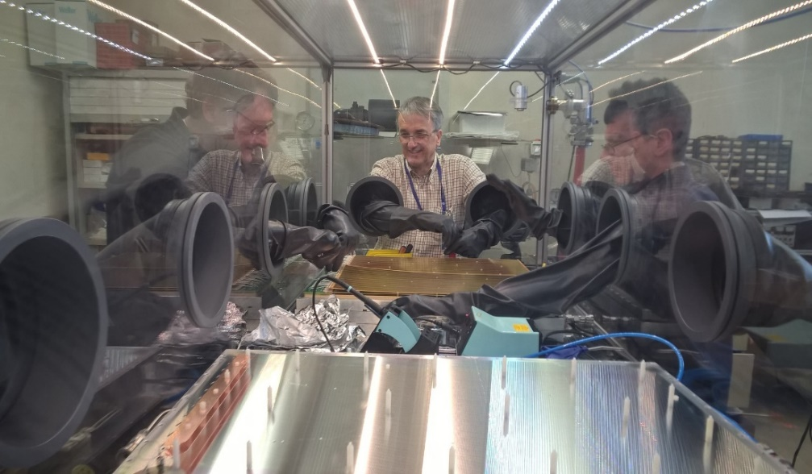
The Upgrade: challenging and acrobatic
More acrobatic images or details of upgrade related adventures?
→ S.S. Dasgupta CERN-THESIS-2017-069

Slide 7
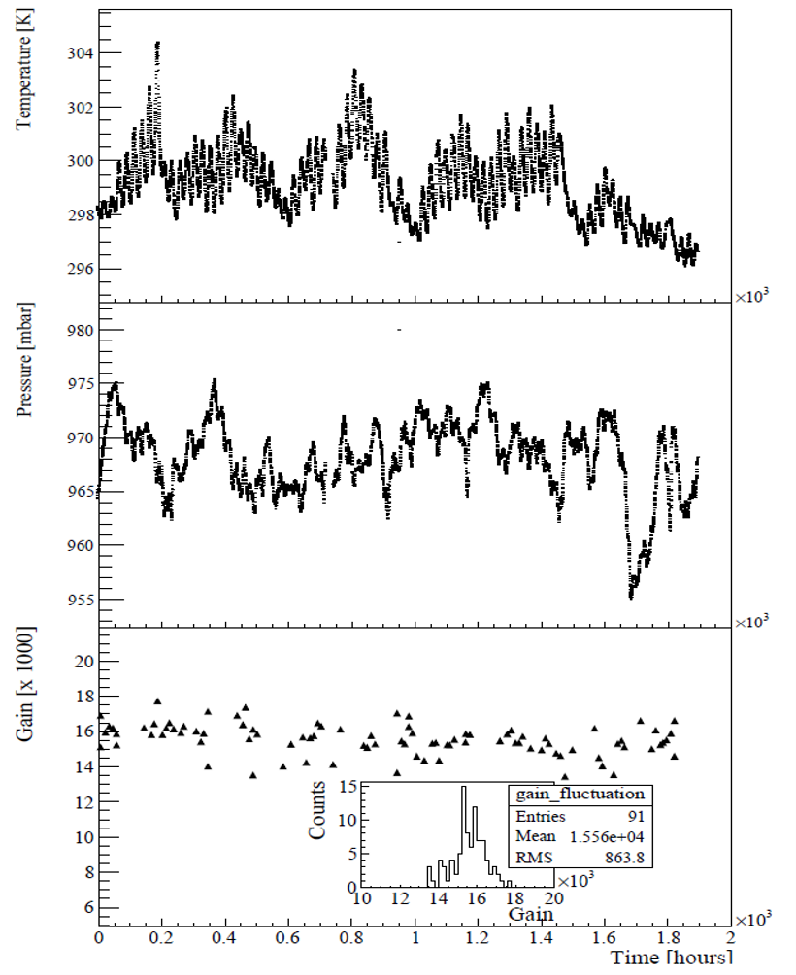
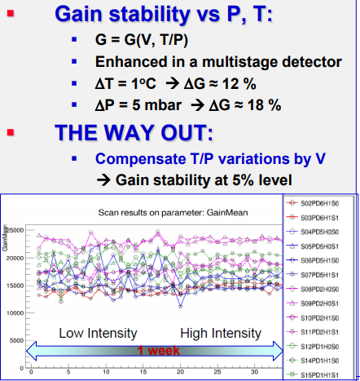
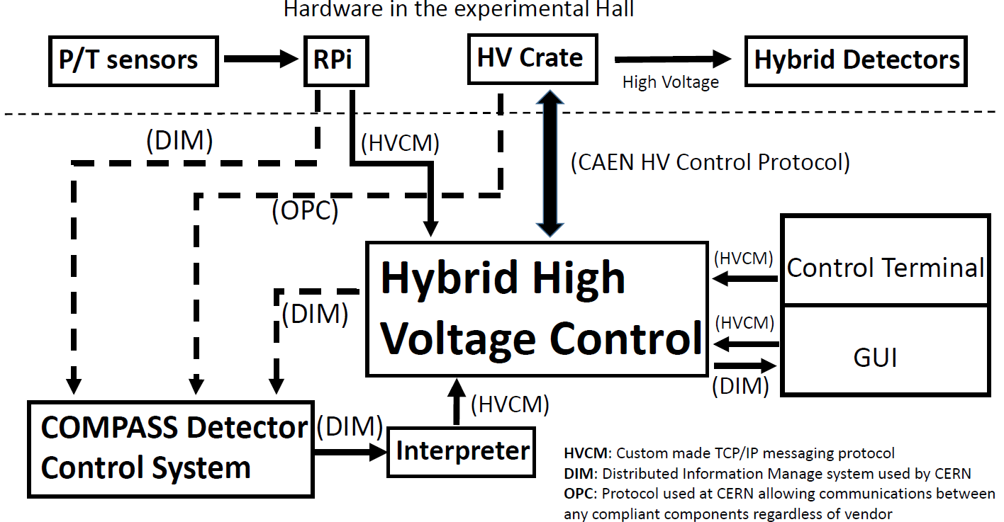
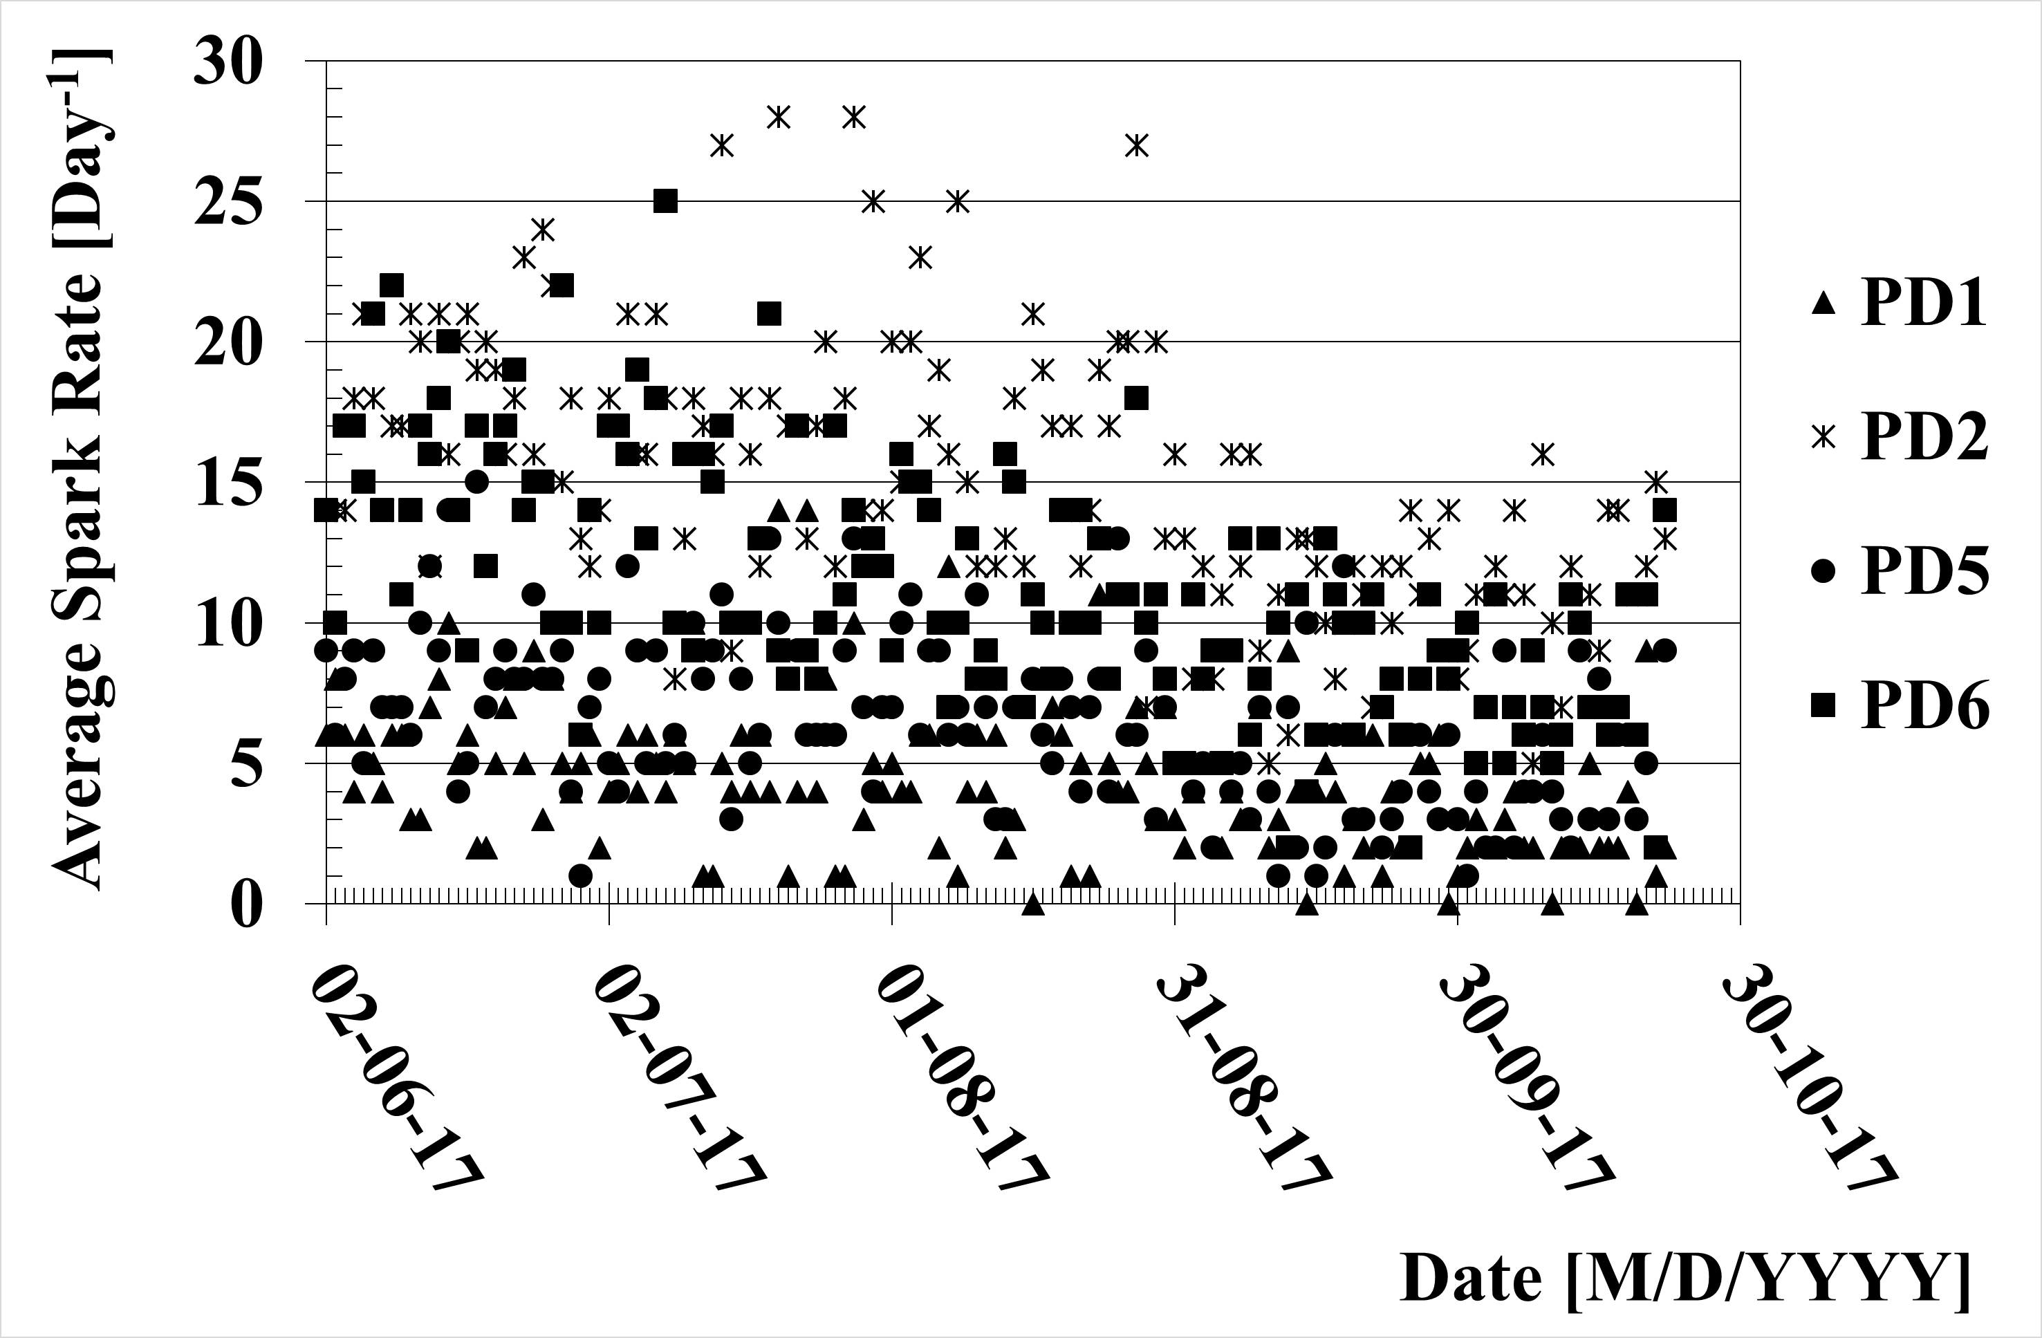
T/P fluctuations and way-out
Without correction roughly 25% fluctuation of gain is expected.
NIMA 952(2019)162378
Similar hardware & software have been prepared and tested for MWPCs. Will be used in 2021 data taking!

Slide 8
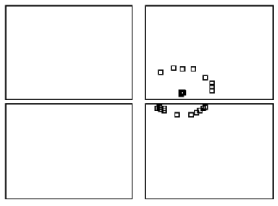
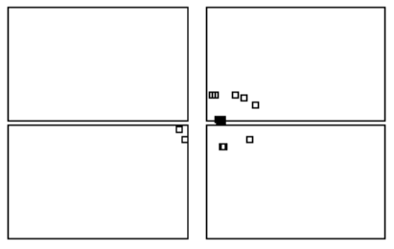
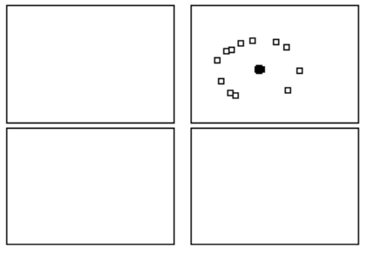
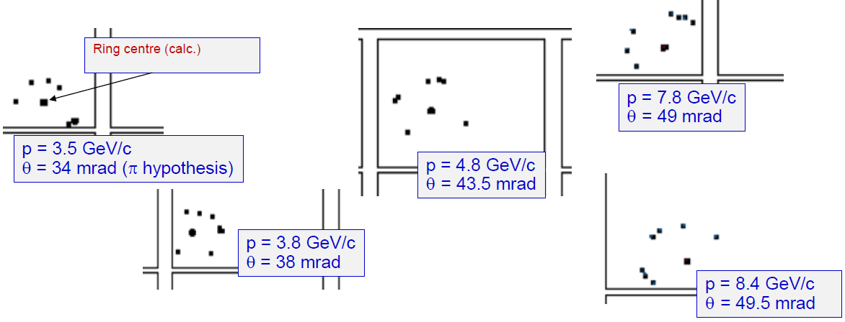
Event displays
6.76 GeV pion
6.4 GeV pion
Hybrid
6.36 GeV pion
Hybrid
Hybrid
photons
PMT
PMT
PMT
Ring center
from track
For reference:
Θ (β = 1) = 52.5 mrad
Ring center calculated from particle trajectory
Detected photoelectrons : hits on the sensors. No noise filtering

Slide 9
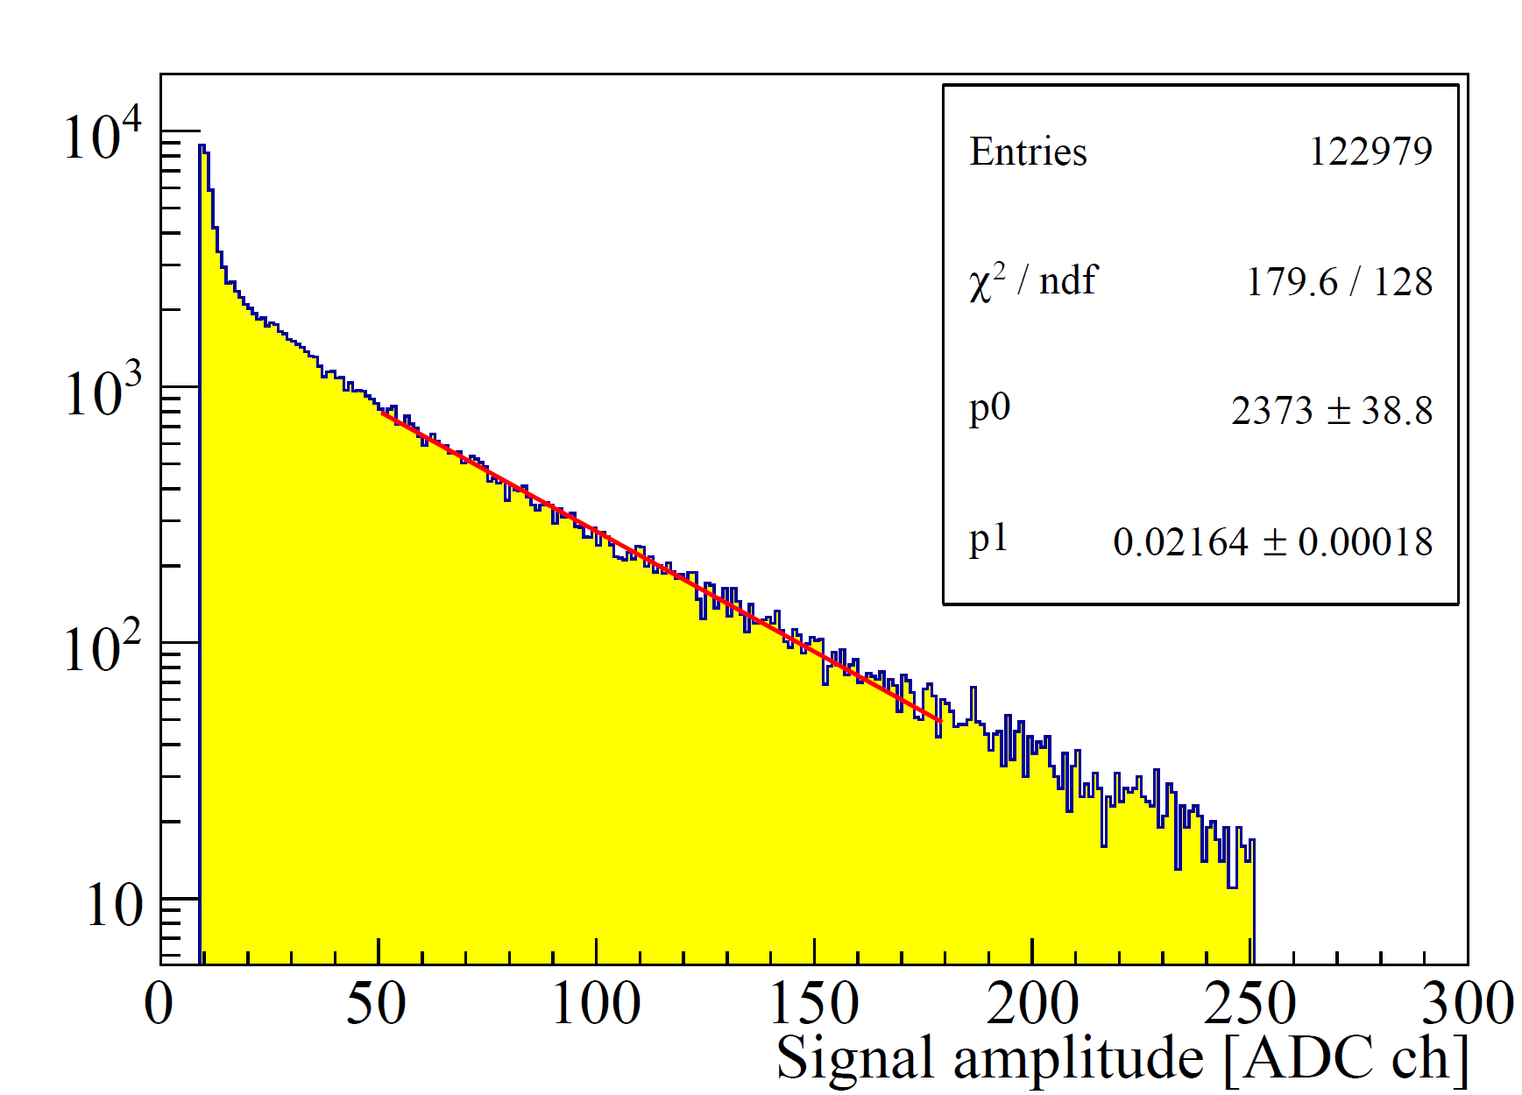
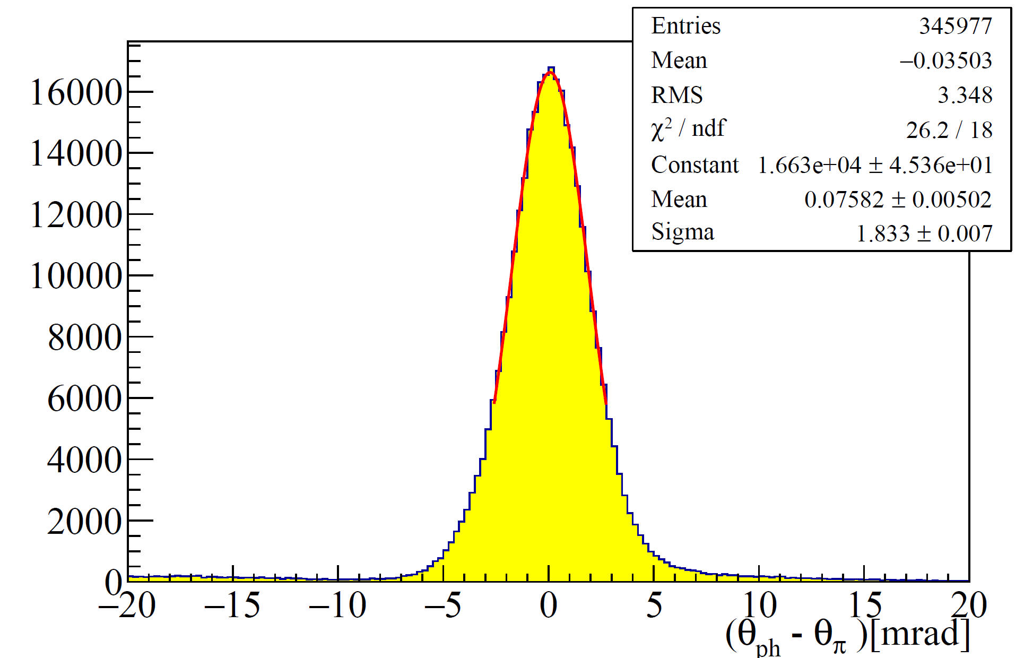
Characterization of the novel Photon detectors
Dedicated pion beam was used to characterize the novel detectors and by extracting the following properties from reconstructed rings
Effective Gain
Single photon resolution
Number of photons per ring at saturation
Dedicated pion beam to characterize!
Fit Range: 50 to 160
Formula: p0*exp(-p1*x)
1 ADC Channel -> 300 electrons
Single photon resolution: 1.83 +- 0.01 mrad
Effective gain : ~14000 +- 140

Slide 10
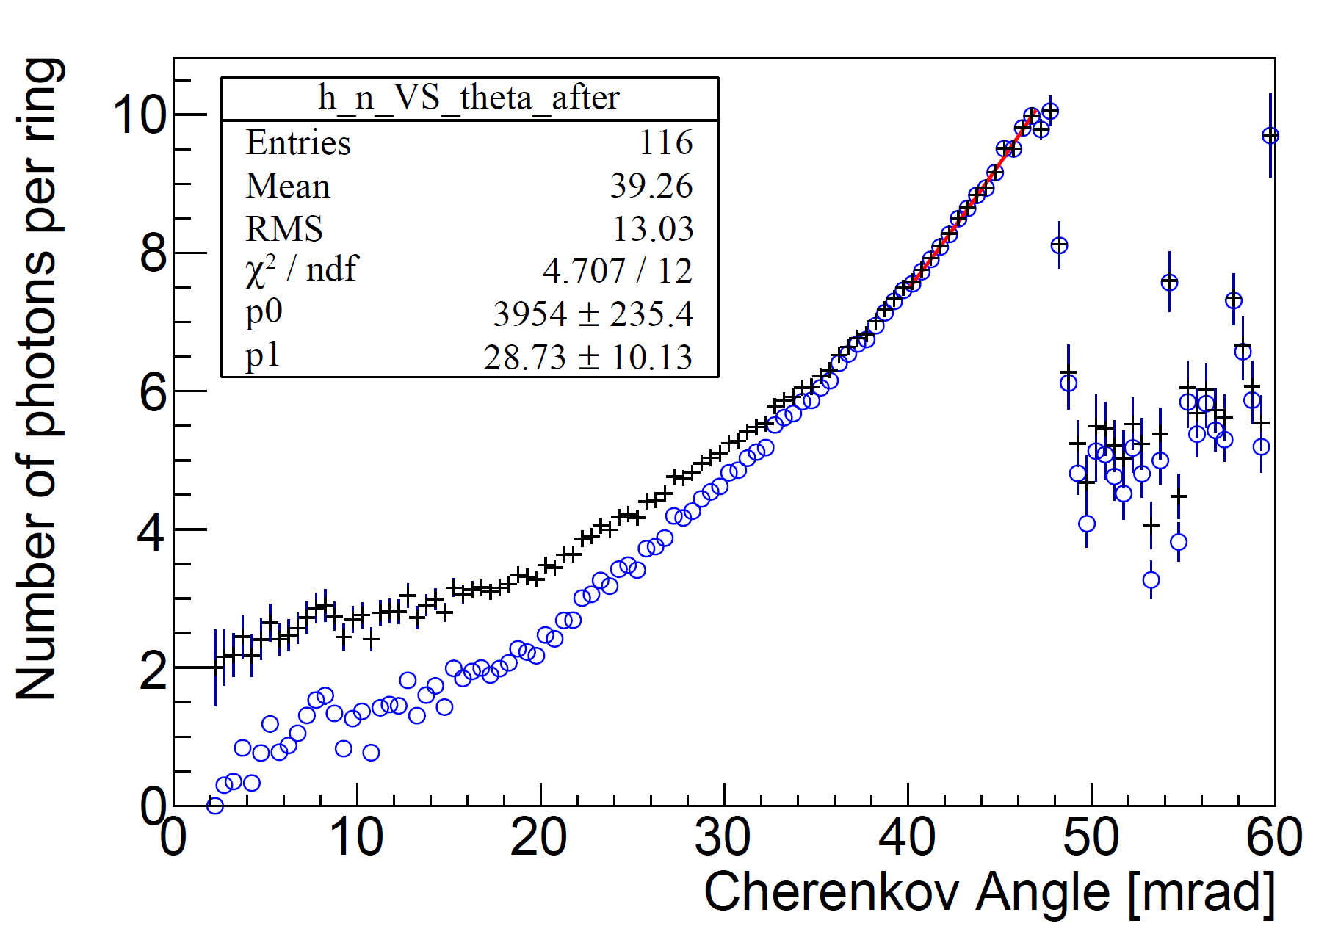
Characterization of the novel Photon detectors …
Extrapolate to saturation, number of photon= 12.9
First part of the function = 11.5 +/- 0.4
Second part of the function= 1.4 +/- 0.3
N(ϴ_{Ch}) = p₀sin²ϴ_{Ch}+ p₁ϴ_{Ch}

Slide 11
COMPASS 2016 RICH upgrade summary
A 7 years long R&D program had been dedicated to upgrade COMPASS RICH with MPGD based single photon detection.
COMPASS has pioneered MPGD based PDs for RICH application in 2016.
The detector performance is thoroughly studied, and results are encouraging for use of MPGD based single photon detectors for future RICH applications.
The hybrid PDs are working at an effective gain of 14k, with a level of 5% stability. An IBF below 3% is achieved (thanks to inclusion of MM and staggered THGEMs).
Single photon resolution is 1.83+-0.01 mrad.
In best working condition the detector can detect ~11 signal photons per ring at saturation.

Slide 12
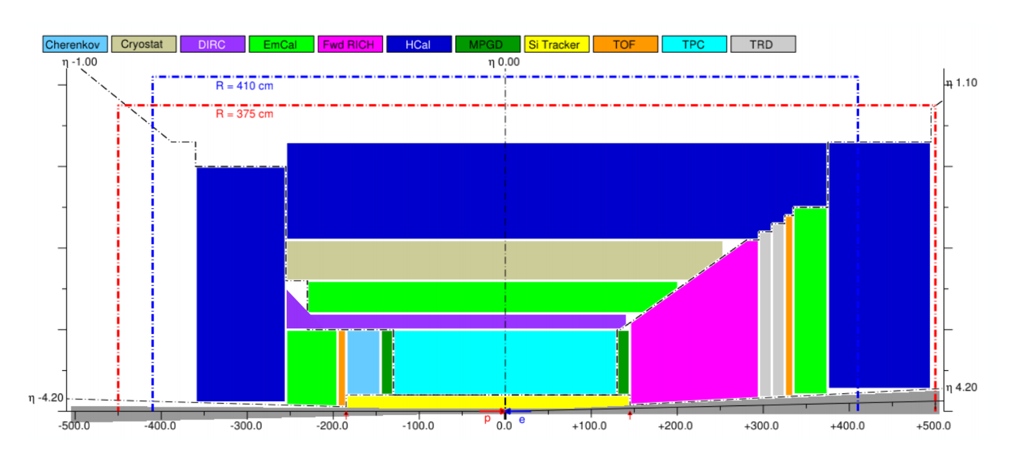
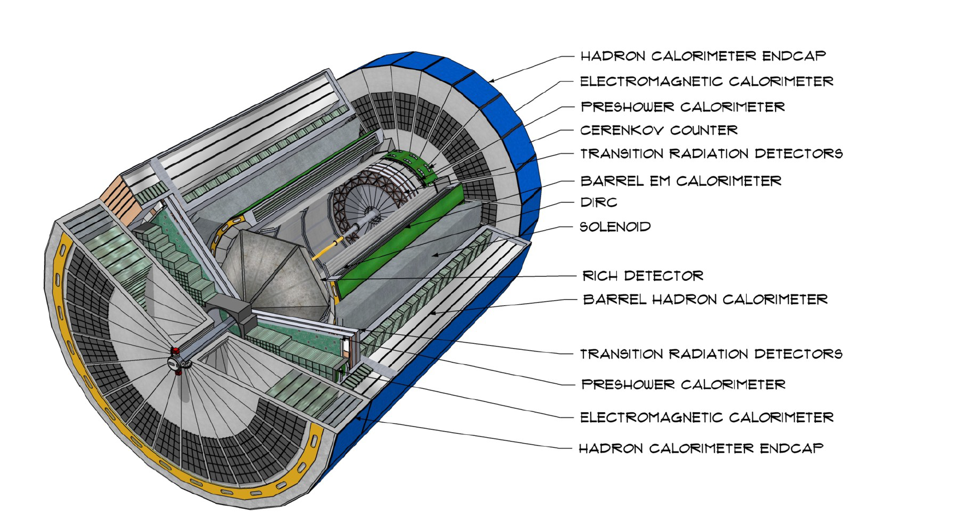
PID in the EIC at USA
A.Accardi et al., “Electron Ion Collider: The Next QCD Frontier,” Eur. Phys. J., vol. A52, no. 9, p. 268, 2016.
National Academies of Sciences, Engineering, and Medicine, “An Assessment of U.S.- Based Electron-Ion Collider Science.” The National Academies Press, Washington DC, 2018. https://doi.org/10.17226/25171.
EIC is Approved!!!
4π detector setup.
Challenge→ include high momentum PID detectors in hermetic detector!
Compact collider set-up →short radiator length (around 1m) → Limited number of generated photons
Standard quartz window opaque λ < 165 nm → possibility windowless RICH (M. Blatnik et al., IEEE NS 62 (2015) 3256 ) → Gaseous detectors
CsI most used, however ageing due to humidity and ion bombardment → quest for novel PC with sensitivity in the far UV region → H-ND powder as possible alternative photocathode of CsI (Talk by D.D’Ago).
Improvement of Spatial resolution→ Smaller pad size.
Operation in intense magnetic field → MPGD based single photon detectors are tested cost effective solution (Thanks to COMPASS 2016 upgrade).

Slide 13
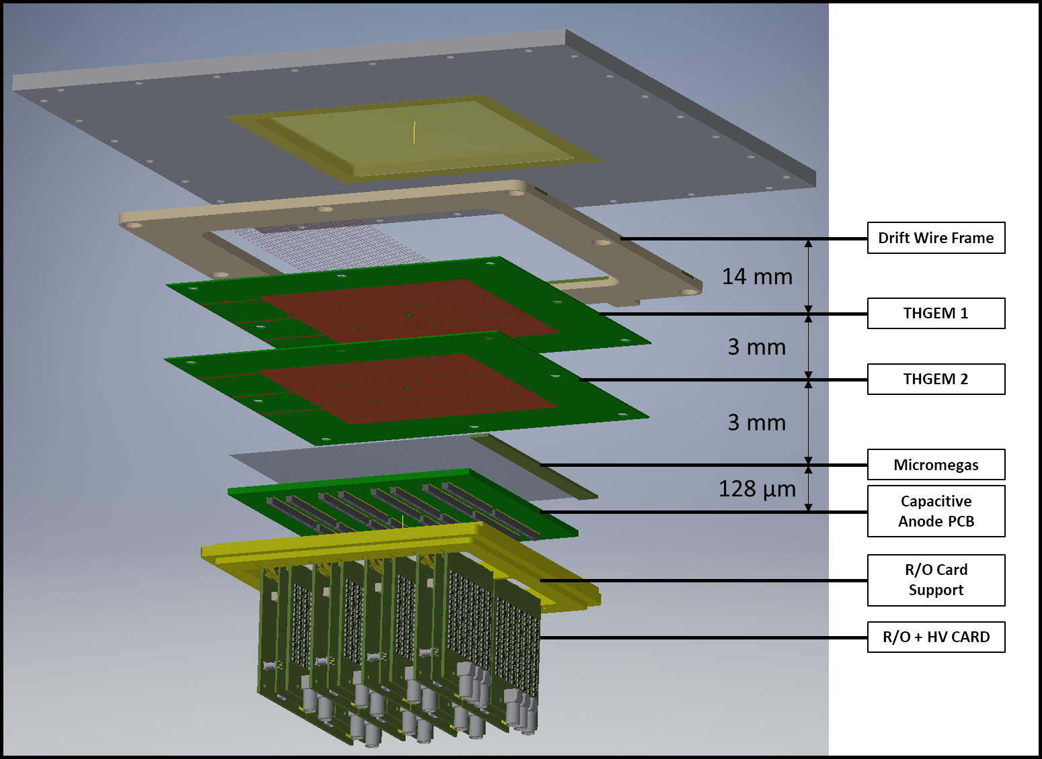
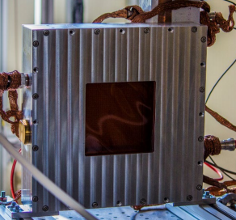
Minipad detector setup
Modular structure: all components and services within the active area.
Prototype with 10x10 cm2 active area.
1024 square pads of 3x3 mm2 with 0.5 mm inter-pad space

Slide 14
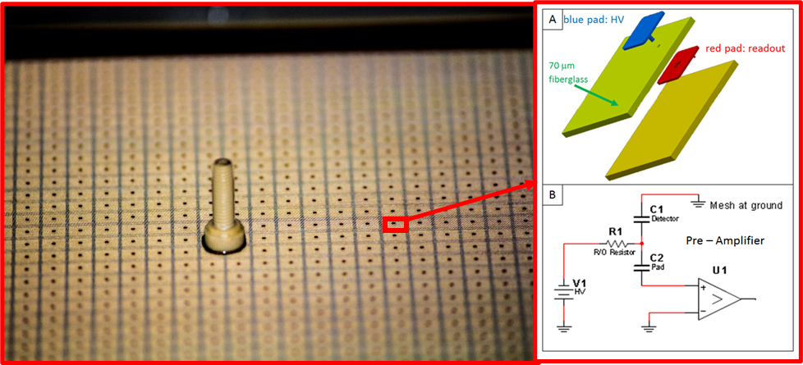












Components: Lab Test and performance
8 x 16 (=128) pads connected via SAMTEK1143 (130 pin) SMD connector Individual 470 MΩ SMD resistor per pad on HV distribution cards (128/card). 8 cards
COMPASS Protocol
Produced at CERN, standard bulk technology woven stainless steel mesh,18 μm wires, 63 μm pitch One pillar per pad, 500 μm diameter. Gap = 128 μm.
CAEN N1471H
Standalone MM test
Standalone THGEM test
NIMA 936 (2019) 565

Slide 15



DAQ and online analysis: RAVEN
Home made DAQ and Decoder based on LABView and C++
Read-out system : SRS (from RD51)
FE chip: APV25
DAQ: RAVEN, an original system developed for these studies based on LabVIEW.
Decoding and online analysis included.
Good rate capability: 10 kHz for single APV.
Ar:CH₄ 50:50 Picoquant PLD 4000B pulsed UV laser source
Master Thesis: M.Baruzzo, Construction, characterisation and DAQ development of a single photon MicroPattern Gaseuos Detector for the future EIC RICH.

Slide 16




Towards beam test at RD51 beamline

Slide 17



Beam test results
Development of an optimized detector for increased resolution based on the hybrid THGEM + MM and 3mm x 3mm minipad.
Study the compatibility of these hybrid PDs with CF₄ for a windowless RICH for the future Electron Ion Collider
Timing
Gain from cluster amplitude : 30 K

Slide 18
Summarizing Minipad activities
COMPASS hybrid like PD prototype has been coupled to miniaturized pad size.
THGEMs and MMs have been studied in standalone and in hybrid architecture in lab.
Dedicated DAQ has been prepared for decoding and online analysis.
A beam test had been conducted at CERN H4 beamline.
Clean signature of photon is observed.
Covid-19 outbreak has been a show-stopper in 2020 activities.
Further R&Ds in both activities are foreseen in 2021.
Thanks for your attention.

