Slide 1



dE/dx, classical and with cluster counting
A brief review of particle identification in gaseous detectors
Outline
  some basics and fundamental problems of dE/dx measurements
    Bethe-Bloch, clusters and all that
    resolution, particle separation power
  the classical way: dE/dx by charge measurement
  the alternative way: dE/dx by cluster counting
    cluster counting in time
    cluster counting in 2D with micropattern detectors

Slide 2





Particle ID with dE/dx
at e⁺e– colliders and elsewhere
QCD
  inclusive hadronic particle spectra (pions, kaons, protons)
Heavy flavour physics
  b-tagging (electrons from semi-leptonic b-decays)
  c-tagging, D meson spectroscopy (kaon/pion separation)
Tau physics
  hadronic branching ratios, strange spectral functions
Searches
  heavy charged long-lived/stable tracks (SUSY)
  free quarks
  magnetic monopoles

Slide 3
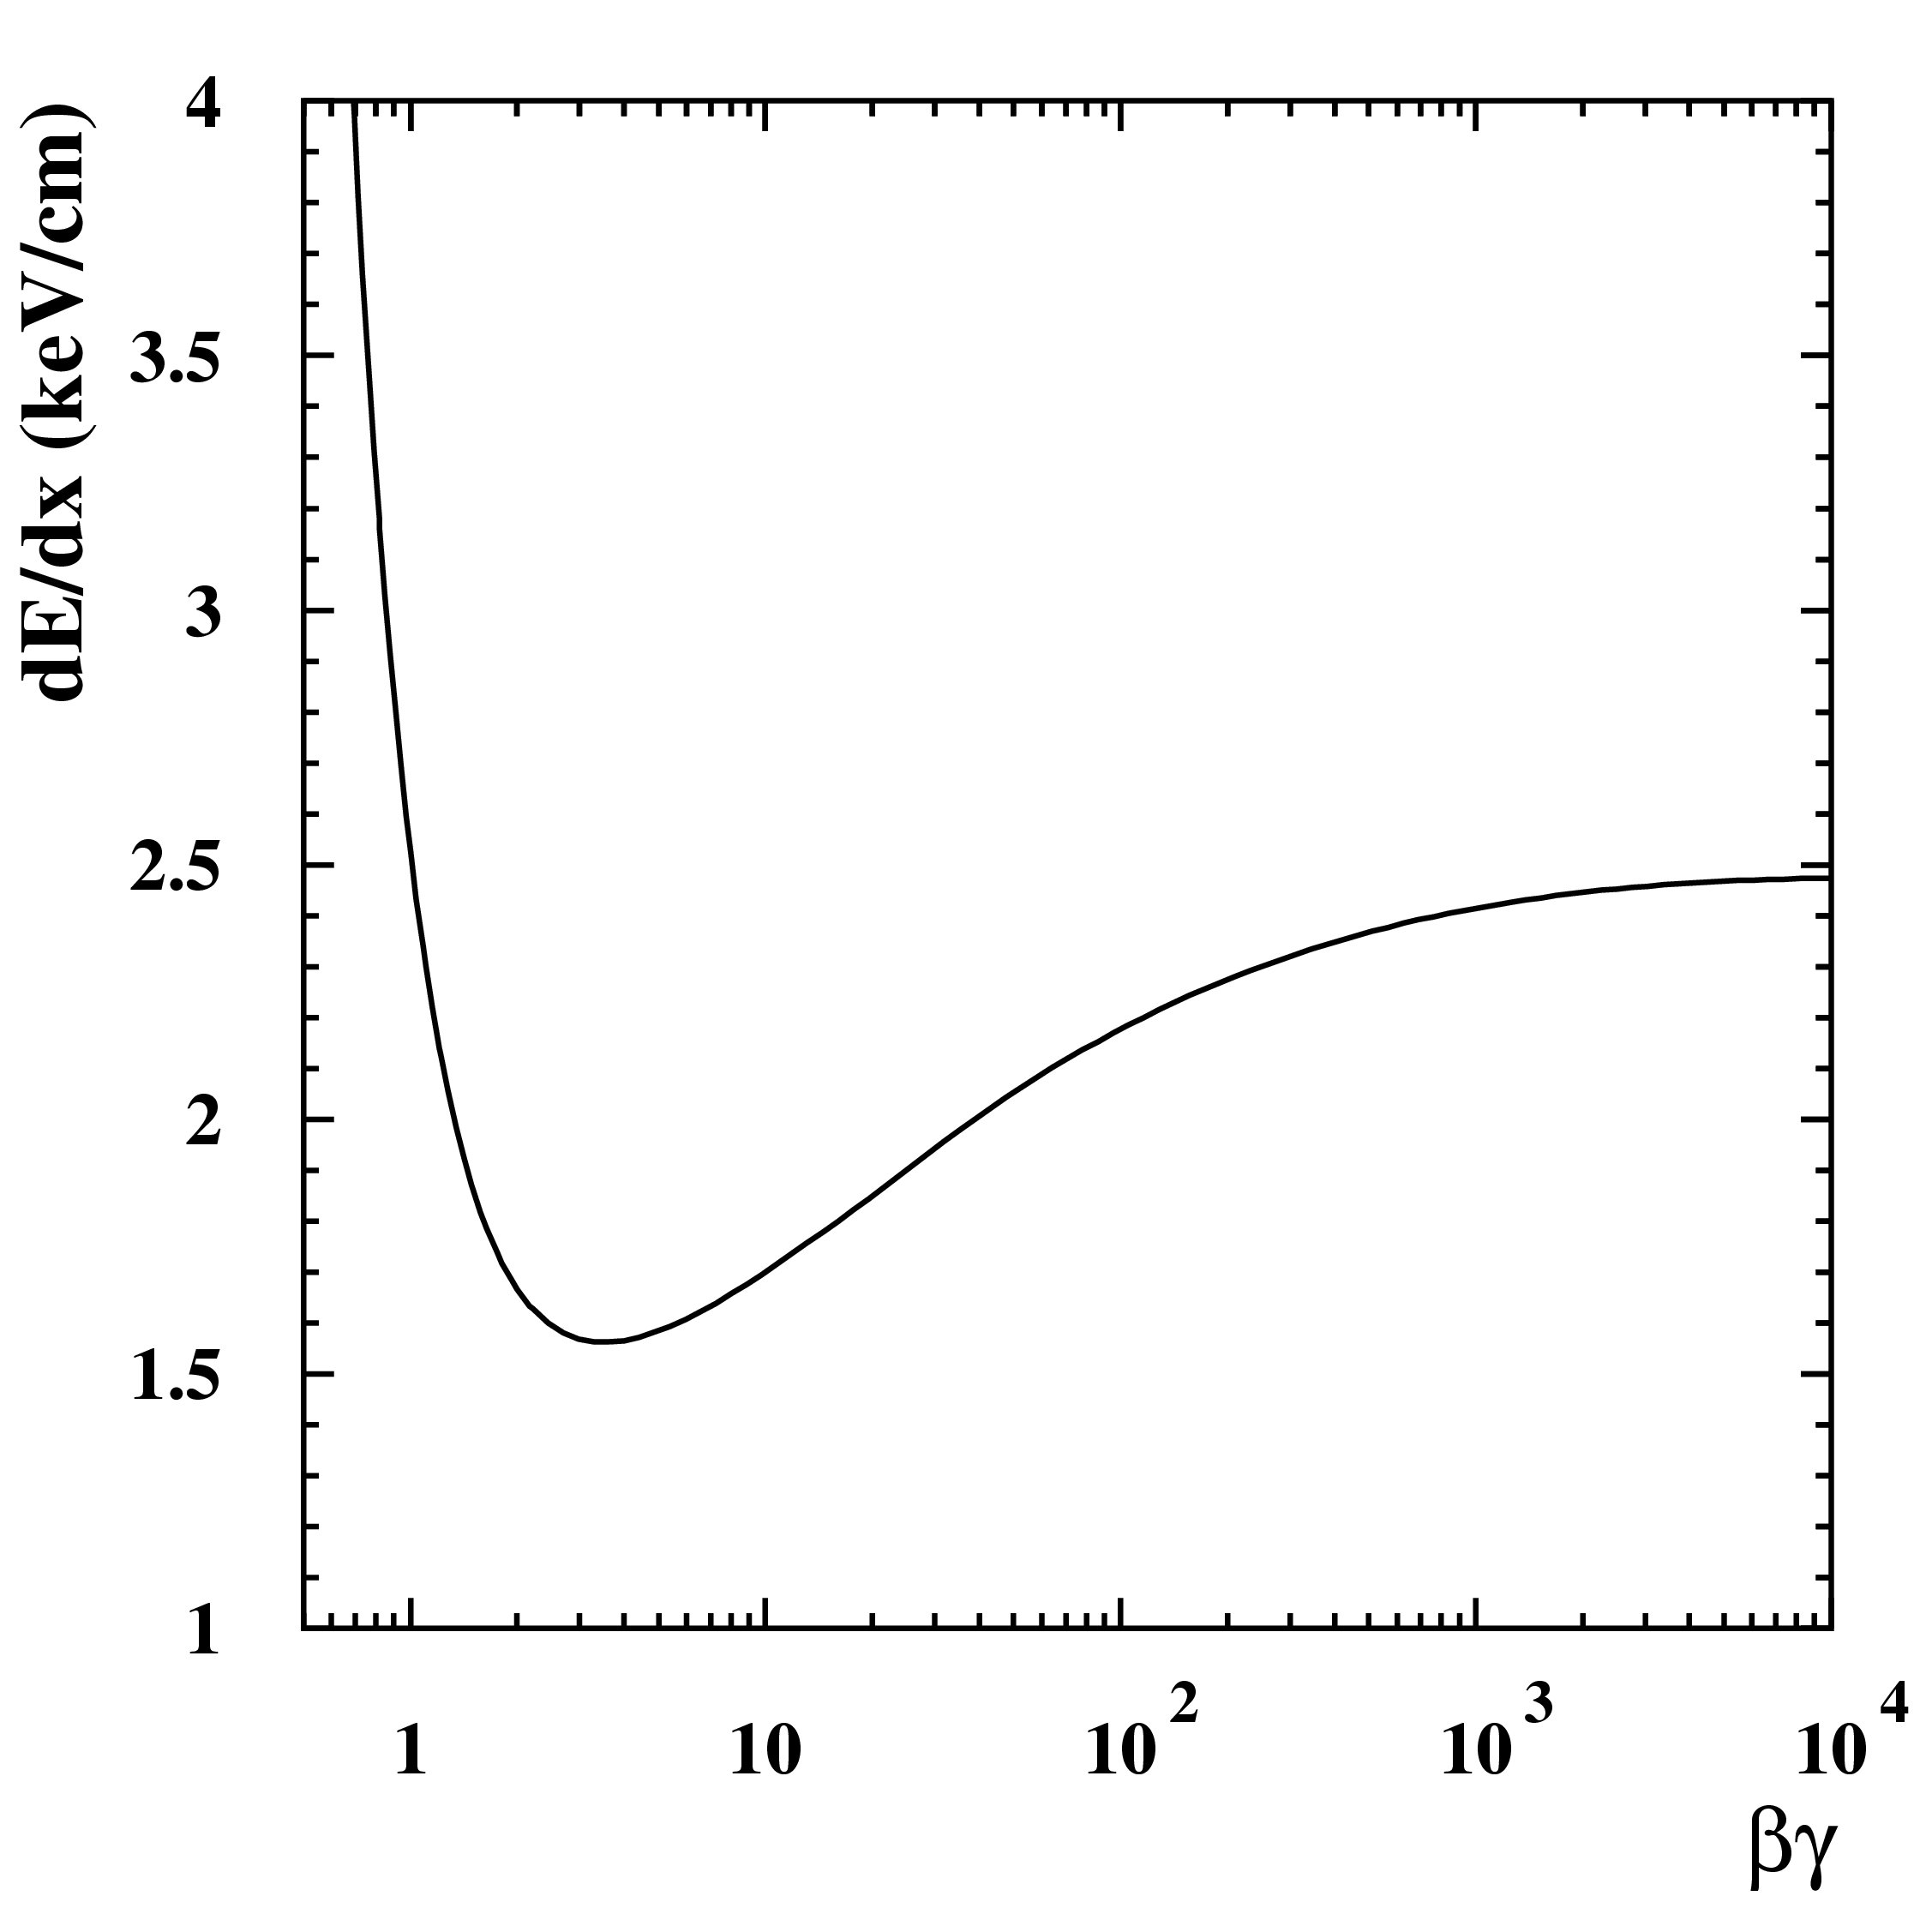
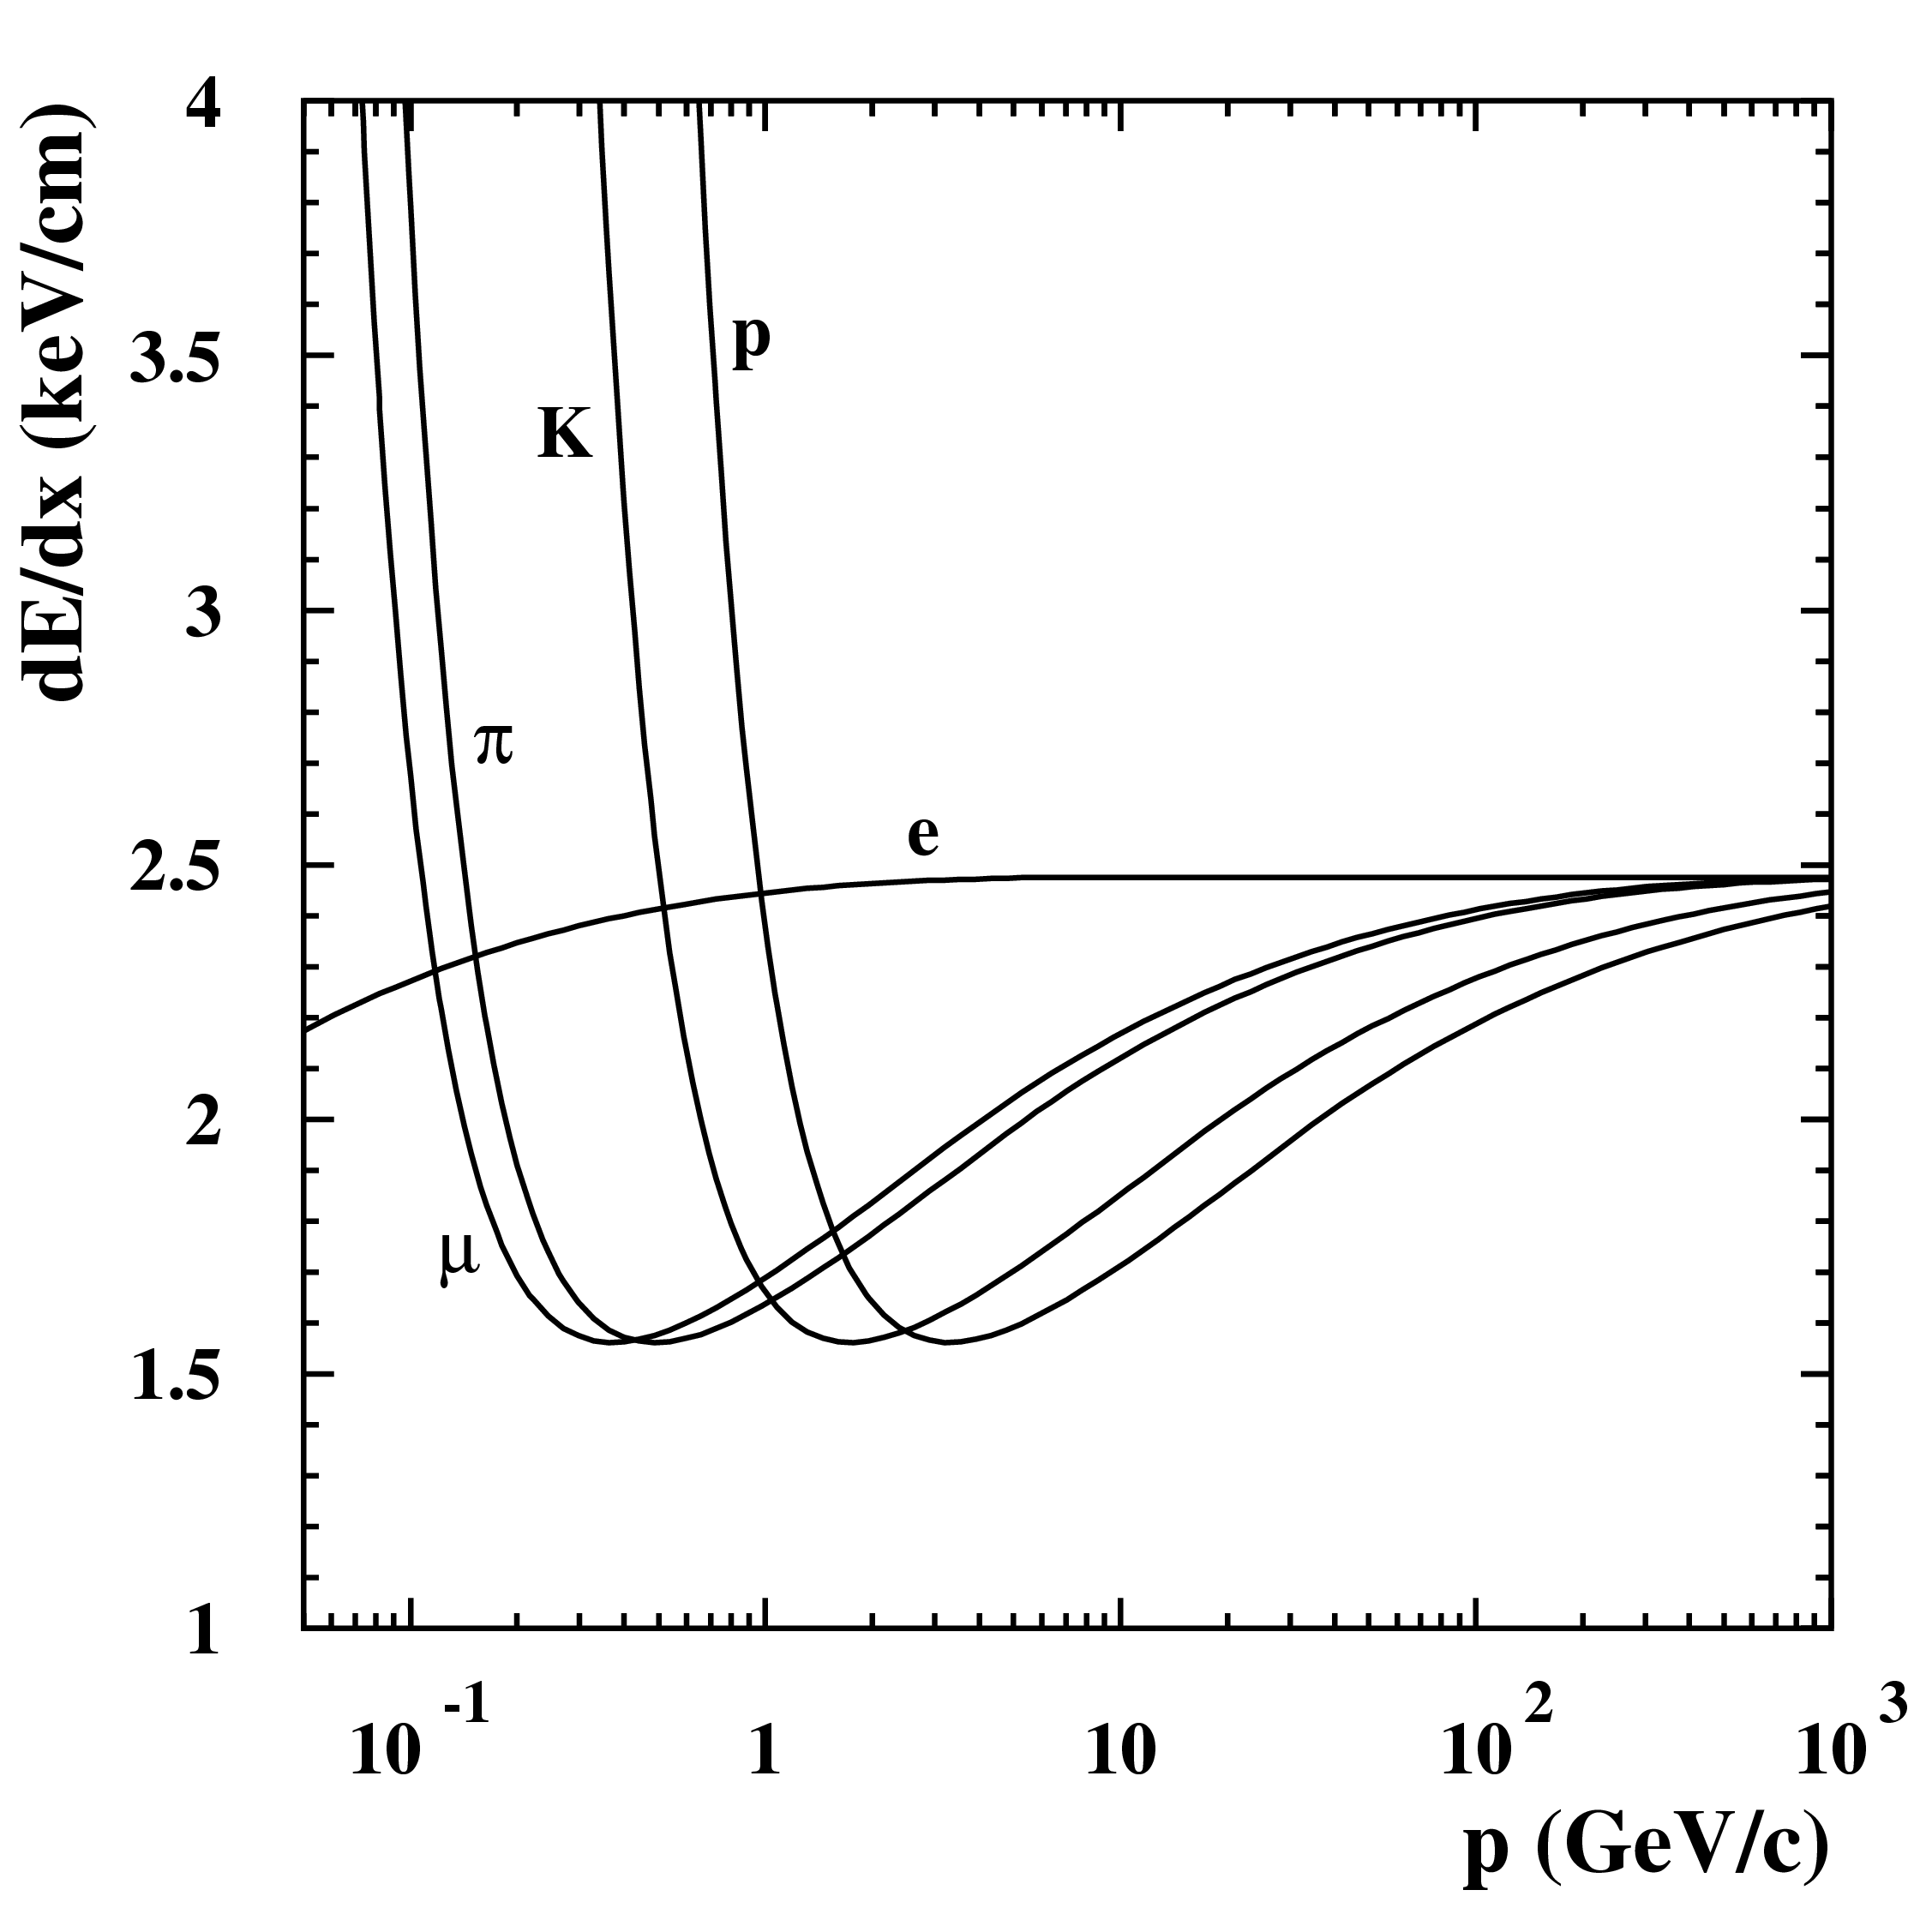

Energy Loss Function (Bethe-Bloch)
“mean” energy loss as function of Q, βγ :
<dE/dx> = ξ * 1/β² * Q² * [K + lnQ² + lnγ² - β² - δ(β)]
electron density
of medium
classical Rutherford
scattering (non-relativistic)
relativistic rise -
“Lorentz boost”
(medium feels higher E-field)
density effect -
(Fermi) plateau due to polarization of medium
  ~1/β²
unique function for
all particle species
m
region of
physics interest
  ~lnγ²- δ(β)
50%
  ~lnγ²
minimum ionising particle (m.i.p.)
3...4

Slide 4
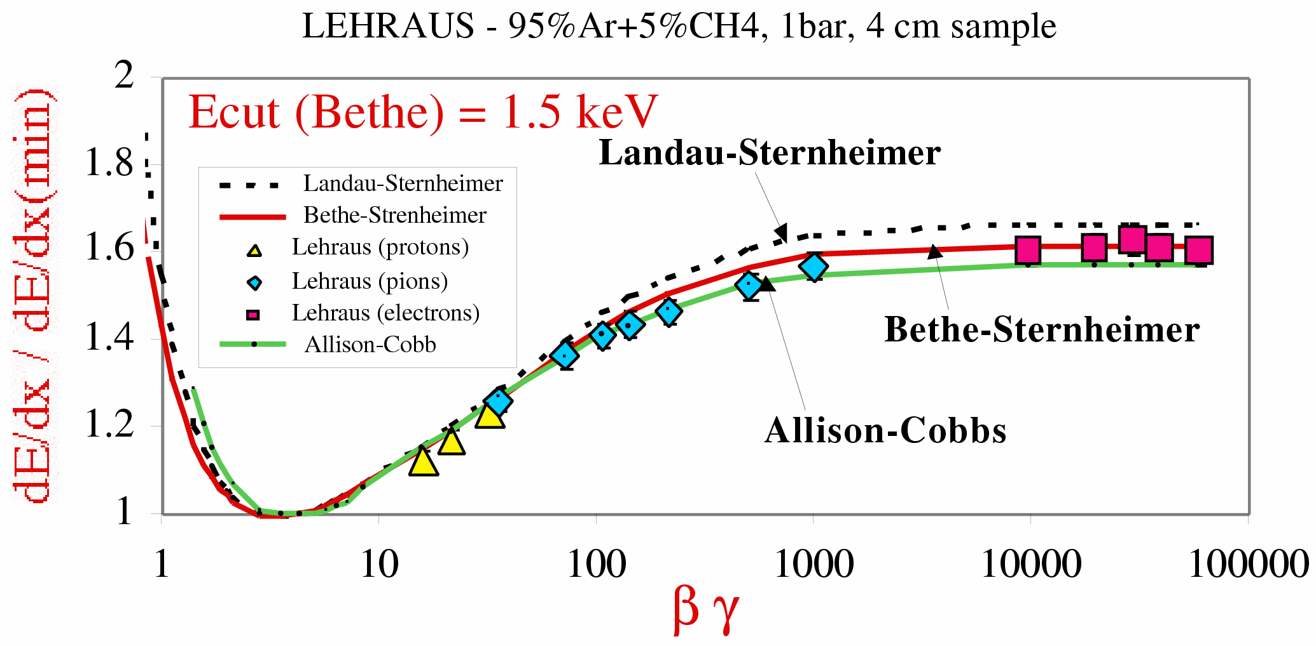




Bethe-Bloch Calculations...
...are difficult, different models exist
  Landau-Sternheimer calculation
  Bethe-Sternheimer calculation
  Allison-Cobb Monte Carlo Ann. Rev. Nucl. Sci., 30 (1980) 253
Level of (dis)agreement: ~3% in relativistic rise
Common problem
  what E_{cut} to be used? What’s E_{cut} at all?
J. Va'vra, NIM A 453 (2000) 262-278

Slide 5
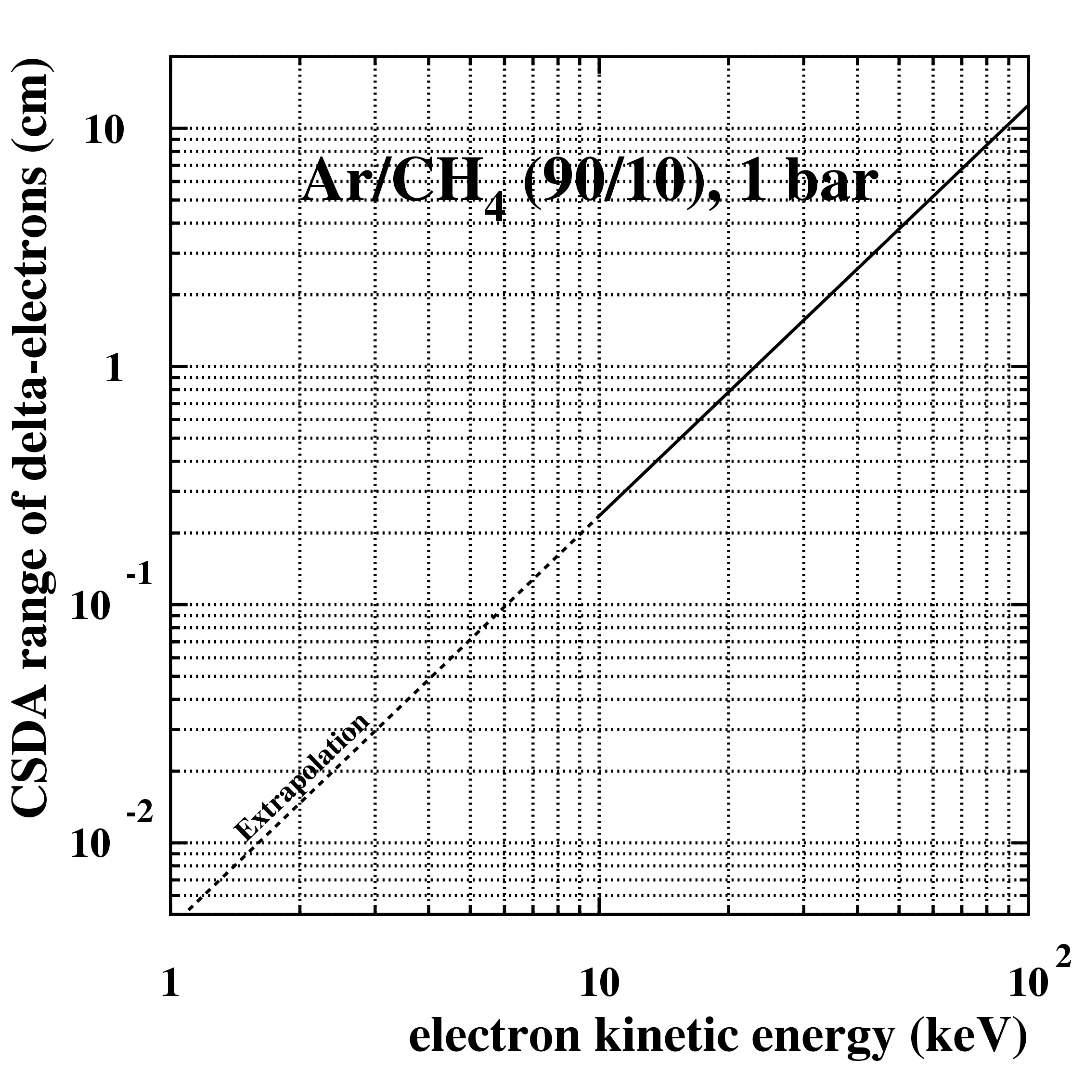
The cut-off Energy (E_{cut})
Tracking detectors usually DON'T measure the full energy loss of a particle!
Secondary electrons with sufficient energy may escape from track, e.g. to adjacent drift cell, pad etc.
  may be recognized as separate hit, not associated to track
  detectors measure RESTRICTED energy loss instead of full energy loss
Cut-off energy E_{cut} defines maximum energy of an electron still associated to a track
  depends on detector geometry, double hit resolution, magnetic field, diffusion and more
  typical E_{cut} ~a few keV corresponding to some 100 μm – 1 mm range
1 mm
Electron Range
(CSDA = Constant Slowing Down Approximation)
6 keV

Slide 6
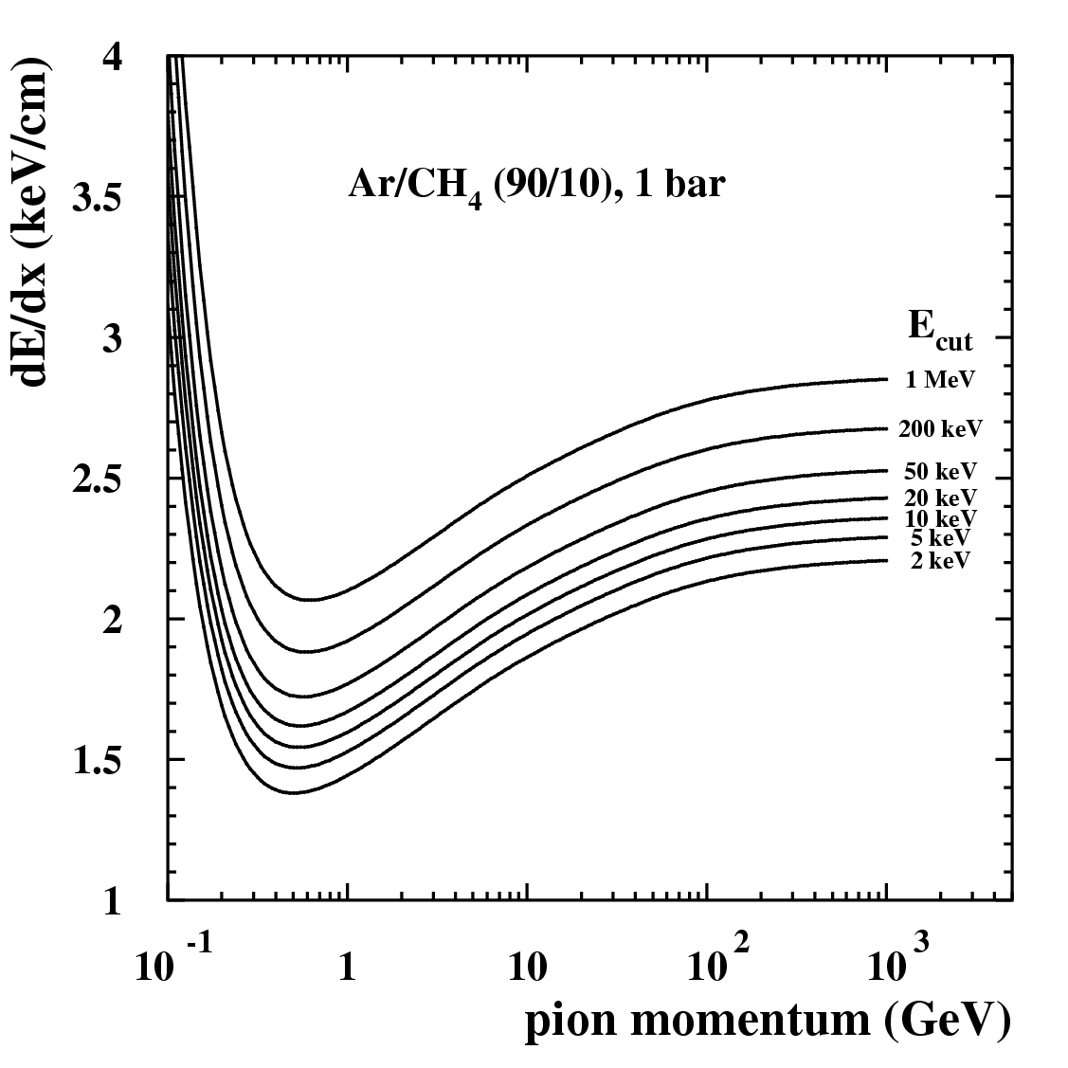
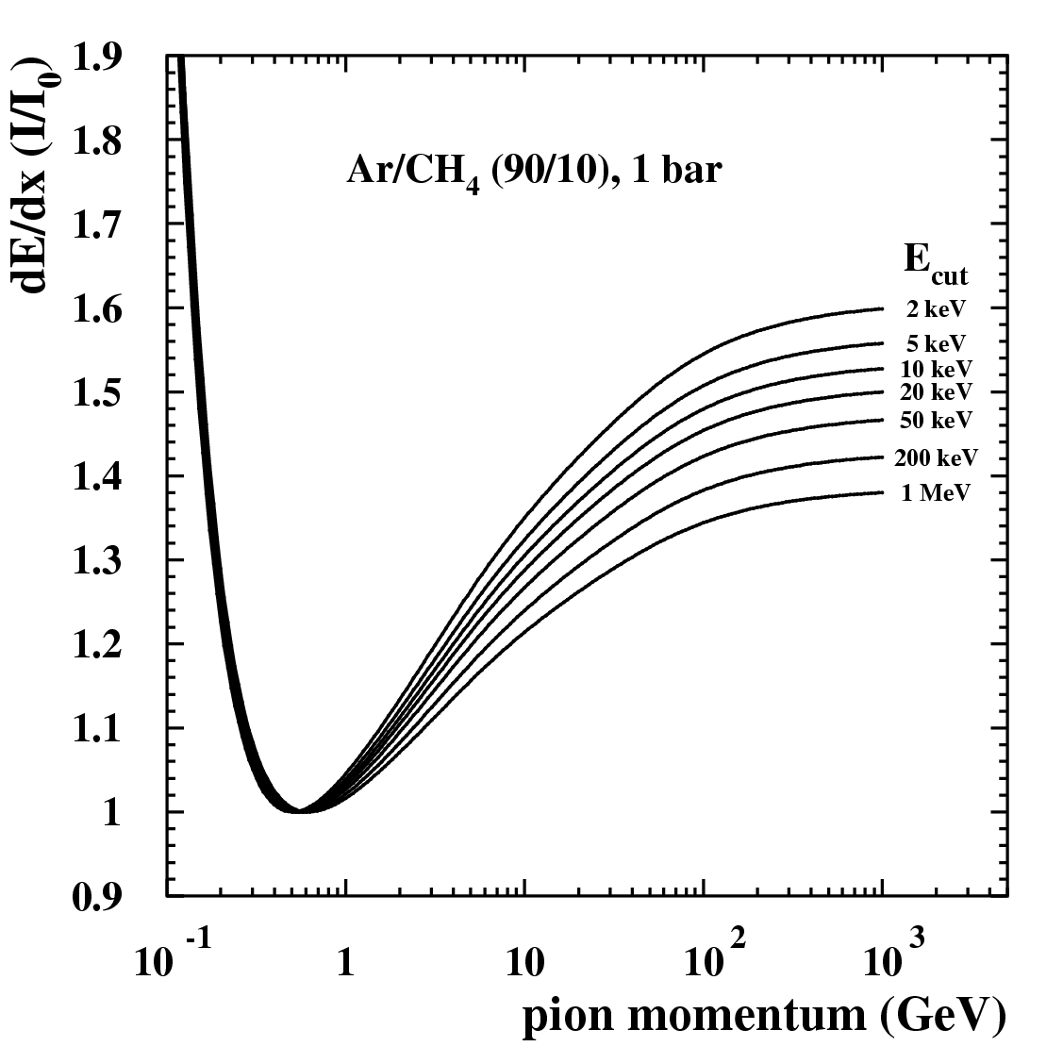
E_{cut} Dependence
E_{cut} is difficult to determine, basically a free parameter
Impossible to make calculations of Bethe-Bloch function to percent level or even better
  results depend on E_{cut} a lot
Empirical parameterization used in practice
relativistic rise variation up to 50%
50%
40%
measured dE/dx
scales by 40%

Slide 7
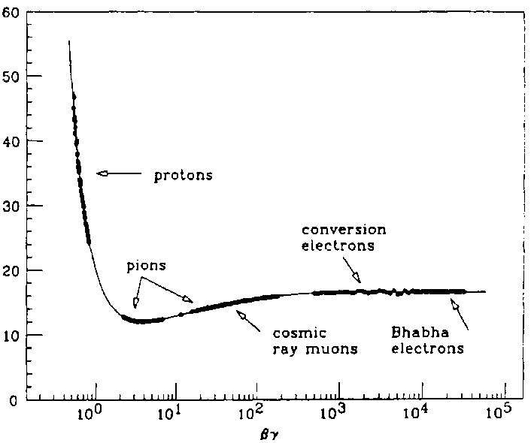
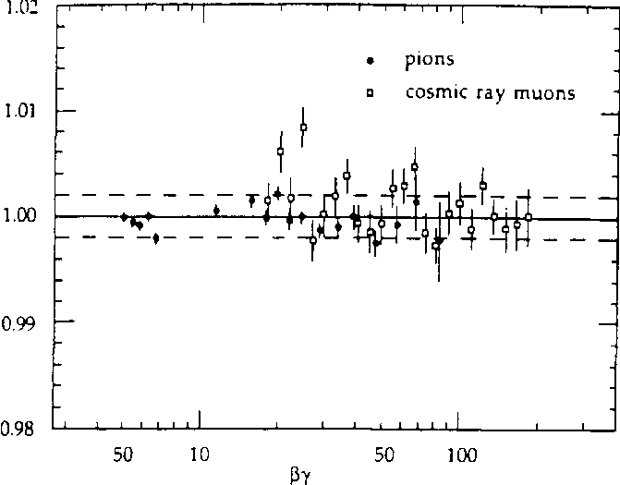

dE/dx Parameterization
Parameterization usually by fit to data (various functional forms)
    fully empirical (any Polynomials), semi-empirical (Bethe-Bloch + parameters)
Use of dE/dx in physics analysis requires
  good dE/dx parameterization and good estimate of dE/dx resolution
  for any track in question: calculate Χ² probabilities for each particle species (typically e, µ, π, K, p)
TPC/2γ
< ±0.2%
input data from
many sources
(< ±0.07σ)
G. Cowan, PhD Thesis, LBL (1988), LBL-24715
G. Cowan, PhD Thesis, LBL (1988), LBL-24715
TPC/2γ
2
dE/dx_{measured} - dE/dx(e,µ,π,K,p)_{predicted}
Χ²(e,µ,π,K,p) =
σ (dE/dx)

Slide 8
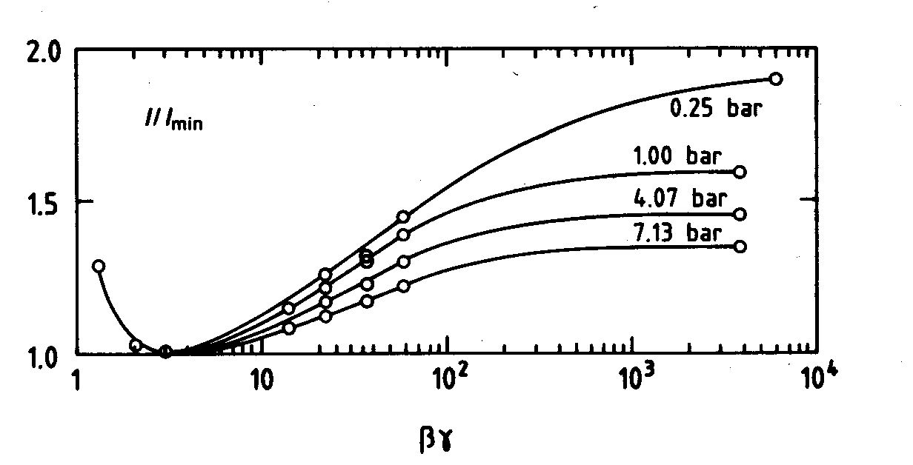
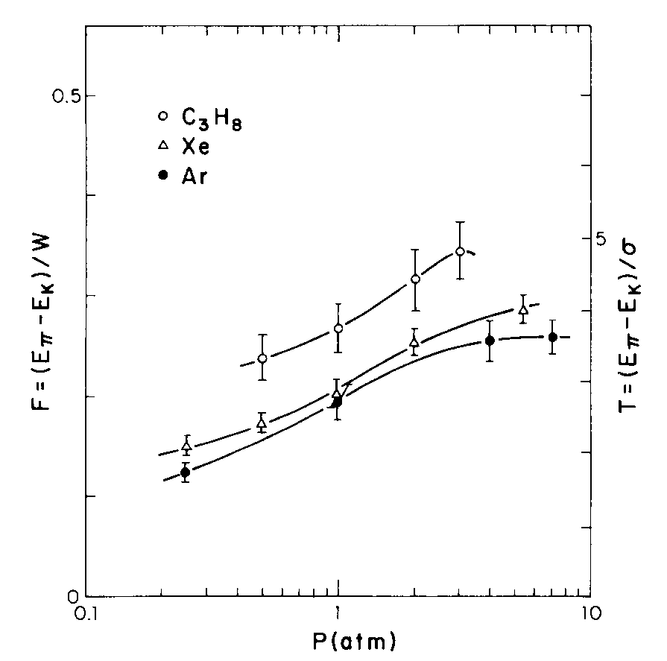


Particle Separation Power
separation
Important for physics
  particle separation power in relativistic rise
  dE/dx resolution is NOT important!
  need to optimize separation power (if possible)
Higher pressure reduces separation in relativistic rise
Optimal separation power at 3 - 4 bars
  also less diffusion, but...
  pressure vessel needed...
separation
separation power =
resolution
A.H. Walenta et al., NIM 161 (1979) 45
higher pressure doesn't
further improve
separation power
Walenta 1979

Slide 9
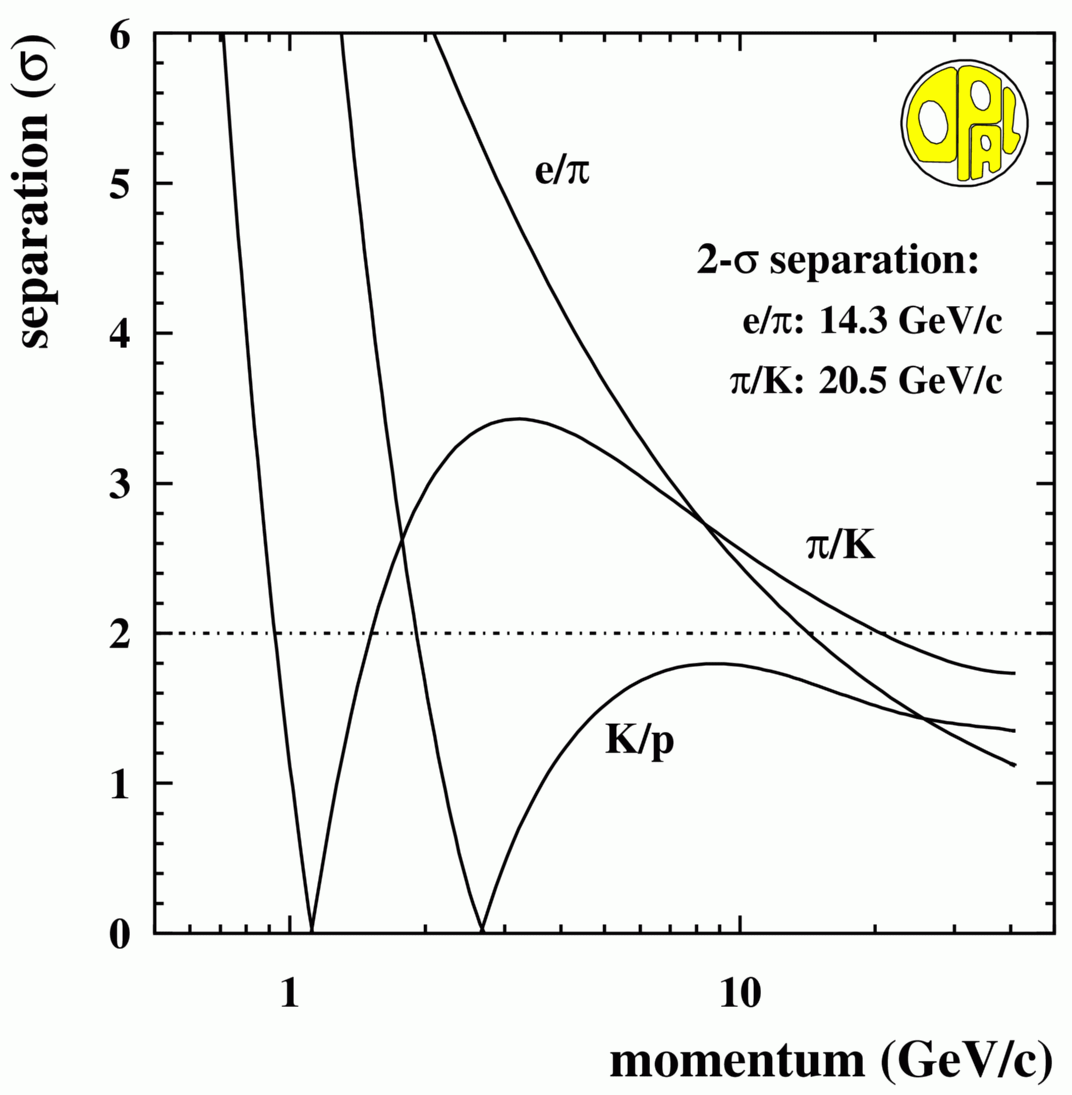
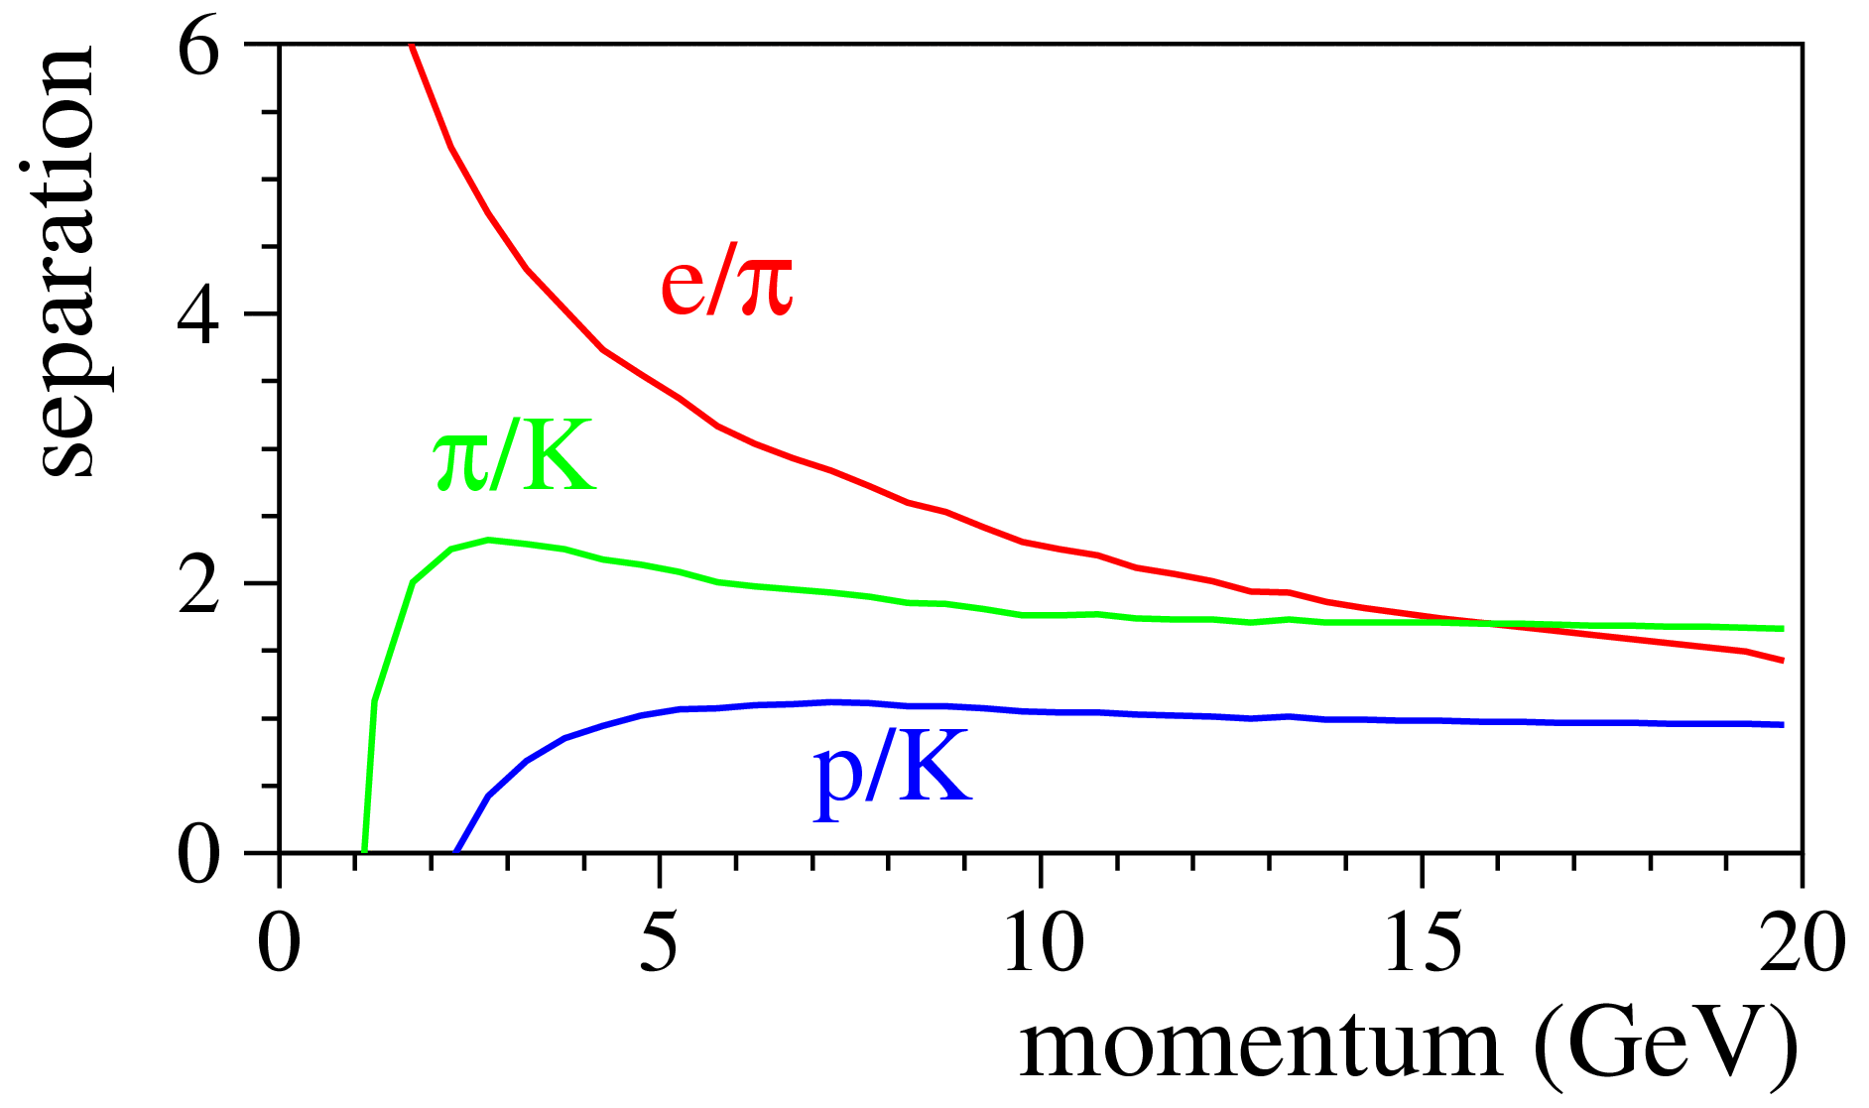
Particle Separation Power
Typical (average) particle separation power at LEP
  e/π > 2σ up to 12...14 GeV
  π/K > 2σ up to 8...20 GeV (max. 2.5 – 3.5 σ)
  p/K always below 2σ (max. 1 – 1.7 σ)
similar detector size, different pressure
ALEPH TPC, 1 bar
OPAL Jet Chamber, 4 bar

Slide 10
Energy Loss by Ionization
(brief reminder)
Primary number of ionizations per unit length is Poisson-distributed
  typically ~30 primary interactions (ionization clusters) / cm in gas at 1 bar
However, primary electrons sometimes get large energies
  can make secondary ionization
  can even create visible secondary track (“delta-electron”)
  large fluctuations of energy loss by ionization
  Typically: total ionization = 3 x primary ionization
    on average ~ 90 electrons/cm
Primary ionization
Total ionization = primary + secondary ionization

Slide 11
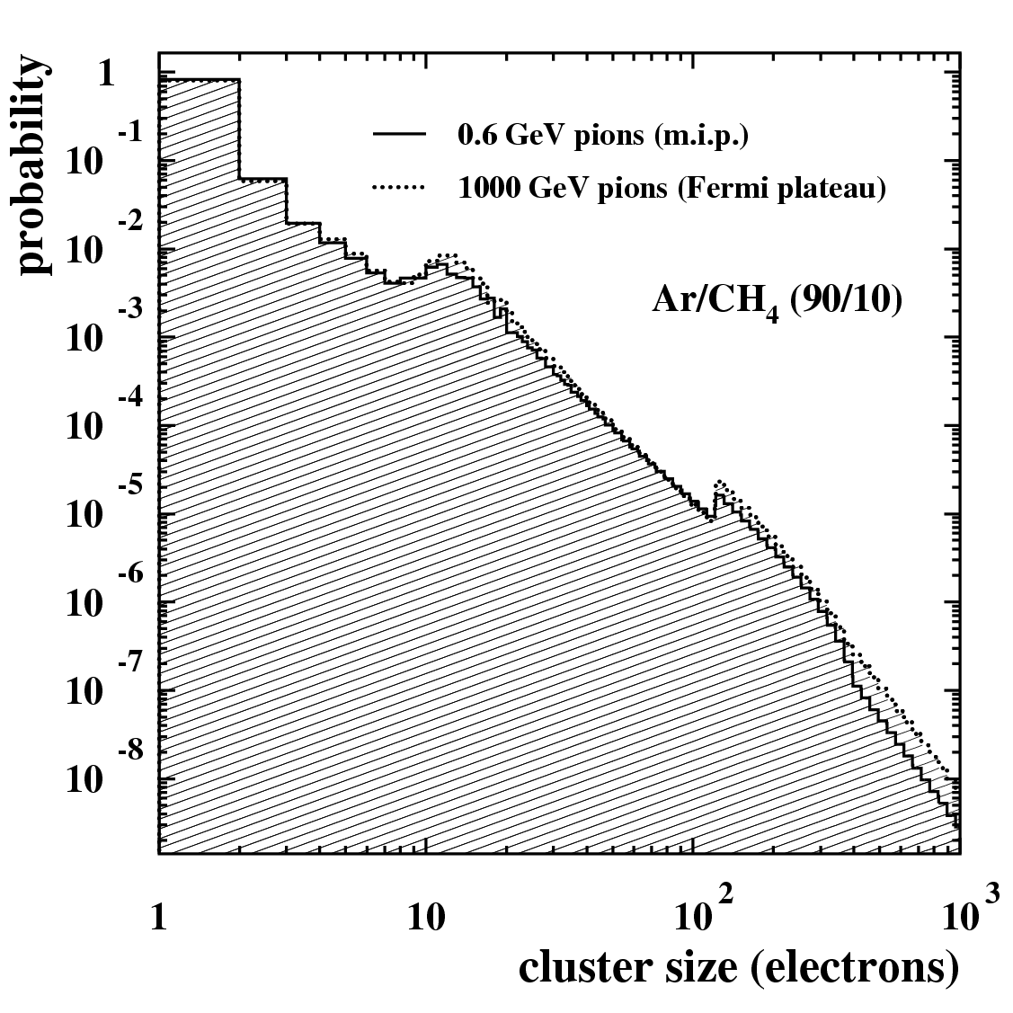

Cluster Size Distributions
Probabilities (%) to create N_{el} electrons
single
electron
multi-
electron
cluster
data from H. Fischle et al., NIM A 301 (1991) 202
slightly dependent also on
particle energy
HEED cluster simulation (HEED written by I. Smirnov)
less multi-electron clusters
in Helium (better!)

Slide 12
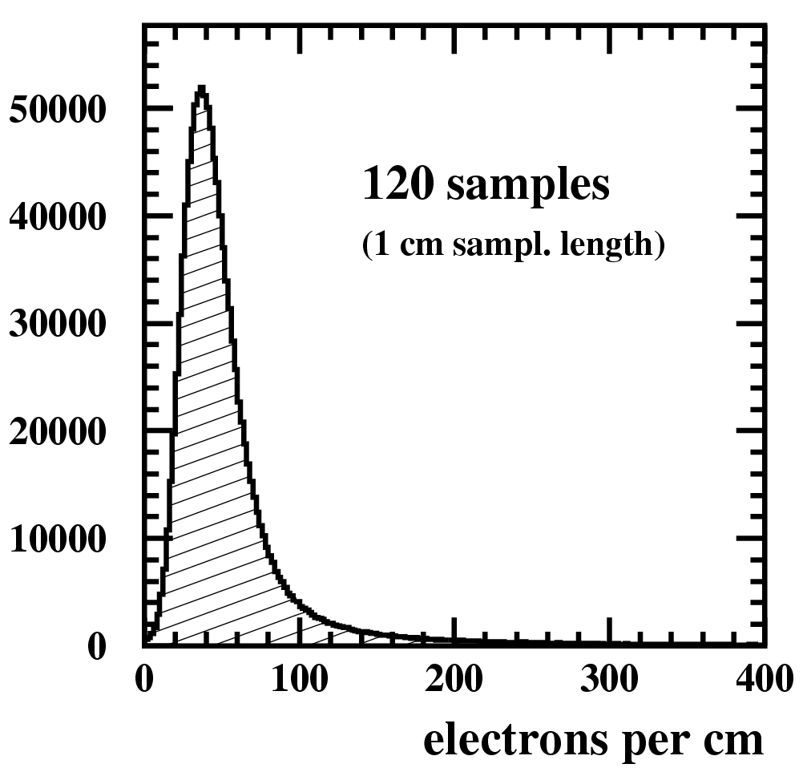
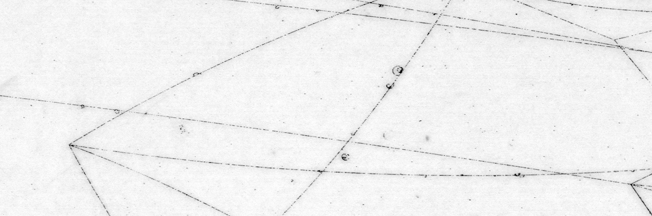
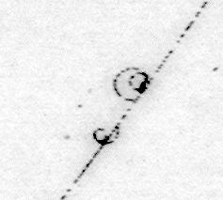
Cluster Size Fluctuations
Cluster size fluctuations cause large variations of energy loss from sample to sample
  Landau distribution
    large broad peak (single or few el. clusters)
      soft collisions, interaction with whole gas molecule
      small energy transfer
    looong tail (multi el. clusters, δ-electrons)
      hard collisions, semi-free shell electrons
      large energy transfer
1 cm sampling length
looong tail
tracks in CERN 2m bubble chamber
beam

Slide 13
Ideal dE/dx measurement
Count number of clusters along track
  cluster density should be proportional to dE/dx
Obvious problem
  how to resolve individual clusters and count them?
    usually high cluster density (20 - 30 cl./cm in Ar mixtures for m.i.p.) → 1 cluster per 300 – 500 μm
    at typical drift velocities of 50 μm/ns → 6 – 10 ns in between clusters
  need device with high time resolution or high granularity to resolve them
    difficult to achieve
Most detectors measure CHARGE per sample along a track (charge ≃ number of primary + secondary electrons)
  sensitive to LARGE fluctuations
    makes dE/dx resolution by charge measurement much worse than cluster counting
    this is the fundamental, central problem of all dE/dx measurements by charge

Slide 14


Classical dE/dx Measurement by Charge
Widely used (because counting is difficult)
  measure charge of many samples along track
  get ”mean" charge over samples = dE/dx
Problem
  simple “mean” charge subject to large fluctuations due to multi-election clusters
How to get better estimate of “mean” energy loss?
  Most commonly used
    “Truncated Mean” (robust) → reject samples with highest charge
  Other methods (rarely used)
    Max.-Likelihood fit to charge distribution (but more sensitive to changes of Landau shape)
    Inverse transformation: mean of (1/sqrt[(dE/dx)_{i}])⁻¹

Slide 15
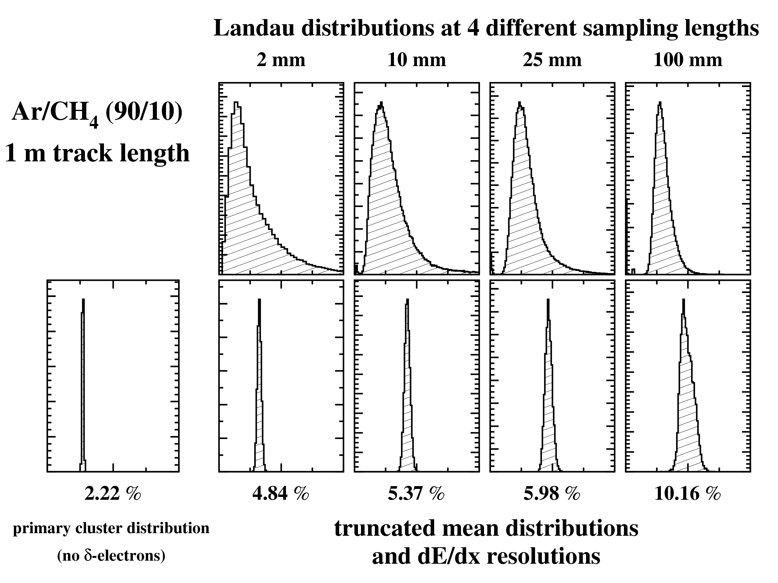
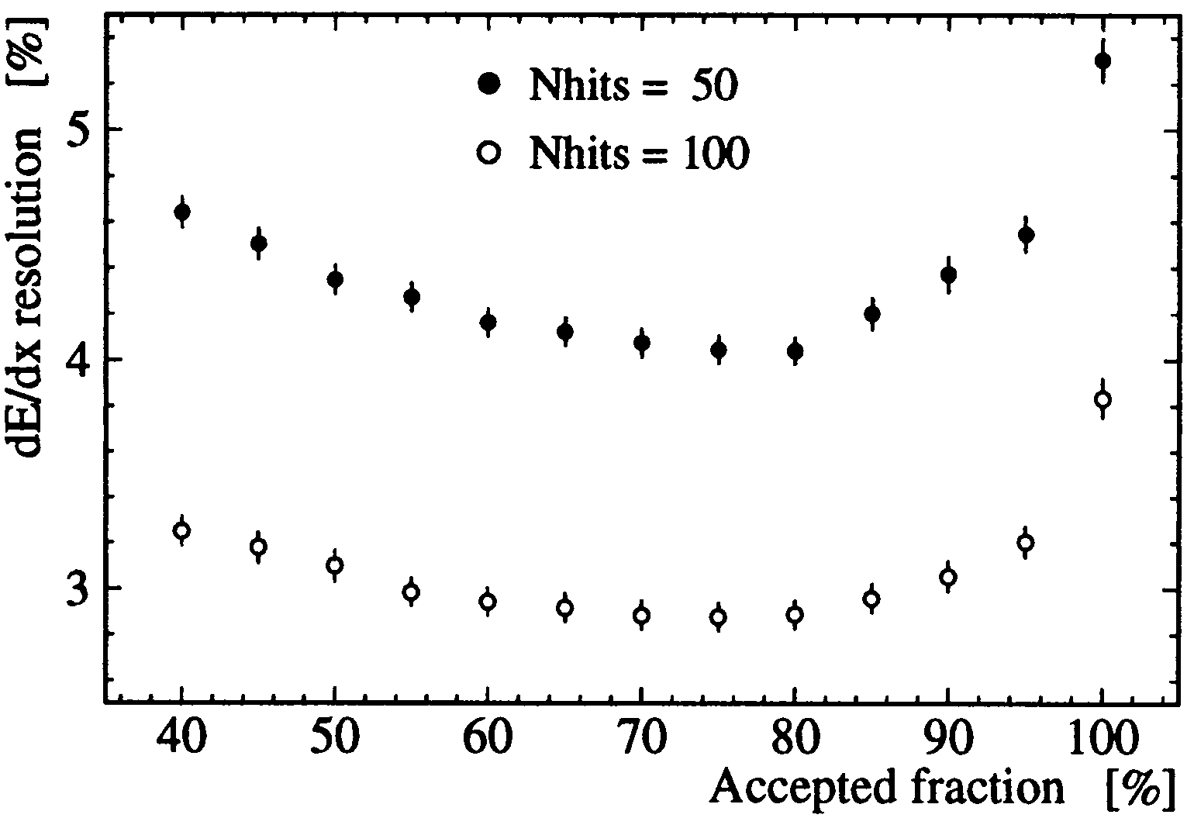




Truncated Mean
  reject (typically) 20-30% of samples with highest charges
    sometimes also 5...10% of lowest charge samples rejected (noise removal)
  calculate mean (“truncated” mean) of remaining samples
  optimize truncation empirically (→ best dE/dx resolution)
    Helium mixtures (less multi-electron clusters) need less truncation than Argon mixtures
    typically accepted fraction
        He mixtures: 80%
        Ar mixtures: 65-70%
number of samples / sampling length per track also plays a role
simulation
KLOE
KLOE Collaboration, A. Andryakov et al., NIM A 409 (1998) 390-394
HEED cluster simulation (HEED written by I. Smirnov)

Slide 16
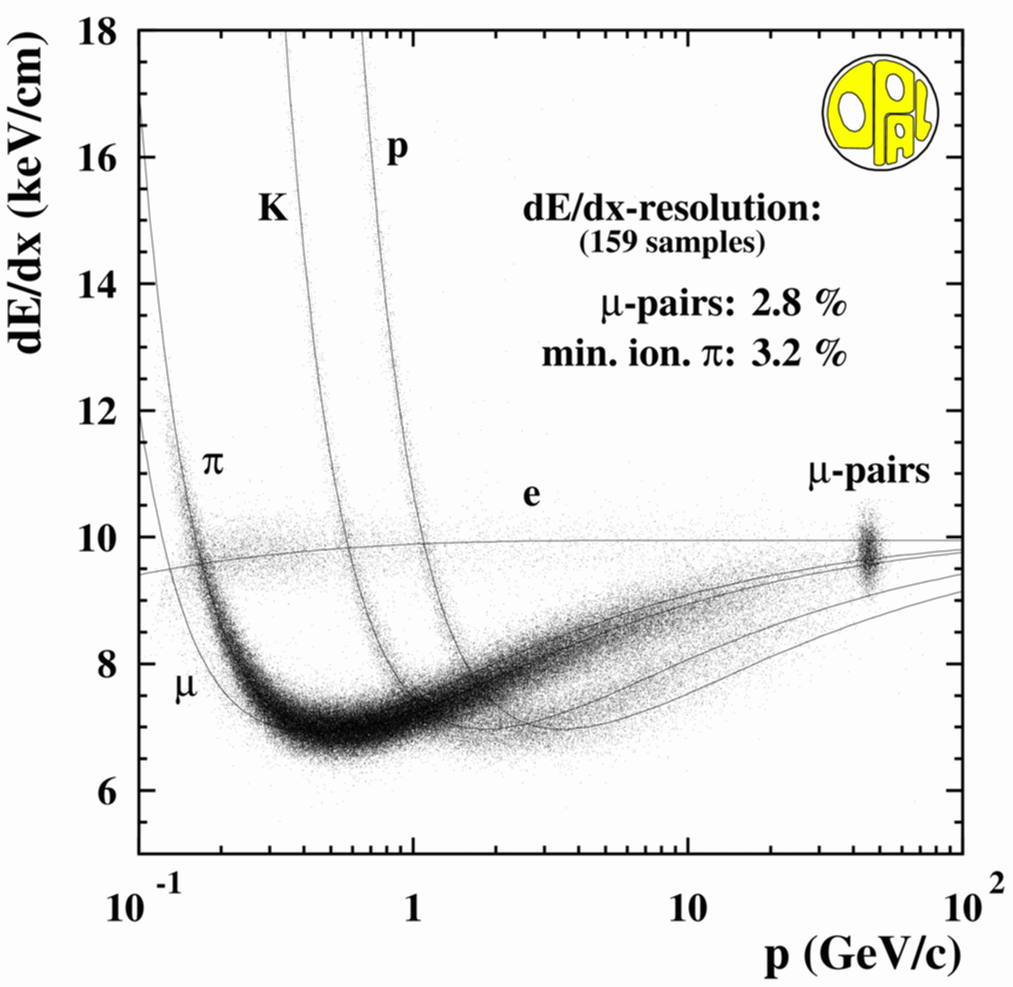
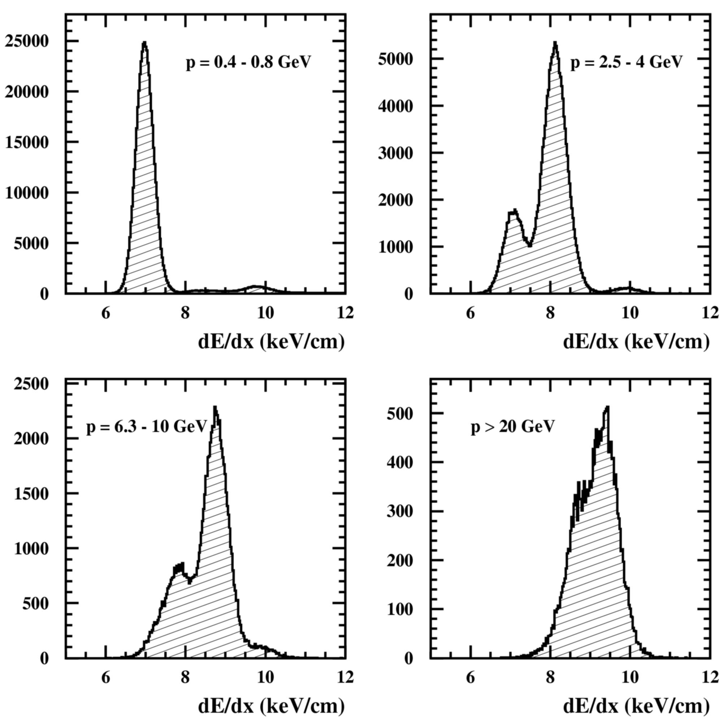

dE/dx resolution
For a specific gas, dE/dx resolution depends on
  effective detector length L (track length x pressure)
  ~ L^{-0.32...-0.36}
  number of samples N
  ~ N^{-0.43...-0.47}
  Long tracks and/or high pressure help
OPAL Jet Chamber
  1.6 m track length, 4 bar pressure
NOT ~ N^{-0.5}
due to non-gaussian
Landau distribution
π
K
p
e
momentum slices

Slide 17
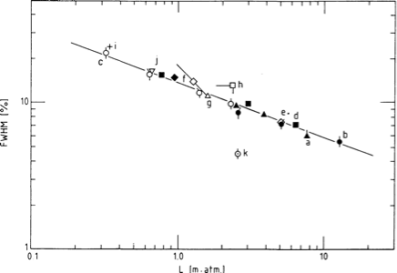
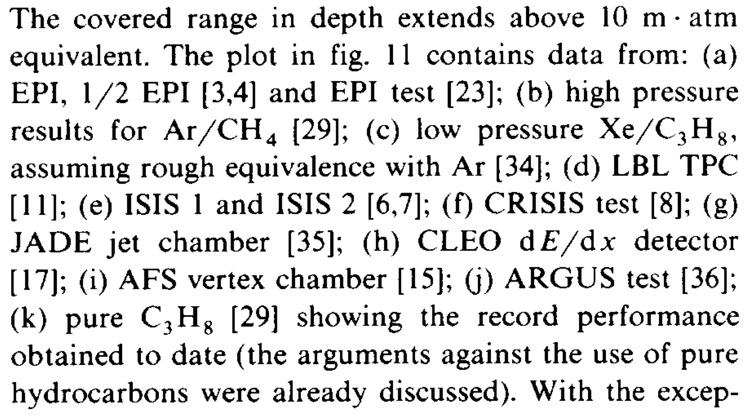

“Lehraus” Plot 1983
First attempt by Ivan Lehraus in 1983 to connect dE/dx resolution and detector size (effective detector length L = track length * pressure)
Results from 14 large detectors used
Fit by Lehraus :
  dE/dx res. = 5.7 * L^{-0.37} (%)
I. Lehraus, NIM 217 (1983) 43-55
dE/dx resolutions achieved in large detectors as a function of the effective detector length.

Slide 18
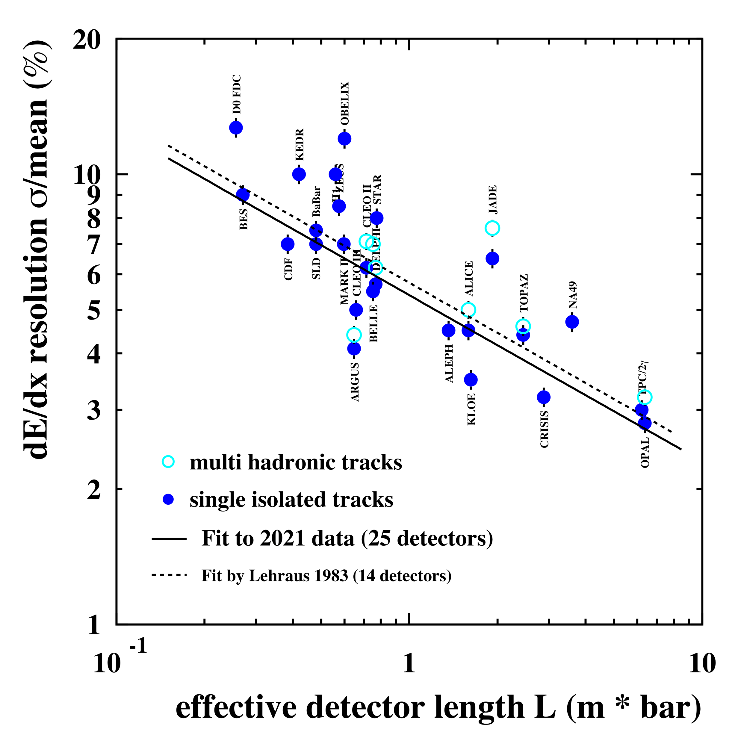

“Lehraus” Plot 2021
dE/dx resolution achieved in large detectors, mainly at e⁺e– colliders, at some hadron colliders and fixed target expts.
Fit by Lehraus 1983:
  dE/dx res. = 5.7 * L^{-0.37} (%)
Fit in 2021 (25 large detectors):
  dE/dx res. = 5.4 * L^{-0.37} (%)
  5.4% typical dE/dx resolution for 1 m track length
  no significant change to 1983
  performance of present generation of detectors as predicted ~40 years ago

Slide 19
dE/dx Resolutions of major Particle Physics Detectors
Input data for the 2021 “Lehraus” plot

Slide 20
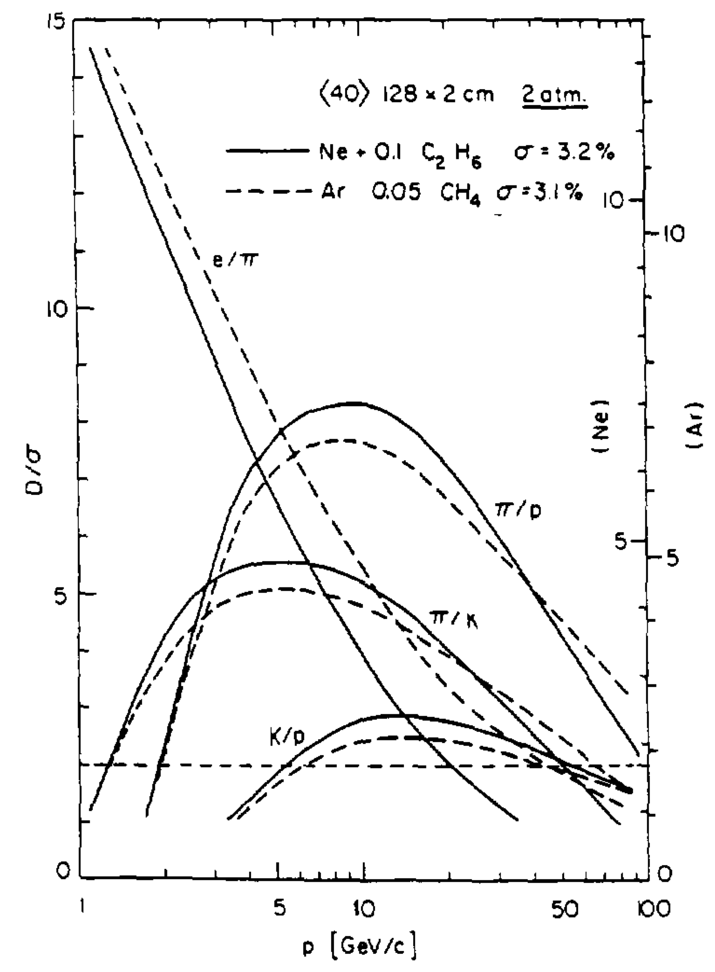



Cluster Counting
Direct cluster counting would avoid any problems with cluster fluctuations, truncated mean etc.
  no charge measurement need, just counting
In theory → ultimate way to measure dE/dx
  30 clusters/cm * 100 cm track length = 3000 clusters
  1.8% dE/dx resolution by cluster counting (statistical error only)
  5.4% dE/dx resolution by charge measurement (Lehraus fit)
Not a brand new idea
  first ideas (1969) by A. Davidenko et al. (JETP, 1969, Vol. 28, No. 2, p. 223)
  Detailed studies in mid-1990s by G. Malamud, A. Breskin, B. Chechik
      cluster statistics
      measurements in low pressure drift chamber
      simulations
      expected particle separation
G. Malamud, A. Breskin, B. Chechik, NIM A 372 (1996) 19-30

Slide 21


Cluster Counting How To?
How to resolve (and count) individual clusters?
  reminder:
    typically 30 clusters/cm at 1 bar in Argon mixtures
    → about 300 µm separated along track on average
    → time separation in fast gases (~50 µm/ns) about 6 ns
Most attempts tried to resolve clusters in time
  however, 6 ns average time separation challenging to resolve them
    need proper detector geometry/principle
      clusters need to arrive sequentially at wires/pads, not simultaneously
    need slow gas with small drift velocity (e.g. CO₂ mixtures, ~10 µm/ns)
      to stretch arrival time of clusters
    need gas with lower cluster density (e.g. He mixtures)
      to further increase time separation between clusters
    need gas with low diffusion
      to avoid dissolution of multi-electron clusters
    gas with good cluster statistics helps too (e.g. He mixtures)
      more single electron clusters, less multi-electron clusters
    requires electronics with sufficient time and multi-hit resolution
      short pulses (proper pulse shaping)

Slide 22
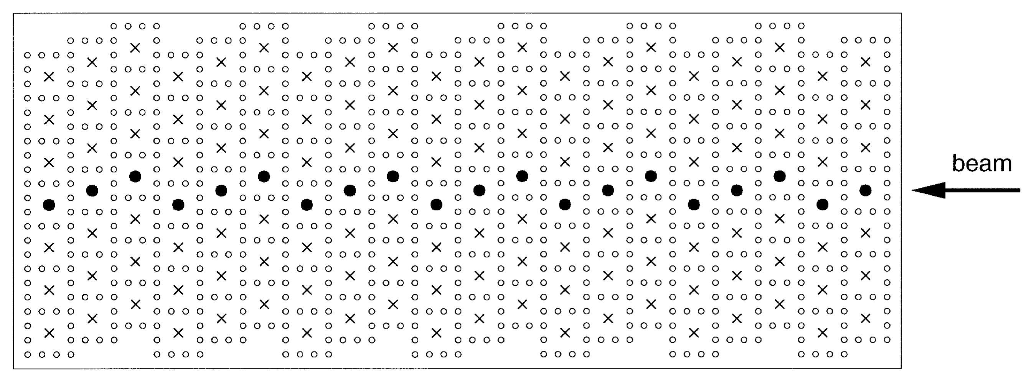
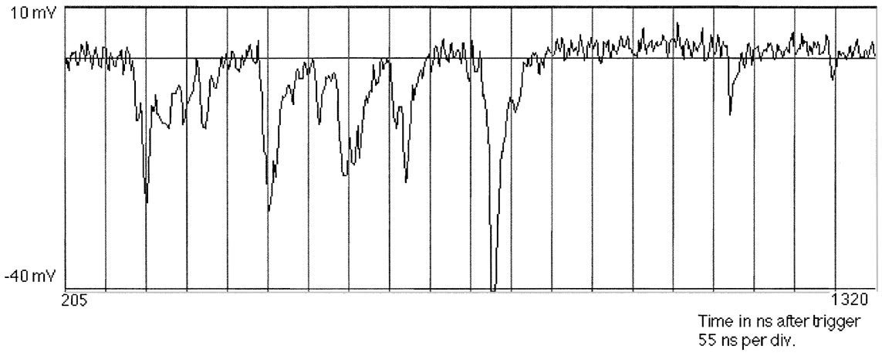
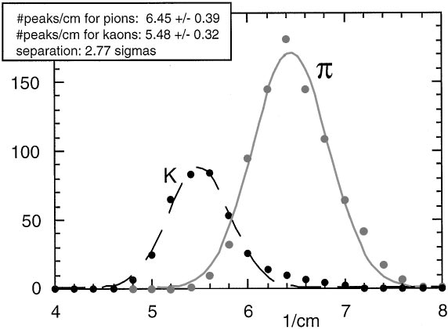
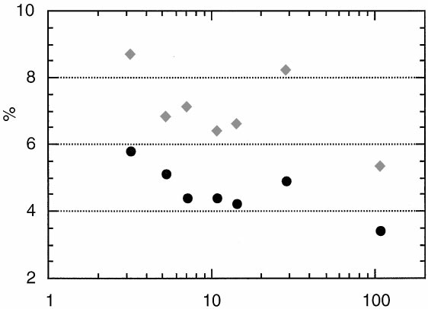
Cluster Counting (by time)
Test beam measurements 1998 using He/CH₄ (80/20)
5 Gsamples/s
1 GHz bandwidth
L. Cerrito et. al, NIM A 436 (1999) 336-340
drift cells
Time
Clusters
3 GeV/c
120 cm
track
length
L. Cerrito et. al, NIM A 434 (1999) 261-270
dE/dx res.
dN/dx
L. Cerrito et. al, NIM A 434 (1999) 261-270
  Cluster Counting works in test beam under controlled conditions
  but not yet used in large scale particle detectors
dN/dx res.
βγ

Slide 23
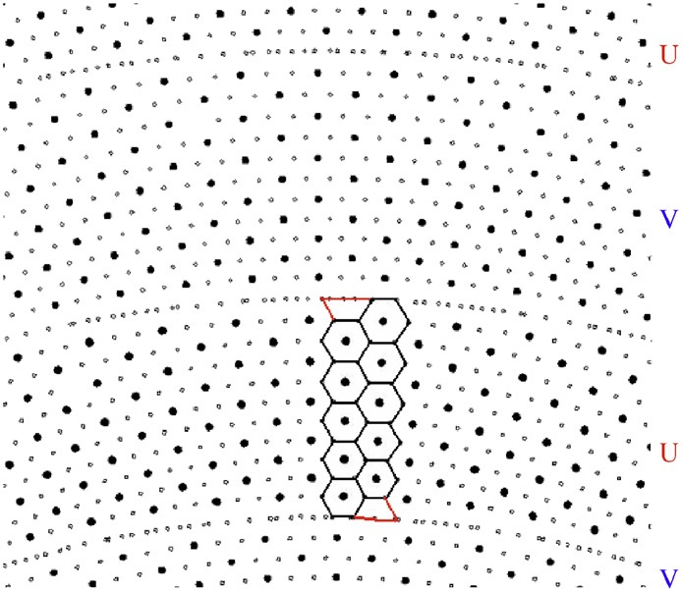
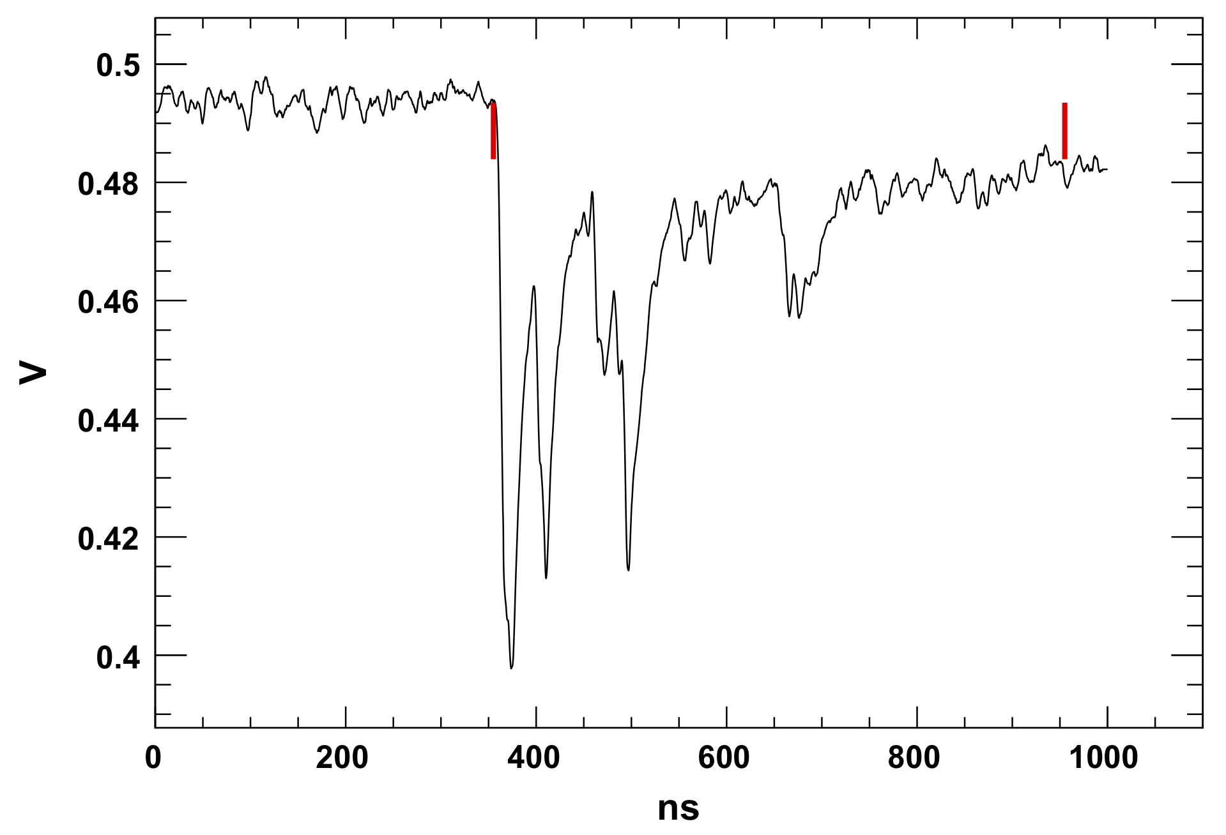
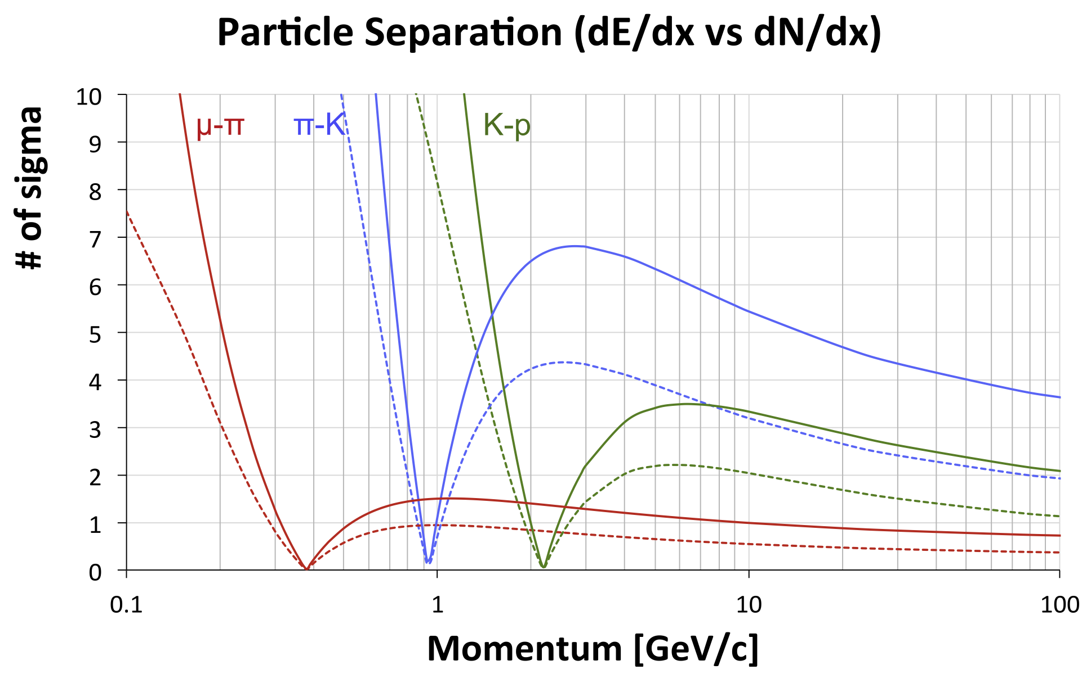
Cluster Counting for Large Detectors
New large detector concepts for future e⁺e– colliders consider cluster counting
  4th detector concept for ILC (discontinued)
    CluCou drift chamber with small drift cells
    He/i-Butane (90/10) gas mixture
  detector for Super-B (discontinued)
    full-length single cell drift chamber prototype
    He/i-Butane (90/10) gas mixture
  IDEA detector for FFC-ee or CEPC
    follow-up of CluCou, small drift cells
    He/i-Butane (90/10) gas mixture
    simulation shows clear advantage of cluster counting vs. classical dE/dx
    assumes 4.2% dE/dx resolution and 80% cluster counting efficiency
R. Perrino et. al,
NIM A 598 (2009) 98-101
J.-F. Caron et al,
NIM A 735 (2014), 169-183
testbeam
simulation
G. Chiarello et. al,
NIM A 936 (2019) 503-504

Slide 24
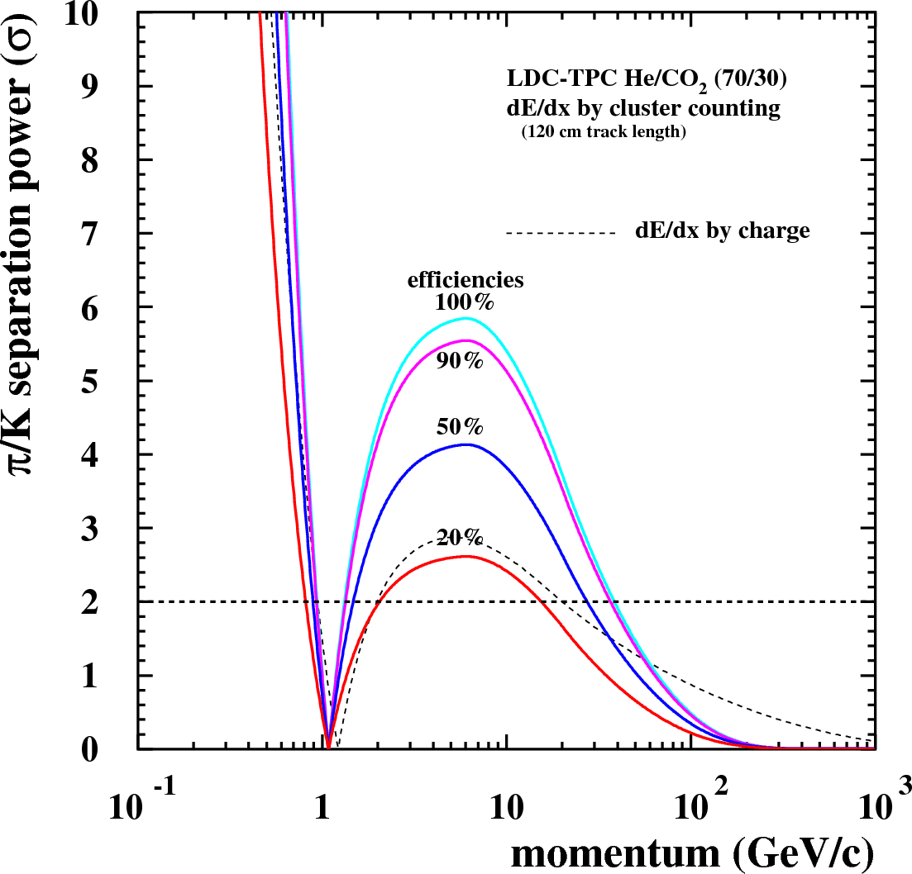
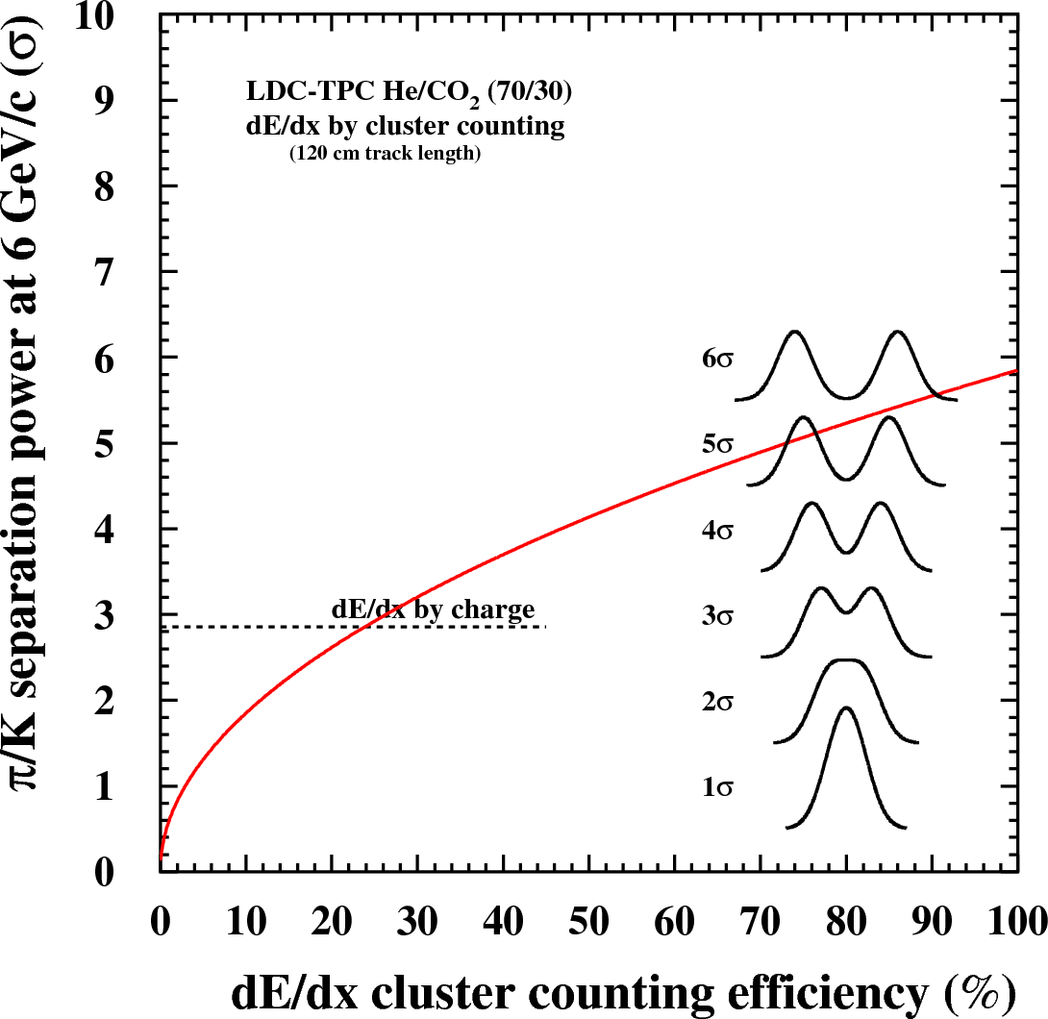
Cluster Counting Efficiency
Cluster Counting is not (never) perfect
  some narrow clusters cannot be resolved
  but cluster counting efficiency >25% sufficient to beat charge measurement
Simulation study for ILD-TPC
with He mixture

Slide 25
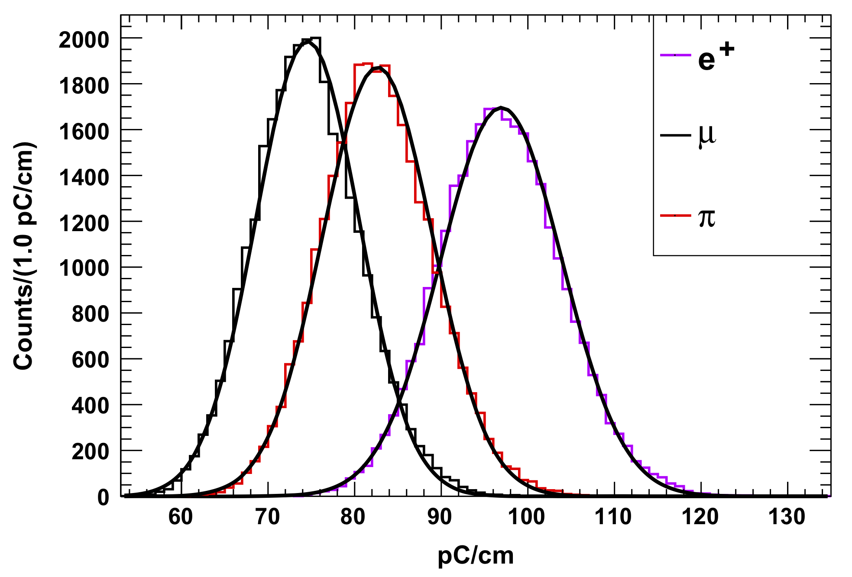
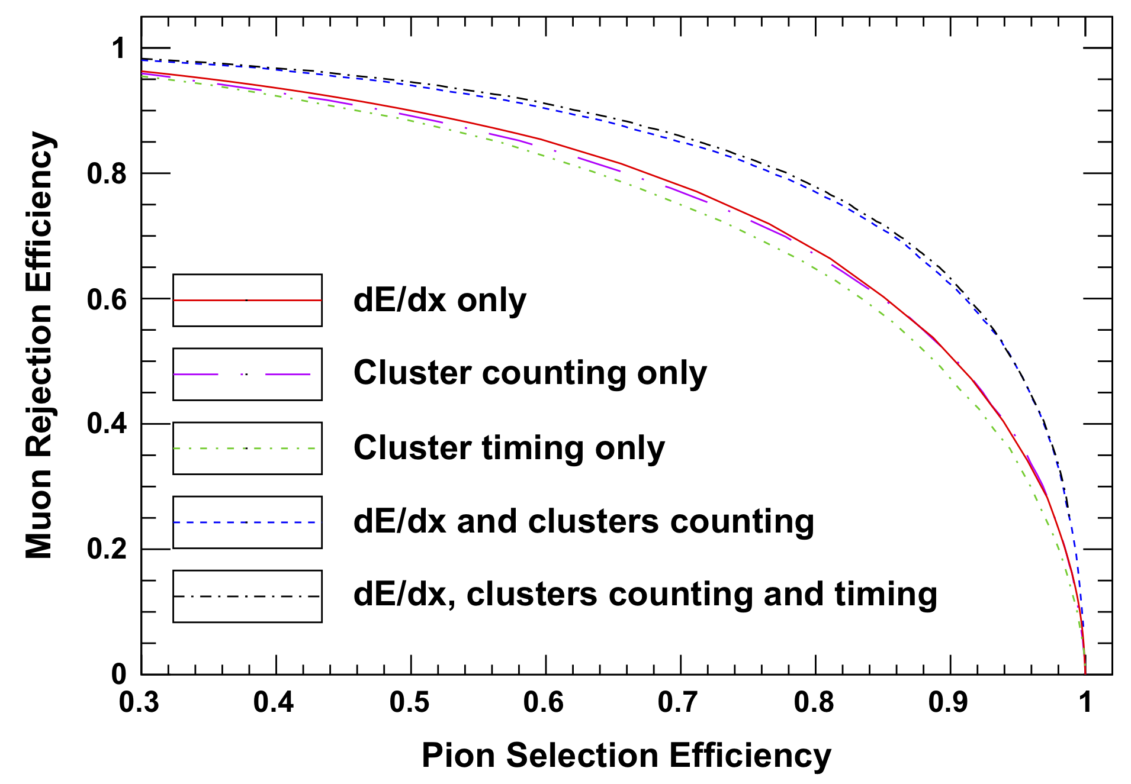
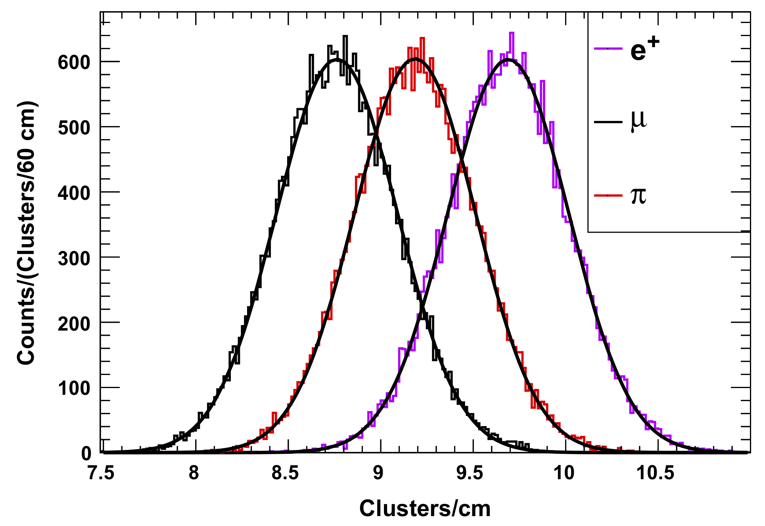
PID Improvement with Cluster Counting
PID improvement demonstrated in the full-length single cell drift chamber prototype for Super-B
  simultaneous charge and cluster counting measurement
dE/dx
by charge
210 MeV/c
J.-F. Caron et al, NIM A 735 (2014), 169-183
J.-F. Caron et al, NIM A 735 (2014), 169-183
at 210 MeV/c: similar PID capabilities
of dE/dx only and of Cluster Counting only
improved PID performance by
combination of both
cluster counting
dN/dx

Slide 26
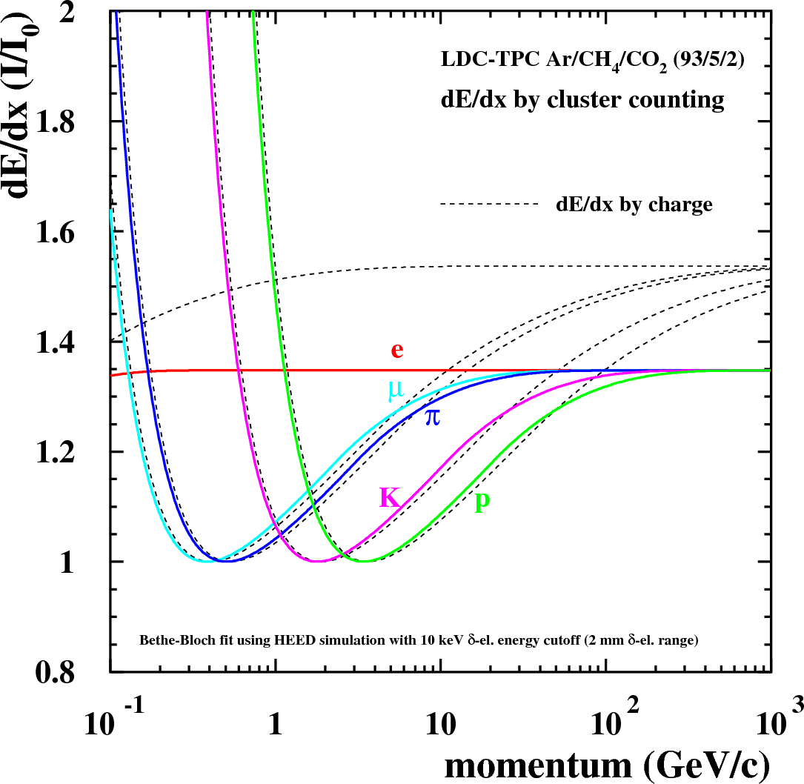
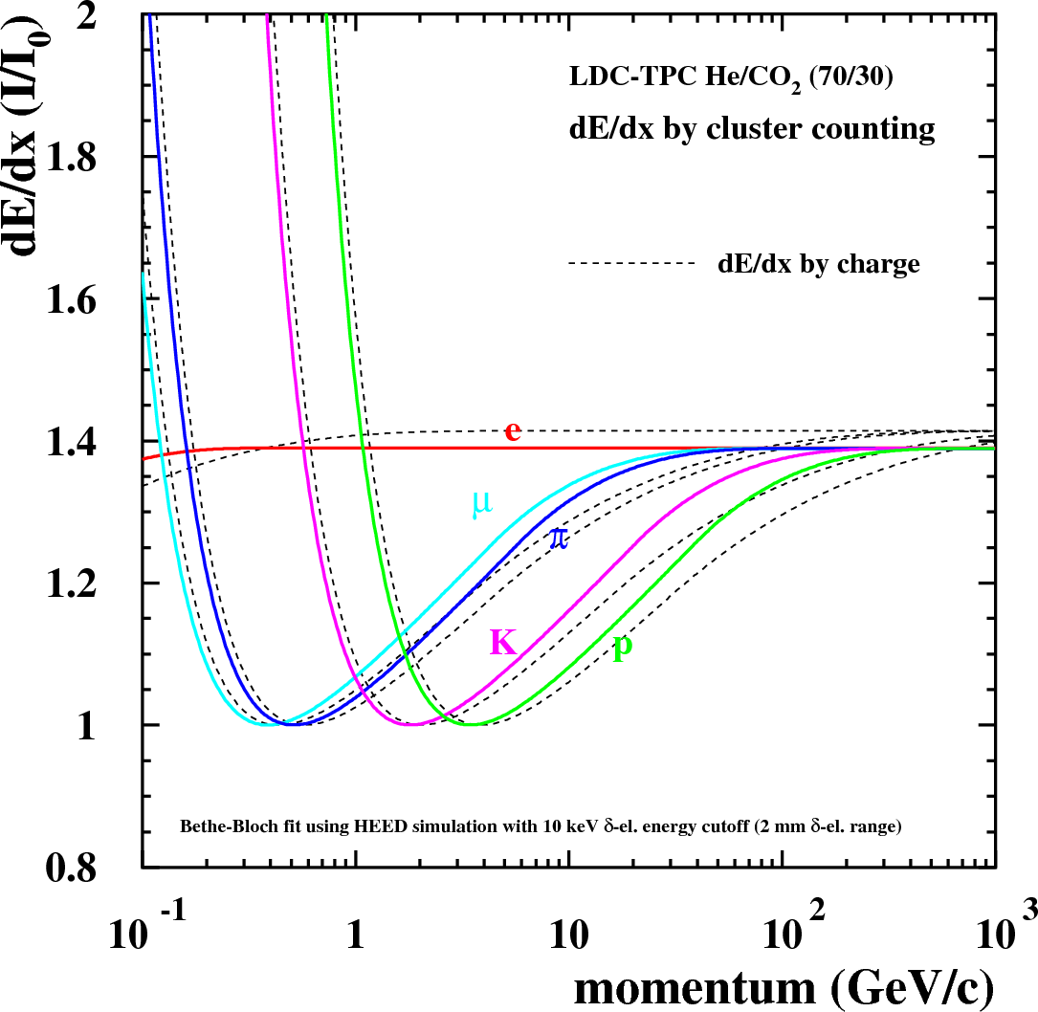
Bethe-Bloch with Cluster Counting
Different Bethe-Bloch functions for dE/dx (by charge) and dN/dx (by cluster counting)
  relativistic rise differs (important for particle separation)
      charge measurement is highly sensitive to secondary electrons
      more secondary electrons (deltas) at higher momenta → larger tails in Landau distribution
      (perfect) cluster counting ignores them → relativistic rise “truncated”
  more different at Argon than at Helium (fewer secondary electrons in Helium)
Simulation study for ILD-TPC
Argon
mixture
Helium
mixture

Slide 27
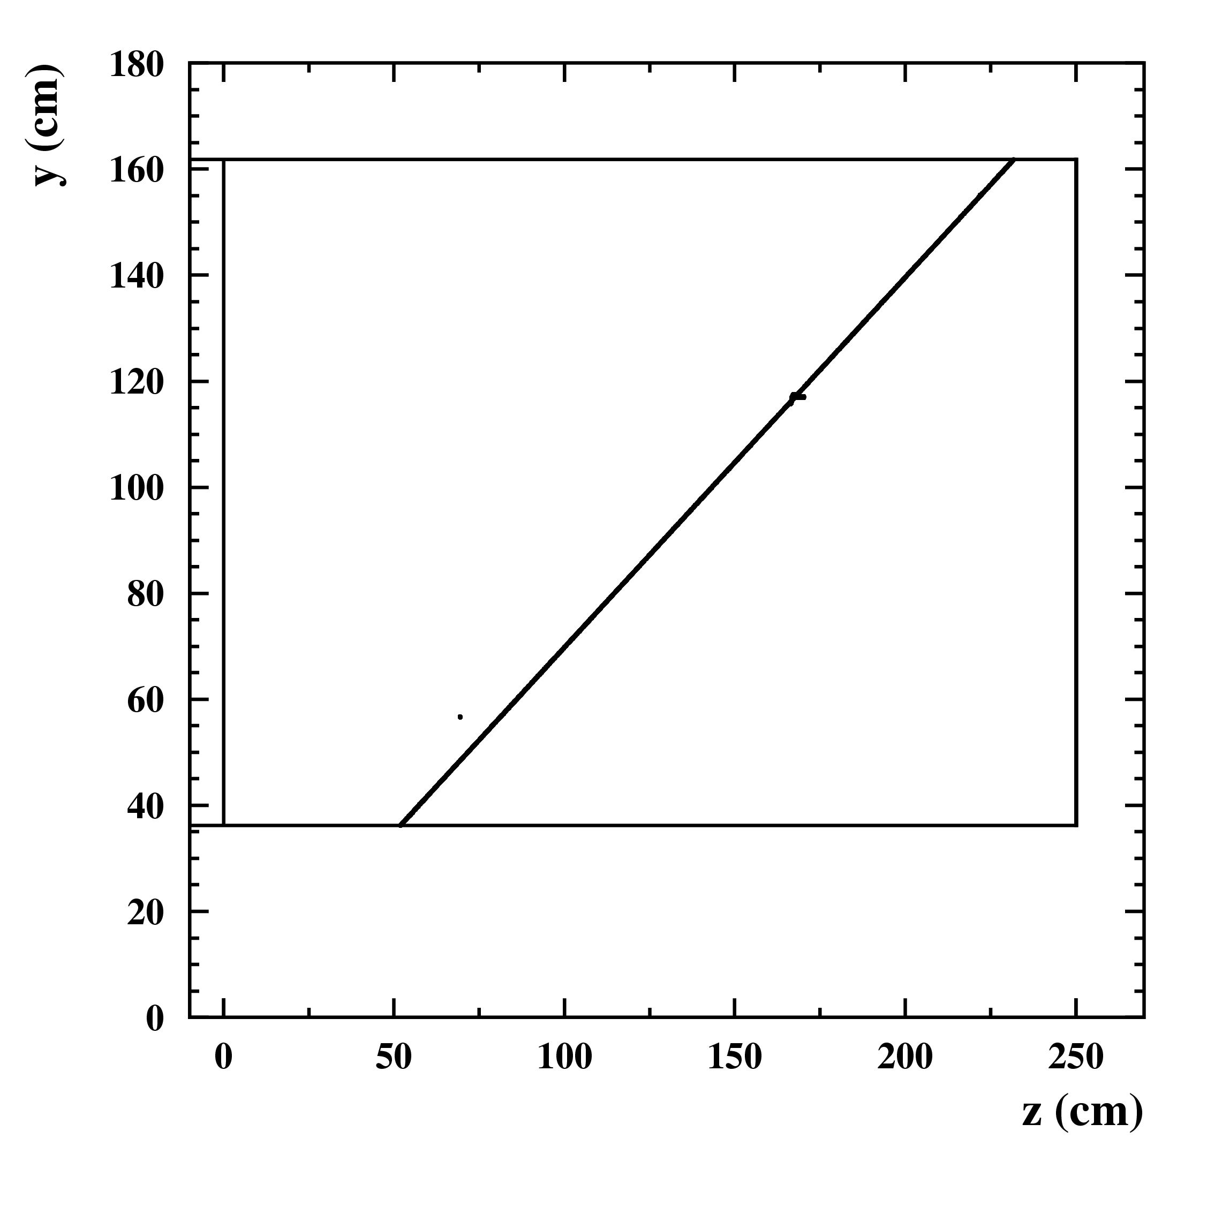
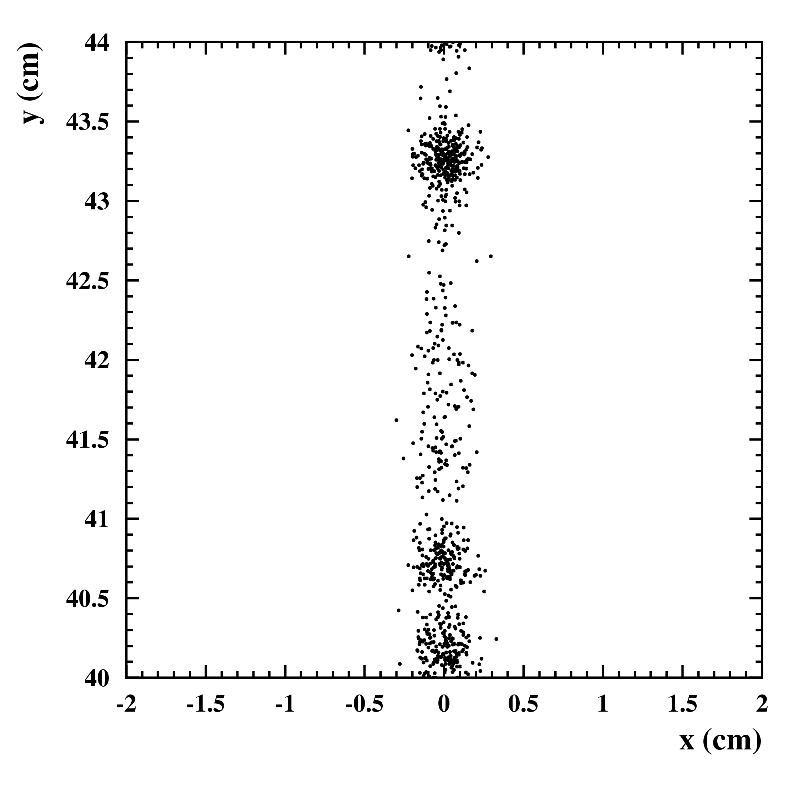
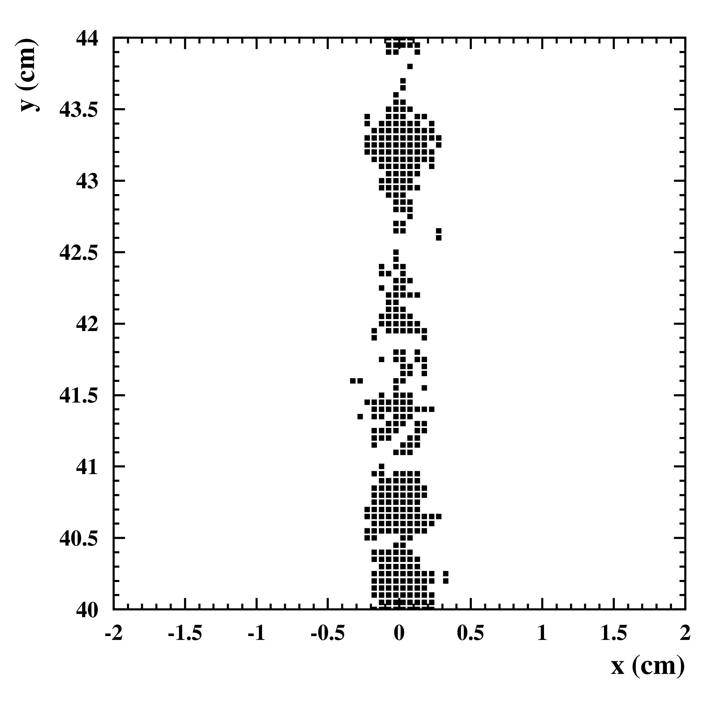
Cluster Counting in 2D
Cluster Counting so far based on time measurement in small drift cells
Future TPCs with micro-pattern devices (GEMs/MicroMegas) + small pads/pixels have high granularity
  could make it possible to resolve clusters in space (2D imaging)
  if time could be added → even 3D positions in space
single track (clusters)
Simulation study for ILD-TPC
with GEMs and small pads
TPC frame
(sideview)
endplate with GEMs or MicroMegas
projection of single electrons
on endplate
pad response (0.5 x 0.5 mm²)
above threshold (1500 e⁻)

Slide 28
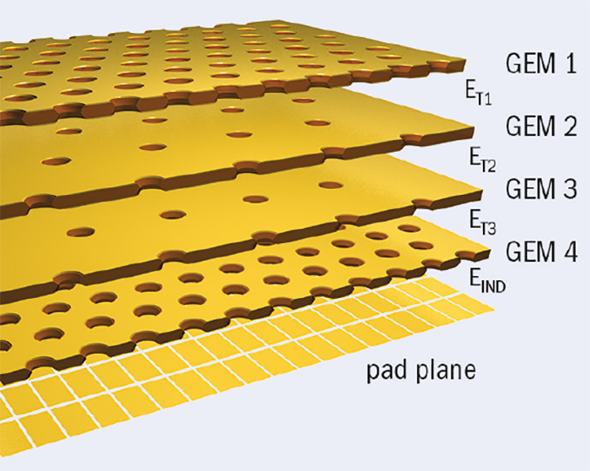
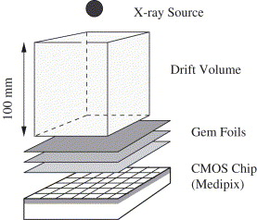
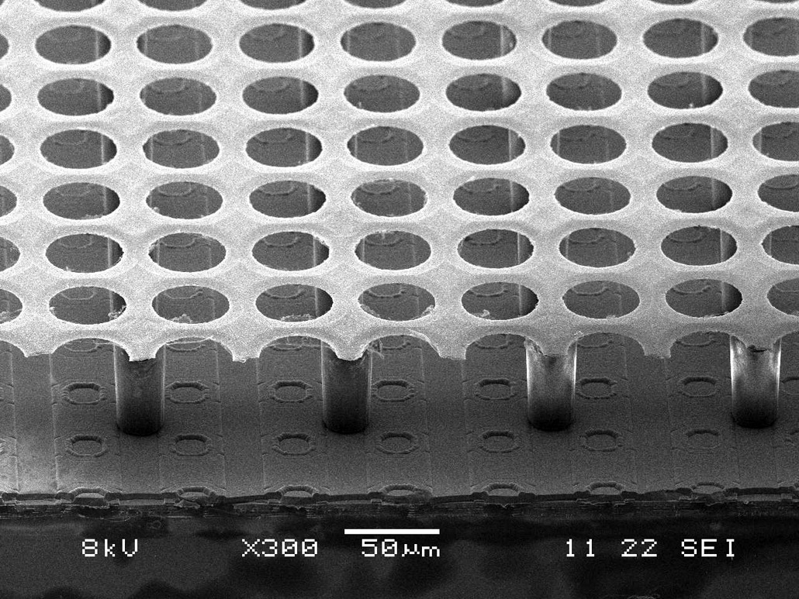
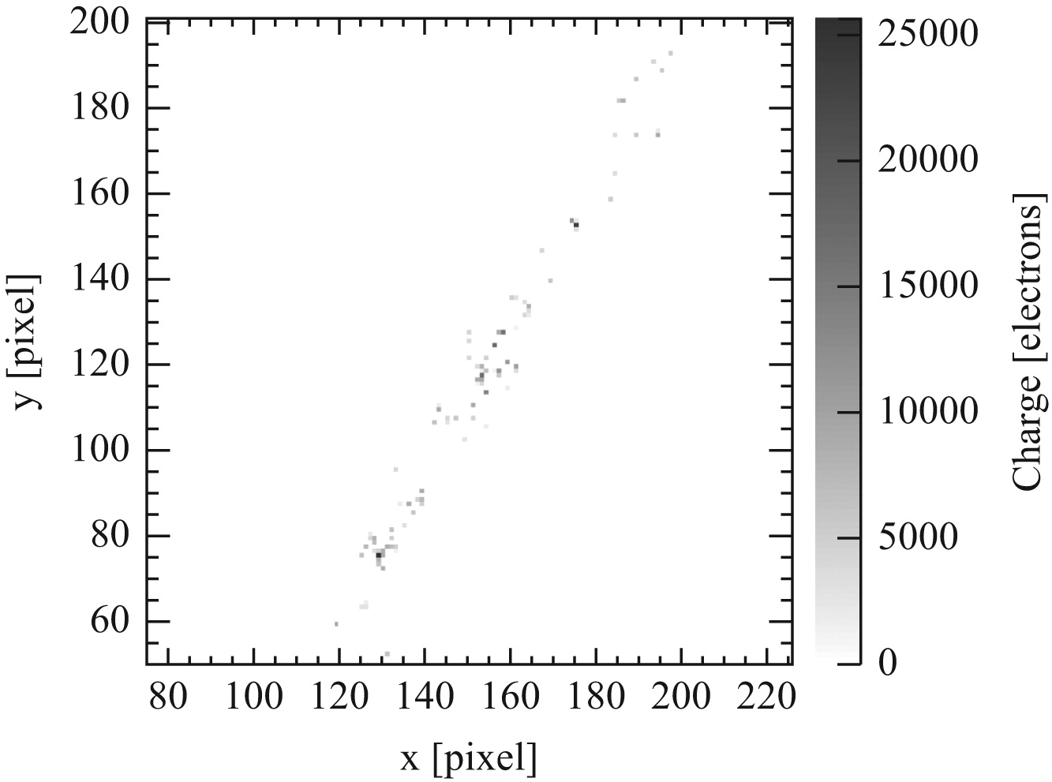
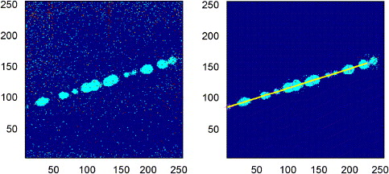
TPC with Cluster Counting
Different endplate technologies suitable for Cluster Counting
Visible individual clusters
Multiple-GEMs with conventional (passive) pads
Multiple-GEMs with TimePix
(active pads, 55 x 55 µm²)
InGrid / GridPix = MicroMegas on top of TimePix
(active pads, 55 x 55 µm²)
ALICE TPC-upgrade + ILD TPC
cosmic ray track
electron track
from ¹⁰⁶Ru source in Ar/CO₂ (70/30)
“blobs” due to diffusion in GEM stack
before noise
suppression
after noise
suppression
A. Bamberger et al, NIM A 573 (2007), 361-370
C. Krieger et al, NIM A 729 (2013), 905-909
14 mm
14 mm

Slide 29
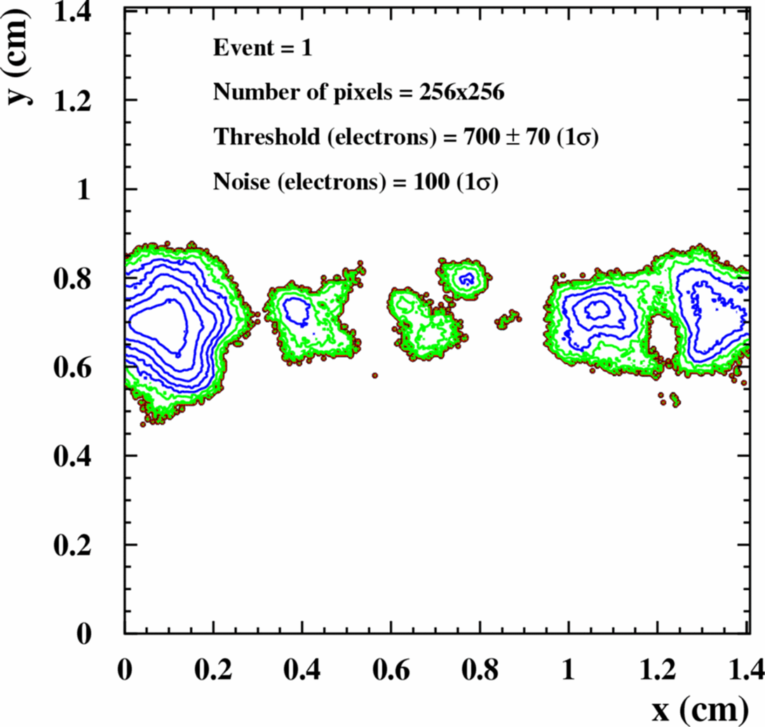
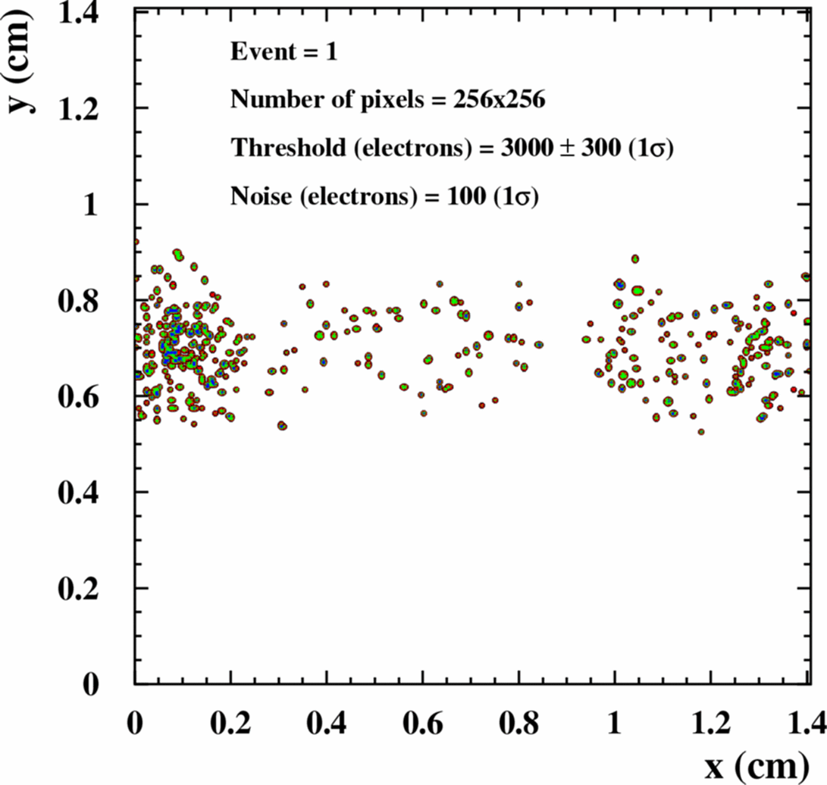
Counting Clusters
How to properly count clusters in space (2D)?
  need cluster finding algorithm
  difficult to find clusters dissolved by diffusion
  efficiency also strongly depending on drift length
  + electronics thresholds + noise
Cluster counting in space sensitive to quite some systematics
ILD-TPC simulated 100 GeV muon, 100 cm drift
identical events: same generated primary clusters/electrons
triple-GEM + TimePix
MicroMegas on top of TimePix (InGrid)

Slide 30
Conclusions
Classical PID with dE/dx by charge measurement established since many decades at large detectors
  dE/dx resolution depends on track length x pressure
  ”Lehraus” plot still valid, no miracles to be expected
Cluster Counting promises up to ~3x better dE/dx resolution (~2x better separation power)
  two ways to count clusters
    resolve clusters either in time (small drift cells)
      He mixtures needed, slow gas, fast electronics needed
    or resolve them in space (TPC with micropattern + pad/pixel endplates)
      diffusion plays key role, needs good cluster finding algorithm
      large systematics expected, e.g. depending on drift length
Cluster Counting can be complementary to classical dE/dx by charge → but no miracles to be expected for PID

