Slide 1
Probabilistic Numeric Convolutional Neural Networks (Finzi et al 2020)
Discussion Leader:
Shah Rukh Qasim

Slide 2
Introduction
Essentially: Extension of CNNs to continuous signals that are irregularly sampled (I can’t help but think about HGCal) done using Gaussian Processes (GP) to fill the gaps and numerical methods for approximations (and proofs?).
Dataset used (one of them): Superpixel MNIST is an adaptation of the MNIST dataset where the 784 pixels of the original images are replaced by 75 salient superpixels that are non uniformly spread throughout the domain and are different for each image (Monti et al., 2017).
Imagine HGCal data or any calorimetric data: Is the underlying signal continuous?

Slide 3
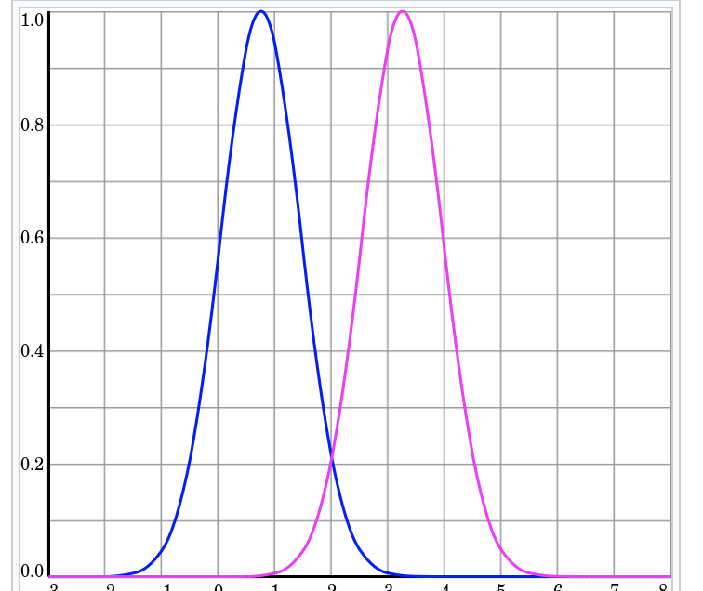
Gaussian Processes
Let’s start with a nice animation here:
https://distill.pub/2019/visual-exploration-gaussian-processes/
Done using covariance, mean matrix
Simple calculation using cov/mean matrix
Source: wikipedia

Slide 4
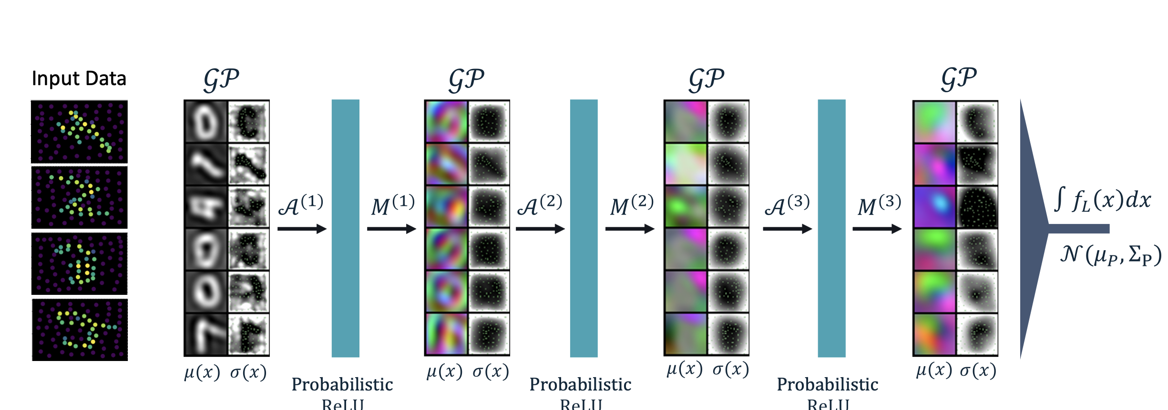
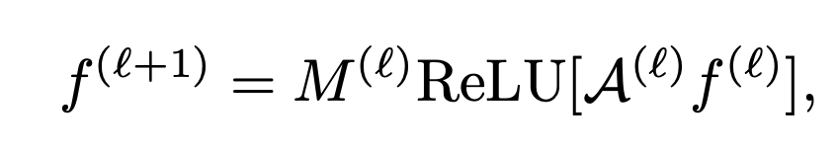
Hollistic view
Discuss HGCal data again
Challenge with windowing
Can we take the whole calorimeter?

Slide 5

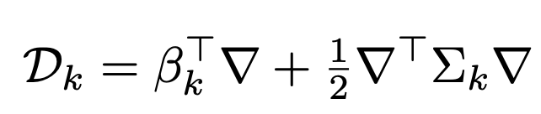

PNCNNs
$e^{D_{k}}$ is diffusion equation
For discrete case it can be defined as
[Page 4 of the paper]

Slide 6
Application to radial basis kernal (RBF)
Closed form solution of mean/variance
Then reduces to simple convolution
Discuss from the paper [Page 5]

Slide 7
Channel mixing
After non-linearity, can’t go with gaussian process assumption
Thanks to central limit theorem, after mixing channels, you get gaussian assumption back

Slide 8



Training procedure
Channel mixing, diffision:
Hyperparameters of kernel
Loss is
[Go to paper page 7, equation 11 to discuss exact loss function]

Slide 9
Final Remarks
Should definitely be looked into
We can start with HGCal data with single particle shot into it and try to regress a class or energy
Or the toyset
Code available

