Slide 1
HTS Demonstrator Design Overview
T. Lehtinen

Slide 2
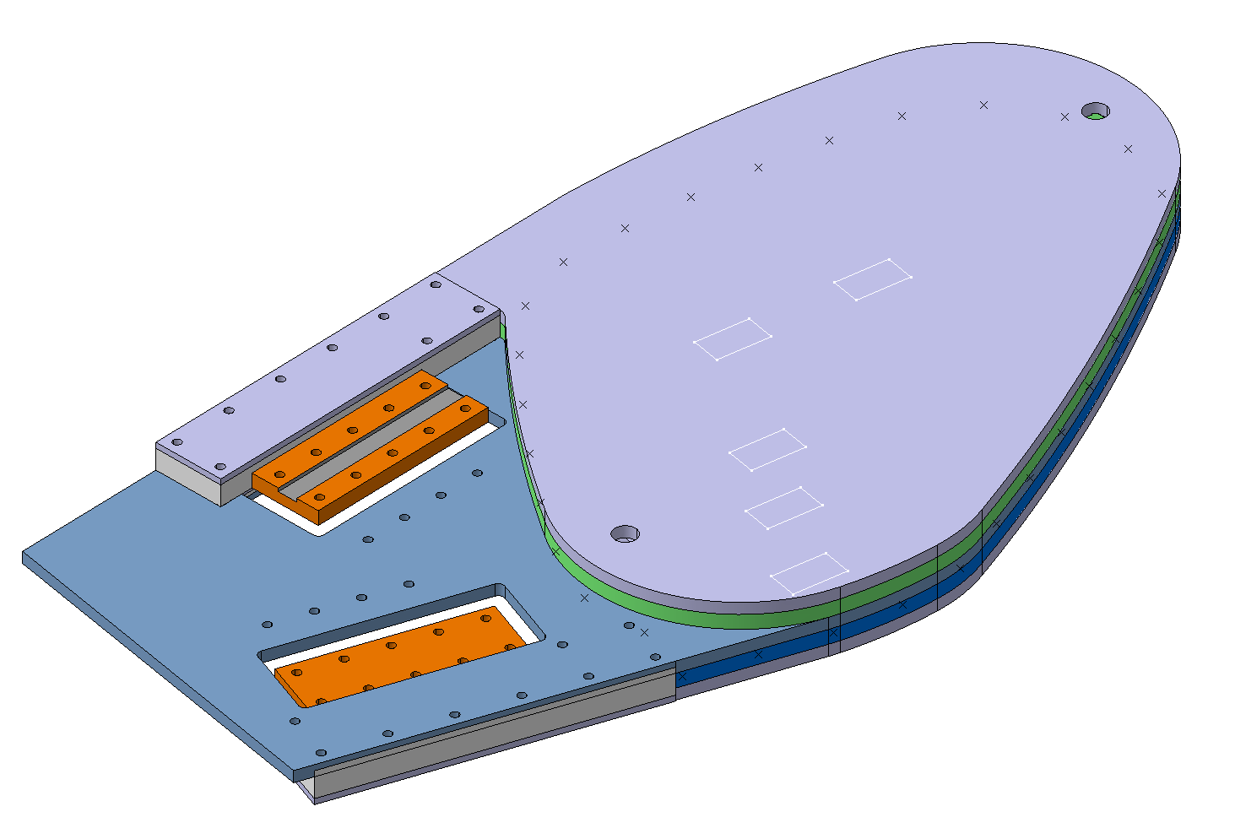
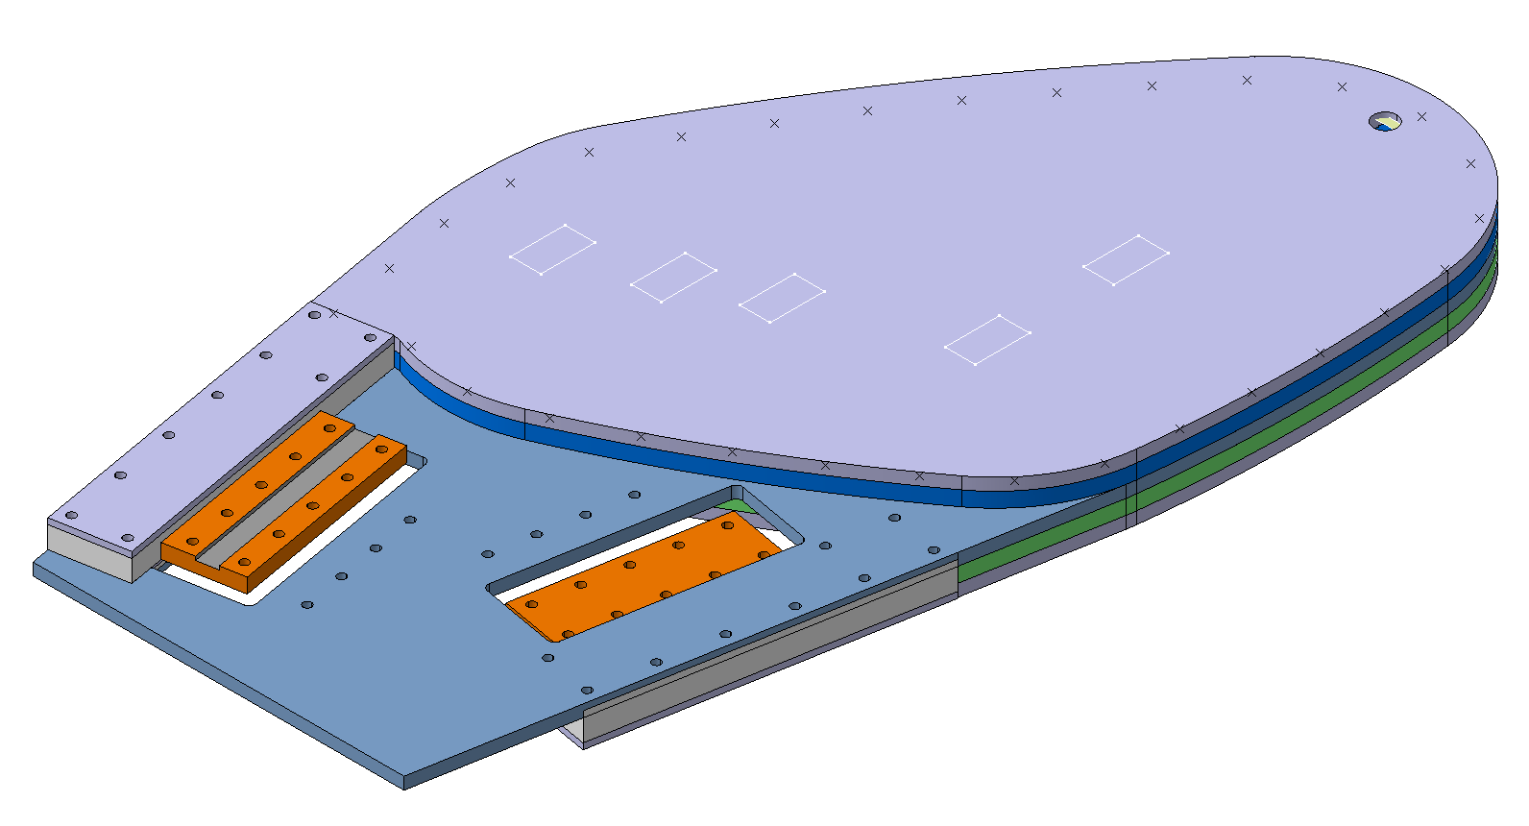
Overview of both sides

Slide 3
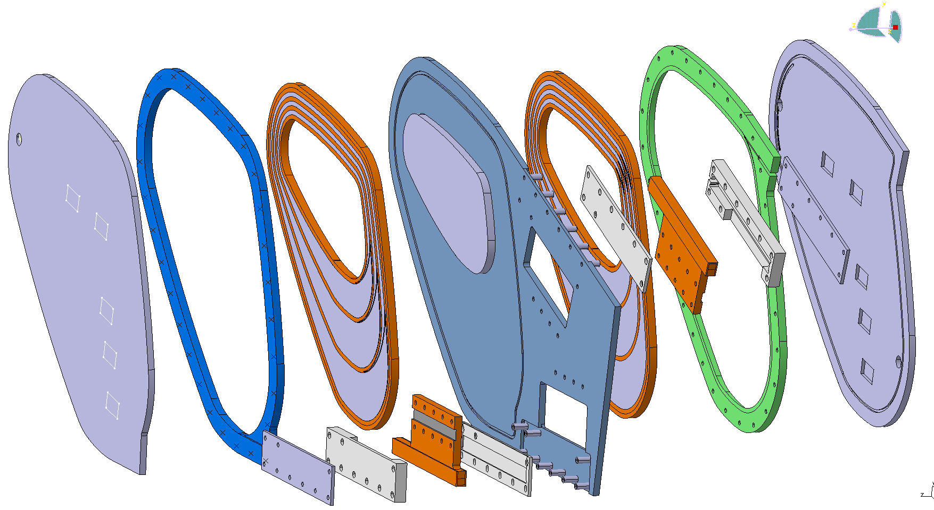
Outer rim
Intermediate plate with pole
Coil with spacers
Outer rim
Cover plate
Coil with spacers
Cover plate
Current joint with HTS staircase
Cover plate
Insulation casing
Insulation base
Insulation tubes

Slide 4
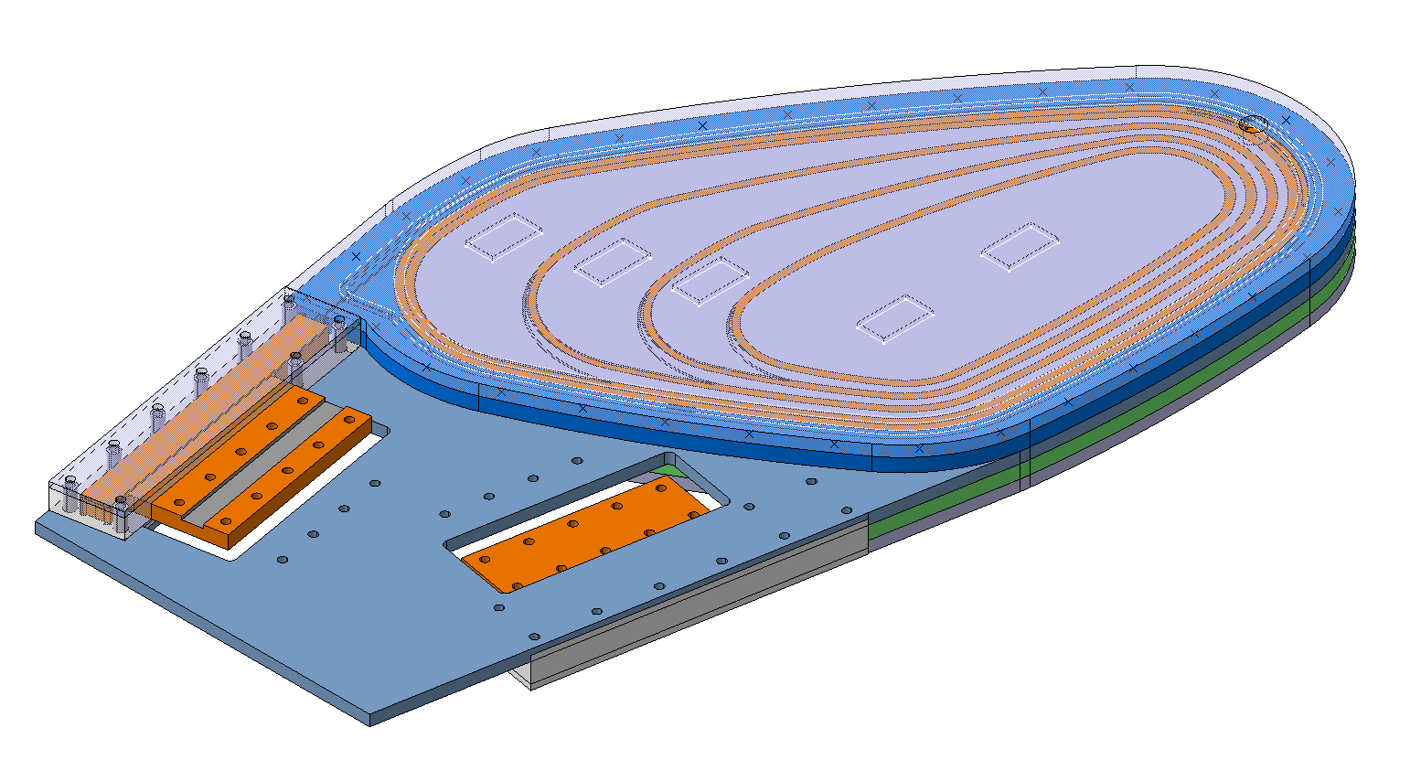
Current joint
Through-bolted

Slide 5
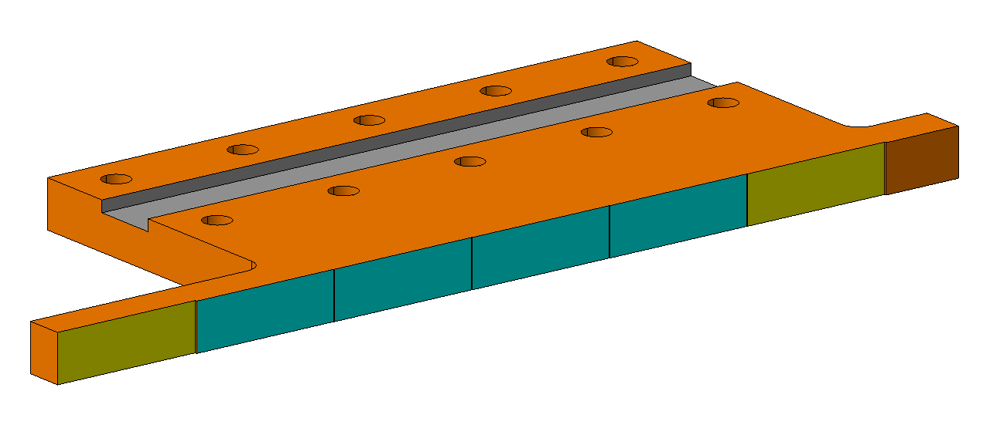
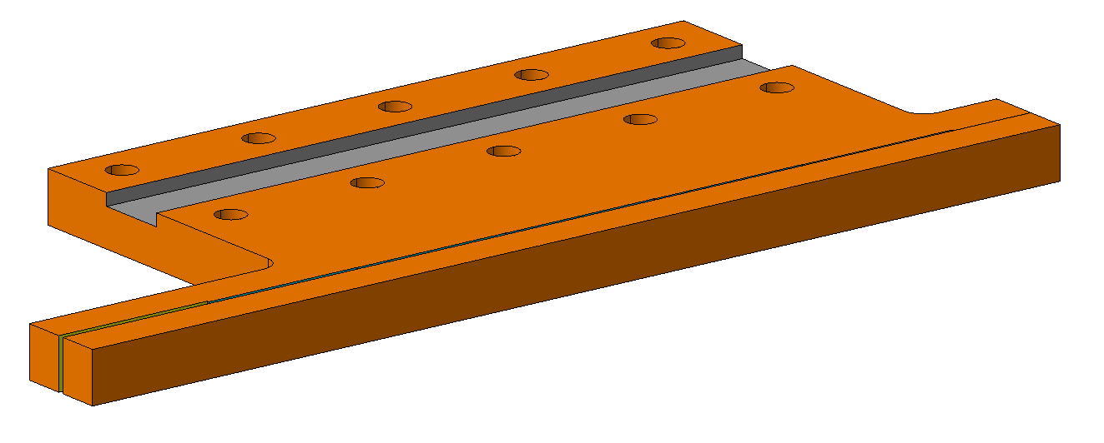
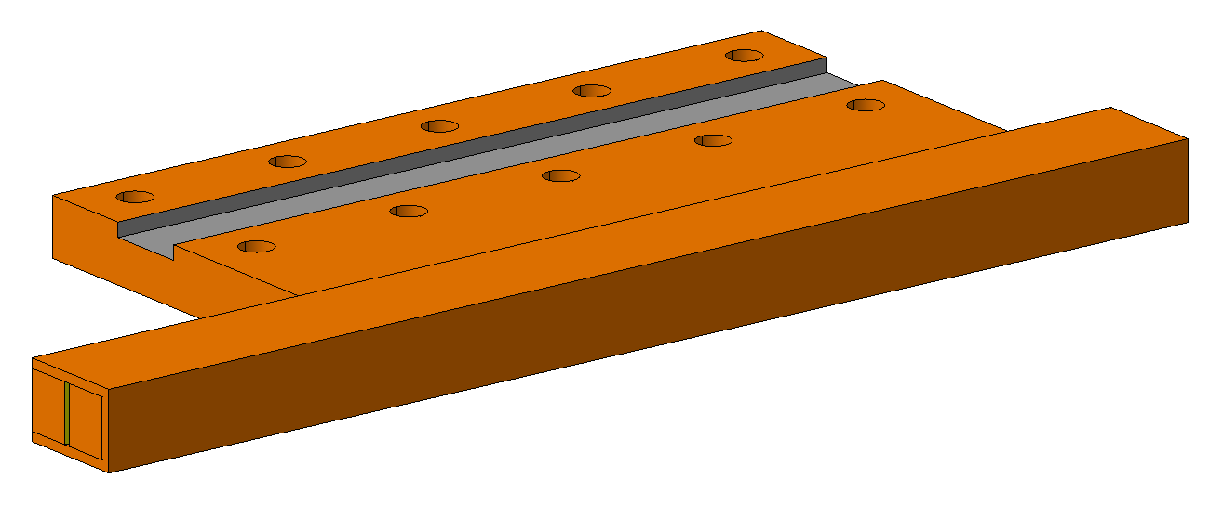
HTS Staircase
Staircase and cable groove
Backing piece for staircase
Channel piece to encapsulate staircase

