Slide 1
Mechanics and magnetics update
Studies for the GaToroid Demonstrator Magnet

Slide 2
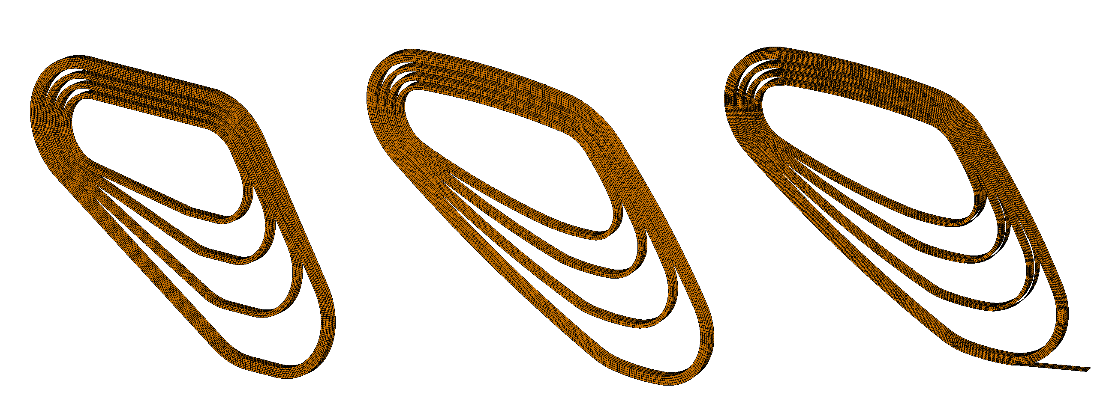
Magnetics
Models

Slide 3
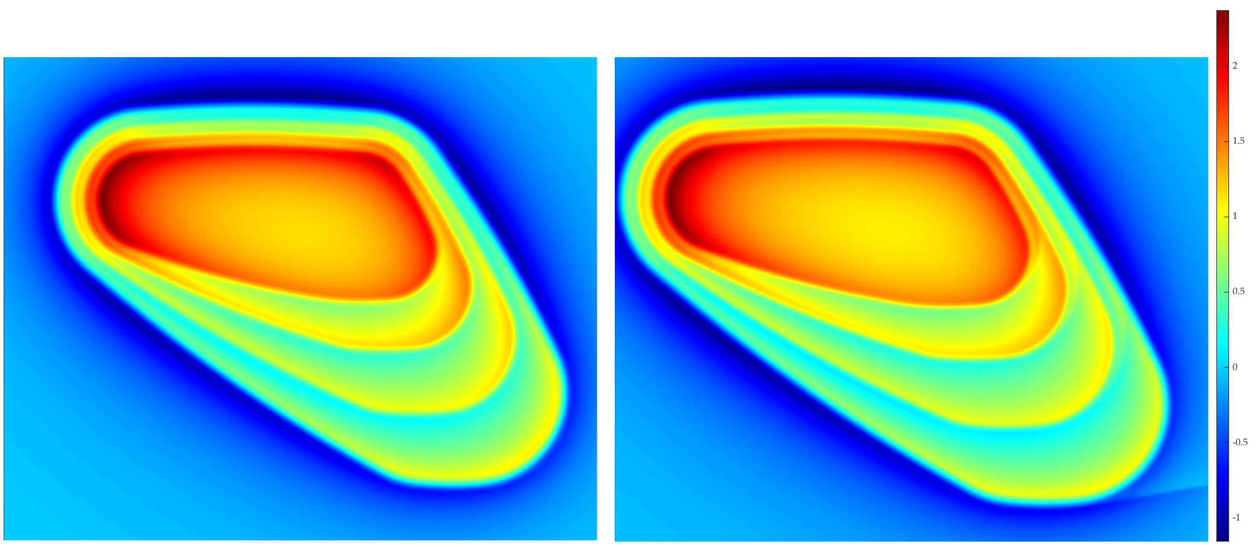
Results in terms of field maps

Slide 4
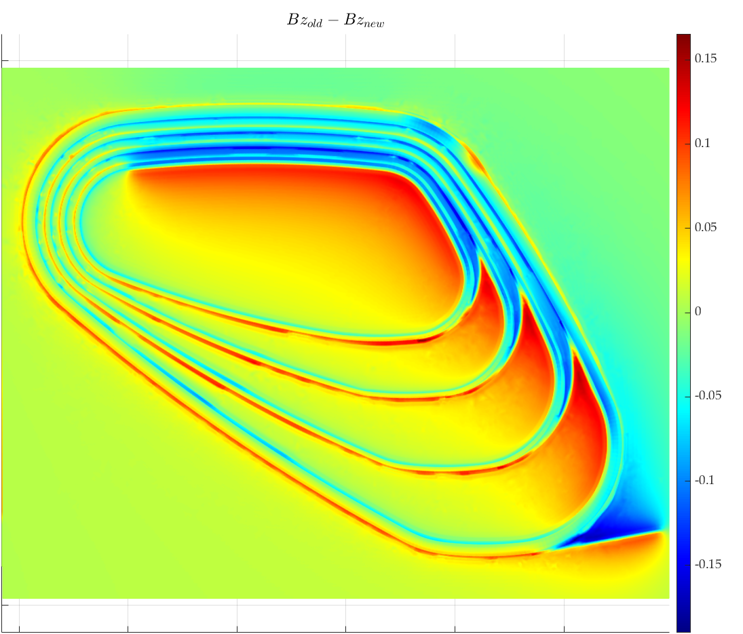
Computed field differences (Bz)

Slide 5
Some numerical values
 | Straight Cables | Curved (no jumps) | Final
|B|_{max} on cables | 2.886 T | 2.871 T | 3.09 T
|B|_{max} | 3.02 T | 3.03 T | 3.13 T
Bz_{max} | 2.97 T | 2.996 T | 3.10 T
Fx | 82.71 N | 21.88 N | 679 N
Fy | 134.41 N | 40.16 N | 553 N
Fz | 101.5 kN | 109,1 kN | 104,5 kN

Slide 6
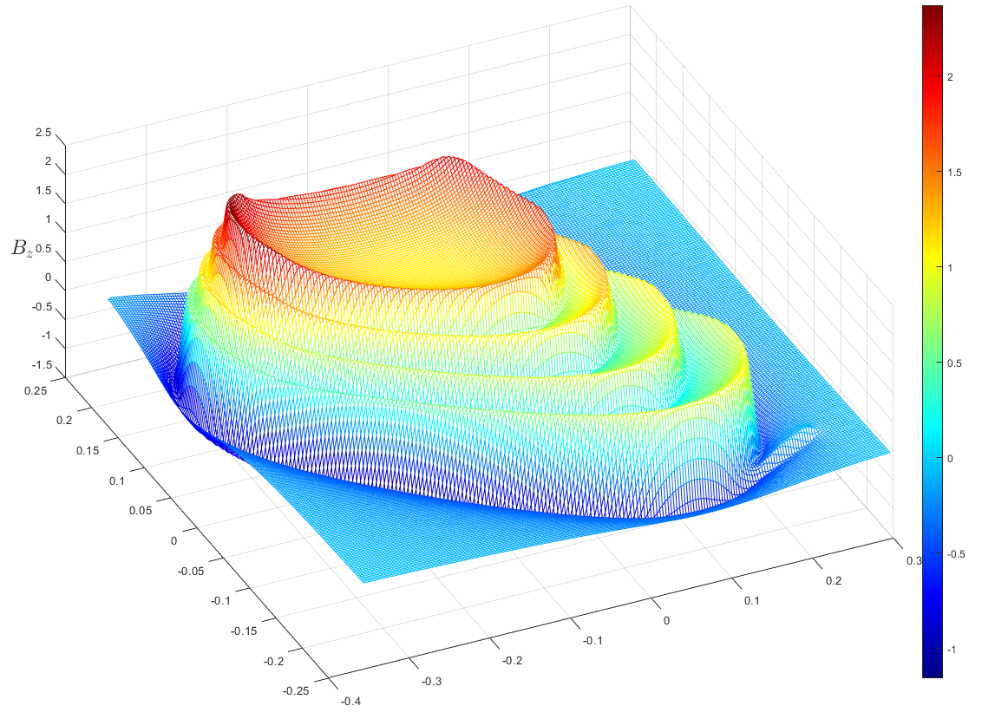
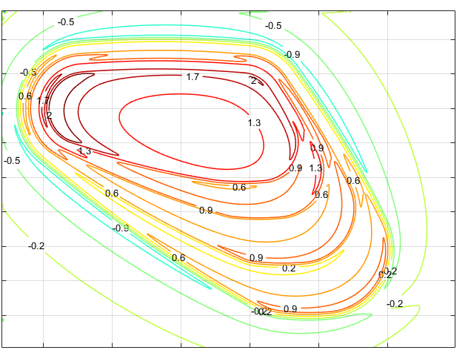
Other ways of visualization

Slide 7
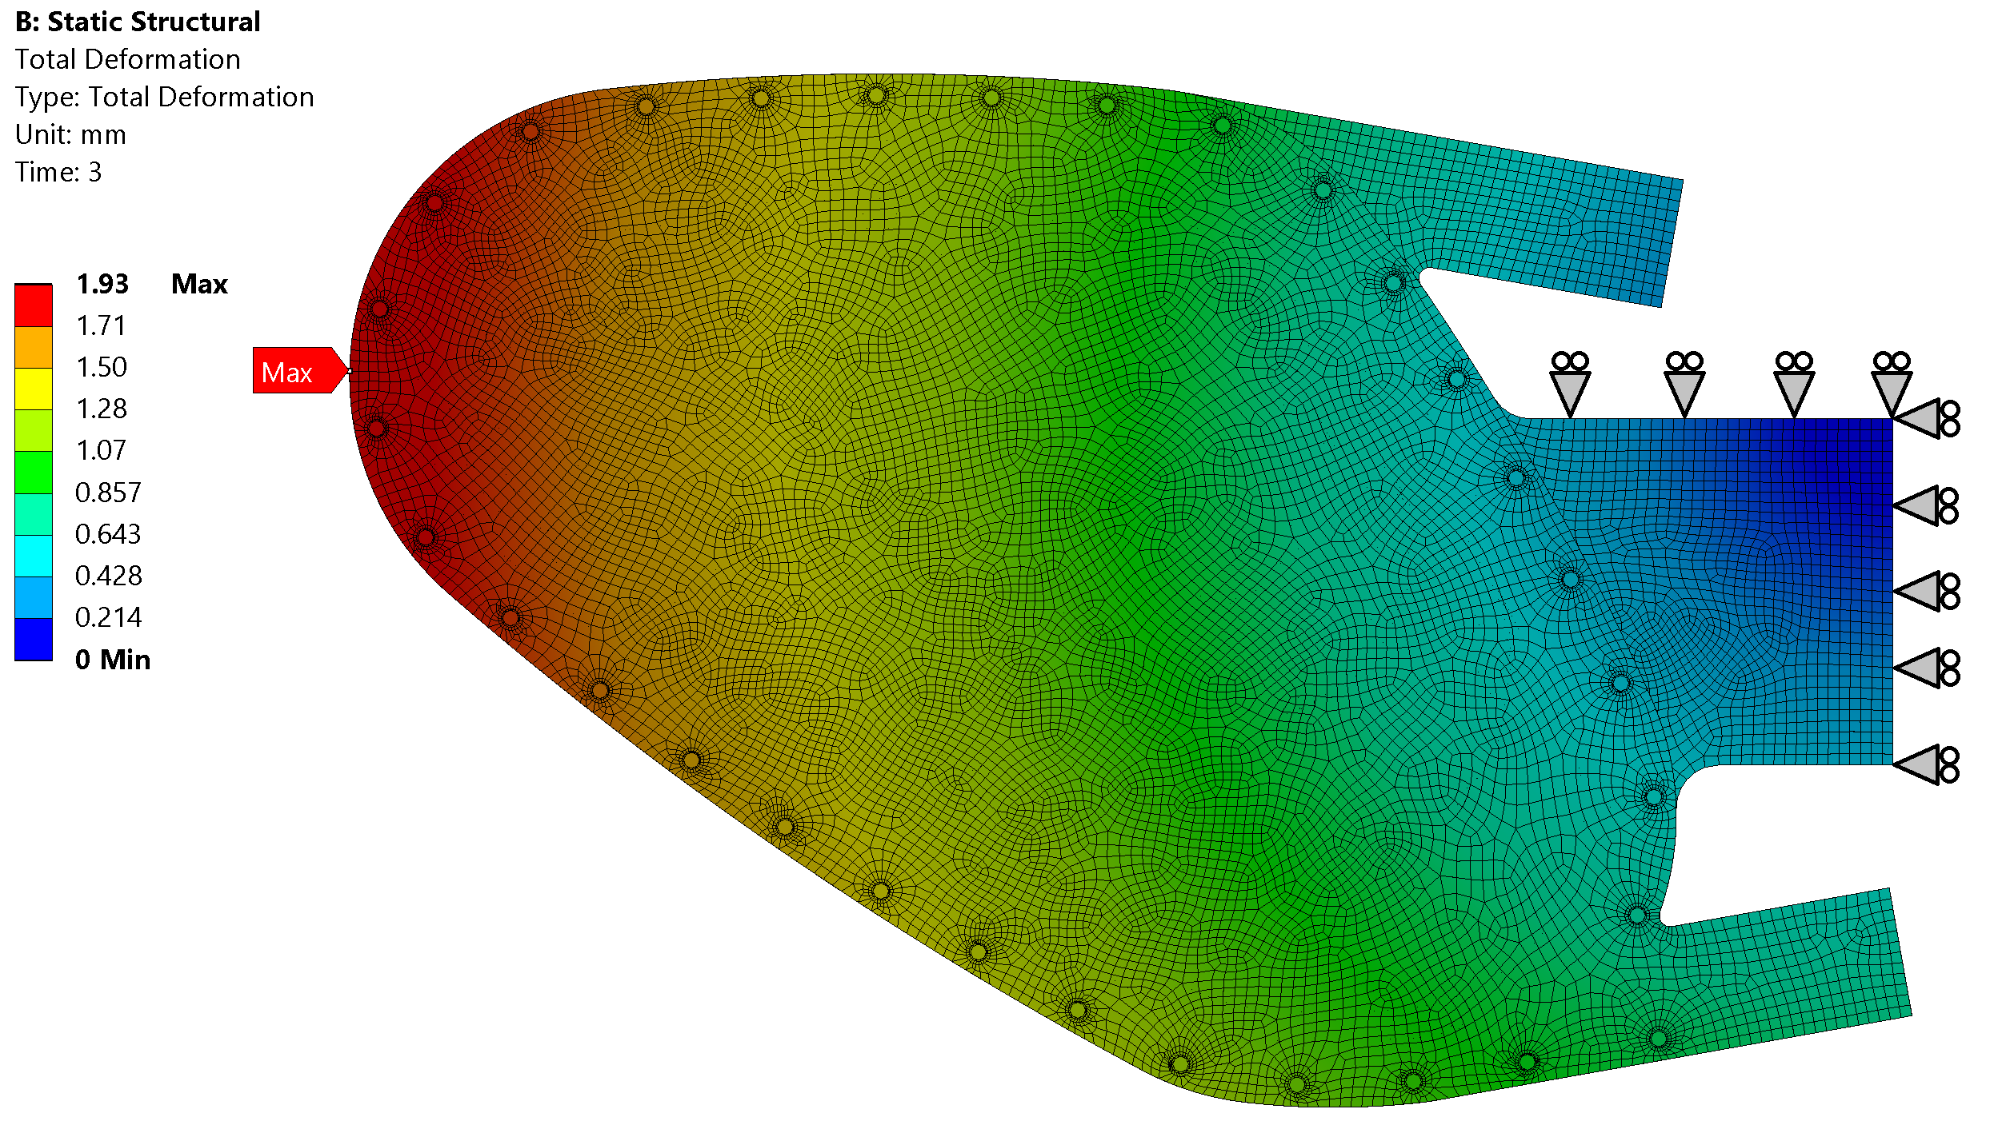
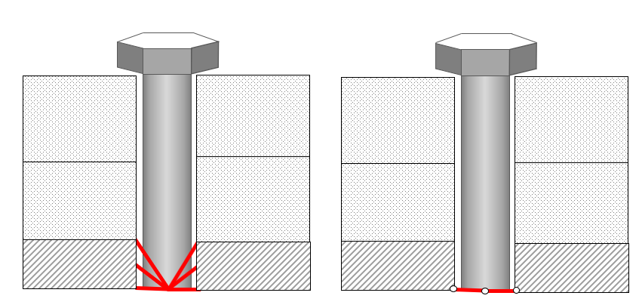
Mechanics
Through holes are modelled;
Bolts positions are still to be defined;
Impossibility of modelling resin inserts due to very sharp angles → 0 deg
Constraints on the intermediate plate to be better defined;
Negligible effects on the stress state in the magnets

Slide 8
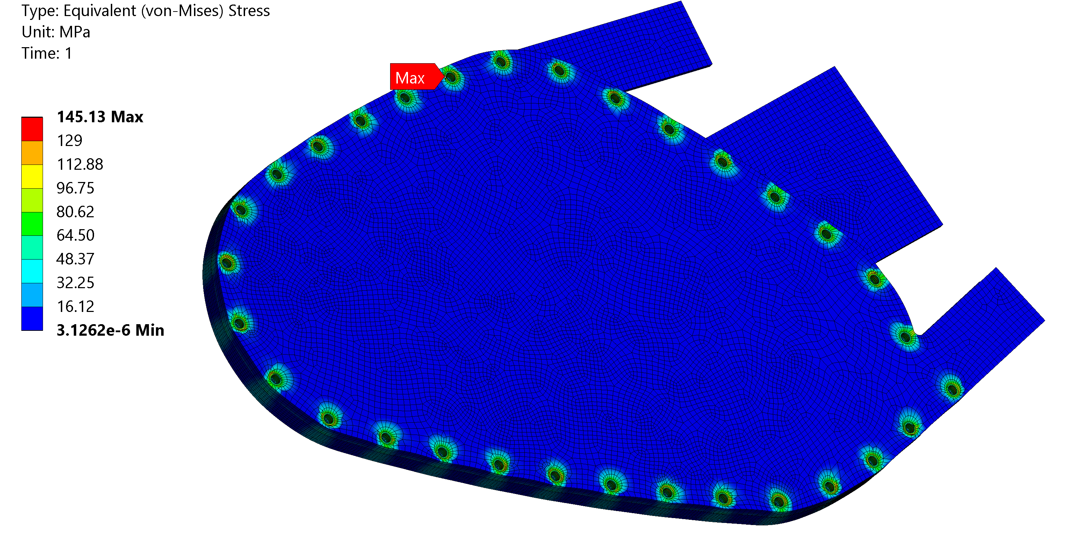
Mechanics
During bolt pretensioning the stress values have changed a little as expected;
Different bolting constraints lead us to different values of stresses.
Stresses are also lowering so it’s not a problem.

Slide 9
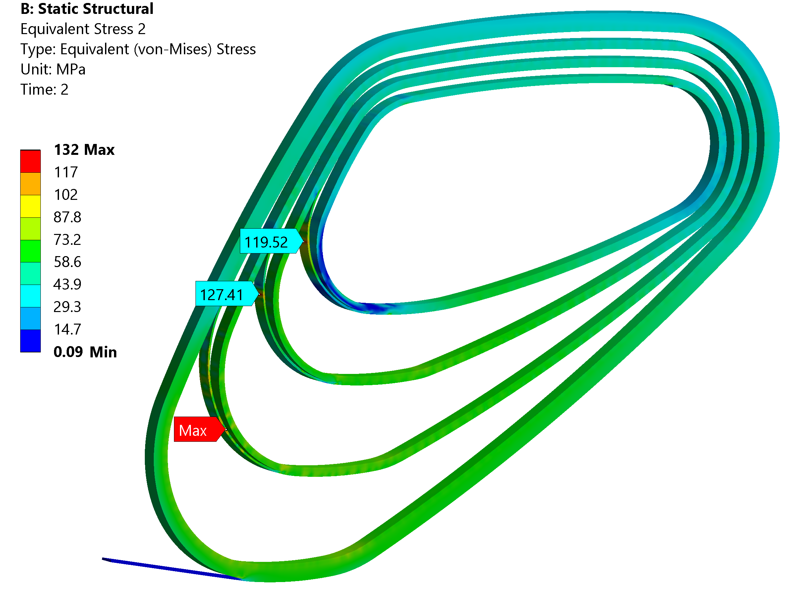
Mechanics
Stress state again dominated by cooldown process to cryogenic temperatures;

Slide 10
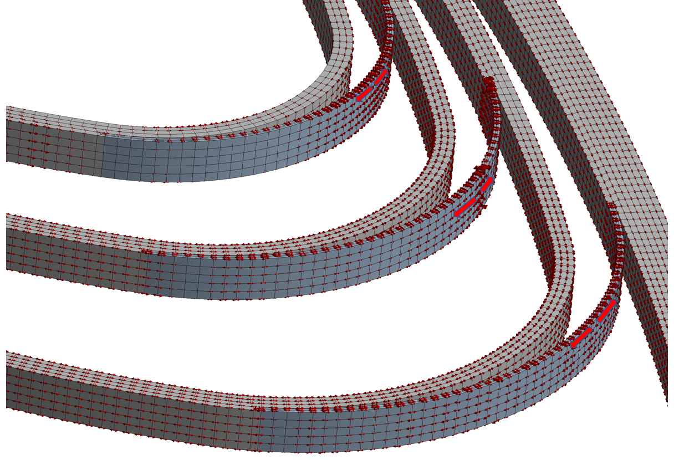
Mechanics
principal stresses and directions:
stress is acting in a longitudinal way

Slide 11
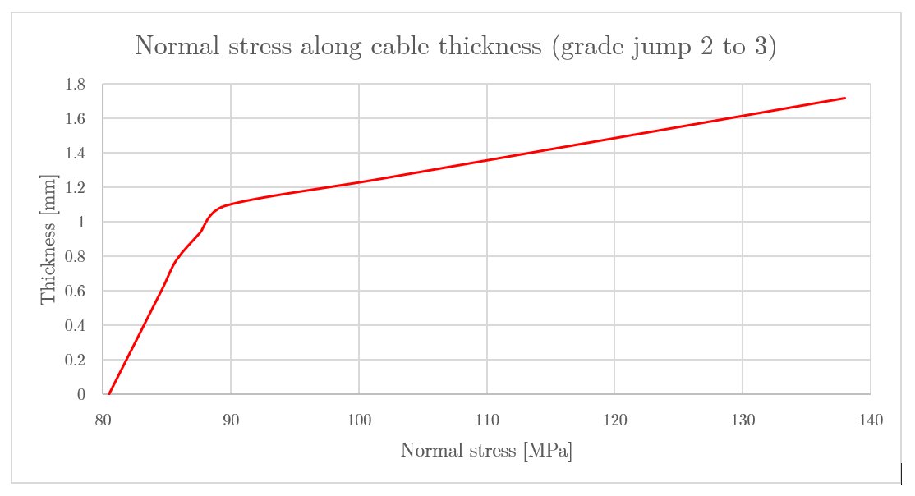
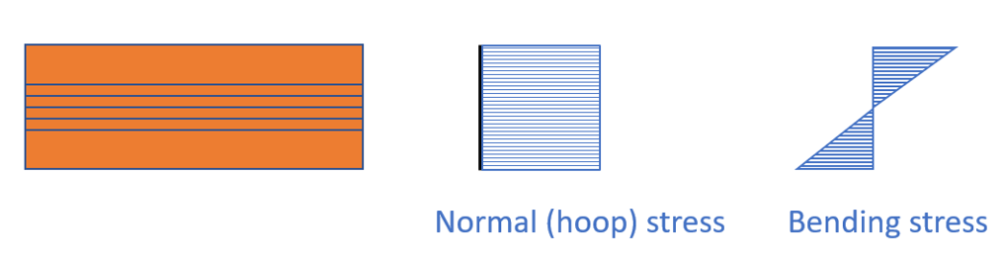
Mechanics
Closer look at high stress regions seems to evidence a superposition of a normal traction and a bending moment on the single cable.
In my opinion this seems like:

Slide 12
Thank you!

