Slide 1


Slide 2
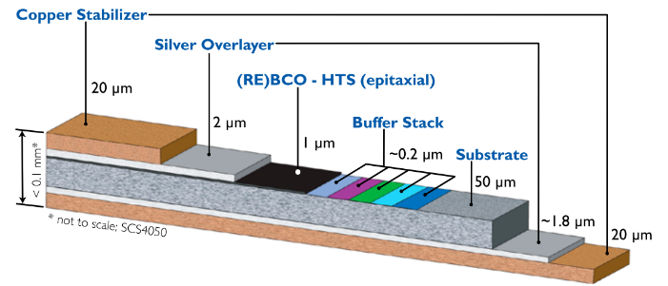
Motivation
Courtesy SuperPower
Impregnated HTS tape coils have shown degradation after thermal cycles.
  Feather.M0, Feather.M2
  HTS Roebel cable (Peng Gao - Twente)
The degradation could be caused by :
  Delamination of the tape due to resin thermo-mechanical properties
  Cracks in the resin causing points of defect on the tape
We want to investigate the compatibility of the impregnation resin with the HTS tape.

Slide 3
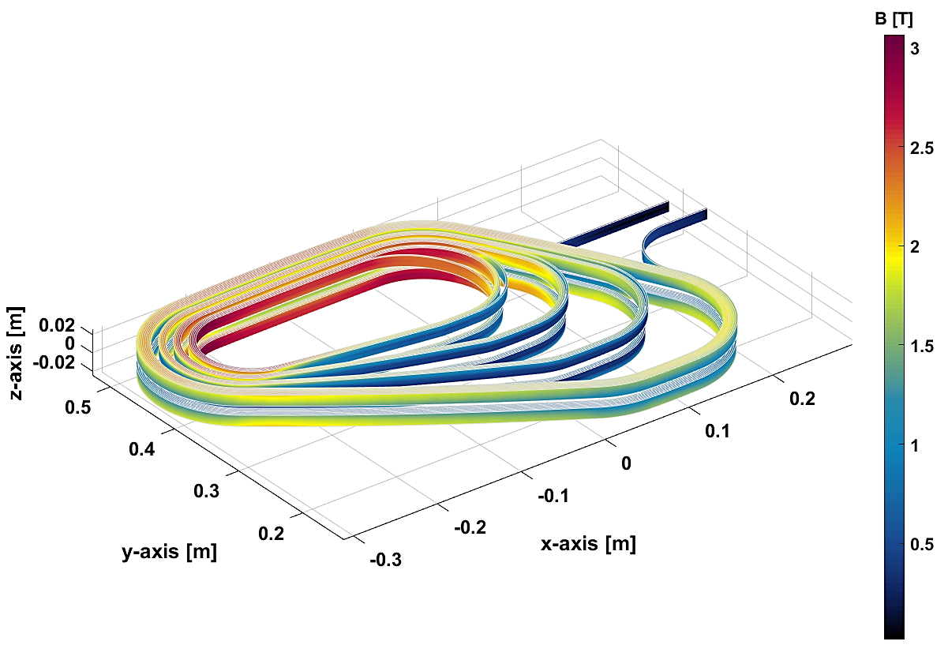
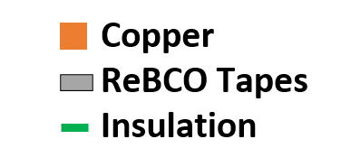
Context
GaToroid HTS demonstrator coil
Superconductor | ReBCO
Cable topology | Stack
N of HTS tape | 4 (0.1 mm)
N of Copper tape | 2 (0.55 mm)
Cable width | 12.2 mm
Cable thickness | 1.8 mm
Cu: Non-Cu ratio | 5.3
1.8 mm
12.2 mm

Slide 4
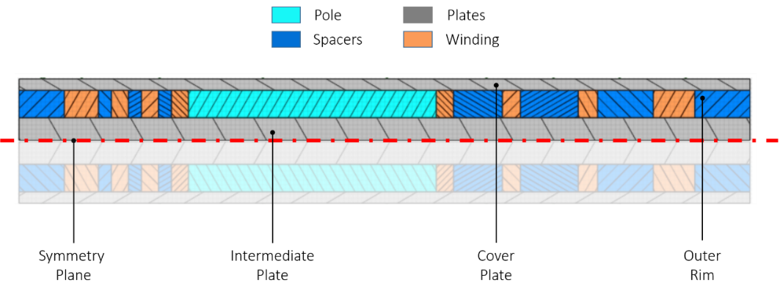
Context
GaToroid HTS demonstrator coil
3 inner grades with 4 turns and outer grade with 8 turns are forming stacks of 4 or 8 cables.
Requirements :
  good infiltration between cable (structural and insulation)
  no infiltration in the cable (contact and risk of damage)

Slide 5
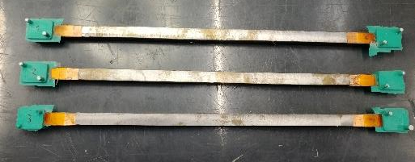
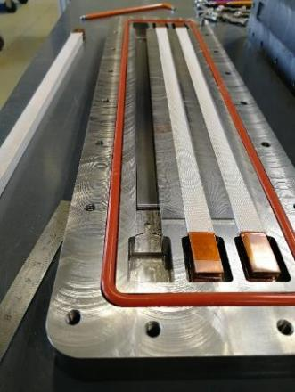
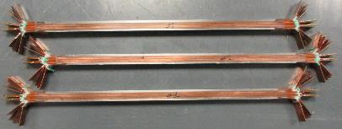
Test plan
Phase 1 - Dummy stacks
Dummies are made from Copper tapes mimicking the real HTS cable stack.
An impregnation mold allows the preparation of 3 identical samples per batch.
Parameters are: - insulation type
        - resin type
        - compression
Copper tape dummy cable
0.55 mm
0.1 mm
0.1 mm
0.1 mm
0.1 mm
0.55 mm

Slide 6
Test Plan
Overview
Preparation: Lukas Henschel
Impregnation: Sebastien Clement, Romain Gavaggio, Ahmed Benfkih
Electrical tests: Pierre-Antoine Contat,
Francois-Olivier Pincot
Cut and microscope: Ana Teresa Perez Fontenla
Supervision: Nicolas Bourcey, Juan Carlos Perez
To check:
Impregnation quality (voids, bubbles)
Mechanical properties (peeling, cracking)
Insulation between cables
Contact between tapes in a cable
Our tools:
Peeling and visual inspection
Cutting and microscopic inspection
Electrical tests at room Temp. and at 77K
Electrical tests after 10 low Temp. cycles
V
V

Slide 7
Test Plan
Status
 |  | STACK CONFIGURATION |  |  | PROCESS
Batch # | Stack # | Insulation | Resin | Compression | Preparation | Impregnation | Electrical test | Peel and VI | Cut and VI
1 | 1-3 | Fiber glass | MY750 | High | Done | Done | Done | Done | Done
2 | 4-6 | Fiber glass | CTD101K | High | Done | Done | Done | Done | Done
3 | 7-9 | Fiber glass | CTD101K | Low | Done | Done | Done | Done | Done
4 | 10-12 | Fiber glass | MY750 | Low | Done | Done | Done | Done | -
5 | 13-15 | C-Shape Polyimide | CTD101K | Low | Done | Done | - | - | -
6 | 16-18 | C-Shape Polyimide | MY750 | Low | Done | Done | tbd | Done | -
5.2 | 19-21 | C-Shape Polyimide | CTD101K | Low | Done | Done | On-going | Done | Done
7 | 22-24 | C-Shape Polyimide | Mix61 | Low | Done | Done | On-going | Done | -
8 | 25-27 | Fiber glass | Mix61 | Low | Done | Done | - | Done | -
8.2 | 28-30 | Fiber glass | Mix61 | Low | On-going | On-going | tbd | Done | -

Slide 8
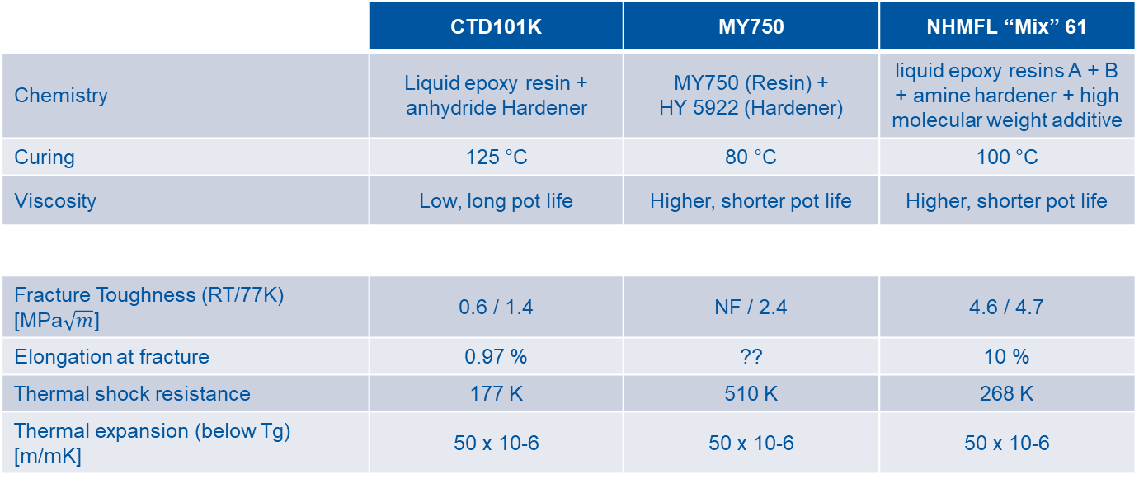
Test Plan
About the resins
 | CTD101K | MY750 | NHMFL “Mix” 61
Chemistry | Liquid epoxy resin + anhydride Hardener | MY750 (Resin) + HY 5922 (Hardener) | liquid epoxy resins A + B + amine hardener + high molecular weight additive
Curing | 125 °C | 80 °C | 100 °C
Viscosity | Low, long pot life | Higher, shorter pot life | Higher, shorter pot life
Fracture Toughness (RT/77K) [MPa$\sqrt{m}$] | 0.6 / 1.4 | NF / 2.4 | 4.6 / 4.7
Elongation at fracture | 0.97 % | ?? | 10 %
Thermal shock resistance | 177 K | 510 K | 268 K
Thermal expansion (below Tg) [m/mK] | 50 x 10-6 | 50 x 10-6 | 50 x 10-6
André Brem, Barbara Gold, Theo Tervoort, Auchmann and Davide Tommasini (ETH + CERN)
Shijian Yin, Tengming Shen (Berkeley lab)

Slide 9
Test Plan
About compression
Different shims of different thickness are used to modify the size of the cavity depending on the insulation type and the desired compression.
Cavity size: 12 mm
Stack with fiberglass (0.15 mm) : 7.2 mm
Stack with polyimide (0.05 mm) : 6.4 mm
The compression parameter should be understood here as the free space for the resin.
Void low compression: 1 mm
Void high compression: 0.2 mm

Slide 10
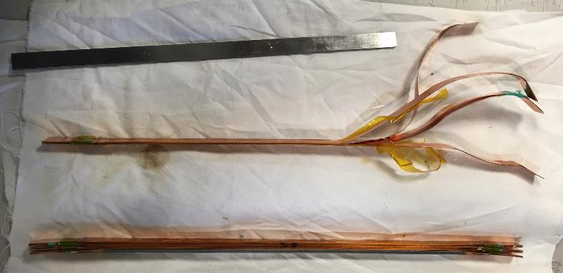
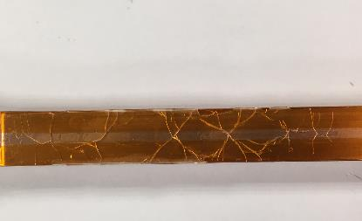
Results
Quality of impregnation / peeling resistance
Sample 19 - Polyimide + CTD101K
Sample 23 - Polyimide + MY750
Peeling resistance is generally higher with fiber glass than with polyimide. The structure is reinforced by the fiber.
Peeling resistance is higher with MY750 and Mix61 (more elastic) than with CTD101K that tends to fracture and propagate a crack.
Cracks can be observed with CTD101K after LN2 thermal cycles.

Slide 11
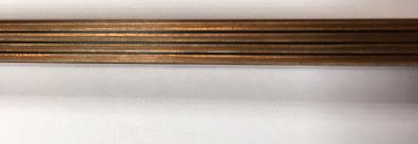
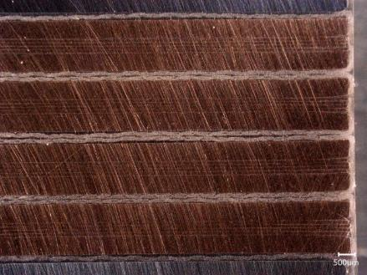
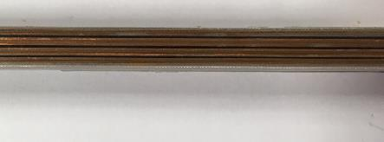
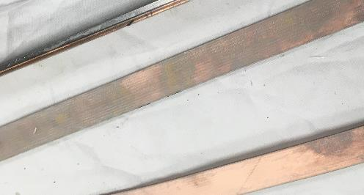
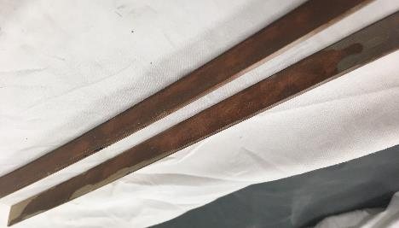
Results
Insulation between cables – Fiber glass
Sample 9 – Fiber glass + MY750 (low)
Sample 1 – Fiber glass + MY750 (low)
Distance between cables is homogenous along the sample for both compressions.
The impregnated fiber glass fills the gap and plays a buffer role.
  167 µm at high compression
  213 µm at low compression
Sample 3 – Fiber glass + MY750 (high)
Sample 1 - Fiberglass + MY750
Sample 5 - Fiberglass + CTD101K
The fiber glass is impregnated for both CTD101K and MY750
MY750 did not wet the copper while the CTD101K wet it only partially.

Slide 12
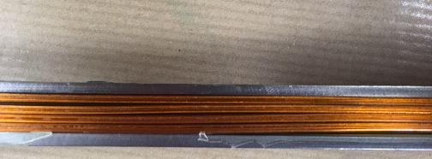
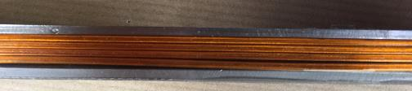
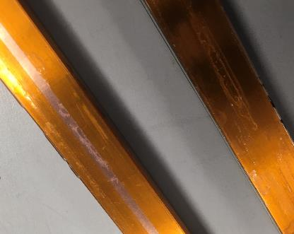
Results
Insulation between cables - Polyimide
Sample 23 - Polyimide + Mix 61
The impregnation is not homogenous between the cables. The resin (for all of them) fills preferentially one inter-cable space and pushes the other cables against each other.
Sample 23 - Polyimide + Mix61
As a result, the resin is almost not present when the cables are compacted together.

Slide 13
Results
Insulation between cables – Electrical tests
Fiber Glass | No T cycle | T cycle
MY750 (high) | 705 GΩ | 593 GΩ
MY750 (low) | 2162 GΩ | 882 GΩ
CTD101K (high) | 1869 GΩ | 1964 GΩ
CTD101K (low) | 2610 GΩ | 1269 GΩ
Mix61 (low) | tbd | tbd
Pre-Conclusion
With fiber glass the CTD101K shows better insulation properties between cables than the MY750 as it seems to wet better the cable.
Low compression samples are showing better result as the inter-cable distance is larger.
With polyimide, the insulation is good although non-homogenous filling is observed, and more measurements are needed.
In all cases insulation between cable is not an issue.
Polyimide | Before | after
MY750 (low) | tbd | tbd
CTD101K (low) | + 3000 GΩ | 2913 GΩ
Mix61 (low) | 829 GΩ | tbd

Slide 14
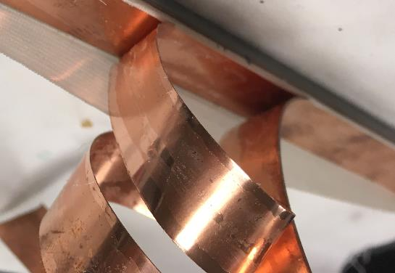
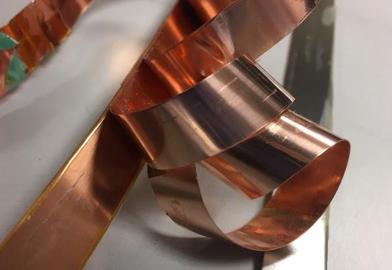
Results
Contact between tapes in a cable
Sample 1 - Fiberglass + MY750
The fiber glass allows the resin to flow through and the samples are showing some traces of resin between the tapes.
Also, it seems the MY705 is more likely to go in between than the CTD101K.
Samples with polyimide are showing only very few resin traces between the tape with the MY750 and no signs of resin are observed with the CTD101K and the Mix61.
Sample 23 - Polyimide + Mix61

Slide 15
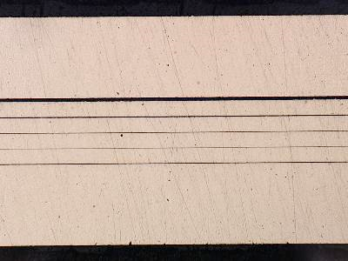
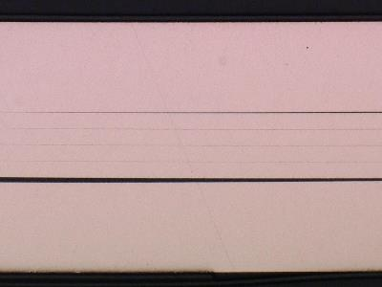
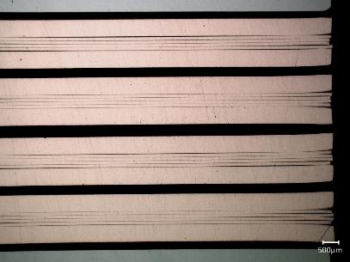
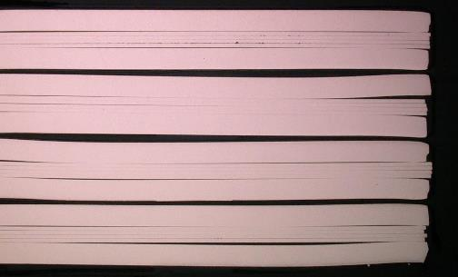
Results
Contact between tapes in a cable
Sample 1 - Fiberglass + MY750
Sample 20 - Polyimide + CTD101K
Confirmed by microscopic views.
Gaps are few microns with the fiber glass and are not measurable with the polyimide

Slide 16
Results
Contact between tapes in a cable
Calculated: 4.3 mΩ @ 300K
0.53 MΩ @ 77k
Fiber Glass | No T cycle | T cycle | At 77 K
MY750 (high) | 3.0 mΩ | 3.2 mΩ | 0.52 mΩ
MY750 (low) | 2.3 mΩ | 2.2 mΩ | 0.33 mΩ
CTD101K (high) | 2.2 mΩ | 2.3 mΩ | 0.36 mΩ
CTD101K (low) | 2.5 mΩ | 1.7 mΩ | 0.35 mΩ
Mix61 (low) | tbd | tbd | tbd
Pre-Conclusion
No differences are seen between MY750 and CTD101K with fiber glass.
As for the visual observations, one could measure a better contact with the polyimide, but more measurements are needed.
Polyimide | Before | after
MY750 (low) | tbd | tbd | tbd
CTD101K (low) | 1.9 mΩ | 1.7 mΩ | tbd
Mix61 (low) | 1.5 mΩ | tbd | tbd

Slide 17
Results
Complete table
Stack samples |  |  | Fiberglass sleeve |  |  |  |  | Polymide C-shape
 |  |  | High compression |  | Low compression |  |  | Low compression
 |  |  | MY750 | CTD101K | MY750 | CTD101K | Mix61 | MY750 | CTD101K | Mix61
Peeling observations |  |  | Hard to peel. A fair continuous pull is necessary | Easy to peel after a first crack | Hard to peel. A fair continuous pull is necessary | Easy to peel after a first crack |  | Very easy once the polyimide removed | Very easy, don’t even need to remove polyimide | Very easy to peel no adhesion. Resin is pretty flexible
Visual observation | Impregnation between cables |  | FB is impregnated but it did not wet the cable | FB is impregnated and it partially wet the cable | FB is impregnated but it did not wet the cable at all | FB is impregnated and it partially wet the cable |  | Not Homogeneous some resin under the polymide on both side of the "C" | Not homogeneous. No resin under the polyimide. | Not homogeneous
 | Resin between tapes |  | several traces | very few traces | several traces | very few traces |  | very few traces | almost none | almost none
 | Gap between cables |  | 329 µm | 334 µm | - | 426 µm | - | Not homogeneous | Not homogeneous | Not homogeneous
Electrical test | Resistance between cables [GΩ] | Before thermal cycles | 705 | 1869 | 2162 | < 2610 |  |  | < 3000 | 829
 |  | After thermal cycles | 593 | 1964 | 882 | 1269 |  |  | 2913
 | Resistance between tapes [mΩ] | Before thermal cycles | 3.012 | 2.222 | 2.323 | 2.491 |  |  | 1.944 | 1.535
 |  | After thermal cycles | 3.205 | 2.263 | 2.198 | 1.748 |  |  | 1.682
 |  | At 77K | 0.520 | 0.362 | 0.333 | 0.349

Slide 18
Conclusion
Fiber glass
+ Better distribution of the cable stack
+ Better structural resistance
- Let some resin flow in between the tapes, less electrical contact
Polyimide
- Does not keep the cables away from each other
- Less resistance to peeling
+ Prevent the resin from flowing in the cable, better electrical contact
MY750
+ Not too brittle
- Does not wet too much
- Can be found between tapes
CTD101K
- Brittle, it cracks
+ Good wetting properties
+ Flows less between tapes
Mix61
+ Not too brittle

Slide 19
Conclusion
For Gatoroid
An insulation with fiber glass seems preferable.
For their mechanical resistance MY750 and Mix61 are preferred (choice waiting for the last batch).
Next phase:
Ic degradation tests on real HTS stacks.
In general
A more exhaustive study is needed.
Explore other resins and fillers.
Advantages of polyimide are appealing. One could fix the lack of mechanical resistance coupling it with fiber glass.
Mechanical models could be used to simulate the peeling stress caused by the resins on tape stacks.

Slide 20
Thank you

Slide 21
Conclusion
About the resins
Viscosity: CTD101K << Mix61 ~ MY750
Young Modulus MY750 ~ CTD101K ~ Mix61
Yield strength CTD101K < MY750 < Mix61
Fracture toughness CTD101K << Mix 61 ~ MY750
Thermal shock resistance CTD101K << Mix61 ~ MY750

Slide 22
Test Plan
About compression
Different shims of 1.6 mm, 2.0 mm, and 2.6 mm thick are used to modify the size of the cavity depending on the insulation type and the desired compression.
Cavity size: 12 mm
Stack without insulation : 6 mm
Fiber Glass
  Low compression: 2 + 1.6 mm (void: ~1 mm)
  High compression: 2 + 2.6 mm (void: ~0 mm)
Polyimide
  Low compression: 2 + 2.6 mm (void: ~1 mm)
  High compression: ??
Example (polyimide, low): 12 - 4 * (1.5 + 2 * 0.05) - 2 – 2.6 = 1 mm

