Slide 1
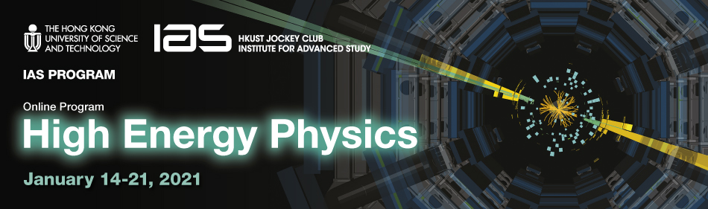
https://indico.cern.ch/event/971970
a few impressions from HKUST IAS 2021 HEP conference
Frank Zimmermann, 22 January 2021

Slide 2
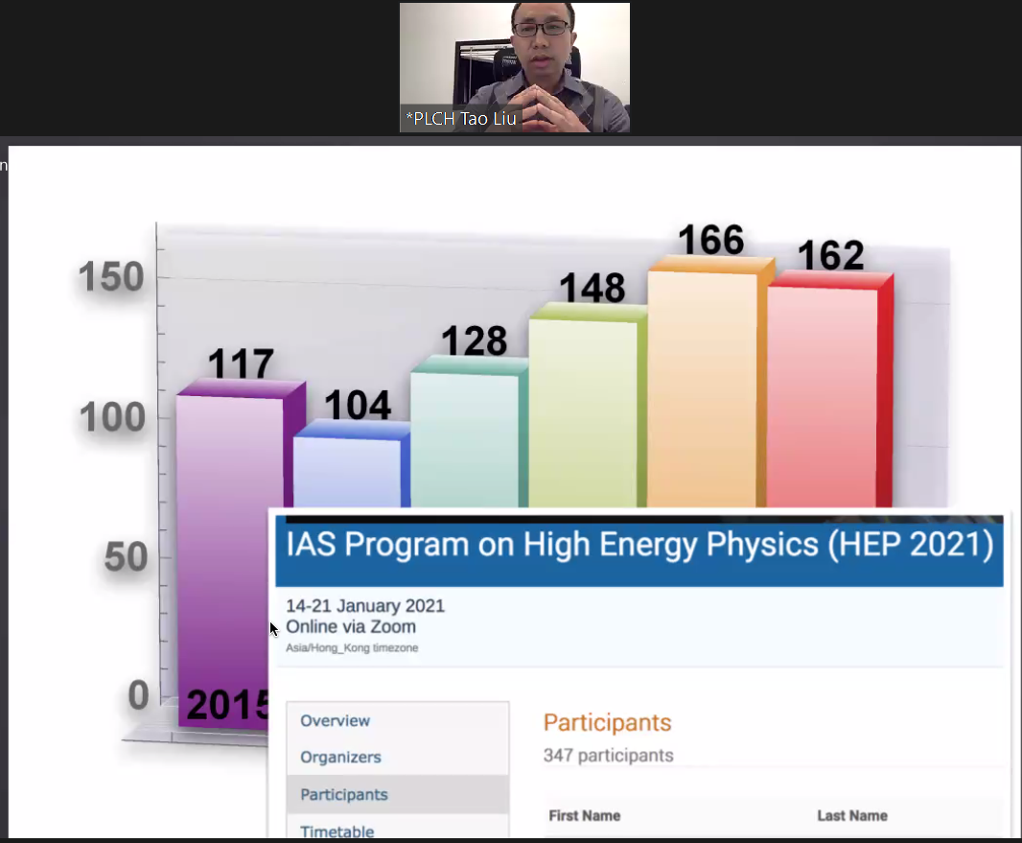
big increase in the number of
participants
from 162 (2020)
to 347 (2021)
-
the boost from virtual meetings
T. Liu

Slide 3
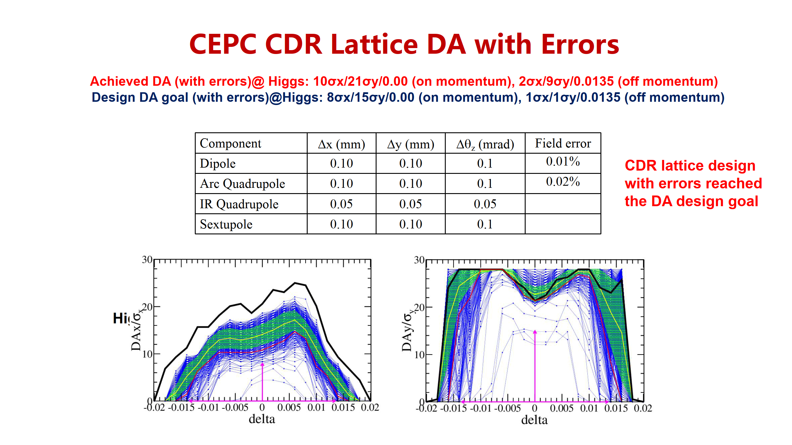
J. Gao

Slide 4
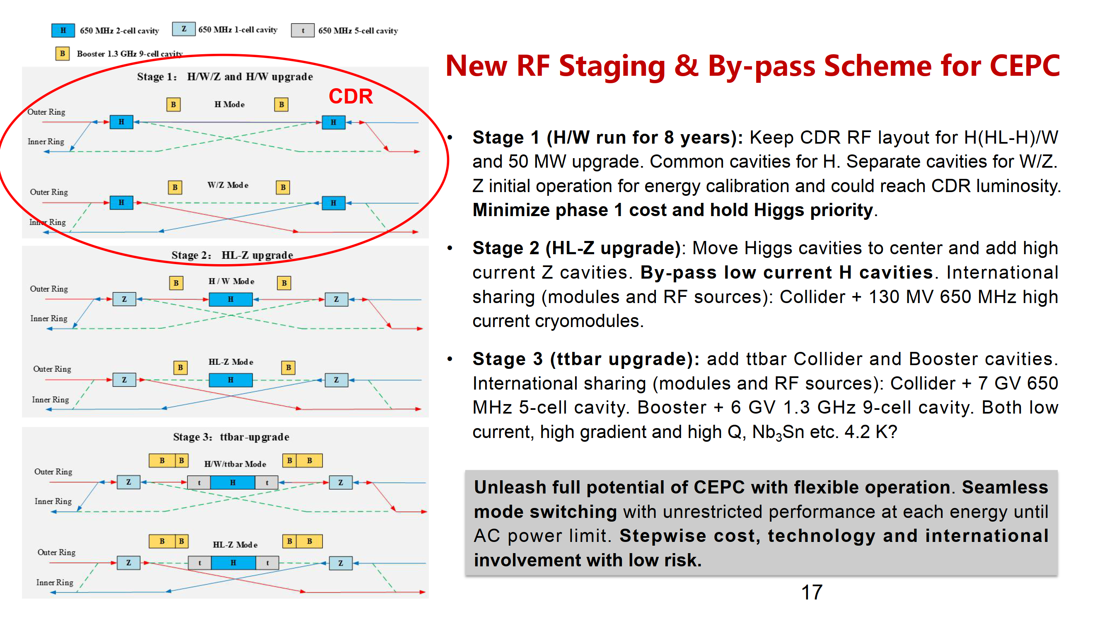
J. Gao

Slide 5


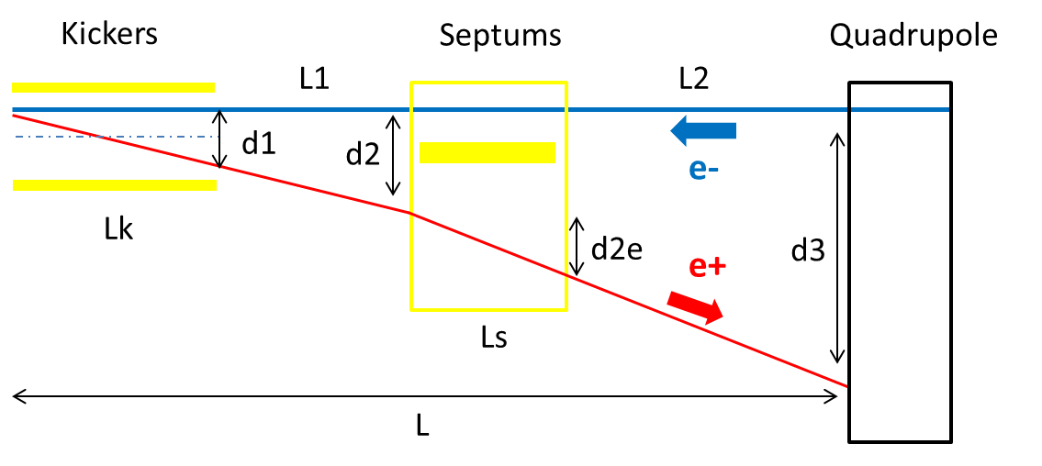
Alternative separation scheme at RF region
With kicker instead of electro-static separator to reduce the impedance
(Proposed by Jinhui Chen)
 | Kicker | Septum
Integrated strength BL [T*m] | 0.1624 | 1.4
Strength B [Guass] | 203 | 1000 | Field for up to 182.5GeV. Septum is weak to suppress emittance growth.
Effective length Leff [m] | 8 | 14
Half width of good field region Hgf/Vgf [mm] | 10.1/3.8 @ 5E-4 | 18.9/3.8 @ 5E-4 | Kicker: 18σx+3mm+d1/2, 18σy+3mm Septum: 18σx+3mm+d2e/2, 18σy+3mm
Half width of beam stay clear Hbsc/Vbsc [mm] | 9.6/3.6 | 9.2/3.6 | 18σx+3mm, 18σy+3mm
Septum width width [mm] | - | 5
Y. Wang

Slide 6
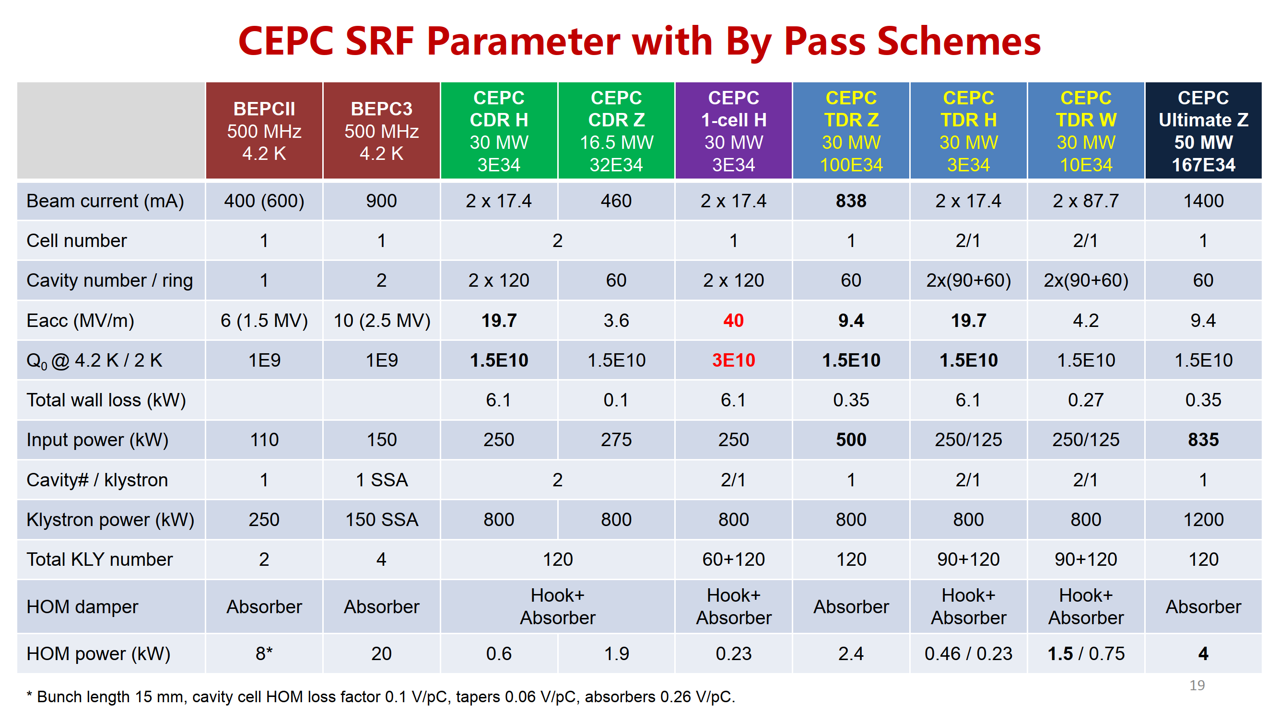
J. Gao

Slide 7
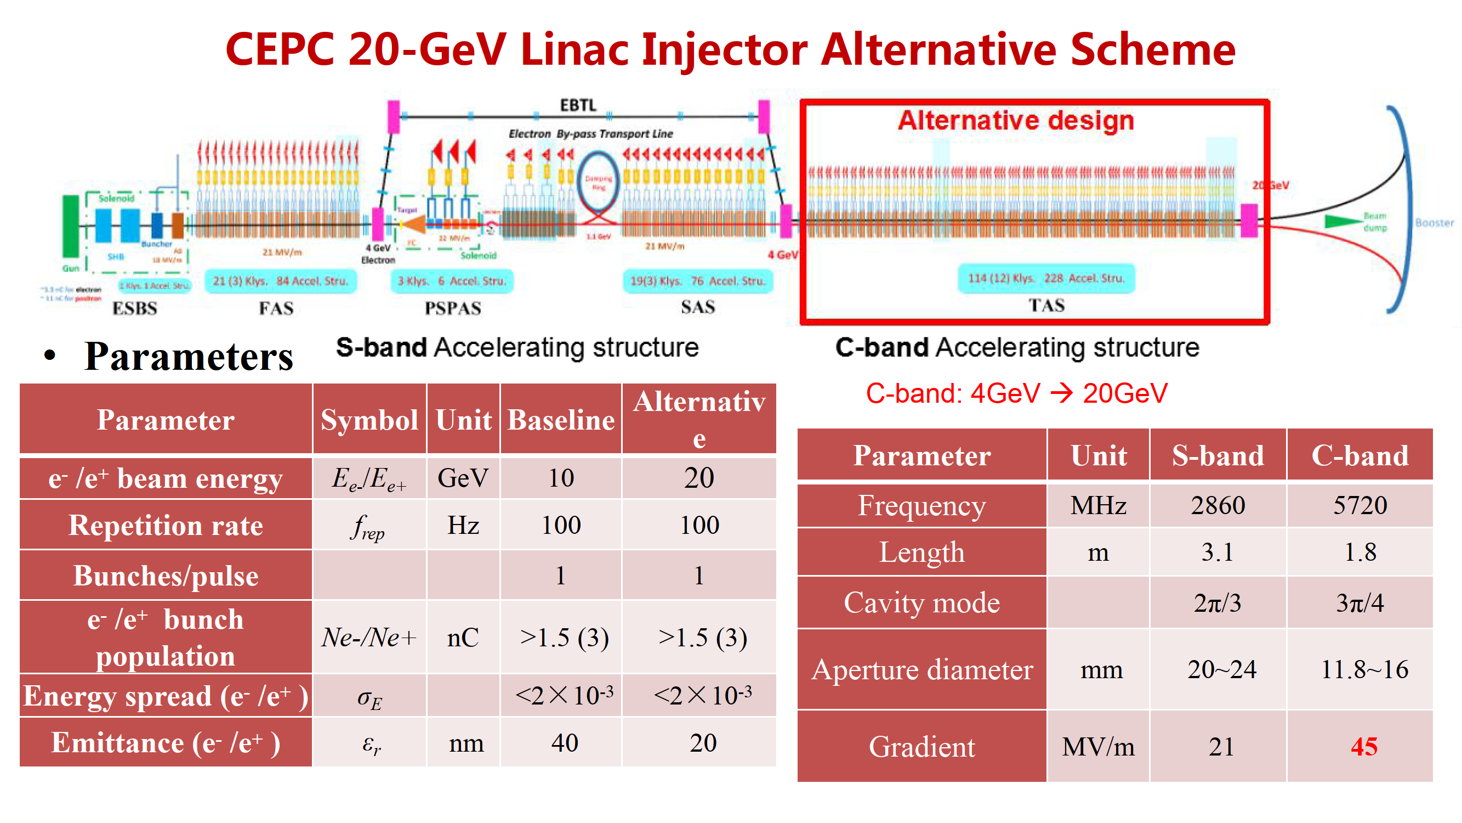
J. Gao

Slide 8
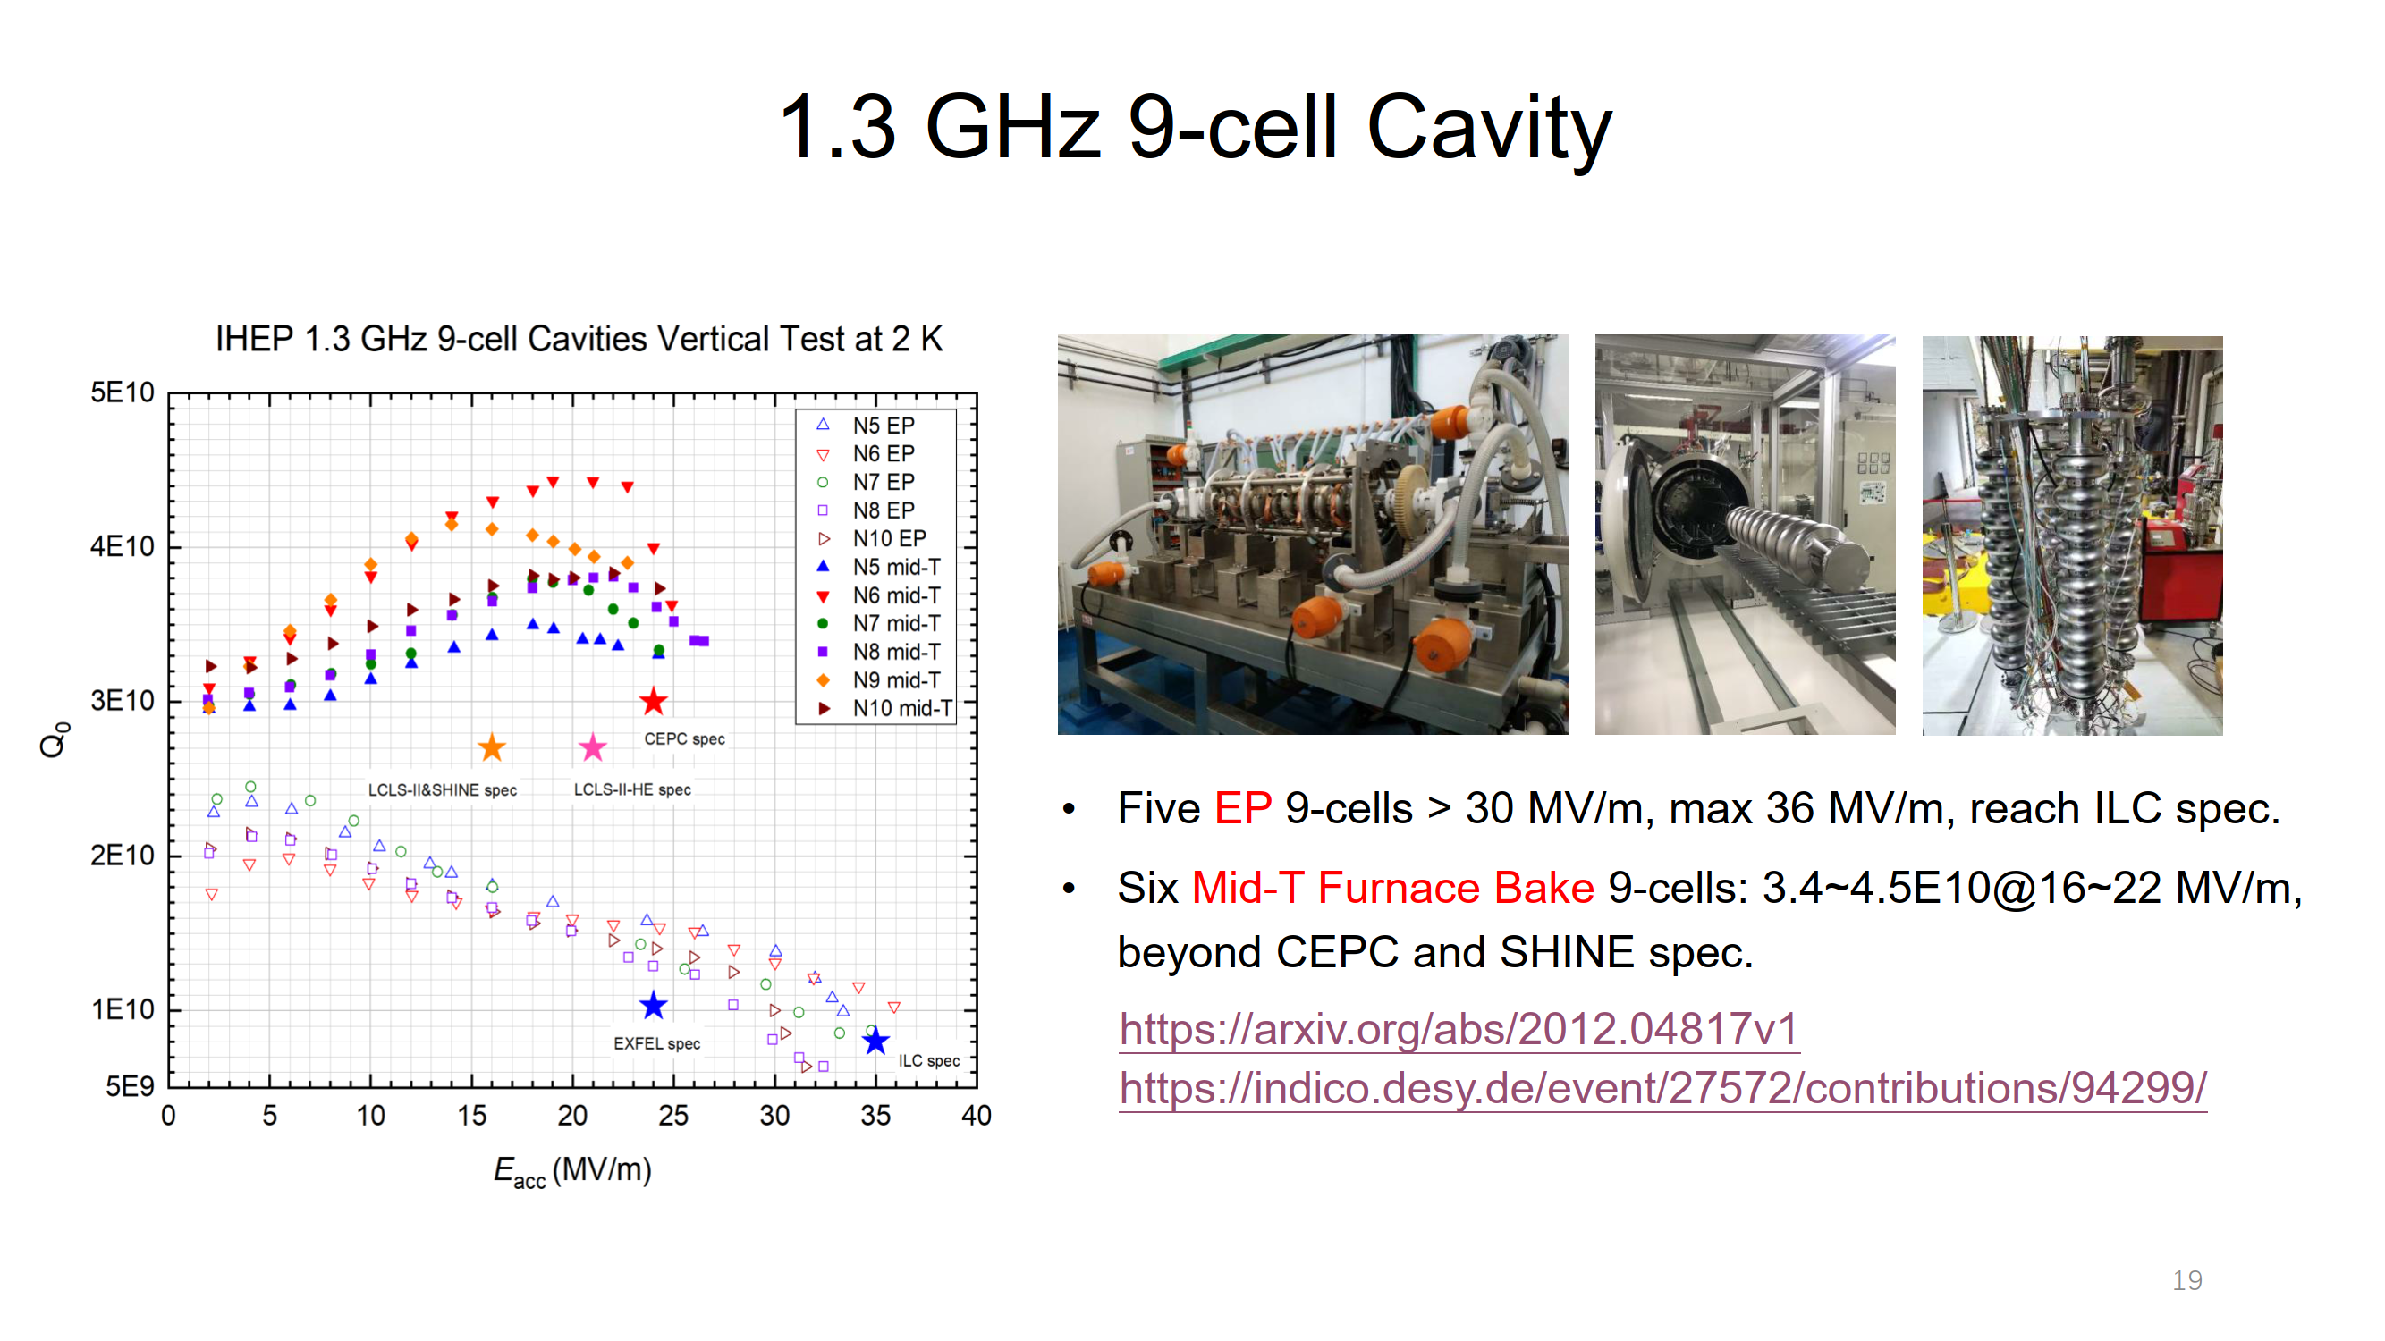
meeting or exceeding SC cavity specs for all projects
J. Zhai

Slide 9
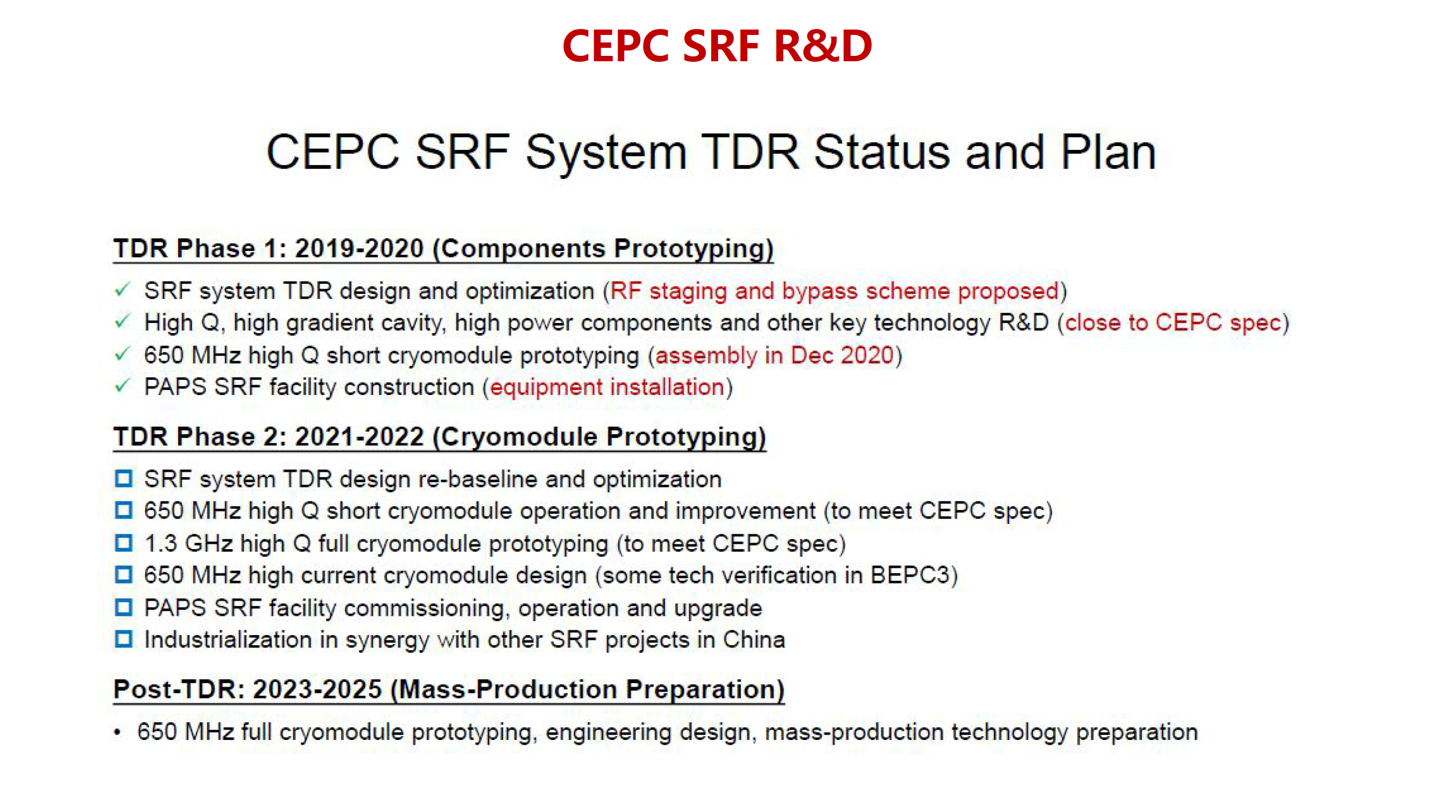
J. Gao

Slide 10
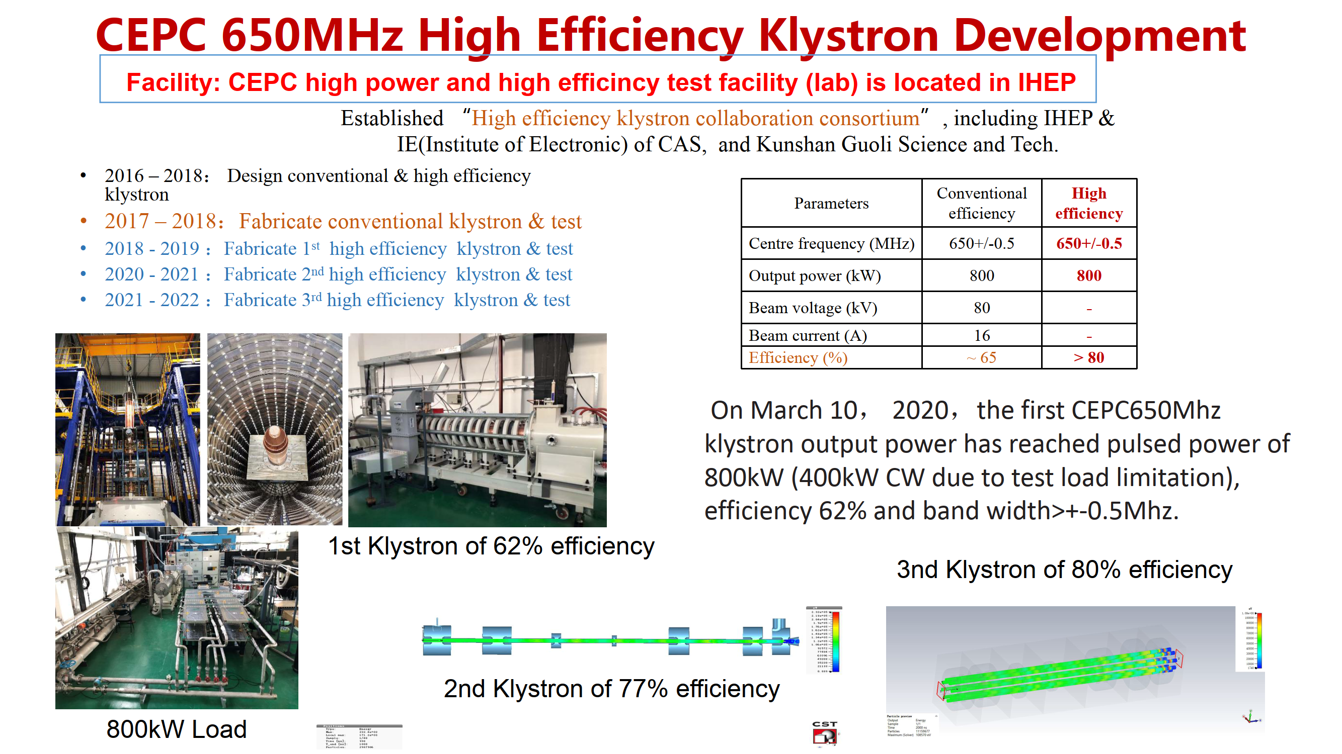
J. Gao

Slide 11
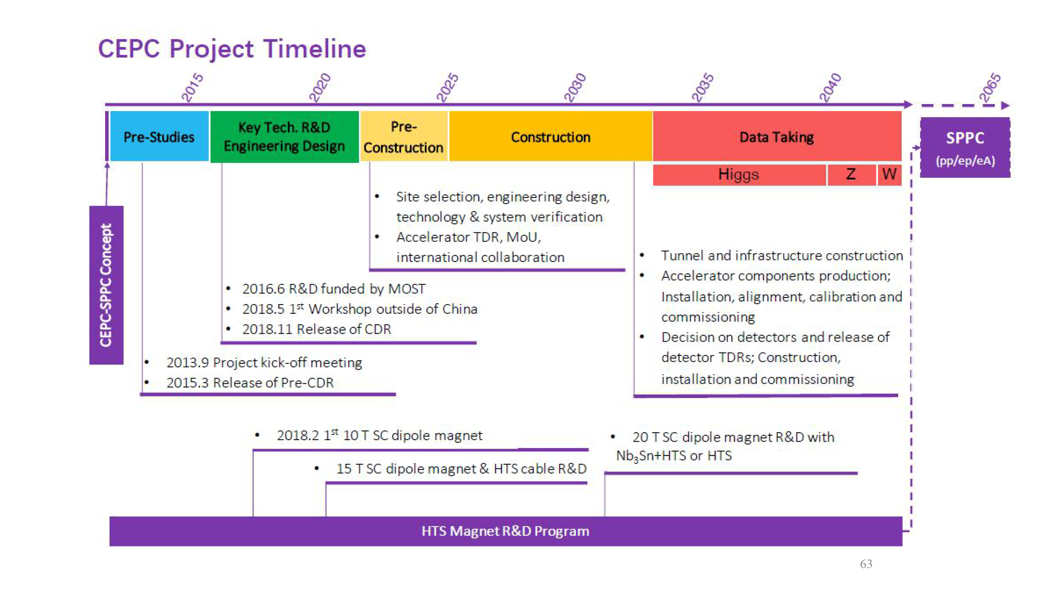
J. Gao

Slide 12
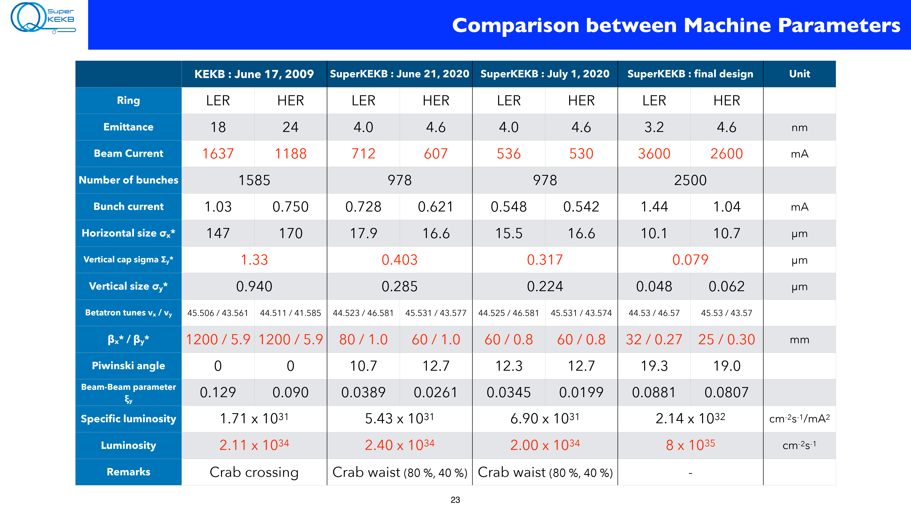
Y. Ohnishi

Slide 13
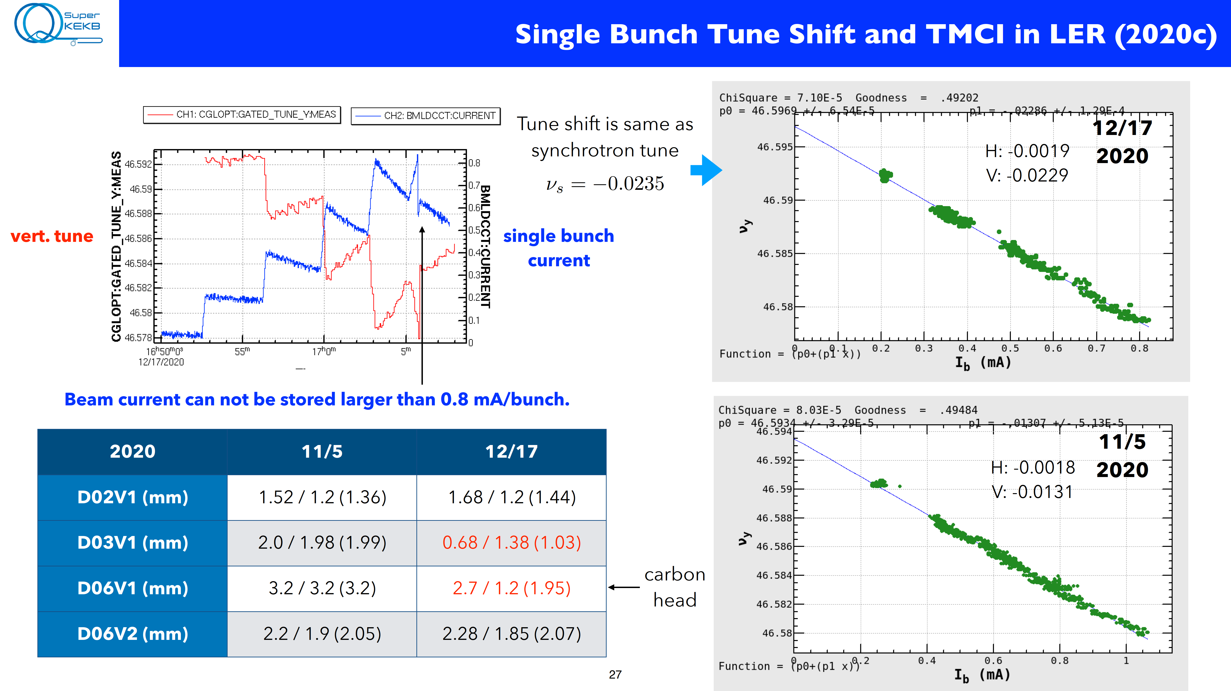
Y. Ohnishi

Slide 14
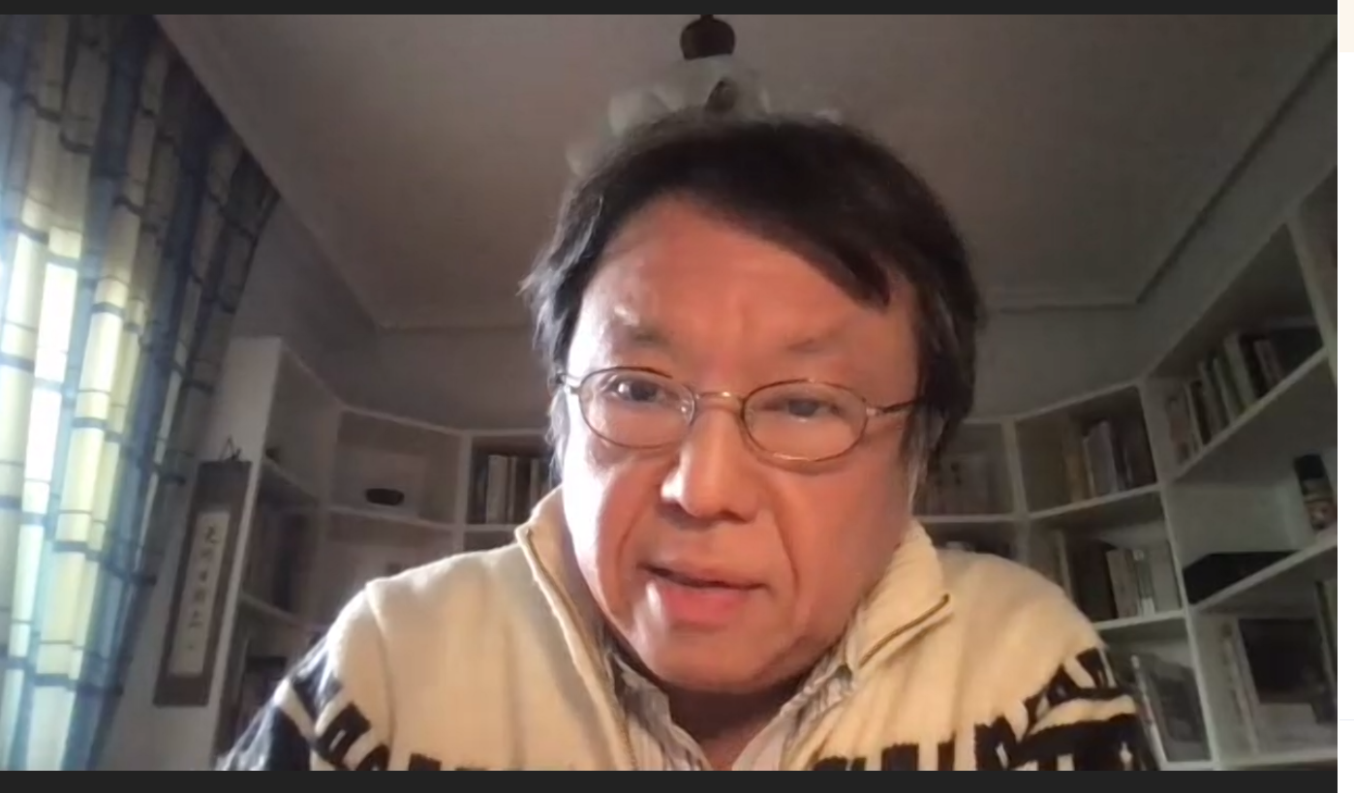
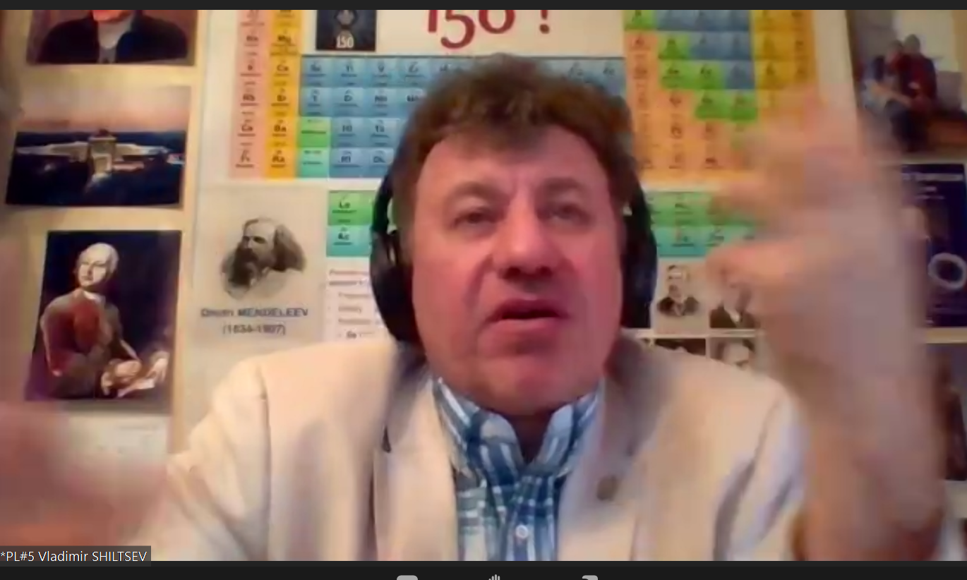
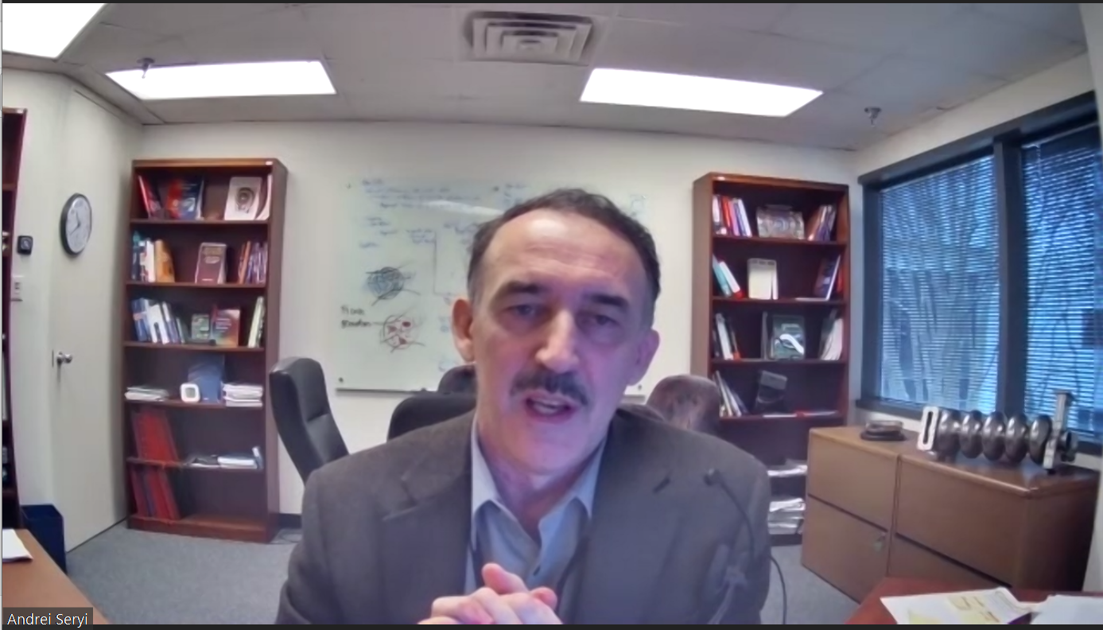
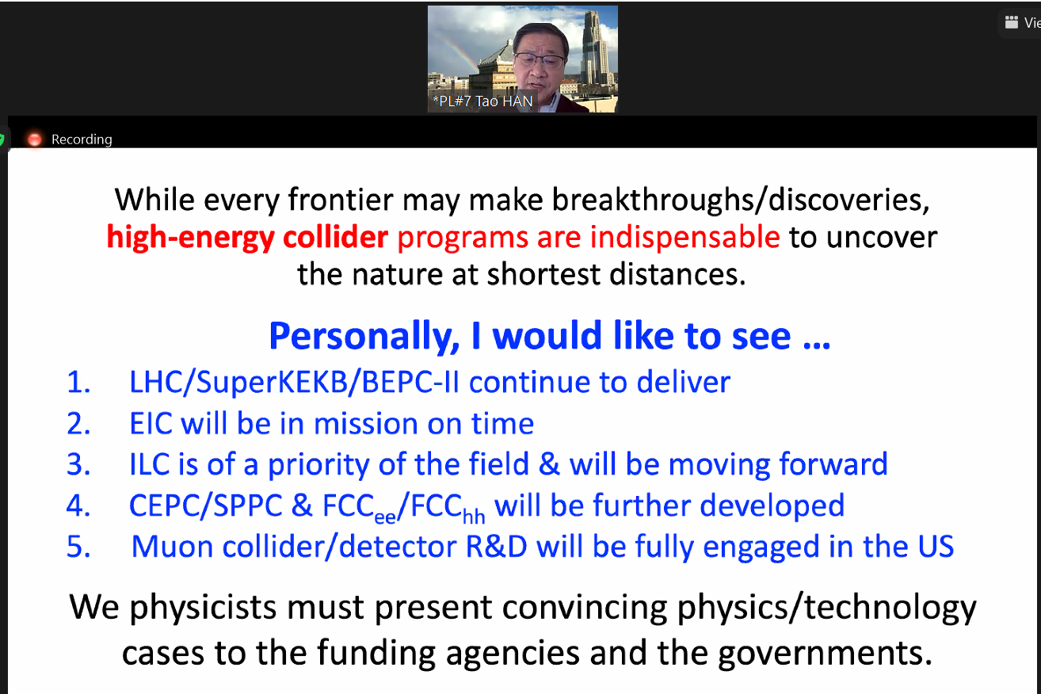
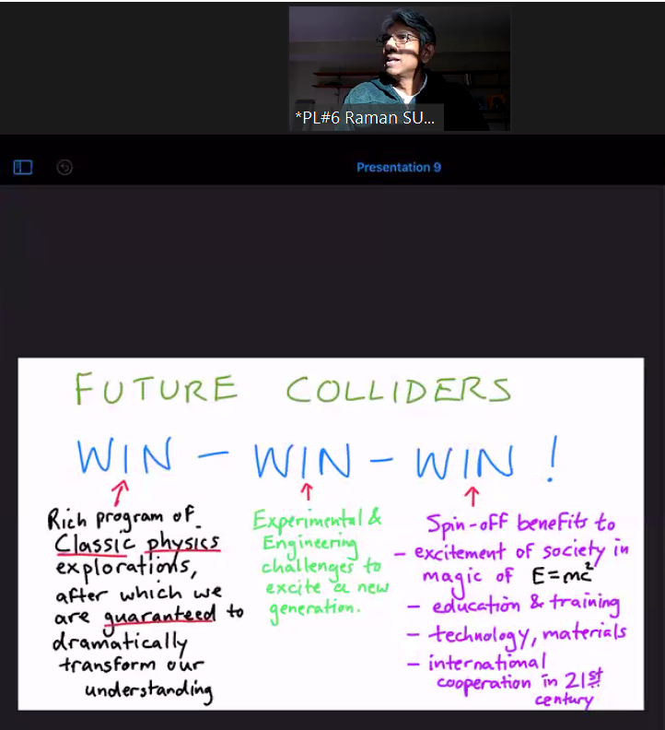
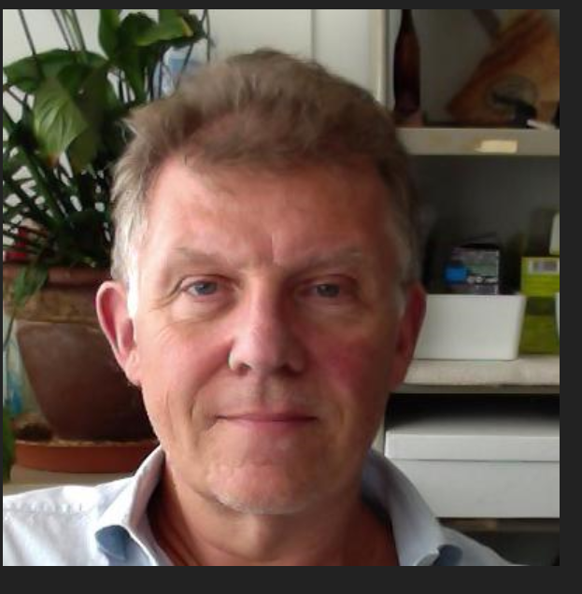
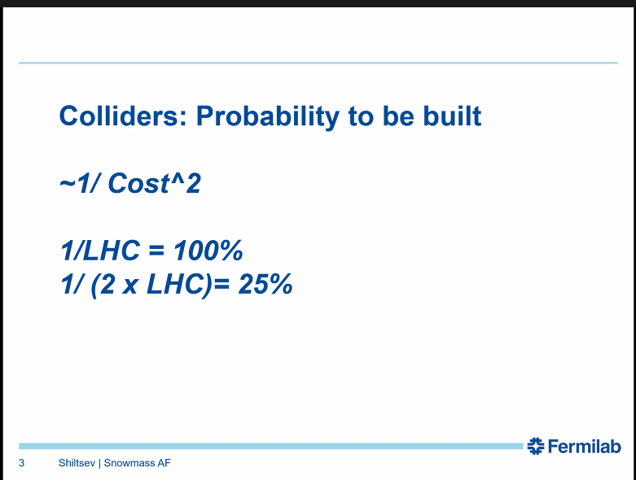
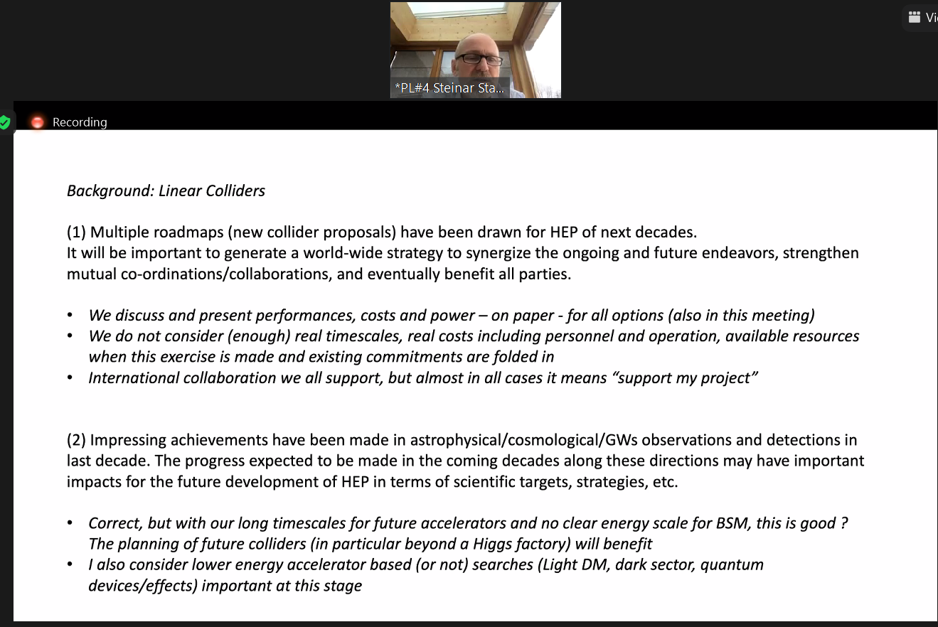
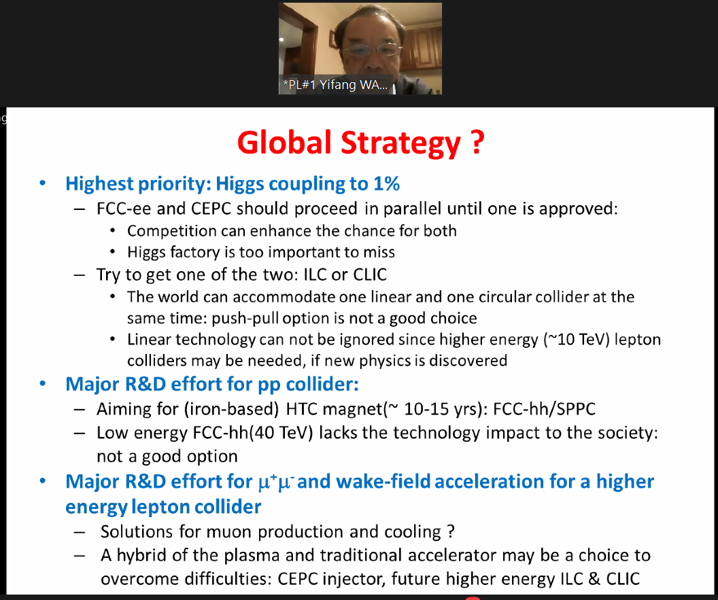
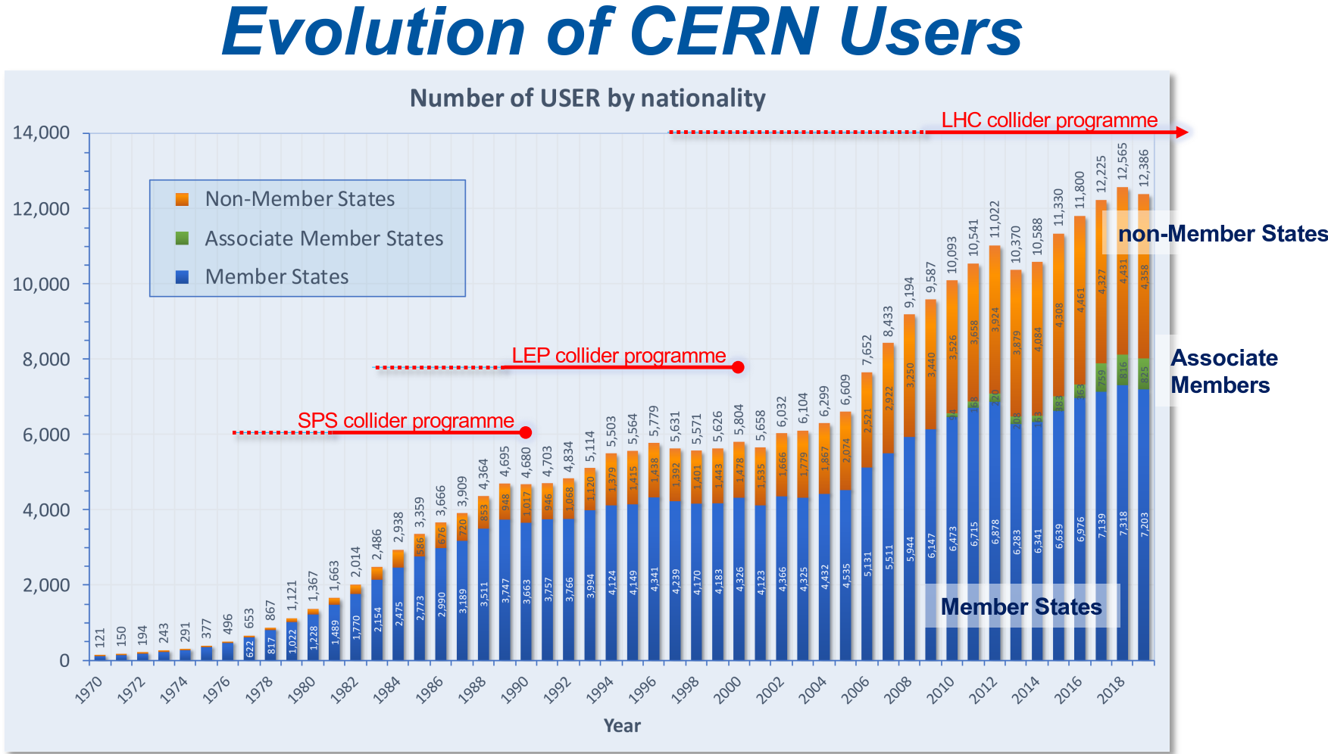
HEP Panel Discussion

