Slide 1
IAS2021: highlights
M. Koratzinos
FCC-ee Optics Design Meeting
22/1/2021

Slide 2
introduction
A very eclectic and biased review of the IAS conference
I have only things that:
  I noticed
  That I was interested in
  That show a deviation from my preconceptions

Slide 3
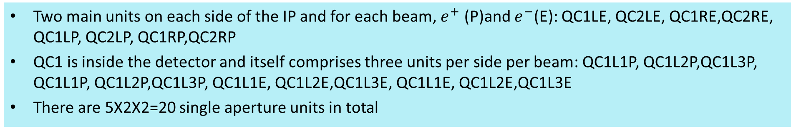
Final focus quadrupoles
Two main units on each side of the IP and for each beam, $e^{+}$ (P)and $e^{−}$(E): QC1LE, QC2LE, QC1RE,QC2RE, QC1LP, QC2LP, QC1RP,QC2RP
QC1 is inside the detector and itself comprises three units per side per beam: QC1L1P, QC1L2P,QC1L3P, QC1L1P, QC1L2P,QC1L3P, QC1L1E, QC1L2E,QC1L3E, QC1L1E, QC1L2E,QC1L3E
There are 5X2X2=20 single aperture units in total
From the FCC CDR update 13/12/2019, Katsunobu Oide
Optics design is such that E and P quads have the same strength
Maximum strength is 100T/m
The most difficult element is QC1L1, the closest to the beam and where the E and P quads are closer together
 | Start position (m) | Length (m) | B’ @Z (T/m) | B’ @W (T/m) | B’ @ H (T/m) | B’ @ tt (T/m)
QC2L2 | -8.44 | 1.25 | 25.05 | 43.82 | 61.30 | 69.50
QC2L1 | -7.11 | 1.25 | -0.18 | 0.00 | 7.32 | 56.85
QC1L3 | -5.56 | 1.25 | -19.35 | -34.38 | -53.08 | -99.98
QC1L2 | -4.23 | 1.25 | -18.57 | -32.94 | -53.07 | -99.98
QC1L1.1 | -2.9 | 0.7 | -40.95 | -70.00 | -99.71 | -95.39
QC1L1.2 | 2.2 | 0.7 | -40.95 | -70.00 | -99.71 | -95.39
QC1R2 | 2.98 | 1.25 | -25.44 | -37.25 | -51.94 | -100.00
QC1R3 | 4.31 | 1.25 | -19.54 | -39.51 | -53.65 | -91.87
QC2R1 | 5.86 | 1.25 | 14.64 | 16.85 | -2.65 | 37.19
QC2R2 | 7.19 | 1.25 | 19.50 | 44.32 | 67.52 | 94.43
The updated parameters are rather different for QC1L1: its length is now 70cm from 120cm

Slide 4
My impression regarding the CEPC
A lot of hardware
Very aggressive design – more aggressive than FCC-ee!
  L* less than FCC-ee: 1.9m
  B field of detector higher than FCC-ee: 3T
  Beam pipe diameter @FF quads smaller than FCC-ee: 17mm
  FF quad strength higher than FCC-ee ~140T/m
  (beam pipe diameter @ the IP: 28mm)
Still some errors

Slide 5
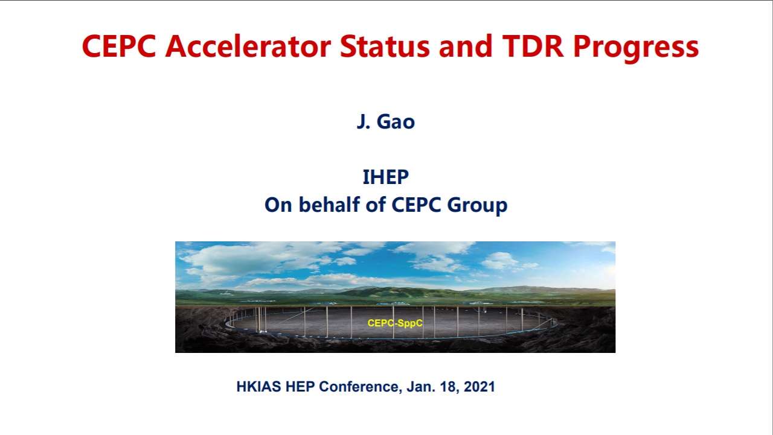

Slide 6
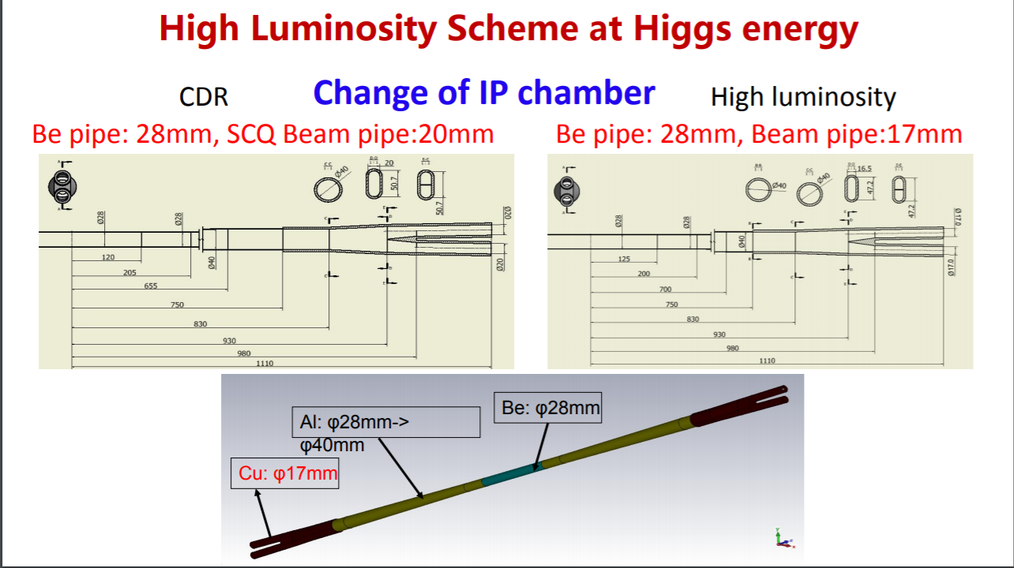

Slide 7
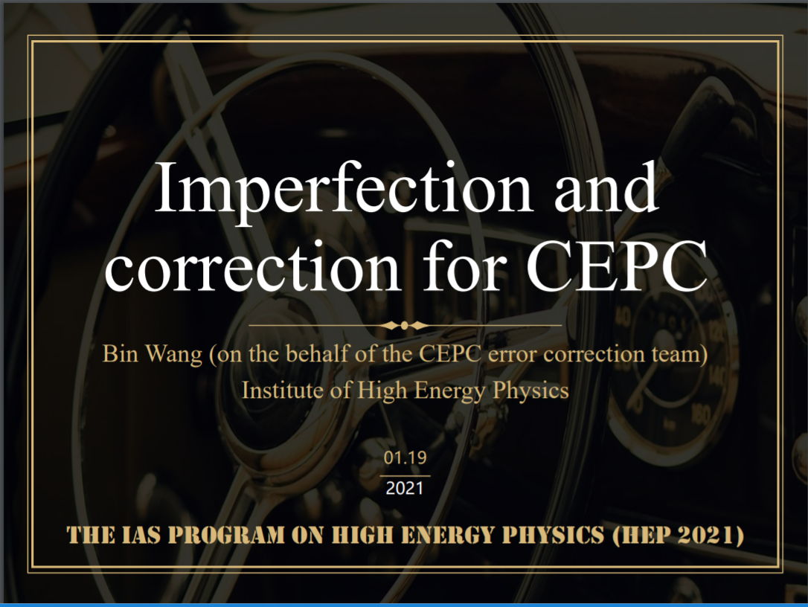

Slide 8
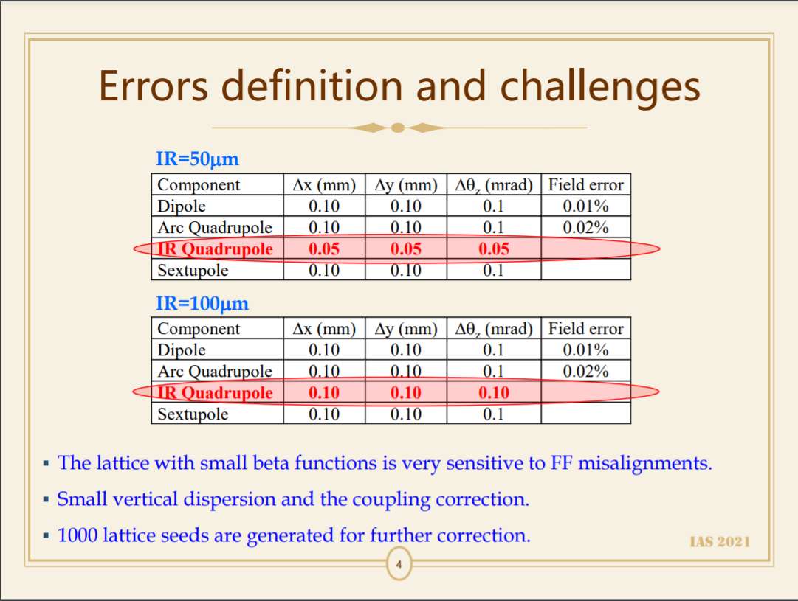
Similar assumptions to ours?
E = 120GeV

Slide 9
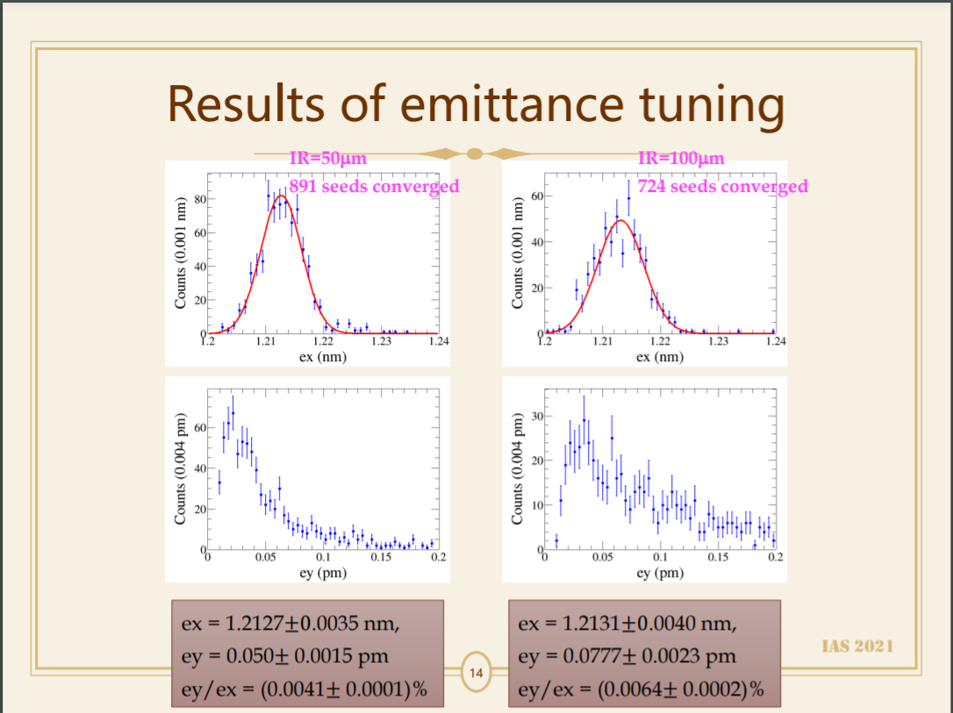

Slide 10



CEPC MDI Issues
Sha Bai
for CEPC MDI group
IAS Program on High Energy Physics,
Hong Kong, Jan 19-21, 2021.
2021-01-21

Slide 11
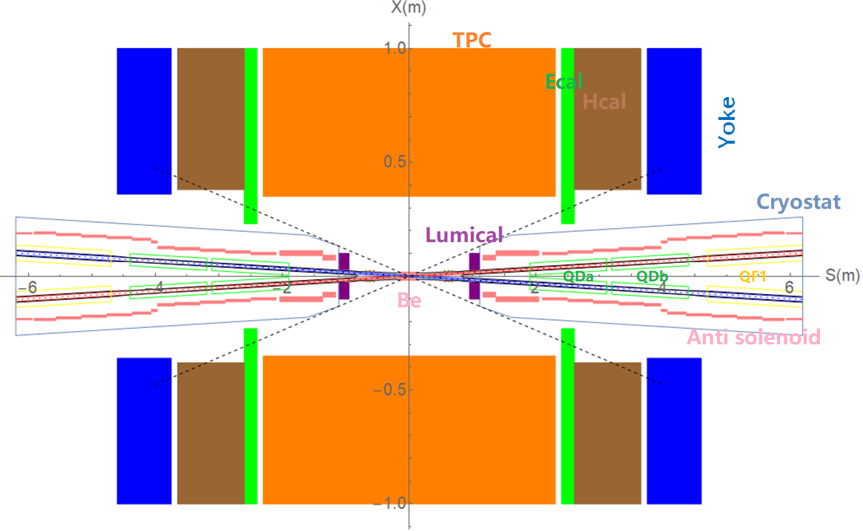
MDI layout and IR design
The Machine Detector Interface (MDI) of CEPC double ring scheme is about ±7m long from the IP.
The CEPC detector superconducting solenoid with 3T magnetic field and the length of 7.6m.
The accelerator components inside the detector without shielding are within a conical space with an opening angle of cosθ=0.993.
The e+e- beams collide at the IP with a horizontal angle of 33mrad and the final focusing length is 1.9m.

Slide 12
Chances since their CDR
Now L* is 1.9m, strength of FF quad ~150T/m
Design is more aggressive than ours!
B-s-c is ~15mm, but beam pipe (from Jie Gao’s talk) is only 17 mm diameter

Slide 13
MDI parameters
 | range | Peak filed in coil | Central filed gradient | Bending angle | length | Beam stay clear region | Minimal distance between two aperture | Inner diameter | Outer diameter | Critical energy (Horizontal) | Critical energy (Vertical) | SR power (Horizontal) | SR power (Vertical)
L* | 0~1.9m |  |  |  | 1.9m
Crossing angle | 33mrad
MDI length | ±7m
Detector requirement of accelerator components in opening angle | 8.11˚
QDa/QDb |  | 3.2/2.8T | 141/84.7T/m |  | 1.21m | 15.2/17.9mm | 62.71/105.28mm | 48mm | 59mm | 724.7/663.1keV | 396.3/263keV | 212.2/239.23W | 99.9/42.8W
QF1 |  | 3.3T | 94.8T/m |  | 1.5m | 24.14mm | 155.11mm | 56mm | 69mm | 675.2keV | 499.4keV | 472.9W | 135.1W
Lumical | 0.95~1.11m |  |  |  | 0.16m |  |  | 57mm | 200mm
Anti-solenoid before QD0 |  | 8.2T |  |  | 1.1m |  |  | 120mm | 390mm
Anti-solenoid QD0 |  | 3T |  |  | 2.5m |  |  | 120mm | 390mm
Anti-solenoid QF1 |  | 3T |  |  | 1.5m |  |  | 120mm | 390mm
Beryllium pipe |  |  |  |  | ±120mm |  |  | 28mm
Last B upstream | 64.97~153.5m |  |  | 0.77mrad | 88.5m |  |  |  |  | 33.3keV
First B downstream | 44.4~102m |  |  | 1.17mrad | 57.6m |  |  |  |  | 77.9keV
Beampipe within QDa/QDb |  |  |  |  | 1.21m |  |  |  |  |  |  | 1.19/1.31W
Beampipe within QF1 |  |  |  |  | 1.5m |  |  |  |  |  |  | 2.39W
Beampipe between QD0/QF1 |  |  |  |  | 0.3m |  |  |  |  |  |  | 26.5W

Slide 14
QDa/QDb, QF1 physics design parameters β_{y}*=1mm, β_{x}*=0.33m
QDa/QDb | Horizontal BSC 2（18σ_{x}+3） | Vertical BSC 2（22σ_{y}+3） | e+e- beam center distance
Entrance | 12.41/19.66 mm | 12.89/15.22 mm | 62.71/105.28mm
Middle | 14.84/23.02 mm | 14.61/14.88 mm | 82.84/125.41mm
Exit | 17.92/24.14 mm | 15.21/13.87 mm | 102.64/145.21mm
Good field region | Horizontal 12.13/17.92 mm; Vertical 15.21/15.22 mm
Effective length | 1.21 m
Distance from IP | 1.9/3.19 m
Gradient | 141/84.7 T/m
QF1 | Horizontal BSC 2（18σ_{x}+3） | Vertical BSC 2（22σ_{y}+3） | e+e- beam center distance
Entrance | 19.66 mm | 13.21 mm | 155.11 mm
Middle | 23.02 mm | 12.00 mm | 179.87 mm
Exit | 24.14 mm | 11.60 mm | 204.62 mm
Good field region | Horizontal 24.14 mm; Vertical 13.21 mm
Effective length | 1.5 m
Distance from IP | 4.7 m
Gradient | 94.8 T/m

Slide 15
Heating load on beam pipe
Big discussion on SR heating and collision debris heating, but no mention of resistive heating…
Huge amount of HM heating (4kW around +-2m from the IP)
Paraffin cooling does not work, use water instead.

Slide 16
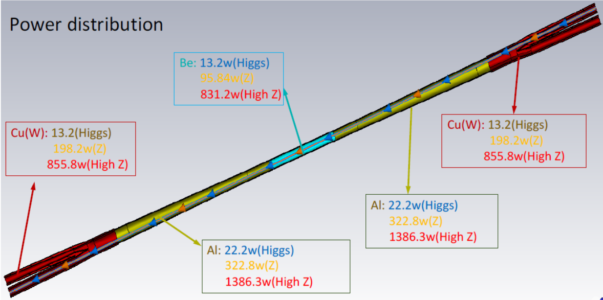
HOM power distribution

Slide 17
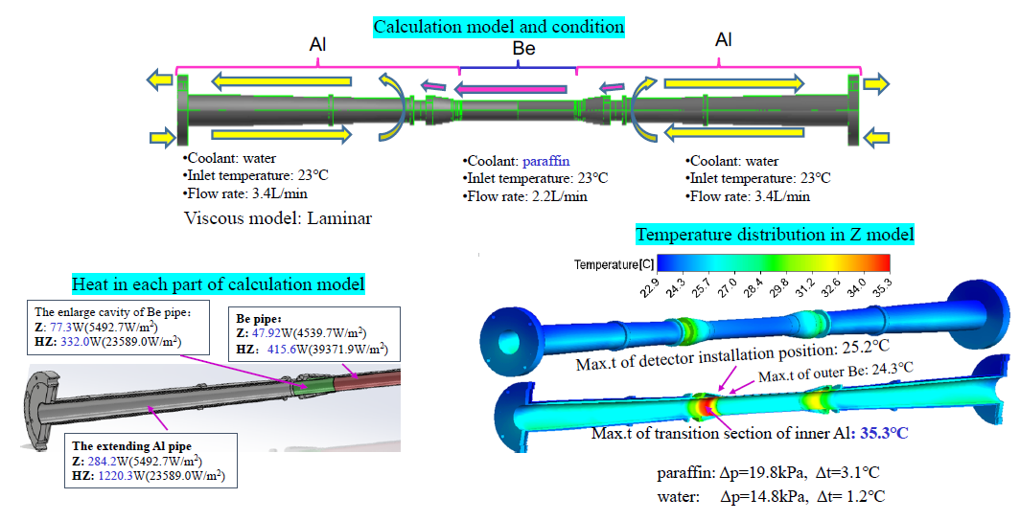
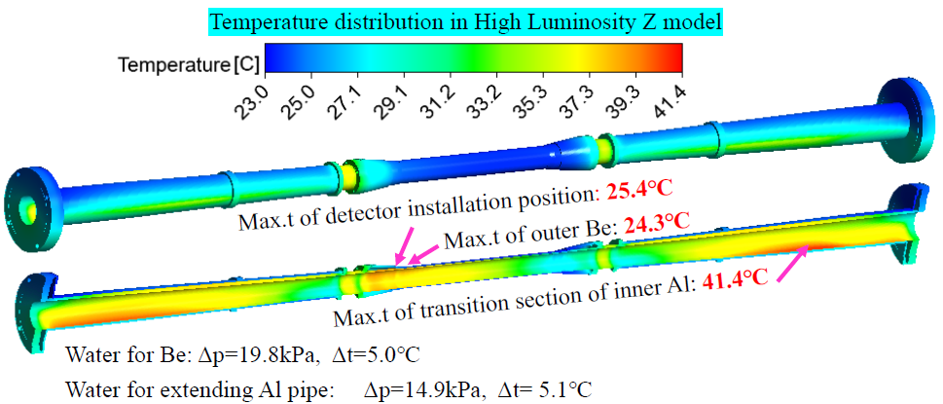
Beam pipe thermal analysis
With the heat deposition in High Luminosity Z mode, it becomes impossible to cool the Be beam pipe with oil. Water is chosen as the coolant for the demonstration purpose.
Water flow rate for Be: 3.4L/min
Water inlet temperature: 23⁰C
Other calculation condition is the same as before
High Lumi Z parameters
CDR Z parameters

Slide 18
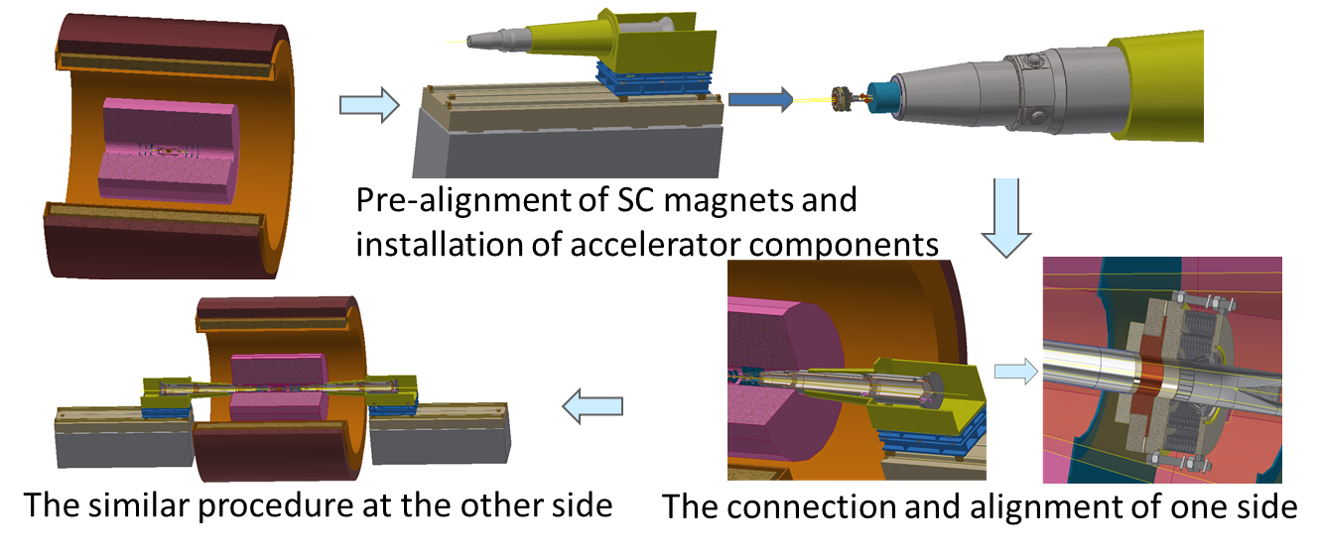
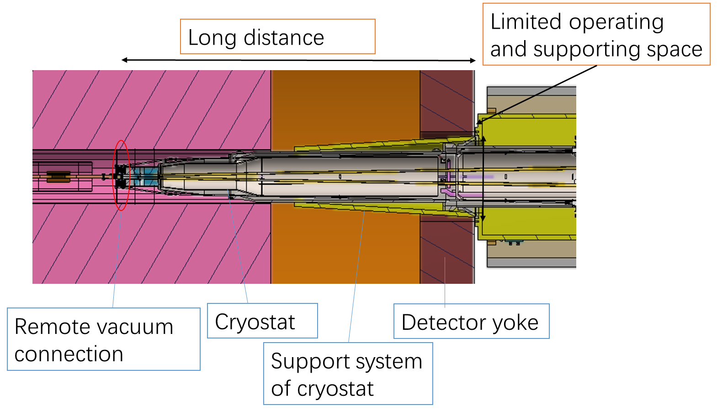
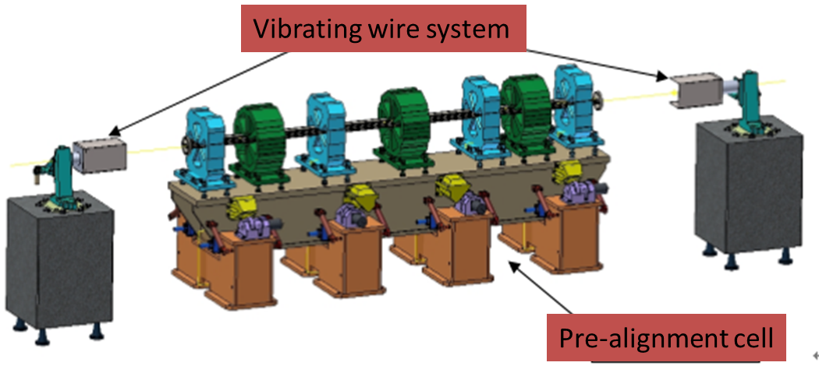
MDI integration and alignment
Alignment scenario:
  Pre-align the SC magnets using vibrating wire system to “certain location” to compensate the effect of loads.
  Align the SC magnets in two cryostats using optical system.
  Measure misalignment using SSW and adjust by corrector magnets meet the alignment requirements.
VWS is a candidate pre-alignment method, accuracy of magnet centers: ≤10 μm

Slide 19
Still lumical behind flange
Also Lumical not centred on outgoing beam pipe

Slide 20
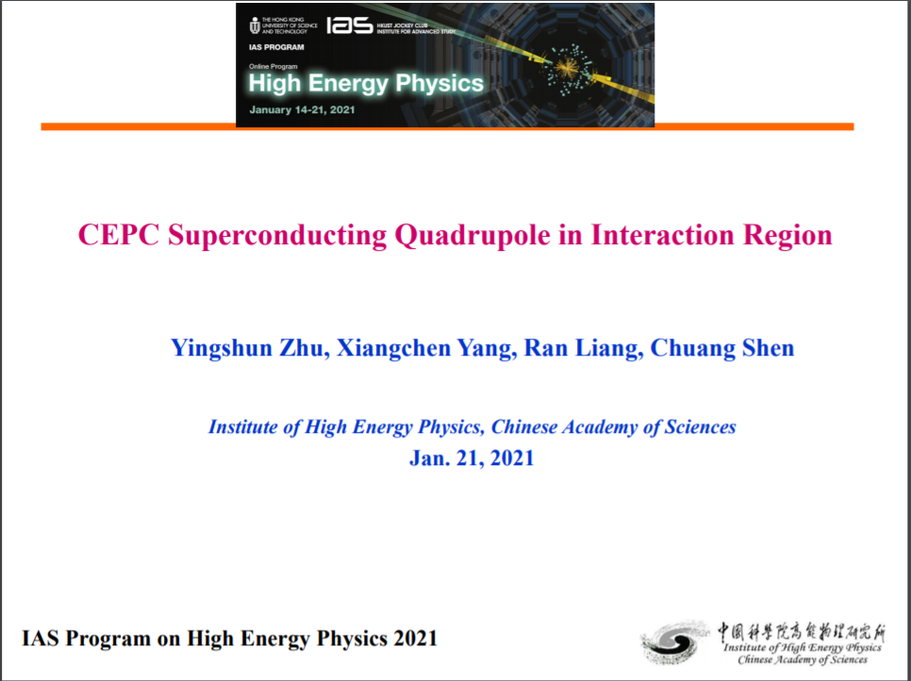

Slide 21
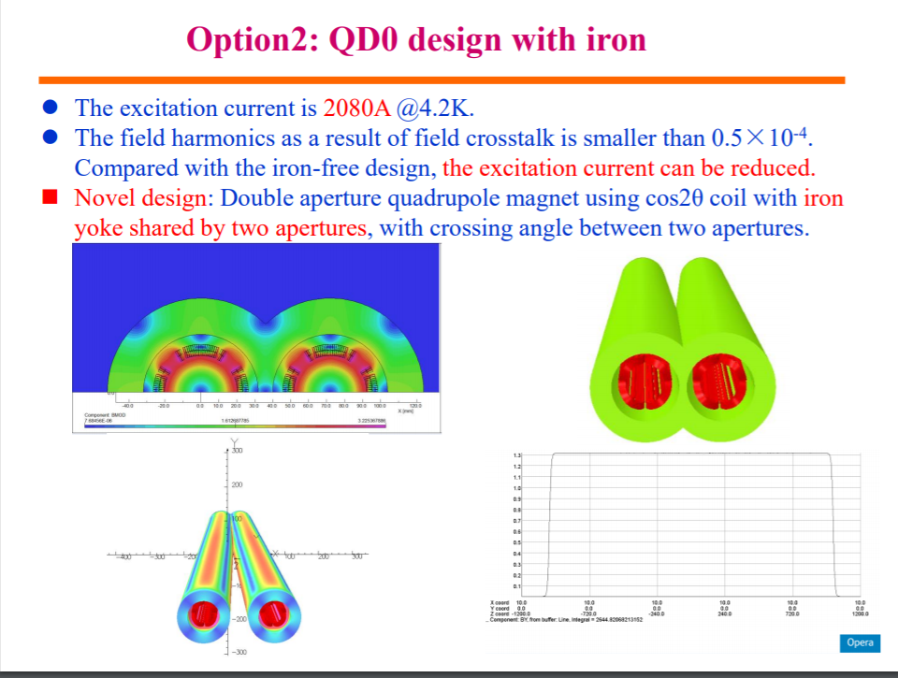
Old design

Slide 22
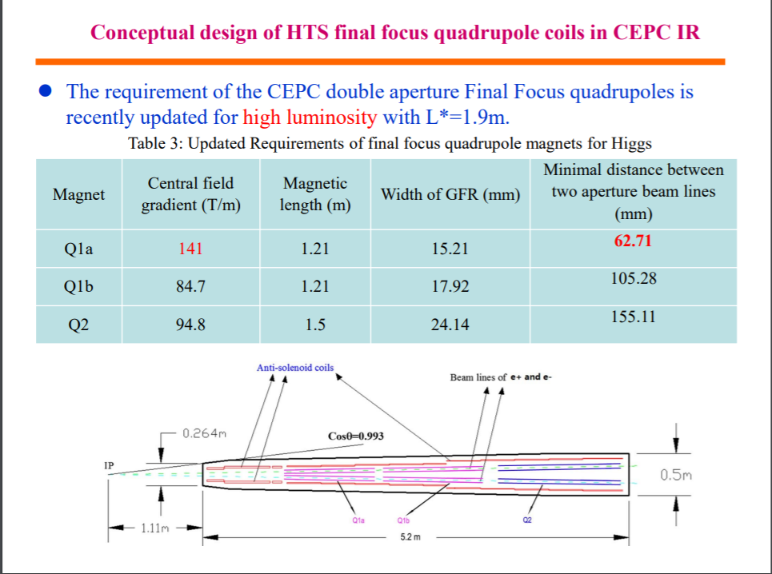
New “high luminosity” design

Slide 23
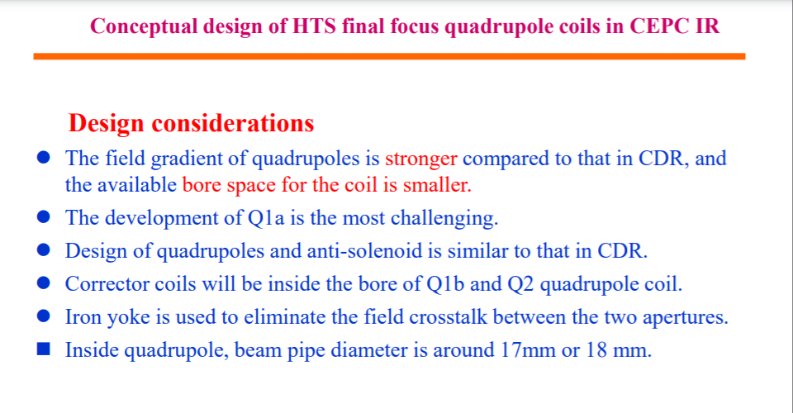

Slide 24
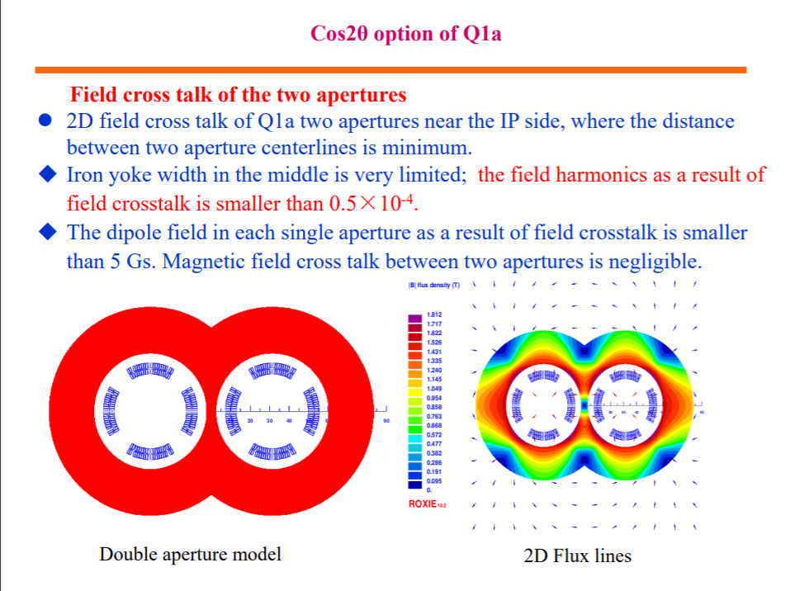
Miraculously, crosstalk is still at 0.5 units

Slide 25
Progress of CEPC Magnet R&D
Wen Kang, Mei Yang
IAS 2021
Beijing, Jan. 21, 2021

Slide 26
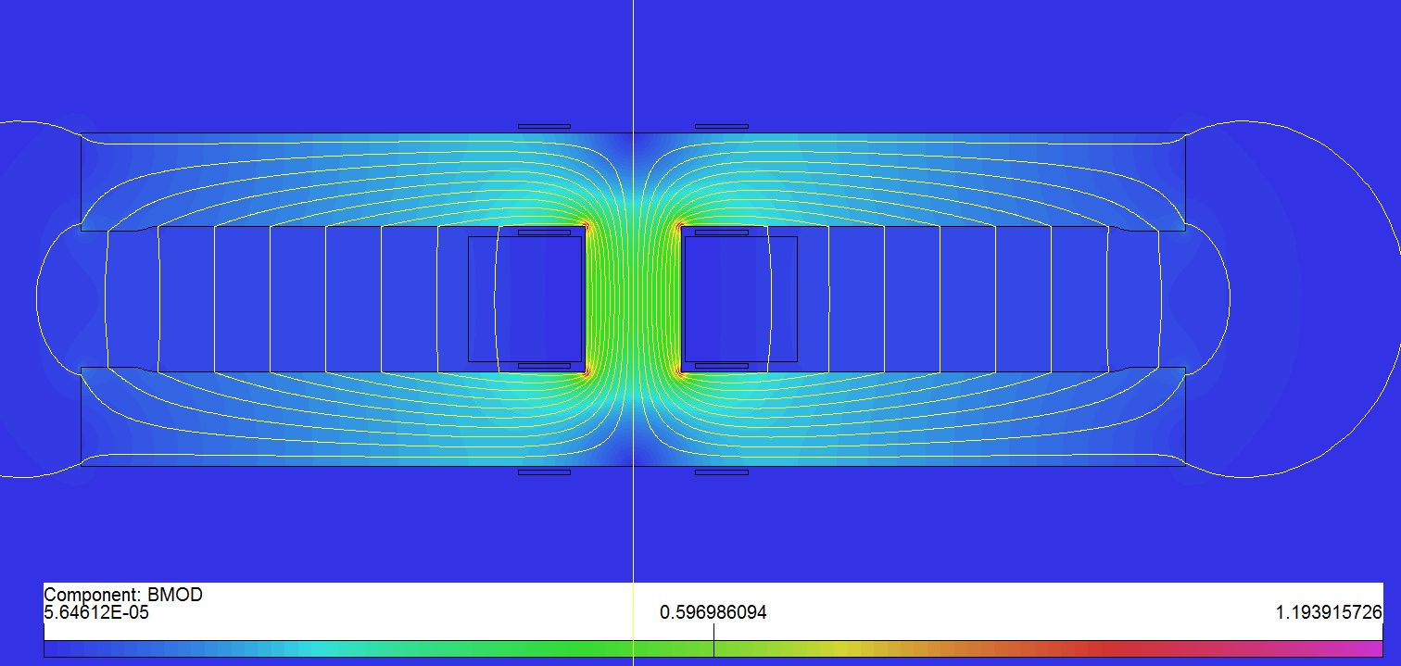
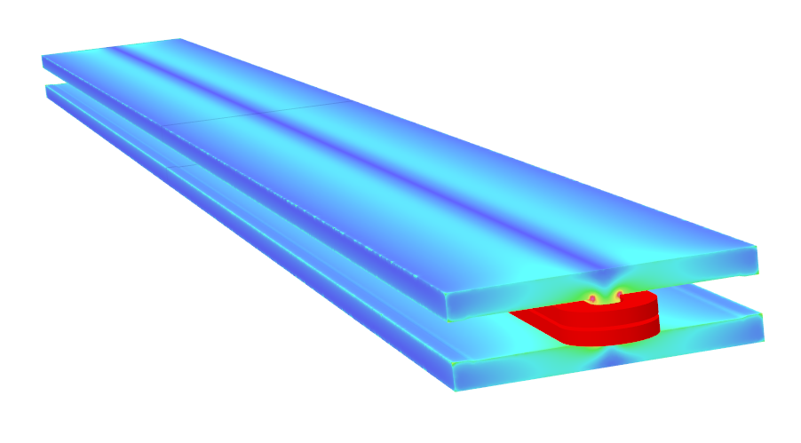
Design of long DAD magnet
As the magnetic length is up to 28.7m, the 5.7m pure dipole model will be built to check the field quality, mechanical strength and deformation.
Basic parameters and design considerations
  Beam center separation is 350mm;
  Solid iron with DT4;
  Two turns of aluminum busbars with cooling hole;
  Anodizing treated insulation coil;
  Silvered contact face to reduce contact resistance.
 | Item
Center field (Gs) | 141.6@45.5GeV，373@120GeV，568@182.5GeV
Gap (mm) | 66
Magnetic Length (m) | 5.737
Good field region (mm) | ±13.5
Field harmonics | <0.05%
Field adjustability | ±1.5%
Field difference between two apertures | <0.5%
Cross section of long DAD

Slide 27
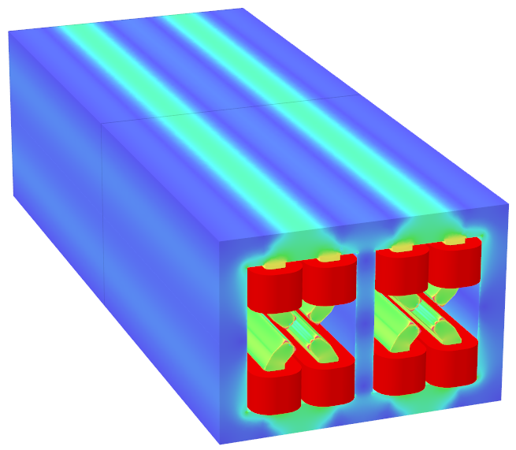
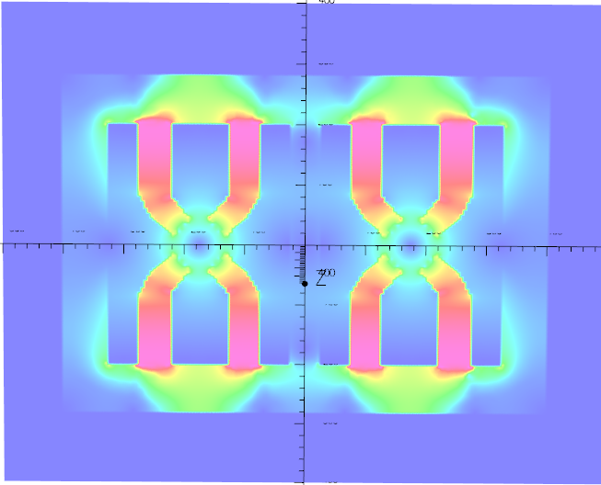
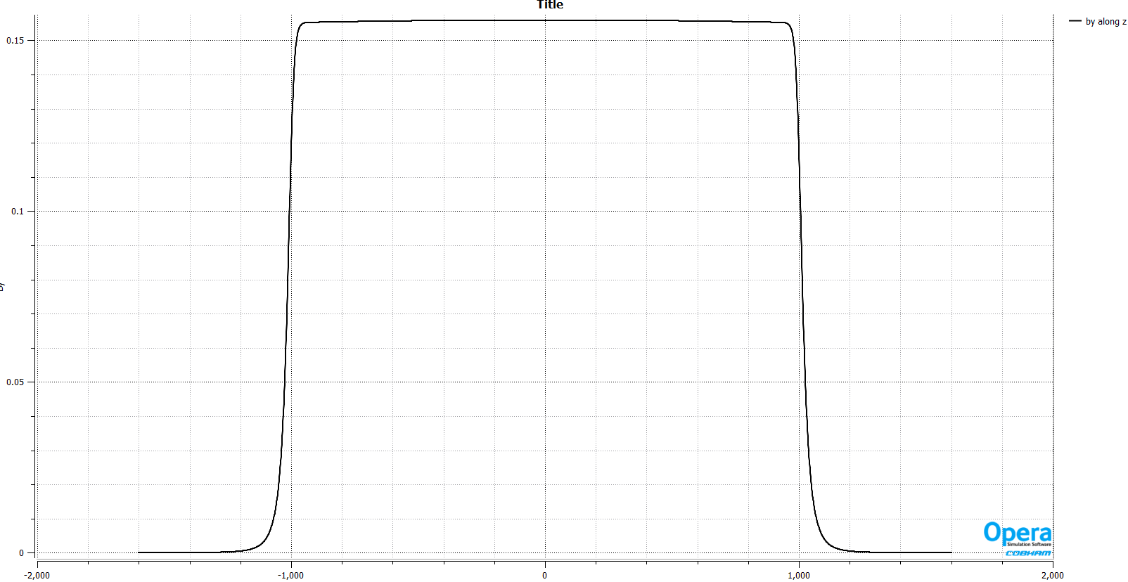
A new design of DAQ magnet
3D simulation (2m long iron)
  The iron weight is about 4 ton, the coils’ weight is about 270kg .
  The power consumption 9kW @120GeV.
Bmod@182.5GeV
Bmod@182.5GeV, @center plane
By along z @r=12.2mm in Ap2

Slide 28
Arc quad
 | Dipole | Quad. | Sext. | Corrector | Total
Dual aperture | 2384 | 2392 | - | - | 13742
Single aperture | 80*2+2 | 480*2+172 | 932*2 | 2904*2
Total length [km] | 71.5 | 5.9 | 1.0 | 2.5 | 80.8
Power [MW] | 7.0 | 20.2 | 4.6 | 2.2 | 34
CEPC moved to a double aperture design. Power consumption: 9kW@120GeV
@top energies: 21kW
Number of quads: 2400
Total power of quads: 50MW!! (compared to 60MW SR power!!)

Slide 29
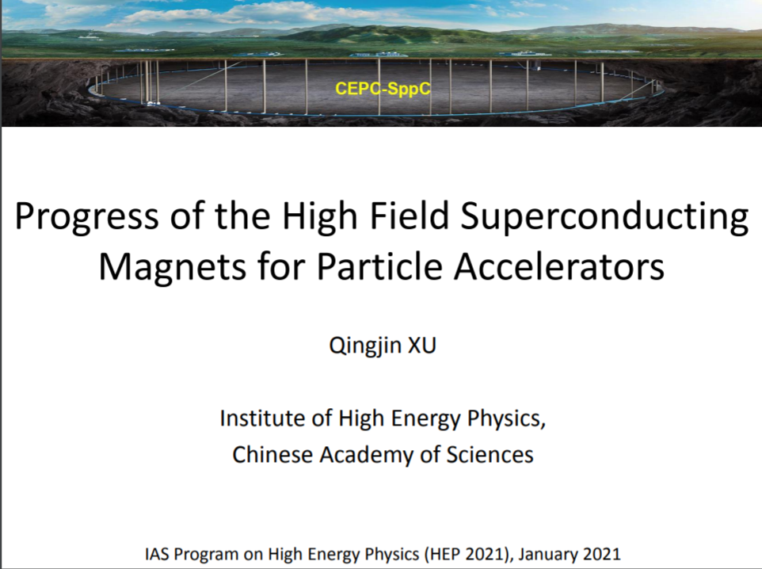

Slide 30
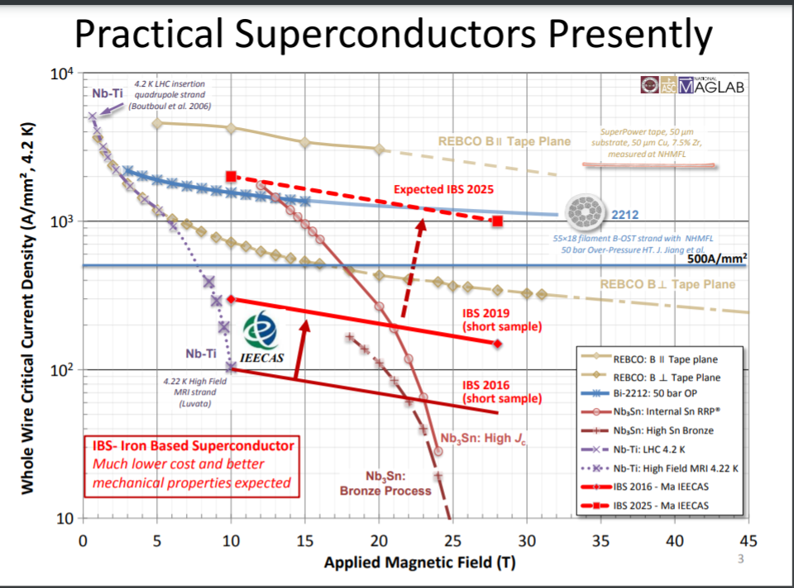

Slide 31
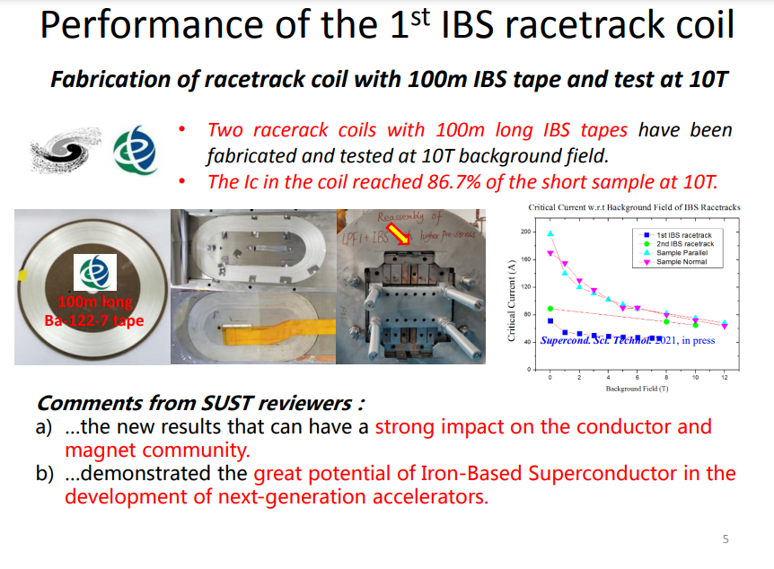
It seems reality is different… we are down from 500A/mm2 to ~50A/mm2

