Slide 1

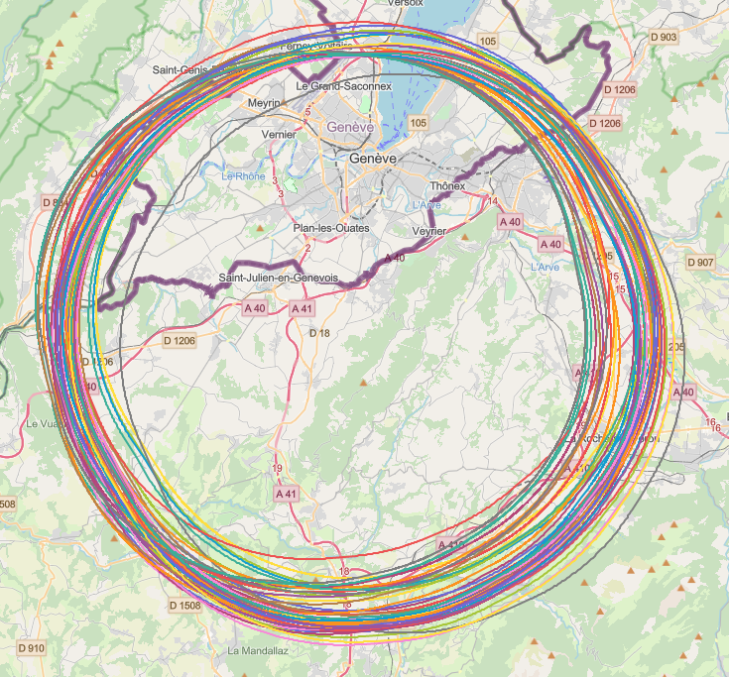
collider placement optimisation → 2 layouts
CDR baseline: C=97.756 km
total straight sections length: S=2x2.8+6x1.4=14 km
total arc length: A=C-S=83.756 km, A/(2 pi)=13.330 km
dipole bending radius ρ = 10.760 km
more realistic candidate layouts:
PB17_08: C=96.094 km
total straight sections length: S=2x3.25+6x1.4=14.88 km
total arc length: A=C-S=81.214 km, A/(2 pi)=12.926 km
dipole bending radius ρ ~ 10.434 km (3% reduction w.r.t. CDR)
PB19_03: C=91.324 km
total straight sections length: S=2x2.69+6x1.36=13.54 km
total arc length: A=C-S=77.784 km, A/(2 pi)=12.380 km
dipole bending radius ρ ~ 9.993 km (7% reduction w.r.t. CDR)
J. Gutleber, V. Mertens
Consequences for our parameters? $V_{RF}∝U_{0}∝1/ρ$ , $L∝ρ$ ?

