Slide 1
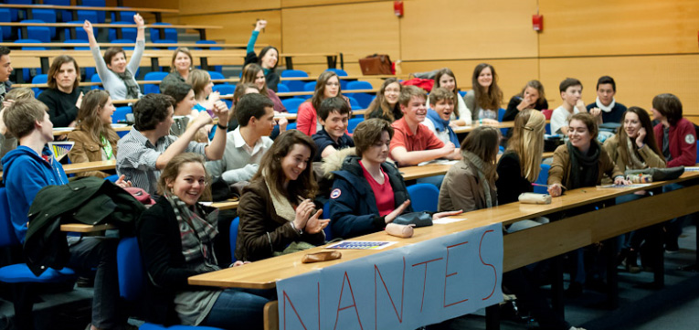

INTERNATIONAL MASTERCLASSES
HANDS ON PARTICLE PHYSICS
Nantes

Slide 2
A day of immersion in particle physics for 16-18 year old pupils
Typical day of International Masterclasses
Morning : introductory lectures on
Particle physics (elementary particles, forces, Standard Model and beyond)
Detectors – accelerators – experimental methods
Visit of laboratory / experimental site / discussion with scientists and graduate students
Lunch – usually offered by the Host Institute
Afternoon : students analyse data from an LHC experiment and do a physics measurement
They work in groups of 2 per computer; analysis is visual in most cases
At the end of the day : Video Conference
moderated by two physicists at CERN and connecting up to 5 institutes
presentation / merging/ discussion of results, answering questions, quiz

Slide 3
A bit of history and present status
1996: Started in UK
2005: Adopted by EPPOG (European Particle Physics Outreach Group) for all Europe
  Use data from LEP (the Large Electron Positron collider, CERN, 1989-2000)
  OPAL Identifying Particles
  DELPHI Hands on CERN
  Z0 decays / calculation of branching ratios
2006: U.S. joined program
2010: preparing to move to LHC-based Masterclasses
2011: Start using data from LHC
ATLAS W+W- (MINERVA) structure of the proton
ATLAS Z0 (HYPATIA) mass, width (+Z' from MC)
CMS J/Ψ (in 2011) and W/Z (in 2012)
ALICE Looking for strange particles (V0 decays)
ALICE Nuclear modification factor
LHCb Measurement of the Dº lifetime
Central organisation TU Dresden (Uta Bilow, Michael Kobel)

Slide 4
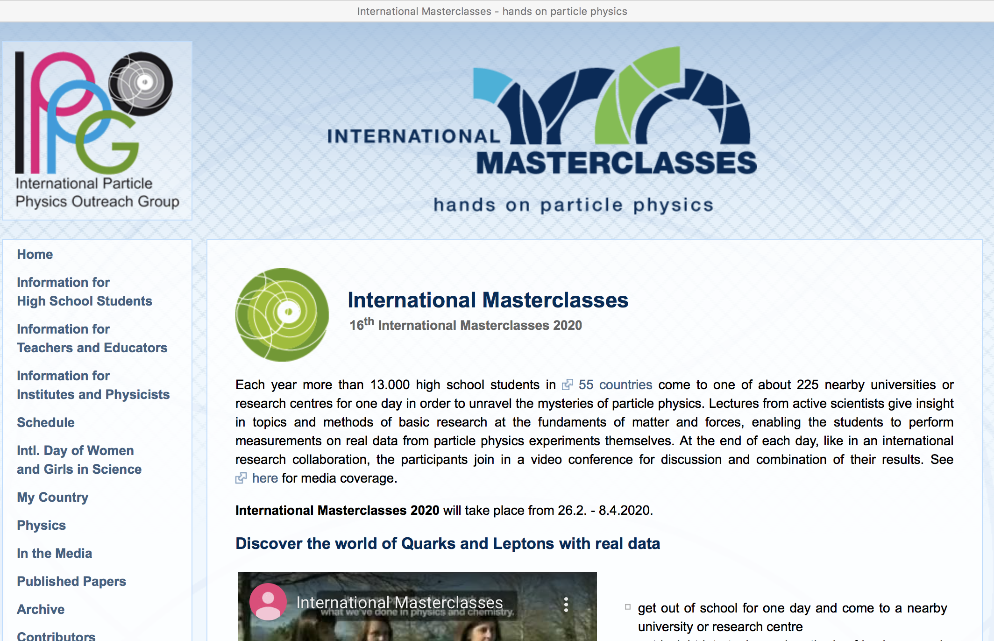

Slide 5
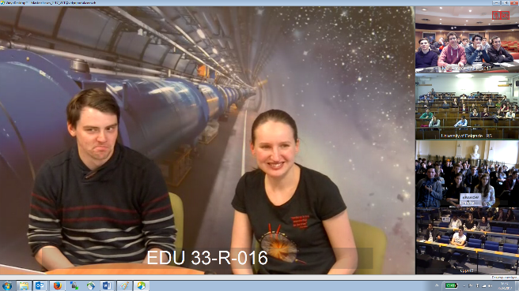
Video Conference
Presentation of the moderators
Welcome of the participating institutes
General questions from the participating institutes
Presentation of the results of the measurements by institutes
Merging of results by moderators
Comments, discussion, more questions
Quiz
Often it is the highlights of the day
General appreciation of the International Masterclasses very positive
New countries join every year

Slide 6
Statistics International Masterclasses
2005
2006
2007
2008
2009
2010
2011
2012
2013
2014
2015
2016
2017
2018
18
countries
52
58
institutes
225
72
masterclasses
307
3k
students
14k
12
video conferences
82

Slide 7
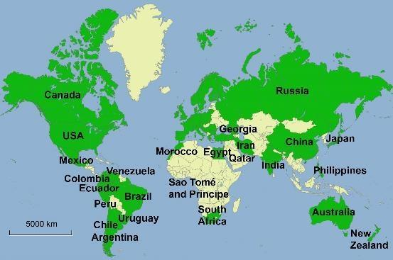
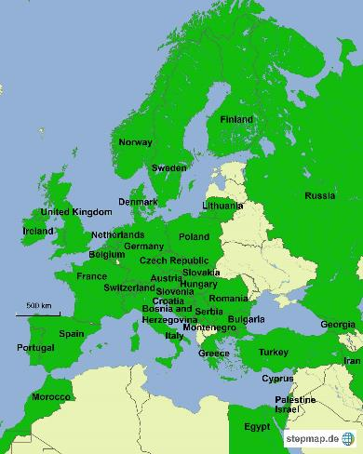
THE 2019 MASTERCLASSES
Masterclasses : 7.3. - 16.4.2019
54 countries
239 institutes
15k students (preliminary number)
1k teachers (preliminary number)
Coordination.: TU Dresden
Coordination.: QuarkNet
188 institutes (177)
266 LHC Masterclasses (257)
  30 ATLAS W (35)
  101 ATLAS Z (104)
  64 CMS (58)
  41 LHCb (39)
  27 ALICE SP (18)
  3 ALICE R_AA (3)
51 institutes (48)
54 LHC Masterclasses (50)
  22 ATLAS (19)
  32 CMS (31)
(Incl. TRIUMF program)
12 MINERvA Masterclasses

