Slide 1
Pulsed DC System Irradiated Cu Electrode Update
21st January 2021

Slide 2
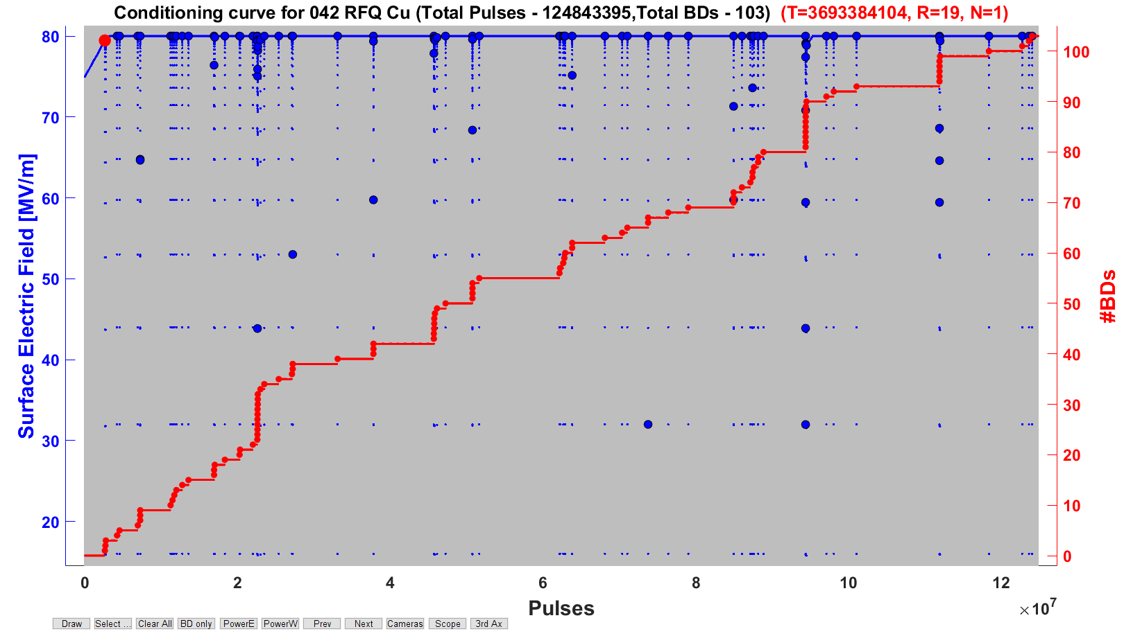
Current E-Field (run19)

Slide 3
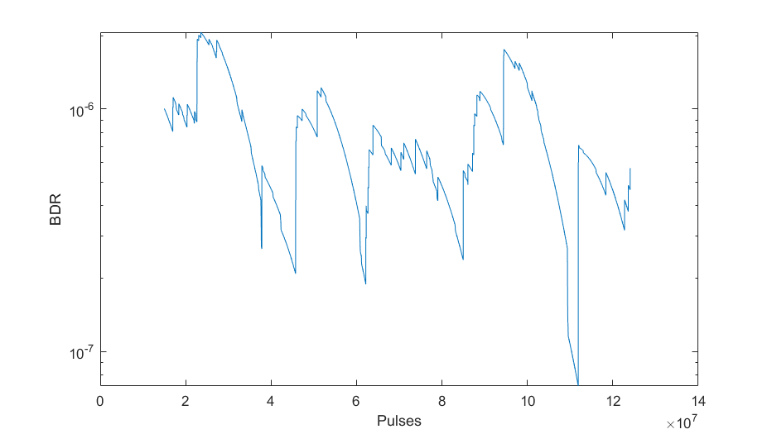
BDR for current field (run19)

Slide 4
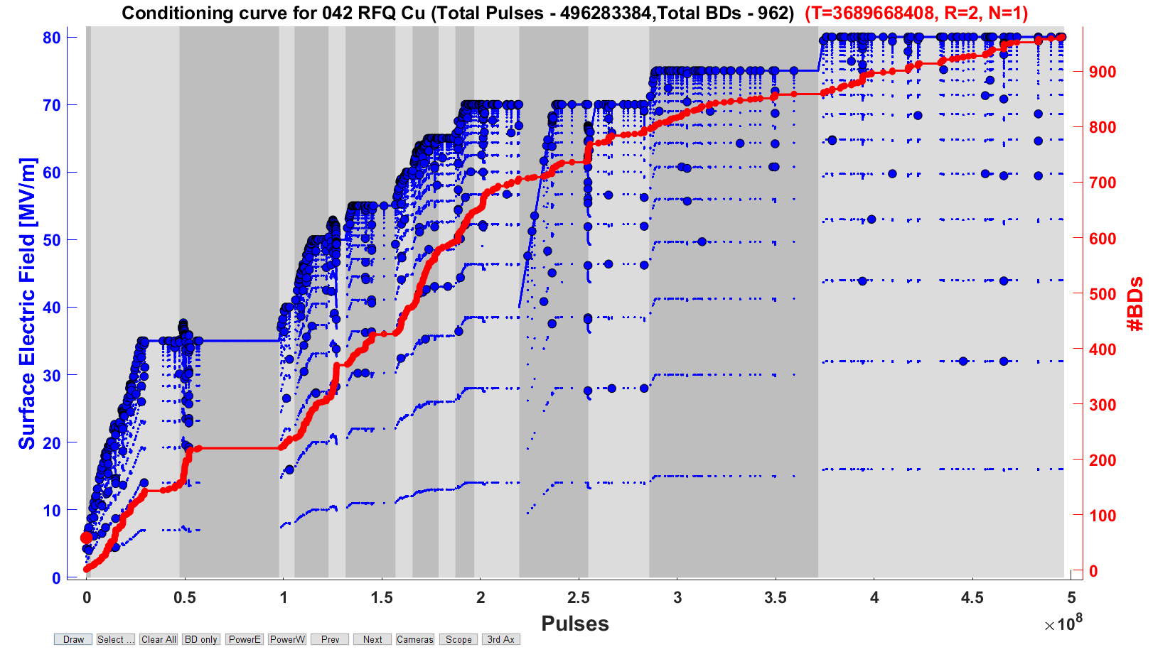
Conditioning Plot

Slide 5
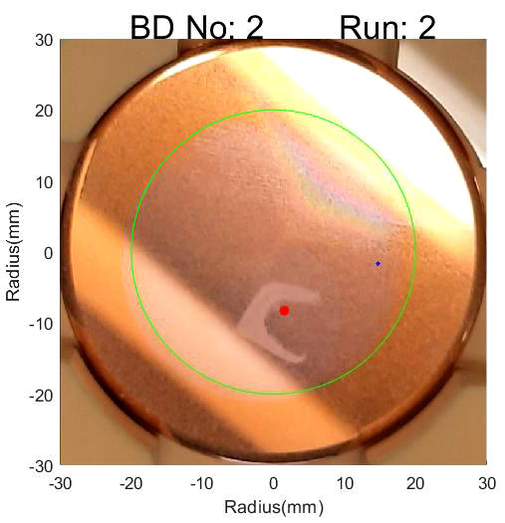
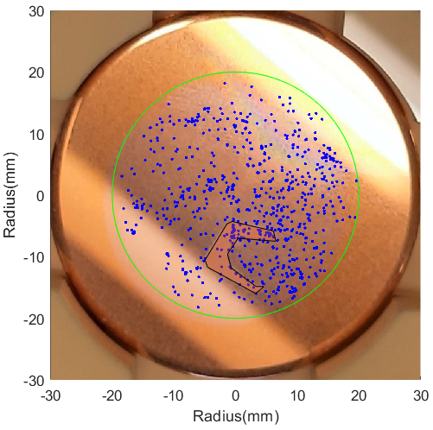
Breakdown Locations

