Slide 1
IEFC meeting highlights
Ray VENESS
29/1/21
https://indico.cern.ch/event/1000273/

Slide 2
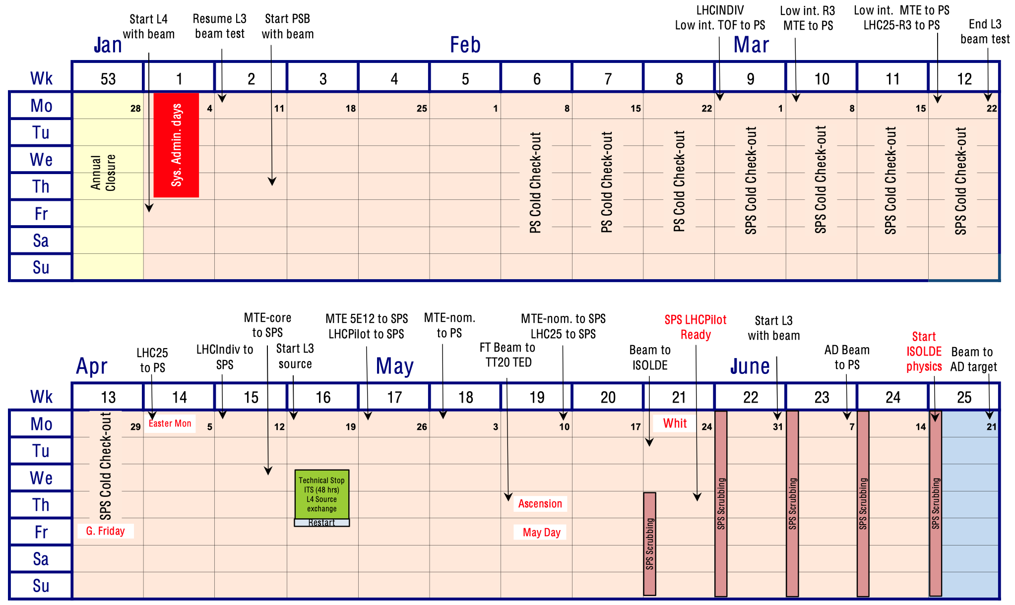
2021 Injectors Schedule: Q1 + Q2
Mainly concentrating on commissioning and Scrubbing.
  Many intermediate milestones.
First beam to ISOLDE on 25.05 and start of physics 21.06.
Details for the technical stop in week 16 remains to be defined:
  Exchange of Linac 4 source and beam recovery time.
  RP cooldown time.
  Technical stop interventions time window.
Agreement to provide NA setting-up beam already in week 25.

Slide 3
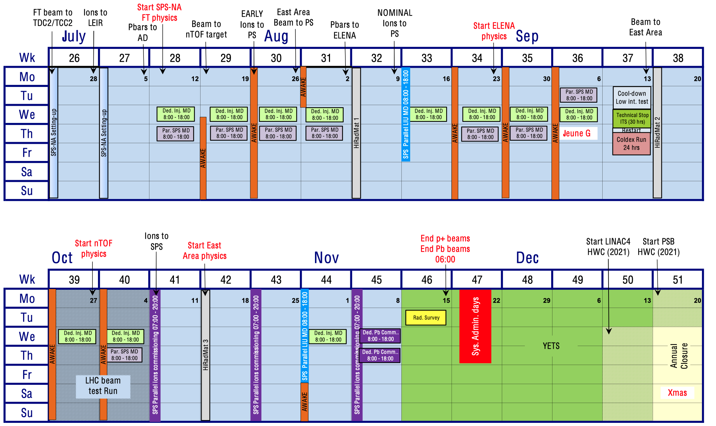
2021 Injectors Schedule: Q3 + Q4
Most experimental areas will start of physic during this period.
AWAKE, HiRadMat and MDs during prolonged days – impact on duty cycle for physics.
  No AWAKE during dedicated MDs.
Aim for high duty cycle for physics during nights and weekends.

Slide 4
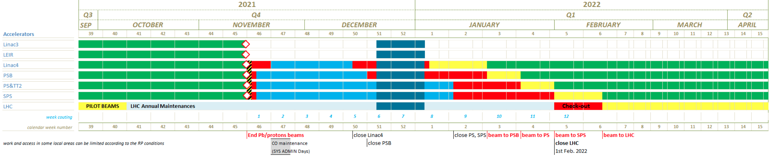
Presently Planned Short YETS ’21-’22
Courtesy of J. Coupard et al.
EDMS 2439145 – version 1.0
5 weeks for commissioning (hardware tests + cold check-out + beam commissioning) in the injectors (PSB, PS, SPS) before beam ready for PS the LHC.
The start of hardware re-commissioning in Linac 4 and PSB start before the annual closure.
The 6 (9) week YETS for the SPS is too short for the replacement of the MKP-L, which requires 12 weeks.

Slide 5
LIU milestones in 2021 – recover pre-LS2
Throughout 2021 pre-LS2 beams will be recovered in the upgraded injectors…
2021
March
April
May
June
July
August
September
October
Beams for set-up:
LHCINDIV
MTE low int
LHC25 short train
AD beam:
1.6e13 pot/cycle
nTOF beam:
1e13 pot/cycle
EAST beam:
1 – 5e11 p/spill
ISOLDE beam:
8e12 p/ring
Nominal Pb to PS:
8e8 ions/b
2 b/injection
Nominal Pb to SPS:
3e8 ions/b
4 b/injection
14 injections
Nominal pre-LS2 LHC25:
1.3e11 p/b
2.5 um
North Area:
4e13 p/spill

Slide 6
LIU milestones in 2021 – MD beams
MD time in 2021 will be limited due to late start and early end – first iteration for MD prioritization done (IPP meeting 1 October 2020)
2021
May
June
July
August
September
October
November
SPS scrubbing
Optimisation of PSB brightness and achievement of 2021 target PS brightness
HW commissioning of FFA and SS
1.6e11 p/b at SPS extraction
ε = 3 μm
2.6e11 p/b at PS extraction
ε = 3.5 μm
Beam commissioning of FFA and SS, and beam stabilisation

Slide 7
Additional Covid Measures in BE-OP Control Rooms
CCC capacity is reduced and access rights have been revisited.
  Only essential personnel should work in the CCC.
A dedicated (recently revised) document describes the use of the BE-OP control rooms during the Covid-19 pandemic (EDMS: 2391375).
Tools to remotely meet and share desktops and applications are available.
Masks:
  FFP2 masks: working days between 07:00 and 20:00. if one spends less than 1 hour in the control room, no need to exchange the surgical mask for an FFP2 mask (available in CCC).
  Surgical masks of type 1: outside the abovementioned working hours, provided 2 m distance can be respected.
In addition, clean your work space before and after each shift/activity and indicate your name near your workstation.
  Avoid sharing it without intermediary cleaning - Instructions at the entry of the CCC.

