Slide 1
BI LHC Planning for LS2
Global LHC LS2 Planning
https://espace.cern.ch/en-dep-mef-lpc/LS2/Global%20Schedules/Forms/AllItems.aspx
BI Planning

Slide 2
In-work Global planning LHC-LS2 V4.1

Slide 3
For BI in LS2:
All planned activities with VSC implication done
BSRT mirror LSS4L possible replacement end 2021

Slide 4
On-going activites
BLM: Following smoothly the planning
BPM → On-going, details next slide
BTV maintenance → Done and cameras mounted, except P4 and dump line
BRAN maintenance → Done
Others?

Slide 5
BPM activity details
There are 6 BPMs which need to be connected to the cables after vacuum bake-out:
BPTX.5L2.B1
BPMSW.1R2 -
BPMWC.6L7.B1 + BPMWC.6L7.B2
BPTX.5L8.B1 + BPMWI.A5L8.B1
We also have 11 other BPMs for which we would like to access the tunnel to debug problems with the electronics:
BPMSX.7R1.B1
BPM.11R1.B1
BPM.33L2.B1
BPMYB.5L2.B2
BPMSX.4R2.B1
BPM.30L3.B1
BPM.24L3.B2
BPM.16R4.B1
BPM.29R4.B2
BPM.11L7.B1
BPM.11L7.B2 Info copy/paste from Michal

Slide 6
To do list
List of activities before and after the test beam
Up-date and possibly simplify “Authorisation for Work in Sensitive Areas for He Spill for Run3”, request by Thomas Otto
Re-group by section?
  https://edms.cern.ch/document/1459321/1.0
  https://edms.cern.ch/document/1459326/1.0
  https://edms.cern.ch/document/1459351/1.0
  https://edms.cern.ch/document/1459792/1.0
  https://edms.cern.ch/document/1459881/1.0

Slide 7
Activities 2021 (reminder)
Handover for EN-ACE to BE-OP in February 2021
When does BI want to do what in 2021 after February?
  Do we need access for instrument calibration for the pilot beams?
  For all activities between February 2021 and October 2021 check with Jörg Wenninger and Matteo Solfaroli and EN-ACE, please keep me in the loop
  Need to make a list on our side as a starting point. Any inputs?
Annual Maintenance starts after pilot beams

Slide 8
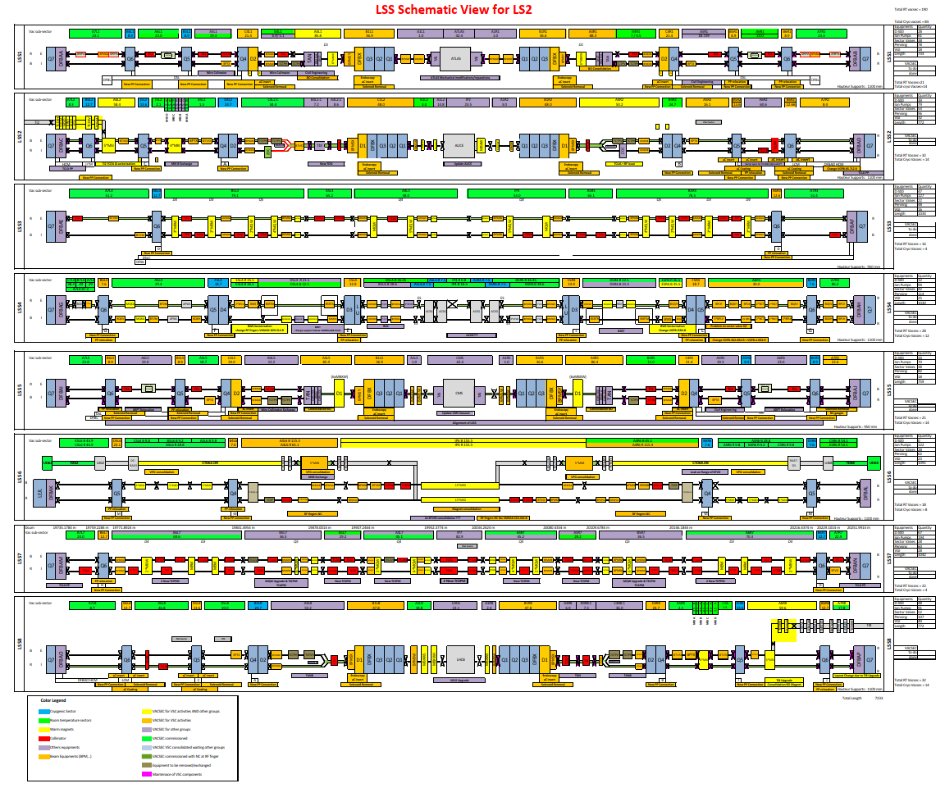
Latest Vacuum Schematic
If you cannot read that: Check Indico https://indico.cern.ch/event/857131/

