Slide 1


AD FACILITY
Technical Coordination Meeting
YETS works follow up

Slide 2
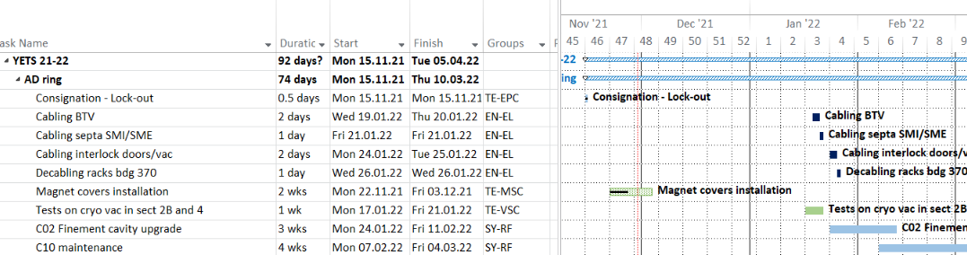
AD ring - general
Planning is at AD/ELENA planning
https://oss-coordination.web.cern.ch/gantt/latest?facilities=AD/ELENA&scale=week&worktypeproject=

Slide 3
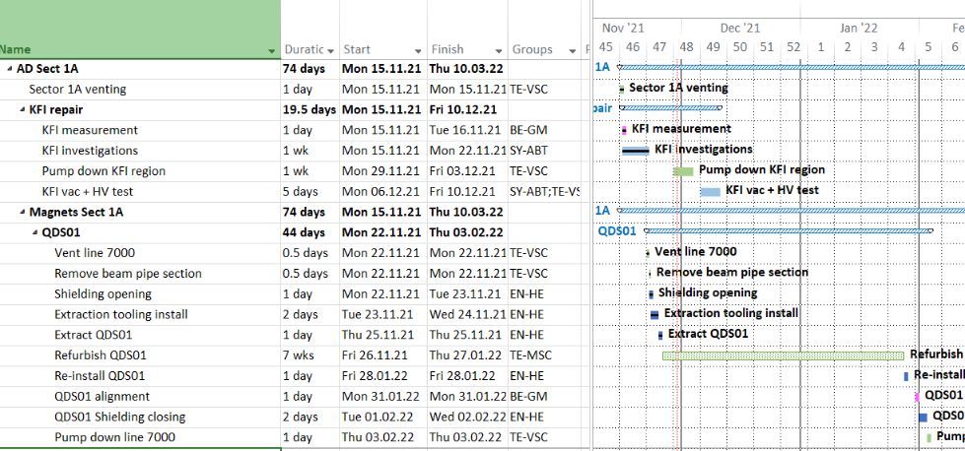
AD KFI repair
Critical Path

Slide 4
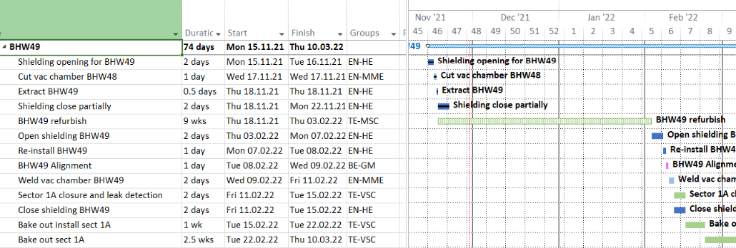
AD Magnet BHW49
Delayed
Critical Path

Slide 5
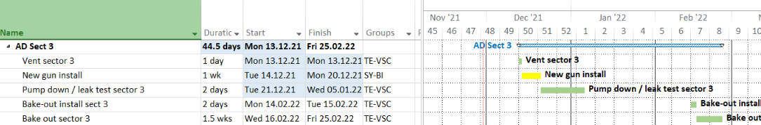
Sect 3: AD e-cooler
TBC
Availability
of gun !

Slide 6
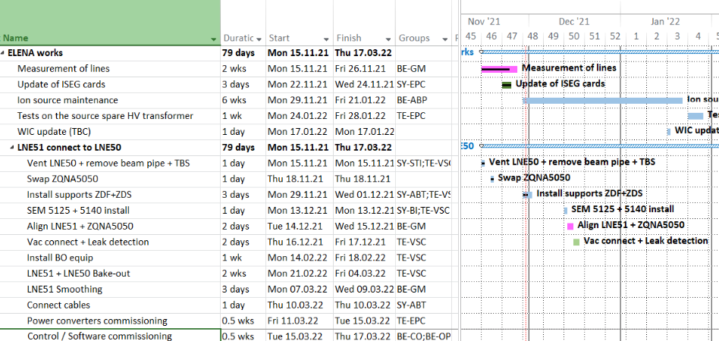
ELENA works

Slide 7
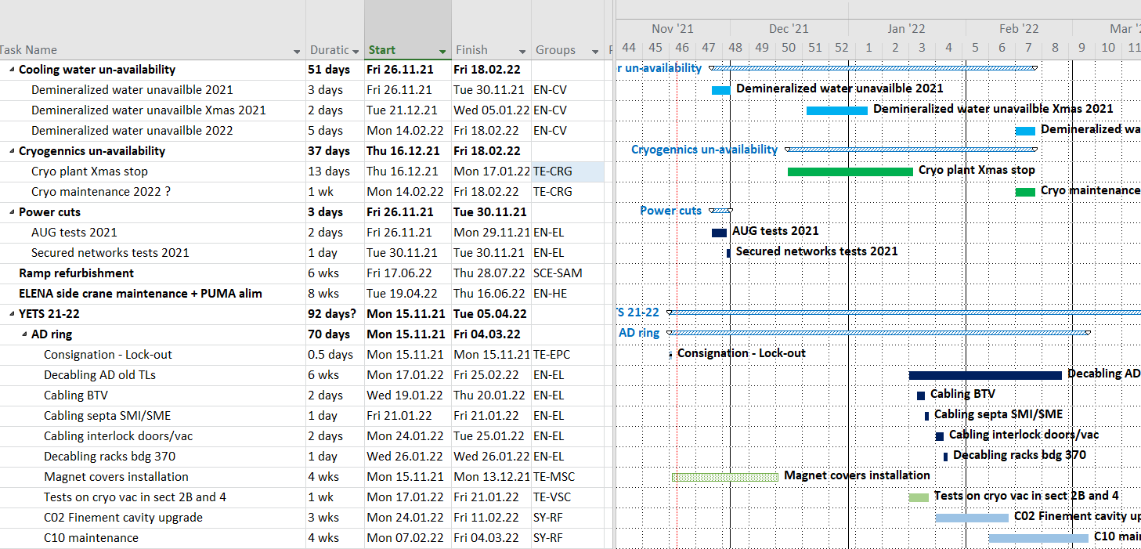
Service disruptions
NEW
TBC

