Slide 1
Illumination of test stand BGC camera due to cathode radiation
Noah Jens – 21.01.2021

Slide 2
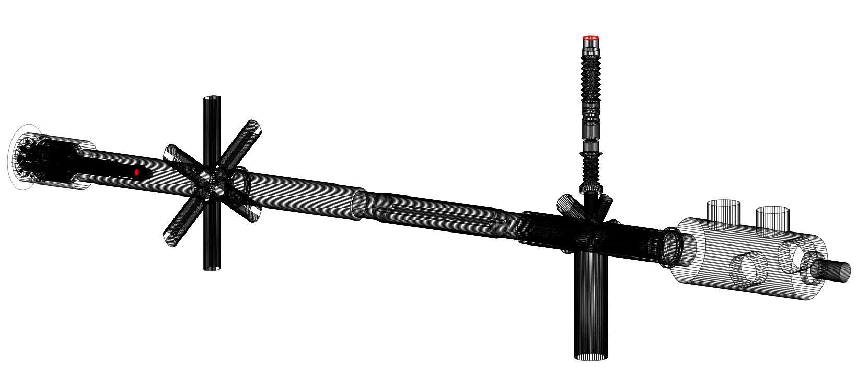
HEL test stand model in MolFlow
Camera
Cathode in e-gun

Slide 3
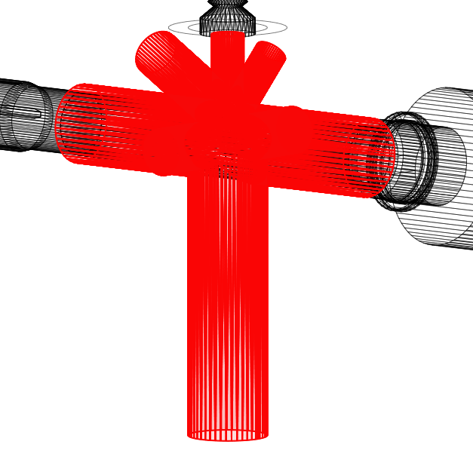
Correction of interaction chamber coating
Interaction chamber is NOT AC coated
about 10875 $\frac{1}{s}$ are expected at camera facet (instead of 1783 $\frac{1}{s}$)

Slide 4
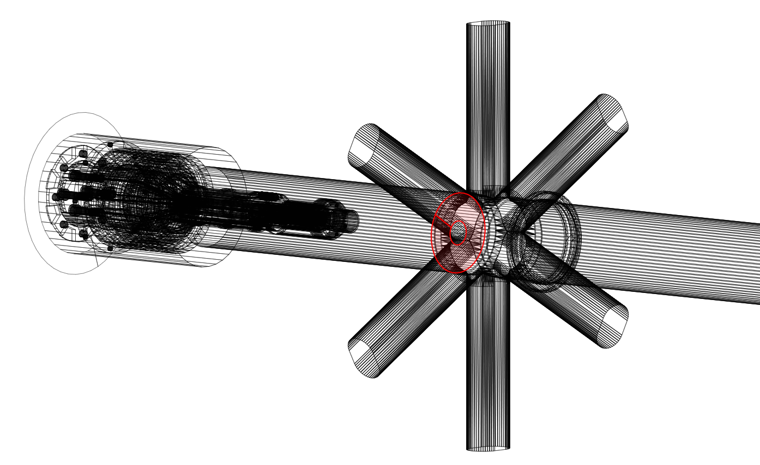
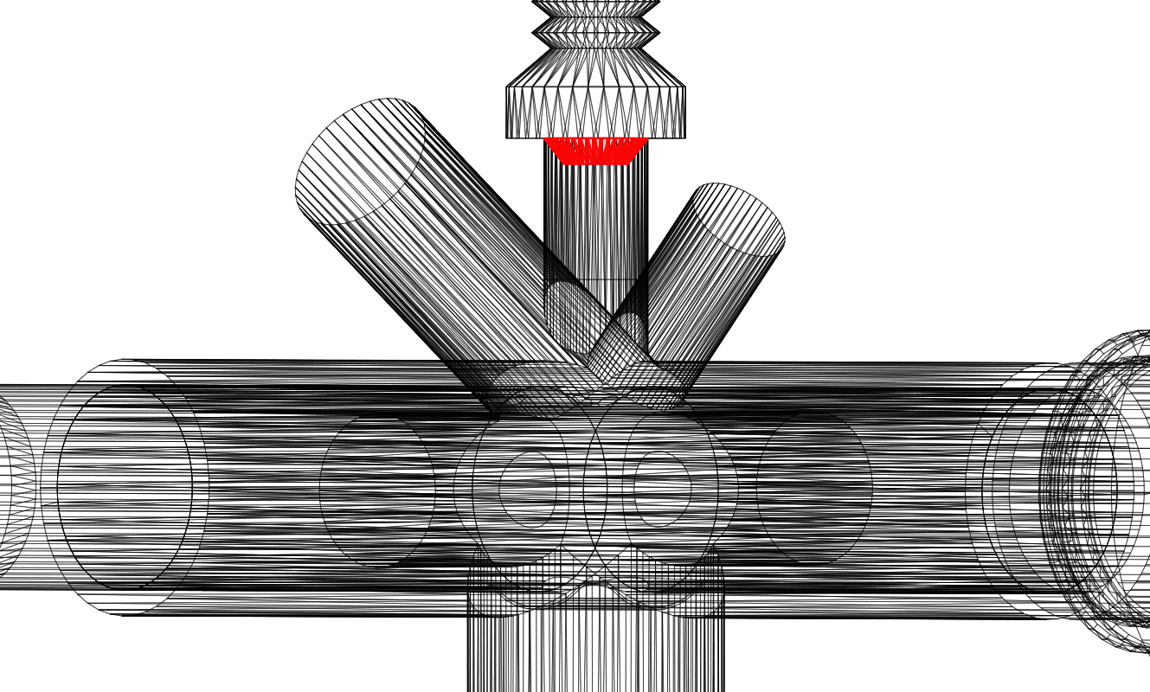
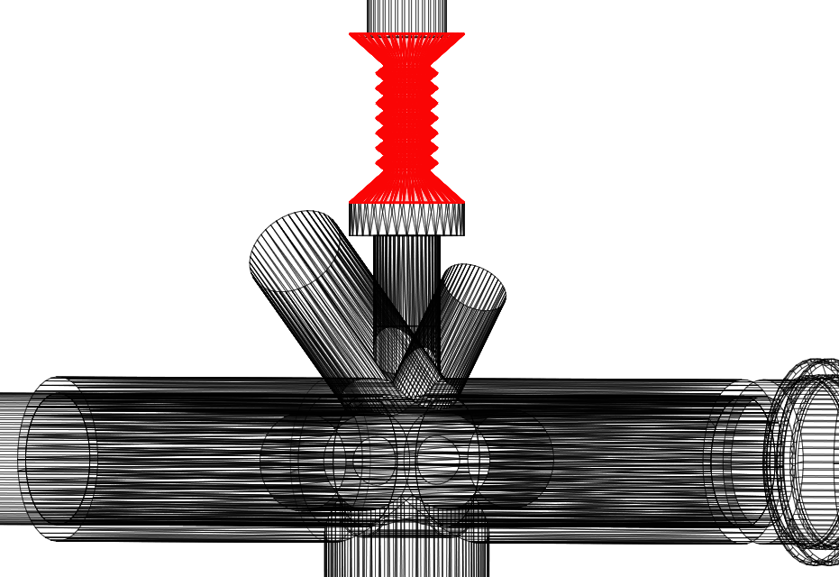
Measures to reduce photon rate at camera
Mask in front of gun
Mask in camera arm
Narrower bellows
30mm ID
AC coated or steel
25mm ID
AC coated
25mm ID

Slide 5
Simulation results in photons per second
Mask in front of gun
Mask in camera arm
Narrower bellows
no front mask | 10875 1/s
mask front (steel) | 802 1/s
mask front (AC) | 771 1/s
no front mask | 6186 1/s
mask front (steel) | 441 1/s
mask front (AC) | 411 1/s
no front mask | 4078 1/s
mask front (steel) | 292 1/s
mask front (AC) | 282 1/s

Slide 6
Simulation results in counts per second
Due to the maximum transmission of the filter (80%) and the quantum efficiency of the photocathode (10%), the counts per second can be estimated as followed:
Mask in front of gun
Mask in camera arm
Narrower bellows
no front mask | 870 cps
mask front (steel) | 65 cps
mask front (AC) | 62 cps
no front mask | 495 cps
mask front (steel) | 36 cps
mask front (AC) | 33 cps
no front mask | 327 cps
mask front (steel) | 24 cps
mask front (AC) | 23 cps

Slide 7
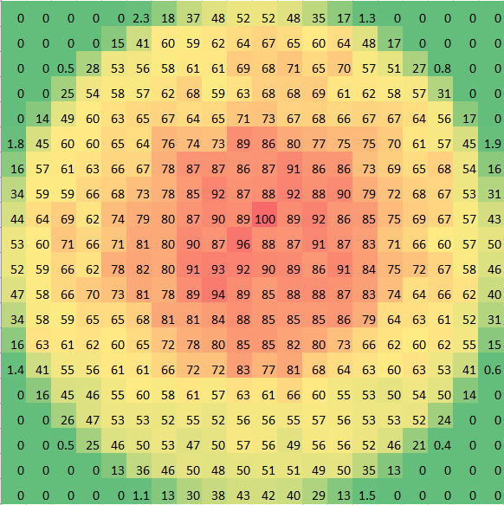
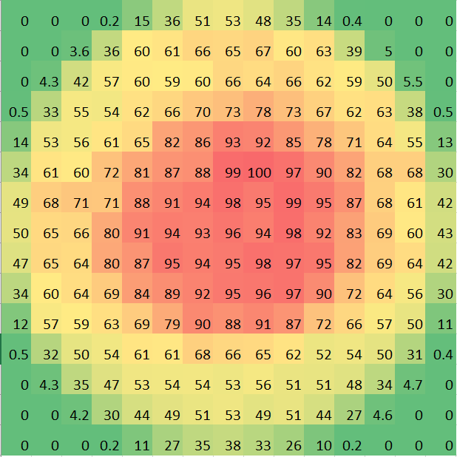
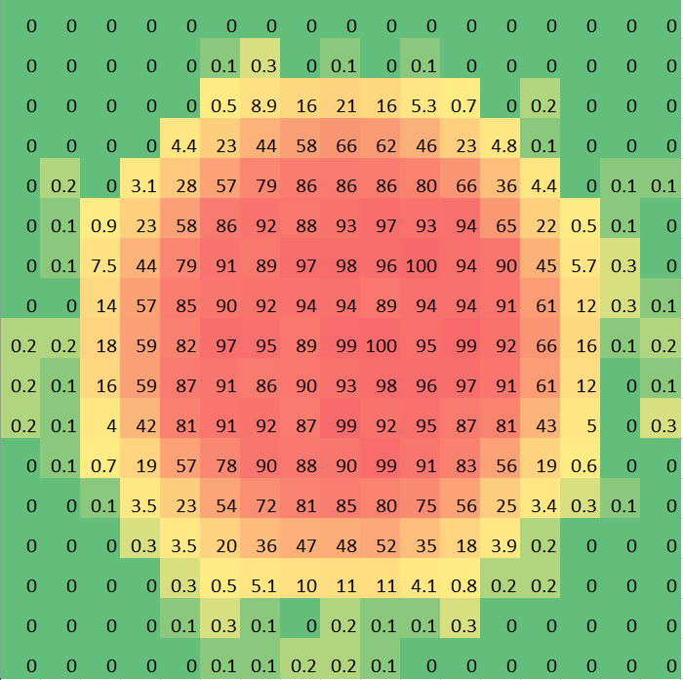
Distribution at the camera facet
(normalized and in percent)
AC mask front
AC mask front & mask in camera arm
AC mask front & narrow bellows

