Slide 1

BGC – HEL assembly sequence proposal
1 – 21/01/2021
Ioannis Papazoglou
January 2021 – CERN, Geneva, Switzerland

Slide 2
Design Decisions
Bellows on both sides of the BGC
Need to be able to align the BGC → Add at least 2 DoF table

Slide 3
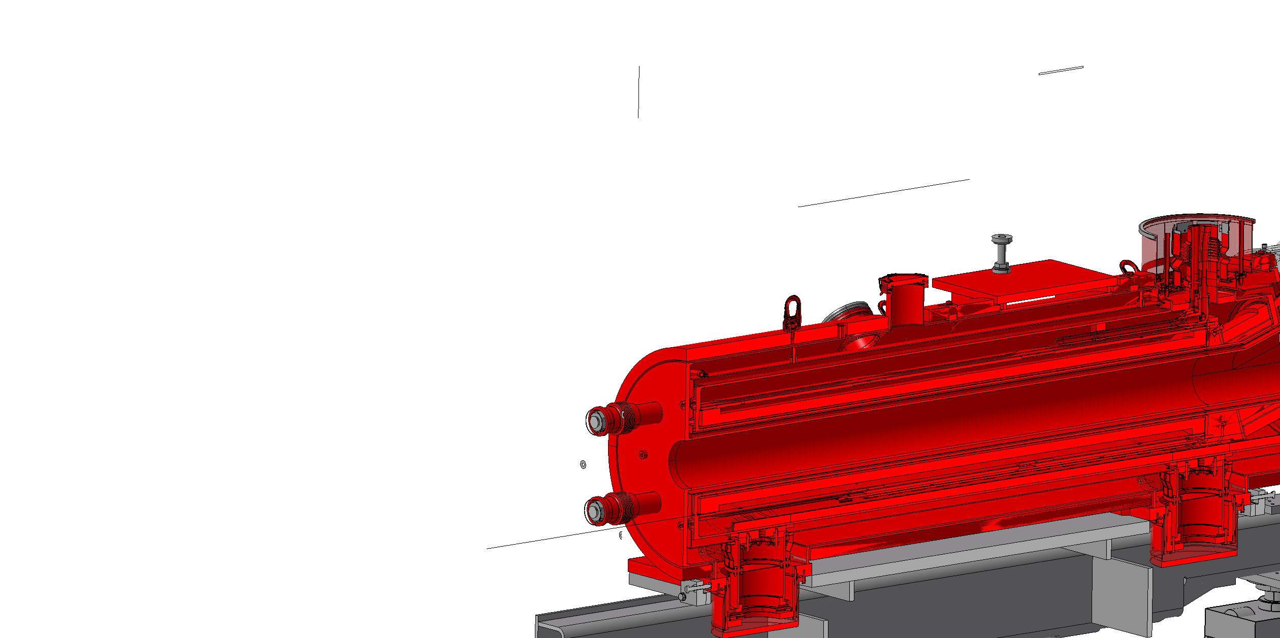
Step 1
Assemble the right magnet on the frame

Slide 4
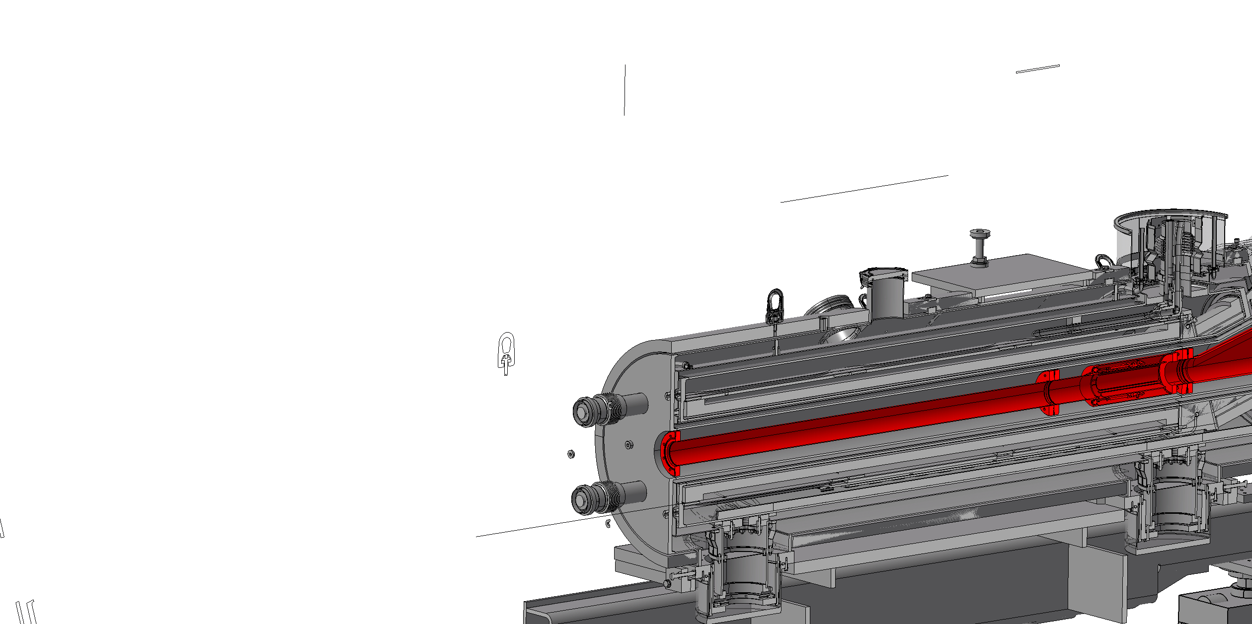
Step 2
Insert the beamline chamber in the magnet

Slide 5
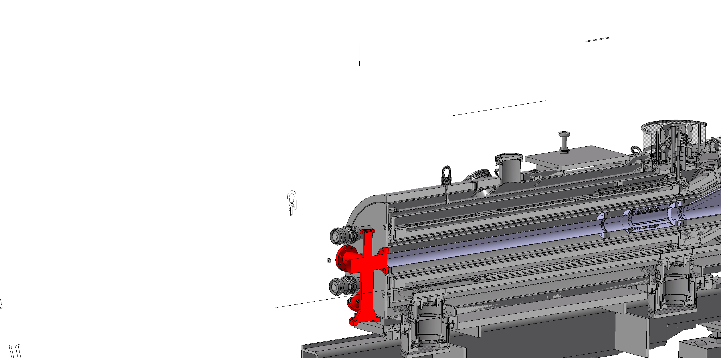
Step 3
Mount the BGC in the support structure
Slide it to the right chamber and connect it to the bellow

Slide 6
Step 3 notes
Need to check the order of assembly:
  Mount the BGC chamber on its support structure
  Slide it to place and connect it to the right hand bellow
  Assemble the valves and rest of components or leave it blank for ease of assembly of the left side bellow? → Check transportation to the tunnel

Slide 7
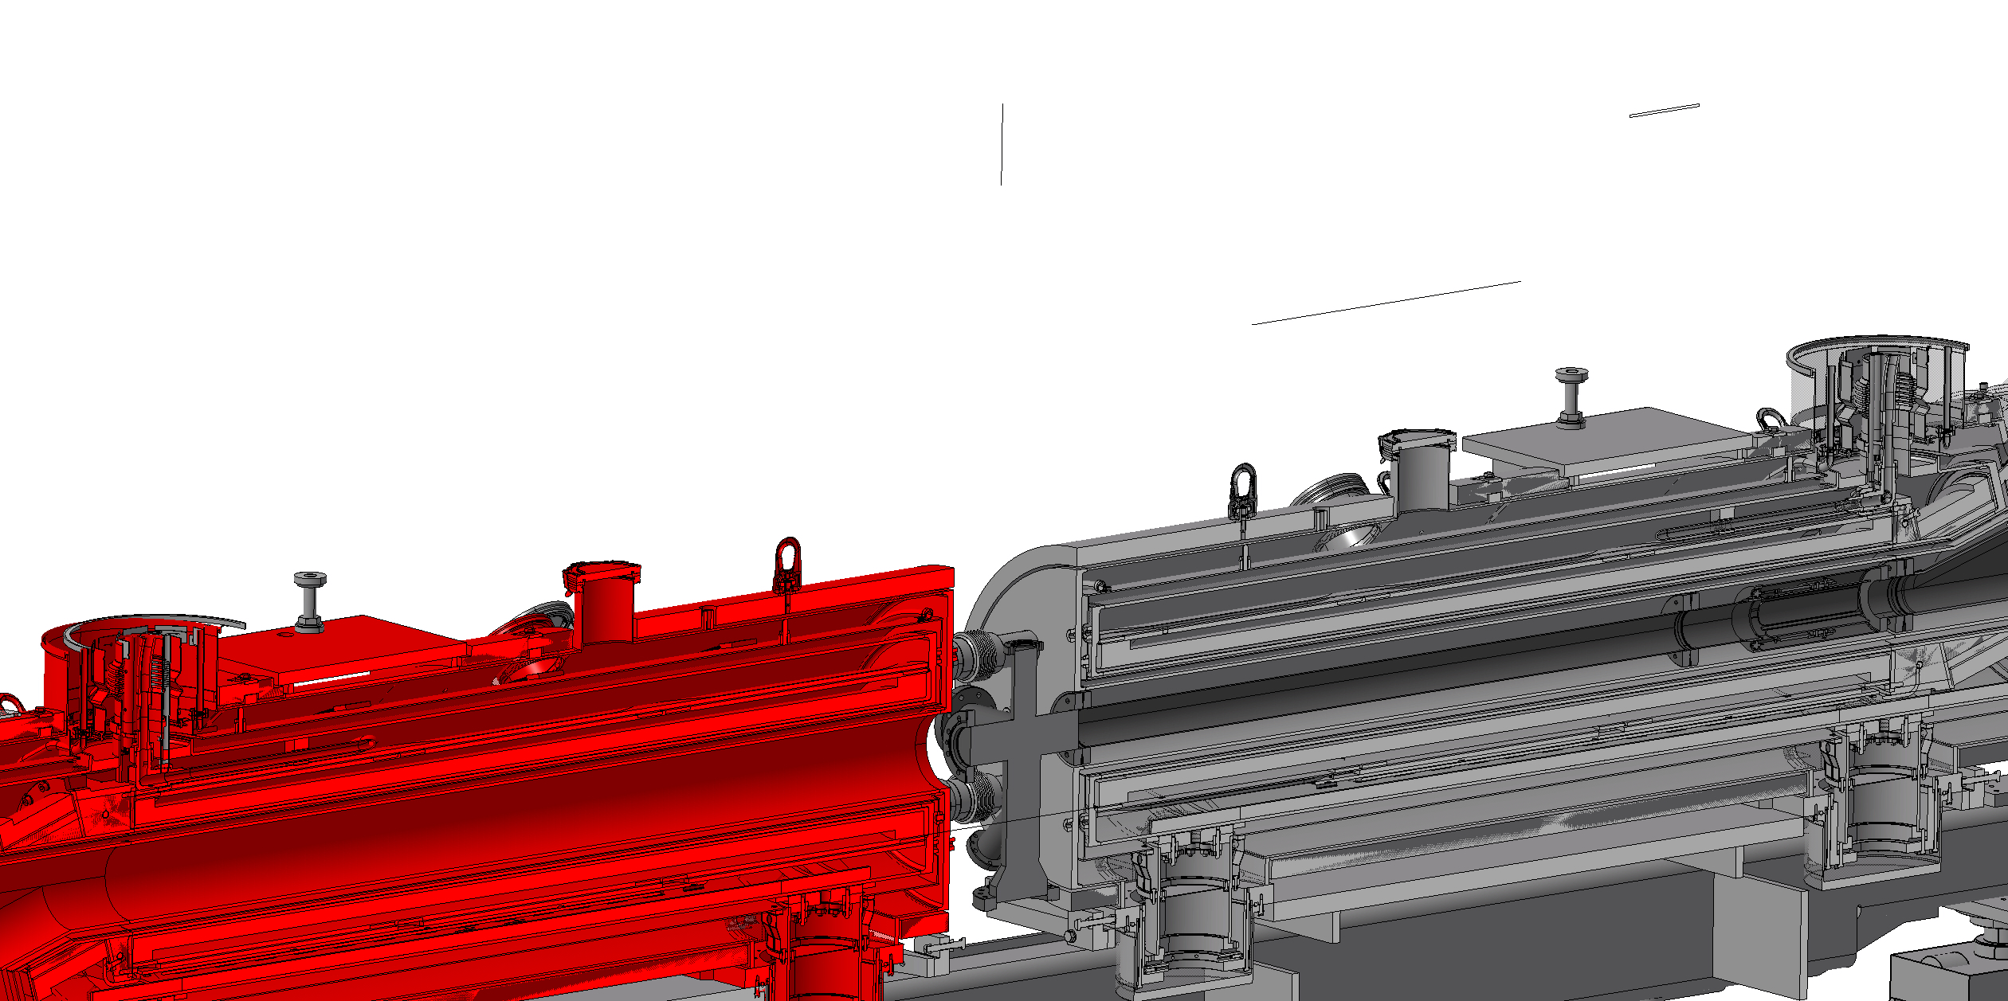
Step 4
Put the left magnet in place → Leave some space for the connection of the BGC chamber to the left bellow

Slide 8
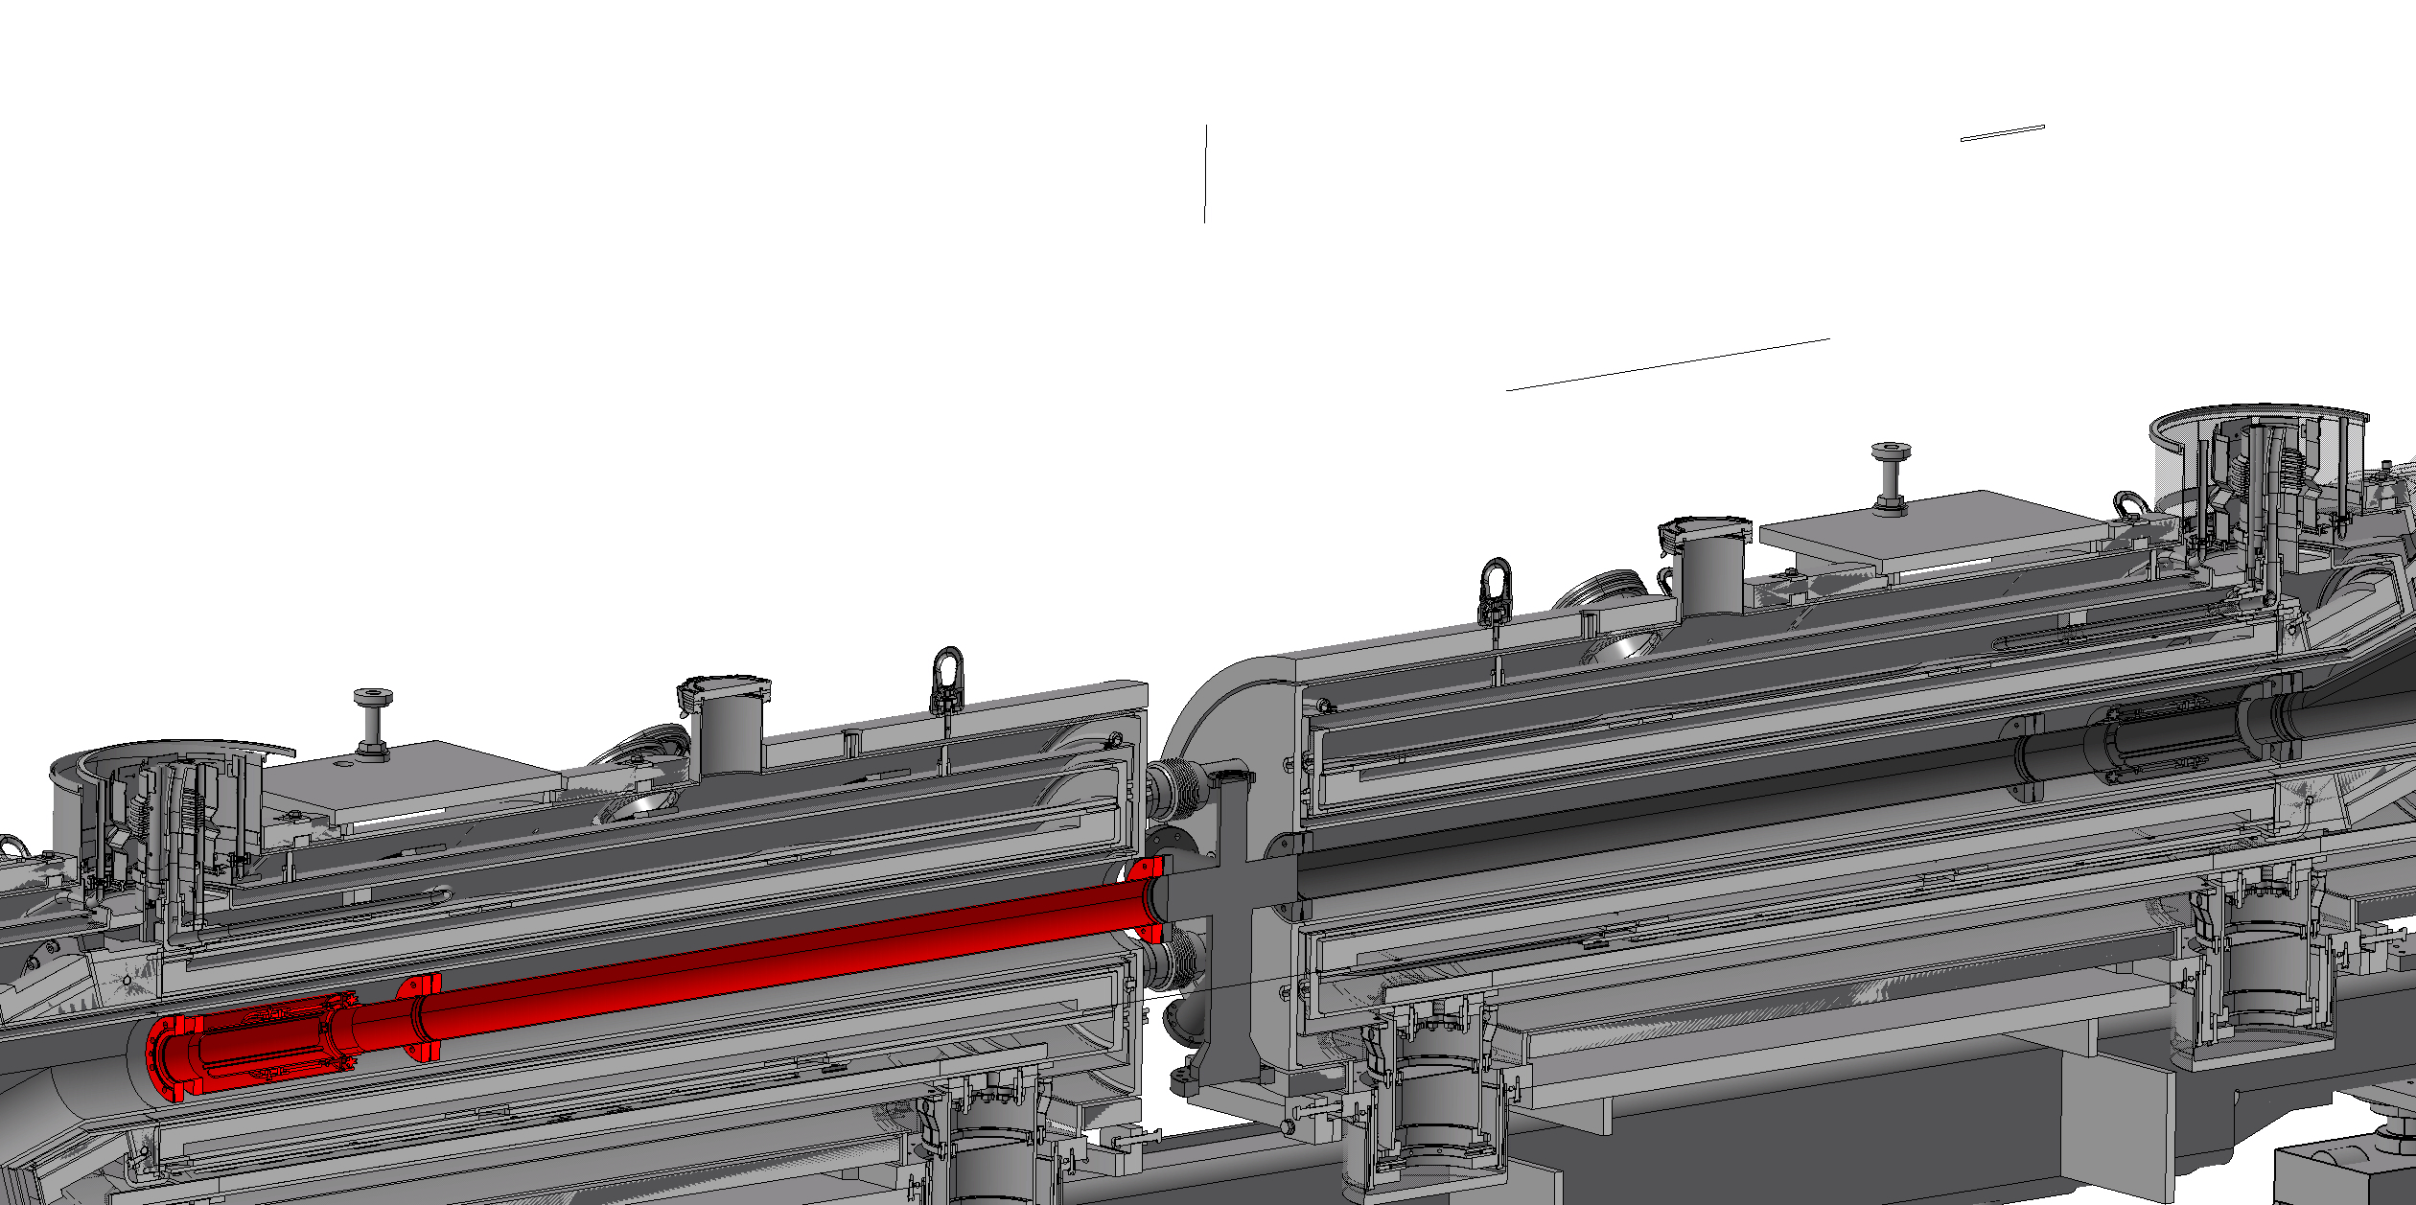
Step 5
Insert the left vacuum chamber in the 2nd magnet
Mount the chamber bellow to the BGC chamber

Slide 9
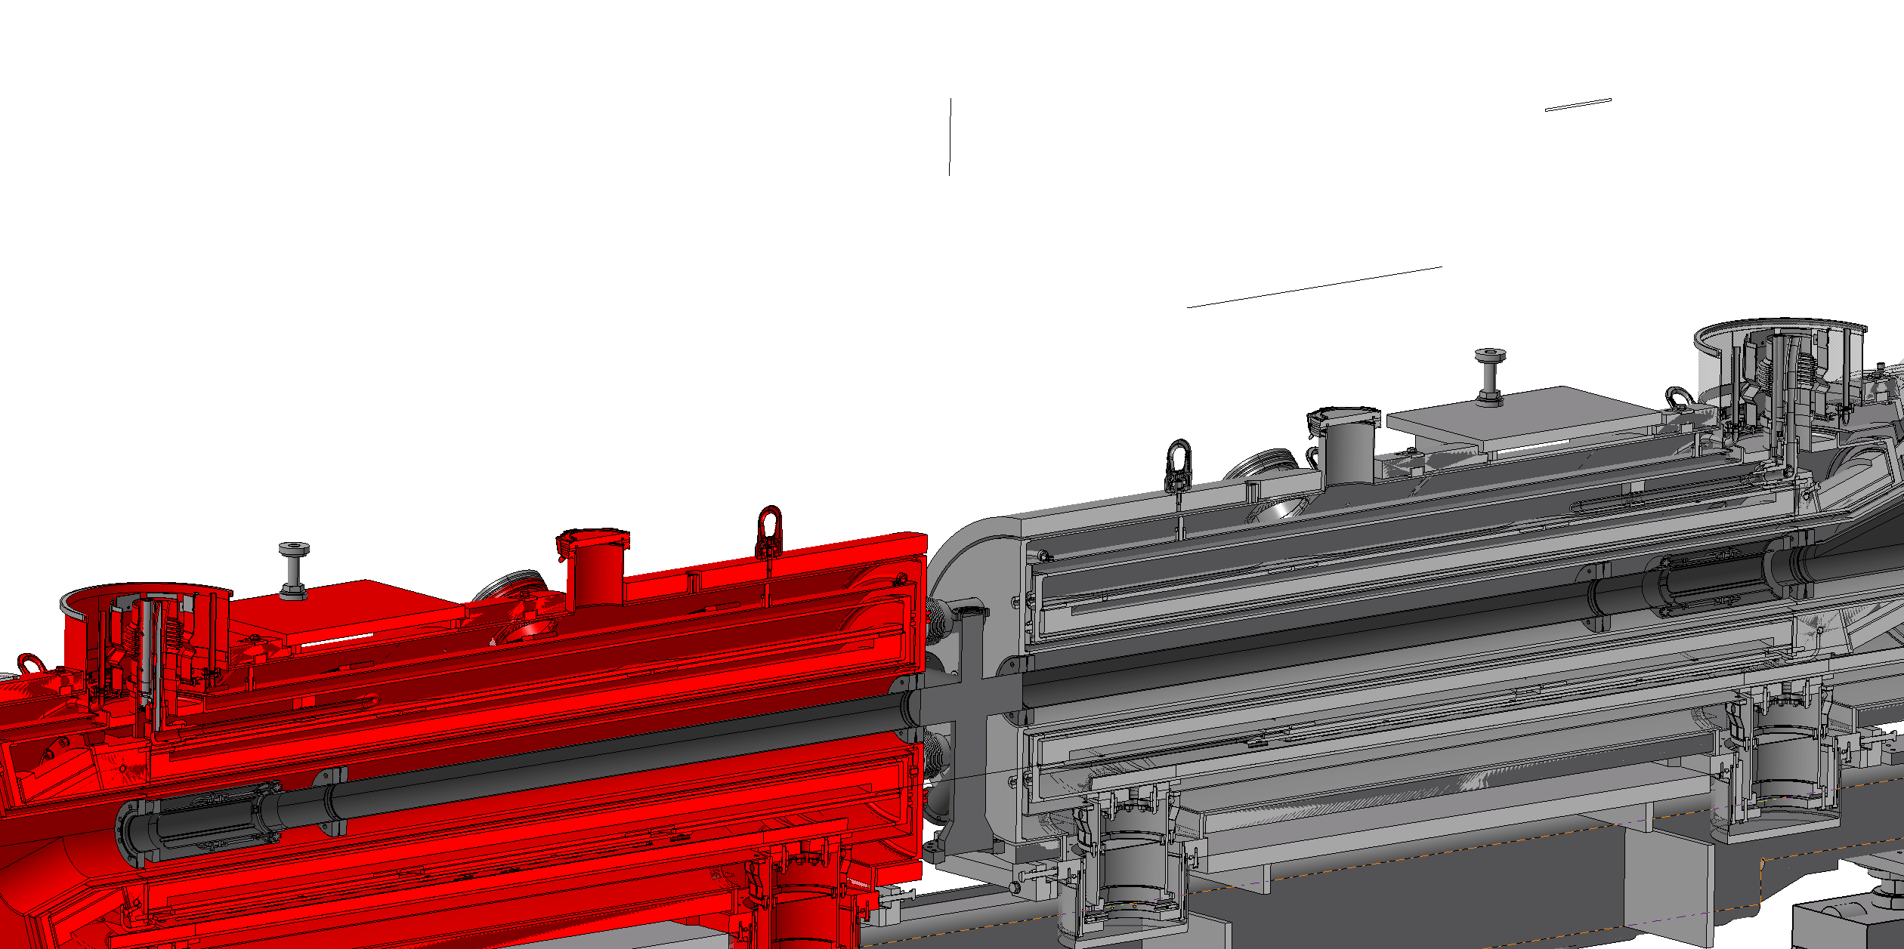
Step 6
Move magnet 2 to final position

Slide 10
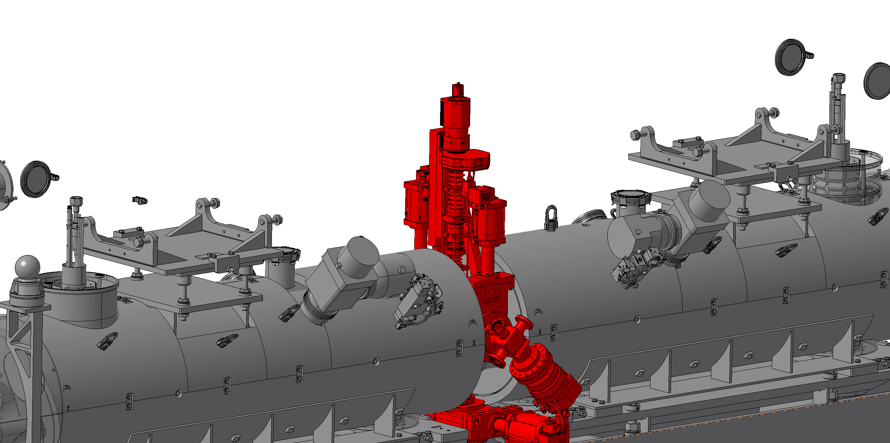
Step 7
Assemble the rest of the BGC

Slide 11
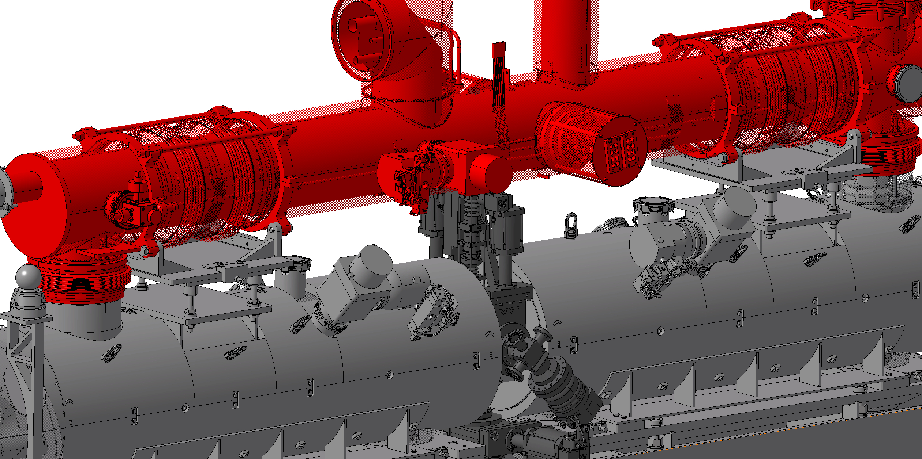
Step 8

