Slide 1
Rules of the Game
7 questions, each with 4 answers to choose from (A, B, C, D).
✔
Mark your answer on your answer sheet before the timer ends.
We will then reveal the correct answer.
✔
If you have answered correctly you may tick off the next energy level.
Let‘s see which energy level you can reach!

Slide 2
Set
Ready?
GO!

Slide 3
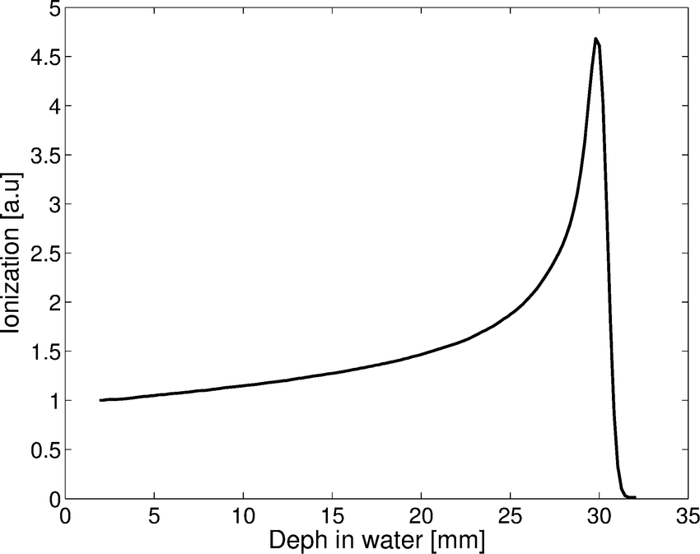

Which physical principle is
important for Hadron
Therapy?
STOP
1
A. Brad’s valey
B. Bragg valey
C. Bragg peak
D. Bill’s peak

Slide 4
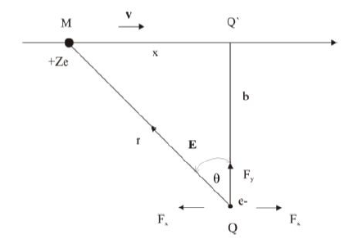
Which type of interaction is
dominant between proton/ion
beam with electrons from
molecules of human body?
STOP
2
A. Electromagnetic force
B. Weak force
C. Strong force
D. Gravitational force

Slide 5
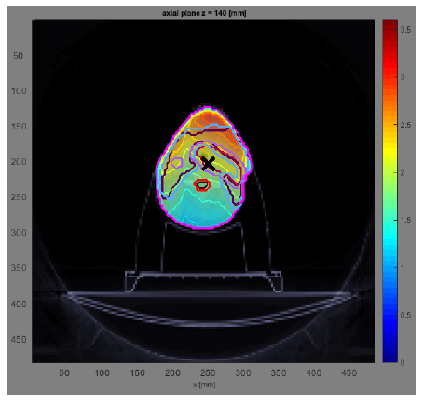
From the picture below, what
particles are used to treat
tumor?
STOP
3
Protons
Photons
A.
B.
Carbon ions
Pions
C.
D.

Slide 6
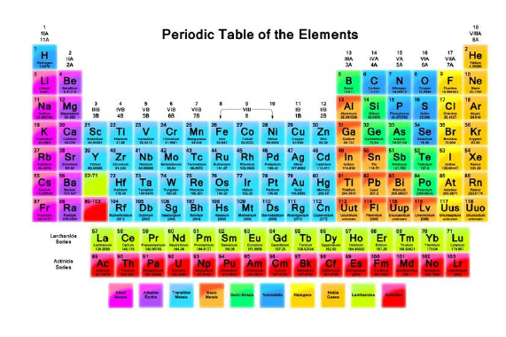
Most commonly used ions for
therapy?
STOP
4
A.
B.
Uranium ions
Argon ions
Oxygen ions
C.
D.
Carbon ions

Slide 7

What is the unit for absorbed
dose?
STOP
5
A. 1Joule
B. 1 Newton
1 Green
D. 1 Gray
C.

Slide 8
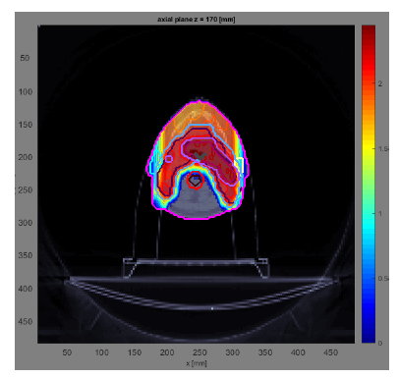
Dose on the critical organs using
proton/ion therapy instead of X-ray
therapy is:
STOP
6
A.
B.
bigger
smaller
equal
C.
D.
I don’t know

Slide 9
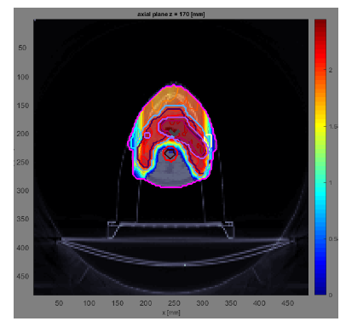
Dose on the skin using proton/ion
therapy instead of X-ray therapy is:
STOP
7
A. smaller
B. bigger
C. equal
D. I don’t know

Slide 10
Which energy level did you reach?

