Slide 1
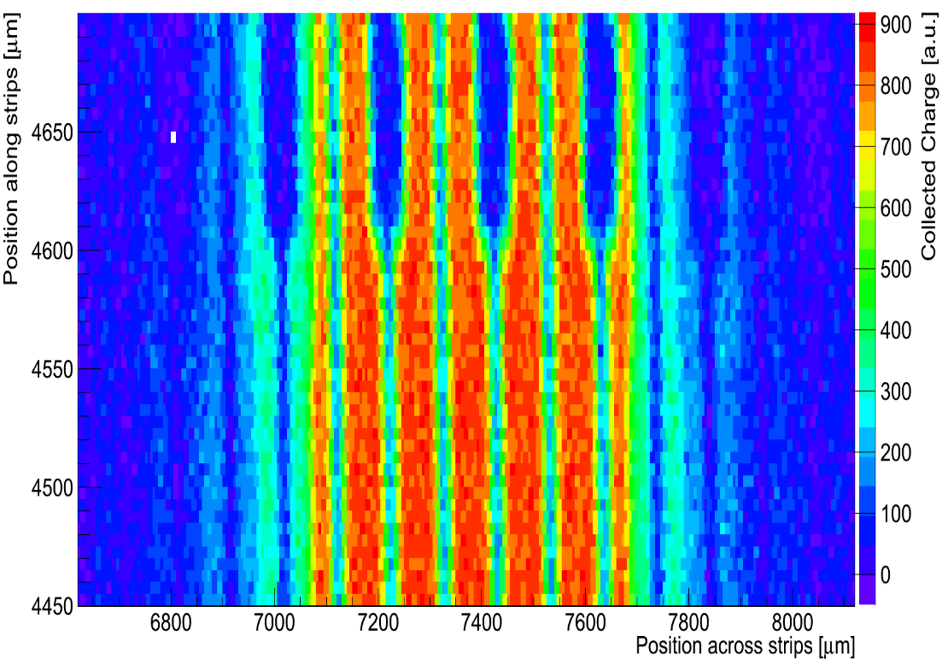
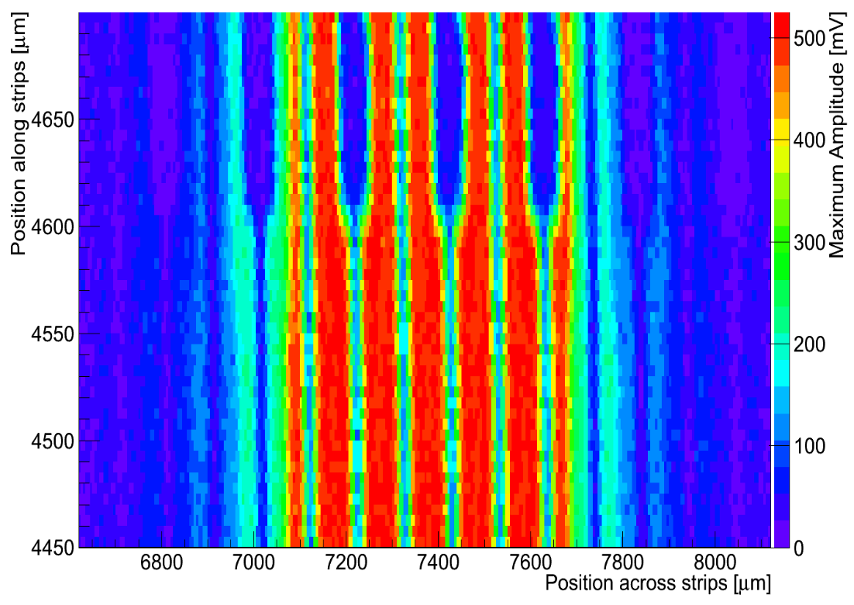
Status/ Overview
Infrared laser used, unirradiated strip sensor on the timing board
6 Strips connected to readout, neighbors not grounded
TCT Scan to determine positions, then do timing measurements on certain positions
between the strips

Slide 2
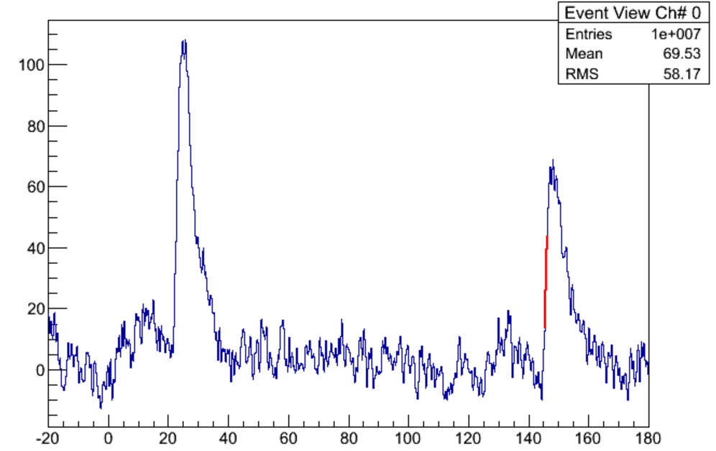
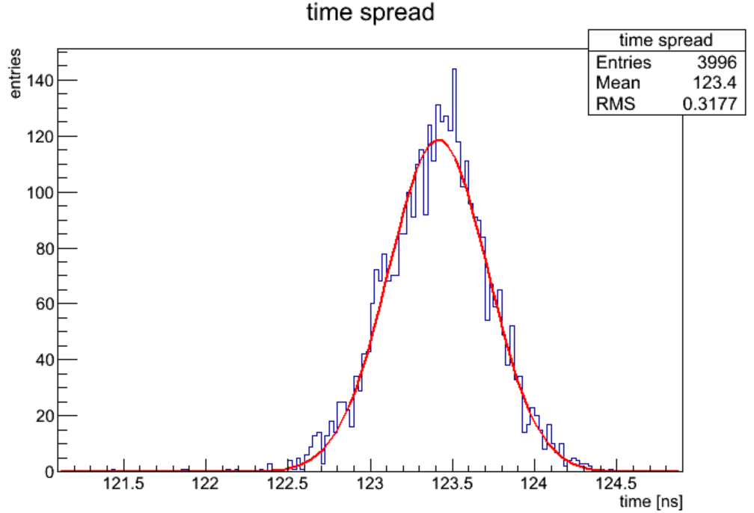
2 Pulses, “Self-reference”
Use of a beam splitter and cable delay -> significantly lower signals, difference in signal
height (partially fixed now)
Triggered still by the laser, 20 averaged/ event or sampled

Slide 3
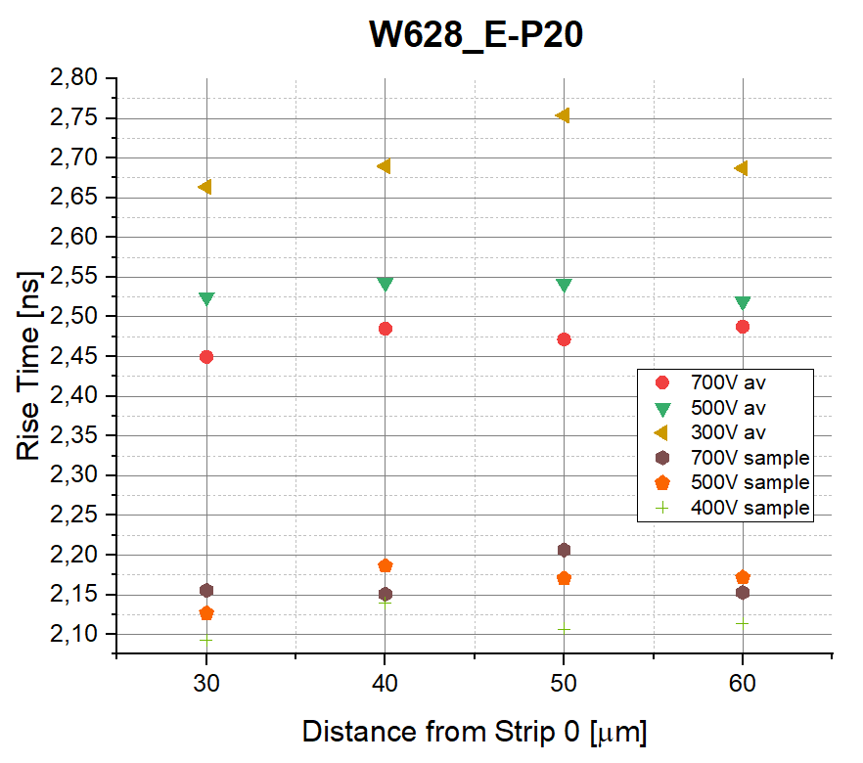
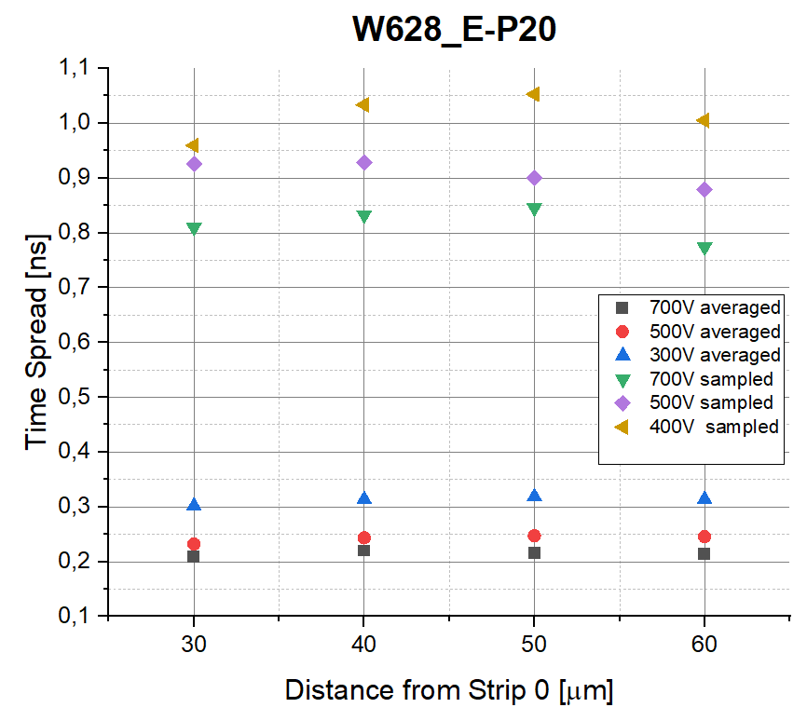
2 Pulses, “Self-reference”
Voltage dependence as expected
Small position dependence – more pronounced for lower voltages
Values seem to be in the expected range

Slide 4
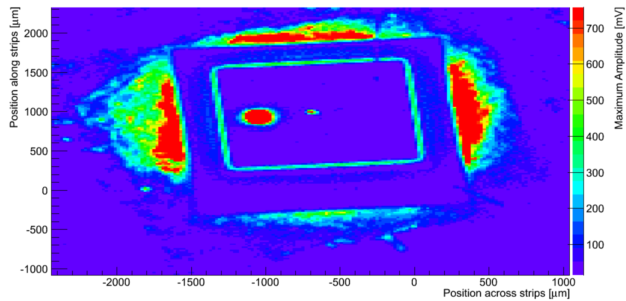
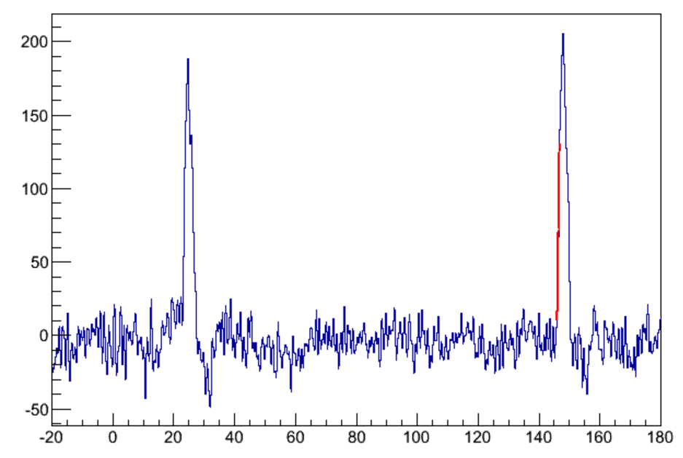

LGAD, comparing different measurements
LGAD, 50$μ$m thickness
TCT scan showed some
interesting features of the
used glue
Timing measurements
in the opening then
4 Types of measurements:
Laser trigger as reference, 20 waveforms averaged
Laser trigger as reference, sampled
2 pulses, self reference, 20 waveforms averaged
2 pulses, self-reference, sampled

Slide 5
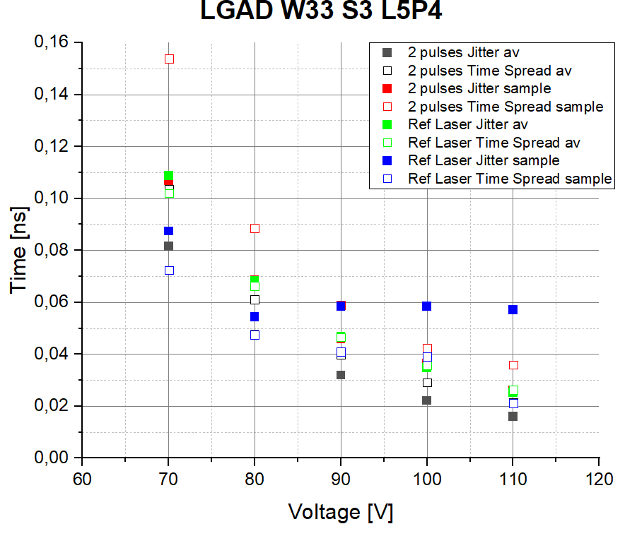
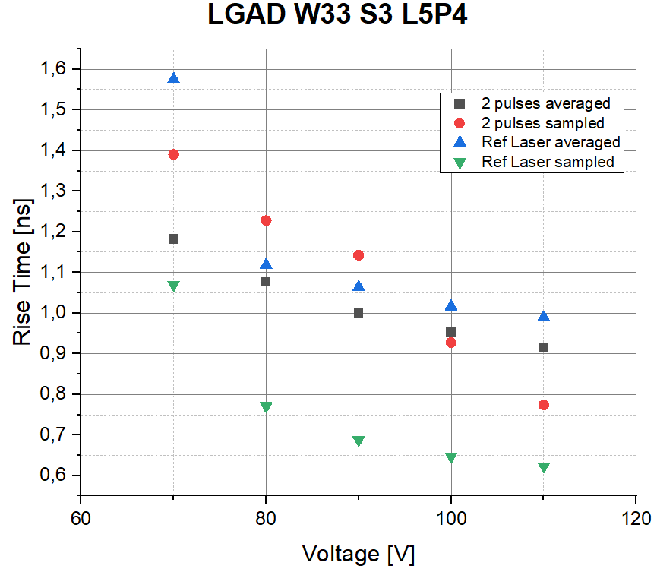
Comparison

Slide 6
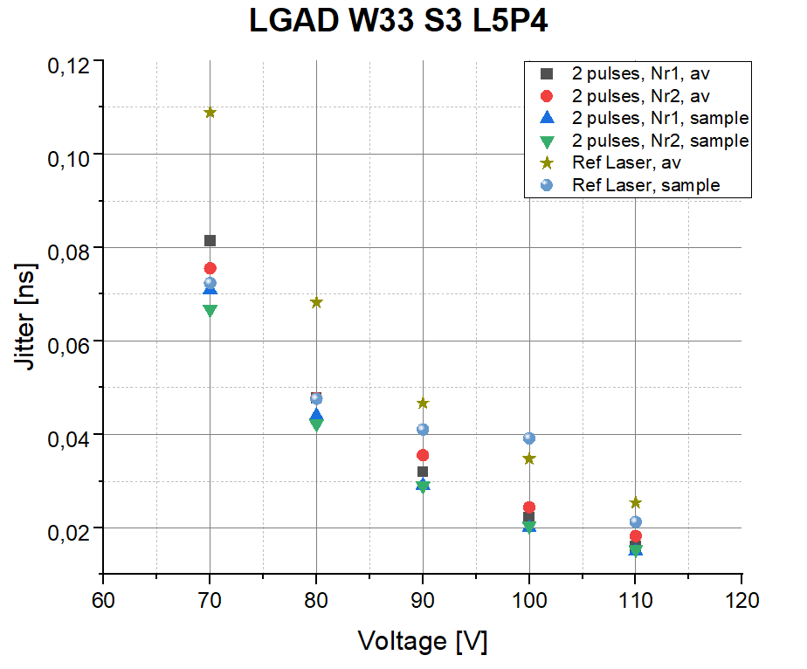
Comparison
Questions:
Is using the averaging giving
me “wrong” good results or can I use
it with the laser measurements?
The self-referencing seems to give
more reliable results – can I use the
sensor itself as timing reference?

