Slide 1
ILC Experience and
Recommendations
Tim Barklow (SLAC)
Jul 09, 2010

Slide 2
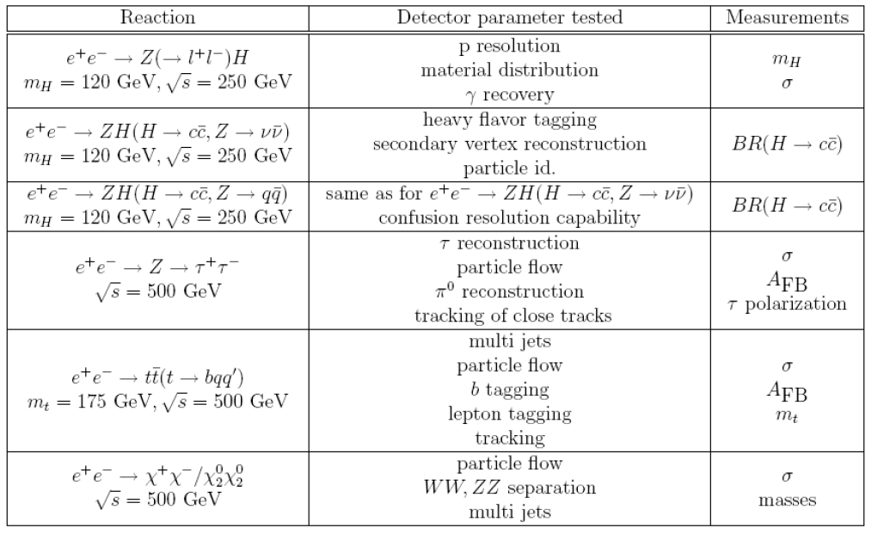
LOI Benchmarks

Slide 3
Monte Carlo Production
WHIZARD Monte Carlo is used to generate all 0,2,4,6-fermion and t quark dominated 8-fermion processes.
100% electron and positron polarization is assumed in all event generation. Arbitrary electron, positron polarization is simulated by properly combining data sets.
Fully fragmented MC data sets are produced. PYTHIA is used for final state QED & QCD parton showering, fragmentation, particle decay.

Slide 4
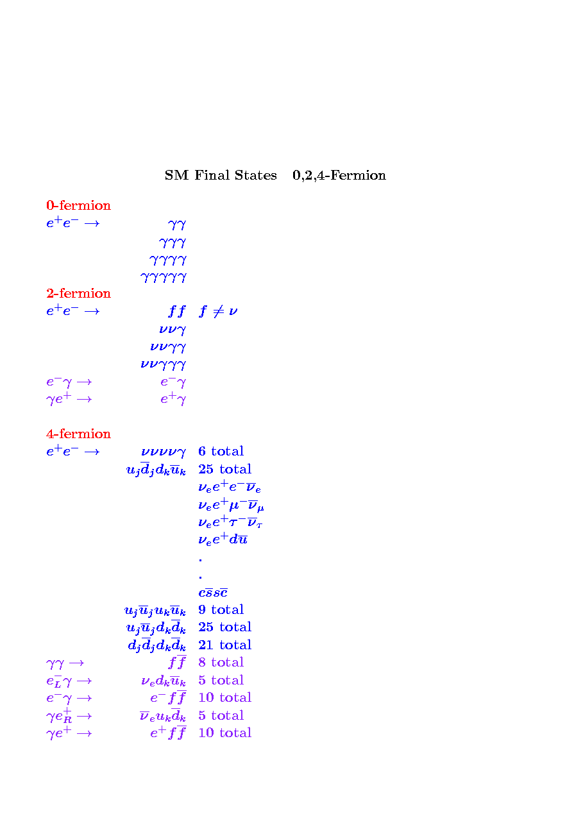
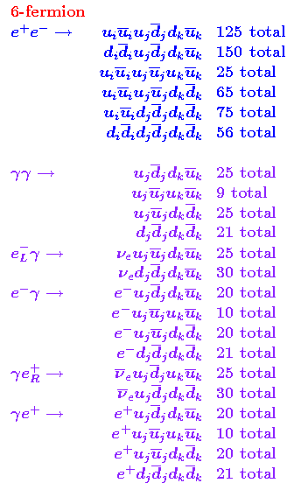
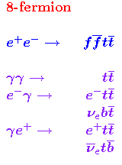

Slide 5
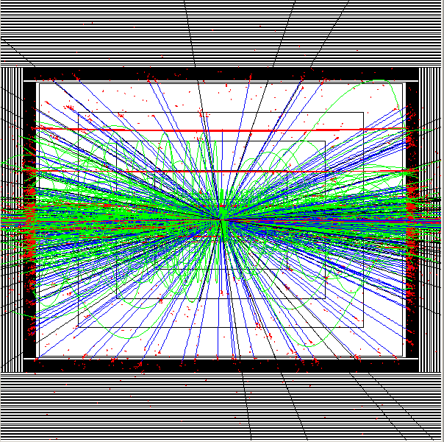
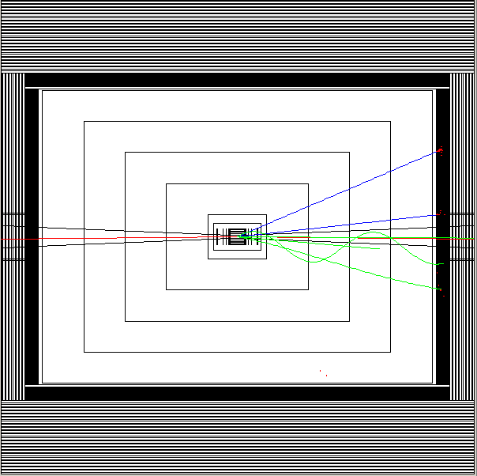
Beam-Beam Background
Yellow = muons Red = electrons Green = charged hadrons
Black = Neutral Hadrons Blue = photons with E > 100 MeV
150 bunch crossings (5% of train)
1 bunch crossing

Slide 6
There are currently 14 MC production groups:
0-2-4-fermion
6-fermion/ddi-udj-duk
6-fermion/eminus-gamma
6-fermion/gamma-eplus
6-fermion/gamma-gamma
6-fermion/uui-udj-duk
6-fermion/zzz_1
6-fermion/zzz_2
8-fermion/
bench-point-5
ffh
ffhh
tesla_bosons
tth

Slide 7
For each Production Group There are 5 Steps Needed to Produce (Raw) MC Stdhep Data Sets: (corresponding shell script is shown in italics)
Generate Executable
  /nfs/slac/g/lcd/mc/prj/sw/dist/whizard/v1r4p0/whizard-v1r4p0/remake_process_class
Submit MC Integration Jobs
  /afs/slac/g/nld/whizard/ILC/multiple_whiz_ini
Repair MC Integration Jobs
  /afs/slac/g/nld/whizard/ILC/multiple_whiz_ini_cleanup
Submit MC Event Generation Jobs
  /afs/slac/g/nld/whizard/ILC/multiple_whiz_run
Repair MC Event Generation Jobs
  /afs/slac/g/nld/whizard/ILC/multiple_whiz_run_repair

Slide 8
New ILC Common Data Sample Subgroup was formed recently to deal with ILC MC event generation issues . Members are : Akiya Miyamoto, Mikael Berggren and Tim Barklow
Near term goals for MC generator improvements:
Include full CKM matrix when simulating processes with Wff’ vertices
Include gluon intermediate states when simulating processes with final state quarks
Replace W/Z/t resonance-based color flow guess with correct color flow calculation from WHIZARD
Use TAUOLA to perform polarized tau decay for all taus produced by WHIZARD & PYTHIA
Store final state helicity and color flow information in stdhep file
Upgrade to PYTHIA 6.422 and include optimum LEP fragmentation tune
Improve Bhabha generation using GRACE
Reevaluate SUSY generators and identify the best one for ILC physics

Slide 9
Near term goals for MC event generation improvements:
Determine if WHIZARD can sum over many fermion flavors in a single run so that we don’t have to submit a process intergation and event generation job for every distinct final state fermion combination (see next slide). The current method works, but is time-consuming, especially for six-fermion final states. It may be impossible without flavor summation to submit a job for every distinct 8-fermion combination (needed for tth background).
Import SLAC’s MC integration and MC event generation scripts to KEK so that KEK and SLAC can generate events in an identical manner
Develop a common data base that is updated automatically whenever a MC event generation job completes at SLAC, KEK or DESY.
Automate MC event generation job submission and batch job repair at SLAC using FERMI pipeline system. If successful implement something like it at KEK.

Slide 10
Observations
The WHIZARD Monte Carlo offers several advantages for linear collider event generation:
  The same Monte Carlo framework can be used for background generation and most signal event generation.
  Initial state polarization is always available
  It is straightforward to include beamstrahlung effects, and these effects are identical across all signal and background event generation.
  Final state polarization effects are automatically included when one specfies the n-fermion final state (e.g. e⁺e⁻ → uDsC instead of e⁺e⁻ → W⁺W⁻)
The WHIZARD Monte Carlo is used for both LHC and linear collider event generation, and is well supported by its authors.
CLIC might want to take advantage of the software ILC has written to interface WHIZARD to PYTHIA and Guinea-Pig and to generate a full set of background events in a systematic manner.
Both ILC and CLIC could benefit from future software written to utilize WHIZARD.

