Slide 1

CTMC 2020 Financial Review
Club Treasurer – Jamie Pinnell

Slide 2
Membership Situation
For the Year 2020, there are only 9 paid up members of the club, and 1 Honourary Membership for M. Flockhart.
As there is a new locking system installed on the clubhouse, be aware that in order to gain access to the clubhouse, membership will have to be paid before access will be granted in ADAMS.
Already membership fees are coming in for 2021, thank you for your speed.

Slide 3
Purchases Made
The first main purchase was the new PRUSA Mk3 3D Printer we will soon be setting up in the clubhouse.
Another was a New FPV Drone Starter Kit, for anyone wishing to get into FPV and wants to take practise from a simulator to the real deal.
Please be aware that this will be used on a sign out basis and if you aren’t sure what you are doing, I will be available to show you how to use it. Please do not try and guess how to use it.
Some soldering accessories. As we are still waiting for COVID to allow us to resume proper club activities, preparations for the Solder Station and PC simulator have taken a back seat.
As previously mentioned, around 800CHF will need to be paid for the new electronic access system on the clubhouse, but this will figure in the 2021 Review.

Slide 4
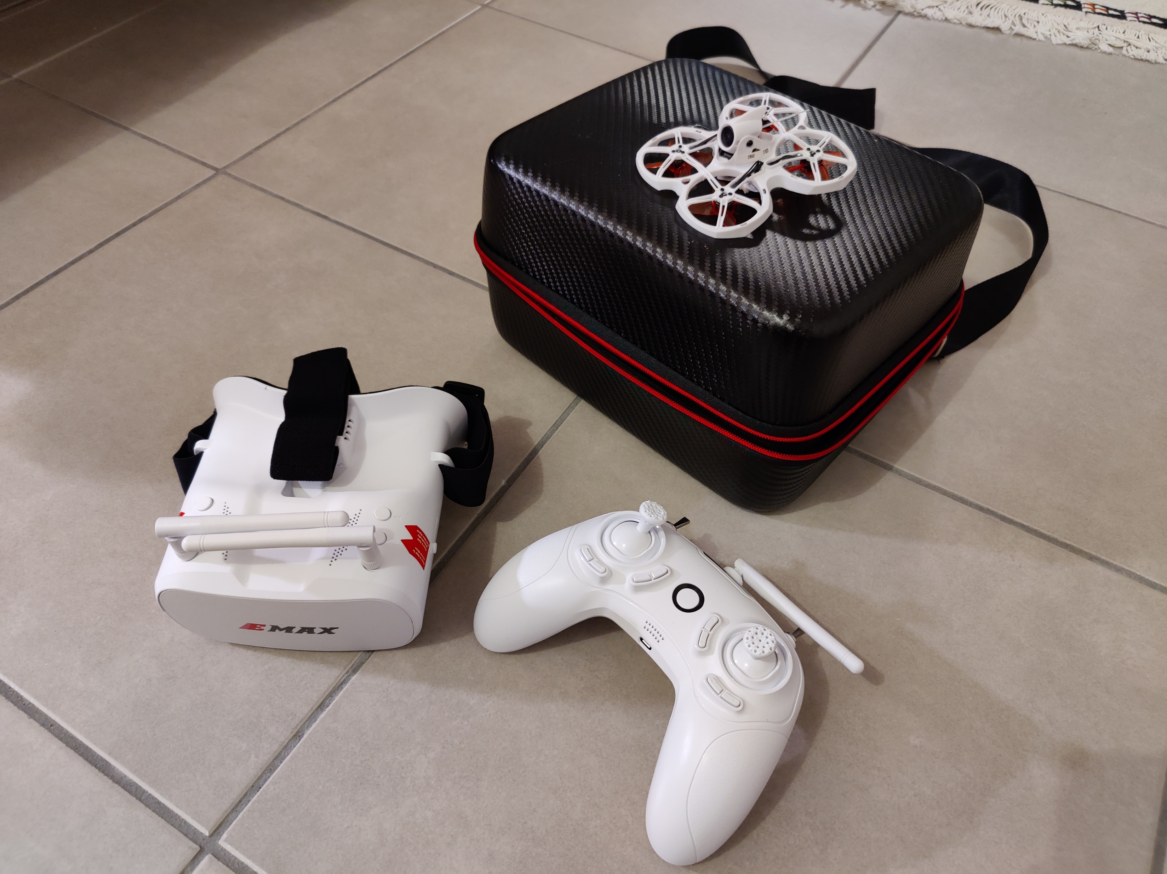
FPV Starter Kit
If this is proved to be popular, a much easier to fly indoor RTF kit has become available in France.

Slide 5
In & Outs – Short but Sweet…
Reason | Quantity | Ins (Chf) | Out (Chf)
Membership Fees | 9 | 450
New 3D Printer | 1 |  | 1121.62
FPV Starter Kit | 1 |  | 220
Solder Accessories | ~~ |  | 46
Staff Association | 1 | 2250
Banking Fees | 1 |  | 5.80
Total |  | 2700 | 1393.42
Start of the Year Balance | 22,232.20 CHF
2020 End Balance | 23,538.78 CHF

Slide 6
2021 Purchases
As you can see, we have a decent amount of money to sort out properly equipping the club for you…
Certain things, agreed by the commitee last year include; Realflight Plane Sim, Velocidrone Sim, New Soldering Posts and a club Lipo charger capable of up to 12S charging. This will amount too ~600CHF.
This year we would like approval for; a new PC ~1200 CHF to run the Sims, Club Radios (FUTABA ~600, FrSky~80), 1 or 2 Club Planes ~150, a club drone ~250, and anything our members would like to put forward.

