Slide 2
Availability and Reliability
prediction with AvailSim4
Andrea Apollonio, Milosz Blaszkiewicz, Thibaud Buffet, Thomas Cartier-Michaud,
Lukas Felsberger, Jan Uythoven
Acknowledgments to the MPE software team!

Slide 3
Structure of talk
Motivations: reliability and availability prediction tailored to accelerators
Algorithm: Discrete Event Simulation & Monte Carlo
Code: python3, process, how to install, doc
Main features: Phases, Sensitivity analysis, ...
LHC model
Conclusions and Outlook

Slide 4
Reliability and Availability tailored to accelerators
AvailSim: a tool to simulate availability of particle accelerators
v1 developed at SLAC, v2 at IFMIF, v3 at ESS/CERN
Availsim4 developed at CERN
  python3 with high software quality standard for long term maintainability (lifetime of HL-LHC)
  Model accelerator specific features (Phases, minimal replaceable units, repair in the shadow, ...)
  Reusable for all CERN machines and potentially any other accelerators (MYRRHA)
  Extended to Reliability prediction (rare event simulation)

Slide 5
Discrete Event Simulation & Monte Carlo
DES: jumping from event to event
B events: events Bound to happen = failure in 3.15 hours
C events: events happening only if some Condition is true:
repairing component if it has failed
While current_time < end_simulation_time:
for B_event in list_of_B_events_at_current_time:
B_event.execute()
for C_event in list_of_valid_C_events:
C_event.execute()
current_time += time_to_next_B_event

Slide 6
Discrete Event Simulation & Monte Carlo
Output of a DES = Timeline succession of events
Easy to read, easy to debug, easy to explain:
no abstract analytical view in a formula
A
B1
B2
System
= A and
(B1 or B2)
DT
DT
time
T1:failure of A
T1:failure of System
T1:start repairing A
T1:start repairing system
T2:A repaired
T2:system repaired
T3:failure of B2
T3:start repairingB2

Slide 7
Discrete Event Simulation & Monte Carlo
Monte Carlo algorithm converges slowly:
  Availability: frequent low duration faults: O(10**3) sim. LHC
  Reliability: rare long duration faults: O(10**6) simulations
Use of CERN cluster (~HTCondor) to massively parallelize
Better sampling strategies of the possible timelines exist
= avoiding the repetition of 10**6 almost similar simulations
Milosz Blaszkiewicz’s master thesis (+ Energy Extraction study)

Slide 8
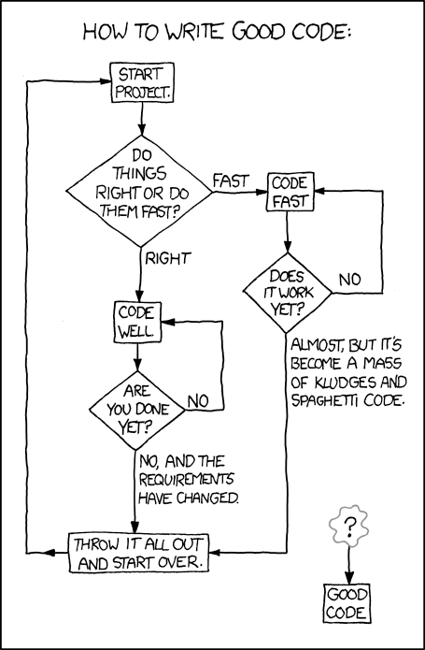
Code quality
Python3.7 and pandas, numpy, …
few well known modules
11k lines, > 200 tests in the Continuous
Integration, 95% coverage, user guide,
doc/comment in the code
1st release 2021/03/01, accessible by
the whole CERN community
Can be installed using:
pip install availsim4
from a pypi repository hosted by acc-py
https://xkcd.com/844/

Slide 9
Code: modeling a system (1/2)
A system is based on components:
‘basics’ are elements which have a failure mode attached
‘compounds’ are elements which group basics for logical reasons and have their status defined by their children
System = A and (B1 or B2)
System
System
Bs
AND
Bs
A
B1
B2
A
OR
B1
B2

Slide 10
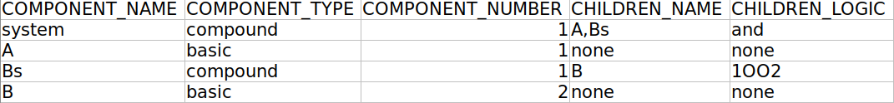
Code: modeling a system (2/2)
‘logics’ are derived from a unique logical function: “out of”
XOOY : at least X running children out of Y children (or = 1OO2)
ZTF : Z = Y-X tolerated faults amongst the children
XRC : X running children needed
AND: YOOY

Slide 11
Code reusability
To model additional accelerator specific logic:
define a new key word for the input
add a new class taking a list of children as an input
Dynamic compensation:
parent status = (XOOY) and (not 2 adjacent failures)
“XOOY” already coded
“not 2 adjacent failures” : simple loop to check statuses
OK
NOT OK

Slide 12
Code inputs
The input is based on 3 excel files describing:
  the system:
  ARCHITECTURE, FAILURE_MODES,
  FAILURE_MODE_ASSIGNMENTS, PHASES,
  MRU(minimal replaceable units), INSPECTION
  the simulation: Monte Carlo parameters
  a possible sensitivity analysis

Slide 13
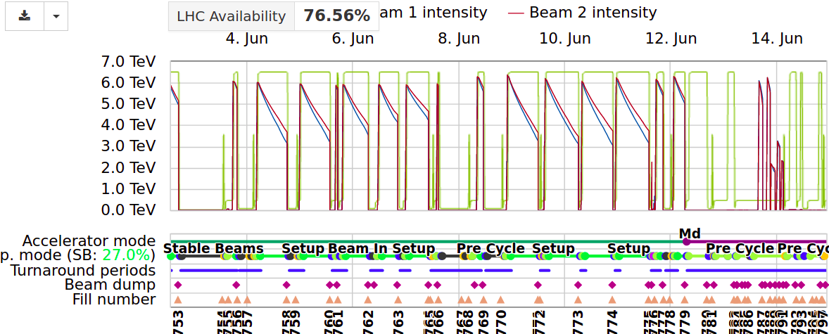
Phases feature (1/4)
LHC is operated performing a so called cycle

Slide 14

Phases feature (2/4)
LHC is operated performing a so called cycle
Main consequences:
LHC operating != LHC producing physics
Even if they are short, some faults have a large impact (turn around)
In different phases, the failure modes don’t have the same PoF
quenches are more likely to occur at high energy
infrastructure faults are not affected by phases
(neither weasels… )

Slide 15
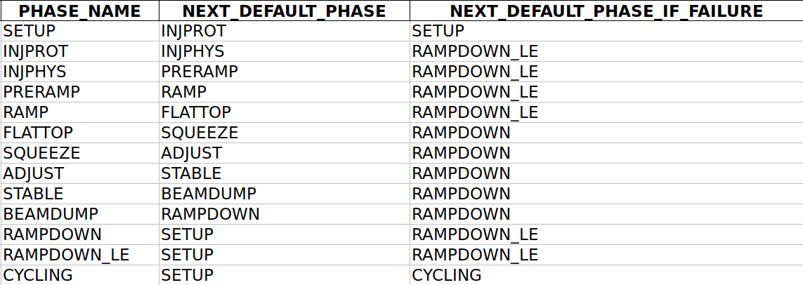
Phases feature (3/4)
How to get into CYCLING?

Slide 16
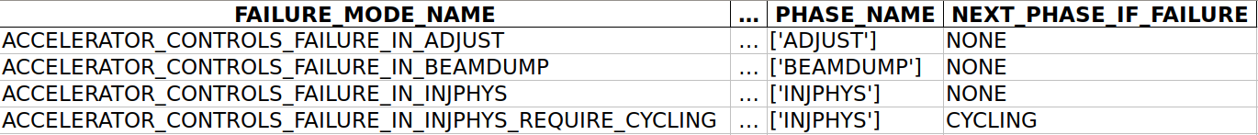
Phase feature (4/4)
Defining when a failure mode can occur is done in the FAILURE_MODE sheet
After a failure, it is possible to force the following phase with a CYCLING for example

Slide 17
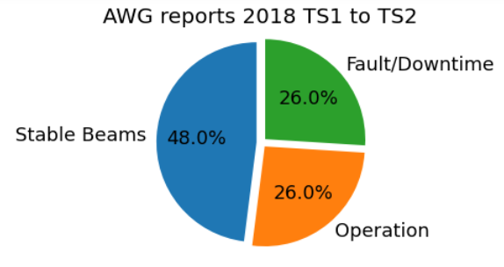
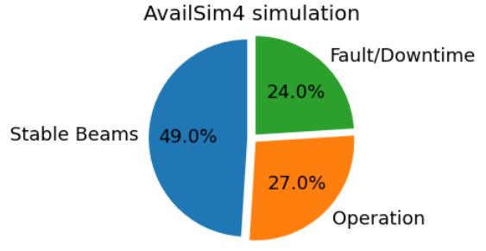
LHC example:
Extraction of AFT (WIP)
Quick look at the inputs
Results:
Time spent in different phases,
Ratio of aborted/successful
stable beams, ...

Slide 18
Sensitivity analyses
Most of the time, sensitivity analyses are required:
    Uncertainty on the input
    Comparison of different operational conditions
    Comparison of different designs, ...
The Sensitivity analysis input files allows for that easily
FAILURE_PARAMETER = MTTF of the failure mode

Slide 19
Conclusion / Outlook
First release of Availsim4 2021/03/01: `pip install availsim4`
Availsim4 successfully used to model a number of cases :
LHC availability,
Inner Triplet / D1 / D2 protection reliability,
Energy Extraction reliability (HL vacuum switch),
SSPA of SPS reliability and availability, …
Available for CERN community (3/5 users and 2/3 devs)
Next main features:
Deeper insight into statistics, faster execution time,
user experience, post treatment of sensitivity analysis

