Slide 1



Hi-Lumi RFD CM
Project P455 at TRIUMF
Bob Laxdal
TRIUMF Hi-Lumi Technical Coordinator
Dec 11, 2020
Hi-Lumi “Chrisis” PSM

Slide 2
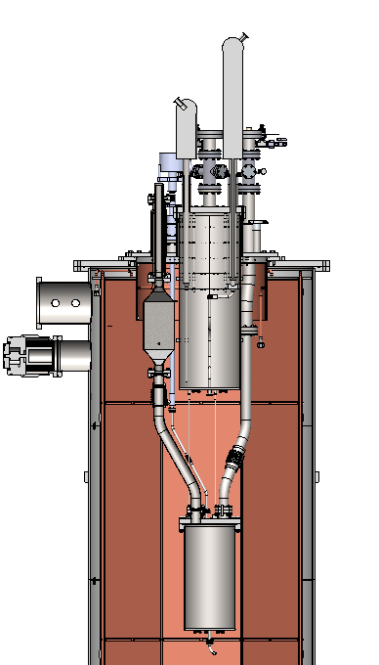
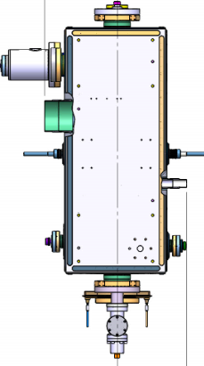
Our status –
TRIUMF is now in Phase 3 CV-19 protocols – technical staff on site at 80% level – work on CM work is ramping up – we have one CM in the pipeline before we start Hi-Lumi TCM-0
We are preparing clean room and cryostat for Hi-Lumi testing – adding 2K capability (next slide)
Student designer is now working on testing infrastructure
Preparing for Gate 3A

Slide 3
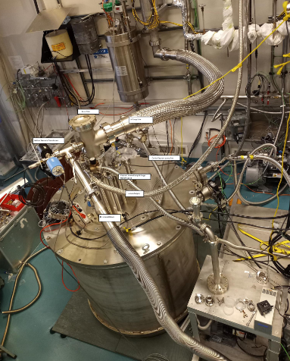
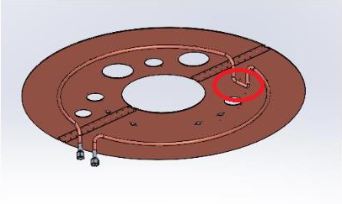
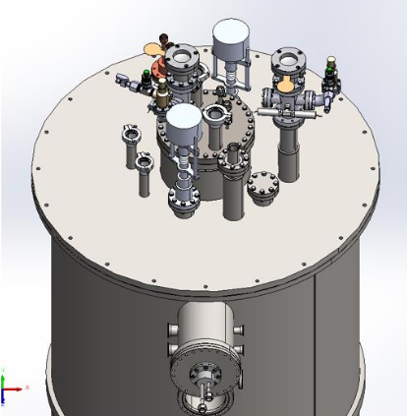
4k-2k
Modifying existing cryostat lid for adaption of 4k-2k insert
Reviewing feedthroughs/port orientation

Slide 4
Cavity test – diagnostics
Diagnostics
  Temperature sensors
    Requirement - <50K thermal gradient across cavity
    Would be good to see CERN and FNAL position of sensors
    Need additional temperature sensors to monitor 4K fill and 2K production
  Magnetic field probes
    Requirement is <1micT at the cavity
    Would be good to see CERN and FNAL position of sensors

Slide 5
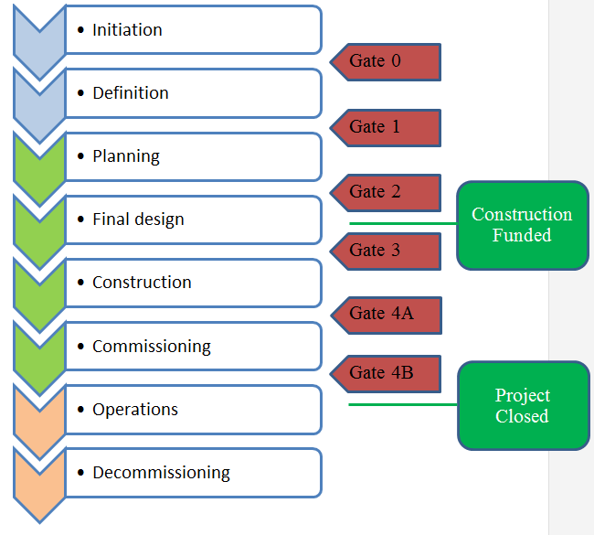
TRIUMF Project milestones
The project has now completed Gate 2 within TRIUMF project planning
We would like to get to Gate 3 before standard procurements. The prototype TCM0 could be considered in a Gate 3A – need to have released drawings and specifications from CERN
Project Milestone | Proposed date | Hi-Lumi input
Gate 1 | Dec 2019 | Conceptual design review, preliminary scope def’n
Gate 2 | Aug. 2020 | Final scope def’n, detailed budget
Gate 3A TCM0 | Feb 2021 | TCM0 design review, released drawings and specifications
Tech review | Dec. 2021 | Launch long lead procurements
Gate 3B TCM1-4 | Feb. 2022 | Final design review, released drawings and specifications
Nov. 12, 2019 Hi-Lumi C&S Review CERN Nov. 2019 - Laxdal
5

Slide 6
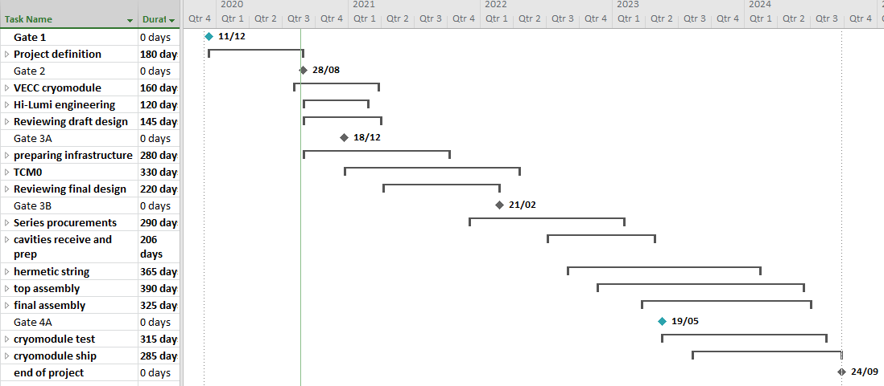
Level 1 WBS – as of Gate 2

Slide 7
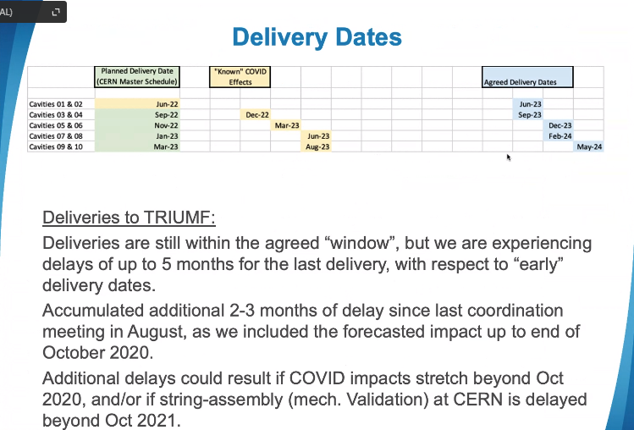

Slide 8
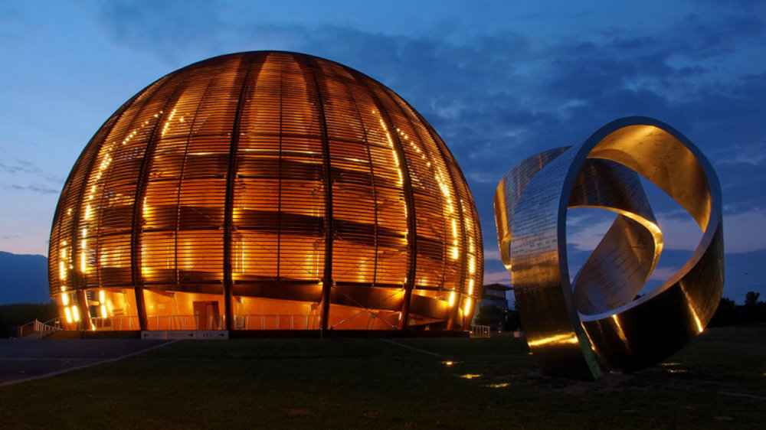
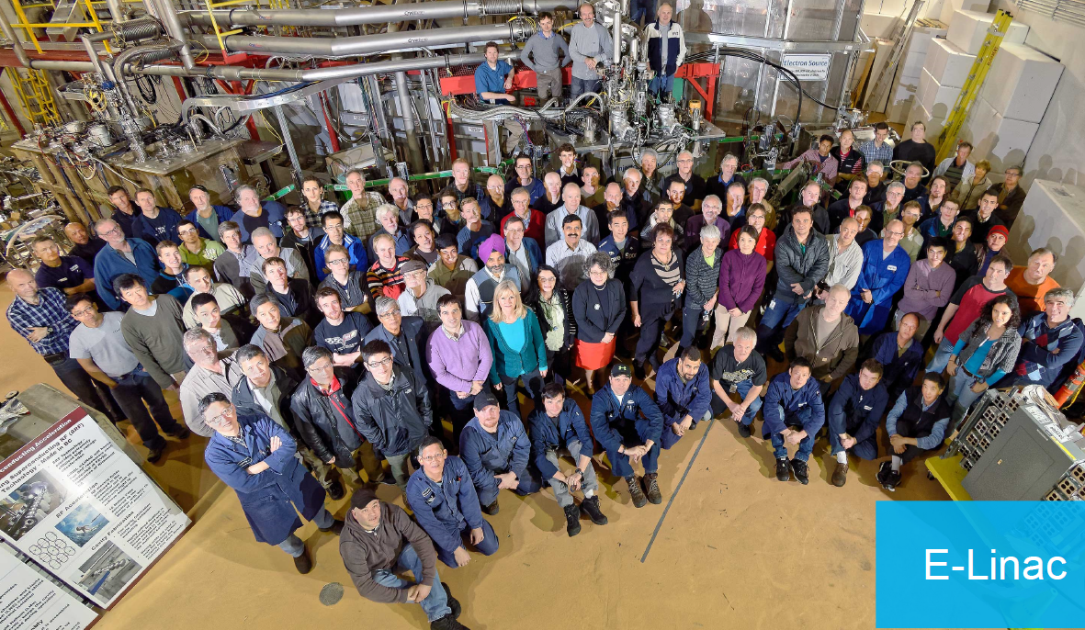

Summary
CV-19 update (now in Phase 3)
  Technical staff now in 80% occupancy
  Professional staff to 25% occupancy
Working on clean room equipment for cavity testing and handling – adding 2K capability
CM Tooling and handling fixtures
  Student engineer now engaged

