Slide 1

Challenges and New developments
Precision timing detectors
ECFA Detector R&D Roadmap Symposium of Task Force 1 Gaseous Detectors
April 29th 2021
Piet Verwilligen – INFN Bari
with input from:
Georgios Fanourakis (NCSR Demokritos) & Alberto Blanco (LIP)

Slide 2
Outline
Motivations
Timing with Gaseous Detectors
Fast Timing with RPCs
  Improved RPCs
  Multi-Gap RPCs
Fast Timing with MPGDs
Challenges in building large systems
Outlook
Disclaimer:
I would like to thank the colleagues of Picosec & MRPC that have provided me info and were open for discussion… I would have liked to discuss more with all of you …
… but time time has no mercy …
Selection of the material is my responsibility as well as the way it is presented …
… thanks to the people from who I stole slides, plots, ideas, …

Slide 3
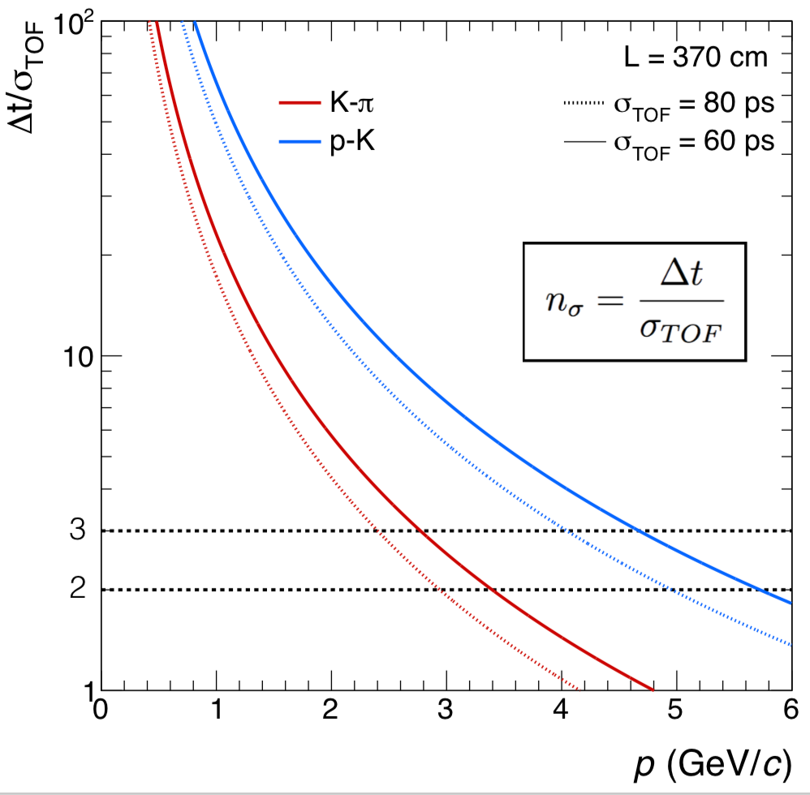
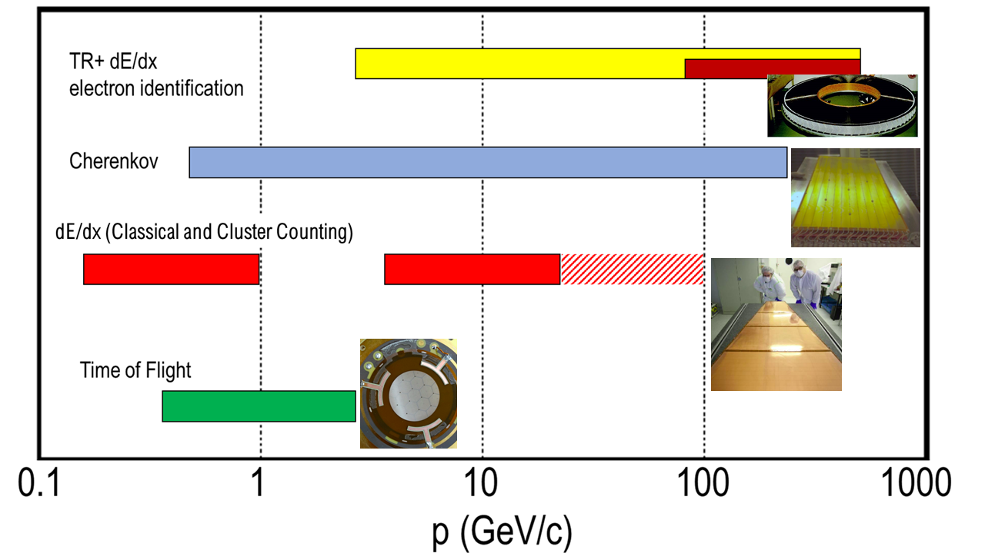
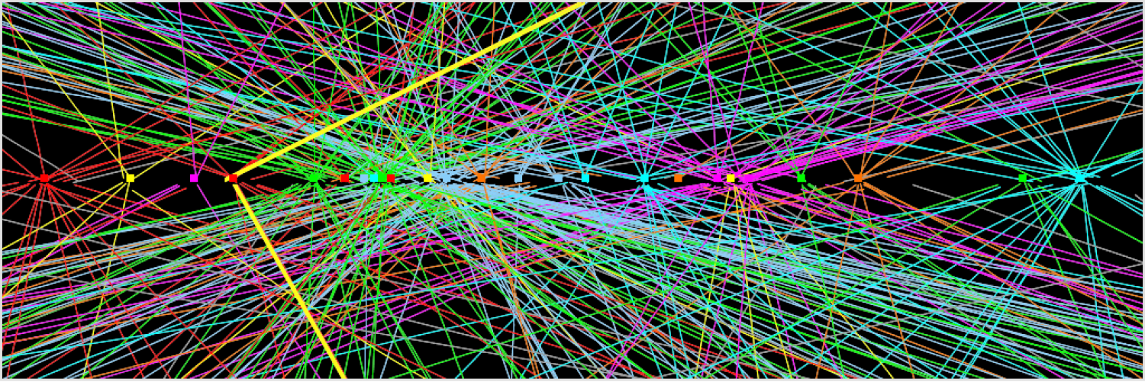
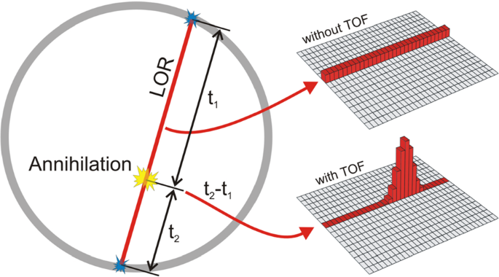
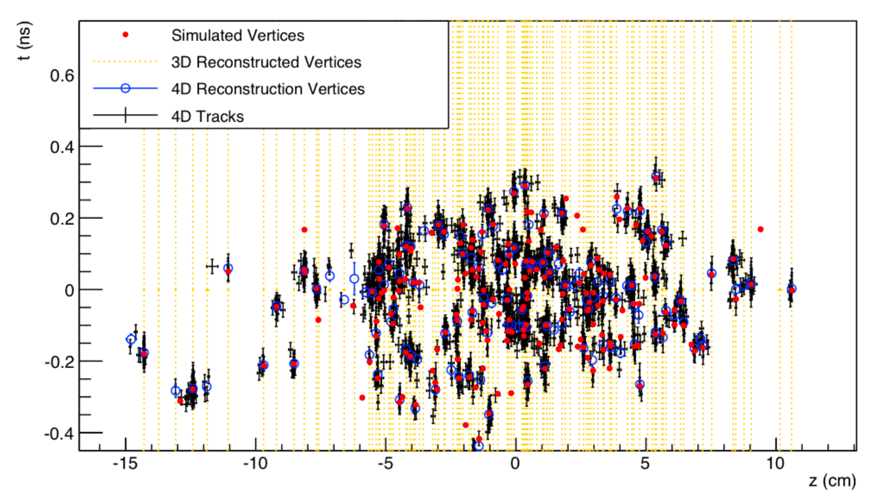
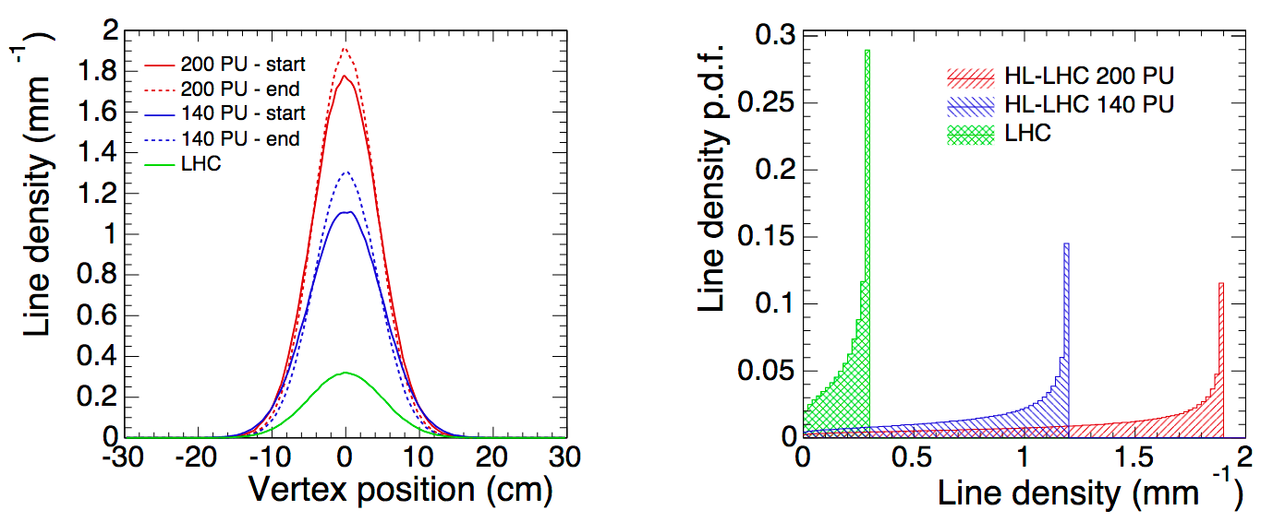
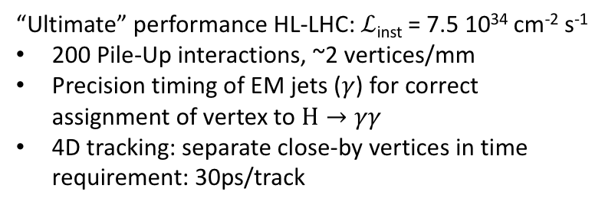
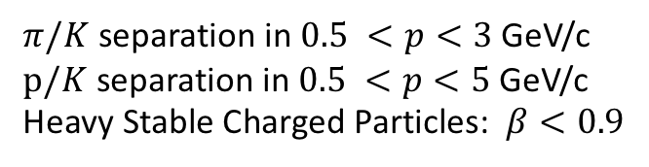
Motivation to name just a few …
Particle Identification (TOF)
Pile-up mitigation at Present & Future Colliders
$π/K$ separation in $0.5 <p<3$ GeV/c
$p/K$ separation in $0.5 <p<5$ GeV/c
Heavy Stable Charged Particles: $β<0.9$
“Ultimate” performance HL-LHC: $ℒ$_{inst} = 7.5 10³⁴ cm⁻² s⁻¹
200 Pile-Up interactions, ~2 vertices/mm
Precision timing of EM jets ($γ$) for correct assignment of vertex to $H→γγ$
4D tracking: separate close-by vertices in time
requirement: 30ps/track
Medical Imaging (TOF-PET)
10 ps challenge to improve PET scan

Slide 4
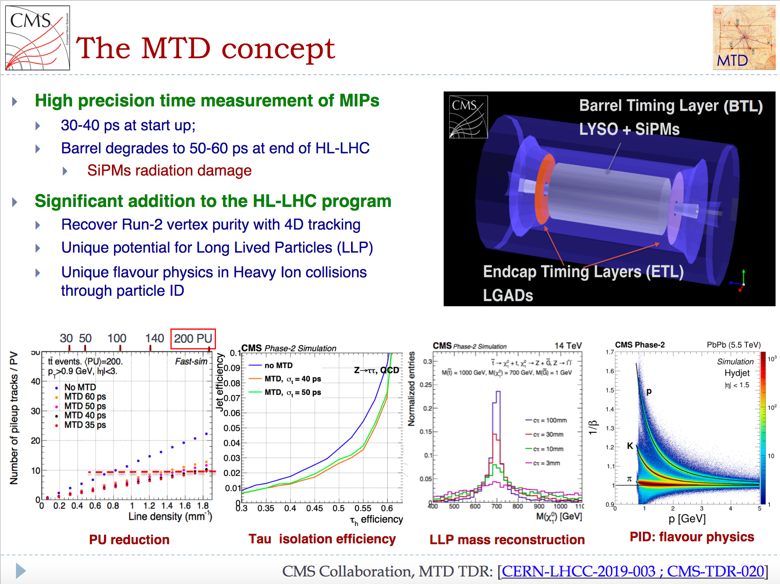
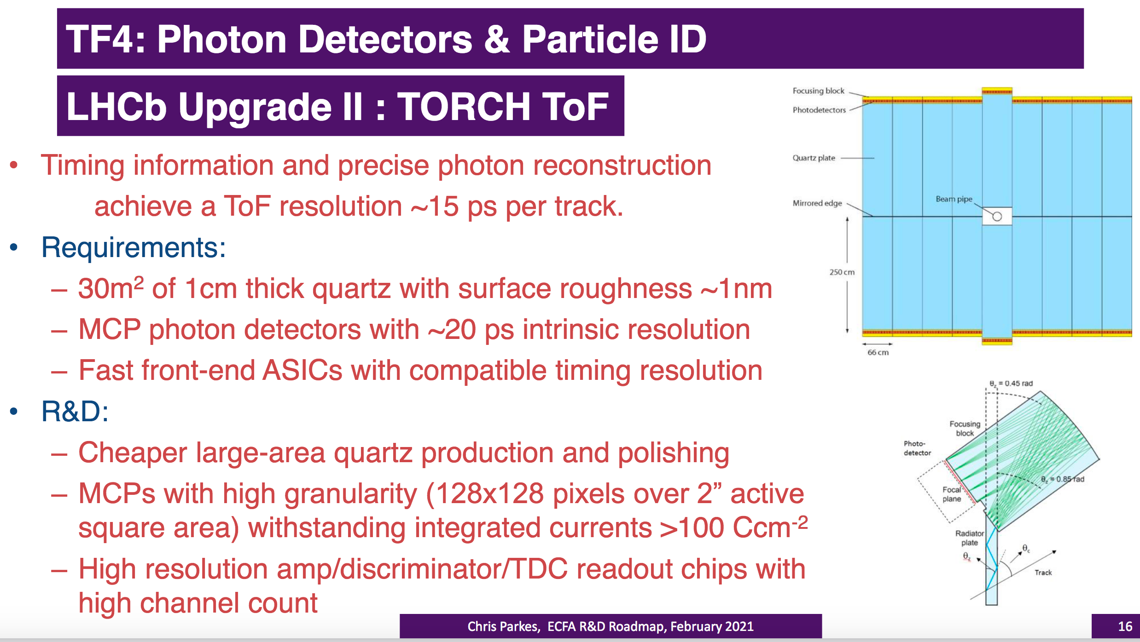
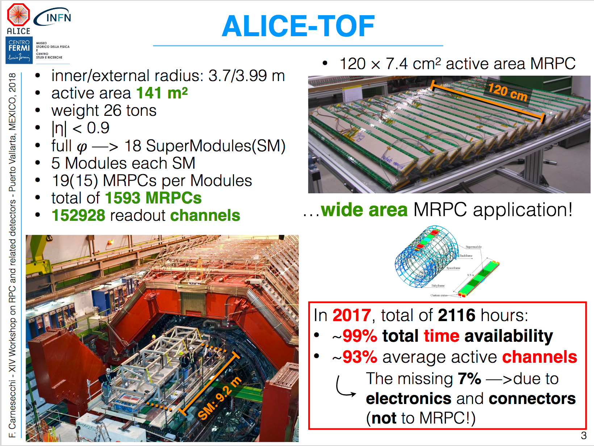
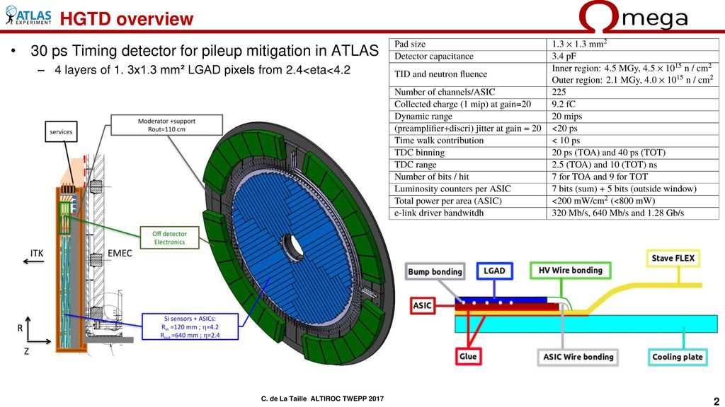
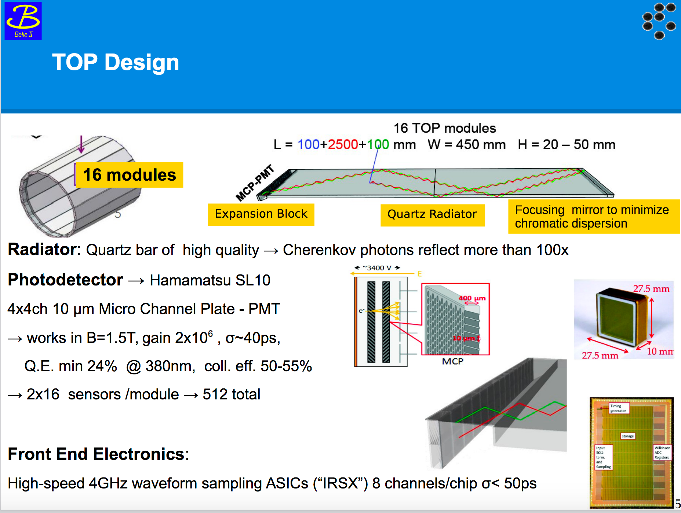
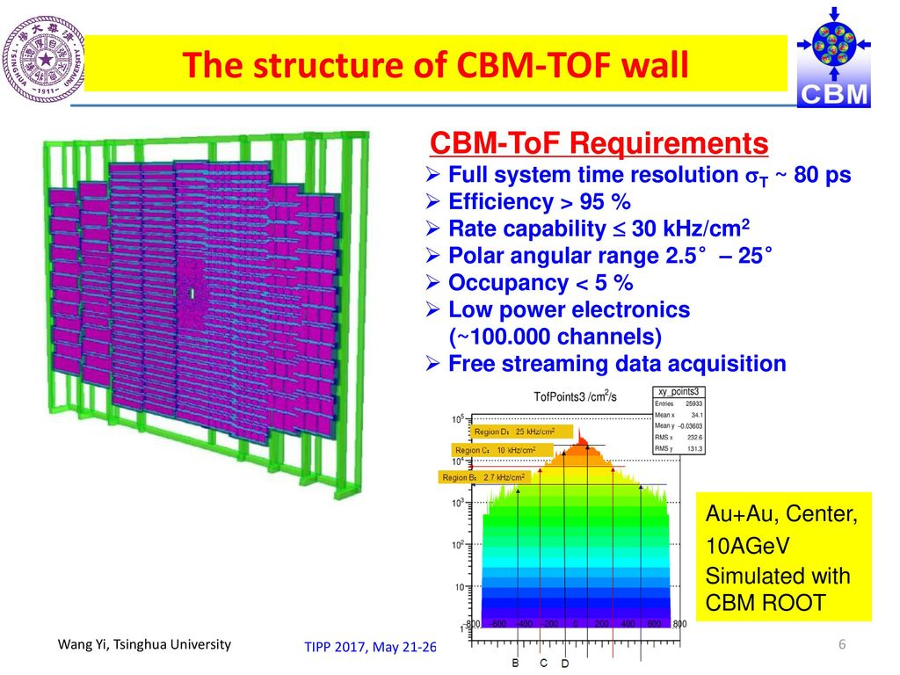
Large TOF systems at Accelerators currently operating or under construction … only few examples few of them gaseous … could be more in the future?
High-Rate MIP timing detectors
LYSO + SiPM and UFSD
30-40ps / Track @ startup
Cherenkov TORCH / TOP
Quartz + MCP-PMT
30ps / Photon => 15ps / Track
MRPC TOF counters
system time resolution < 80ps

Slide 5
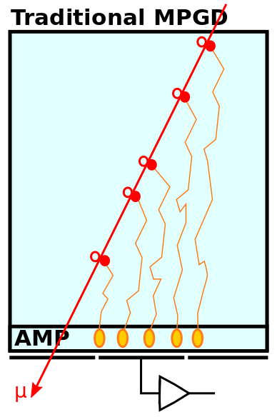
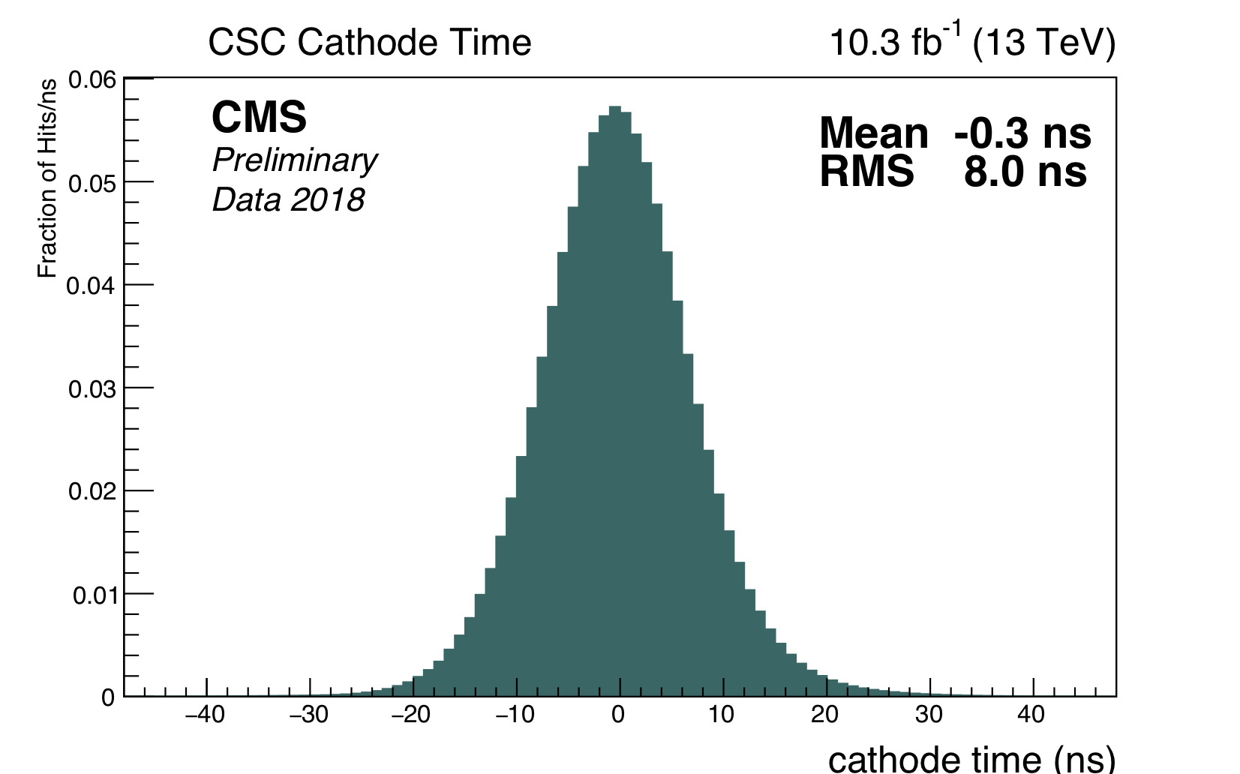
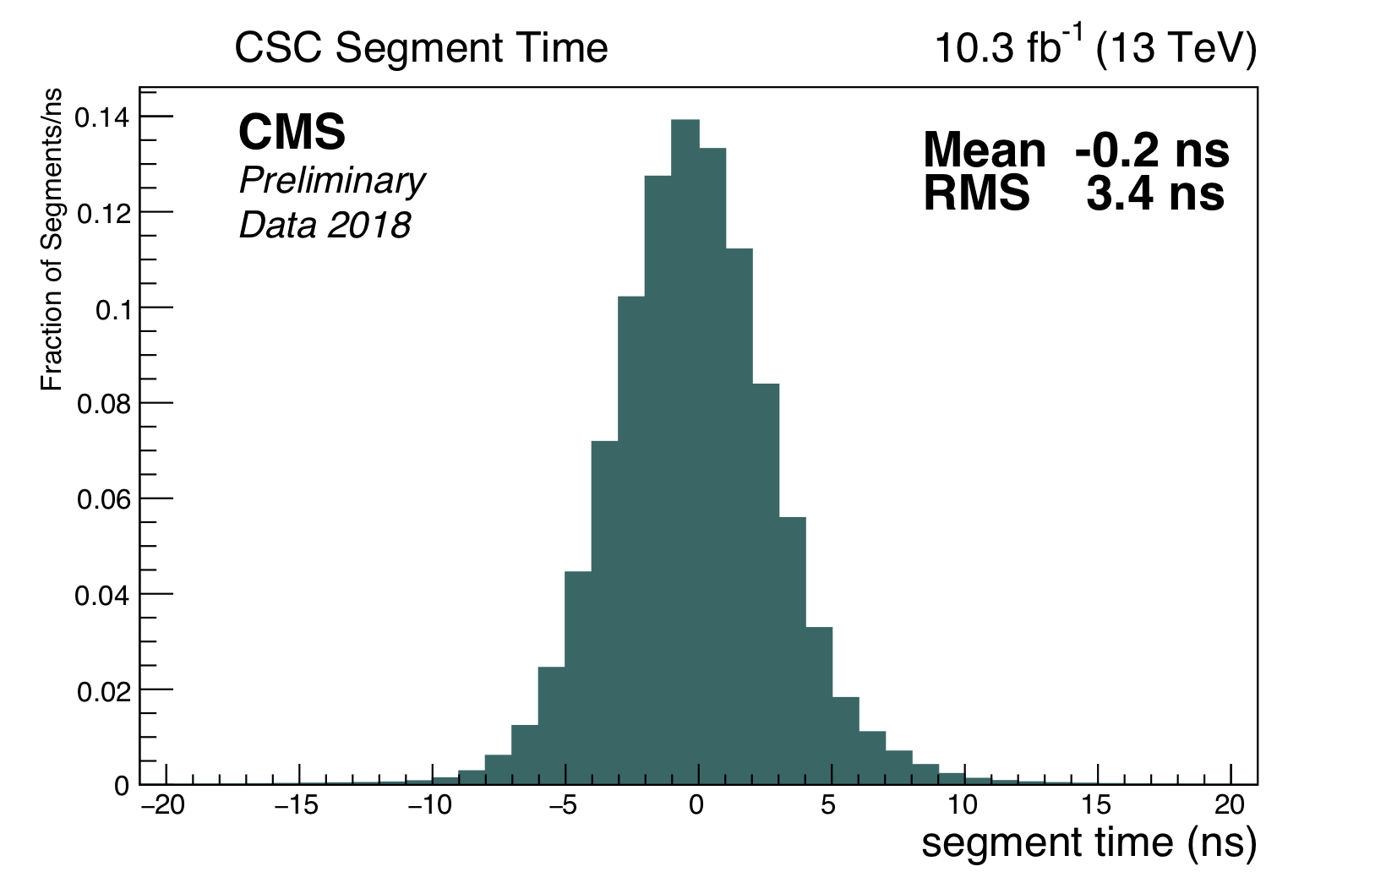
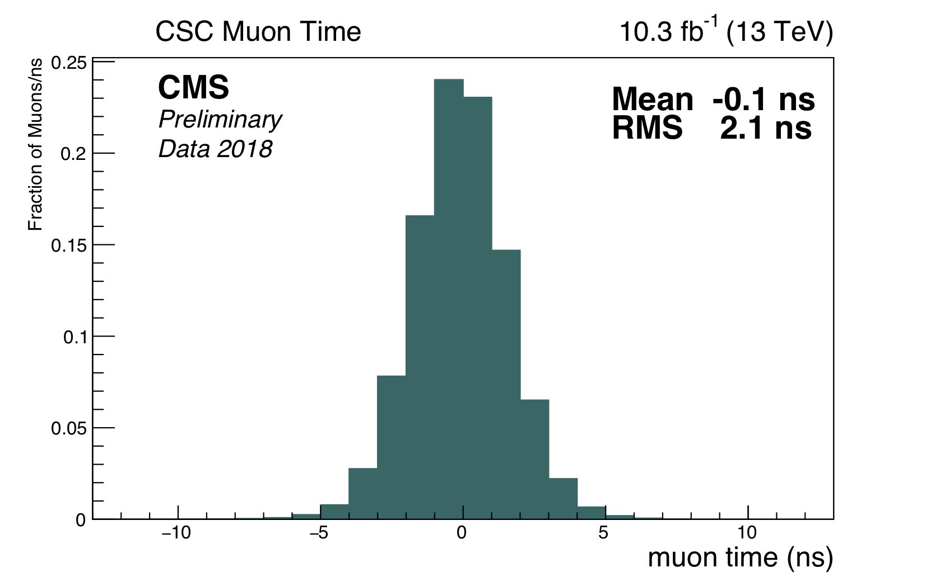

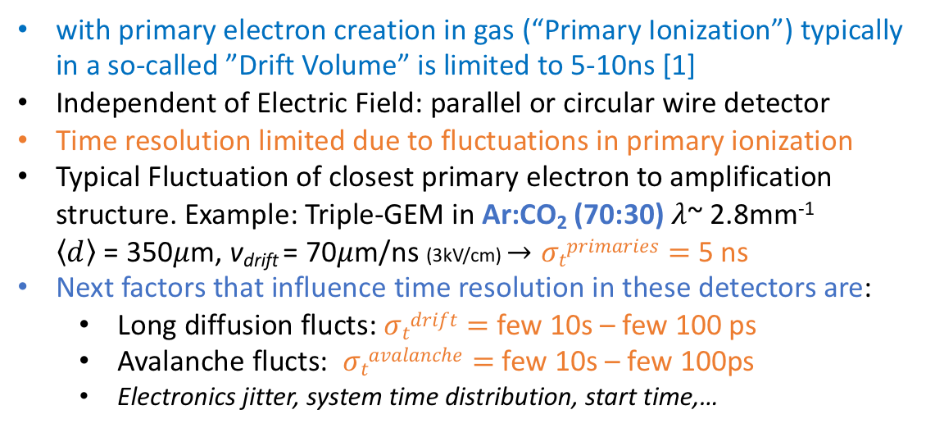



Timing with Gaseous Detectors
with primary electron creation in gas (“Primary Ionization”) typically in a so-called ”Drift Volume” is limited to 5-10ns [1]
Independent of Electric Field: parallel or circular wire detector
Time resolution limited due to fluctuations in primary ionization
Typical Fluctuation of closest primary electron to amplification structure. Example: Triple-GEM in Ar:CO₂ (70:30) $λ$~ 2.8mm⁻¹
$\left\langle d\right\rangle$ = 350$μ$m, v_{drift} = 70$μ$m/ns (3kV/cm) $→σtprimaries=$ 5 ns
Next factors that influence time resolution in these detectors are:
  Long diffusion flucts: $σtdrift=$ few 10s – few 100 ps
  Avalanche flucts: $σtavalanche=$ few 10s – few 100ps
  Electronics jitter, system time distribution, start time,…
1
2
1
3
2
4
3
4
Example at LHC: CMS CSC
Exa
Better time resolution obtained: $σt/\sqrt{N}$
Single-hit $σt=$ 8ns
6-hit stub $σt=$ 3.4ns
4-stub muon $σt=$ 2.1ns

Slide 6
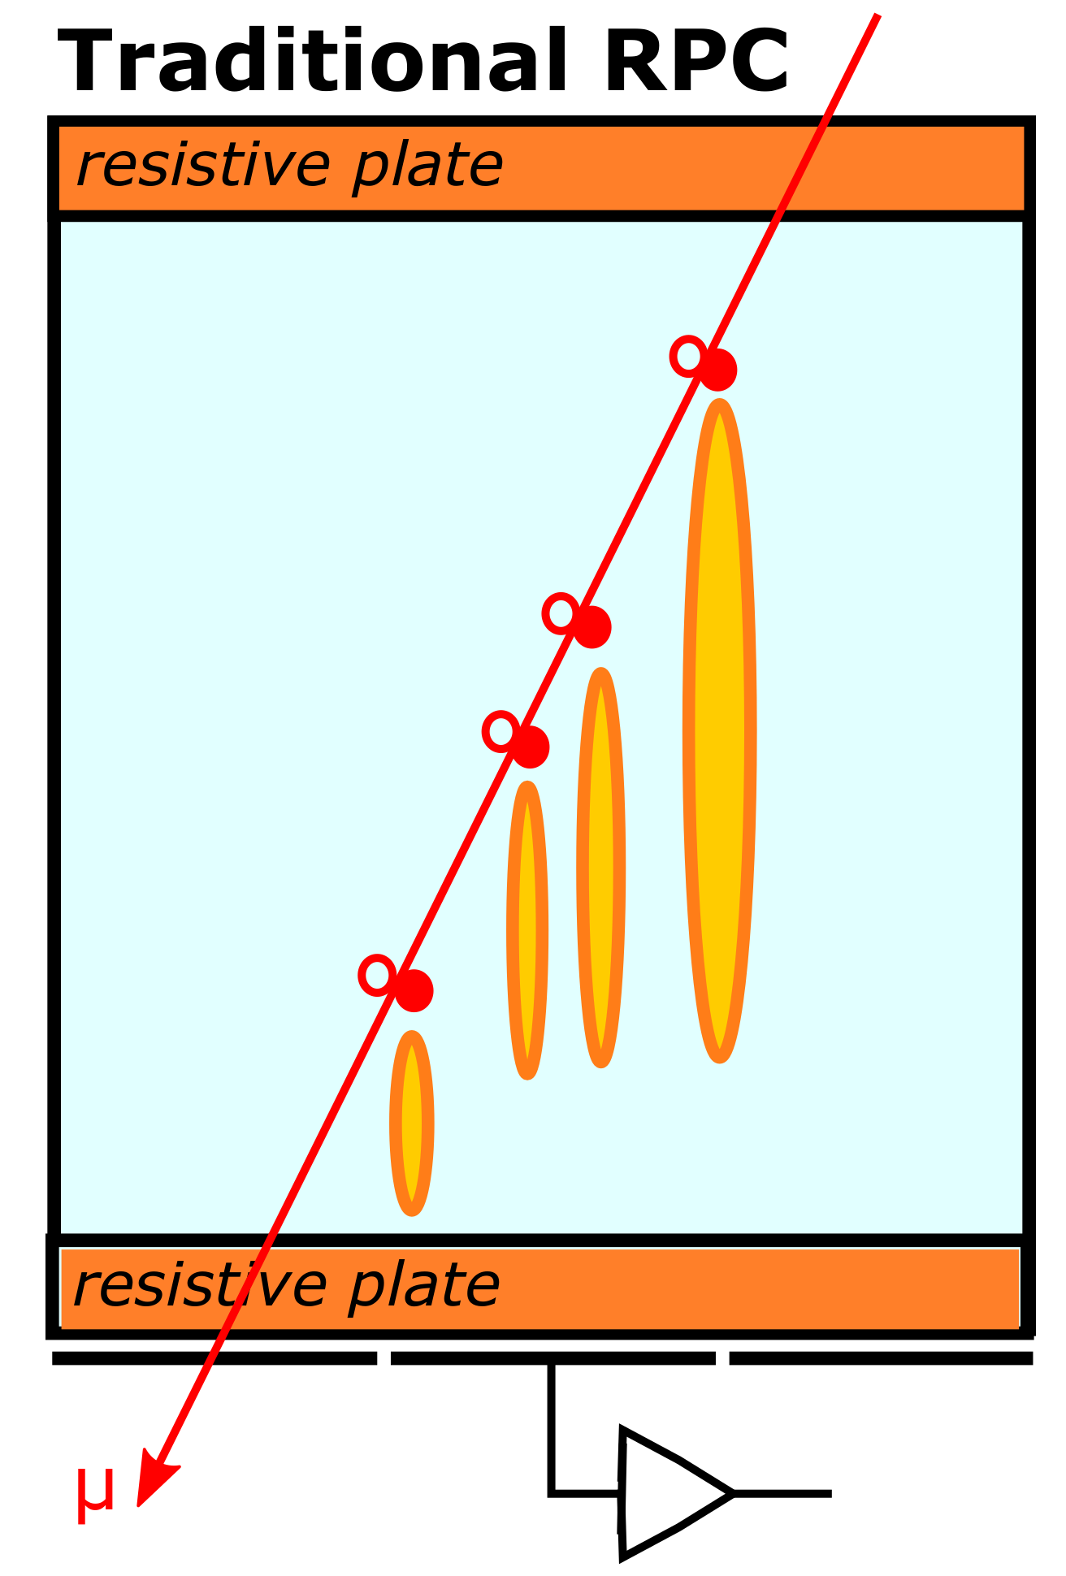
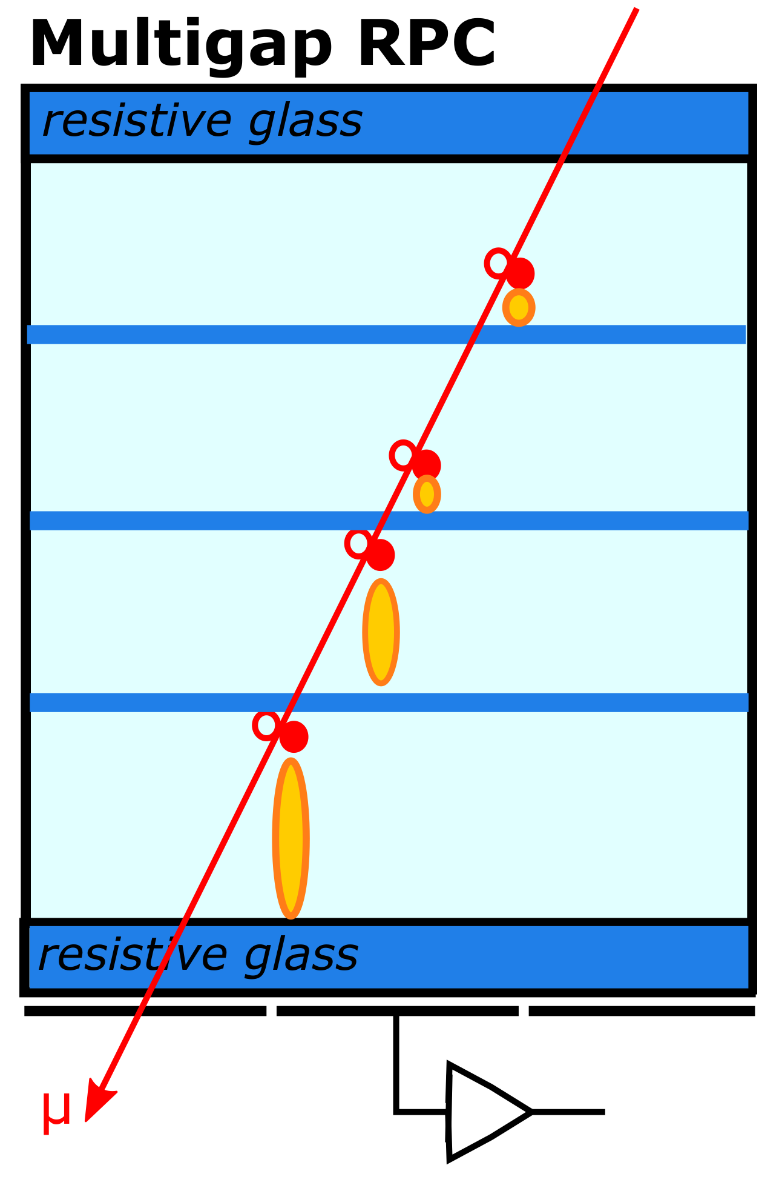
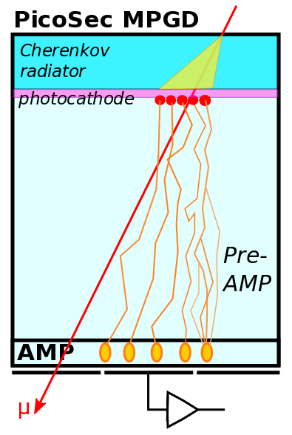
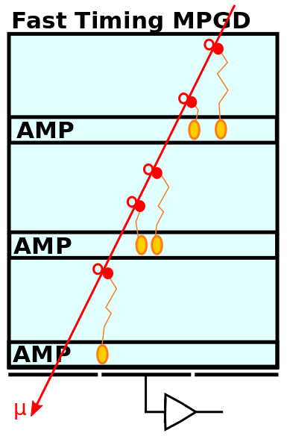
Overcome limits time-resolution
Possible Solutions:
No drift volume, amplify immediately: Resistive Plate Chamber(2ns – 300ps)
- at cost of loss of Proportionality, reduced Rate Capability & limited position resolution
Reduce gap width with order of magnitude and use multiple gaps:
Multigap-RPC (100ps – 20ps)
- same as RPC, but difficult for large area
Create all primary electrons at same place (use Radiator+PC): PicoSec (25ps)
- but expensive radiators (Quartz, MgF2) & non rad-hard photo-cathodes (CsI)
Sample the fluctuations in primary electron creation: Fast Timing MPGD (~300ps – not proven yet)
- resistive MPGD: spark protection
but reduced rate capability

Slide 7
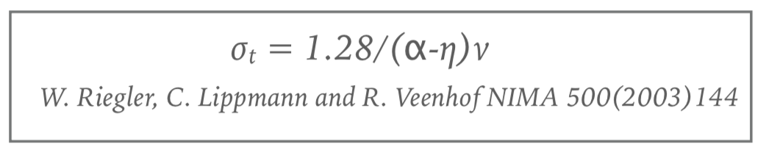
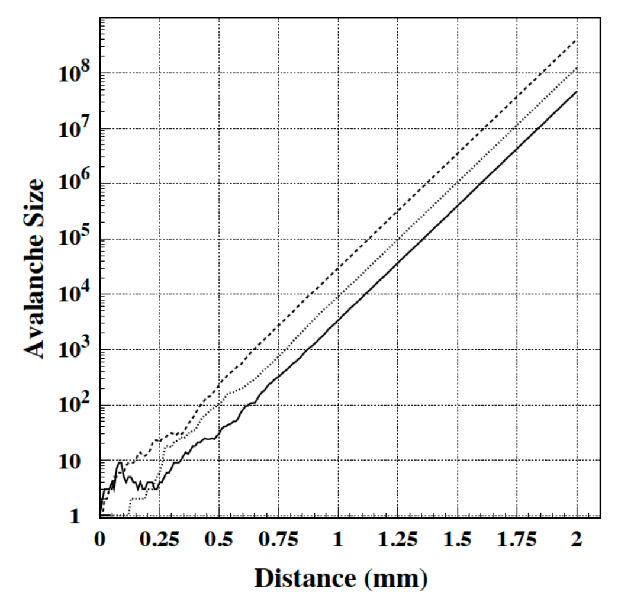
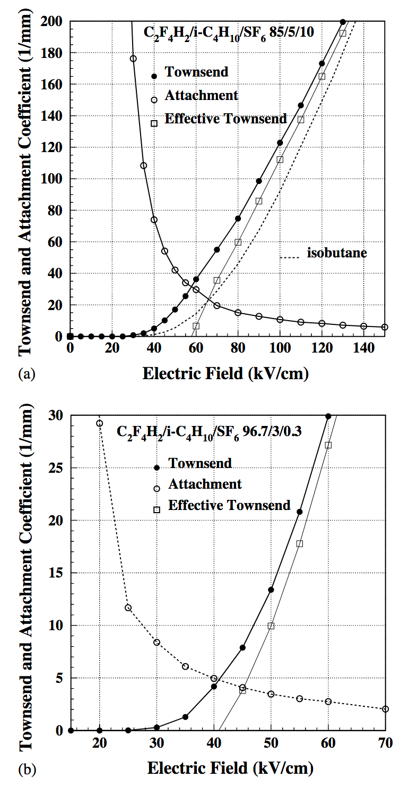
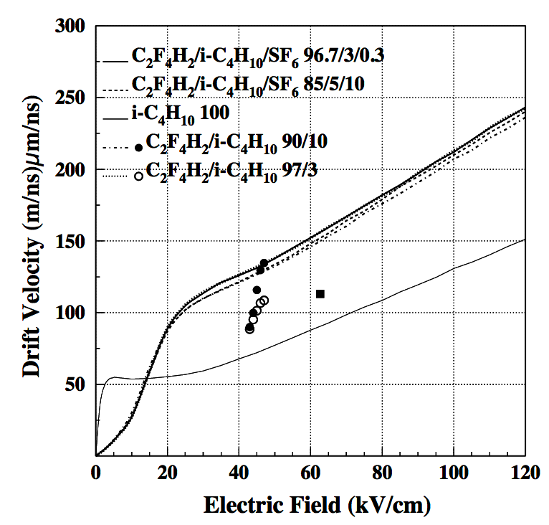
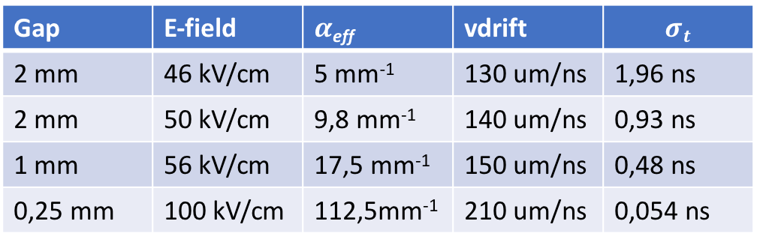

Fast Timing with RPCs
Abolish electron drift before starting the avalanche
First Implementation: Parallel Plate Avalanche Counters (PPAC)
  Observed sub-ns time resolution (‘70 of 20th century)
Various subsequent developments => Resistive Plate Chamber
=> More info in Talk G. Aielli this morning
Time resolution of RPC driven by fluctuations in the avalanche
  Important: start of the first avalance (primary ionization fluctuations)
  => use gas with high number of clusters / mm (C2H2F4)
  Important: fluctuations early inside the avalanche
Traditional RPC 2mm 50kV/cm $α$_{eff} = 10 mm⁻¹
3 e- created at x = 0
thr
Gap | E-field | $α$_{eff} | vdrift | $$σt$$
2 mm | 46 kV/cm | 5 mm⁻¹ | 130 um/ns | 1,96 ns
2 mm | 50 kV/cm | 9,8 mm⁻¹ | 140 um/ns | 0,93 ns
1 mm | 56 kV/cm | 17,5 mm⁻¹ | 150 um/ns | 0,48 ns
0,25 mm | 100 kV/cm | 112,5mm⁻¹ | 210 um/ns | 0,054 ns
NIM A500 (2003) 144-162
1.7ns
NIM A500 (2003) 144-162
Jitter created early
during avalanche

Slide 8
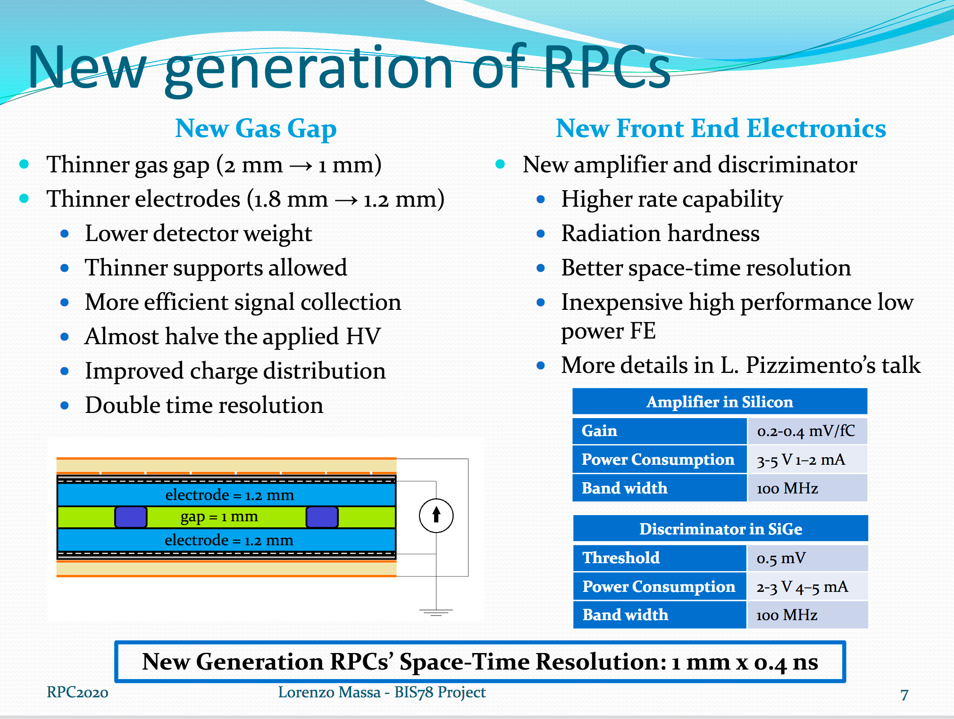
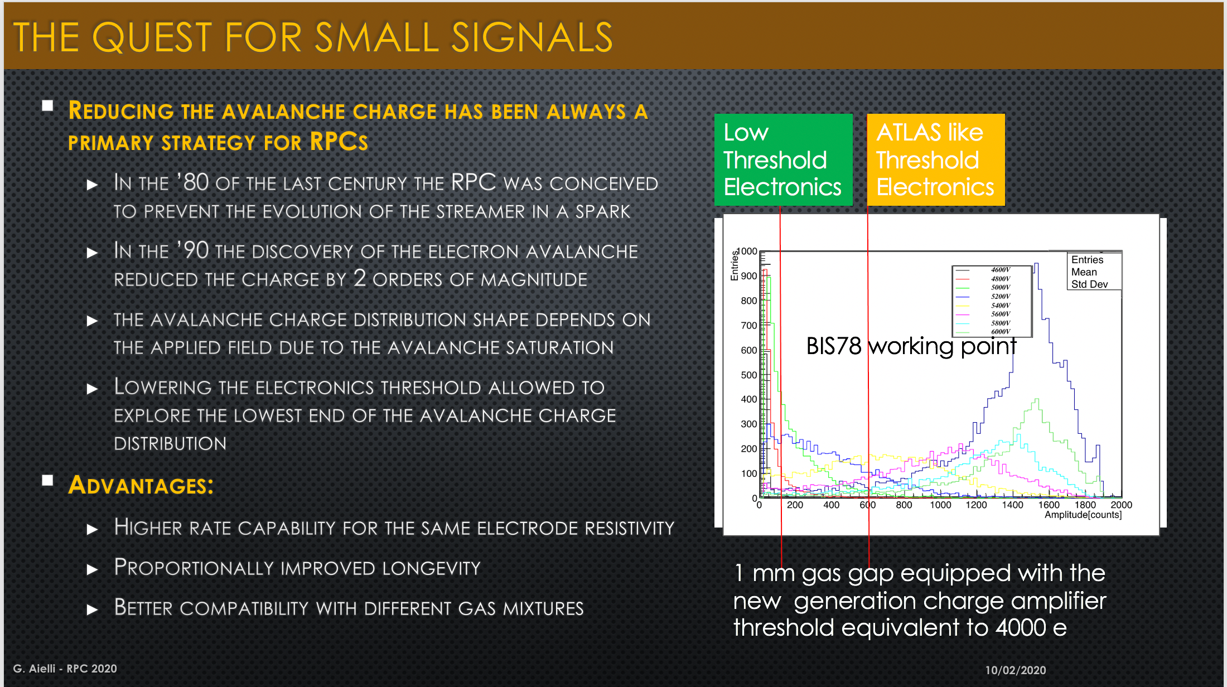
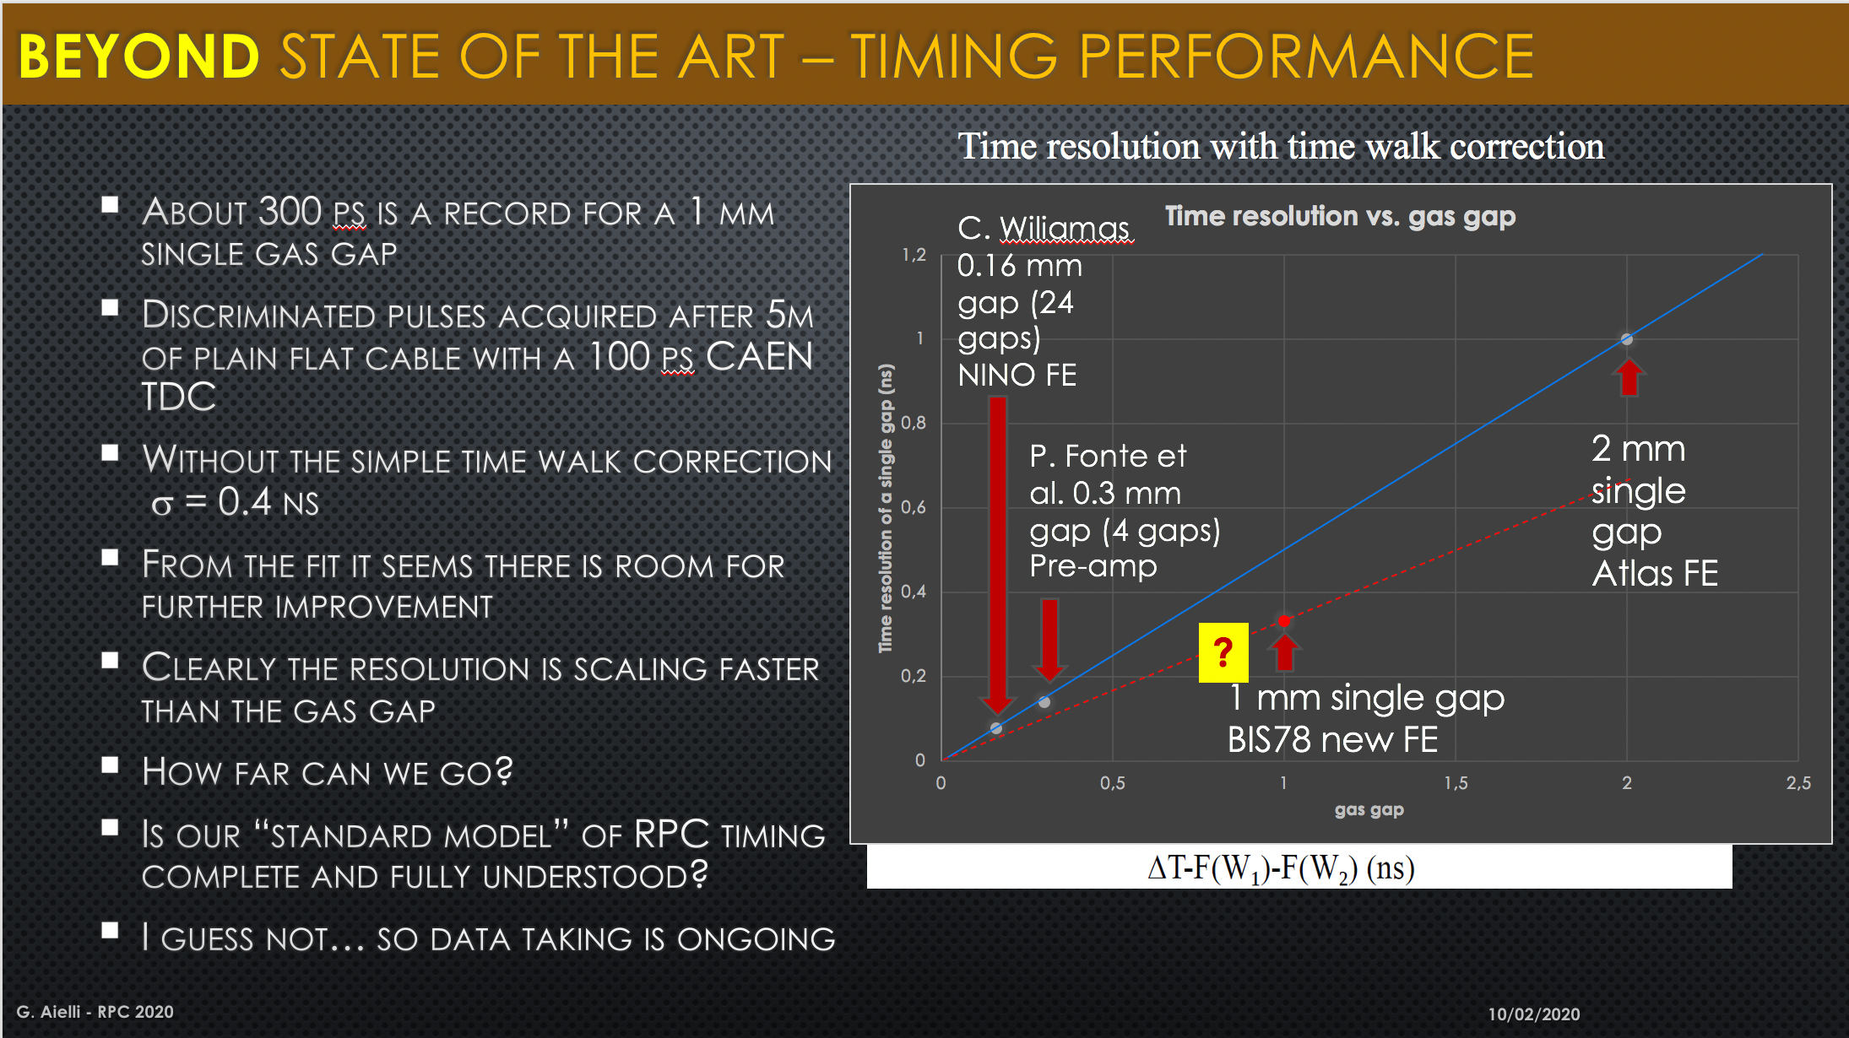
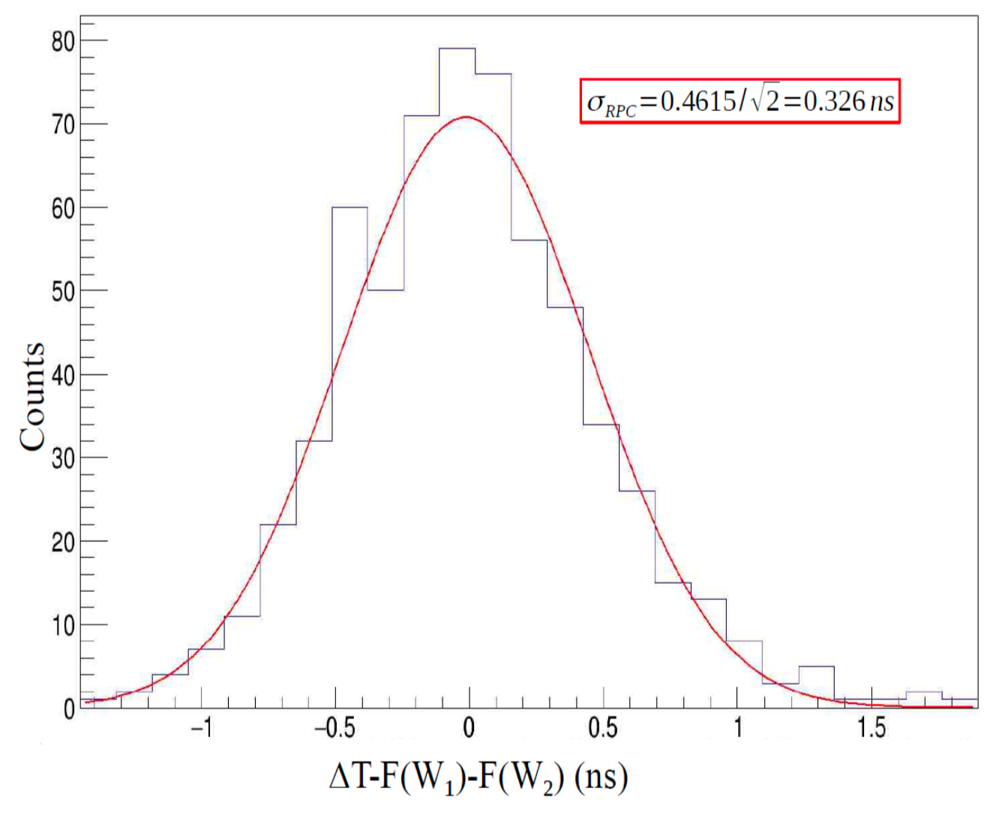
Fast Timing with ‘improved’ RPCs
Improved sensitivity of FE
Primary Ionization must happen here to have
avalanche > threshold
L.Pizzimento, L.Massa
& G.Aielli – RPC 2020
Operate at lower gain
Reduced bakelite thickness (1.2mm)
Reduce Total Voltage
Reduced gap thickness (1mm)
Improved Time resolution
Impressive breakthrough realized with ‘standard’ bakelite RPC
< 325ps possible, but not much margin to maintain efficiency
Thinner gaps require Multi-Gap RPC to maintain efficient

Slide 9
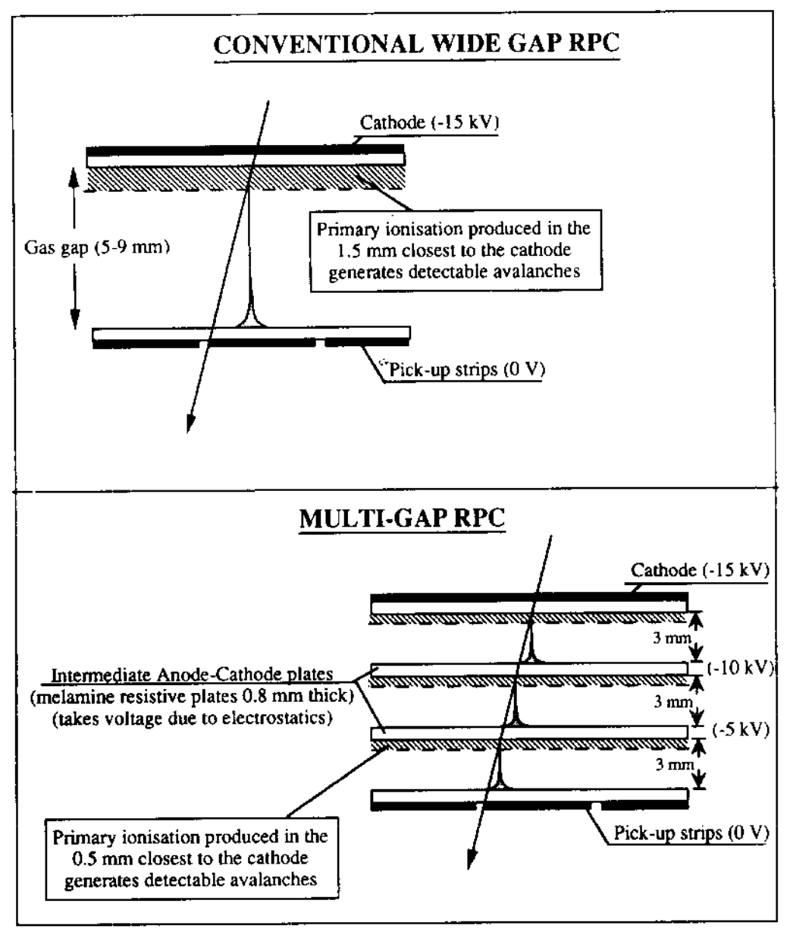
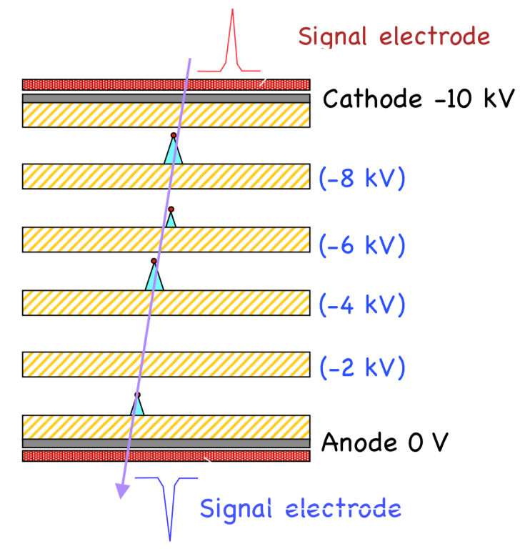
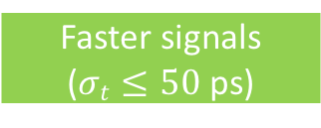
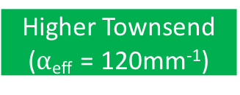
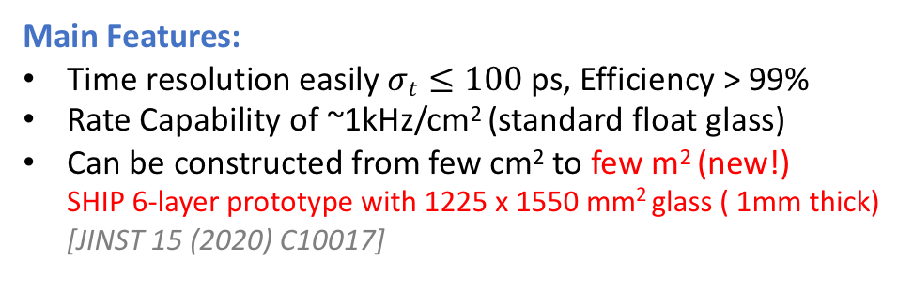
Fast Timing with multigap-RPCs
Smaller gap width (300um)
Higher Electric Fields (100kV/cm)
Higher Townsend ($α$_{eff} = 120mm⁻¹)
Faster signals
($σt≤50$ ps)
NIM A374 (1996) 132-135 – MCS Williams
Efficiency < 75%
(primary ionization)
Multigap RPC
Efficiency > 99%
NIM A500 (2003) 144-162
Main Features:
Time resolution easily $σt≤100$ ps, Efficiency > 99%
Rate Capability of ~1kHz/cm² (standard float glass)
Can be constructed from few cm² to few m² (new!)
SHIP 6-layer prototype with 1225 x 1550 mm² glass ( 1mm thick)
[JINST 15 (2020) C10017]

Slide 10
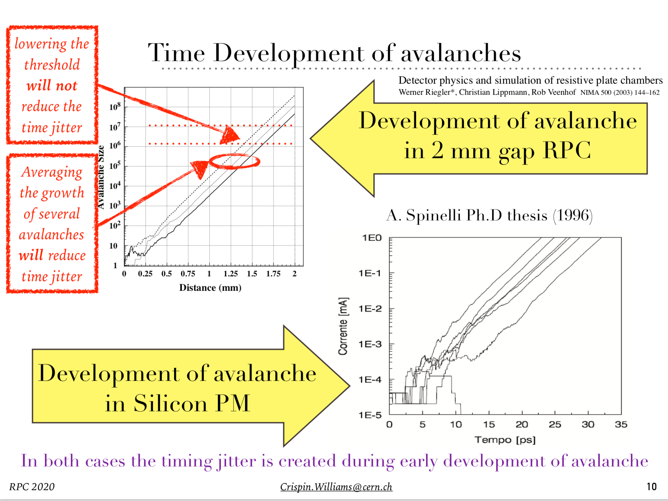
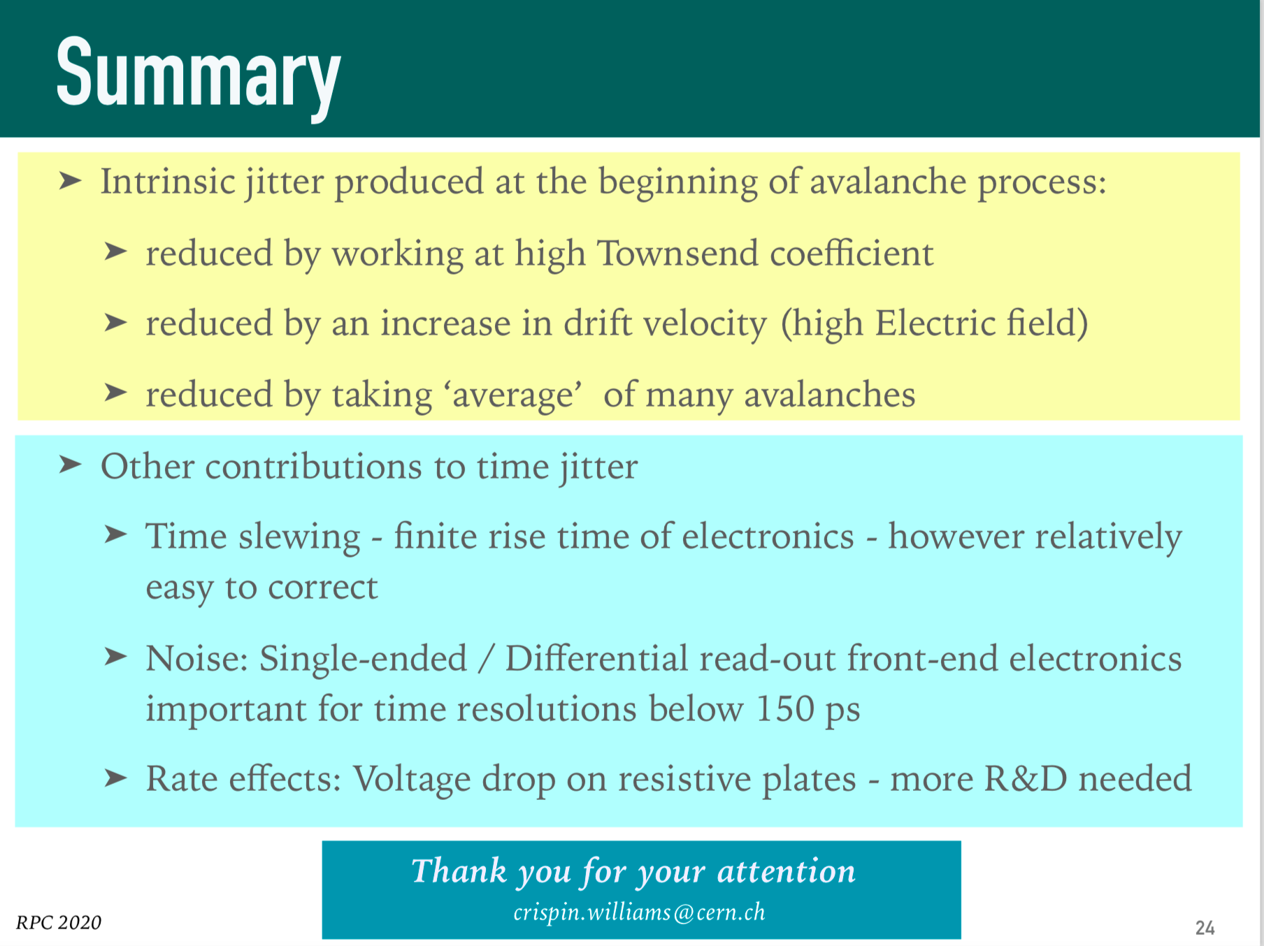
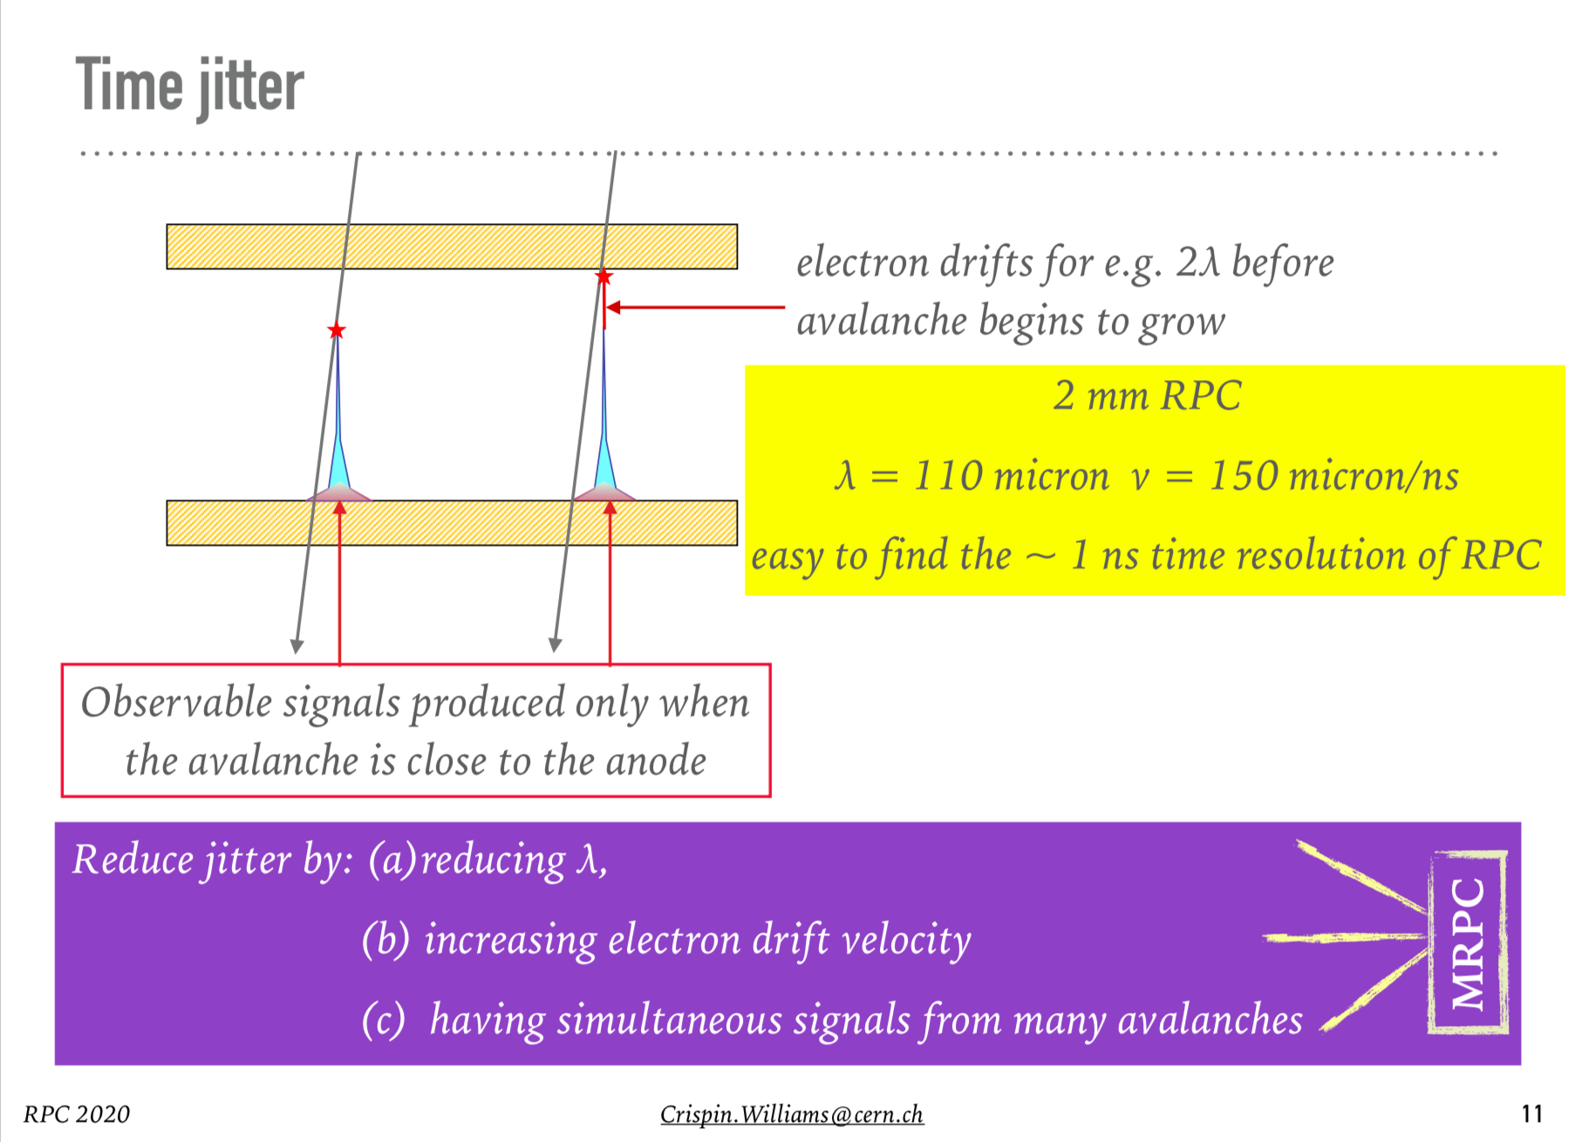
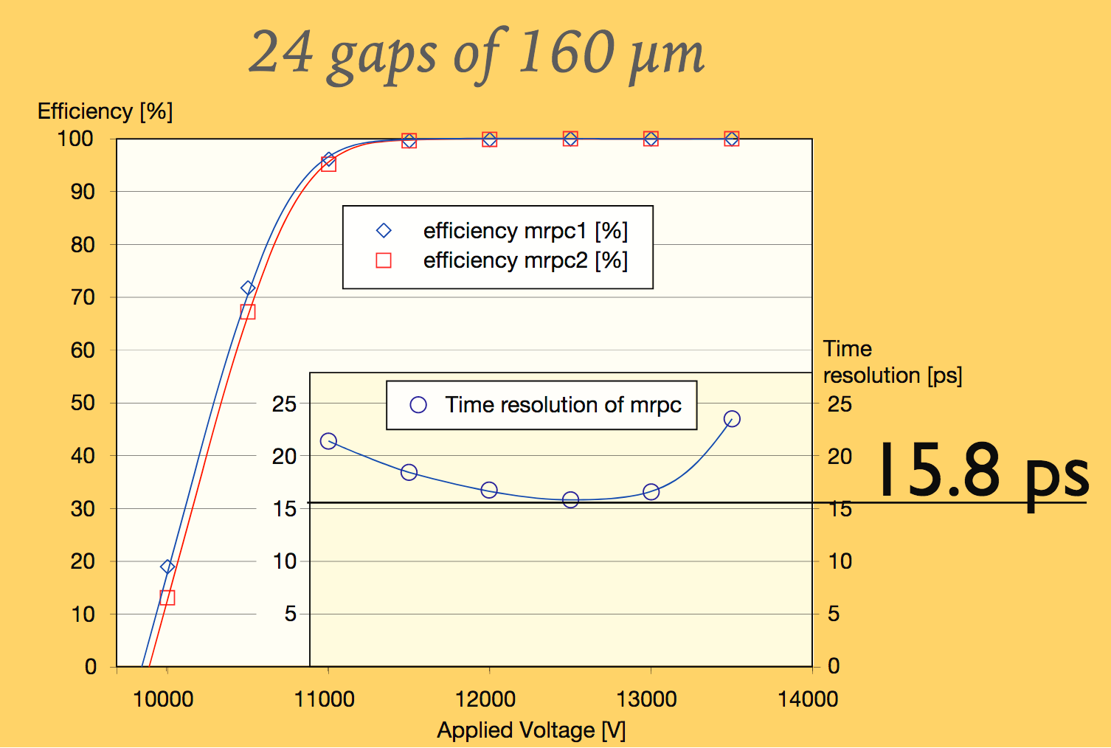

Fast Timing with RPCs: Jitter
Traditional RPC 2mm 50kV/cm $α$_{eff} = 10 mm⁻¹
3 e- created at x = 0
Factors that influence Timing properties
MCS Williams – RPC 2020
thr
Best result known to me
1.7ns
Jitter created early
during avalanche
AIDAinnova Task 7.2
MCS Williams – 14.04.21

Slide 11
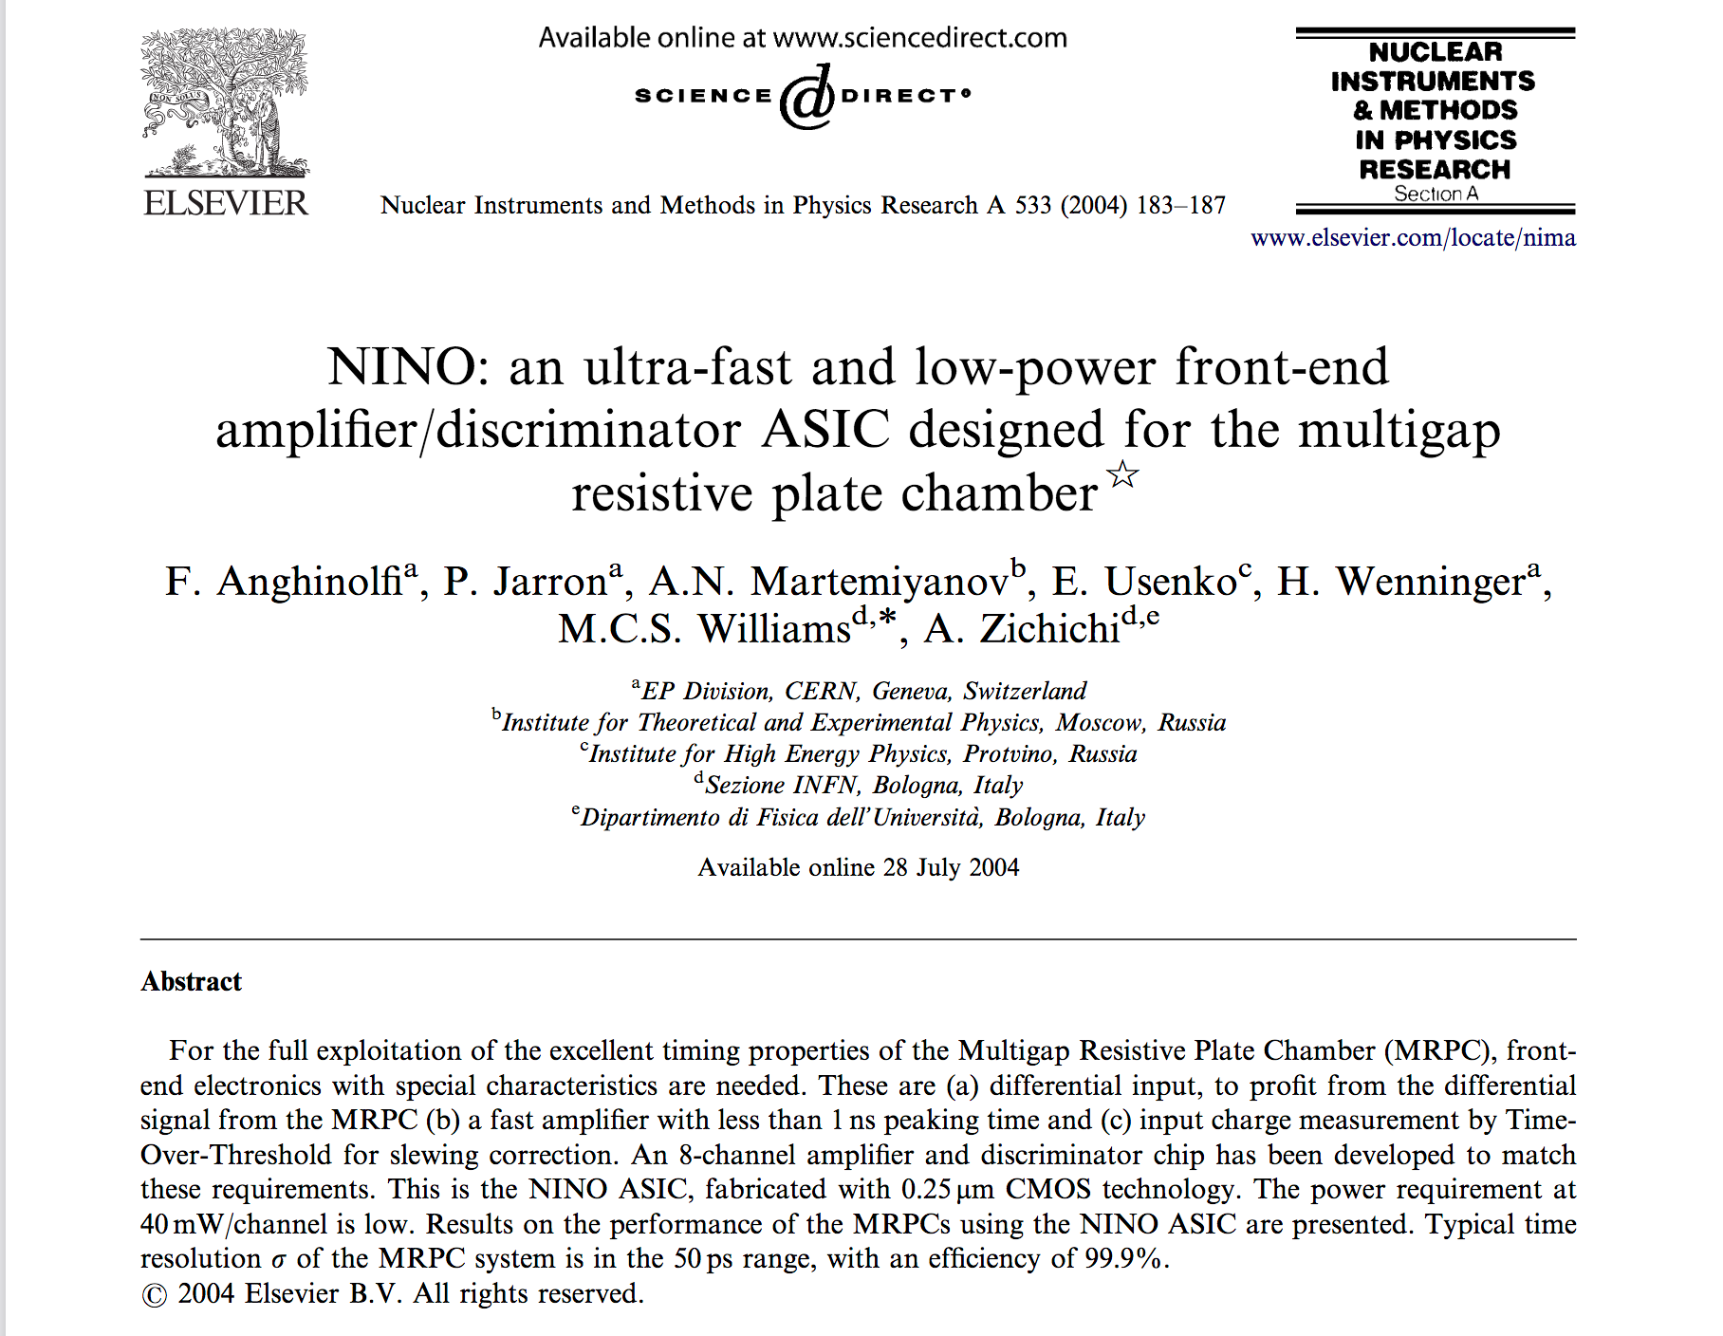
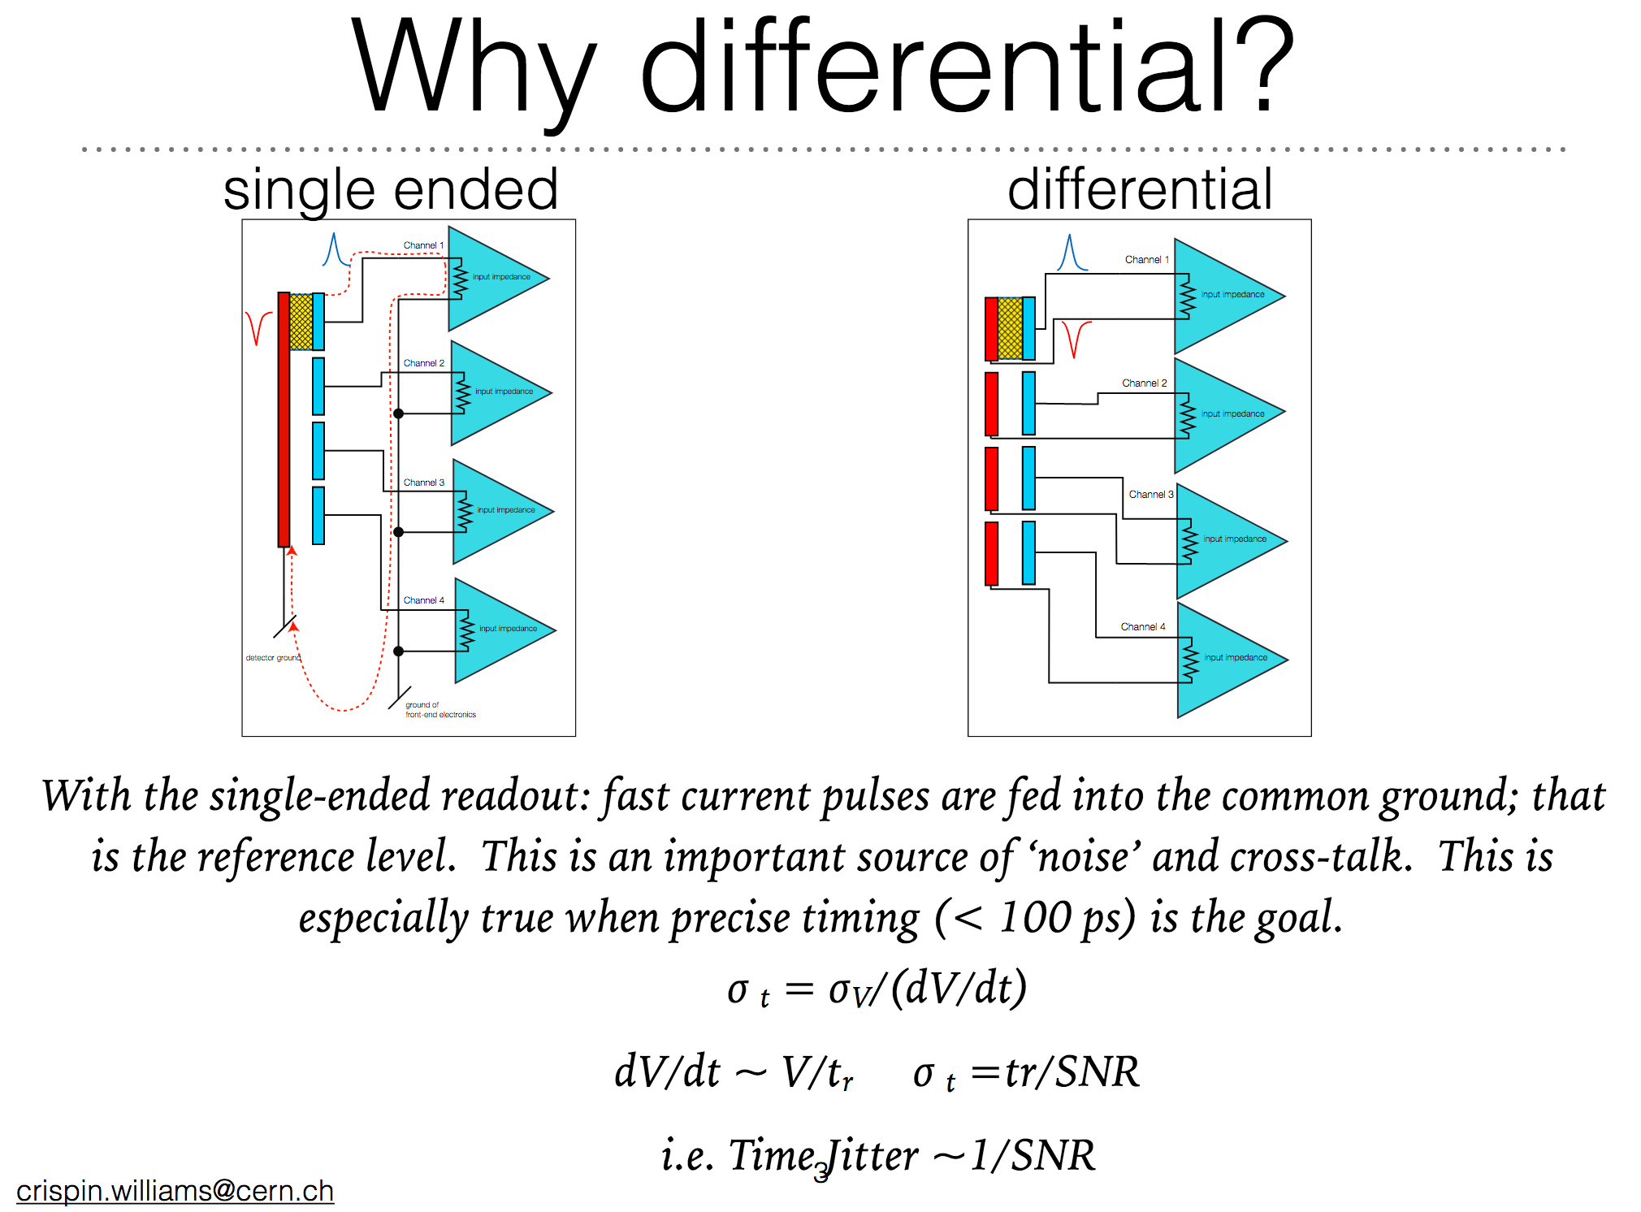
Fast Timing with RPCs: Electronics
ALICE MRPC developed dedicated Front-End electronics: NINO
Differential input
Fast amplifier (risetime < 1ns)
Time-over-Threshold (TOT) for slew correction (charge correction)
Discr. Threshold 10-100fC
ENC: ~4300e- at 15pF
Factors that influence Timing properties
MCS Williams – RPC 2020

Slide 12
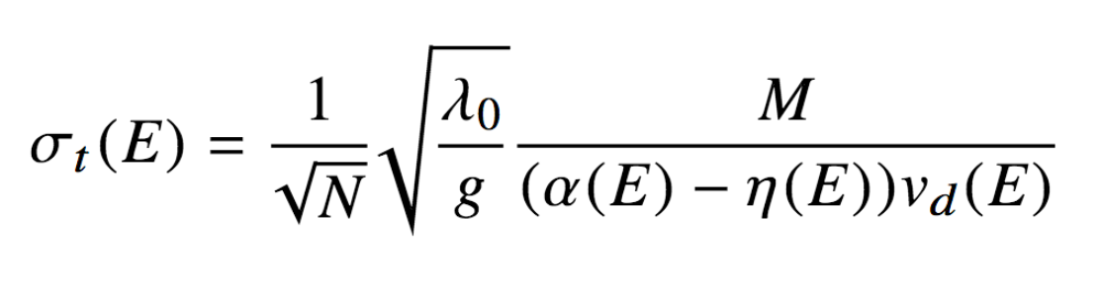
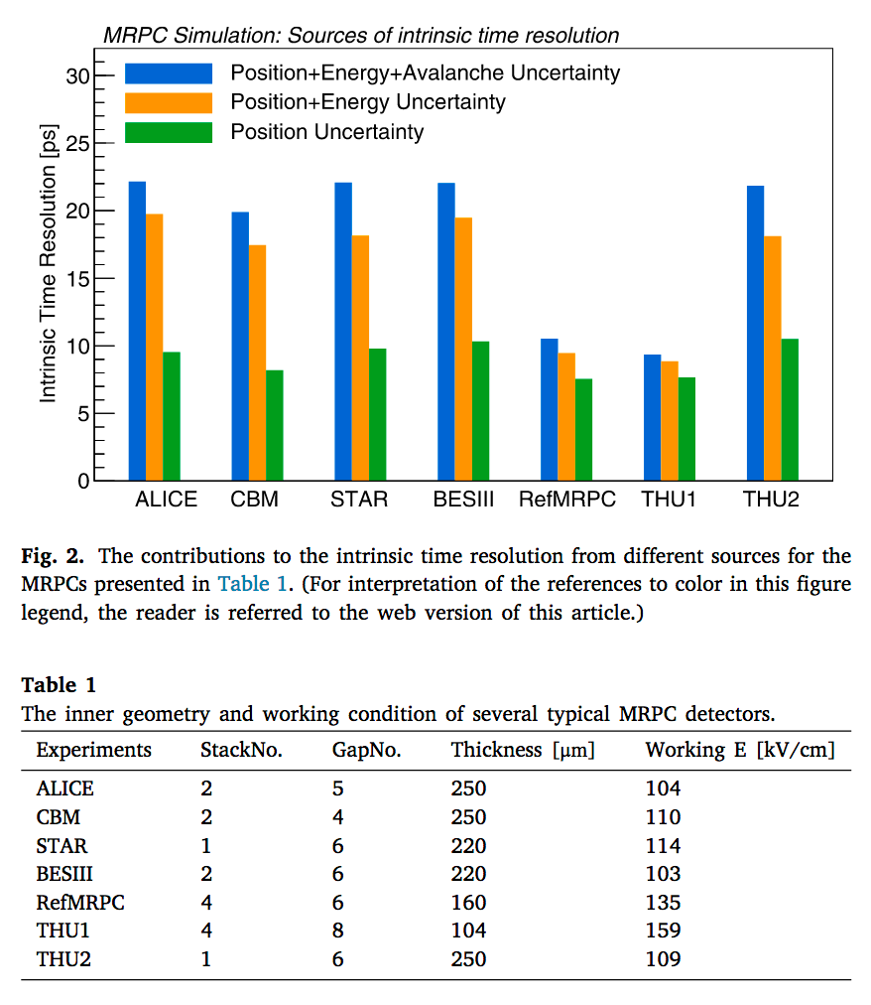


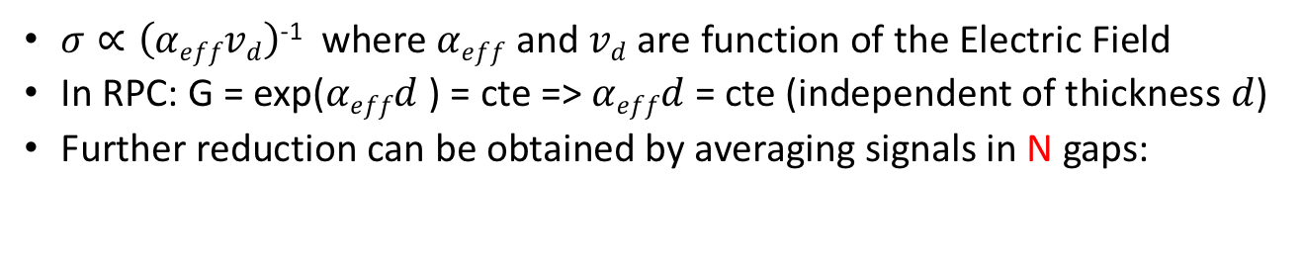

What is the time resolution limit in MRPC?
$σ∝\left(αeffvd\right)$⁻¹ where $αeff$ and $vd$ are function of the Electric Field
In RPC: G = exp($αeffd$ ) = cte => $αeffd$ = cte (independent of thickness $d$)
Further reduction can be obtained by averaging signals in N gaps: x
D. Gonzalez-Diaz
JINST 12 (2017) C03029
Reduce gap thickness
Increase
$αeff$
Increase Electric Field
Increase
v$d$
Reduce
$σt$
simulation
10ps
NIM A500 (2003) 144-162
NIM A950 (2020) 162932
d
E

Slide 13
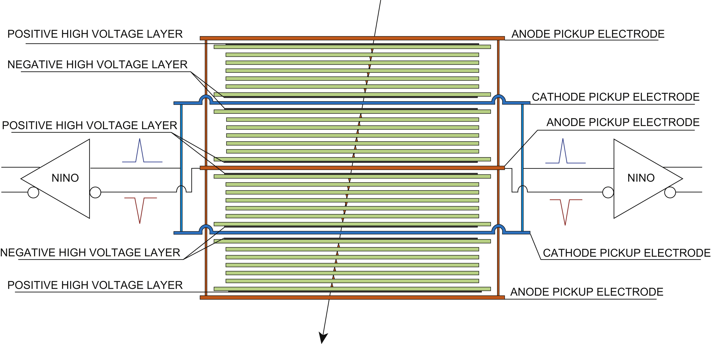

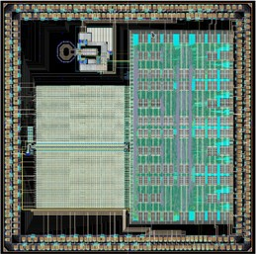
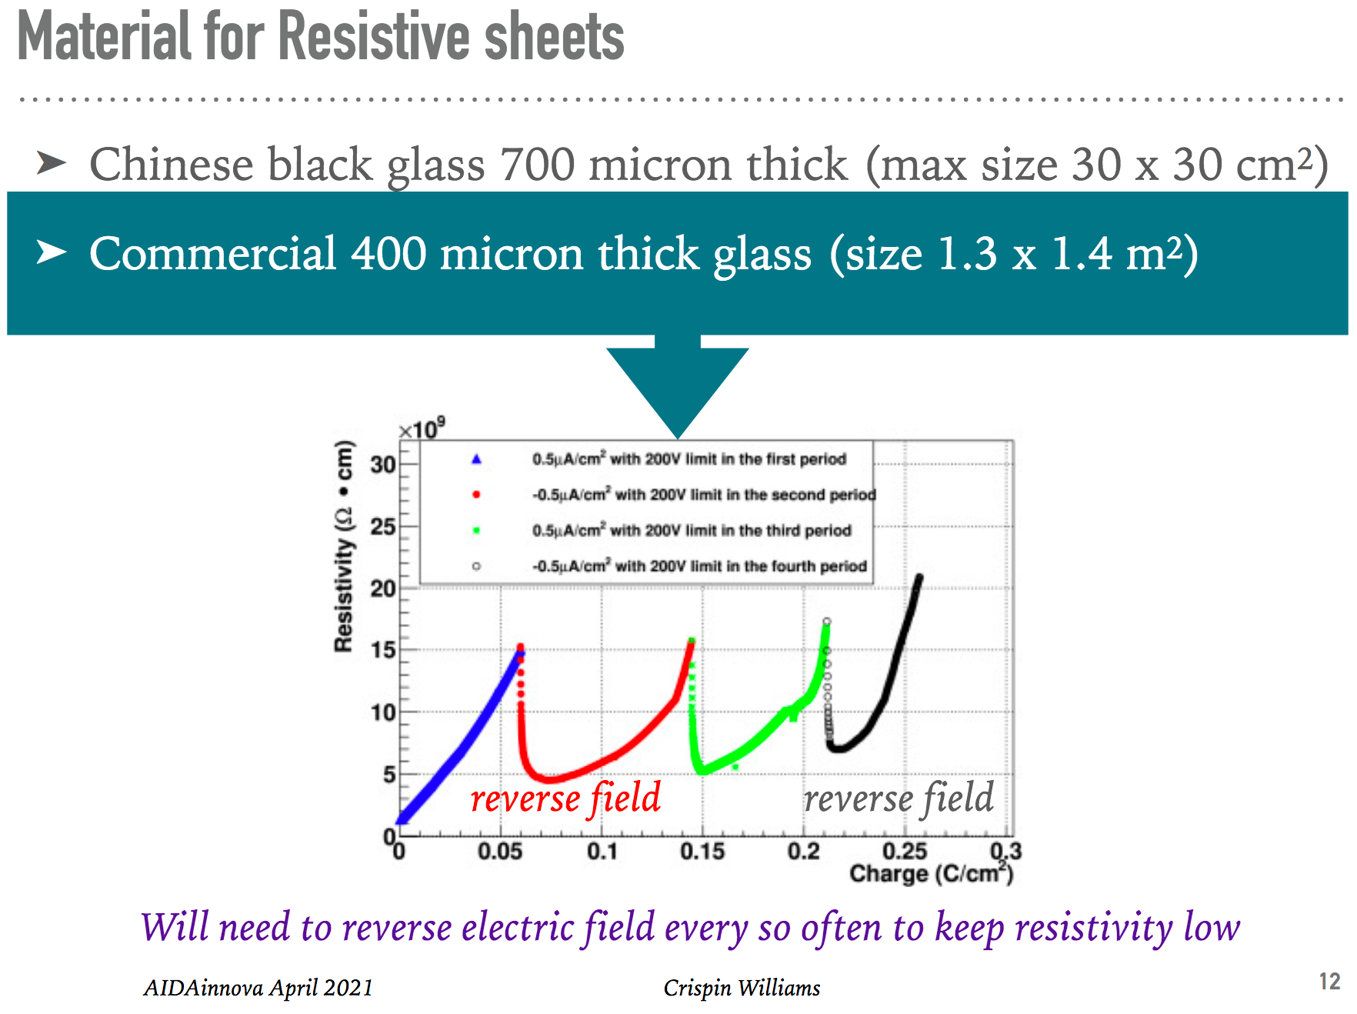

Limitations & Future Perspectives
24 gaps
Timing: $σt≤$50 ps for large areas becomes a challenge
  More &thinner gas gaps: 20ps with 24 gaps (160um)
    Thinner electrodes for better signal induction
    Very thin gaps & glass, Mechanically complicated multi-stacks
  Time resolution below 15-20 ps will be very hard …
    Reaching the avalanche jitter floor – can be overcome by averaging many avalanches
  Exploit best time resolution at system level: New low noise FEE and DAQ
  R&D continues in WP 7 AIDAinnova
    Goal: 20ps time resolution at 50 kHz/cm²
Rate Capability:
  Standard float glass is limited to ~kHz/cm² [bulk resistivity $ρ$ ~10¹² Ω $∙$cm]
  Lot of research ongoing to search for new materials [$ρ$down to 10⁹⁻¹⁰ Ω $∙$cm]
  CBM requires rate capability up to 25 kHz/cm² --- But new problems pop up
  Large sizes could be an issue due to material non-homogeneities
  Thinner electrodes will help but mechanics will be an issue.
  Gas distribution in thinner gaps at high rate could be an issue.
  Increase Temperature will decrease $ρ$ (but increase the noise)
  Lower the charge for efficient detection => Electronics!
Climate Friendlyness:
  EU HFC phase down affecting C₂H₂F₄ (likely also SF₆ in future)
  Need GWP-neutral gas-mixture for RPC & MRPC
  R&D is currently focused in trigger-RPCs => should start also for timing-RPC
NIM A594 (2008) 39-43
PicoTDC
https://kt.cern/technologies/picotdc
AIDAinnova Task 7.2
MCS Williams – 14.04.21

Slide 14







Fast Timing with MPGDs: picosec
PICOSEC
Micromegas
Principle of Operation
First Tests with MPGD (MM) detectors in 1999
Common Project within RD-51 in 2015
  Started with small detector (1 pad: ø 1cm)
Obtained Time-Resolution:
  76 ps for single photons (tested with fs UV laser)
  24 ps for 150 GeV muons (Npe = 10)
Nominal configuration:
  3 mm MgF₂ + 5.5 nm Cr substrate + 18 nm CsI Photocathode (PC)
  Bulk MicroMegas, 200 μm drift + 128 μm amplification
  Optimum WP: V_{drift} : V_{mesh} :V_{anode}: -475V : 0V : +275V
  Ne:C₂H₆:CF₄ 80:10:10 allows gain of few 10⁵ – 10⁶
  Readout: 1 pad (ø 1cm, ~10pF)
Many different configurations tested:
  Different bulk-MM: Thin-Mesh, Resistive, Floating-Pads
  Different Photo Cathodes: CsI, Cr, Al, DLC, B₄C, B-doped DLC
Processes very well modeled in Simulation
References: NIM A903 (2018) 317–325
σ_{tot}=24.0±0.3 ps
<N_{phe}> $=\sim 10$
150 GeV muons
single pad – ø 1cm
266nm photons
σ_{ph}=76.0±0.4 ps
Use of CIVIDEC 2GHz 40dB current amplifier … however at G= 10⁵ – 10⁶ signal directly visible on oscilloscope
ion signal
electron signal
150 GeV muons

Slide 15








Fast Timing with MPGDs: picosec
PICOSEC
Micromegas
Custom
single-channel electronics
Single pad PICOSEC detector
Multi-pad PICOSEC: 19 hex pads ø 1cm
10x10 pad PICOSEC module with 100 discrete Amplifiers
R&D dedicated to more Robust & Large Area picosec detectors
R&D on Rad-Hard Photocathodes
2.5nm DLC is Rad-Hard & allows σ_{t} $<50$ ps
CSI with protection layer? (humidity, IBF)
Secondary Emitter?
R&D on amplification structure
Improve timing / stability (different meshes)
Resistive MM improve dynamic range (HIPs)
Gas (current gasmix is flammable + GWP)
References: NIM-A 993 (2021) 165049
Multi-pad detector:
σ_{t} preserved with signal on multiple pads.
All tracks passing within R<2mm from the center of any pad
All tracks passing within R<2mm from any pad corner
σ_{t} = 25.8ps
σ_{t} = 32.2ps

Slide 16




Fast Timing with MPGDs: picosec
PICOSEC
Micromegas
Applications: PID ( $πK$)
σ_{t} (MIP) = 24 ps
Calorimetry
σ_{t} (80 pe) = 8 ps
Picosec in EM after few X0
R&D dedicated to more Robust & Large Area picosec detectors
R&D on Large Area
10x10 cm² prototype under construction
Ceramic MM (<10um flatness over 100cm²)
Larger areas: Tiles of 10x10 or 20x20 cm²
Main challenge: mechanical stability (few um)
Hermetic detector pursued (PC cleanness)
R&D on electronics / readout
Hybrid: Discrete Amplifier + ASIC for Timing
Single ASIC: more complex (app specific)
Optical Readout?
References: NIM-A 993 (2021) 165049

Slide 17



Fast Timing with MPGDs: FTM
Under development
author’s bias
Fast Timing MPGD (FTM): Principle
Divide drift in multiple layers, each w/ own Amplification
Resistive electrodes => Electrode Transparency
Signal induced in External Pick-Up strips
Closest primary electron => Fastest Signal
Time Resolution $σt$ = 1/($λ$ $∙$ v_{drift} $∙$N), where N = layers
Observed: 2ns with 2 layer detector [4] ($→$OK)
Fast Timing MPGD: Challenges:
Detect single-electron (or single cluster) instead of many clusters
Requires High Gain Structures
Requires sensitive front-end electronics
Test Beam Results (2 layers)
300ps for MIPs
simulation
References:
[1] F.Sauli, Yellow Report, CERN-77-09 (1977)
[2] P.Verwilligen et al. J.Phys.Conf.Ser. 1498 (2020)
[3] M.Maggi et al. arXiv:1503.05330 (2015)
[4] I.Vai et al. NIM A 845 (2017) 313

Slide 18








Fast Timing with MPGDs: FTM
Under development
author’s bias
Challenges & New Developments
B Future Applications:
Tracking & Muon Detection
High-rate & good position resolution combined w/
High Time-Resolution (bkg migitation)
for first muon stations in Future Collider Exps
Hadronic Calorimetry
Fast Timing of shower particles in High Granularity Calorimeters; Read both photons & charged particles
Medical Applications
Beam Monitor (Hadron Therapy) TOF-PET
Development of Sensitive Front-End Electronics (FATIC-chip)
Low noise (500e-)
fast rise time (7ns)
Sensitive to 1fC signal (10⁴ Gain)
Faster Timing & more digital processing possible in 28 nm
Front-End Electronics
for Timing & Tracking
Disclaimer: FTM no proven technology
Demonstrate Time resolution scaling with small-scale multi-layer prototype
Develop High Gain Resistive Foil
High Gain in Low Noise environment
Use thick (mm) layers & High Gain Gas
Controlled & High Quality DLC product
Single-Stage MPGD detectors have typical gain of 3 $∙$10³ – max 10⁴. Assuming signal not dispersed over different strips, results in signals of 0.5-1fC
Fast Timing typically done for large signals:
$σt$ = $σnoise$ / dV/dt = t_{rise} / SNR
=> Now we want to bring fast timing to smaller signals. Need very low noise amplifiers
1
2
Scale to Larger Surface
Maintain performance small
Go towards thinner Gaps
Careful design Readout chan
Integration with FE electronics
High Gain structure / Gasmix
Go steadily to 10⁵ – 10⁶ in single amplification stage for single e⁻
Careful choice of gas mixture (flammable quenchers)
Increase height of Etched Polyimide 50um $→$ 125um
FATIC (130nm Si CMOS)
32 channels + 1 test
Gain: 10mV/fC & 50mV/fC
ENC: 500e⁻ @ 15pF
Rise time: 7.5ns
Analog: time & Charge
Digital: TDC (100ps)
Want to develop new
version in:
C Development Tools & Environment
Simulation: need to develop code extensions to simulate Resistive electrodes in Garfield++
Simulation: GEANT+Garfield integration effort
Common FrontEnd DAQ, Common Lab Equip.
Infrastructure & Networking: RD51 fundamental
  Easy & low level exchange of ideas & practice
    Collaborative instead of Competition based
    Coordinated common Test-Beam campaigns
    CERN MPT Workshop access for Design & Prod
    Difficult to immagine MPGD development without continuation of RD51 collaboration for next 20y
3
Explore New Ideas to implement Fast Timing
Solid state conversion: Enhanced SEE (DLC?)
Resistive Micromegas as Amplification Stage
Higher Gas pressure for increased $λ$ ..
Improved Resistive Electrodes (Graphene…) explore different techniques, …
4
Implement FTM for Applications
And investigate performance through GEANT/Garfield simulat.
As active layer Calorimeter
5
DLC electrode
$∅$78um
This is just one example of an emerging MPGD technology
… there might be many more different ideas around
Blue-Sky R&D performed in this contexts is of potential benefit for the larger Micro-Pattern Gas Detector community
6
$∅100$um

Slide 19



Fast Timing at system level
Great to develop (small) prototypes or large detectors with few tens of ps resolution
However maintaining this while scaling up to very large systems is very challenging
Example: ALICE TOF:
  Test Beams: intrinsic resolution likely 22ps (*)
  Run-1 resolution 85ps, Run-2 resolution 56ps
AIDAinnova Task 72
. MCS Williams – 14.04.21
JINST 14 (2019) C06023
RD51 Precise Timing Workshop
. MCS Williams – 21.02.17
(*) J.Va’vra Other PID techniques RICH 2016

Slide 20

Common Issues few items … for discussion…
Prototype testing:
  Often lacking dedicated fast & (very) sensitive Pre-amps
  Offline analysis of waveforms collected on oscilloscope is ok
    Can emulate CFD, waveform fitting & analysis, …
    Larger systems -> many options … a topic worth a talk on it’s own
    Oscilloscope on chip, Waveform TDC: SAMPIC, …
Test-Beams: have a reference time-stamp detector as service
  Expensive MCP-PMTs and high bandwidth Oscilloscopes
  RPC & MRPC typically make 2 prototypes and divide by $\sqrt{2}$
Rate Capability tests:
  Important to test large-area detectors in a large-area irradiation setup
  irradiating small surface in Test Beam >< rate in Experiments (uniform irradiation)
  Currently no facility that can irradiate m² detectors with R $≥$ 10 kHz/cm2 (limit GIF++)
Scale your prototype to large area / system size
  Requires another challenging electroncs engineering effort

Slide 21
Backup

Slide 22
Further Reading
J. Va’vra “Other PID techniques” RICH 2016
https://indico.cern.ch/event/393078/contributions/2241767/attachments/1333660/2005259/2-Vavra_invited_talk_Bled_2016.pdf
J. Va’vra “Picosecond Timing detectors and applications” MPGD 2019
https://indico.cern.ch/event/757322/contributions/3325190/attachments/1840379/3021153/Vavra_invited_talk_LaRochelle_2019-wide.pdf
M.C.S. Williams “Factors that influence the timing properties and rate capability of Multigap Resistive Plate Chambers” RPC 2020
https://agenda.infn.it/event/19942/contributions/108489/attachments/70509/87998/RPC_Rome_2020_final-CrispinW.pdf
E.Oliveri “Charged particle timing in the sub-50 picosecond regime with MicroMegas based detector” CERN Detector Seminar 29-09-17
Fast Timing Workshops (I had no time to go through them)
  12th workshop 2020 Zurich (Postponed) https://indico.cern.ch/event/861104/
  11th workshop 2018 Torino https://agenda.infn.it/event/15031/
  …
RD51 Precise Timing Workshop (2017) https://indico.cern.ch/event/607147/
  SAMPIC: https://indico.cern.ch/event/607147/contributions/2476911/attachments/1415361/2168327/SAMPIC_RD51_Breton.pdf
  Super-NINO
Many more … (I will update after the workshop)

