Slide 1


HORIZON 2020
SUPPLYING ACCURATE NUCLEAR DATA FOR ENERGY AND NON-ENERGY APPLICATIONS
SANDA
General meeting 2021
E.M. Gonzalez-Romero (CIEMAT)
on behalf of the SANDA Euratom project
H2020 Grant Agreement number: 847552
CIEMAT, Atomki, CEA, CERN, CNRS, CSIC, CVREZ, ENEA, HZDR, IFIN-HH, IRSN, IST-ID, JRC, JSI, JYU, KIT, NPI, NPL, NRG, NTUA, PSI, PTB, SCK-CEN, Sofia, TUW, UB, ULODZ, UMAINZ, UMANCH, UOI, UPC, UPM, USC, USE, UU.
SANDA General meeting 2021 Brussels 9th February 2021

Slide 2
General meeting 2021
Welcome
Objectives of the meeting
  Review the status and progress of the SANDA project, including:
    Research and scientific and technical achievements
    Preparatory efforts for experimental campaigns
    Status of deliverables and milestones
    Other achievements
  Review the impact of the COVID-19 on the project
  Review procedures and obligations for the execution of the project
  Information from ARIEL project and the NEA/OECD + JEFF
  Perform the annual Governing Board meeting and identify actions needed
Agenda for the meeting + practical arrangements
Brief reminder of the project commitments

Slide 3
General meeting 2021
The updated agenda can be found at the CERN INDICO web page for the SANDA Project: https://indico.cern.ch/event/999813/
Tuesday, 9 February General meeting 2021 part 1
09:00 - 10:20 SANDA opening sesión
10:20 - 13:00 SANDA WP 1 Innovative detectors
13:00 - 14:30 Lunch break
14:30 - 17:25 SANDA WP2: Measurements
Wednesday, 10 February No session
Thursday, 11 February General meeting 2021 part 1
09:00 - 10:20 SANDA WP3: Target Preparation
10:30 - 12:45 SANDA WP5: Nuclear data validation and Integral experiments
12:45 - 14:00 Lunch break
14:00 - 16:15 SANDA WP4: Nuclear data evaluation and uncertainties
16:30 - 17:50 SANDA WP6 Management, ND coordination and E&T
Friday, 12 February
10:00-12:00 SANDA Governing Board meeting 2021
Presentations are or will be available from the Indico web page
When not talking please mute the speaker and turn off the camera
For comments or questions please “rise the hand” electronically then put it down

Slide 4
SANDA in the COVID-19 crisis
Year 2020 has been very special because the COVID-19 crisis that has challenged our health, our lives, and the way we make research and work for the projects we perform.
Unfortunately this meeting and the progress of the project, the presentations and part of the discussions will be affected by the COVID-19 (a topic in the GB meeting agenda).
SANDA has been especially affected by the pandemic because we need to implement truly international collaboration for experimental activities:
Traveling across many country borders
Accessing foreign installations (neutron sources) and laboratories from other institutions
Using workshops, laboratories and activities that can not be done remotely
Training and Education
Doing dissemination and coordinating interests for future pan-European initiatives
We informed the EC officer of the project (R. Garbil) before summer 2020 and we organized a dedicated EXCOM meeting and my present perception of the project is that:
The COVID has introduced significant delays and difficulties and more might come, but we have not stopped our efforts to do all that is possible in the present conditions and to be ready to do experiments as soon as travel and scientific visits are possible. We are working and programming our activities to complete the project, maybe with some delay (that we will try to minimize) but with the same excellence and results of previous projects.
So I hope that your presentations will not only show the difficulties and delays but also how we have adapted to the present working conditions, good results preparatory work, and how we will minimize the delays maintaining the quality of results.

Slide 5
SANDA in the COVID-19 crisis
The effects of COVID-19 will be discussed in the Governing Board meeting on Friday.
I will summarize the input from the WPs and the content of a letter to be submitted to the EC officer with the details of the effects and risks induced by the COVID in the project.
We will show that we expect delays ranging from 6 months to 1 year in different tasks of the project.
So far I think that the risk to fail achieving the proposed deliverables or equivalent is small.
However we will have to discuss in the GB meeting:
if we need to propose an amendment to the project to postpone the finalization of the project
If so, when is the best time to propose it- immediately or later when we can better estimate the required extension.

Slide 6
SANDA Basic data
SUPPLYING ACCURATE NUCLEAR DATA FOR ENERGY
AND NON-ENERGY APPLICATIONS
H2020 Grant Agreement number: 847552
A project for the EURATOM WP2018 for NFRP-2018-4
Project Start date: 01/09/2019
Duration: 48 months
EU contribution: 3.5 MEuros
35 Partners: CIEMAT, Atomki, CEA, CERN, CNRS, CSIC, CVREZ, ENEA, HZDR, IFIN-HH, IRSN, IST-ID, JRC, JSI, JYU, KIT, NPI, NPL, NRG, NTUA, PSI, PTB, SCK-CEN, Sofia, TUW, UB, ULODZ, UMAINZ, UMANCH, UOI, UPC, UPM, USC, USE, UU.
from 18 countries (Au, Be, Bu, Cz, Fi, Fr, Ge, Gr, Hu, It, Ne, Pol, Por, Ro, Sln, Sp, Sw, UK)
Coordinator: CIEMAT
EC-Officer: Roger Garbil -> Katerina Ptackova
Consortium agreement signed and available from SANDA web

Slide 7
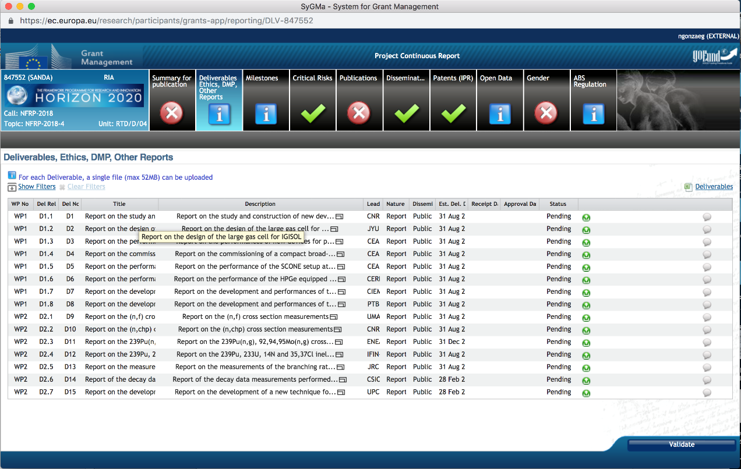
SANDA Basic data
Project Start date: 01/09/2019 -> 18 months period 28/02/2021
Periodic report in 60days 29/04/2021
- periodic technical report
- periodic financial report
Continuous reporting functionality in the Funding & Tenders Portal:
As a beneficiary, you can and should use the continuous reporting functionality as soon as the project starts to submit information about the progress of your project. This includes:
  Deliverables
  progress in achieving milestones
  updates to the publishable summary
  response to critical risks,
  publications,
  communications activities,
  IPRs

Slide 8
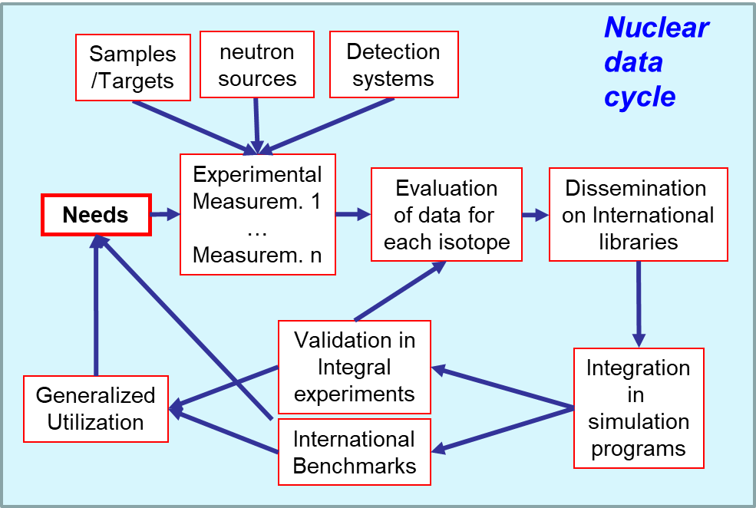
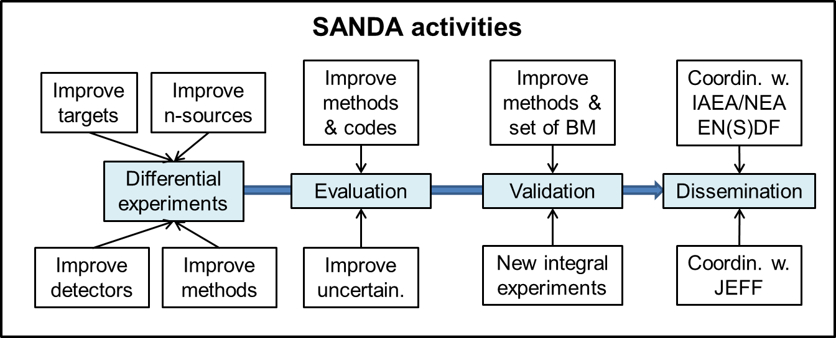
SANDA objectives
The proposal has been prepared in close contact with OECD/NEA, the IAEA Nuclear Data Section and the various organizations contributing to the JEFF project.
The project will strongly collaborate with the ARIEL proposal for access to Nuclear Data related facilities.

Slide 9
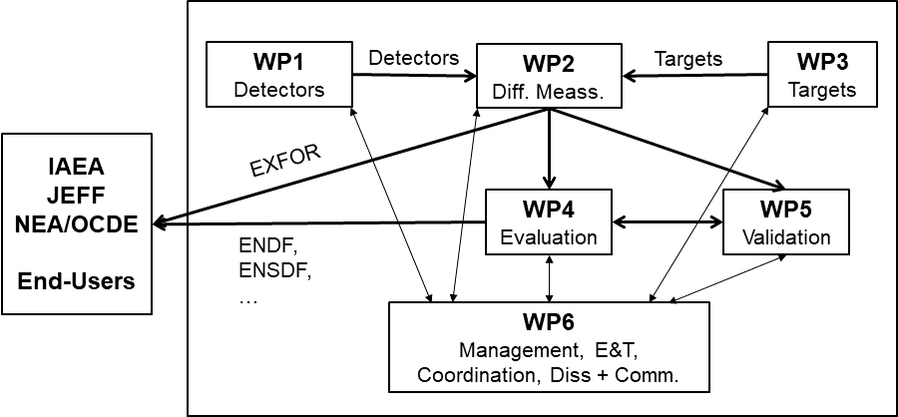
SANDA structure
WP# | Work Package Title | Lead P | PM
1 | Developments of new innovative detector devices | CNRS | 80.8
2 | New nuclear data measurements for energy and non-energy applications | CIEMAT | 213
3 | Target Preparation for Improvement of Nuclear Data Measurements | PSI | 66.2
4 | Nuclear data evaluation and uncertainties | PSI | 173.2
5 | Nuclear data validation and integral experiments | CEA | 69.2
6 | Management, ND research coordination at EU level and Education and Training | CIEMAT | 27.4

Slide 10
Deliverables of the first 36 months:
M3 D6.4
M6 D6.5, D6.6
M9 D6.1
M12 D6.3
M24 D1.2, D1.3, D1.8,
D5.1,D5.2, D5.3, D5.4
M30 D2.7, D2.11, D3.3, D5.6
M34 D2.14
M36 D1.4, D2.8, D2.12, D3.1, D3.5, D4.3,
D4.4, D4.5, D4.6, D5.5, D6.2
Milestones of the first 36 months:
M12 M1
M18 M3, M29
M24 M5, M9, M11, M12
M30 M14
M34 M22
M36 M13, M15, M16, M17, M18, M20,
M21, M26

Slide 11
New EURATOM program 2021-2025 (Horizon EUROPE)
The 5 years program has been approved but it is still not formally signed
Yesterday second meeting of the Shadow Program Committee to prepare the work-program for the first call 2021-2022. To be open before summer (probably April 2021).
Next round of feedbacks before this Friday.
The proposal includes an action for “European Facility in Nuclear Research” to support access to facilities in the WP2021-2022.
France & Spain propose for the Multiannual Approach and Strategic Orientations for Euratom indirect actions during 2021-2025: to have a Nuclear Data action (eventually in the form of a Co-funded European Partnership) for the following call 2023-2024.
  If you can contact your representative people at the Shadow Program Committee pass the message and try to get support to this proposal.

