Slide 1
JEFF
The Joint Evaluated nuclear data library for
Fission and Fusion
Arjan Plompen, EC-JRC Geel, Belgium
SANDA meeting 9-2-2021

Slide 2
Content
JEFF-3.3 paper
JEFF-4.0 goals, status and needs

Slide 3
JEFF-3.3 paper
80 authors
36 affiliations, 30 EU
Description of the library
  JEFF-3.3 and JEFF-3.2
Benchmarking and impact
True joint effort
Eur. Phys. J. A (2020) 56:181
108 pp

Slide 4
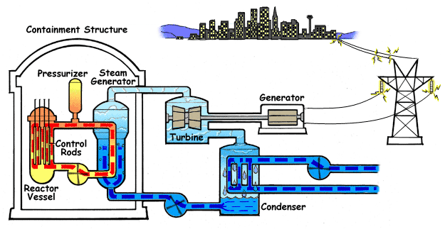
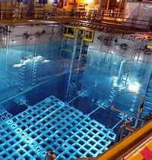
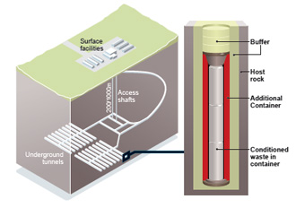
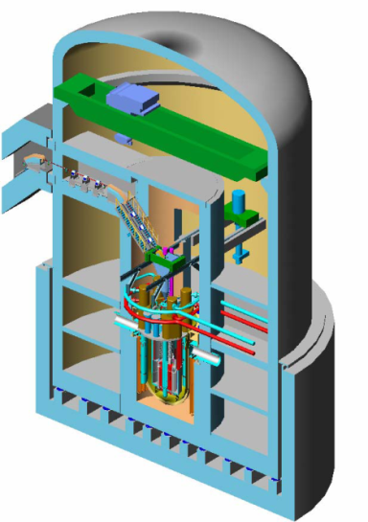
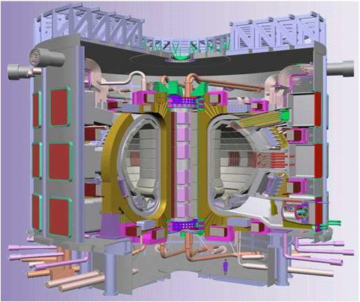
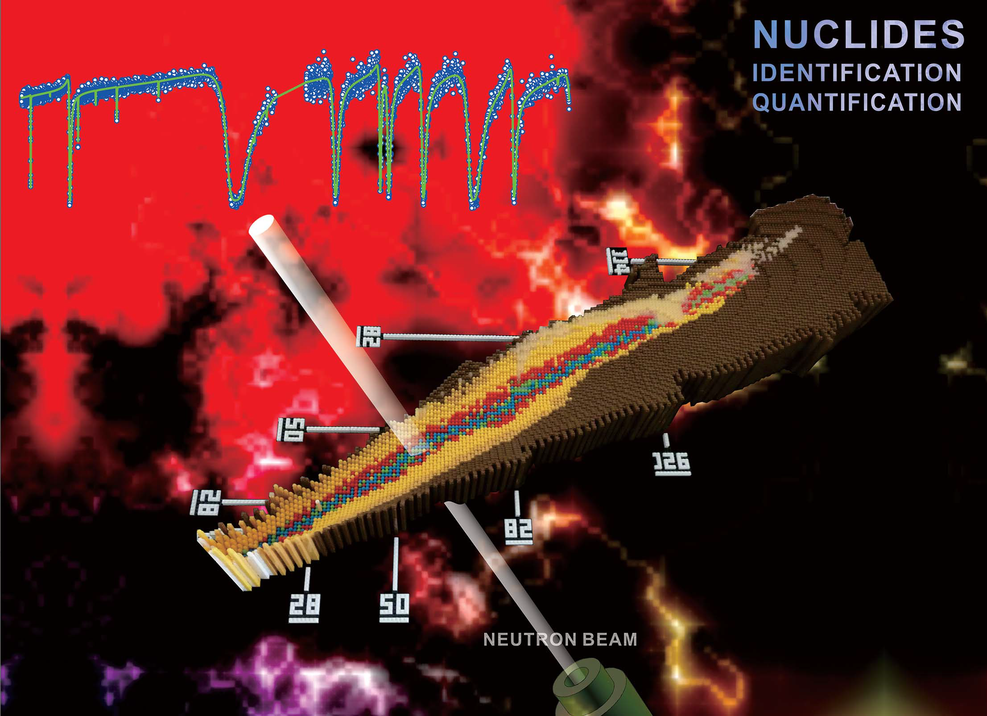
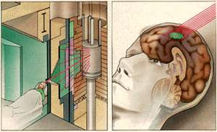
JEFF-4
Target date: December 2024
Status: JEFF-4T0, October 2020
Goals
  True general purpose
    Broaden range of application
  Best available science for users
  Improved focus on stakeholders
  Improved production methods
  Improved uncertainty estimation
  Unadjusted & adjusted library

Slide 5
Recommendations JEFF Stakeholder meeting NEA/MBDAV/DOC(2019)5
Ensure JEFF-4 is developed targeting its potential use in future industry applications
New fuel development: ATF, higher enrichment, innovative FC
Small modular reactors
Decomm., waste, final disposal
ADS (MYRRHA)
Fusion (IFMIF/DONES etc. )
Non-energy applications
  Medical (radionuclides production)
  Academia (astrophysics, …)
Demonstrate the impact, in applications of interest, of updating to a new JEFF library
Function of the Data Bank: strengthen QA infrastructure dedicated to JEFF and actively manage JEFF’s user base
Enhance the co-ordination role of the Data Bank JEFF – stakeholders
Enhance role Data Bank in pre-release V&V phases of JEFF libraries

Slide 6
Recommendations JEFF Stakeholder meeting NEA/MBDAV/DOC(2019)5
Ensure JEFF-4 is developed targeting its potential use in future industry applications
New fuel development: ATF, higher enrichment, innovative FC
Small modular reactors
Decomm., waste, final disposal
ADS (MYRRHA)
Fusion (IFMIF/DONES etc. )
Non-energy applications
  Medical (radionuclides production)
  Academia (astrophysics, …)
Demonstrate the impact, in applications of interest, of updating to a new JEFF library
Function of the Data Bank: strengthen QA infrastructure dedicated to JEFF and actively manage JEFF’s user base
Enhance the co-ordination role of the Data Bank JEFF – stakeholders
Enhance role Data Bank in pre-release V&V phases of JEFF libraries

Slide 7
Small modular reactors, Molten salt reactors
No sensitivity analysis, so difficult to identify and prioritize data needs.
MSRs are innovative and specificities for predictive and modeling needs of neutronics and source terms are not clear.
Slide Ondrej Benes

Slide 8
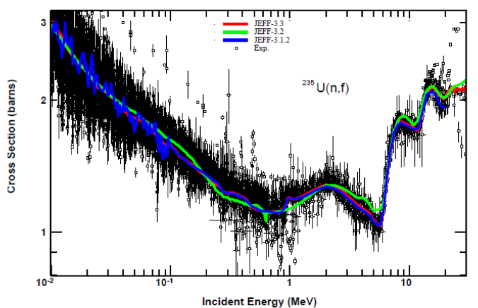
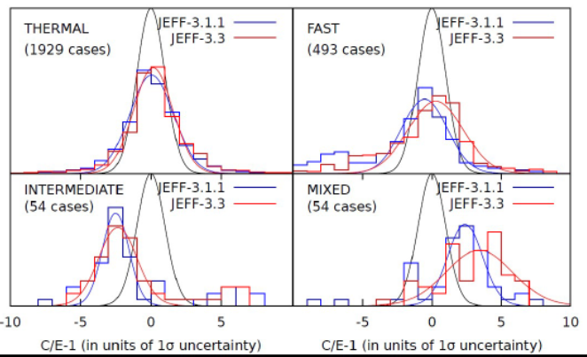
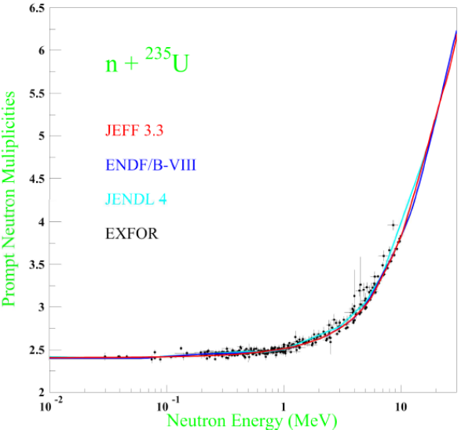
Challenge: Best physics to applied performance
We achieved improvement for selected benchmarks.
How well do we do in real applications?
How relevant is our benchmarking?
Is best physics working in benchmarks … our targeted applications?

Slide 9
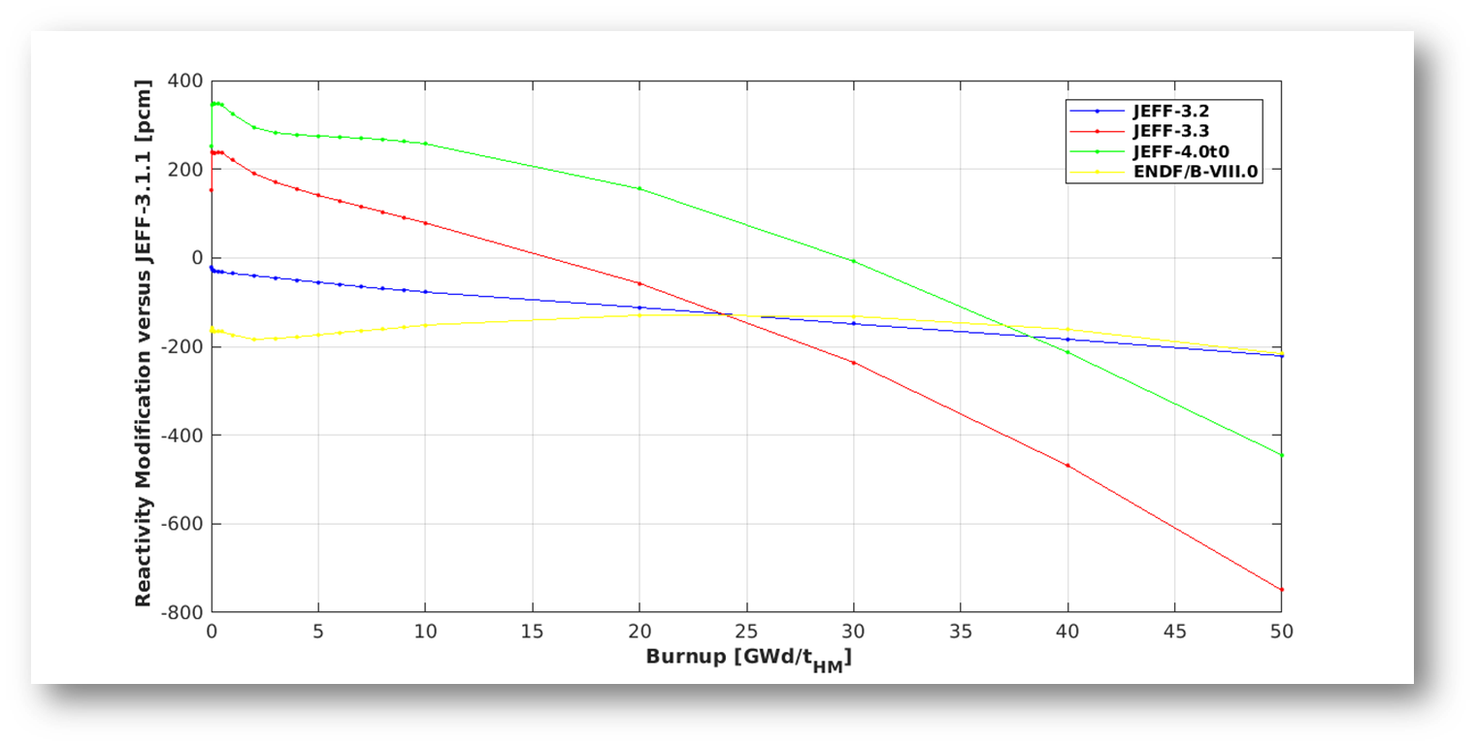
Challenge: Reactor applications jefdoc-1991, O. Cabellos; jefdoc-1996 D. Bernard; jefdoc-2000 R. Ichou (Apr 2020) jefdoc-2017 L. Fiorito; jefdoc-2022 A. Trkov (Nov 2020) ; jef-mtg Jan 2021
LWR pin cell
Significant trends with burnup
  Major actinides
  FY
  Some FP cross sections
GU3, sfcompo, Physor 2020

Slide 10
Challenge: Reactor and spent fuel applications
D. Rochman, JEFF jan. 2021
PIE, 52 MWd/kg, UO2
Significant role of FY/DD (FY)
Large difference Sm-151
Significant differences for FP

Slide 11
Challenges: benchmarks matching applications
Use of sensitivity profiles with representativity factors
  Which benchmarks have similar sensitivity profiles as a PWR for boron let-down or for inventory evolution (O.Cabellos nov. 2020 Pu-pst034)?
  Can we be more systematic about that?
  From pin-cell trends to icsbep?
Use of reaction rate ratios in critical benchmarks (O.Cabellos, apr., nov. 2020)
  Reaction rates in benchmark spectra from thermal to fast.
  U5 ratios in P9 benchmarks to test U5 cross section ratios directly (no impact on spectrum)
  U5 ratios in U5 benchmarks to include spectrum modification effect.
  Similar for Pu ratios
  Use of cross ratios
Reaction ratios to test leakage?

Slide 12
JEFF-4t0 jefdoc-2018, D. Foligno, nov 2020
Changes due to feedback
TENDL replacing legacy files
New evaluations not in JEFF-3.3

Slide 13
JEFF-4t0 jefdoc-2018, D. Foligno, nov 2020
Updates to adopted evaluations
Some backing up
New TSL H in H2O (Bariloche)

Slide 14
JEFF-4t0
Some bugfixing
TENDL updates

Slide 15
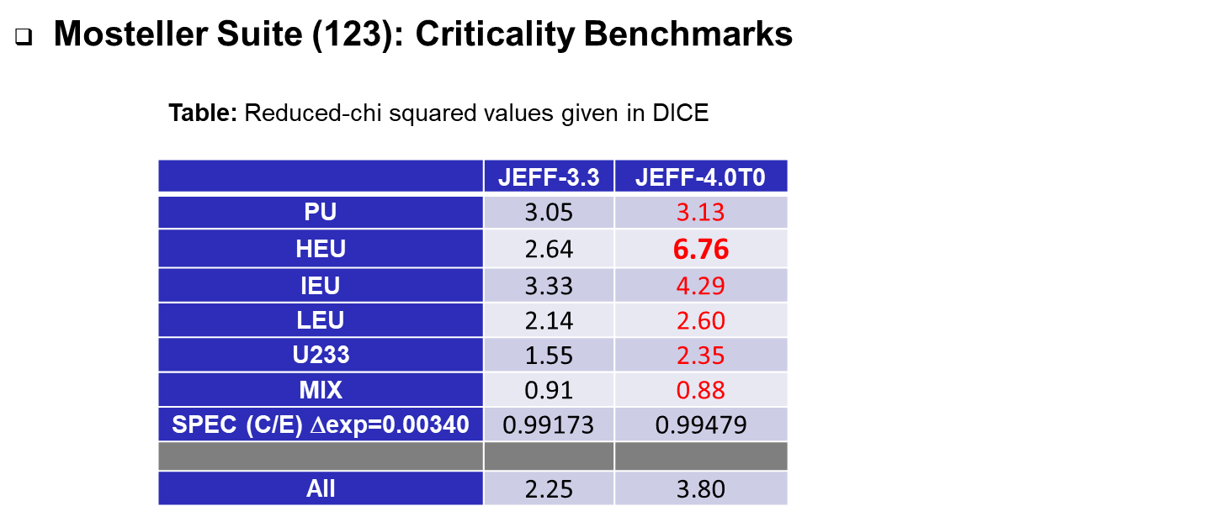
First testing of JEFF-4t0
O. Cabellos jefdoc-2015; L. Fiorito jefdoc-2017

Slide 16
First testing of JEFF-4t0 pst034 – increasing Gd concentration

Slide 17
New developments – ¹⁶O(n,a)
¹³C(a,n) TTY normalize thin target data
Time reversal below 5 MeV for ¹⁶O(n,a)
Set of renormalization factors
New evaluation Luiz Leal ongoing
Include transmission data Junghans

Slide 18
New developments – ⁵⁶Fe
Controversy over the data for inelastic scattering
Challenge to get good overall performance in benchmarks (criticality and shielding)
Difficulty with modeling due to OMP not matching the average total below 5 MeV.
New shielding benchmark evaluation (vd Marck)
New experimental campaign on scattering planned (JRC, IFIN-HH, PTB, KVI, …)
New evaluations ongoing (IRSN, IAEA, UU, …)

Slide 19
New developments – “Other”
See the jefdocs for more information
New actinide evaluations
  IRSN, CEA
  New PFN data spectra and multiplicity (CEA @LANL)
Resonance range evaluations FPs a.o. integrated in full TENDL approach
  Fine tuning needed
  Working group starting
Model development for better actinide evaluations (CEA, …)
Further benchmarking to establish nuclide deficiencies (IRSN)
Inclusion of correlated gamma data for inelastic scattering (and capture; CEA)
Method development for future FY evaluations
……

Slide 20
Further challenges: accelerator photon data
Electron accelerators, air activation
For many common materials in accelerator design there are no good activation cross sections
Unless ‘hardwired’ in codes as Fluka
¹²C(g,n)¹¹C
¹⁴N(g,n)¹³N
¹⁶O(g,n)¹⁵O

Slide 21
Further challenges: accelerator proton data jefdoc-1956 A. Stankovskij (Baeten stakeholder mtg)
Jefdoc-1956 (Baeten, stakeholder mtg)

Slide 22
Further challenges: accelerator driven systems
MYRRHA, A. Stankovskij jefdoc-1891
Jefdoc-1926

Slide 23
Challenge: from microscopic to adjusted library
Candidate methodologies are many.
Systematic approach is not yet clear.
Which benchmarks?
Can it be done on a large scale?
Do we understand sufficiently well what will happen?

Slide 24
Summary
JEFF is a collaborative project involving many institutes
Advanced reactors & fuel-cycle, current fleet, Gen-III, waste management, fusion, accelerator applications (ADS), forensics, characterization, medical radionuclides, astrophysics …
There is considerable emphasis on benchmarking and validation
Mustering human resources for evaluations of cross sections, decay data and fission yields is considerably more challenging
Many data remain unevaluated (e.g minor actinides from EU projects, photon-induced and proton-induced activation data)
We want to cater to stakeholder interests among the participating organisations including their industrial stakeholders and engage the latter better.
We need your support to make scientific knowledge available to advanced applications of nuclear technology.

