Slide 1



CEA/LNE-LNHB Activities relating to Sub-task 1.1.2
Mark A. Kellett

Slide 2
CEA/LNHB Activities within SANDA – Subtask 1.1.2
Task 1.1: Innovative devices from fission cross section to fission products decay studies (CEA/DRF/IFRU)
Partners: CEA/DAM, CNRS/CENBG, CEA/LNHB (2 pm = 15 k€), JYU, UPC
Subtask 1.1.2: fission yields and decay data studies
  A new measurement facility at CEA/LNE-LNHB composed of a dedicated ionisation chamber and an automated sample changer
  Half-life measurements for a number of radionuclides important to the nuclear medicine community, as well as the nuclear industry, with uncertainties of 0.1%.
  M.1.3 Completion of a new measurement facility by CEA/LNHB (Presentation or short communication) M18
  D.1.3 Report on the performances of new devices for precise study of fission products and their decay in view of measurements, CEA M24

Slide 3
CEA/LNHB Activities within SANDA – Subtask 1.1.2
  The COVID situation in France meant a 3 month closure of our laboratory and new prioritisation of our activities upon our return
  M.1.3 Completion of a new measurement facility by CEA/LNHB (Presentation or short communication) M18 -> M30
  D.1.3 Report on the performances of new devices for precise study of fission products and their decay in view of measurements, CEA M24 -> M30-M36
  There was a 6-month delay in the delivery of the new ionisation chamber which we received in June 2020 from the UK

Slide 4
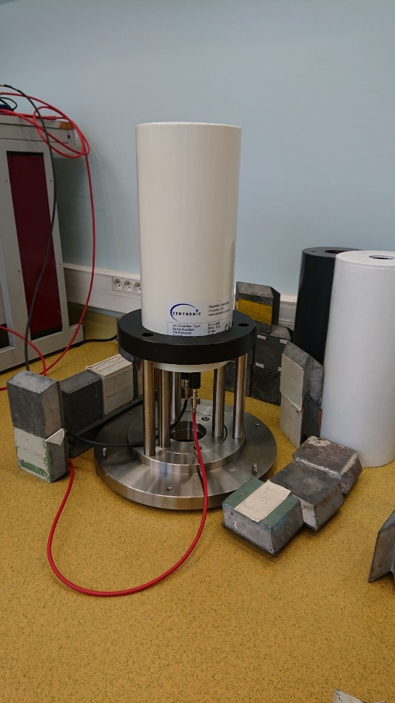
CEA/LNHB Activities within SANDA – Subtask 1.1.2
  The new chamber (a Centronics IG11) was cabled and the new chamber support completed between September and December 2020
  The new chamber is now under test and background measurements have been performed
  The source holder was received last week (02/02/2021) and measurements with our test sources (Ba-133 and Cs-137) are scheduled to begin shortly
  We had to discard our original check source (Ra-226) due to it being more than 10 years old (French regulations)
  In parallel, we are working with the BIPM and IRA (Suisse National Metrology Institute) to produce a new check source of Ho-166m
  A Master's student will join the team for 6 months this year to help implement the automatic sample changer (M.5.3 and D.1.3 will be delayed by 1 year)

Slide 5
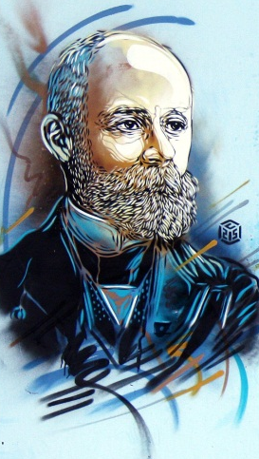
Thank you for your attention
Commissariat à l’énergie atomique et aux énergies alternatives
Centre de Saclay | 91191 Gif-sur-Yvette Cedex
T. +33 (0)1 69 08 27 76 | F. +33 (0)1 69 08 26 19
  Etablissement public à caractère industriel et commercial | RCS Paris B 775 685 019
DRT/LIST/DM2I/LNHB/LMA
Laboratoire National Henri Becquerel
Laboratoire de la Métrologie de l’Activité

