Slide 1





H2020 SANDA: Supplying Accurate Nuclear DAta for energy and non-energy applications
WP2. New nuclear data measurements for energy and non-energy applications
TASK 2.6: New measurements for non-energy applications
Task coordinator: USE, partners: IST, NPL, PTB
NPL (Mike Bunce), PTB (Ralf Nolte), IST (Pedro Vaz) & USE (Carlos Guerrero)
SANDA meeting, February 9th 2021

Slide 2
H2020 SANDA: Supplying Accurate Nuclear DAta for energy and non-energy applications
WP2. New nuclear data measurements for energy and non-energy applications
TASK 2.6: New measurements for non-energy applications
Task coordinator: USE, partners: IST, NPL, PTB
Subtask 2.6.1. Spectrum averaged cross sections for dosimetry (NPL)
NPL will perform spectrum-averaged benchmark measurements of the activity induced in foils by neutrons from a ²⁵²Cf source via the ¹¹⁷Sn(n,inl)^{117m}Sn and ⁶⁰Ni(n,p) reactions. […]
D.2.9 Spectrum averaged cross sections for dosimetry (NPL) M44
Subtask 2.6.2. Measurement of cross sections relevant for hadron therapy (PTB and IST)
PTB and IST will collaborate in the research of secondary high neutron production in particle radiation therapy of cancer. […] double-differential charged-particle emission cross sections will be carried out at the CERN n_TOF facility […] Part of the necessary equipment will be developed by HZDR within WP1.
D.2.10 Report on the measurement of double-differential charged-particle emission cross sections at the CERN n_TOF facility in the neutron energy range from 20 MeV to 200 MeV. (PTB) M48
Subtask 2.6.3. Measurement of β⁺ emitters for proton therapy (USE)
USE will perform measurements of production cross sections of beta+ emitters used for range verification in proton therapy. The list of isotopes covers the high priorities of IAEA: ¹¹C, ¹³N, ¹⁵O, ³⁰P produced by protons with energies up to 250 MeV. Other recently proposed isotopes for range verification, with shorter half-lives such as ¹⁰C, ¹²N, ^{38m}K and ²⁹P will be considered along the project.
D.2.11 Report on the production cross sections of beta+ emitters used for range verification in proton therapy. (USE) M30

Slide 3
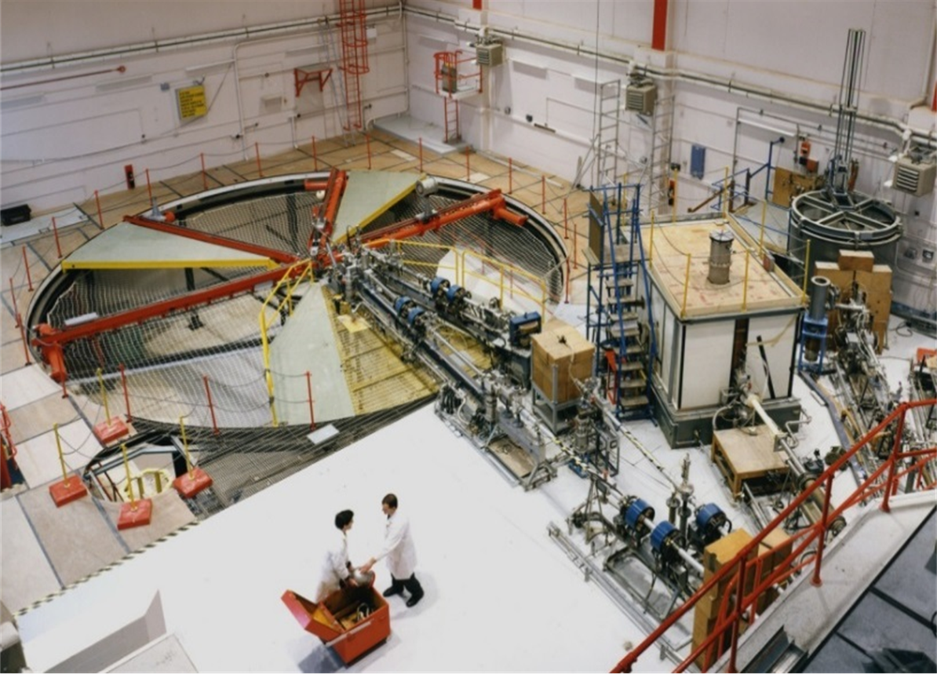
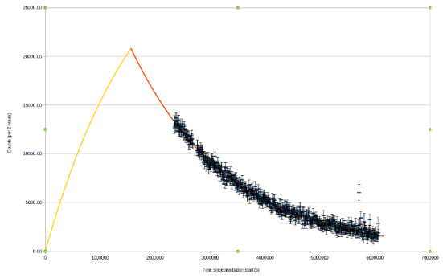
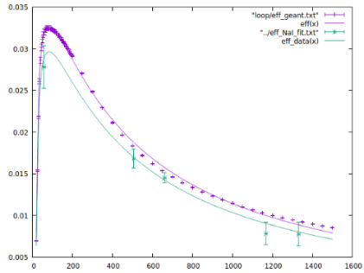
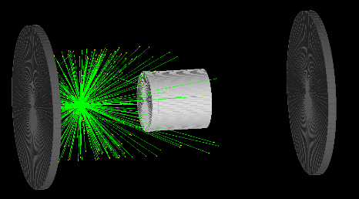
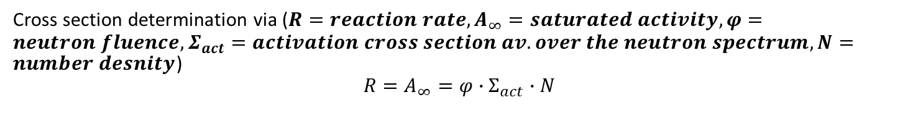
Subtask 2.6.1. SACS for dosimetry (NPL)
D.2.9 SACS for dosimetry (NPL) (M44, May 2023)
NEA
HPRL
Impact: The International Reactor Dosimetry and Fusion File (IRDFF) aims at providing evaluated neutron dosimetry reactions validated for all applications related to fission reactors and fusion technology development
Justification document: Accurate cross sections as well as (SACS) in relevant and well-characterized neutron fields are essential for improvement and validation of the evaluated data.
Measurement of spectrum averaged cross section of the ¹¹⁷Sn(n,n’)^{117m}Sn reaction using ²⁵²Cf source at NPL low scatter facility (supported by NMS and SANDA collaboration).
18d
10d
43d
18 day irradiation – fluence rate ~42k neutrons/s/cm²
Measurement using NaI scintillator ~43 days (10 days after irr. end, t_{1/2} ~14 days)
GEANT4 simulations and measurements to determine efficiency
Cross section determination via ($R=reaction rate, A_{∞}=saturated activity, φ=neutron fluence, Σ_{act}=activation cross section av. over the neutron spectrum, N=number desnity$)
$$R=A_{∞}=φ∙Σ_{act}∙N$$

Slide 4
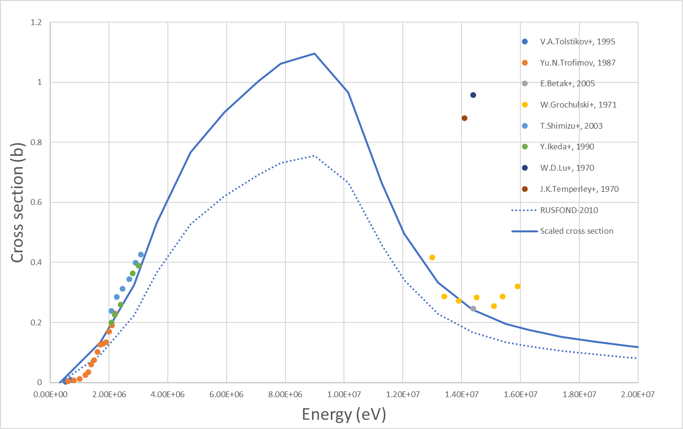
Preliminary results
Measurement of spectrum averaged cross section of the ¹¹⁷Sn(n,n’)^{117m}Sn reaction using ²⁵²Cf source at NPL low scatter facility (supported by NMS and SANDA collaboration). Reaction on NEA HPRL, required for reactor dosimetry.
Preliminary results look promising. Scaling the evaluation to match measured spectrum-averaged cross-section agrees with data. Still more analysis to finalise!
Re-measure 2021 (hopefully!) using HPGe
Investigate a monoenergetic measurement at ~ 5 MeV
D.2.9 Spectrum averaged cross sections for dosimetry (NPL) (M44. May ‘23)

Slide 5

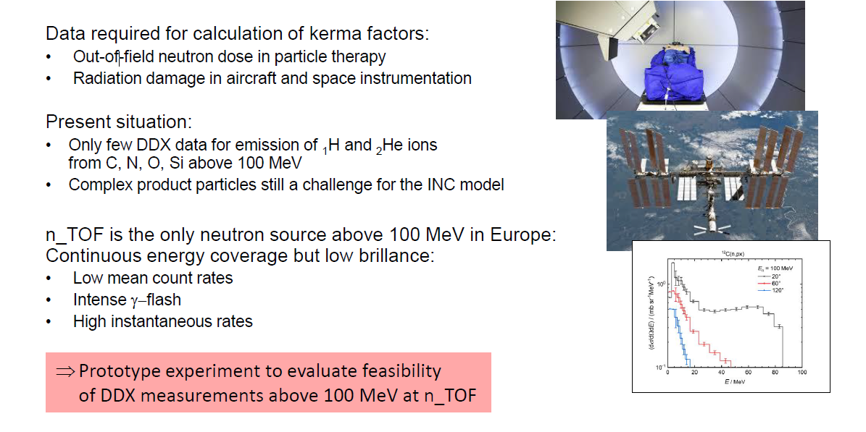
Subtask 2.6.2. Measurement of cross sections relevant for hadron therapy (PTB and IST)
D.2.10 Report on the measurement of double-differential charged-particle emission cross sections at the CERN n_TOF facility in the neutron energy range from 20 MeV to 200 MeV. (PTB) M48

Slide 6
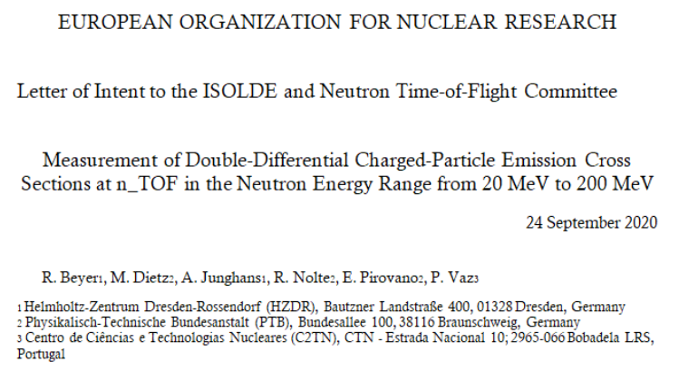
Subtask 2.6.2. Measurement of cross sections relevant for hadron therapy (PTB and IST)
D.2.10 Report on the measurement of double-differential charged-particle emission cross sections at the CERN n_TOF facility in the neutron energy range from 20 MeV to 200 MeV. (PTB) M48
WP1, Task 1.4: detectors for non-energy application
[…] test beam time for detector development is requested to extend the existing techniques from the ²³⁵U(n,f)/¹H(n,n)p experiment to this more demanding task.
WP2, Subtask 2.6.2. Measurements of DDX for light charged particles at n_TOF (E_{n}> 100 MeV)
• First of this kind at n_TOF
• Final experiment not before 2023
• Acceptance of the proposal by the INTC required
D.2.10 Report on measurements of DDX for (n, lcp x) at n_TOF (M48, Aug ’23)

Slide 7

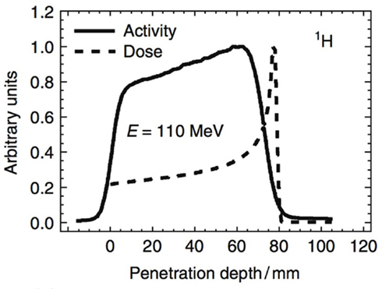
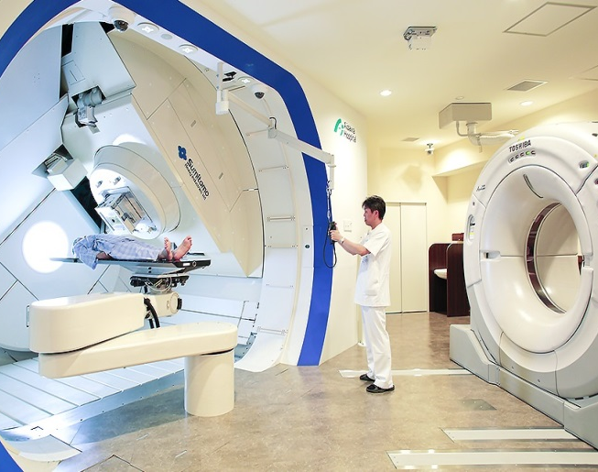
Subtask 2.6.3. Measurement of beta+ emitters (USE)
D.2.11 Report on the production cross sections of beta+ emitters used for range verification in proton therapy. (USE) M30
Verification of dose delivered to the patient by measuring the activity induced by the proton beam: PET range verification
[Full exploitation of the technique by minimizing safety margins]
Aizawa Hospital, Japan
protons
PET
Monitored table
The corresponding activation (long-lived: ¹¹C, ¹²N, ¹³N, ¹⁵O, ³⁰P; short-lived: ¹⁰C, ²⁹P, ^{38m}K) cross sections in C, O, N, P and Ca involved are poorly known in the range of interest [E_{p}=0-230 MeV]

Slide 8

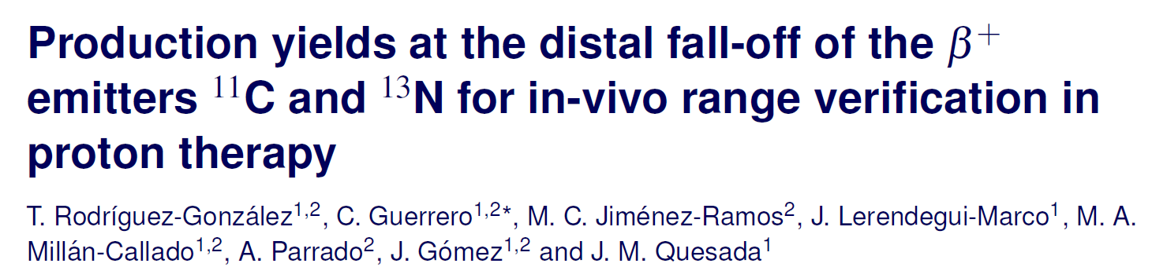
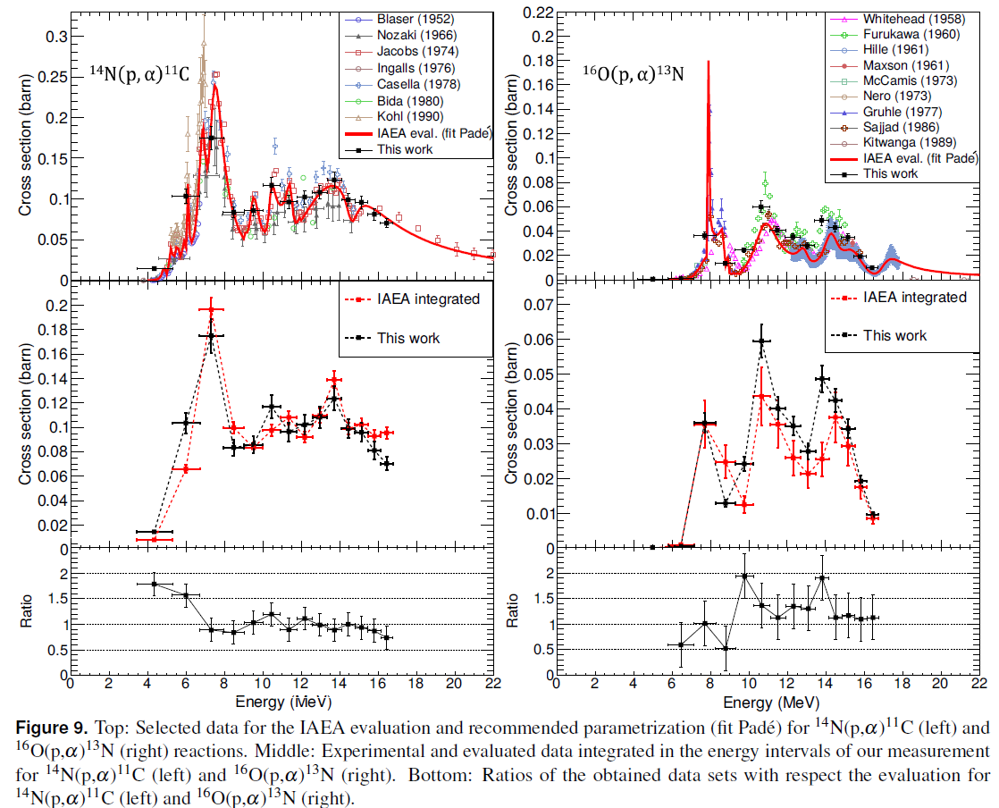
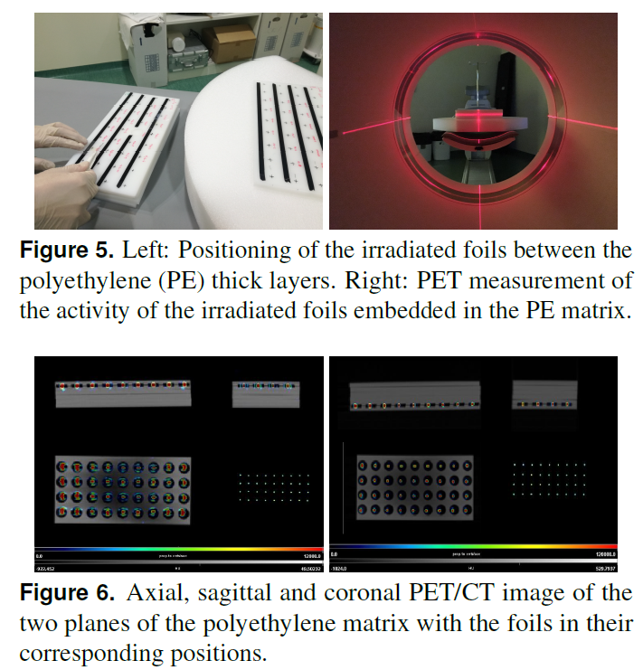
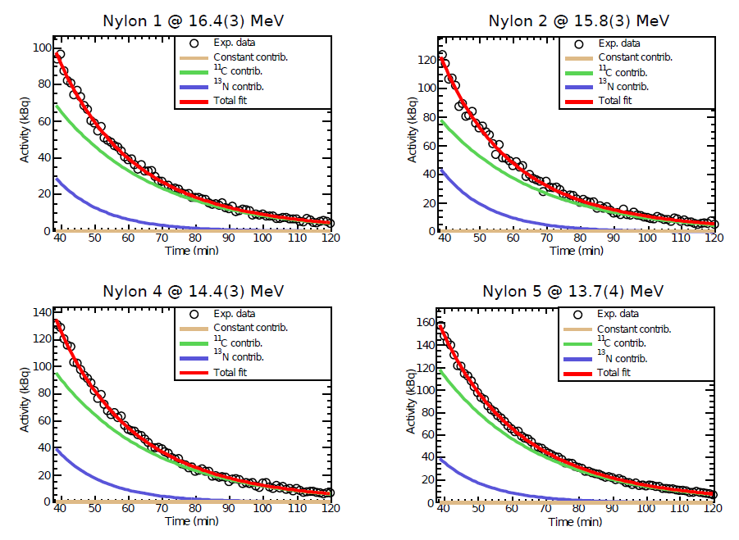
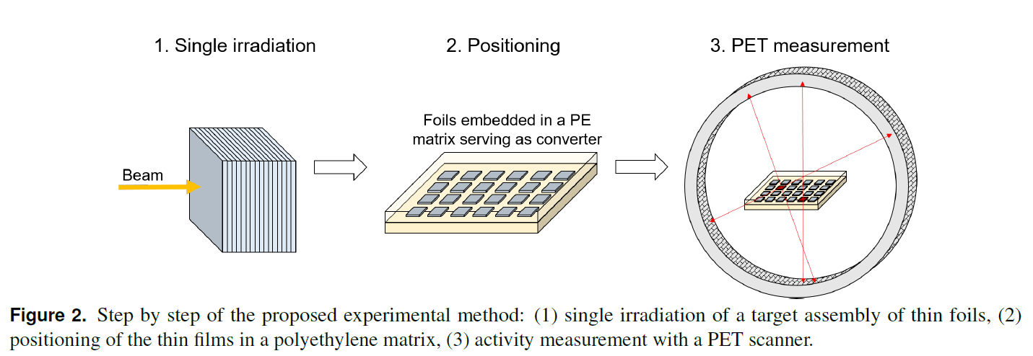
Submitted to Physics in Medicine & Biology (01/2021)

Slide 9

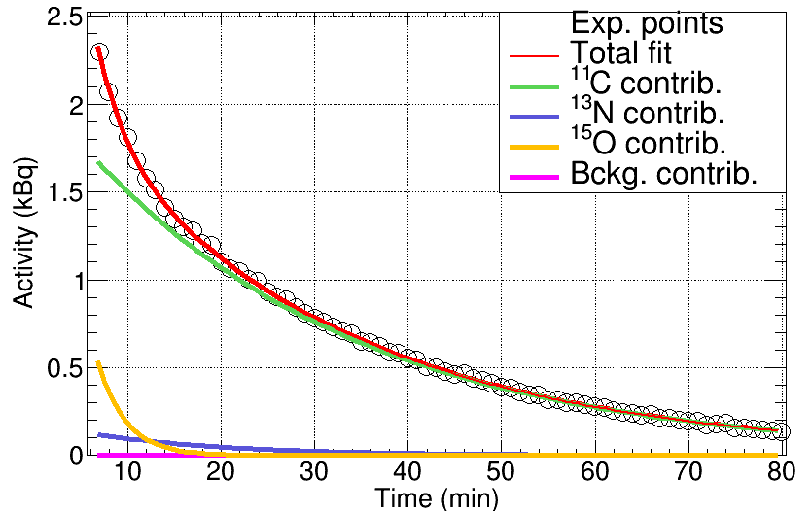
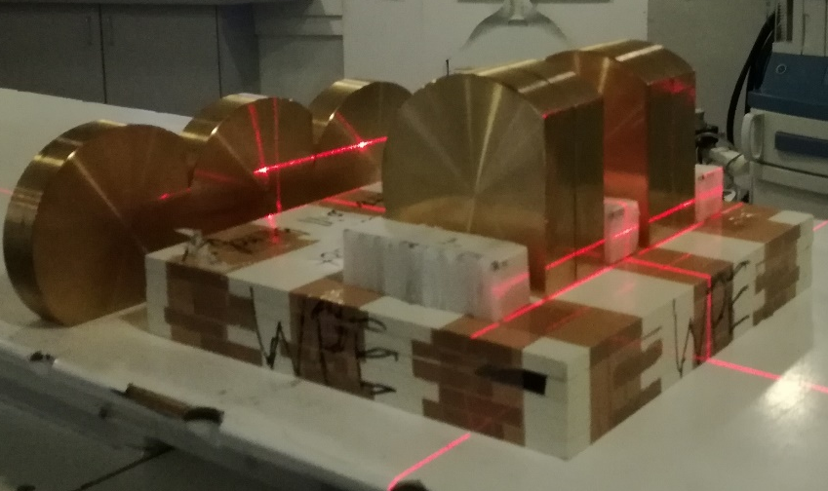


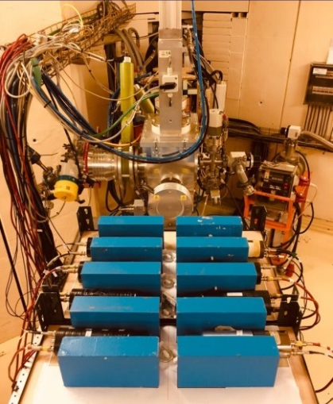
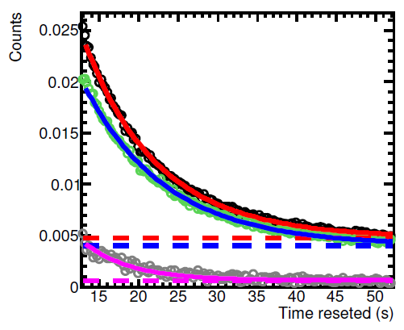
Production of long-lived (¹¹C, ¹³N and ¹⁵O) up to 230 MeV (July 2020)
Nylon-6 @ 98.8(6) MeV
Production of short-lived (¹²N, ²⁹P and ^{38m}K) up to 230 MeV
Test @KVI only partially succesful:
Background from degraders dominates
KVI technical+pandemic delays
Work to continue a PT center:
  Quiron salud (Madrid, ES)
  WPE (Essen, GE)
Test experiments@KVI (July 2019)
D.2.11 Report on the production cross sections of beta+ emitters used for range verification in proton therapy. (M30, March 2022)
- True for long-lived (¹¹C, ¹³N and ¹⁵O)
- Maybe 3-6 months more needed for short-lived (¹⁰C, ¹²N, ²⁹P and ^{38m}K)

