Slide 1


SANDA
HORIZON 2020
SUPPLYING ACCURATE NUCLEAR DATA FOR ENERGY AND NON-ENERGY APPLICATIONS
General Meeting 2021
WP6- Task 6.1: Management
CIEMAT, JRC
E.M. Gonzalez-Romero (CIEMAT)
SANDA General meeting 2021 Videoconference (Zoom) 9th February 2021

Slide 2
SANDA WP6: Management, ND research coordination at EU level and Education and Training
Task 6.1: Management : CIEMAT, JRC
This task will handle the management of the consortium, including:
the administrative and financial operations,
the notification of the consortium agreement preparation,
the draft version for the rules of operation of the different management bodies and
the reporting to the EU.
One specific objective will be the coordination of the three periodic reports and the final report of the project.
To facilitate the dissemination of the project progress and results and the exchange of information within the project a Web site will be prepared and open by the project. All consolidated information will be fully open, but a restricted access area will be reserved for materials under discussion within the project participants.

Slide 3
SANDA WP6: Management, ND research coordination at EU level and Education and Training
Task 6.1: Management : CIEMAT, JRC
This task will handle the management of the consortium, including:
the administrative and financial operations,
the notification of the consortium agreement preparation,
the draft version for the rules of operation of the different management bodies and
the reporting to the EU.
Consortium agreement was completed was signed between November 2019 and January 2020. EC was notified. Available from SANDA web:
http://www.sanda-nd.eu/system/files/docs/V4%20SANDA_CA_V6-15_11_2019_final_signed.pdf
Administrative and Financial operations. First payment was completed for most partners on January 2020 (as soon as the CA was signed). Some delayed because of problems in their bank account. All payments completed in April 2020.
Forms for Deliverables and Milestones available from SANDA web:
http://www.sanda-nd.eu/documents-partners
Reporting to Officer (EC): Situation of the project because of COVID-19
  Verbal reporting + preparation of a written note + Executive meeting
EXCOM meeting September 10th, 2020 available at SNADA web and Indico
SANDA WEB: http://www.sanda-nd.eu/calendar/sanda-excom-meeting-01
SANDA indico: https://indico.cern.ch/event/951096/

Slide 4
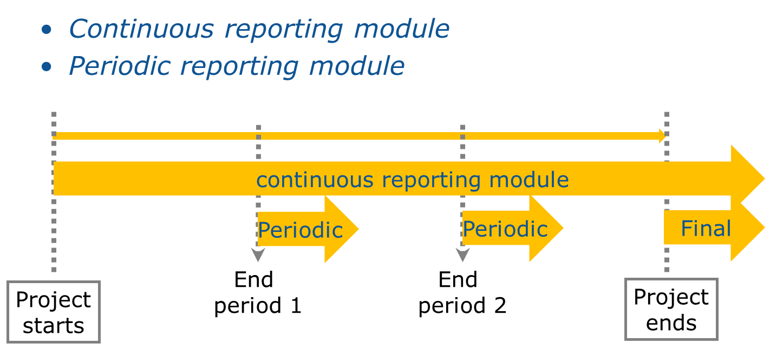
SANDA WP6: Management, ND research coordination at EU level and Education and Training
Task 6.1: Management : CIEMAT, JRC
One specific objective will be the coordination of the three periodic reports and the final report of the project.
Preparations or the 18-month report.
18 months period ends on 28/02/2021. Periodic report in 60 days (29/04/20)
Introduction and talk in the GB meeting tomorrow.

Slide 5
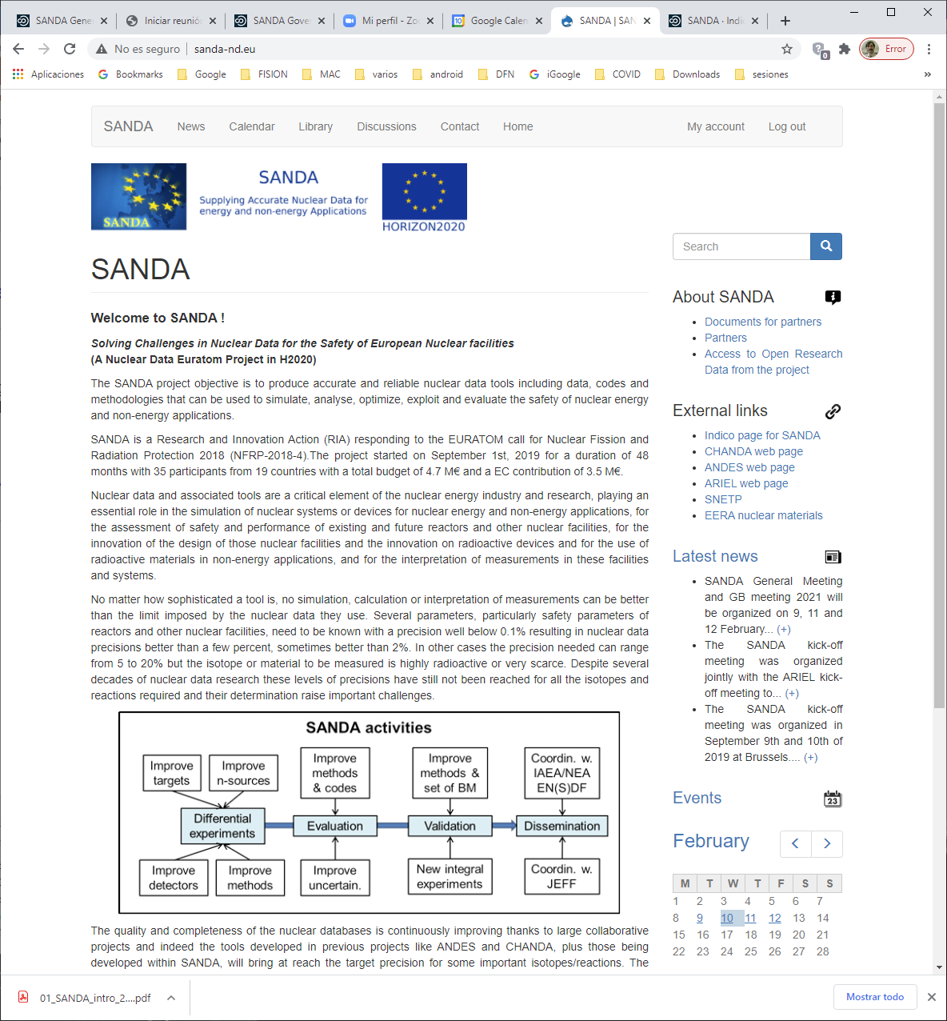
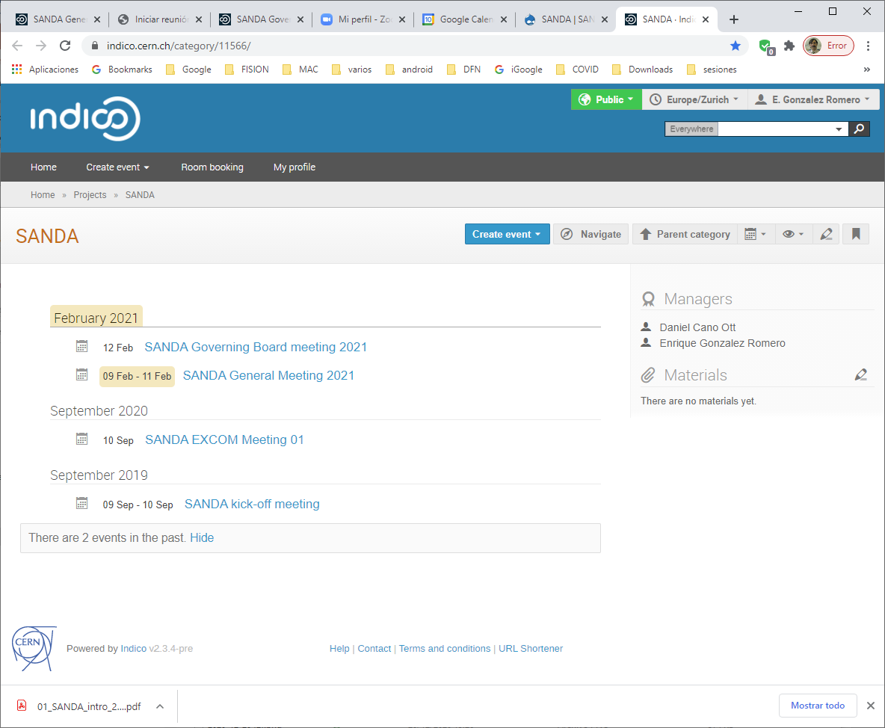
SANDA WP6: Management, ND research coordination at EU level and Education and Training
Task 6.1: Management : Web site
The SANDA WEB is composed by two groups of web pages: a set of web pages hosted at CIEMAT computers and developed using the DRUPAL system and a set of INDICO web pages hosted by CERN.
The main entry point is the DRUPAL CIEMAT hosted web pages: http://www.sanda-nd.eu/
The indico web address is: https://indico.cern.ch/category/11566

Slide 6
SANDA WP6: Management, ND research coordination at EU level and Education and Training
Task 6.1: Management : DRUPAL CIEMAT hosted web pages: http://www.sanda-nd.eu/
This part of the SANDA Web includes:
General information
Contractual documents
News related to the project
A calendar of events related to the project
A library (searchable data-base) of journal papers, presentations, deliverables, and other documents related to the project
Links to other web-pages related to the project
Access to open data repositories
Most of this WEB is public and can be read without any limitation and without any login. Only some pages and documents at preliminary state are restricted and require to login using a password provided to the SANDA participants.
A generic acount (SANDA-user Password) has been created and the password is provided to the members of the project allowing to view all elements of the WEB.

Slide 7
SANDA WP6: Management, ND research coordination at EU level and Education and Training
Task 6.1: Management : DRUPAL CIEMAT hosted web pages: http://www.sanda-nd.eu/

Slide 8
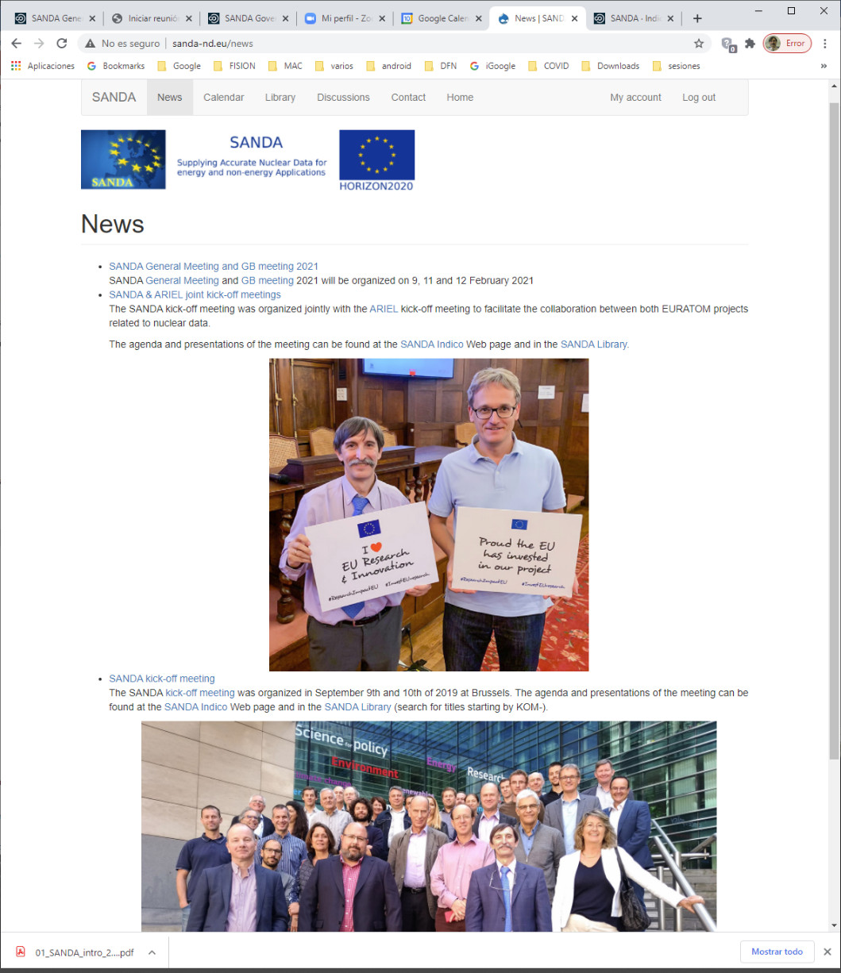
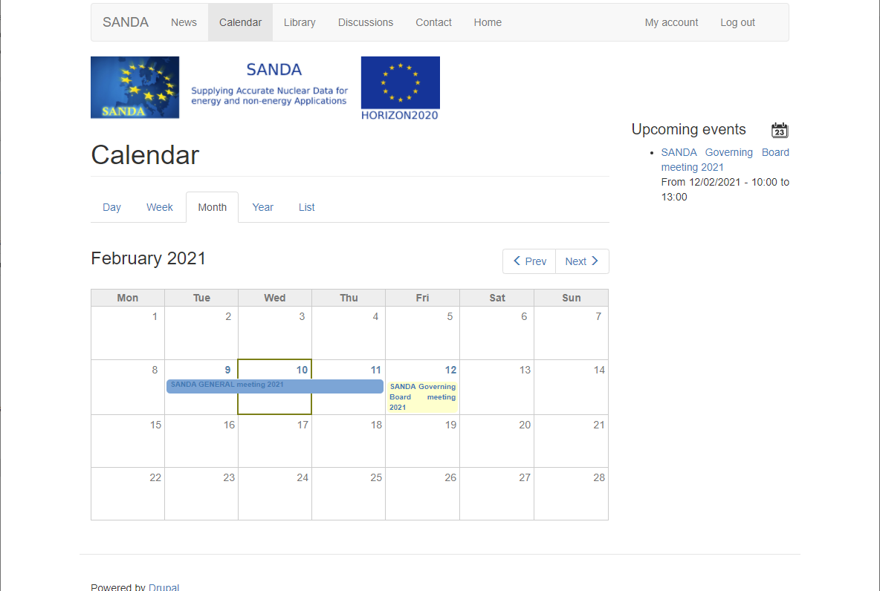
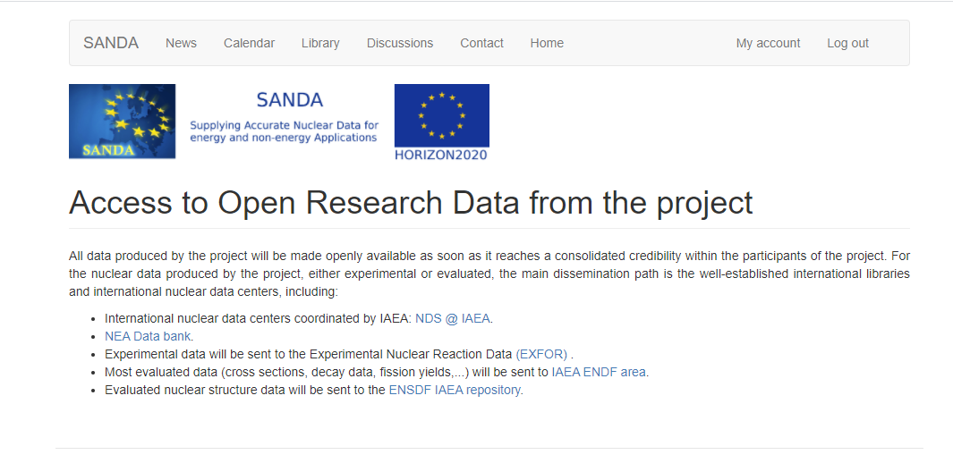
SANDA WP6: Management, ND research coordination at EU level and Education and Training
Task 6.1: Management : DRUPAL CIEMAT hosted web pages: http://www.sanda-nd.eu/

Slide 9
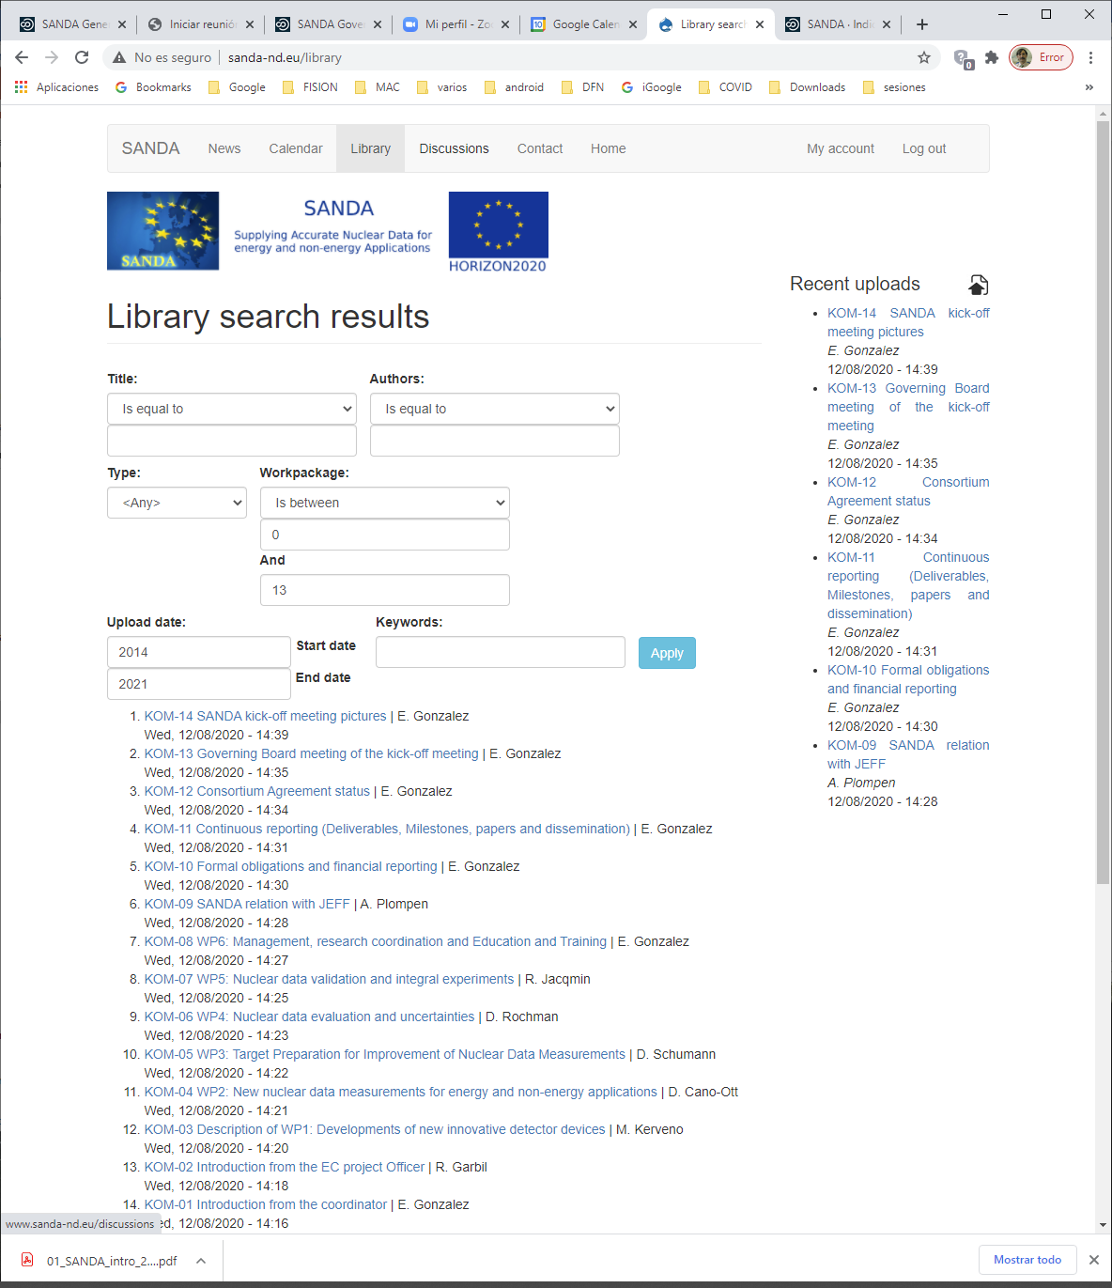
SANDA WP6: Management, ND research coordination at EU level and Education and Training
Task 6.1: Management : DRUPAL CIEMAT hosted web pages: http://www.sanda-nd.eu/

Slide 10
SANDA WP6: Management, ND research coordination at EU level and Education and Training
Task 6.1: Management : The indico web address is: https://indico.cern.ch/category/11566
The CERN INDICO system, is dedicated to the organization, management, provide videoconference support and storage of the presentations for complex conferences, workshops and meetings.
Taking advantage that CERN is one participant on the SANDA project, SANDA has been allocated the status of “project“ with the corresponding web structure.
Direct links to some events or documents in this INDICO web structure are directly available form the main SANDA WEB.
The INDICO SANDA WEB is public and can be read without any limitation but might require a CERN account (a light CERN account can be requested from the WEB).
Only some partners can modify certain elements of the WEB. But people with CERN account can upload material for the presentations.

Slide 11
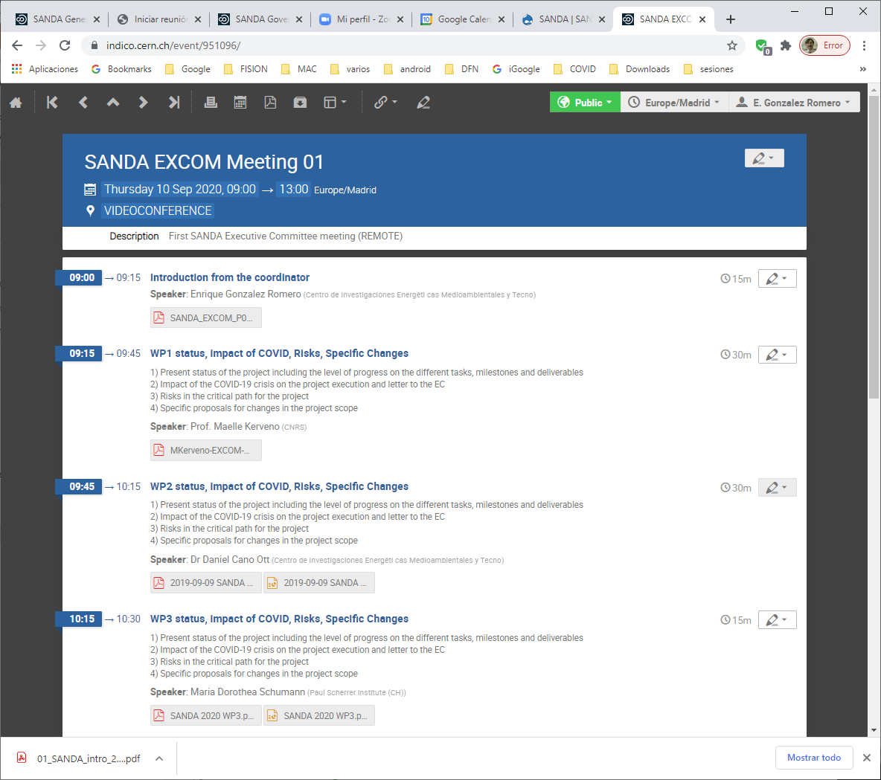
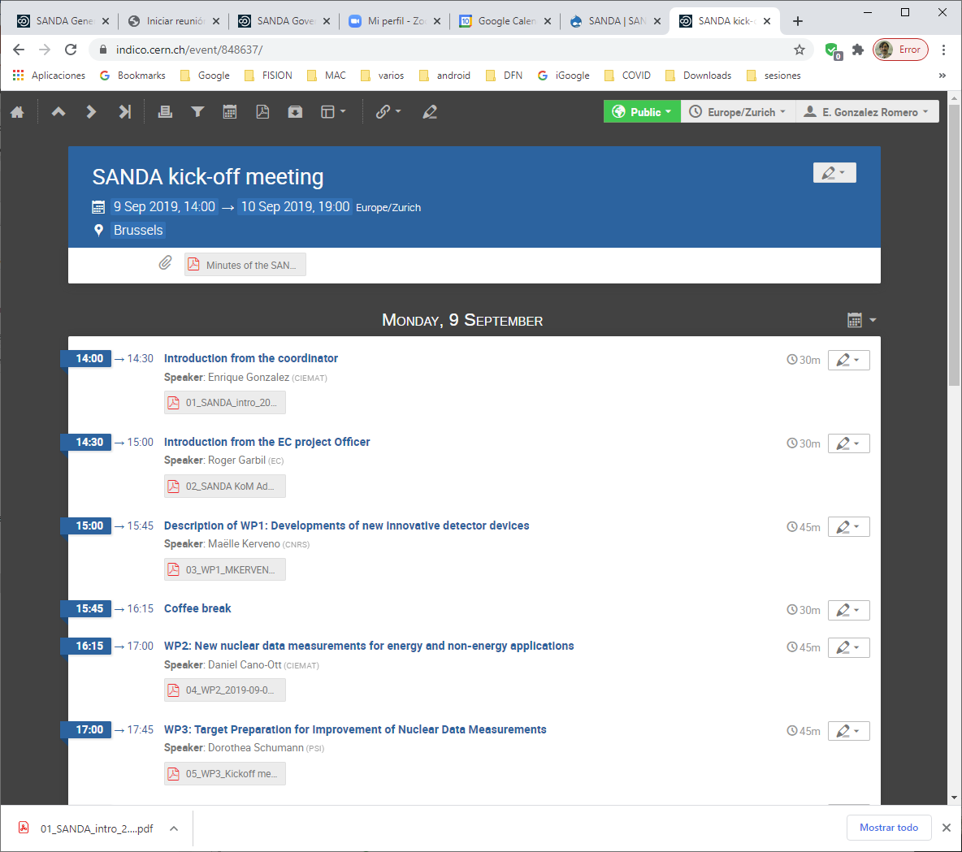
SANDA WP6: Management, ND research coordination at EU level and Education and Training
Task 6.1: Management : The indico web address is: https://indico.cern.ch/category/11566
The INDICO SANDA pages include the agenda of the meeting, including access to the presentation material that can be downloaded, and a list of registered participants.
Pages available after the event had been completed.

Slide 12
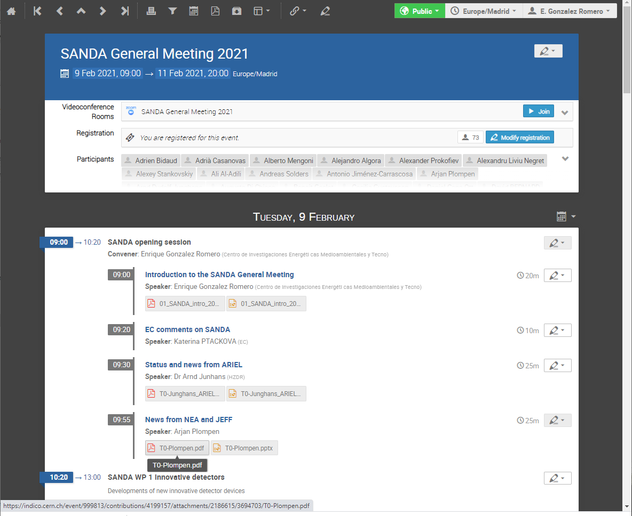
SANDA WP6: Management, ND research coordination at EU level and Education and Training
Task 6.1: Management : The indico web address is: https://indico.cern.ch/category/11566
The INDICO SANDA pages are updated during the event performance.

Slide 13
SANDA WP6: Management, ND research coordination at EU level and Education and Training
Task 6.1: Management : CIEMAT, JRC
Deliverables:
D.6.1: “Web for the project”, CIEMAT, Month 9, Public DONE
http://www.sanda-nd.eu/
https://indico.cern.ch/category/11566/
COVID-19 effects:
Some delays on deliverables
Meeting organization as online

