Slide 1
SANDA WP3
Task 3.3: Target production
Goedele Sibbens, EC-JRC Geel, Belgium
SANDA meeting 11-02-2021

Slide 2
Content
Task 3.3: Target production
Target requests
Status pending target requests
Some examples of prepared targets

Slide 3
Task 3.3: Target production
Task coordinator: JRC, partners: PSI
Target requests related to energy and non-energy applications are considered.
During the first 12 months of the project, target requests from collaborators were collected.

Slide 4
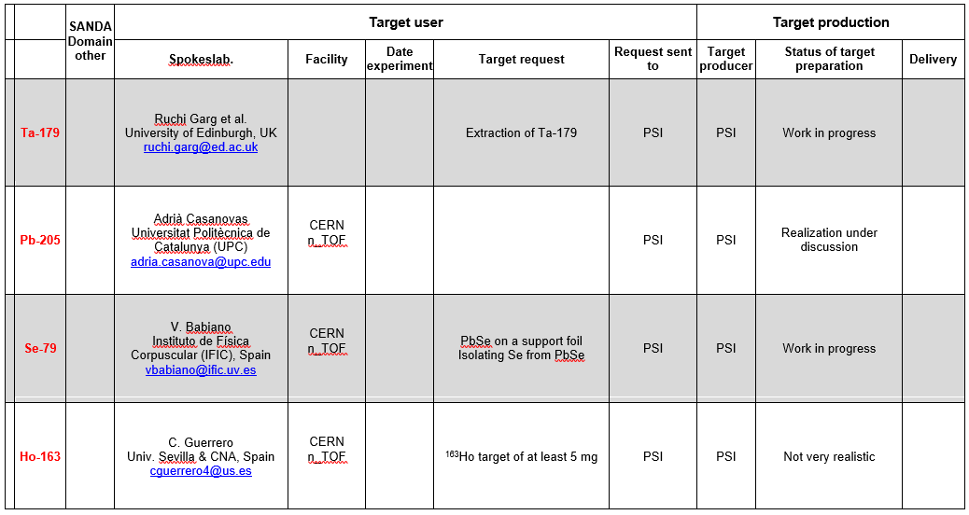
Target requests

Slide 5
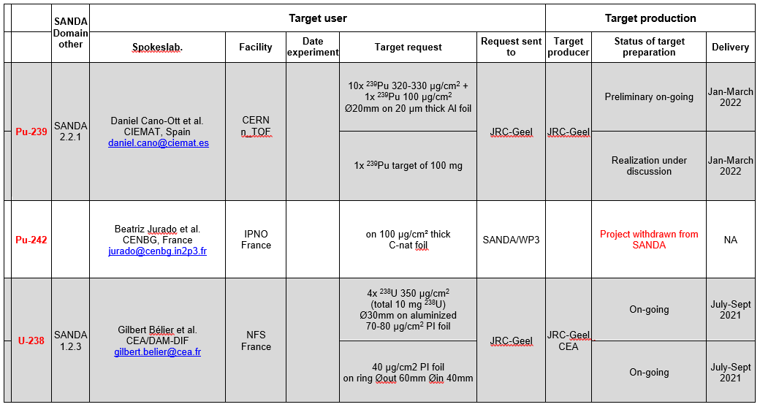
Target requests

Slide 6
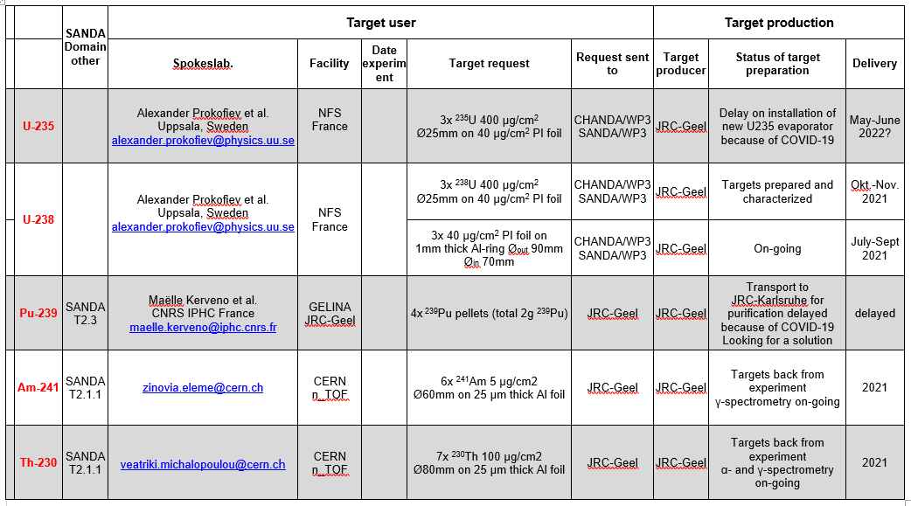
Pending target requests

Slide 7
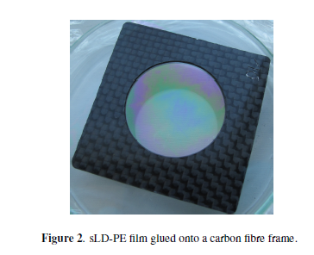
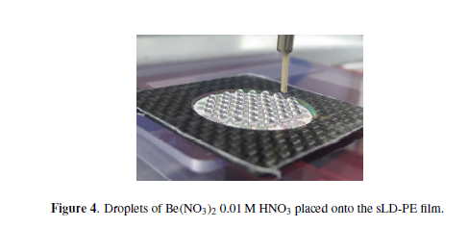
Examples
⁷Be(NO₃)₂ layer by drop deposition
Backing
0.635 µm thick polyethylene film
Deposit
Be(NO₃)₂ thickness: 0.36 µm
⁷Be activity: 24.5 GBq
PSI
E.A. Maugeri et al., Preparation of ⁷Be targets for nuclear astrophysics
research, 2017 JINST, Published by IOP Publishing for Sissa Medialab

Slide 8
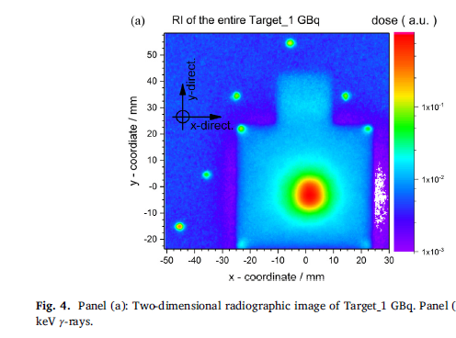
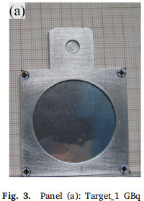
Examples
Implantation of ⁷Be into aluminium foils
Backing
50 × 50 × 0.018 mm Al foil
placed between two Al frames
with a 40 mm diameter central hole
Implantation
⁷Be activity: 1 GBq
PSI
E.A. Maugeri et al., Preparation and characterization of three ⁷Be targets for the measurement
of the ⁷Be(n, p)⁷Li and ⁷Be(n, 𝛼)⁷Li reaction cross sections, Nuclear Inst. and Methods in Physics Research, A 889 (2018) 138–144

Slide 9
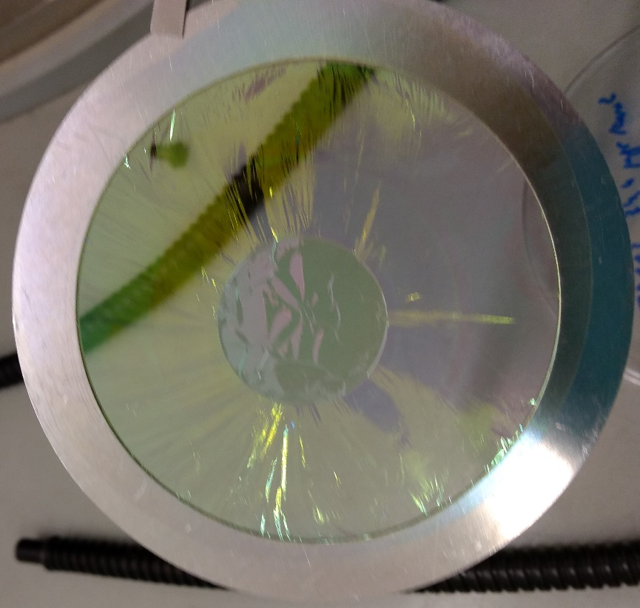
Examples
²³⁸UF₄ deposit by vacuum evaporation
Backing
34 µg/cm² polyimide foil
on 1 mm thick Al ring Ø_{out} 90 mm Ø_{in} 70 mm
Deposit
²³⁸U diameter: 20 mm
²³⁸U areal density: 377 µg/cm²
²³⁸U mass:1.84 mg
JRC-Geel

Slide 10
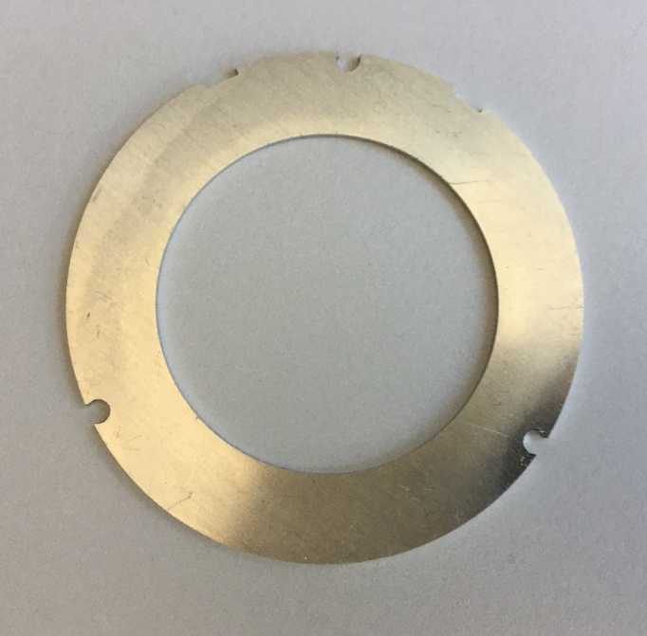
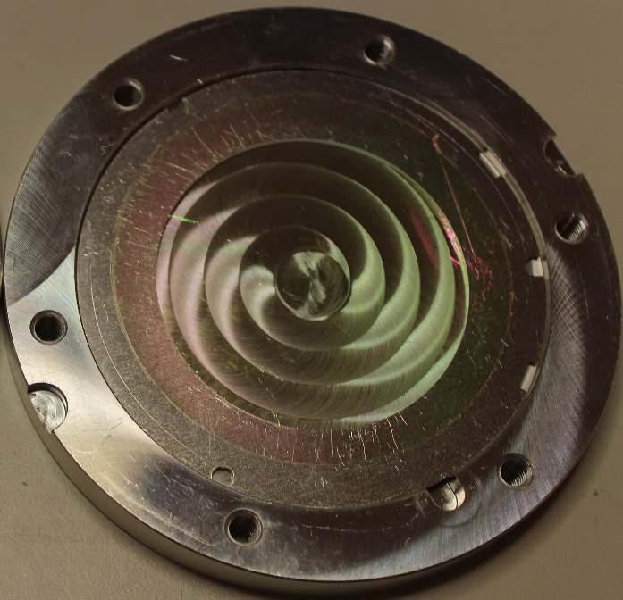
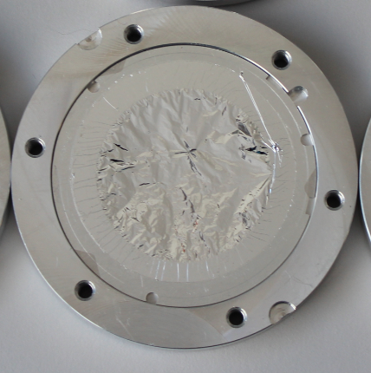
Examples
Backings for target request 4x ²³⁸U 350µg/cm² Ø 30mm (SANDA T1.2.3)
1mm thick Al ring
Ø_{out} 60mm Ø_{in} 40 mm (JRC-Geel)
+ 62 µg/cm² PI foil (JRC-Geel)
+ 87 nm Al deposit (CEA)

Slide 11
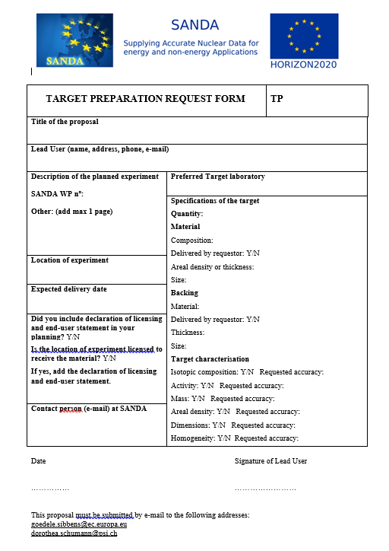
SANDA
target request form
Target request to be sent to
Dorothea Schumann
dorothea.schumann@psi.ch
Goedele Sibbens
goedele.sibbens@ec.europa.eu

Slide 12

Thank you
Goedele Sibbens
EC-JRC Geel, Belgium goedele.sibbens@ec.europa.eu
© European Union 2020
Unless otherwise noted the reuse of this presentation is authorised under the CC BY 4.0 license. For any use or reproduction of elements that are not owned by the EU, permission may need to be sought directly from the respective right holders.
Notes:
Update/add/delete parts of the copy right notice where appropriate.
More information: https://myintracomm.ec.europa.eu/corp/intellectual-property/Documents/2019_Reuse-guidelines%28CC-BY%29.pdf

