Slide 1
What R&D needs to be done to use it in the first layer of FCC?
Use of diamond detectors
in 20 years
Alexander Oh
University of Manchester
Results and material from the RD42 collaboration.

Slide 2
Solid state detectors for future (4D) trackers
With avalanche gain
Without avalanche gain
Sub-geiger mode (LGADs, APDs)
Geiger mode (SPADs)
Material in the backup
Hybrid
Monolithic
DC-coupled
AC-coupled
BiCMOS
(SiGe)
Planar
Si/Diamond
3D
Si/Diamond
CMOS
BiCMOS
(SiGe)
HV- CMOS

Slide 3
FCC first layer requirements
Unprecedented particle flux and radiation levels
10 GHz/cm² charged particles
10¹⁸ cm⁻² 1 MeV-n.eq. fluence for 30ab⁻¹
Rate & Radiation
challenge
@ r=2.5cm

Slide 4

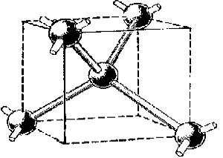
Diamond properties
Property________________ Diamond____ Silicon
band gap 5.47 1.12
mass density [g/cm³] 3.5 2.33
dielectric constant 5.7 11.9
resistivity [Ωcm] >10¹¹ 2.3e5
breakdown [kV/cm] 1e3...20e3 300
e mobility [cm²/Vs] 1700 1400
h mobility [cm²/Vs] 2100 440
therm. conductivity [W / cm K] 10..20 1.5
radiation length [cm] 12 9.4
Energy to create an eh-pair [eV] 13 3.6
ionisation density MIP [eh/mm] 36 89
ion. dens. of a MIP [eh/ 0.1 ‰ X₀] 450 840
  Low dielectric constant ➔ low capacitance
  Low leakage current ➔ low noise
  Room temperature operation
  Fast signal collection time
  MIP signal ~2 smaller at same X₀
  Efficiency < 100% (pCVD)

Slide 5
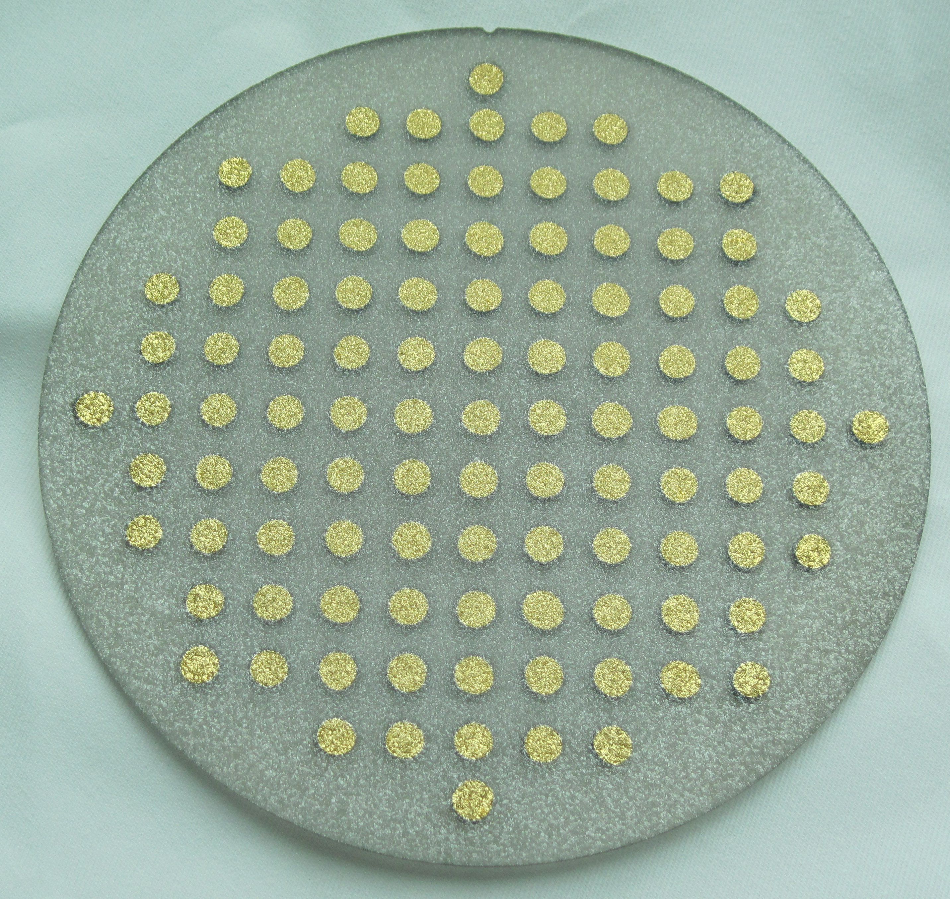
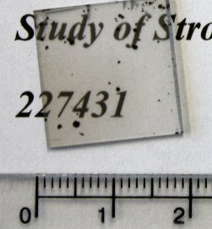
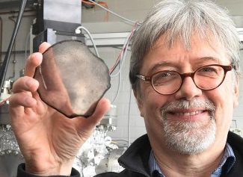
Development of CVD Diamond for detector applications
Today two main manufacturers of detector grade diamond
  ElementSix Ltd UK
    polycrystalline wafers
    small single crystal diamonds
  II-VI Inc. USA
    large polycrystalline wafers
    development effort underway
Alternative sources
  Diamond on Iridium (DoI) (Audiatec, Germany)
  Hetero-epitaxially grown -> medium area
  Highly oriented crystallites.
5’’ waver
poly crystal 5 inch wafer, II-VI Inc.
DoI, 155ct
single crystal
Notes:
5 inch wafer (dots are 1cm apart)

Slide 6
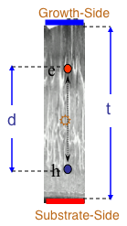
Development of CVD Diamond for detector applications
Impressive progress over the last 25 years.
Current state of the art for polycrystalline CVD diamond δ ~ 320 μm in 500um thickness
  (~11500 e/MIP)
  commercially available.
  1995: δ ~ 50 μm
  2000: δ ~ 180 μm
  2020: δ ~ 320 μm

Slide 7
CVD Diamond development goals
removal of surface defects
  few per cm² → < 1 per cm²
wafer CCD in pCVD
  400 um → 500 um
size of wafers = 15cm (6 inch) diameter state of art
  fixed by microwave frequency (not expected to change)
wafer uniformity
  5% → 2% across whole wafer.
price per cm²
  ~1500USD / cm² → 800USD /cm²

Slide 8
Radiation Hardness
Irradiated polycrystalline and single crystal CVD diamond.
  Protons 25MeV, 70MeV, 300MeV, 800MeV, 24GeV
  Pions 300MeV
  Neutrons ~1MeV (TRIGA reactor)
Signal response tested in test-beam.
  120 GeV proton
  pad, strip and pixel-detector pattern, E = ±2V/μm
  Samples pre-exposed to Sr⁹⁰ to fill traps (aka pumping)
  Require track on active area, no threshold on strip signals.
  Build signal of five highest contiguous signals within 10 strips around the track.
Notes:
To be included in these k_factor determinations we have
to get the same signal (to within 5%? 10%?) for both polarities,
and then we plot the average of the two. All reference measurements
are at 1000V, typically on a (500+/-20) micron thick sensor.

Slide 9
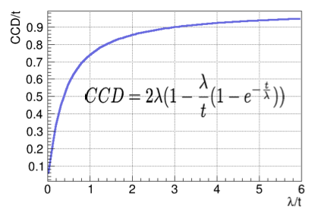
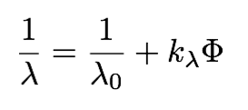
Radiation Hardness
“Charge Collection Distance” (CCD) is measured.
Traps reduce the life-time of charge carriers, or “Schubweg” (λ).
  Relation between CCD and λ:
Radiation damage is fitted
with simple damage model:
damage constant
particle fluence

Slide 10
Radiation Hardness (planar)
Scaling to 24 GeV protons
  Universal scaling for all particle types with fluence.
  Poly and single crystal diamond show consistent damage constants.
  Predictions are possible for any particle type and fluence.
https://www.research-collection.ethz.ch/handle/20.500.11850/222412
Notes:
k_{λ} = 0.67 ± 0.04 ×10⁻¹⁸ cm²μm⁻¹

Slide 11
Radiation Hardness:
Signal Uniformity

Slide 12
Radiation Hardness
*
Summary of RD42 irradiation results:
”Back-of-an-envelope calculation, expect Schubweg of:
λ ∼ 16μm at 10¹⁷ cm⁻² protons_24 GeV_eq
*normalized to 24GeV protons
Notes:
800 MeV proton update: https://indico.cern.ch/event/505107/contributions/1182410/attachments/1272791/1887710/RD42Meeting-May2016-800MeVResults.pdf
l = l_0 / (l_0 * k * Phi + 1)

Slide 13
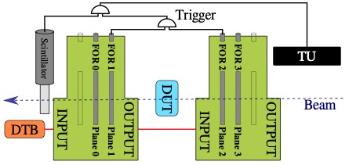
High Rate tests
Tests the pulse height as function of particle rate.
Test single and poly crystalline diamond.
Irradiated and un-irradiated.
100um
Notes:
ICHEP2020: July 29, 2020

Slide 14
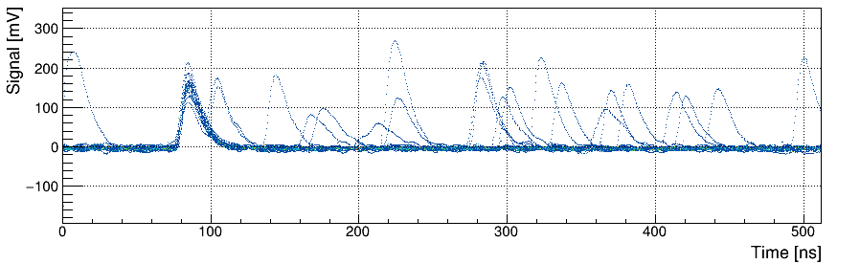
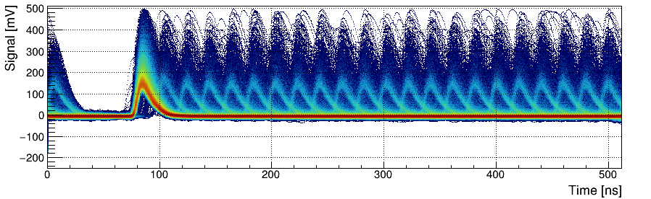
High Rate tests
Raw Data from 10 MHz/cm² Flux
Notes:
ICHEP2020: July 29, 2020

Slide 15
High Rate tests
neutron irradiated pCVD
Flat to better than 2% up to 10-20 MHz/cm2.
Exploring systematics of O(1%)
Notes:
ICHEP2020: July 29, 2020

Slide 16
Carrier lifetime challenge –
3D diamond detectors
After large radiation fluence all detectors are trap limited
Mean free paths (schubweg) λ< 50μm
Need to keep drift length (L) smaller than mfp(λ)
Build 3D detectors to reduce transit time.
Huge progress made in fabrication of 3D diamond detectors
in the last 10 years.

Slide 17
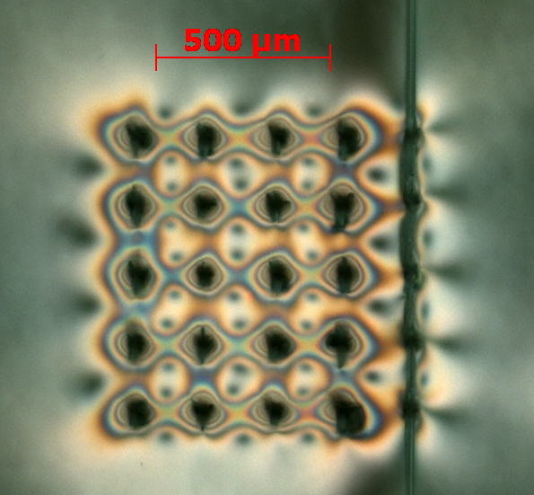
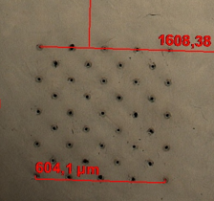
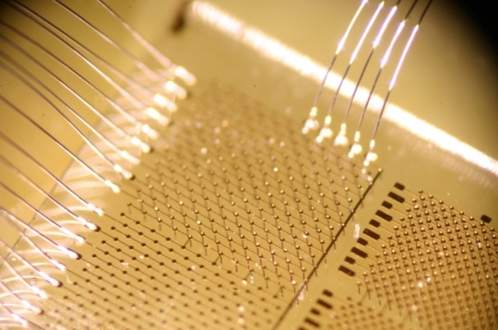
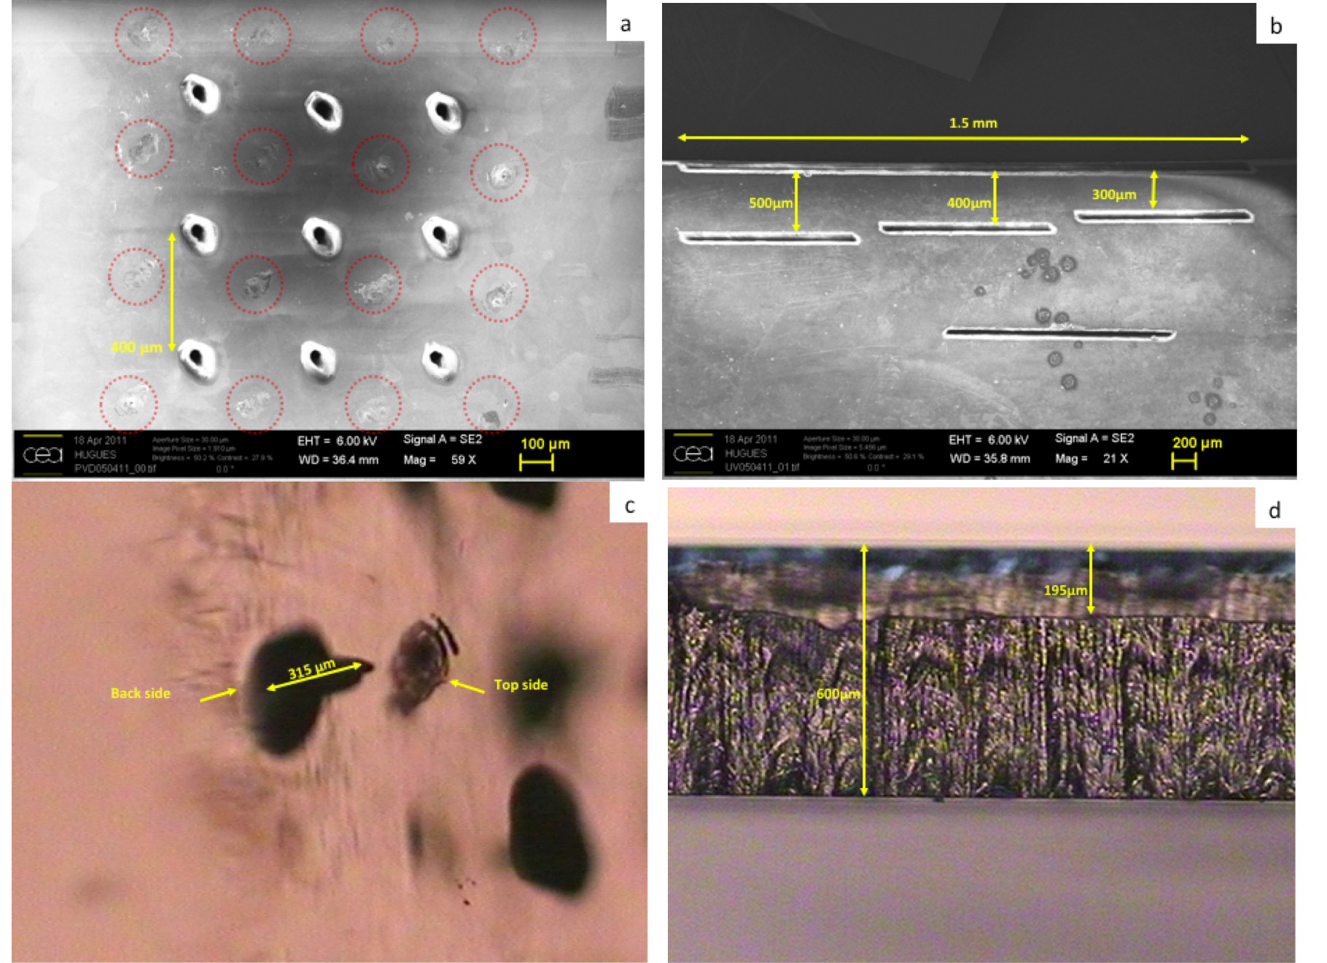
3D diamond? (2008)
  Lasered graphitic structures in pCVD (’10)
  Single crystal with column structure (‘11)
  Several Prototypes tested at
  Diamond Light Source
  CERN test beam
  RBI proton beam
  Clinical Photon beam
  Pico second laser for improved graphitic electrodes (‘12)
  Femto second laser processing and TCAD simulation (’13,’14)
  Phase modulated laser processing (’15,’16)
  Polarised & Phase modulated laser processing (’17,’18)
  Prototypes with poly and single crystal diamond (2019 ++.

Slide 18
3D diamond prototypes
CMS and ATLAS pixel prototypes tested:

Slide 19
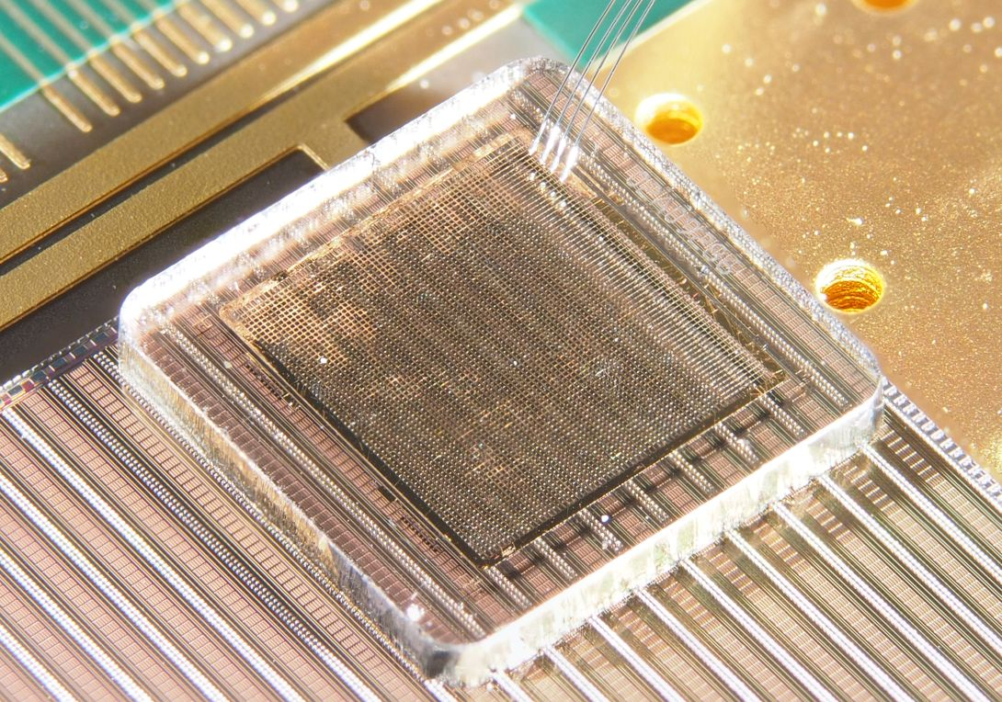
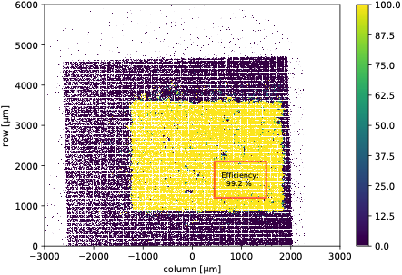
3D diamond prototypes
CMS and ATLAS pixel prototypes tested:
HV=-55V
Eff. > 99.2%
RD42 Preliminary

Slide 20
3D diamond detectors challenges for the future
Optimise graphitisation process for 3D diamond production in terms of:
  Resistivity: currently at (1 - 0.1Ωcm) aim for <0.1Ωcm.
  Processing speed: currently O(10um/s), aim to speed up and/or parallel processing of wires.
  Wire thickness / uniformity: Little data available, needs more research effort.
Optimization of internal electric field
  Geometry: Recently internal cage structure optimise E field.
  Will explore the full potential (see later slides).
Radiation hardness:
  Need to check predictions with latest devices.
  25um cells in 3D.

Slide 21
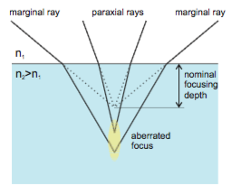
Resistivity challenge
Laser wave front shaping helps to decrease resistivity.
Dependence on processing parameters being studied.
More research needed to lower resistivity.

Slide 22
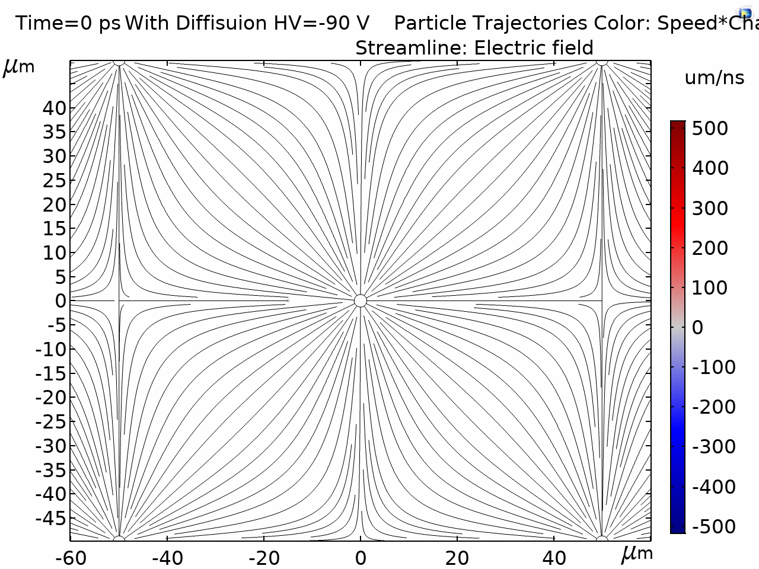
Carrier lifetime challenge –
3D diamond detectors
Low field regions might effect transit time.
Preliminary simulations show not a concern due to diffusion.
More work needed to quantify impact of radiation damage.

Slide 23
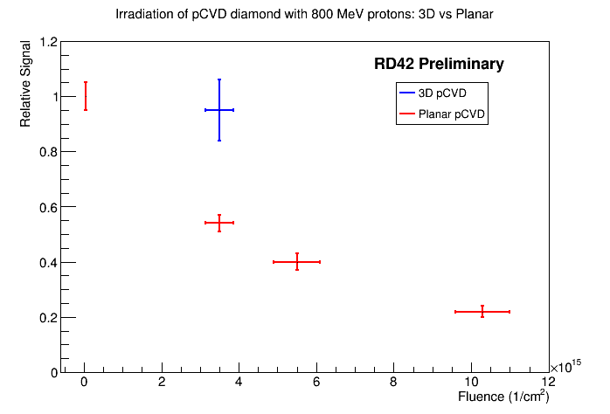
3D diamond detectors: Radiation challenge
Few radiation hardness data available, but promising:
  Compare signal loss in 3D pixels to published results from planar
  3D sensors collect twice as much charge when unirradiated
  3D sensors see 5±10 % reduction in signal at 3.5 x10¹⁵
  Planar sensors see 45±5 % reduction for 3.5 x10¹⁵
3D cell size:
50um x 50um
Notes:
0.88 normalisation

Slide 24
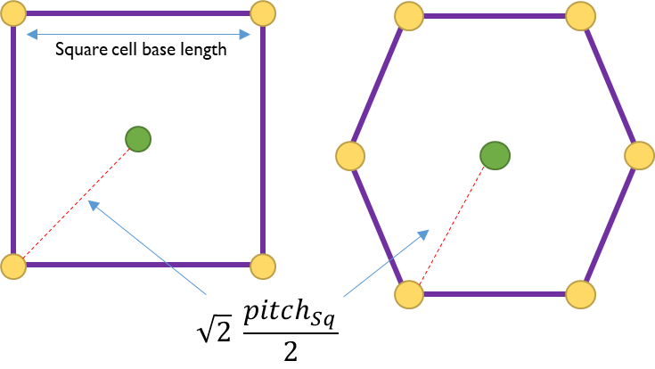
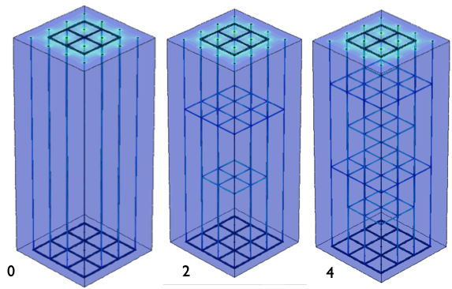
3D diamond detectors
Geometry challenge
Laser processing allows any geometry, including horizontal wires.
  Exiting possibility to optimise the electric and weighting field.
  Small cell sizes realizable, wire diameter at abut 1μm.
  Simulation studies currently ongoing.
Future research in this area:
  Optimise geometry
  Wire processing
  cell sizes <(25μm)²
  Simulation – Prototyping – Characterization.

Slide 25
3D diamond detectors:
Characterization challenge
TPA demonstrated.
More accurate ionization profiles possible using same beam shaping techniques as in production of wires.
Research needed to fully exploit technique for characterizations.
https://www.research-collection.ethz.ch/handle/20.500.11850/445547
Notes:
https://www.research-collection.ethz.ch/handle/20.500.11850/445547

Slide 26
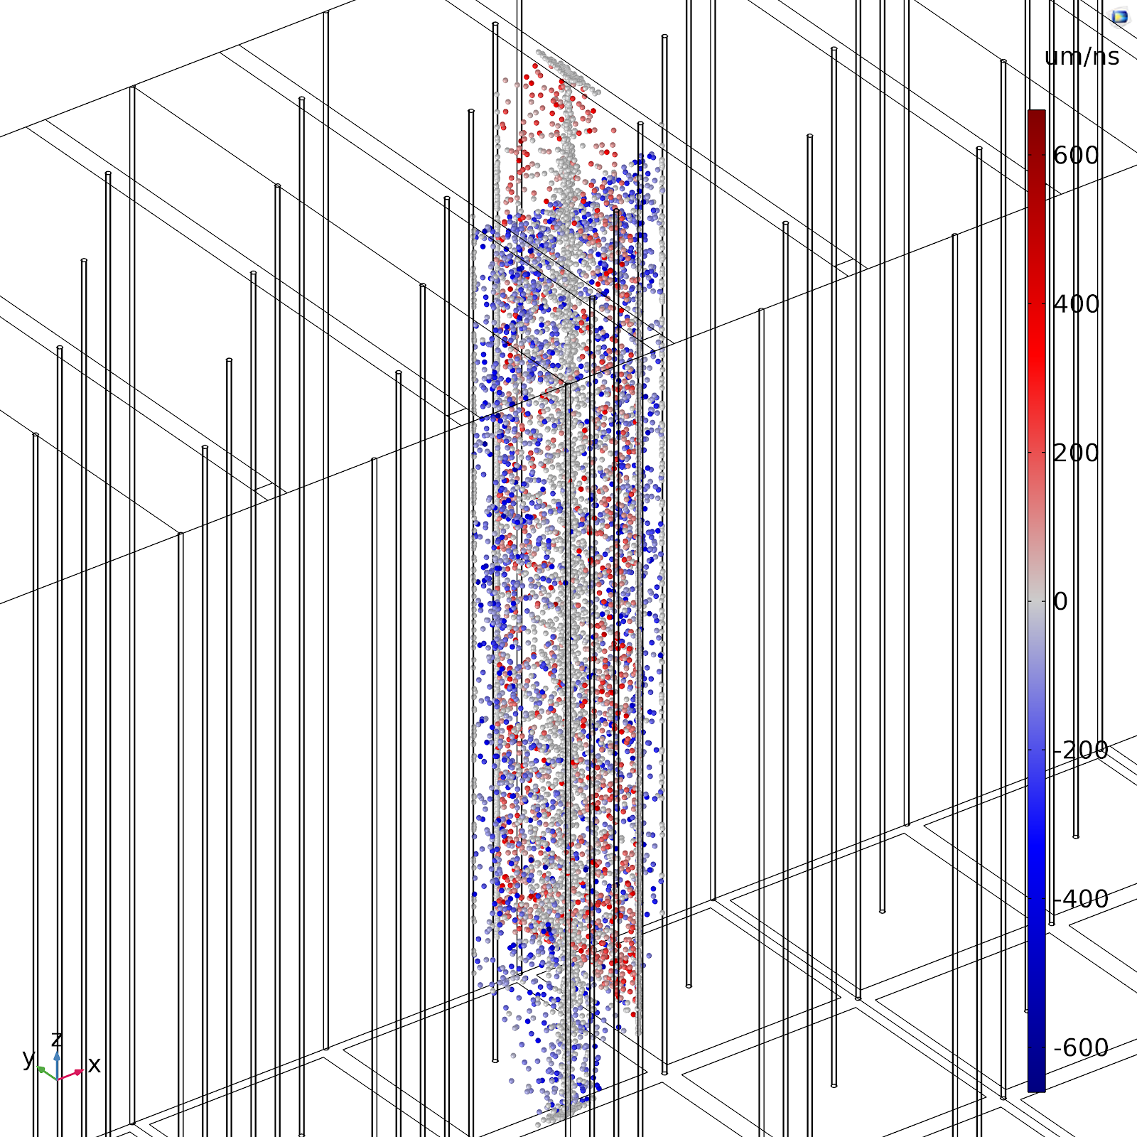
3D diamond detectors
Simulation challenge
Lack of build-in models, especially pCVD and traps / polarisation in current TCAD tools being addressed.
Need effort to improve simulations:
  polycrystalline CVD diamond, grain boundaries.
  graphitic wire simulation
  radiation damage
  new geometries
3D diamond simulation examples from RD42

Slide 27
3D diamond detectors
Devices in future experiments
The BCM’ phase-2 project of ATLAS will feature a small area 3D diamond detectors.
  Prove technology readiness for small cells.
  Stepping stone for larger area application.
planar diamond detector
3D diamond detector
Notes:
https://www.google.com/search?q=bcm%27+atlas&client=firefox-b-d&ei=ySSAYI6yKY6Ai-gP2tKnuA8&oq=bcm%27+atlas&gs_lcp=Cgdnd3Mtd2l6EAMyBggAEBYQHjoHCAAQRxCwAzoECAAQHjoICAAQFhAKEB5QoxFYmRpgjxtoAXACeACAAU-IAYwEkgEBN5gBAKABAaoBB2d3cy13aXrIAQjAAQE&sclient=gws-wiz&ved=0ahUKEwjOutmKtY_wAhUOwAIHHVrpCfcQ4dUDCA0&uact=5

Slide 28
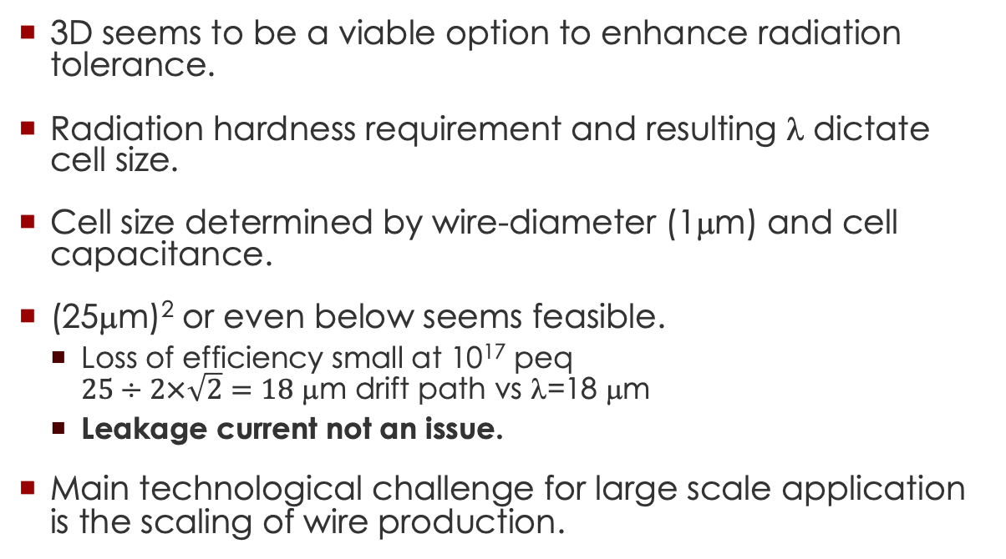
3D diamond detectors
Possible FCC devices
3D seems to be a viable option to enhance radiation tolerance.
Radiation hardness requirement and resulting λ dictate cell size.
Cell size determined by wire-diameter (1μm) and cell capacitance.
(25μm)² or even below seems feasible.
  Loss of efficiency small at 10¹⁷ peq
  $25÷2×\sqrt{2}=18$ μm drift path vs λ=18 μm
  Leakage current not an issue.
Main technological challenge for large scale application is the scaling of wire production.

Slide 29
Research Challenges for the next 20y
Summary
Polycrystalline CVD diamond.
  Collection distance 25% increase.
  Decrease price by 50% (happens with larger use as in Si).
Radiation tolerance.
  Go to smaller cell size.
  True 3D field electrodes (internal cages) offer huge potential to optimize electric field distribution to minimize drift time.
  Also offer possibility of gain in diamond.
Processing of 3D graphitic wires in diamond.
  Reduce resistivity.
  Scale production capability.

Slide 30
Discussion

