Slide 1
4D tracking – sensors with internal gain
N. Cartiglia
INFN - Torino
23 April 2021

Slide 2
Sensors for future trackers
With avalanche gain
Without avalanche gain
Low-gain mode (LGADs)
High-gain and Geiger mode (APD, SPADs)
Hybrid
Monolithic
Resistive readout
DC-coupled
BiCMOS
(SiGe)
AC-coupled
Planar
Si/Diamond
3D
Si/Diamond
Passive
CMOS
BiCMOS
(SiGe)
CMOS

Slide 3
4D tracking – sensors with internal gain
With avalanche gain
First design innovation: low gain avalanche diode (LGAD)
  ==> ~ 20 gain, thin sensors, large signals, large dV/dt
  Excellent timing resolution (~ 30 ps), not so good spatial resolution (pixel/sqrt(12))
Low-gain mode (LGADs)
Second design innovation: resistive read-out (joining RPC, GEM..)
  ==> Spread the signal over many pads while maintaining good efficiency (due to internal gain)
  Excellent position and timing resolutions (<5 um, ~ 30 ps)
Resistive readout
DC-coupled
BiCMOS
(SiGe)
AC-coupled

Slide 4
4D tracking – options
By “4D tracking” we mean the process of assigning a space and a time coordinate to a hit.
Timing can be available at different levels of the event reconstruction:
Timing in a single point (timing layer ATLAS,CMS)
We are just at the beginning of this path
Timing at some points along the track
Timing at each point along the track

Slide 5
4D tracking: Sensor – ASIC interaction
Sensor
ASIC
Sensors produce a current pulse
ASICs measure the time of arrival
==> Sensors and ASICs are two parts of a single object
R _{in}
C _{Det}
Optimization of 4D tracking can only happen with a very strong collaboration between the two community.
Future developments need to be done by desiging the sensors and the ASIC together
In timing circuits ”things can go wrong very rapidly” (quote from a wise ASIC designer),
==> this is not a simple evolution of what we know how to do.

Slide 6
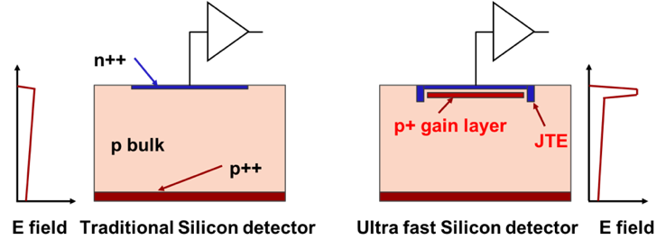
First design innovation: low gain avalanche diode
zoom
Drift area with gain
0.5 – 2 μm long
The gain layer:
a parallel plate capacitor with high field
The LGAD sensors, as proposed and first manufactured by CNM
(National Center for Micro-electronics, Barcelona):
High field obtained by adding an extra doping layer
E ~ 300 kV/cm, closed to breakdown voltage
The low-gain mechanism, obtained with a moderately doped p-implant, is the defining feature of the design.

Slide 7
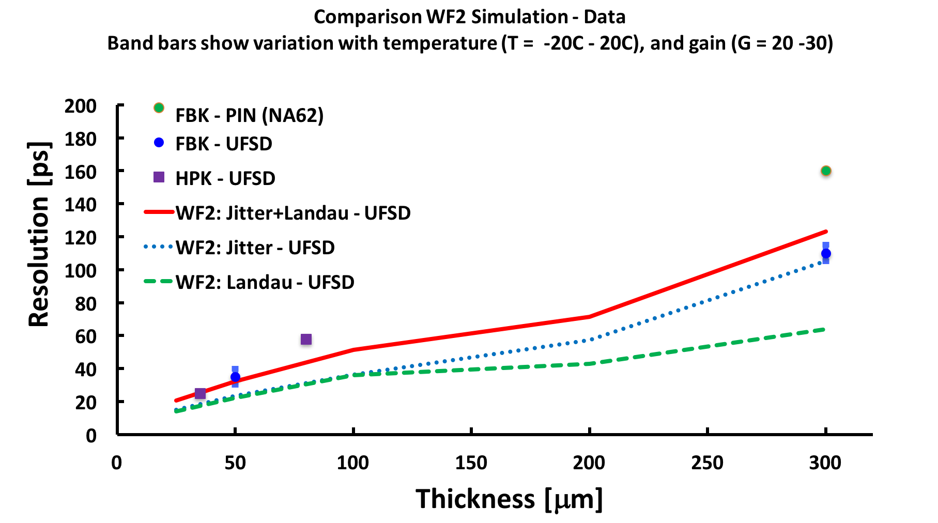
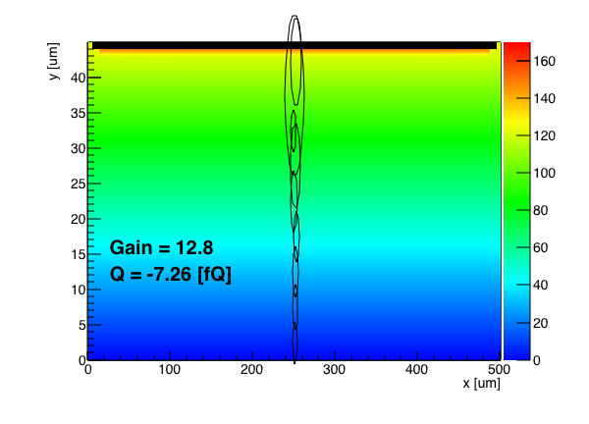
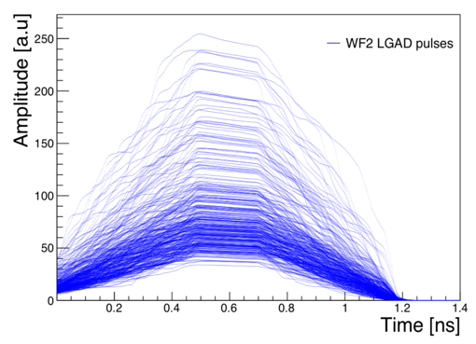
Summary of LGAD temporal resolution
Physical limit:
non uniform signal shape
Resolution without gain
Non-uniform ionization
Simulation of signals in 50-um RSD
Shape distortion
Amplitude variation
There are now hundreds of measurements on 45-55 μm-thick UFSDs
➔ Current sensor choice for the ATLAS and CMS timing layers

Slide 8
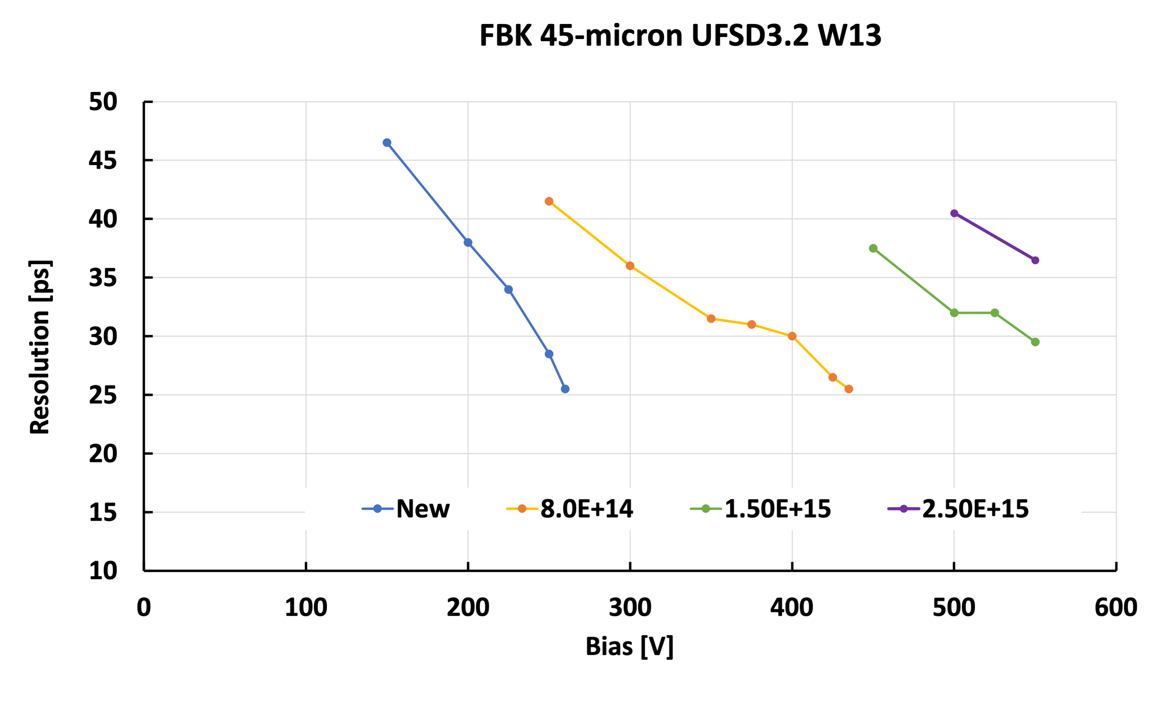
LGAD radiation hardness
Evolution with radiation of the biasing working point for a 45-micron thick LGAD with a carbonated gain layer
Increase bias to compensate for gain implant doping deactivation.
Present LGAD designs provide large signals and low noise up to 2.5E15 n/cm2

Slide 9
Second design innovation: resistive read-out
The signal is formed on the n+ electrode ==> no signal on the AC pads
The AC pads offer the smallest impedance to ground for the fast signal
The signal discharges to ground
long RC
Fast signal
Fast signal
long RC
-+
-+
-+
-+
-+
-+
In resistive readout the signal is naturally shared among pads (4-6) without the need of B field or floating pads
Thanks to the internal gain, full efficiency even with sharing
9

Slide 10
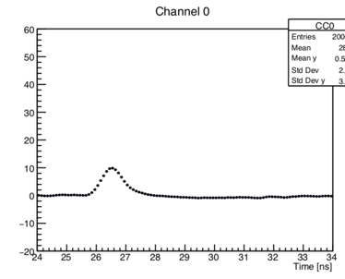
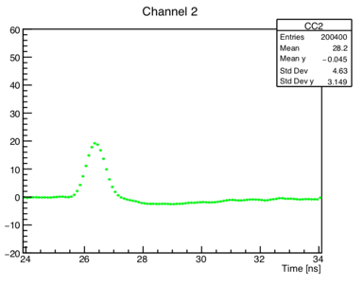
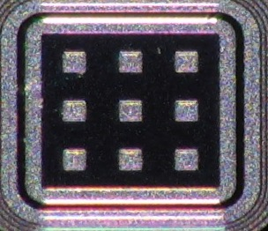
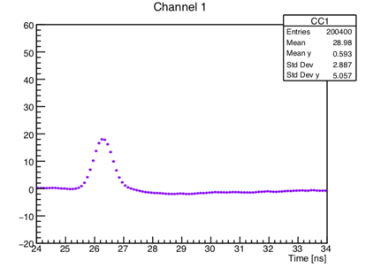
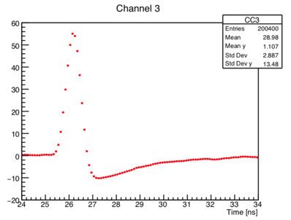
Example of a signal in an RSD
P 1
60
40
20
0
-20
Pad 1
60
40
20
0
-20
Pad 1
Pad 2
Amplitude [mV]
50-mm thick RSD,
Gain ~ 20
0 2 4 6 8 10
0 2 4 6 8 10
1
2
60
40
20
0
-20
60
40
20
0
-20
Pad 3
Pad 4
3
4
Amplitude [mV]
0 2 4 6 8
0 2 4 6 8 10
Time [ns]
Time [ns]
The laser is shot at the position of the magenta dot: the signal is seen in 4 pads
10

Slide 11
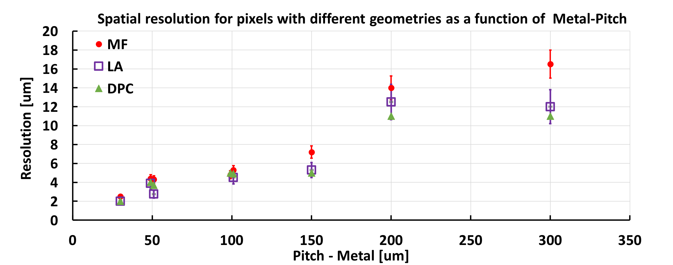
Summary of RSD position resolution
RSDs reach a spatial resolution that is about 5% of the inter-pad distance
➔ ~ 5 μm resolution with 150 μm pitch
RSDs have the “usual” LGAD temporal resolution of 30-40 ps

Slide 12
ASIC for RSD
Very important point: in hybrid technology (sensor bump-bonded to the ASIC), the area available for each read-out channel is identical to the pixel area
ASIC
Sensor
Assuming a goal of ~ 5 μm spatial resolution,
the RSD pitch can be 150-200 μm
At least a factor of 10-20 more space than using binary readout
Can concentrate the power available for that area into a single channel
The needed circuits for timing might actually fit
ASIC channel area
150 x 150 um²
12

Slide 13
Manufacturers: a pretty large pool
Producer | LGAD | RSD | Funding Source | Collab. Institute | Projects
CNM Barcelona (Spain) RD50 member | Doping Radiation Arrays Carbon, Gallium | Time Resolution | Spanish Ministr. RD50 (DoE R&D) AIDA, AIDAInnova | IFAE RD50 IFCA | ATLAS HGTD CMS-ETL
FBK Trento (Italy) RD50 | Radiation Carbon Isolation | Geometry Spatial & Time Resolution. | INFN, ERC, AIDA, AIDAInnova RD50 (DoE R&D) | INFN Torino RD50 | ATLAS HGTD CMS-ETL
Micron (UK) | Small Pixels |  | UK Science Council | Glasgow U. | X-ray Diamond
HPK (Japan) | Doping , Thickness Radiation, Arrays | Time Resolution | (DoE R&D) BNL ATLAS CMS | UCSC KEK | ATLAS HGTD & CMS-ETL Collaboration
BNL, (US) RD50 member |  | Time Resolution | DoE LDRD | BNL, FNAL UCSC | EIC
NDL (China) | 8” |  | Chinese Gov | IHEP | ATLAS HGTD
IME (China) | 8” |  | CAS | USTC | ATLAS HGTD
T-e2v | Time Resolution |  | STFC | Birmingham, Oxford, RAL
Red: Research Institutions
Blue: large commercial manufacturers

Slide 14
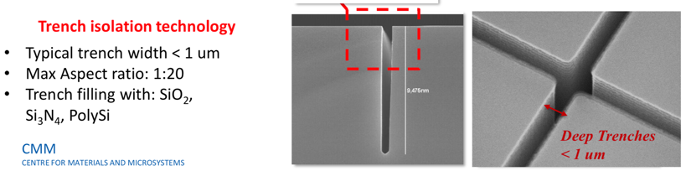
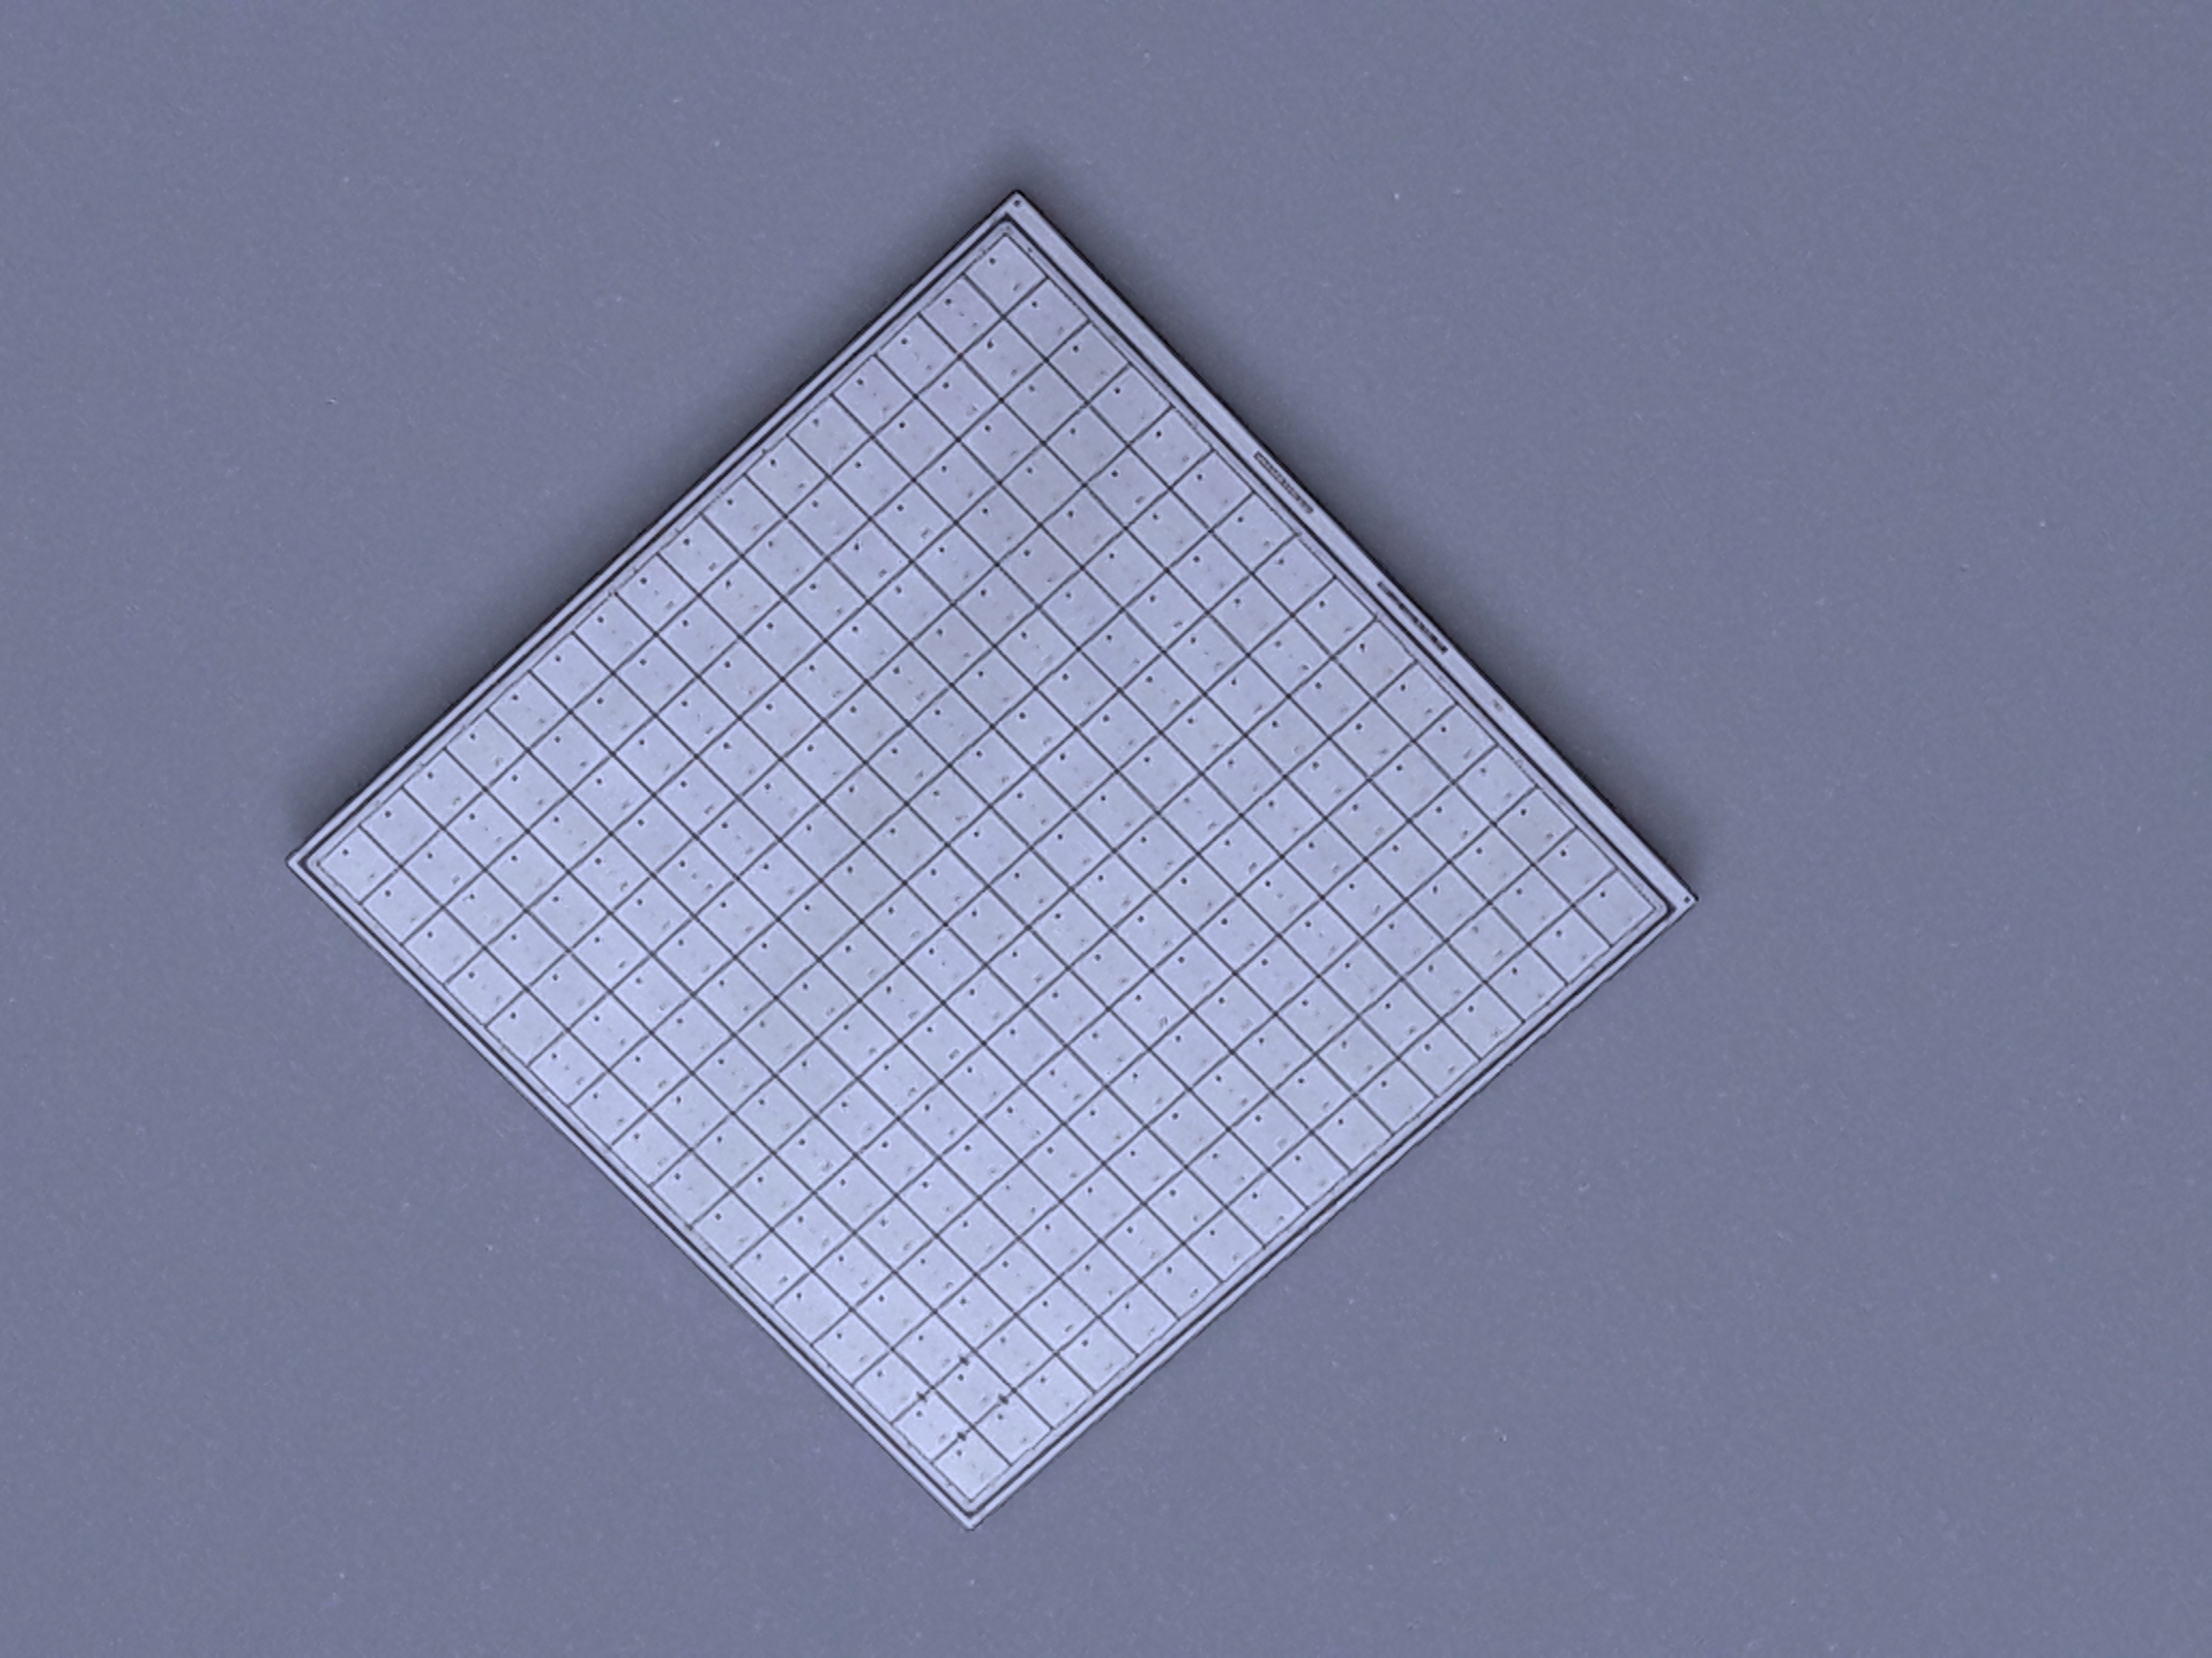
Present results & short term evolutions - I
Physicist
No gain area ~ 50 um
No gain area ~ 5 um
JTE + p-stop design
Trench-isolated design
JTE/p-stop LGAD
CMS && ATLAS choice
Signal in a single pixel
Not 100% fill factor
Very well tested
High Occupancy OK
Rate ~ 50-100 MHz
Rad hardness ~ 1-2E15 n/cm2
LGAD evolution: use trenches
Signal in a single pixel
Almost 100% fill factor
Temporal resolution (50 μm) : 35-40 ps
High Occupancy OK
Rate ~ 50-100 MHz
Rad hardness: to be studied
2.1 cm
HPK2
16x16 array

Slide 15
Present results & short term evolutions - II
i-LGAD
p-side segmentation
Signal in a single pixel
100% fill factor
Thin i-LGAD with single side processing under development (using trenches, spring 2021 @ CNM)
High Occupancy OK
Rate ~ 50-100 MHz
Rad hardness: to be studied
RSD: resistive readout
Signal in many pixels
100% fill factor
Excellent position resolution:
  ~ 5 μm with large pixels
Temporal resolution (50 μm) : 35-40 ps
Rate ~ 10-50 MHz
Rad hardness: to be studied

Slide 16
Contacts and future projects
In the recent past, many experiments have expressed interests in pursuing R&D projects on fast timing
Existing experiments:
ALICE3
CMS LS3
NA62++
LHC-b
HADES
Despite this large group of experiments, there is not a coordinated effort yet on 4D tracking. Each experiment does its own R&D
For the sensors: RD50 is the focal point
Future projects
FCC-ee,
CLIC,
FCC-hh,
μ-μ collider

Slide 17
4D tracking in the far future - I
Dead area:
Now: 50-80 μm between pads
most likely it will become very small, <5 μm
Production yield:
Now: maximum sensor dimensions are ~ 3x3 cm²
it will increase with experience, maybe even to the full 10x10 cm²
Foundries might switch to 8” and dramatically increase productivity
Radiation hardeness :
Now: ~ 2E15 n_{eq}/cm²
Difficult to say, a possible hard limit on the safe bias voltage (10V/μm) might reduce possible improvements. Near goal: ~ 5E15 n_{eq}/cm²

Slide 18
4D tracking in the far future - II
Timing resolution:
Now: 30 ps for 50 μm thick sensor
Thinner LGAD do better, but the signal charge is less.
The improvements will depend on the ASIC more than on the sensor.
Spatial resolution:
Now: < 5 μm in RSD, ~ 100’ μm in LGADs
LGAD have a resolution of pixel/sqrt(12).
Very difficult to measure accurately time in very small pixels.
Resistive read-out has an extraordinary position resolution with large pixels ==> only for low occupancy experiments

Slide 19
Another possible future: the BiCMOS way
With avalanche gain
Without avalanche gain
Low-gain mode (LGADs)
Monolithic
Monolithic BiCMOS, using the properties of SiGe transistors, obtains excellent timing performances.
Presently without internal gain, in the near future with internal gain
BiCMOS
(SiGe)

Slide 20
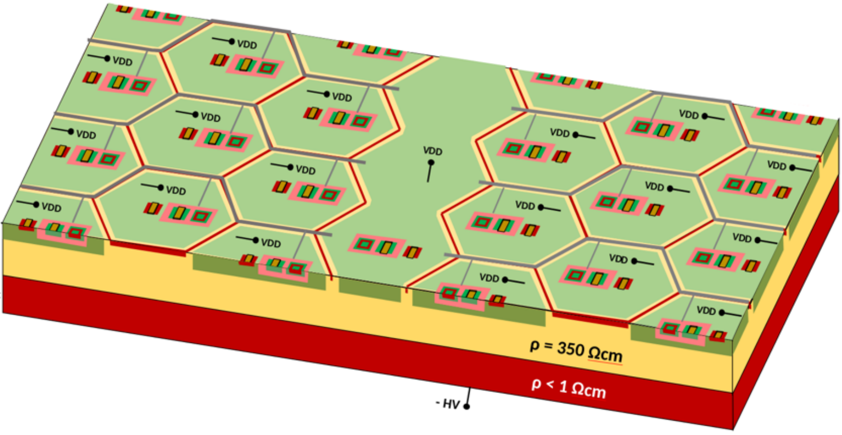
Monolithic design for 4D tracking (FASER)
Isolated HBT for signal amplification.
Analogue electronics in pixel, digital electronics in a separate deep-nwell to improve noise robustness.
>95% fill factor.
Electronics inside the guard-ring, isolated from substrate using deep n-well.
Negative High Voltage applied to the heavily p-doped substrate.

Slide 21
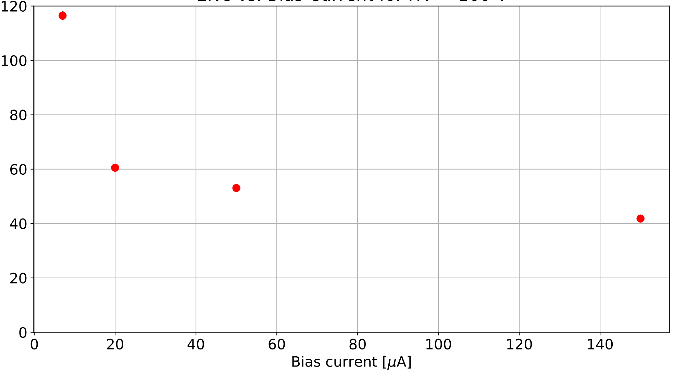
Prototype chip in SiGe BiCMOS
TOF test with Sr-90 source
5
Thr: 1050 e⁻
1
4
Time resolution [ps]
Preliminary
Thr: 920 e⁻
Thr: 600 e⁻
Thr: 570 e⁻
2
3
$$240\frac{mW}{cm^{2}}$$
Pixel size: ~100×100 µm²
Pixel capacitance: 80 fF
MPV input charge: 0.25 fC
No cut on data

Slide 22
R&D in progress at the University of Geneva
MONOLITH Project:
ERC advanced for the development of monolithic silicon pixel sensors in SiGe BiCMOS with picosecond time resolution. Sensor design based on PicoAD concept of the University of Geneva.
FASER :
SNSF project to build of a new pre-shower module for FASER experiment at LHC based on monolithic pixels in SiGe BiCMOS with very large dynamic range, 100 µm pixel size and 100ps time resolution.
100 µPET:
SNSF project to build a small animal PET scanner with 100 µm resolution based on monolithic silicon pixel sensors in SiGe BiCMOS.

Slide 23
Conclusions
4D tracking based on internal gain is a very young development
Presently, the first 2 large timing layers are being built
Intense R&D in many aspects, many new experiments are planning to have a flavor of 4D tracking
Possible to achieve excellent position and time resolutions
Each experiment is different in term of requirements (material budget, fluence, resolutions, etc): there is not a fit-all design
Very difficult to improve from 30 ps to 10 ps per hit

