Slide 1
SPring-8 upgrade : a fast kicker system
for beam injection
T. Nakamura
Japan Synchrotron Radiation Research Institute (JASRI)
SPring-8
CFA Beam Dynamics Mini Workshop on Low Emittance Rings 2011, 2011-10-05

Slide 2
Injection to 2mm Dynamic Aperture Ring
SPring-8 II : 70 pm rad => Dynamic Aperture ~ 2mm, 6 GeV
Injector : SACLA XFEL Linac ( < 0.1 nm rad, 0.25nC )
Bucket-by-Bucket On-axis/Off-axis Injection
Bucket-by-Bucket Injection Control (BBI)
On-axis Swap Injection
Aperture < 1-2mm at Early Stage of Tuning
Full bucket filling
100mA with Top-up Swap Injection with SACLA Linac
Off-axis for high bunch bunch current for variety of filling Aperture > 1-2 mm
Minimum Perturbation on Stored Beam
Rejection of Impurity Electrons from SACLA Linac
for High Purity High Current Singlet Bunch

Slide 3
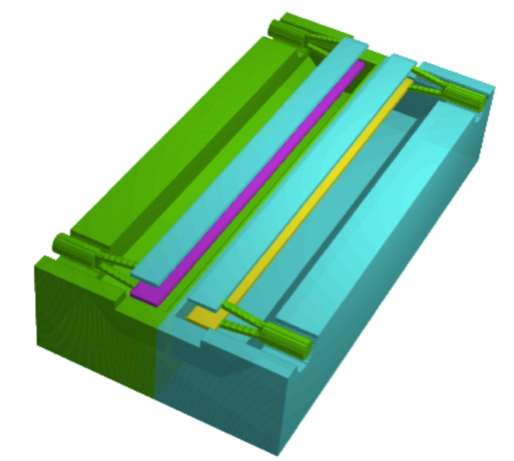
Kicker for Bucket-by-Bucket On-axis/Off-axis Injection
Fast TEM mode Kicker ( ~ 2ns ) [ ex. DR extraction Kickers ]
with Variable Field by changing drive Power and Polarity
Dipole Kick => On-axis swap Injection
Quadrupole Kick => Off-axis Injection
Kick duration < 4ns ( +/- 2ns )
Kicker : Unit x 5
Upper Outer Conductor
is removed
Length 0.2m
(time constant~ 1.3ns)
High Power Pulser 50kV
(FID FPG-50 )
High Power Pulser 50kV
(FID FPG-50 )
Beam

Slide 4
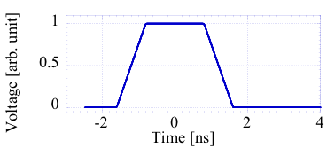
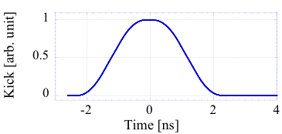
Time Structure of Kick
Output of
High Power Pulser
50kV (FID FPG-50 )
2ns : bucket spacing
Kick Strength
( L = 0.2m )
with MAFIA-T3
Should be smaller than 1/10
Additional Correction Kicker might be required for neighboring bunches

Slide 5
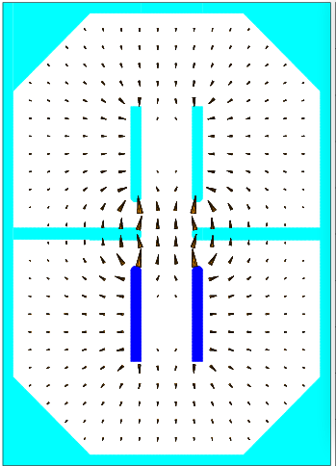
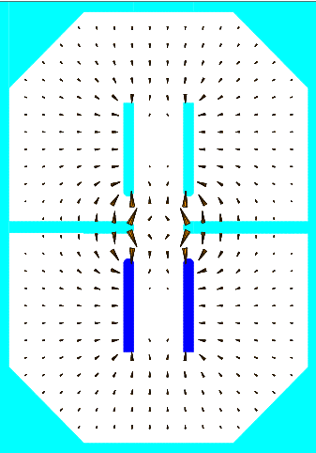
Field Distribution of Kicker
Injected
beam
Dipole Kick
for On-axis Injection
Quadrupole Kick
for Off-axis Injection
1 V
-1 V
-1 V
-1 V
10mm
Kick Field = 0
Stored beam
Field Strength ~ 1/(vertical gap)
Counter Propagating TEM Mode
( Kick by Ex ) = ( Kick by By ) => Total Kick = 2 Ex

Slide 6
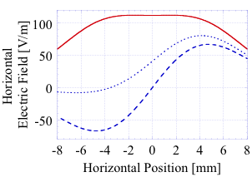
Field Strength Distribution in Horizontal
Quadrupole Kick at 2mm
4 MeV /m (+50kV,+50 kV)
Dipole Kick
11 MeV/m (+50kV,-50kV)
+ 1V
On-axis Injected
-1V
-0.45 V
Off-axis Injected
-1V
Stored

Slide 7
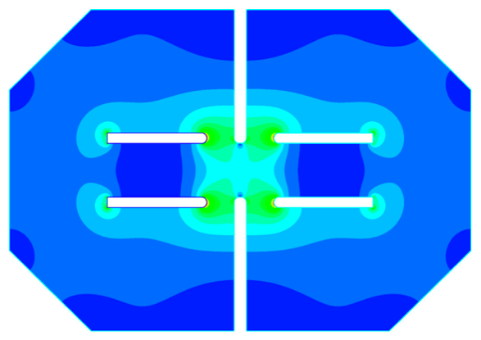
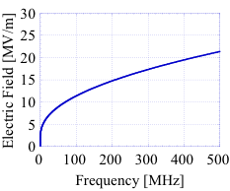
Discharge Limit
Maximum Field Strength without Discharge
Kilpatrick Limit for CW field
Frequency Dependence ~ 250 MHz ( 4ns )
50 kV < Limit but It’s Pulse ! Needs Test
Electric Field Strength Distribution
Kilpatrick Limit
~ 500 V/m
50 kV
30 kV
-1V
1V
250 MHz

Slide 8
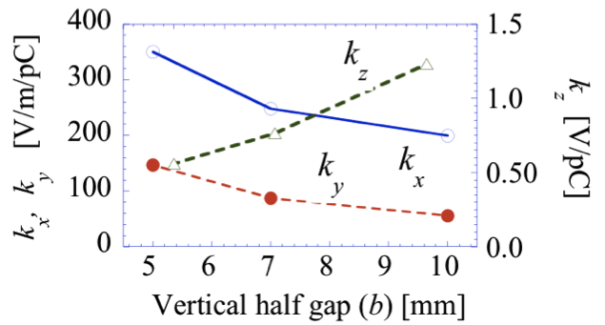
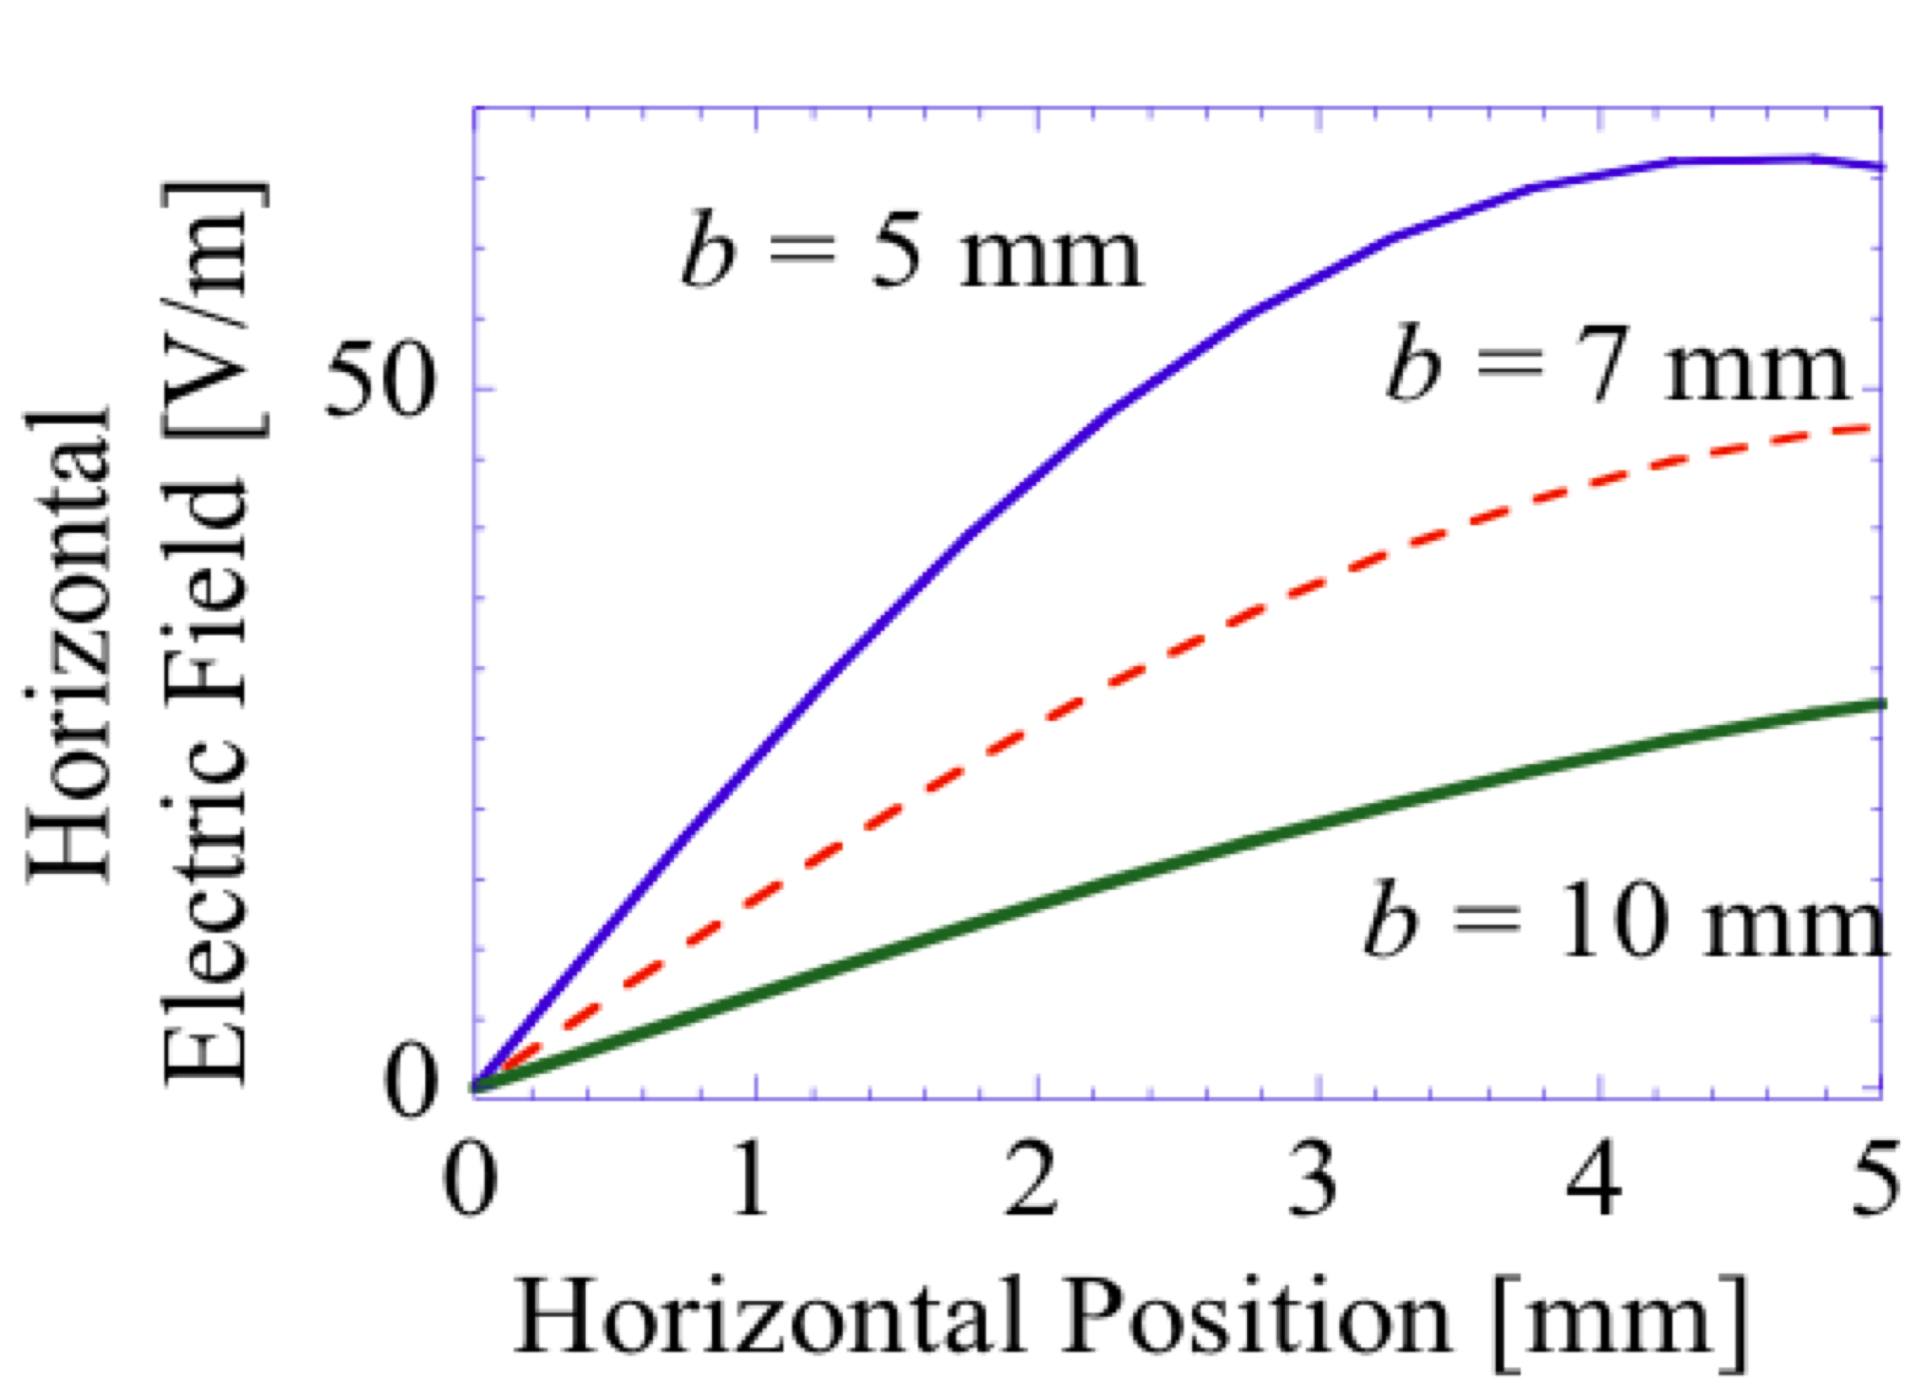
High Transverse Impedance (Horizontal) !!
Loss Factor
Horizontal value (kx ) is
x 70 of
our Bunch-by-bunch kicker
Gap Dependence of
Quadrupole Field
Strength
Quadrupole ~ 1/(gap)²
( Dipole ~ 1/gap )
Total Loss Factor vs Vertical half gap b
Total Loss Factor vs Vertical half gap b
Total Loss Factor vs Vertical half gap b
Total Loss Factor vs Vertical half gap b
Total Loss Factor vs Vertical half gap b
Total Loss Factor vs Vertical half gap b
Total Loss Factor vs Vertical half gap b
Total Loss Factor vs Vertical half gap b
Total Loss Factor vs Vertical half gap b
Total Loss Factor vs Vertical half gap b
Total Loss Factor vs Vertical half gap b
Total Loss Factor vs Vertical half gap b
Total Loss Factor vs Vertical half gap b
Total Loss Factor vs Vertical half gap b
Total Loss Factor vs Vertical half gap b
Total Loss Factor vs Vertical half gap b
Total Loss Factor vs Vertical half gap b
Total Loss Factor vs Vertical half gap b

Slide 9
Injection Scheme at Long Straight Section
0.6 m rad x 6 GeV = 3.6 MeV
On-axis
5 units (0.2m) < 2 m
From SACLA linac
Swapped out
Dipole Field
0.6 m rad
15 mm
15 mm
β_{H} = 25m
+18 kV, -18 kV
β_{H} = 25m
β_{H} = 25m
Off-axis
Quadrupole Field
0.08 m rad
0.6 m rad
2mm
15mm
+50 kV, +50 kV

Slide 10
Injection Scheme at Long Straight Section
Sharing Injection : Offset => Injected Beam + Stored Beam
No field for injected beam
0.08 m rad
Dipole + Quadrupole Field
2mm
15mm
0.08 m rad
+15 kV, +34 kV
-2mm
Additional
Dipole
kicker
Reduction of Input Field Strength
Quadrupole Field
Reduction of Offset
0.04 m rad
with Position Shift 1mm
1mm
15mm
0.04 m rad
+50 kV, +50 kV
-1mm

Slide 11
Summary
Bucket-by-bucket Injection
On-axis 100mA top-up injection
Off-axis to 1-2mm dynamic aperture
with quadrupole
with minimum perturbation on stored beam
Fast TEM mode Kicker with Variable Field Distribution
+/- 2 ns pulse
Dipole filed for On-axis
Quadrupole field for Off-axis
But
E_{max} > Discharge Field Limit ?
Large Horizontal Impedance !!

